Slide 1
Audio Design For Unified Communications
David Roach
President
Optimal Sound LLC

Slide 2
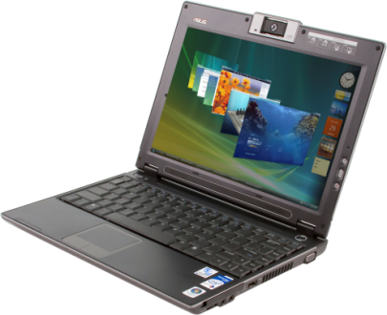
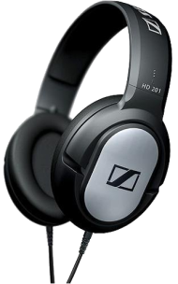
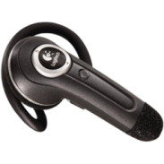
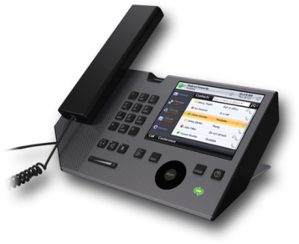
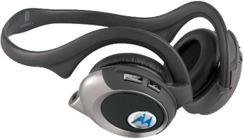
Unified Communications Consists of the integration of
VoIP telephone service (usually wideband)
Audio and video conferencing
Voice mail
Speech technology-enabled Interactive Voice Response
Instant messaging
Presence and contact information
Calendaring
Faxes
E-mail
Good audio is imperative!

Slide 3
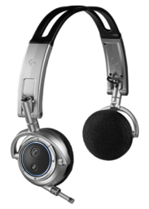
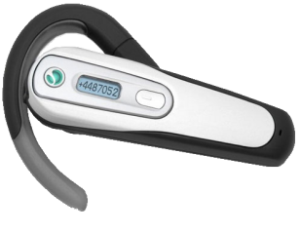
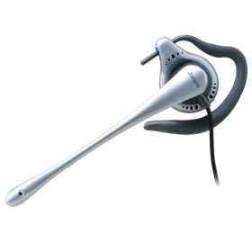

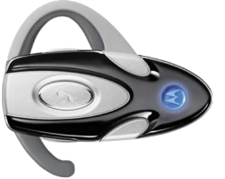
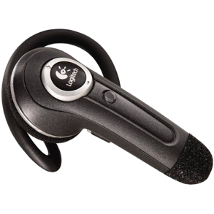
Many New Device Types
HD Audio Integrated Speakers and Microphone Arrays
USB Audio Microphone Arrays
External
Internal (laptop bezel)
USB Audio Handsets
USB Audio Headsets
USB Audio Handset/Speakerphone combos
Bluetooth Headphones/Headsets
HD Audio Analog Headphones/Headsets
USB Webcams with Microphone
External
Internal (laptop bezel, PC monitor bezel)
So many different combinations possible

Slide 4
Communication Challenges User fatigue and frustration is caused by
Limited frequency response
Poor acoustical conditions
Subminiature transducers
Echo
Latency
Poor analog hardware design
Dropped Packets and Jitter

Slide 5
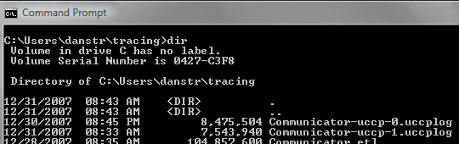
Logging QOS Info For OC 2007
Office Communicator creates a log for all calls longer than 30 seconds. This is logged to the local user's "Tracing" directory in a file named "Communicator-uccp-0.uccplog“
Use this command to convert log to XML
C:\>type *.uccplog | find /i "jitter" > out.xml

Slide 6
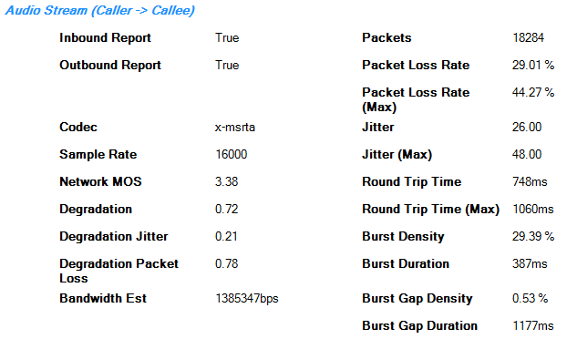
Interpreting Log Results
Network MOS should be > 3.6
Round trip time < 200 milliseconds
Packet Loss Rate should be < 0.5%

Slide 7
Wideband Telephony
Traditional narrowband telephony covers 300 Hertz to 3400 Hertz.
No lows and no highs.
Wideband telephony substantially increases the audio bandwidth
150 Hz to 6800 Hz
Reduces listener fatigue, easier to understand “P” versus “T”, “F” vs. “S”
Narrowband
Wideband
High-Fidelity

Slide 8
Improved Frequency Response Benefits
Narrow-band telephony is more mentally demanding than wideband
the brain has fewer perceptual cues
Tendency to close eyes and tense more muscles if not wideband
Speakers tend to speak louder over narrow-band, to ensure they can be heard
People tend to talk longer over a wideband network than over narrow-band

Slide 9
Challenges Of Miniaturization
Speakers are smaller, further limiting low frequencies
Microphones are in closer proximity to speakers and other noise sources
Mechanical coupling between speaker and microphone is more common
Limited choices for microphone and speaker placement

Slide 10
Challenges For Microphones
Microphone support in the past has often been minimal or non-existent
Beamforming microphone arrays are implemented in a number of incompatible methods
Beamforming microphone array geometries are not always properly defined to allow usage by application
This must get better in order for communications to work properly

Slide 11
Challenges For Echo
Too easy for multiple echo cancellers to be engaged simultaneously, one in application and one in driver
Many different methods used to capture speaker output signal to use for cancellation
Some are device specific, others require the user to specify the output device
Echo cancellers implemented in the application are device independent

Slide 12
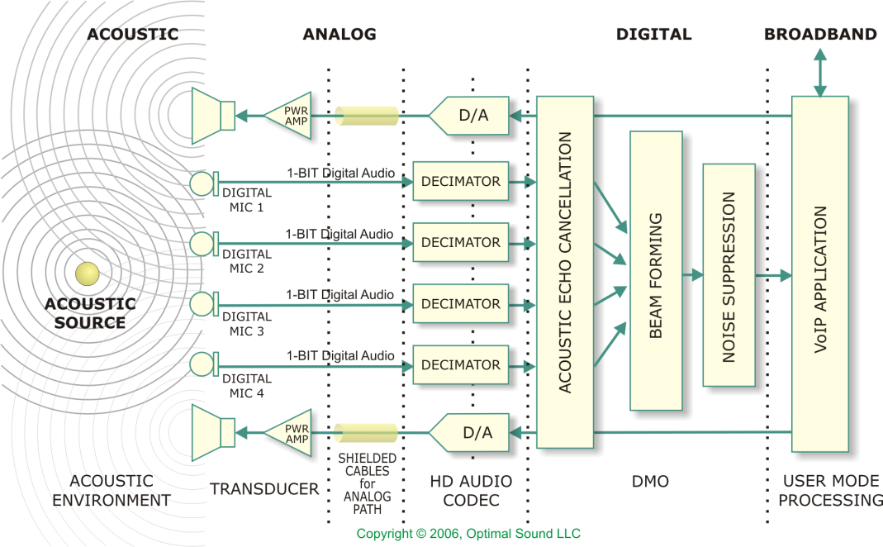
High Quality Voice Capture DMO
Use the DirectX Media Object (DMO) for echo cancellation and beamforming
Supports different endpoints for microphone and speaker
Simple for voice applications to include

Slide 13
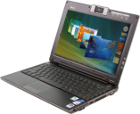

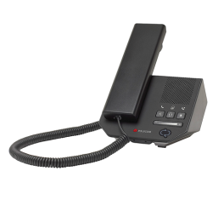
Stream Management My audio follows my device
Dynamic stream re-direction based on default device
Audio follows System Default Device
Audio follows System Default Communication Device
Built into the Dsound, DShow, Wave and Media Foundation API layers
Clients of the Windows Audio Session API, a very low-level interface do not get this behavior automatically
3rd party stacks (OpenAL) do not get this behavior

Slide 14

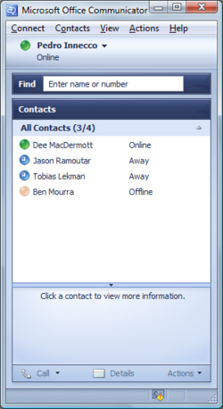

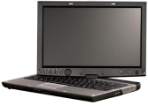


Stream Management My audio follows my device
Application asks for preferred communication device
System Communication Default Device
Dynamic Stream Management
Wave API
Dsound API/Dshow API
Media Foundation API
Integrated HD Audio Class Driver
Bluetooth Audio Class Driver
USB Audio class driver
Rank 3
Rank 2
Rank 1

Slide 15
Stream Management My audio follows my device
System Communication Default Device
Dynamic Stream Management
Wave API
Dsound API/Dshow API
Media Foundation API
User connects/turns on a (wireless) Headset
Integrated HD Audio Class Driver
Bluetooth Audio Class Driver
USB Audio class driver
Rank 3
Rank 2
Rank 1

Slide 16
Stream Management My audio follows my device
System Communication Default Device
Dynamic Stream Management
Wave API
Dsound API/Dshow API
Media Foundation API
User connects USB Handset
Integrated HD Audio Class Driver
Bluetooth Audio Class Driver
USB Audio class driver
Rank 3
Rank 2
Rank 1

Slide 17
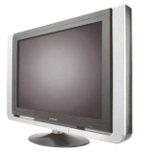
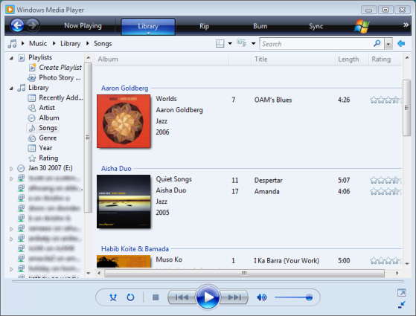



Stream Management My audio follows my device
System Default Device
Dynamic Stream Management
Wave API
Dsound API/Dshow API
Media Foundation API
Integrated HD Audio Class Driver
Bluetooth Audio Class Driver
Integrated HD Audio Class Driver
Rank 3
Rank 2
Rank 1

Slide 18
Stream Management My audio follows my device
System Default Device
Dynamic Stream Management
Wave API
Dsound API/Dshow API
Media Foundation API
User connects HDMI TV
Integrated HD Audio Class Driver
Bluetooth Audio Class Driver
Integrated HD Audio Class Driver
Rank 3
Rank 2
Rank 1

Slide 19
Redirection Changes The Game
To fully support redirection, echo cancellation and beam forming processing must occur in the application layer
It will be difficult, if not impossible for an echo canceller associated with a device to guarantee consistent performance in the face of dynamic redirection
The only way an application can ensure echo cancellation is to do it in the application layer

Slide 20
Echo Cancellation Is In VoiP Application, Not Driver
Office Communicator 2007, Windows Live Messenger and Skype all contain echo cancellers which cannot easily be disabled
An echo canceller in the driver running simultaneously with an echo canceller in the application will produce unpredictable results
Echo cancellation in the driver should default to off

Slide 21
Webcam Example
Laptop user initiates a call using integrated mic array and speakers
During call, user plugs in a webcam with a microphone but no speaker
The microphone dynamically switches from the mic array to the webcam mic, but built-in speakers are unchanged
The echo canceller in the application adjusts dynamically, based upon the new endpoints’ capabilities

Slide 22
Objective Testing Of PC Voice Communications Devices
TIA-920: Telecommunication Industry Association standard TIA-920 “Transmission Requirements for Wideband* Digital Wireline telephones”
Virtually all PC Audio voice communication devices fall into this category
Another standard, TIA-810-A is for narrow-band* devices such as telephone handsets, headsets, and handsfree devices. TIA-920 is derived from TIA-810.
*Wideband is 150 Hz to 6,800 Hz. Narrowband is 300 Hz to 3,400 Hz.

Slide 23
Not Like Audio Fidelity Testing
WHQL Audio Fidelity Testing | TIA-920 Acoustical Testing
Uses Audio Precision Test Set | Uses Listen Soundcheck system or equivalent
No other test equipment required | Requires Head and Torso Simulator and/or artificial ear and artificial mouth
Automated test management, no expertise required to run tests | Significant expertise and training needed to get repeatable results
No special acoustical environment required | Quiet non-reverberant acoustical environment required

Slide 24
Parameters Measured
Receive Loudness Rating (RLR)
(a measurement of the speaker or earphone sensitivity)
Send Loudness Rating (SLR)
(a measurement of the microphone sensitivity)
Frequency Response (send and receive)
Distortion versus Frequency (send and receive)

Slide 25
Measurement Methods
Can’t use traditional electronic techniques such as steady-state sine waves (Results would be inaccurate and not pass)
The test environment creates acoustic challenges and strongly impacts measurement results (reflections from table top, walls, floor and ceiling impact result)
Unlike traditional electronic audio measurements, strong testing expertise is necessary to achieve accurate results

Slide 26
Testing Headsets And Handsets
All devices that are worn on the head, such as Headsets and Handsets, must be tested using a Head and Torso Simulator (HATS)
Devices not worn on the head, such as webcam microphones, handsfree devices, microphones and speakers in notebook computers, can be tested using an artificial mouth and artificial ear

Slide 27
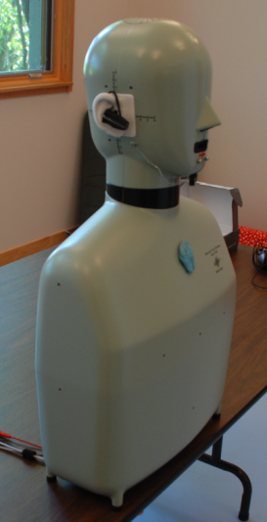
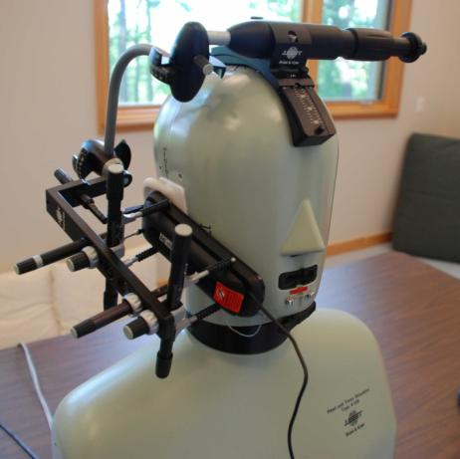
HATS Testing
The human head and body strongly impacts the measurement accuracy
A HATS duplicates this human form for accurate and repeatable results
HATS with handset positioner.
HATS manikin.

Slide 28
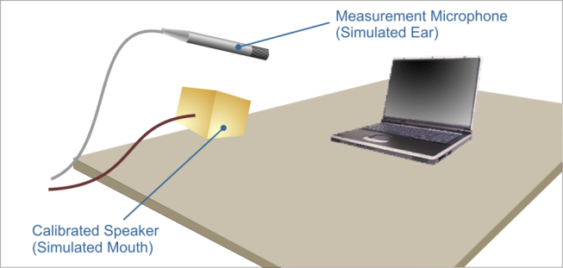
Notebook Computer And Webcam Microphone And Speaker Testing
Microphones are tested using a Mouth Simulator. This is a calibrated speaker with specific directional characteristics
Speakers are tested using an Ear Simulator which is a measurement-grade free field microphone
Notebook computer with simulated mouth and ear

Slide 29
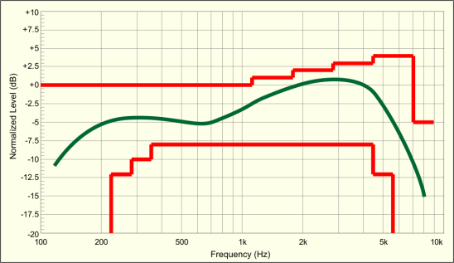
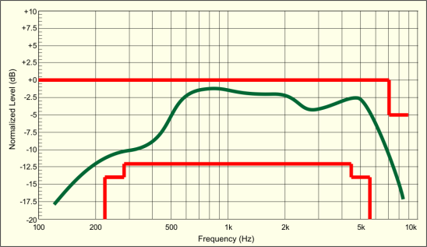
Frequency Response Test Results
Typical graphs of Handsfree devices
Send (microphone) Frequency Response
Receive (speaker/earphone) Frequency Response
Red traces are Standard performance limits. Green trace is measured performance

Slide 30
Recent TIA-920 Testing
Recent testing of 15 commercially available handsets, headsets, and webcams showed that none passed all aspects of TIA-920 testing
The PC communications ecosystem is challenged to keep up with the communications sector, primarily because of poor acoustical performance of microphones and speakers in the communications devices

Slide 31
Impact Of Sub-Par Acoustics
Success Story?
For Unified Communications on the PC to be successful then audio functionality, especially audio capture, must be of a quality consistent with or better than mainstream communication devices
Garbage In, Garbage Out
Audio software is only as good as the signals to and from the audio device. Poor acoustic and analog design cannot be fixed in software

Slide 32
Acoustic Issues Are Not Easily Fixed After The Fact
It is rare that a poor acoustical design can be repaired late in development
Acoustical design must be considered all through development
Work closely with your transducer vendors on industrial design issues such as mounting and enclosing the transducers
Consider using a specialist in micro-acoustics for acoustic design and test

Slide 33
Objective Versus Subjective Testing What if TIA-920 testing is not practical?
Subjective testing is more ad-hoc in nature, and can be funded and staffed at a variety of levels
Subjective testing is difficult, and is never a substitute for objective testing
Subjective testing can be conducted with existing equipment and facilities
Establishing a target baseline system is a key to successful subjective testing

Slide 34
Decouple Network & Signal Path Issues During Subjective Testing
Set up an network capable of testing Office Communicator 2007, Windows Live Messenger, and Skype
Establish two “golden” reference stations in separate acoustical spaces, using known-good transducers
Optimize network and applications to ensure that QOS is not causing artifacts
Test against “golden” systems

Slide 35
System Testing
Define a strategy for testing your communications devices, including laptops with integrated mics
Get the system working well first, and only then attempt to cost-reduce
If possible, use both objective (TIA-920) and subjective testing
Test against Windows Vista and Windows 7
Don’t choose to not test at all

Slide 36
"Golden" Reference System
For a good baseline, you can build a reference system using pro-audio gear
Use a high-quality shotgun mic
Works great with echo canceller in OC2007
Use an XLR to USB microphone preamp/converter
Provides 48 volts phantom power to mic
Use a separate self-powered full-range speaker, pointed in the same direction as the microphone (at the talker)

Slide 37
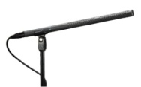
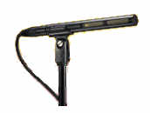
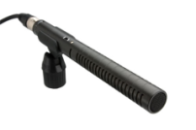
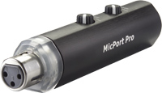
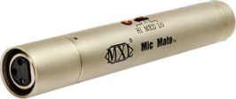
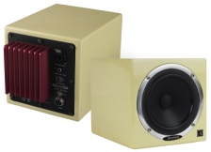
"Golden" Components
 | Equipment List
 | Audio Technica AT-8035
 | Audio Technica AT-875R
 | Rode NTG-1
 | Centrance MicPort Pro
 | MXL MicMate USB
 | AVANTONE Active MixCube
Select the USB mic port as the default microphone
Run green analog speaker or headphone output to powered speaker
Talker can be up to 6 feet from mic

Slide 38
Design Imperatives
Input LFX APO must pass RAW data from microphone array upon request
Audio driver does not perform undiscoverable stream redirection
Capture device has little or no DC offset
A communications audio device exposes itself as a Default Communications Device
Device exposes correct form-factor
No undiscoverable non-linear audio processing that is on by default
Devices with mic arrays expose KSAUDIO_MIC_ARRAY_GEOMETRY

Slide 39
Laptop Implementations
Use two or four digital microphones mounted in the bezel in one of the five supported configurations
Use speakers which extend down to 150 Hz, and which are mounted and baffled properly
Use power amplifiers sufficient to drive the speakers to full excursion without distortion
Calibrate speaker and mic levels to ensure maximum volume with no clipping

Slide 40
New Hardware Opportunities Leverage built-in software
There are new opportunities for hardware-only communications devices which leverage one of the UAA class drivers and the speech processing now included in the leading VoIP applications
Value-add processing, such as headphone virtualization, can be supplied by Audio Processing Objects (APOs) bundled with one of the class drivers

Slide 41
Call To Action
Give careful consideration to acoustical design for microphones and speakers
Play well with others
Test using TIA-920 during development if possible.
Test end-to-end with major VoIP applications, with speech processing in the driver package enabled and disabled
Driver packages should default speech processing to off
Shift your audio investment to better transducers to take advantage of system-provided software

Slide 42
Benefits Of Getting It Right
Clear concise communications
Lack of audio fatigue
Freedom from distortions and dropout
Longer average call length
Unified communications can become a reality
People in touch with other people

Slide 43
Additional Resources
Web Resources
Specs
Telecommunication Industry Association standard TIA-920 “Transmission Requirements for Wideband Digital Wireline telephones”
USB HID Usage Tables
http://www.usb.org/developers/devclass_docs/Hut1_12.pdf
Mic Arrays Guide
http://www.microsoft.com/whdc/device/audio/MicArrays_guide.mspx
Related Sessions
CON-T563 Building a Communication Device in Windows 7
CON-T564 Building a Bluetooth Audio Device in Windows 7
CON-C663 Discussion: Audio Design for Unified Communications
CON-C664 Windows 7 Logo Program for Audio and Communications

Slide 44
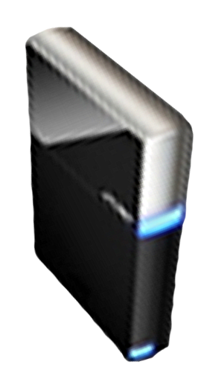


Please Complete A Session Evaluation Form Your input is important!
Visit the WinHEC CommNet and complete a Session Evaluation for this session and be entered to win one of 150 Maxtor® BlackArmor™ 160GB External Hard Drives 50 drives will be given away daily!
http://www.winhec2008.com
BlackArmor Hard Drives provided by:

Slide 45


© 2008 Microsoft Corporation. All rights reserved. Microsoft, Windows, Windows Vista and other product names are or may be registered trademarks and/or trademarks in the U.S. and/or other countries.
The information herein is for informational purposes only and represents the current view of Microsoft Corporation as of the date of this presentation. Because Microsoft must respond to changing market conditions, it should not be interpreted to be a commitment on the part of Microsoft, and Microsoft cannot guarantee the accuracy of any information provided after the date of this presentation. MICROSOFT MAKES NO WARRANTIES, EXPRESS, IMPLIED OR STATUTORY, AS TO THE INFORMATION IN THIS PRESENTATION.

