Slide 1
Authoring A Device
Experience For
Portable Devices
Marc Pottier
Senior Program Manager
Microsoft Corporation

Slide 3

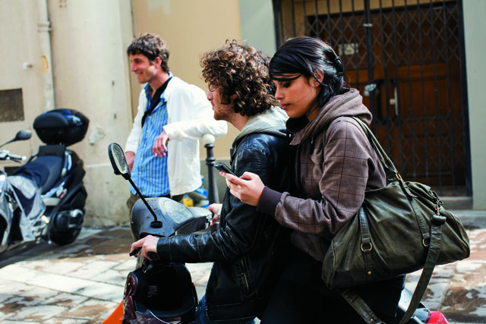






People Love Devices
91% of windows users have devices
114M Digital Cameras
217M Media Players
1.3B Cell Phones
…but the Windows device experience has been limited…

Slide 4
Great Device Experiences With Windows 7
Natural experience for end users
No setup required
Easy to find and use device features and services
Consistent across devices, but specific to my device
Great for partners
Builds emotional connection and customer satisfaction
Drives revenue, reduces support costs
Easy to customize and deploy
Enables greater differentiation

Slide 5
Device Stage™
demo
Portable device experiences in Windows

Slide 6
Authoring Experiences
Motorola E8 Case Study

Slide 7
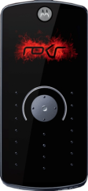
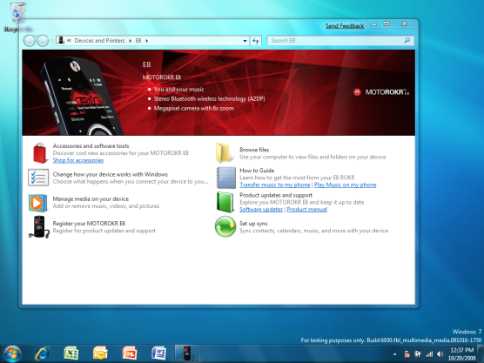



Device Experience Elements
WPD / MTP device
New, or existing devices
that have Windows 7 logo
Device experience XML
Carried in device metadata package (branding, tasks)
Windows 7
Device Stage™ features and
built-in tasks

Slide 8
Authoring The E8 Experience
Choose a device
Brand the experience
Add status
Select tasks
Test device experience
Engage the help of product marketing and design early!

Slide 9
Choosing Devices
Device experiences can be bound to
one or more devices
The more specific the experience,
the better
Experience fidelity depends on
  Marketing and product strategy
  Available firmware properties

Slide 10
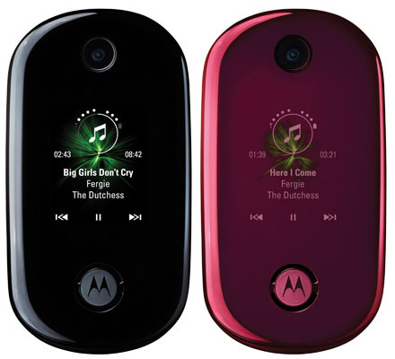

Experience Fidelity
By product line
ROCKR U9
(Black)
ROCKR U9
(Pink)
ROCKR E8
Hardware ID (least specific)
All devices have it, but it is often re-used across models

Slide 11
Experience Fidelity
By model
ROCKR U9
(Black)
ROCKR U9
(Pink)
ROCKR E8
Hardware ID or Model ID
Fidelity depends on how Hardware ID is
assigned to your device

Slide 12
Experience Fidelity
By model variant (e.g., color)
ROCKR U9
(Black)
ROCKR U9
(Pink)
ROCKR E8
Custom Model ID (most specific)
Custom defined by manufacturer - enables complete control

Slide 13
E8 Device Fidelity
PackageInfo.XML
<?xml version="1.0" encoding="utf-8" ?>
<PackageInfo xmlns="http://schemas.microsoft.com/windows/DeviceMetadata/PackageInfo/2007/11/">
<MetadataKey>
<HardwareIDList>
<HardwareID>SFDOID:USB\VID_22B8&amp;PID_6415&amp;REV_0101</HardwareID>
<HardwareID>DOID:USB\VID_22B8&amp;PID_6415&amp;REV_0101</HardwareID>
<HardwareID>SFDOID:USB\VID_22B8&amp;PID_6415</HardwareID>
<HardwareID>DOID:USB\VID_22B8&amp;PID_6415</HardwareID>
</HardwareIDList>
<Locale default="false">en-us</Locale>
<LastModifiedDate>2008-09-25T23:39:15z</LastModifiedDate>
</MetadataKey>
...
</PackageInfo>
Hardware IDs

Slide 14
Authoring The E8 Experience
Choose a device
Brand the experience
Add status
Select tasks
Test device experience

Slide 15
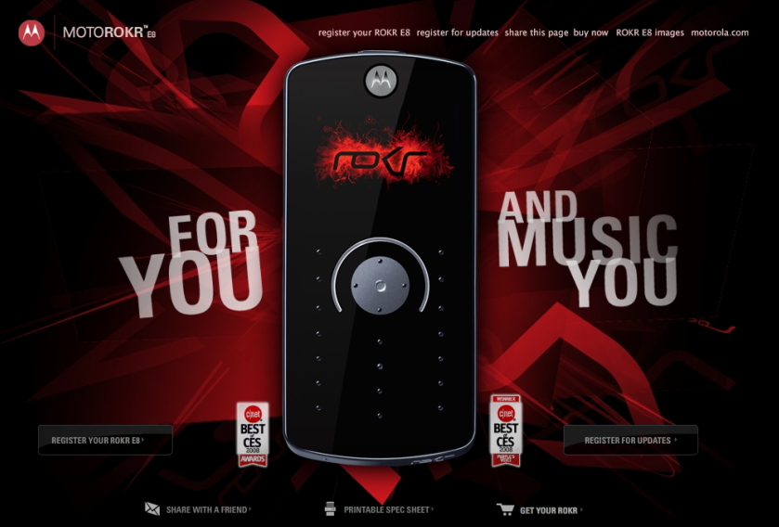
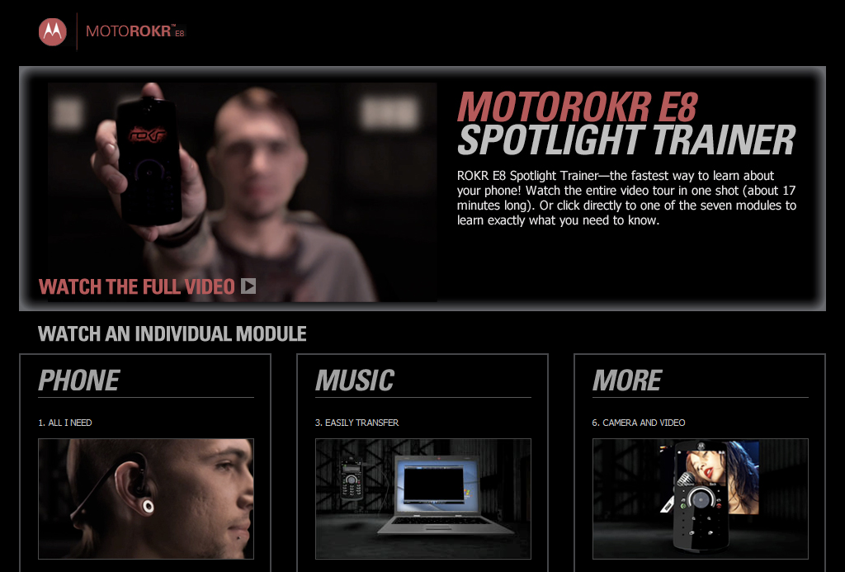
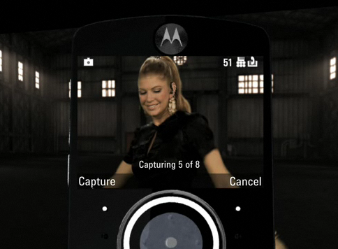
Brand The Experience
Devices are uniquely styled for target markets
Extend branding and customer connection to the desktop
Engage product marketing and design teams

Slide 16
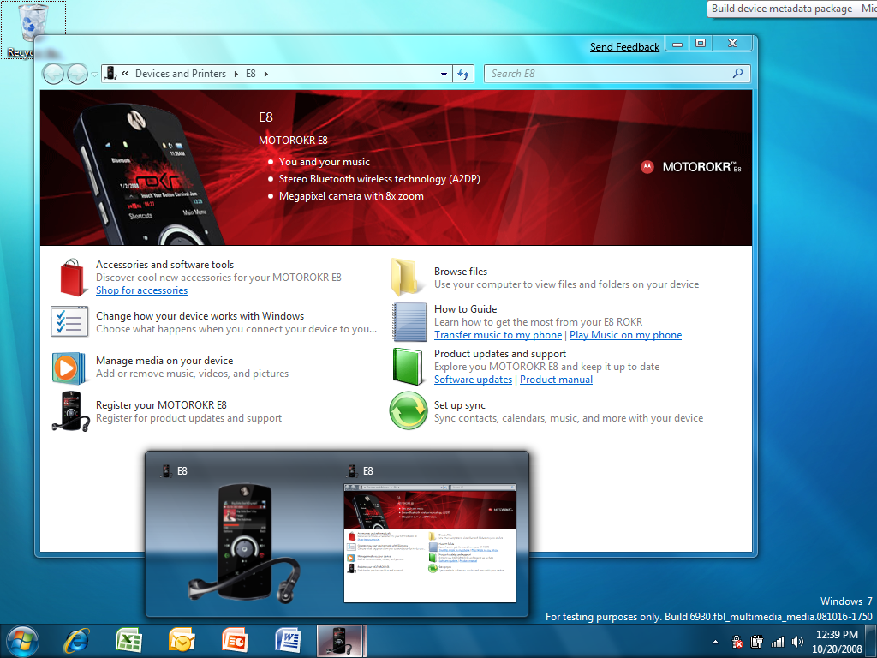
Branding Elements
Branding Bar
Preview
Shell Icon

Slide 17

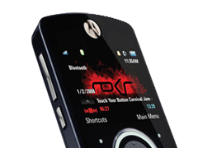

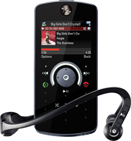
Branding Bar Elements
Logo(s)
Overlay
Background
Preview and
Shell Icon
Device Image

Slide 18
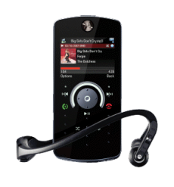
Branding The E8 Experience
Behavior.xml
<header watermarkAlign="right" backgroundColor="#FFFFFFFF" textColor="#FFFFFFFF" backgroundImage="background.png" watermarkImage="overlay.png">
<modelInfo image="device.png" launcherThumbnail="superbar.png" />
<logos>
<logo image="logo.png" url="http://www.motorola.com" tooltip="1" />
</logos>
</header>

Slide 19
Authoring The E8 Experience
Choose a device
Brand the experience
Add marketing bullets or status
Select tasks
Test device experience

Slide 20
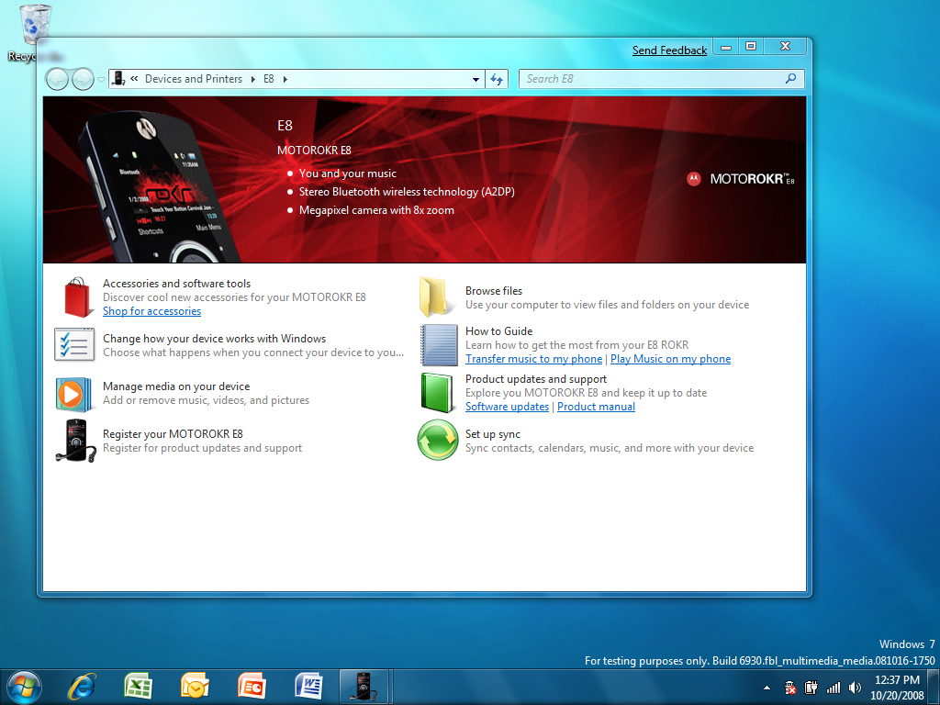
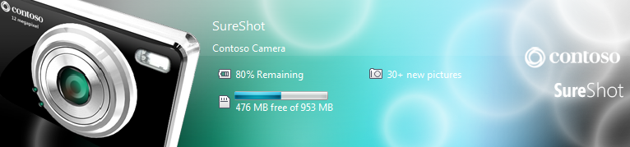
Add Marketing Bullets Or Status
Marketing
Bullets
Status
Branding bar and taskbar may be configured to display status, or marketing bullets

Slide 21
E8 Marketing Bullets
Behavior.xml
Resource.xml
<deviceBehavior>
<header watermarkAlign="right" backgroundColor="#FFFFFFFF" textColor="#FFFFFFFF" backgroundImage="background.png" watermarkImage="overlay.png">
…
<marketingBullets>
<bullet id="2" />
<bullet id="3" />
<bullet id="4" />
</marketingBullets>
</header>
<?xml version="1.0" encoding="UTF-8"?>
<stringTable>
<string id="1">Visit the Motorola website</string>
<string id="2">You and your music</string>
<string id="3">Stereo Bluetooth wireless technology (A2DP)</string>
<string id="4">2 Megapixel camera with 8X zoom</string>
</stringTable>
Bullets for branding bar.
IDs link to localized resource file
Localized strings stored in separate resourc.xml file

Slide 22
E8 Status Providers
Behavior.xml
<statusItems statusPropList="prop:System.Sync.State;System.Devices.BatteryStatus;System.Devices.StorageFreeSpacePercent;" statusProvider="{c2dae44d-c850-425c-b466-d8cbc1469f5d}">
<statusLinks>
<statusLink>
  <statusLink statusProp="System.Devices.StorageFreeSpacePercent" taskId="{b7c7ce85-61f5-49aa-8173-b8e26c0453ff}"/>
  <statusLink statusProp="System.Sync.State" taskId="{308fc75e-c5b7-457e-8589-89f50ac1b0eb}"/>
</statusLink>
</statusLinks>
</statusItems>
Status property list to
display in branding bar
and taskbar preview
Click action for
storage space
status
Click action for
sync status

Slide 23








Status
 | Status Provider | Displays
 | System.Devices.BatteryStatus | % Battery full
 | System.Devices.StorageFreePercent | Storage % full and total storage available
 | System.Sync.State | Sync state
 | System.Devices.SignalStrength* | Signal strength and network
 | System.Devices.Voicemail* | Number of voicemails
 | System.Devices.MissedCalls* | Number of missed calls
 | System.Devices.NewPictures* | Number of new pictures on device
 | System.Devices.TextMessages* | Number of new text messages on device
* Requires Device Status Service

Slide 24
Authoring The E8 Experience
Choose a device
Brand the experience
Add status
Select tasks
Test device experience

Slide 25
Task Model
Built-in Task
Custom Task
Tasks launch built-in features, or custom applications, content, and websites

Slide 26
Task Requirements
Tasks may be authored to be displayed/hidden based on system state
  Software Installation status
  Device presence
  Device Service availability
  Date/Time Range
  Internet availability
  More…

Slide 27

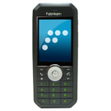
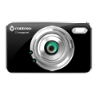
Built-In Tasks
Task | User Scenario | Device Classes
Change how your device works with Windows | I can change my device name and choose a task to launch on connect
Browse Files | I can easily browse my device and copy files and folders to my device
Download your pictures and video | I can import pictures and videos from my device to my PC
Set up Sync (Media) | I can keep my music, pictures and videos up to date on my device
Manage Media on your device | I can see all the media on my PC and device and keep them up to date
Set up Sync (PIM) | I can keep my contacts, calendar, tasks, notes up to date on my device
Set Ringtones | I can create new ringtones for my phone and assign them to contacts

Slide 28
Task Extensibility
Task | User Scenario
Partner Applications | I can easily find and use programs for my device on my computer.
Hosted Site | I can find software installs, accessories, manuals, tutorials, support, and firmware updates for my device in a single place
Hosted Site with Device | I can build web-based software and services for my device using WPD and device services

Slide 29
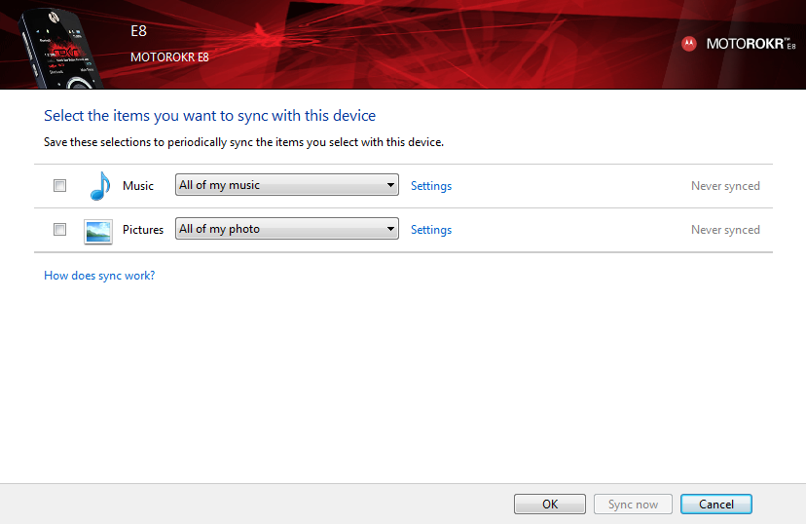
Set Up Sync
Built-In Task
Manual or Automatic Sync for music, pictures, and video
Requires MTP Device Services or custom WPD Driver
<taskCategoryMapping>
<taskRef taskGroupGuid="{8d721941-84f2-11dd-ad8b-0800200c9a66}" taskId="{8d721942-84f2-11dd-ad8b-0800200c9a66}" />
…
</taskCategoryMapping>

Slide 30
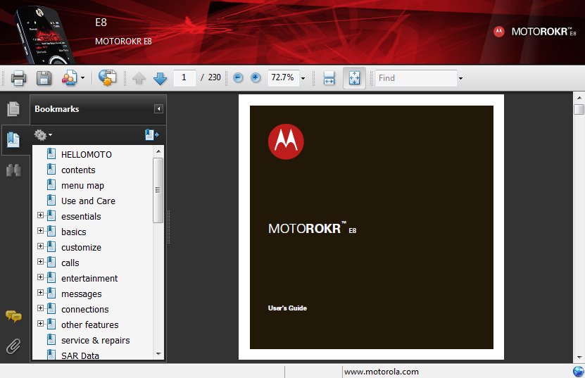
E8 Product Manual
Hosted Site Task
Read product manual (PDF) online
XML defines how to display file
URL for file location
<task id="{8d724052-84f2-11dd-ad8b-0800200c9a66}" issueTime="2008-09-10T14:37:33Z" name="15" description="16" icon="Support.ico">
<requirements />
<command type=“hostedSite">
<arguments>
<commandLine>http://www.motorola.com/Hellomoto/Master%20Lists/Product%20
Manuals/Static%20Files/US-EN/E8_UG_TMobile_9521A11A.pdf</commandLine>
</arguments>
</command>
</task>

Slide 31
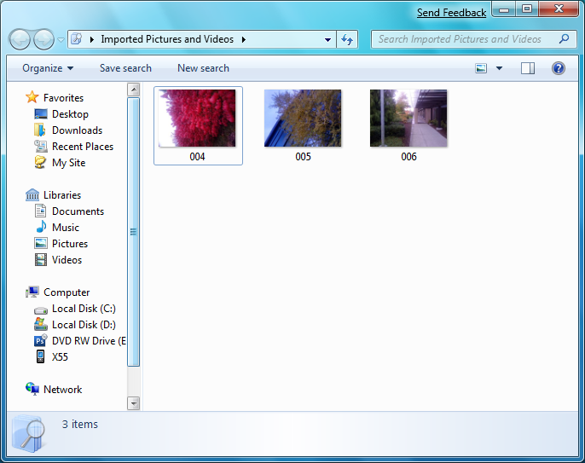
Windows Live Photo Gallery
External Application
Shows task if application is installed
Click to Launch application
<task id="{3ed9fe32-b100-4bbe-be84-206a46b62a55}" rank="0" issueTime="2008-08-06T13:36:23Z" name="23" description="24" icon="photoGallery.ico">
<requirements><registryKeyExists
path="HKEY_LOCAL_MACHINE\SOFTWARE\Microsoft\Windows Live\Photo Gallery"
invert="false"/></requirements>
<command type="ShellExecute"><arguments>
<commandLine xml:space="preserve">%PROGRAMFILES%\Windows Live\Photo
Gallery\WLXPhotoGallery.exe</commandLine>
</arguments></command>
</task>

Slide 32
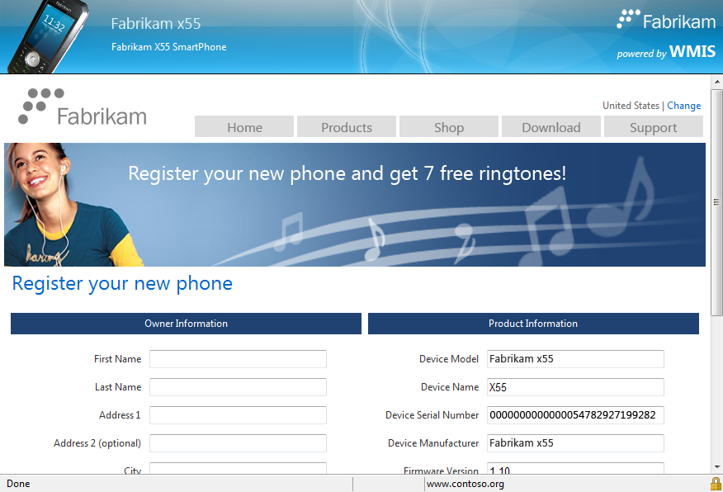
Online Product Registration
Hosted Site with Device
Site which interacts with phone to register device and
reward user
Scripting support enabled via WPD Automation with Device Stage as a trusted script host
<task id="{cf718146-9212-4bcc-ac14-c47d24852d55}" issueTime="2008-08-08T14:33:25Z" name="19" description="20" icon="Register.ico">
<requirements />
<command type="HostedSiteWithDevice" allowedDomain="contoso.org">
<arguments> <commandLine>https://www.contoso.org/register</commandLine> </arguments>
</command>
</task>

Slide 33
How Hosted Site With Device Works
Website
SSL
Sync
Ringtone
Status
…
Hosted Site with device
Device Stage™
Internet Explorer
WPD
Limited access to WPD Services
Contact
Ringtone
Status
…
WPD
Device

Slide 34
Authoring The E8 Experience
Choose a device
Brand the experience
Add status
Select tasks
Test device experience

Slide 35
Test Device Experience
  Boot Windows in Test Mode:
  Bcdedit –set testsigning ON
  Create the new metadata package with CABARC
  Copy metadata package to:
  %PROGRAMDATA%\Microsoft\Windows
  \DeviceMetadataStore\en-us
  Plug in device, Device Stage will launch

Slide 36
Summary
Device Stage provides:
  Great first-connect, subsequent use story
  Built-in tasks for key device functions
  Extensibility for partner applications,
  websites, and content
  Branded experience for customer connection
Reduces development/deployment costs
Device Experience is easy to author

Slide 37
Call To Action
Review Logo requirements for WPD devices
Read Device Stage Documentation and Templates
Develop and test experiences during beta and RC
Engage product marketing and design teams early

Slide 38
Related Sessions
CON-T531 Windows 7 Device Experience Overview
CON-T532 Windows 7 Device Installation Experience
CON-T533 Windows 7 Device Experience
CON-T566 Authoring a Device Experience for
Portable Devices
CON-T567 Windows Logo Program for Portable Devices
CON-T568 Windows 7 Device Services for Media Transfer Protocol
CON-C648 Discussion: Windows Portable Device
Enabling Kit

Slide 39
Additional Resources
Web Resources
  Specifications
    Media Transfer Protocol http://www.usb.org/developers/devclass_docs/MTP_1.0.zip
    MTP Device Services for Windows – See Windows Portable Device Enabling Kit
    MTP Device Service – See Windows Portable Device Enabling Kit
  Whitepapers
    Building Devices with the Windows Portable Device Enabling Kit http://www.microsoft.com/whdc/device/wpd/default.mspx
  Other Resources
    PlaysForSure http://www.microsoft.com/windows/windowsmedia/forpros/consumerelectronics/p4skit/p4s_1.aspx
    Windows Portable Device Enabling Kit http://www.microsoft.com/whdc/device/wpd/default.mspx
Contact Information
  MTP and MTP Device Services Support
  Portable Device Enabling Kit Support
  Device Stage Metadata Support
askmtp@microsoft.com
dekhelp@microsoft.com
askds@microsoft.com

Slide 40
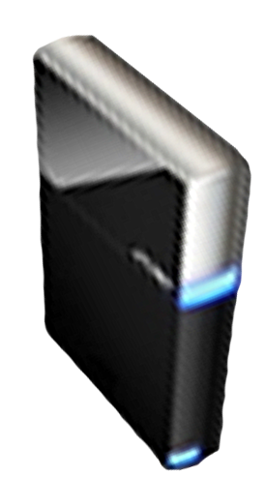


Please Complete A Session Evaluation Form
Your input is important!
Visit the WinHEC CommNet and complete a Session Evaluation for this session and be entered to win one
of 150 Maxtor® BlackArmor™ 160GB External Hard Drives
50 drives will be given away daily!
http://www.winhec2008.com
BlackArmor
Hard Drives provided by:

Slide 41


© 2008 Microsoft Corporation. All rights reserved. Microsoft, Windows, Windows Vista and other product names are or may be registered trademarks and/or trademarks in the U.S. and/or other countries.
The information herein is for informational purposes only and represents the current view of Microsoft Corporation as of the date of this presentation. Because Microsoft must respond to changing market conditions, it should not be interpreted to be a commitment on the part of Microsoft, and Microsoft cannot guarantee the accuracy of any information provided after the date of this presentation.
MICROSOFT MAKES NO WARRANTIES, EXPRESS, IMPLIED OR STATUTORY, AS TO THE INFORMATION IN THIS PRESENTATION.

