Slide 1
Windows Logo Program For Portable Devices
John Felkins
Program Manager
Microsoft Corporation
Robin Goldstein
Principal Lead
Microsoft Corporation

Slide 2
Purpose Of This Session
Provide an overview of Windows 7 portable devices logo programs
Program guidelines
Requirements
Additional Qualifications
PlaysForSure Transition
Call To Action
Additional Resources

Slide 3
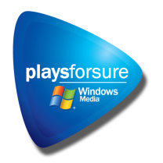

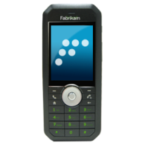

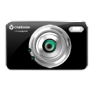

Windows 7 Logo Program Simplified
Today
Windows 7
Artwork
Pending
Starting June 2009

Slide 4
Windows 7 Logo Program Guiding Principles
Great Experience for End Users
Real Scenarios
Value
for device makers
Clearly Documented
Service enabled and customizable
Achievable, Self-testable

Slide 5
Logo Requirements Summary
Core connectivity – based on MTP
Codecs and scenarios vary by device class
Portable media player – media centric
Digital still camera – photo centric
Mobile phone – multiple functions
Optional functions are certified “if implemented”
Advanced devices can opt for “additional qualification”

Slide 6


Logo Requirements Device Class Specifics
Portable Media Player
MTP 1.0 over USB; MTP over IP (IF IMPL)
Windows Shell, Windows Media Player Media Sync
Minimum of 1 natively supported format for audio and video (IF IMPL)
Digital Camera
PTP or MTP 1.0 over USB 2.0, MTP over IP (IF IMPL)
Minimum of 1 natively supported Windows 7 photo and video format (IF IMPL)
Mobile Phone
MTP 1.0 over USB 2.0 Full Speed, MTP over IP (IF IMPL) , MTP over Bluetooth (IF IMPL)
MTP Device Services for Windows* (IF IMPL)
Cell Modem (NDIS-RNDIS and/or BT PAN), Multi-Transport DUID (IF IMPL), Multi-Function FUID (IF IMPL), DLNA 1.5 (IF IMPL)
Minimum of 1 natively supported format for Audio, Video, and Photo (IF IMPL)
*ATTEND CON-C568 Windows 7 Device Services for Media Transfer Protocol

Slide 7
Logo Requirements Mobile Phone exceptions
Multi-function certification required
All compatible Windows functions to be certified
May not certify as a media player, modem, or camera only
Device Stage™* is a baseline feature in Windows 7 and must be supported along with these tasks:
Browse device, Manage your media, Transfer pictures and videos
Device Stage is only available to Mobile Phones that certify under the Mobile Phone class
*REVIEW CON-C566 Authoring a Device Experience for Portable Devices

Slide 8
Logo Requirements Core Connectivity – all classes
USB (required)
Wi-Fi (optional)
Bluetooth (optional)
Core USB (2.0) plus
USB-IF compliance as of June 1, 2010
MTP 1.0 compliance
Support for selective suspend
Core Networking plus
MTP over IP (IF IMPL)
Windows Rally technologies (IF IMPL)
DLNA 1.5 Certification (IF IMPL)
Core Bluetooth minus
Bluetooth 2.0 plus EDR
Device ID Profile
MTP over Bluetooth (IF IMPL)

Slide 9
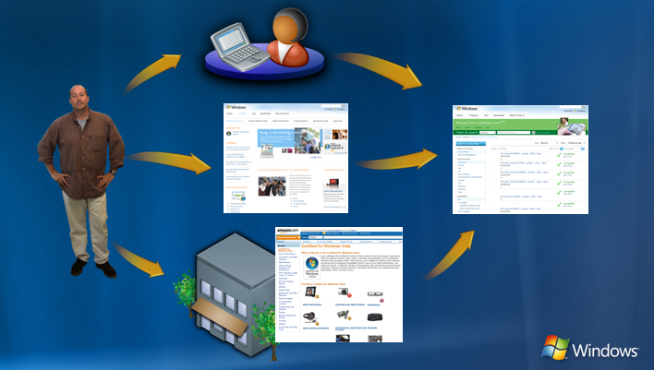
Additional Qualifications Beyond the logo
Enable customers to find specific software, devices, or systems that enable specific experiences
Enable partners to communicate that their device supports specific experiences
Logo = Compatibility with Windows 7 core scenarios
Additional Qualification = Support for advanced scenarios

Slide 10

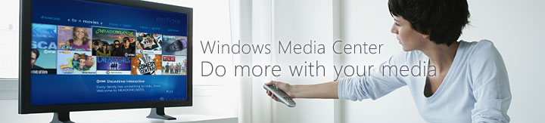
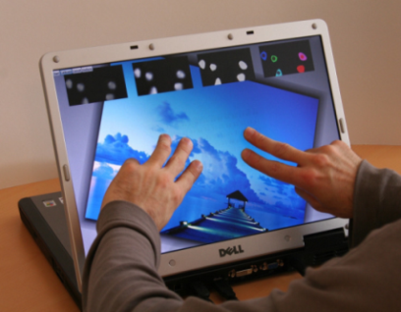
AQs For Windows 7
Media Center
Device Stage
Manages all forms of media throughout the home with rich experience
A simplified way of connecting and managing add-on devices
MultiTouch
Distinguishes systems with this distinct user interface
AQ=Additional Qualification
HD=High Definition

Slide 11

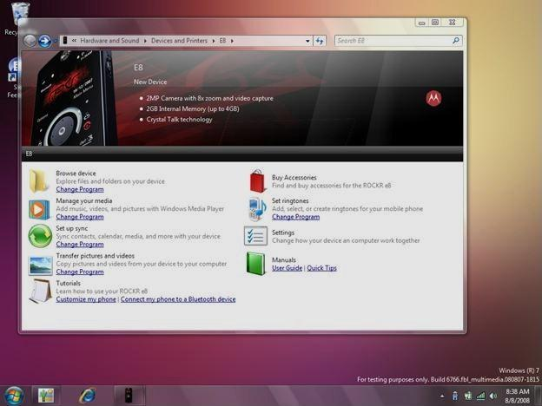

Device Stage
Customizable
Extensible
Multiple branding elements
Easy to manage with XML

Slide 12
Additional Qualification Device Stage
To qualify: Author and certify your custom experience and submit through WinQUAL
Like logo, requirements are device specific
Digital Camera
Must support Browse Device and Import Pictures tasks
Portable Media Player
Must support Browse device, Manage Media tasks
Mobile Phones
Must support Browse device, Manage Media, Import Pictures, Contacts Sync*, Live Status* and Device Metadata*
Optional: Ringtone Personalization*, Device Hints*
*ATTEND CON-C568 Windows 7 Device Services for Media Transfer Protocol

Slide 13
PlaysForSure Transitioning to the Windows Logo Kit
Switch to the Windows Logo Kit (WLK) for certification in June 2009
Stand-alone PFS test kits will end-of-life May 2009
PFS Logo License Agreement will end-of-life May 2009

Slide 14
PlaysForSure WLK Training
Windows Logo Kit (WLK) training events will take place during 1st half of 2009
Hands on experience with the WLK
On-site with WLK engineers and Logo team
Information on Program updates available
Scheduling information available soon
Sign up for the WHQL Weekly Newsletter!

Slide 15
Development Kits
Portable Device Enabling Kit for Windows 7*
ANSI C Reference design/samples for MTP devices
MTP Device Simulator
Tools for device and driver development
Documentation and FAQs
Device Experience Authoring Guidelines and Templates
Windows Logo Kit
Test kit for the Windows Logo Program
Windows Driver Kit
Driver development kit for Windows
Windows Platform SDK
Software development kit for Windows
*ATTEND CON-C648 Discussion: Windows Portable Device Enabling Kit

Slide 16
Call To Action
Review the Windows 7 Logo Program portable device requirements and discuss your feedback with us
Ensure that your devices comply with Windows Logo Program requirements in the Windows 7 timeframe to benefit from Device Stage
Download and start beta testing using the WLK 1.3 which will prepare you for the launch of the Windows 7 logo program

Slide 17
Related Sessions Virtual Track Guide
CON-T531 Windows 7 Device Experience Overview
CON-T532 Windows 7 Device Installation Experience
CON-T533 Windows 7 Device Experience
CON-T566 Authoring a Device Experience for Portable Devices
CON-T567 Windows Logo Program for Portable Devices – This Session
CON-T568 Windows 7 Device Services for Media Transfer Protocol
CON-C648 Discussion: Windows Portable Device Enabling Kit

Slide 18
Additional Sessions Other Key Sessions to Note
COR-T536 Bluetooth and Wireless USB Support in Windows 7
CON-T537 USB Technology Update and Windows Strategy
CON-P578 Panel: Wireless Personal Area Network
COR-C623 Windows Logo Program Process and Policies
COR-C644 What's New in the Windows Logo Program
CON-C658 PC and Device IDs in Windows 7: What You Need to Know
CON-C655 Wired USB Strategy and Implementations
CON-T615 Device Interfaces Overview

Slide 19
Additional Resources Windows Logo Program
Web Resources
Windows Logo Program
http://www.microsoft.com/whdc/winlogo/
Windows Quality Online Services (WinQUAL)
https://winqual.microsoft.com/
Newsletter
WHQL Weekly Newsletter http://www.microsoft.com/whdc/newsreq.mspx
Contact Information
Logo feedback and policy
WinQUAL Web site
Logo related legal agreements
logofb@microsoft.com
winqual@microsoft.com
whqlegal@microsoft.com

Slide 20
Additional Resources Windows Portable Devices
Web Resources
Specifications
Media Transfer Protocol http://www.usb.org/developers/devclass_docs/MTP_1.0.zip
MTP Device Services for Windows – See Windows Portable Device Enabling Kit
MTP Device Service – See Windows Portable Device Enabling Kit
Whitepapers
Building Devices with the Windows Portable Device Enabling Kit http://www.microsoft.com/whdc/device/wpd/default.mspx
Other Resources
PlaysForSure http://www.microsoft.com/windows/windowsmedia/forpros/consumerelectronics/p4skit/p4s_1.aspx
Windows Portable Device Enabling Kit http://www.microsoft.com/whdc/device/wpd/default.mspx
Contact Information
MTP and MTP Device Services Support
Portable Device Enabling Kit Support
Device Stage Metadata Support
askmtp@microsoft.com
dekhelp@microsoft.com
dxpsupp@microsoft.com

Slide 21
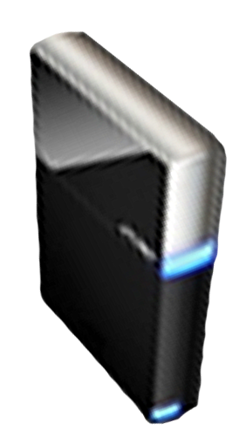


Please Complete A Session Evaluation Form Your input is important!
Visit the WinHEC CommNet and complete a Session Evaluation for this session and be entered to win one of 150 Maxtor® BlackArmor™ 160GB External Hard Drives 50 drives will be given away daily!
http://www.winhec2008.com
BlackArmor Hard Drives provided by:

Slide 22


© 2008 Microsoft Corporation. All rights reserved. Microsoft, Windows, Windows Vista and other product names are or may be registered trademarks and/or trademarks in the U.S. and/or other countries.
The information herein is for informational purposes only and represents the current view of Microsoft Corporation as of the date of this presentation. Because Microsoft must respond to changing market conditions, it should not be interpreted to be a commitment on the part of Microsoft, and Microsoft cannot guarantee the accuracy of any information provided after the date of this presentation. MICROSOFT MAKES NO WARRANTIES, EXPRESS, IMPLIED OR STATUTORY, AS TO THE INFORMATION IN THIS PRESENTATION.

