Slide 2
Windows 7 Device Services for Media Transfer Protocol
John Felkins
Program Manager
Microsoft Corporation

Slide 3
Related Sessions
Virtual Track Guide
CON-T531 Windows 7 Device Experience Overview
CON-T532 Windows 7 Device Installation Experience
CON-T533 Windows 7 Device Experience
CON-T566 Authoring a Device Experience
for Portable Devices
CON-T567 Windows Logo Program for Portable Devices
CON-T568 Windows 7 Device Services
for Media Transfer Protocol
CON-C648 Discussion: Windows Portable Device Enabling Kit

Slide 4
Firmware Update Exercise
The Introduction
Use a web task in Device Stage™
to check the firmware version of
the Contoso CoolPhone
If an update is available, the Web
task is able to apply the update
directly to the device
No software installation necessary!

Slide 5
Firmware Update Exercise
The ingredients
Device implementation of a
“Firmware Update” MTP Device Service
Device Stage™ metadata with the
Device Firmware Update task
Website with a firmware update script

Slide 6
Media Transfer Protocol
Introduced at 2004 WinHEC
Hundreds of millions of devices
In Windows XP with Windows Media Player, Windows Vista, and Windows 7
Mobile phones, media players, cameras, cars, stereos, Xbox 360, etc.
MTP 1.0 standardized in the USB Implementers Forum

Slide 7
Overview of MTP 1.0
Storages with objects
Command and control
Enumeration-based media synchronization
Windows Application Support
  Windows Media Player
  Windows Photo Gallery
  Shell Extension/Explorer

Slide 8
What Worked, What Didn’t
Great For
Music and video synchronization
Picture transfer
Basic file browsing
Devices with hard disk or flash storages
Not so great for
Contacts, calendars, tasks, etc.
Complex operations
like SMS, email, and advanced synchronization
Dealing with
non-media files
Devices with specialized storages (databases,
SIM cards, etc.)

Slide 9
MTP 1.0: Limitations
Limited room for growth and new functionality
  Limited opcode/propcode number space
  Relies on new features not
  “colliding” with existing codes
  Object file formats are set by MTP Specification, not easily changeable

Slide 10
MTP 1.0: Limitations
Very storage-centric
No method to figure out where to put content, other than application-chosen folder names (music, pictures, etc.)
Doesn’t reflect how some devices store information (in a database, not files and folders)
Performance issues
Initiator must crawl device contents
to find certain things
Responders have less control over
how and where objects are stored

Slide 11
MTP Device Services
MTP Device Services allow richer communication between the PC and the device
The device has greater control over how
and where it stores data
Eliminates opcode/propcode shortages
with unlimited expandability
PCs will be able to discover and use
new services more easily
Greater opportunity for IHV enhancements

Slide 12
Key New Concepts
GUIDs/PKeys are now what matters.
16-bit Datacodes are up to the device
Methods are the new operations
Bulk, bulk, and more bulk!
Formats, methods, properties, etc. are now storage-specific, not device-wide

Slide 13
Services: GUIDs and PKeys
MTP 1.0 – Datacodes
Used 16-bit datacodes
All datacodes set by the MTP Specification
For new datacodes, wait
for the next MTP spec or make your own from a limited vendor range. Watch out for collisions!
MTP with Device Services
GUIDs and Property Keys (PKeys) define the meaning
16-bit datacodes used as aliases to the PKeys and GUIDs, defined by the device
GUIDs and PKeys set by device service definitions
GUIDs and PKeys guarantee virtually no conflicts!
No more limited formatcode, opcode, and propcode ranges. Nearly unlimited expandability!

Slide 14
Services: GUIDs and PKeys
The old way:
MTP 1.0 | Datacode
MP3 audio format | 0x3009
Audio Bitrate property | 0xDE9A
The new way:
Device Services | GUID or PKey | Datacode
MP3 audio format | {30090000-AE6C-4804-98BA-C57B46965FE7} | 0x0001
Audio Bitrate property | {B324F56A-DC5D-46E5-B6DF-D2EA414888C6, 9} | 0x0002

Slide 15
Operations for Services
For Core Service Information
  GetServiceIDs, GetServiceInfo, GetServiceCapabilityList, GetServicePropDesc
For Service Properties
  GetServicePropList, SetServicePropList
Other Updates to MTP
  DeleteObjectPropList, UpdateObjectPropList

Slide 16
Operations for Services
Moving to Bulk Operations
MTP 1.0 Operation | Replaced By
GetObjectPropDesc | GetServiceCapabilities
GetObjectPropsSupported | GetServiceCapabilities
GetObjectPropVal | GetObjectPropList
Fewer Transactions
Static datasets
Greater performance!

Slide 17
Methods
Replace operations
Messaged-based communication model, similar to Web Services
Asynchronous

Slide 18
Services: The Core Ingredients
ServiceInfo
  The core definition of what’s
  in a service and what it does
ServiceProperties
  Properties and additional information
  about the service itself
ServiceCapabilities
  Properties and capabilities of the
  objects and methods in a service

Slide 19

Firmware Update Exercise
Firmware service ServiceInfo
Service Information | Service GUID (80ec3a1c-7414-462e-a46e-12c42ab81f90) Service Storage ID (0x50005) Service Name (“FirmwareUpdate”) Service ID (0x7)
Service Properties | CurrentFirmwareVersion (0x0002) CurrentFirmwareDate (0x0003) DeviceSerialNumber (0x0004)
Object Formats | DeviceFirmwareImage (0x0005)
Methods | ApplyFirmware (0x0006)
Events | (none)

Slide 20
Firmware Update Exercise
Firmware service ServicePropList
CurrentFirmwareVersion | 1.15
CurrentFirmwareDate | July 15th, 2008
DeviceSerialNumber | A123B456C789

Slide 21
Firmware Update Exercise
Firmware service CapabilitiesList
Format: DeviceFirmwareImage (0x0005) | Core properties (Storage, Format, Size, Name, PUOID) Format-specific Properties (FirmwareVersion)
Method: ApplyDeviceFirmware(0x0007) | Core properties (Storage, Format, Size, Name, PUOID) Method Parameters (SourceFirmwareImage)

Slide 22
Enumerating Services
Windows 7
GetServiceIDs
MTP Device
Response (0x1, 0x2, 0x3)
GetServiceInfo (0x1)
Response (ServiceInfo Dataset [0x1])
GetServicePropList (0x1)
Response (ServicePropertyList [0x1])
GetServiceCapabilities(0x1)
Response (CapabilityList Dataset[0x1])

Slide 23
Services in Windows 7
Device Status
Device Metadata
Hints
Ringtones
PIM
  Contacts
  Calendar
  Tasks
  Notes
Sync
  Enumeration
  Anchor

Slide 24
Enumerating the Status Service
demo

Slide 25
PIM Synchronization
Sync with Outlook or
Windows Address Book
Other synchronization
plugins can be developed
Each PIM service is combined
with a Sync service

Slide 26
Other Services
Device Status
Device Metadata
“Hints”
Ringtones

Slide 27
MTP 1.0 and Services Together
Media (pictures, videos, music)
continues to work as it does
Services enable new content
functionality
Legacy MTP Initiators will not
know about Services, backwards compatibility is maintained

Slide 28
Firmware Update Exercise
The final piece
Use the WPD Automation API
and web scripting in the DXP

Slide 29
Device Stage™,
Services, and the Web
Contoso Web Service
SYNC
Internet Explorer
Device Stage™
Ringtones
Status
WPD Automation Layer
WPD
Device
SYNC
Ringtones
Status
Firmware Update Service

Slide 30
Firmware Update Exercise
Web page script
var FWUpdateService = deviceObject.Services[FirmwareUpdateGUID];
function DownloadFirmware()
{
var oldFirmware = FWUpdateService.GetChildrenByFormat(“DeviceFirmwareImage”)[0];
if(oldFirmware.Version < 2.00)
{FWUpdateService.RemoveChild(oldFirmware);
var request = new ActiveXObject("MSXML2.XMLHTTP.3.0");
request.open("GET", "http://contoso.com/downloadFirmware.asp", false); request.send();
var stream = request.responseStream;
var newFirmware = FWUpdateService.CreateNewObject(“DeviceFirmwareImage”); newFirmware.Data = stream; newFirmware.Version = “2.0”;
FWUpdateService.AddChild(newFirmware);
}

Slide 31
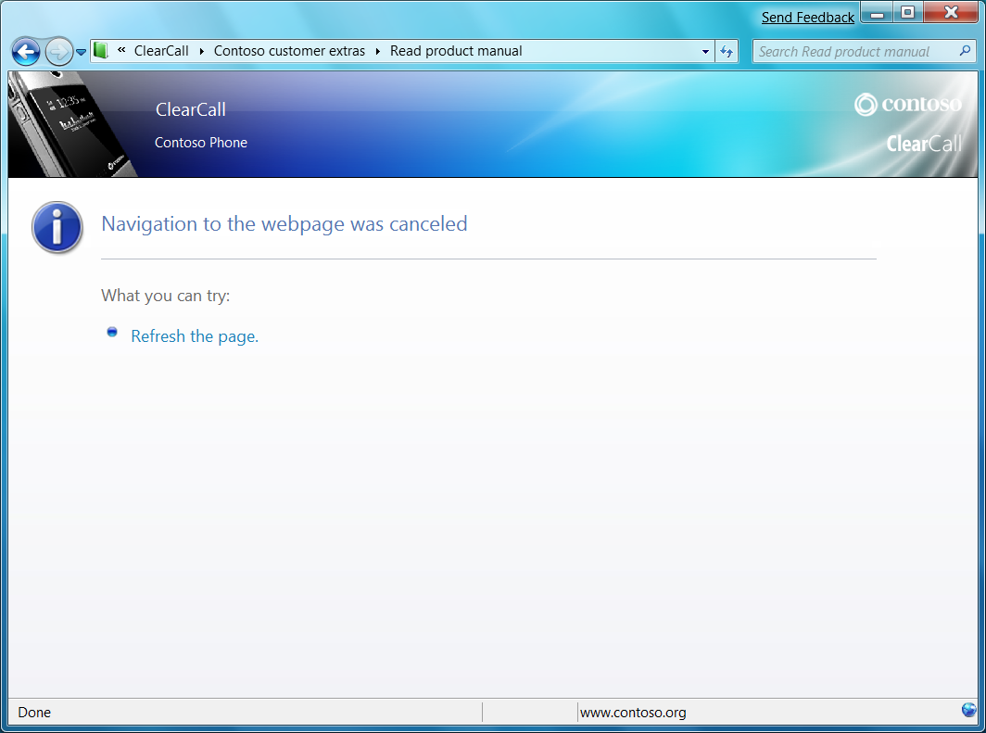
Firmware Update Exercise
The Result
Contoso Update Service
Downloading Firmware
Applying Firmware

Slide 32
Starting Out with Services
Start with the Windows Status Service
  GetServiceIDs, GetServiceInfo, GetServicePropDesc, GetServicePropList
  Service only has properties, is read-only
  Flexible for Windows… add your own
  status and display in the Device Stage™
Next, try a simple PIM sync service
with full enumeration or anchor sync
  Contacts and notes are the simplest

Slide 33
Call To Action
Attend CON-C648 Discussion:
Windows Portable Device Enabling Kit
Download the Device Enabling Kit
  Use the MTP Simulator
  Read the documents
    MTP Device Services Extension
    MTP Device Services for Windows 7
  Look at the reference implementation
Implement Windows 7 Device Services
as well as create your own!

Slide 34
Additional Resources
Windows portable devices
Web Resources
Specifications
  Media Transfer Protocol http://www.usb.org/developers/devclass_docs/MTP_1.0.zip
  MTP Device Services for Windows – See Windows Portable Device Enabling Kit
  MTP Device Service Extension – See Windows Portable Device Enabling Kit
Whitepapers
  Building Devices with the Windows Portable Device Enabling Kit http://www.microsoft.com/whdc/device/wpd/default.mspx
Other Resources
  PlaysForSure http://www.microsoft.com/windows/windowsmedia/forpros/
  consumerelectronics/p4skit/p4s_1.aspx
  Windows Portable Device Enabling Kit http://www.microsoft.com/whdc/device/wpd/default.mspx
Contact Information
MTP and MTP Device Services Support: askmtp@microsoft.com
Portable Device Enabling Kit Support: dekhelp@microsoft.com
Device Stage Metadata Support: dxpsupp@microsoft.com

Slide 35
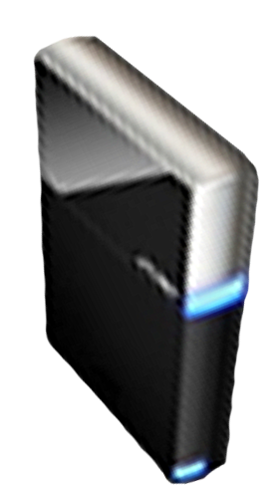


Please Complete A Session Evaluation Form
Your input is important!
Visit the WinHEC CommNet and complete a Session Evaluation for this session and be entered to win one
of 150 Maxtor® BlackArmor™ 160GB External Hard Drives
50 drives will be given away daily!
http://www.winhec2008.com
BlackArmor
Hard Drives provided by:

Slide 36


© 2008 Microsoft Corporation. All rights reserved. Microsoft, Windows, Windows Vista and other product names are or may be registered trademarks and/or trademarks in the U.S. and/or other countries.
The information herein is for informational purposes only and represents the current view of Microsoft Corporation as of the date of this presentation. Because Microsoft must respond to changing market conditions, it should not be interpreted to be a commitment on the part of Microsoft, and Microsoft cannot guarantee the accuracy of any information provided after the date of this presentation.
MICROSOFT MAKES NO WARRANTIES, EXPRESS, IMPLIED OR STATUTORY, AS TO THE INFORMATION IN THIS PRESENTATION.

