Slide 1
Authoring Device Experience For Multifunction Printers
Sangeeta Ranjit
Program Manager
Microsoft Corporation

Slide 2
Agenda
Demo
Case Study – Fabrikam x58 All-in-One Printer

Slide 3
Great Device Experiences With Windows 7
Natural Experience for End Users
No setup required
Easy to find and use device features and services
Consistent across devices, but specific to my device
Great for Partners
Builds emotional connection and customer satisfaction
Drives revenue, reduces support costs
Easy to customize and deploy
Enables greater differentiation

Slide 4
Device Experiences
demo
Multifunction Printer Experiences in Windows 7

Slide 5
Authoring Experiences
case study
Fabrikam x58 All-in-One Printer

Slide 6
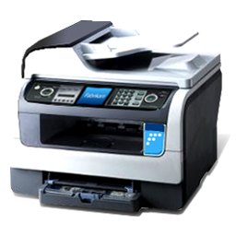
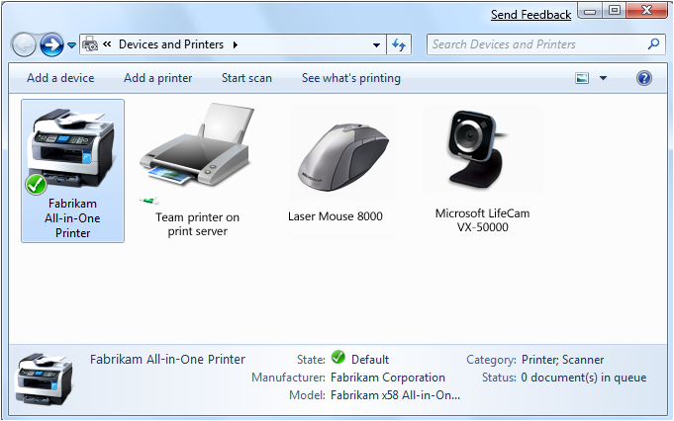
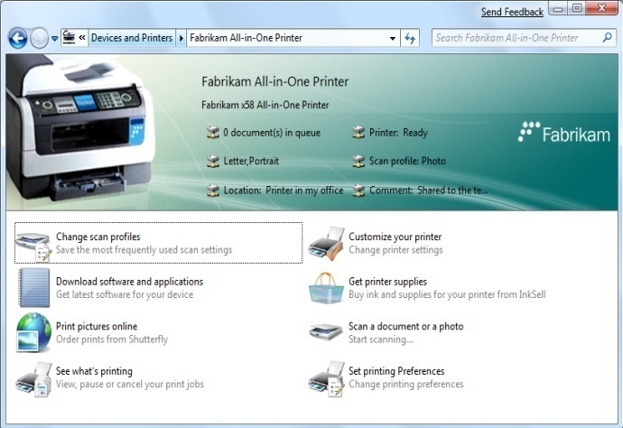

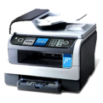

Device Experience Elements
Print/Scan/Multifunction Printer (MFP)
New, or Existing devices
Device Experience XML
Carried in device metadata package (branding, tasks)
Windows 7
Platform Support Built-in Tasks

Slide 7
Authoring The Fabrikam x58 Experience
Choose a device
Add device information
Brand the experience
Add status
Select device tasks
Test device experience
Engage the help of product marketing and design early!

Slide 8
Choosing Devices
Device experiences can be bound to one or more devices
The more specific the experience, the better
Experience fidelity depends on
Marketing and product strategy
Available firmware properties

Slide 9
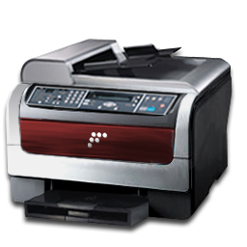
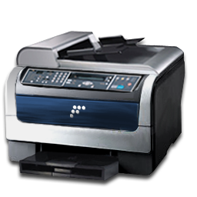
Experience Fidelity By Product Line
Fabrikam x58
Fabrikam x59-1
Fabrikam x59-2
Hardware IDs are used to identity the device metadata

Slide 10
Experience Fidelity By Model
Fabrikam x58
Fabrikam x59-1
Fabrikam x59-2

Slide 11
Device Fidelity
PackageInfo.XML
<?xml version="1.0" encoding="utf-8" ?>
<PackageInfo xmlns="http://schemas.microsoft.com/windows/DeviceMetadata/PackageInfo/2007/11/">
<MetadataKey>
<HardwareIDList>
<HardwareID>SFDOID:USB\VID_04B8&PID_0844&MI_00</HardwareID>
<HardwareID>DOID:USB\VID_04B8&PID_0844&MI_00</HardwareID>
<HardwareID>SFDOID:USBPRINT\Fabrikam_x58_7011</HardwareID>
<HardwareID>DOID:USBPRINT\Fabrikam_x58_7011</HardwareID>
</HardwareIDList>
<Locale default="false">en-us</Locale>
<LastModifiedDate>2008-09-25T23:39:15z</LastModifiedDate>
</MetadataKey>
...
</PackageInfo>
Hardware IDs

Slide 12
Authoring The Fabrikam x58 Experience
Choose a device
Add device information
Brand the experience
Add status
Select device tasks
Test device experience

Slide 13
Device Information
Device icon
Model
Manufacturer
Category

Slide 14

Device Information
DeviceInfo.XML
<DeviceInfo
<DeviceCategoryList>
<DeviceCategory>PrintFax.Printer</DeviceCategory>
<DeviceCategory>Imaging.Scanner</DeviceCategory>
</DeviceCategoryList>
<ModelName>Fabrikam X58 All-in-One Printer</ModelName>
<Manufacturer>Fabrikam Corporation</Manufacturer>
<DeviceIconFile>device_icon.ico</DeviceIconFile>
</DeviceInfo>

Slide 15
Authoring The Fabrikam x58 Experience
Choose a device
Add device information
Brand the experience
Add status
Select device tasks
Test device experience

Slide 16
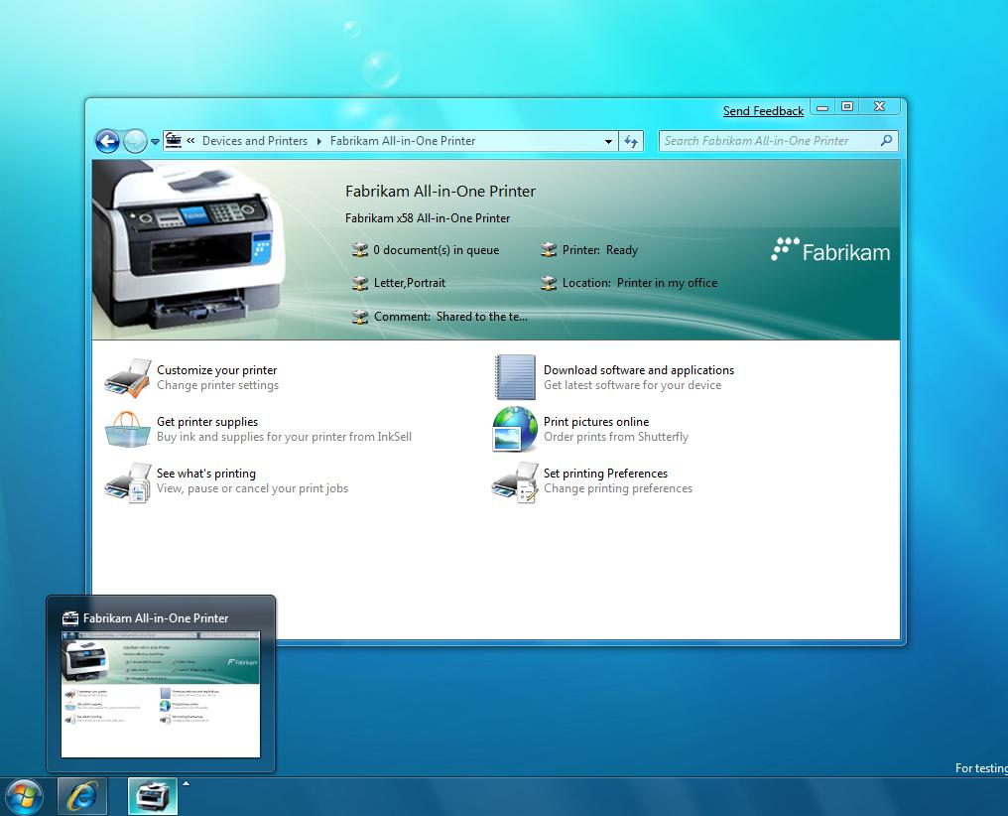
Branding Elements
Branding Bar
Shell Icon

Slide 17


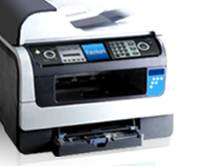
Branding Bar Elements
Logo(s)
Overlay
Device Image
Background

Slide 18

Branding The Experience
Behavior.xml
<header watermarkAlign="center" backgroundColor="#FFFFFFFF" textColor="#FF000000" backgroundImage="Background.png" watermarkImage="Overlay.png">
<modelInfo image=”Device_image.png“ />
<logos>
<logo image="logo.png" url="http://www.fabrikam.com/" tooltip="1" />
</logos>
</header>

Slide 19
Authoring The Fabrikam x58 Experience
Choose a device
Add device information
Brand the experience
Add status
Select device tasks
Test device experience

Slide 20

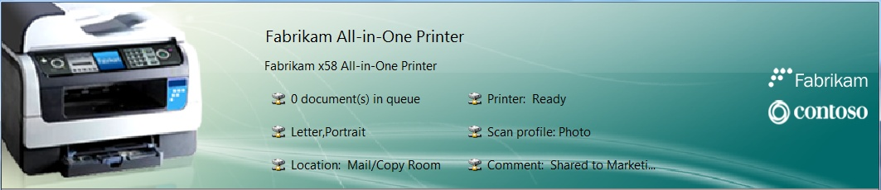
Add Marketing Bullets Or Status
Marketing Bullets
Status
Branding bar and taskbar may be configured to display status, or marketing bullets

Slide 21
Fabrikam X58 Marketing Bullets
Behavior.xml
Resource.xml
<deviceBehavior>
<header watermarkAlign="right" backgroundColor="#FFFFFFFF" textColor="#FF000000" backgroundImage="background.png" watermarkImage="overlay.png">
<marketingBullets>
<bullet id="2" />
<bullet id="3" />
<bullet id="4" />
</marketingBullets>
</header>
</deviceBehavior>
<stringTable>
<string id="1">Visit the Fabrikam website</string>
<string id="2">High-resolution photos: 4800 x 1200 DPI</string>
<string id="3">Great-quality scans: 2400 x 4800 DPI</string>
<string id="4">Bluetooth, Ethernet, wireless 802.11g</string>
</stringTable>
Localized strings stored in separate resourc.xml file
Bullets for branding bar. IDs link to localized resource file

Slide 22
Status Providers
Behavior.xml
<statusItems statusPropList="prop:System.PrintStatus.ErrorStatus; System.PrintStatus.WarningStatus;statusProvider="{0520af9e-e3da-4b32-8be8-0f3e475bfc5f}“>
<statusLinks>
<statusLink statusProp="System.PrintStatus.ErrorStatus" taskId="{16c5d1ee-
eac2-483e-a79a-0bc83c814682}" />
<statusLink statusProp="System.PrintStatus.WarningStatus" taskId="{16c5d1ee-
eac2-483e-a79a-0bc83c814682}" />
</statusLinks>
</statusItems>
Status property list to display in branding bar and taskbar preview
Status property interface
Click action for status

Slide 23
Status
Device Property | Description
System.PrintStatus.ErrorStatus | Displays error status
System.PrintStatus.WarningStatus | Displays warning status
System.PrintStatus.DocumentCount | Displays number of documents in print queue
System.PrintStatus.InfoStatus | Displays informational status (e.g. paper jam)
System.PrintStatus.Preferences | Displays current print preferences
System.ScanStatus.Profile | Displays current scan profile
System.PrintStatus.Location | Displays printer location
System.PrintStatus.Comment | Displays printer comment

Slide 24
Authoring The Fabrikam x58 Experience
Choose a device
Add device information
Brand the experience
Add status
Select device tasks
Test device experience

Slide 25
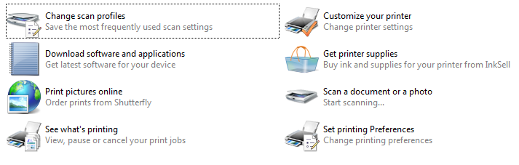
Task Model
Built-in Task
Custom Task
Tasks launch built-in features, or custom applications, content, and websites

Slide 26
Task Requirements
Tasks may be dynamic
Software Installation status
Device presence
Device Service availability
Internet availability
More…

Slide 27
Built-In Tasks
Task | User Scenario | Device Classes
See what’s printing | I can see the print jobs on my printer | Printer, MFP
Customize your printer | I can change the name, security settings, or other printer properties | Printer, MFP
Adjust print options | I can change color, layout, or paper settings | Printer, MFP
Scan a document or photo | I can easily scan my document or photo | Scanner
Manage scan profiles | I can easily create collections of frequently-used scan settings | Scanner
MICROSOFT CONFIDENTIAL – DO NOT DISTRIBUTE

Slide 28
Task Extensibility
Task | User Scenario
Partner Applications | I can easily find and use programs for my device on my computer.
Hosted Site | I can present software installs, accessories, manuals, tutorials, support, and firmware updates for my device in a single experience.
MICROSOFT CONFIDENTIAL – DO NOT DISTRIBUTE

Slide 29
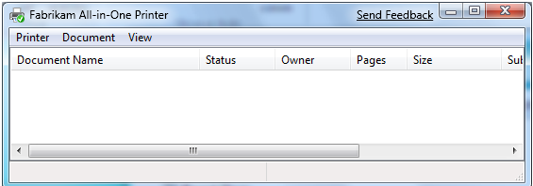
See What's Printing
Built-In Task
Shows the print queue
Simple XML reference to task
<taskCategoryMapping>
<taskRef taskGroupGuid="{8d721941-84f2-11dd-ad8b-0800200c9a66}“
taskId="{ec7ccfaa-8594-4376-9caf-b60c6cc9a34d}“ />
…
</taskCategoryMapping>

Slide 30
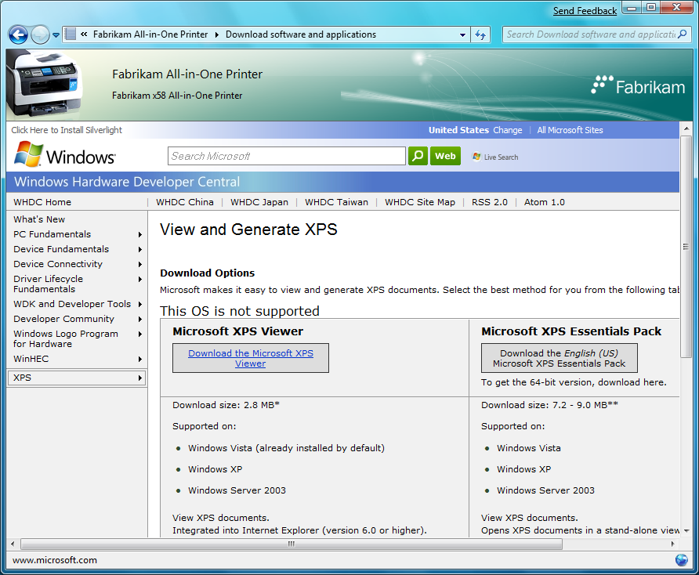

Software Download
Hosted Site Task
Download software and applications
XML defines how to display file (in-frame, external window), as well as URL for file location
<task id=“{ef7e7556-4e2a-11dd-b28a-3c6b56d89593}" issueTime="2008-09-10T14:37:33Z" name="15" description="16" icon=“SoftwareDownload.ico">
<requirements />
<command type=“HostedSite">
<arguments>
<commandLine>http://www.microsoft.com/whdc/xps/viewxps.mspx</commandLine>
</arguments>
</command>
</task>

Slide 31
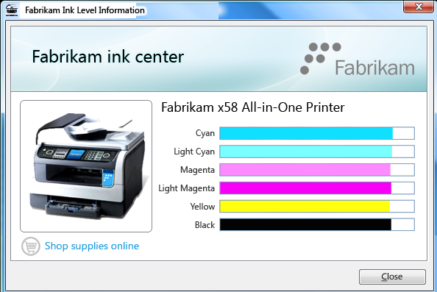
Check Ink Status
External Application
Launch installed application
XML checks whether application is installed and shows task
Clicking task launches executable
<task id="{6dc7d112-0329-4ef7-a9d1-1ad932c0da2e}" issueTime=“
2008-07-09T19:55:17Z" name="10" description="11" icon="inkstatus.ico">
<requirements></requirements>
<command type="ShellExecute">
<arguments><commandLine>inkstatus.exe</commandLine></arguments>
</command>
</task>

Slide 32
Authoring The Fabrikam x58 Experience
Choose a device
Add device information
Brand the experience
Add status
Select device tasks
Test device experience

Slide 33
Test Device Experience
Boot Windows in Test Mode: Bcdedit –set testsigning ON
Create the new metadata package with CABARC
Copy metadata package to: %PROGRAMDATA%\Microsoft\Windows \DeviceMetadataStore\en-us
Plug in device and launch Devices and Printers

Slide 34
Summary
Device Stage provides:
Great device experience
Built-in tasks for key device functions
Extensibility for partner applications, websites and content
Branded experience for customer connection
Reduces development / deployment costs
Easy to author

Slide 35
Call To Action
Review Logo requirements for print, scan, MFP devices
Refer to device experience documentation and templates
Develop and test experiences during beta and RC
Engage product marketing and design teams early

Slide 36
Additional Resources
Feature Resources
Whitepaper
Authoring Experiences for Printers, Scanners, and Multifunction Printers http://www.microsoft.com/whdc/device/DeviceExperience/default.mspx
Related Sessions
CON-T531: Windows 7 Device Experience Overview
CON-T533: Windows 7 Device Experience, Part 1
CON-T534: Windows 7 Device Experience, Part 2
CON-T566: Authoring a Device Experience for Portable Devices
CON-T607: Windows 7 Logo Program for Print and Document Devices
Questions?
Contact prninfo@microsoft.com for questions

Slide 37



Please Complete A Session Evaluation Form Your input is important!
Visit the WinHEC CommNet and complete a Session Evaluation for this session and be entered to win one of 150 Maxtor® BlackArmor™ 160GB External Hard Drives 50 drives will be given away daily!
http://www.winhec2008.com
BlackArmor Hard Drives provided by:

Slide 38


© 2008 Microsoft Corporation. All rights reserved. Microsoft, Windows, Windows Vista and other product names are or may be registered trademarks and/or trademarks in the U.S. and/or other countries.
The information herein is for informational purposes only and represents the current view of Microsoft Corporation as of the date of this presentation. Because Microsoft must respond to changing market conditions, it should not be interpreted to be a commitment on the part of Microsoft, and Microsoft cannot guarantee the accuracy of any information provided after the date of this presentation. MICROSOFT MAKES NO WARRANTIES, EXPRESS, IMPLIED OR STATUTORY, AS TO THE INFORMATION IN THIS PRESENTATION.

