Slide 1
Printer Installation and Driver Management
Shawn Maloney
Program Manager
Microsoft Corporation

Slide 2
Agenda
Building on Windows Vista
  Driver Store
  Package Aware Drivers
  Core Drivers
New in Windows 7
  Driver Isolation
  Compatible IDs
  Print Management Console

Slide 3
Building On Windows Vista
All drivers are copied
into the Driver Store
  Simplifies driver management
  Enables migration, rollback, and recovery
  Provides users access to a
  trusted repository of drivers

Slide 4
Building On Windows Vista
Package Aware drivers
enable Package Point and Print
  Ensures drivers are available in the
  driver store through Point and Print
  Allows full driver installation on the client
  Requires driver dependencies to
  also be package Aware

Slide 5
Building On Windows Vista
Core Drivers support
Package Aware Drivers
  Initially introduced to enable shared components like ntprint.inf to be
  used in Package Point and Print
  Enables smaller and simpler driver packages
  Allows shared components to be
  kept in the Driver Store

Slide 6
Building On Windows Vista
Core Driver Servicing
  All core drivers referenced in
  an INF share the same minimum version
  Use CopyINF to preload a core
  driver into the Driver Store
  Include non-inbox core drivers
  with your driver package

Slide 7
Windows 7: Driver Isolation
Dramatic improvement in reliability
  Isolates print drivers into separate processes
  Minimizes the impact of a driver
  crash on the rest of the print system
IT Admins can force drivers into isolation
Layered control of Isolation behavior
  Group Policy
  Driver INF
  PMC

Slide 8
Driver Isolation – INF Support
“DriverIsolation” is INF declaration
  0 = Disabled
  2 = Enabled
  1,3 = Reserved for future use
INF Example
  [Version]
  …
  DriverIsolation=2

Slide 9
Driver Isolation – Group Policy
Group Policies
  “Run print drivers in isolated processes”
    Enabled – Driver Isolation attempted
    Disabled – No Driver Isolation attempted
  “Override isolation mode compatibility setting advertized by driver”
    Enabled – Driver Isolation attempted
    regardless of INF
    Disabled – Driver Isolation honors INF

Slide 10
Driver Isolation – PMC
Per Driver Control
Filters can key on Isolation state
Driver Isolation values dictates behavior
  Disabled – No Driver Isolation attempted
  Shared – Driver Isolation
  forced in Shared process
  Isolated – Driver Isolation
  forced in Isolated process

Slide 11
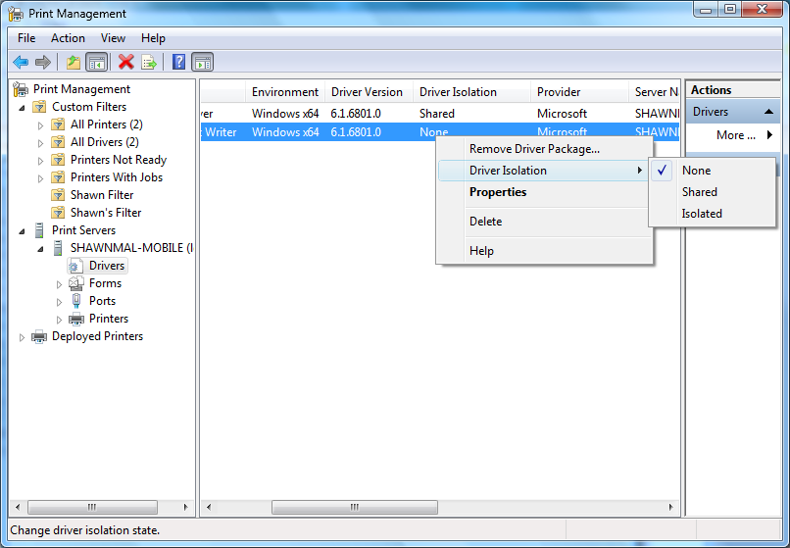
PMC – Manage Driver Isolation

Slide 12
Windows 7: Compatible IDs
Allows for a second level of
Device to Driver mapping
Only considered when a
HWID match isn’t available
Enables families of devices to
be matched against a single driver

Slide 13
Compatible IDs – Implement
Embed the Compatible ID
in the 1284 ID String
  Keywords: “CID” and “COMPATIBLEID”
  Max length of 180 characters
Update INFs to use Compatible IDs
  “Printer Driver Name” = InstallSection,,CompatibleID

Slide 14
Compatible IDs - PnP
PnP alters reported Compatible ID
  Reported by device
    CID=FabrikamClass1 (This is what goes in the firmware)
  Reported by PnP
    1284_CID_FabrikamClass1 (This is what goes in the INF)

Slide 15
Windows 7: PMC
First released in WS 2003 R2
for enterprise print management
Consolidated admin tool for to install, view, and manage all of the printers
and Windows Print Servers across
an organization
Extended in each OS release based
on customer feedback and for
new technology management

Slide 16
PMC – New Win7 Functionality
Information Display and Filters
    Monitor printer queues with new metadata
    Create filters for monitoring drivers
Driver Isolation
    Improve the reliability of the print service
Print Server Security
    Manage organization specific security setting

Slide 17
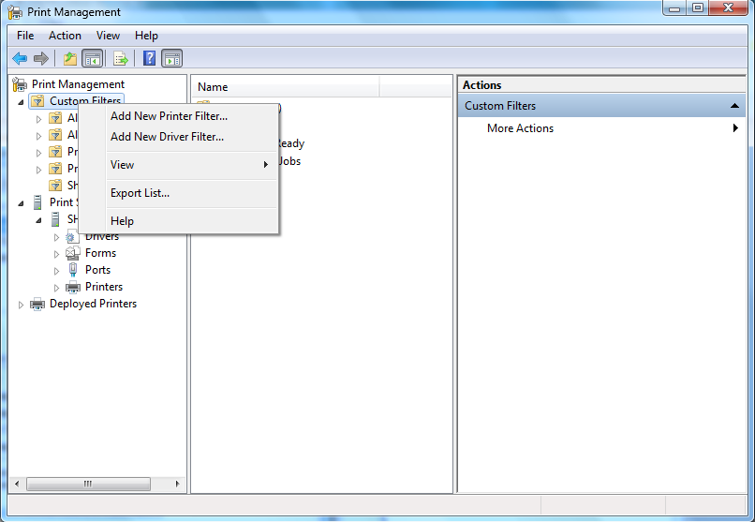
PMC – Creating A Driver Filter

Slide 18
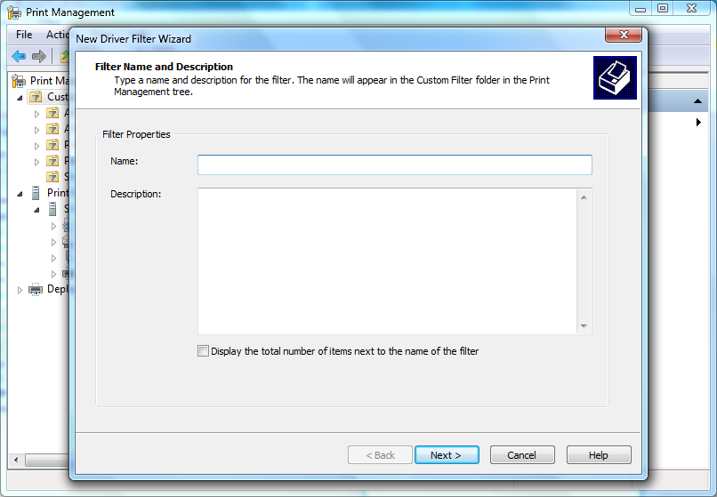
PMC – Creating A Driver Filter

Slide 19
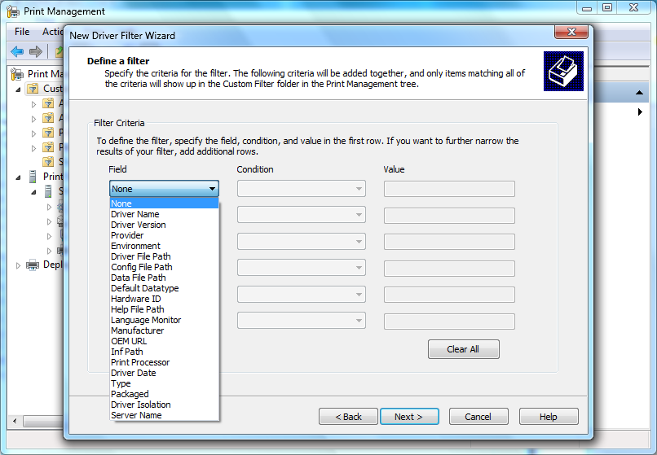
PMC – Creating A Driver Filter

Slide 20
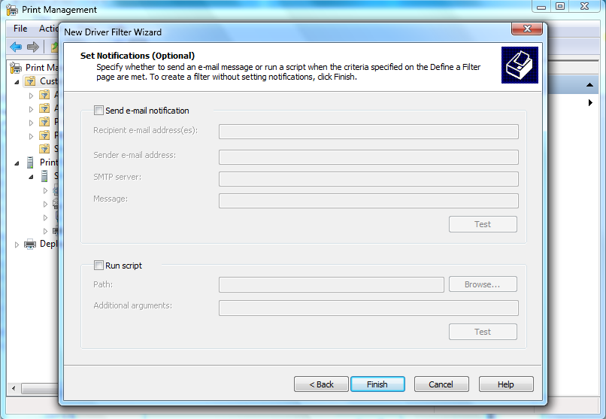
PMC – Creating A Driver Filter

Slide 21
PMC - Security
Allows Admins to set a default
ACL for new printers on a server
  New print queues inherit default security settings
  Security setting for existing queues are not altered
Feature Details
  New Security Tab in Print Server Property UI
  Permission for Print, Manage Printers, Manage Documents, View Server, Manage Server
  User Elevation is required for edit security setting

Slide 22
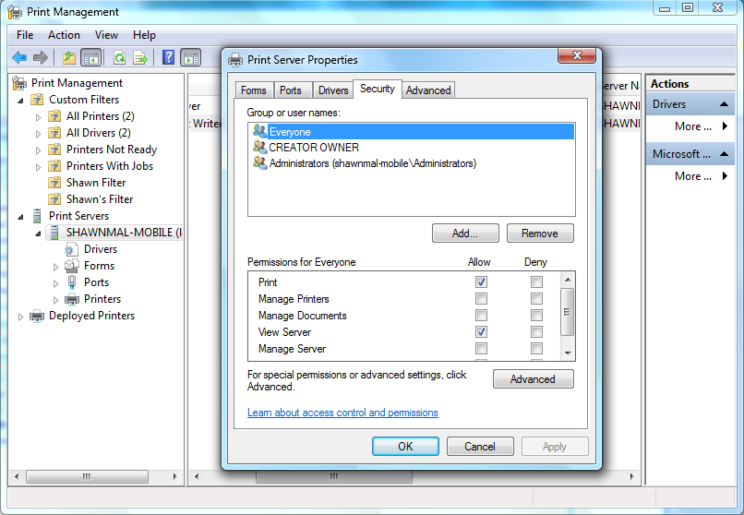
PMC – Security

Slide 23
PMC Demo

Slide 24
Call To Action
Create Package Aware drivers
Test your drivers using driver isolation
Start implementing Compatible
IDs in your hardware
Leverage the PMC in managing
your print infrastructure

Slide 25
Additional Resources
OS Resources
  Print Management Console
Feature Resources
  Best Practices for Developing Printer Drivers White Paper
  Implementing Compatible IDs White Paper
  Printer Installation on MSDN: http://msdn.microsoft.com/en-us/library/ms802217.aspx
Related Sessions
  CON-T571: Windows 7 DXP Experiences for Multifunction Printers
  CON-T572: XPS Printer Driver Development in Windows 7
  CON-T573: Printer Installation and Print Driver Management in Windows 7
  CON-T607: Windows 7 Logo Program for Print and Document Devices
  CON-T608: Print Driver Development Tools and Print Verifier
Questions?
  Contact prninfo@microsoft.com for print questions

Slide 26
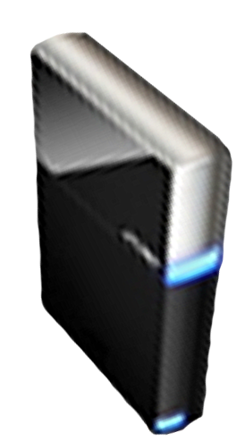


Please Complete A Session Evaluation Form
Your input is important!
Visit the WinHEC CommNet and complete a Session Evaluation for this session and be entered to win one
of 150 Maxtor® BlackArmor™ 160GB External Hard Drives
50 drives will be given away daily!
http://www.winhec2008.com
BlackArmor
Hard Drives provided by:

Slide 27


© 2008 Microsoft Corporation. All rights reserved. Microsoft, Windows, Windows Vista and other product names are or may be registered trademarks and/or trademarks in the U.S. and/or other countries.
The information herein is for informational purposes only and represents the current view of Microsoft Corporation as of the date of this presentation. Because Microsoft must respond to changing market conditions, it should not be interpreted to be a commitment on the part of Microsoft, and Microsoft cannot guarantee the accuracy of any information provided after the date of this presentation.
MICROSOFT MAKES NO WARRANTIES, EXPRESS, IMPLIED OR STATUTORY, AS TO THE INFORMATION IN THIS PRESENTATION.

