Slide 2
Windows Logo Program for Network Media Devices
Kevin Larkin & Gabe Frost
Senior Program Managers
Microsoft Corporation
Featured Partners:
DigiOn, Inc.
I-O Data Device, Inc.

Slide 3
Goals
Understand Windows 7 media sharing technologies and features
Clarify value in Windows 7 Logo program for Network Media Devices (NMD)
Expedite development of devices that meet Windows 7 logo requirements

Slide 4
Agenda
Windows 7 media sharing features
Windows 7 feature demonstration
Windows 7 logo requirements for network media devices
Featured Partners

Slide 5
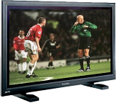
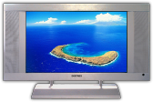


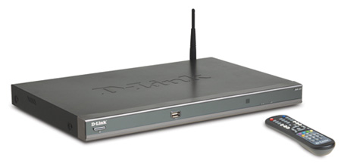


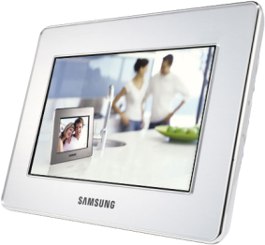


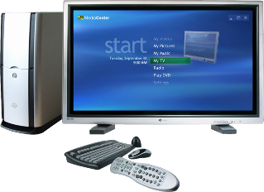
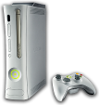
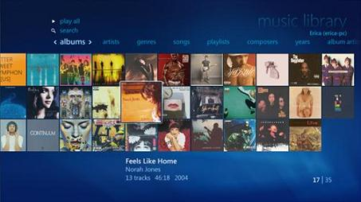
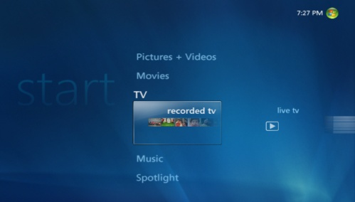
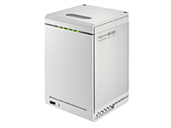
Windows 7 Uniquely Suited For Home Entertainment
content
devices
Pictures
Music
Videos
Recorded TV
Extenders for Media Center
Windows Home Server
Xbox 360
DLNA Media Servers, Renderers, and Controllers

Slide 6
Media Sharing In Windows 7 Guiding Principles
Just Works
Simple, intuitive, and easy to use
Enabling the Best Devices
Platform for Network Media Devices
My Media Anywhere
Access to your media on any device in the home
High Fidelity
Embrace media standards and implement with the highest quality

Slide 7
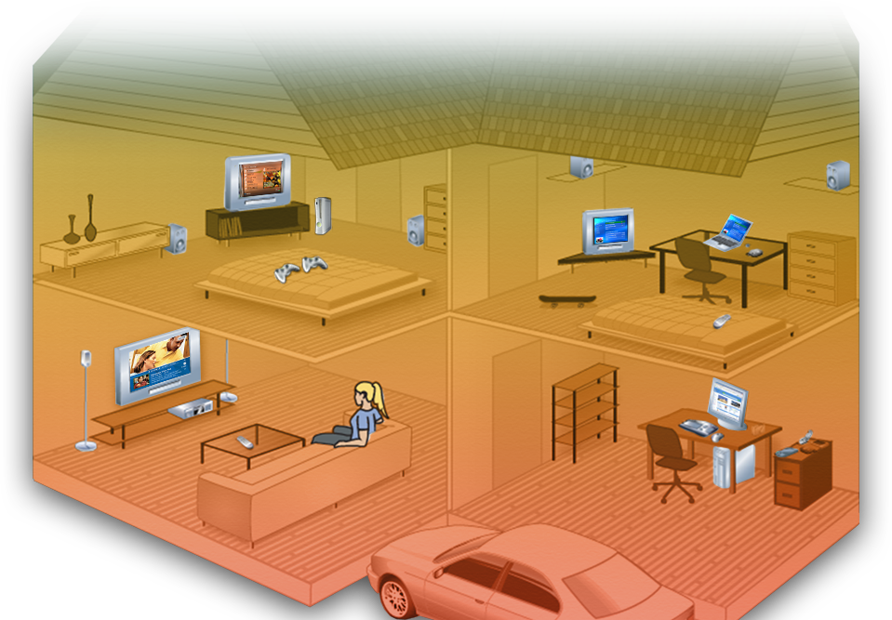
Windows 7 Experience Digital Media Server (DMS)
Windows 7 laptop accesses music
Xbox 360 accesses videos
Digital TV accesses photos
Windows 7 shares media libraries

Slide 8
Windows 7 Experience Digital Media Controller (DMC)
Windows 7 laptop executes Play To Digital Media Renderer
Windows 7 laptop browses server for photos, music and video
Windows 7 laptop discovers devices in the home
Digital Media Renderer streams requested media from server
Windows 7 shares media libraries

Slide 9

Windows 7 Experience Digital Media Renderer (DMR)
Cell Phone discovers devices in the home
Cell phone executes Play to media renderer
User browses server using cell phone
Digital Media Renderer streams requested media from server
Windows 7 shares media libraries

Slide 10
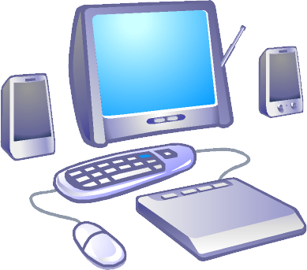
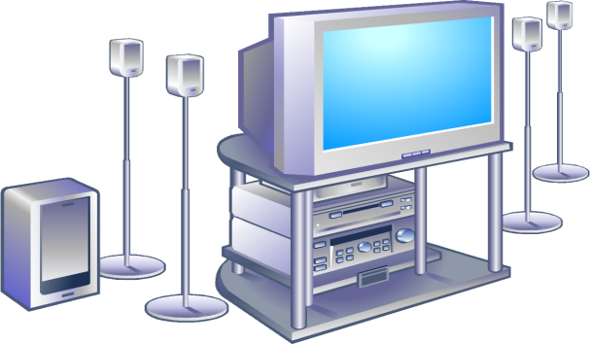



Windows 7 Experience Transcoding
From home theater, user chooses a video to play from the Windows shared media library
Home theater system only supports MPEG-2 video, MP3 audio, and LPCM audio
Windows exposes native file format and transcoded formats
Windows 7 shares media library
Home theater chooses MPEG-2 RES element
<res MP4>
<res MPEG2>
<res WMV>
Windows transcodes from MP4 to MPEG-2
WMV
MP4
WMA
M4A
MPEG2
MP3
LPCM
MP4

Slide 11
Windows 7 Sharing Features
demo

Slide 12
Featured Speakers
Digital Living Network Alliance
Scott Smyers
Chair, DLNA
Sony Electronics, Inc.
Pat Griffis
Co-Chair, DLNA
Microsoft Corporation

Slide 13



























Introduction To DLNA
Industry consortium
250+ companies
Consumer Electronics
Computing Industry
Mobile Devices
Content distributors
Goal: Establish an ecosystem of compatible products for networked media devices
Develops standards-based specifications: “DLNA Guidelines”

Slide 14
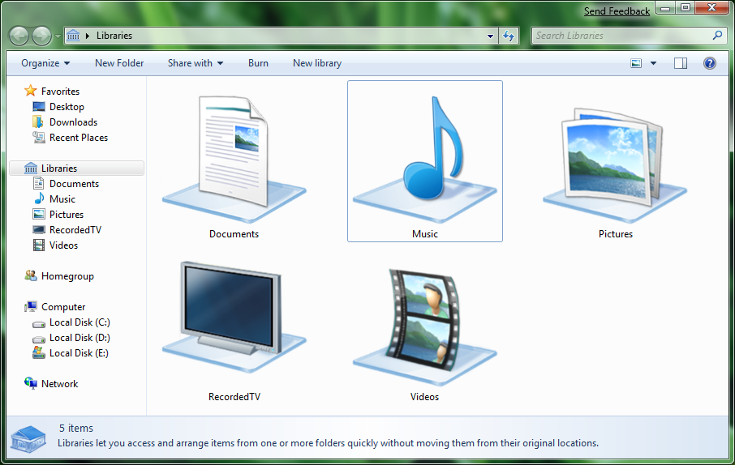
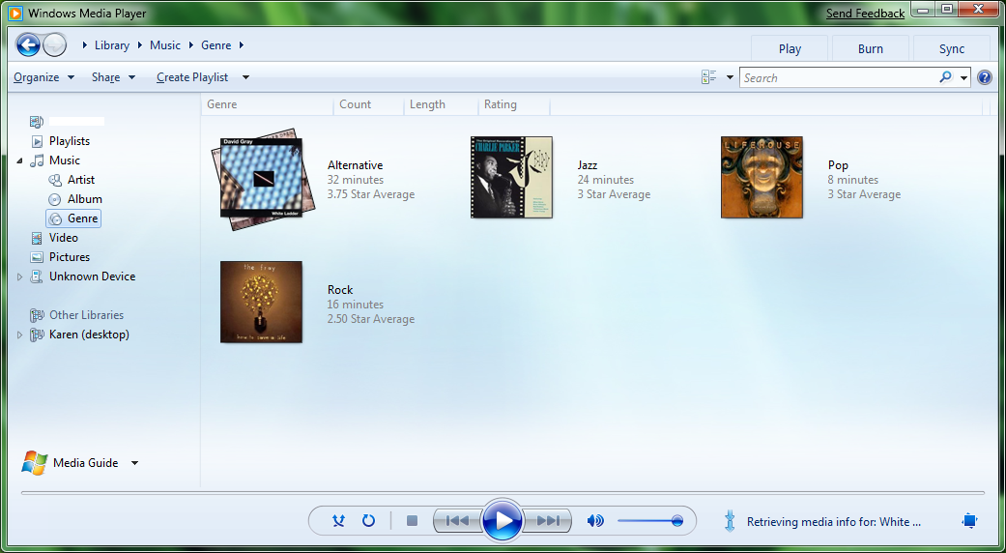
Windows 7 Sharing Features Digital Media Server
Windows 7 adds DLNA 1.5 DMS support
Device may access shared media libraries
Music, Pictures, Videos, and Recorded TV*
* Only unprotected content

Slide 15
Windows 7 Sharing Features Digital Media Server
Device experience enhancements:
Album art
Video and image thumbnails
Rich metadata
Search and Browse
Metadata update (ratings)
Transcode (format/bitrate), and multiple RES elements

Slide 16
Windows 7 Sharing Features Digital Media Player & Renderer
Support for DLNA DMP and DMR
Windows Media Player features
Browsing libraries on by default
Server is primary node in player library
Library queries exposed as pivots
Album art
Video and image thumbnails

Slide 17
Windows 7 Sharing Features Digital Media Player & Renderer
Windows Media Player features
Enhanced metadata
Search and browse
Enables device control of Windows Media Player
Improved codec support
Windows Media Center features
Automatic discovery of DLNA DMS from PC and Extenders

Slide 18
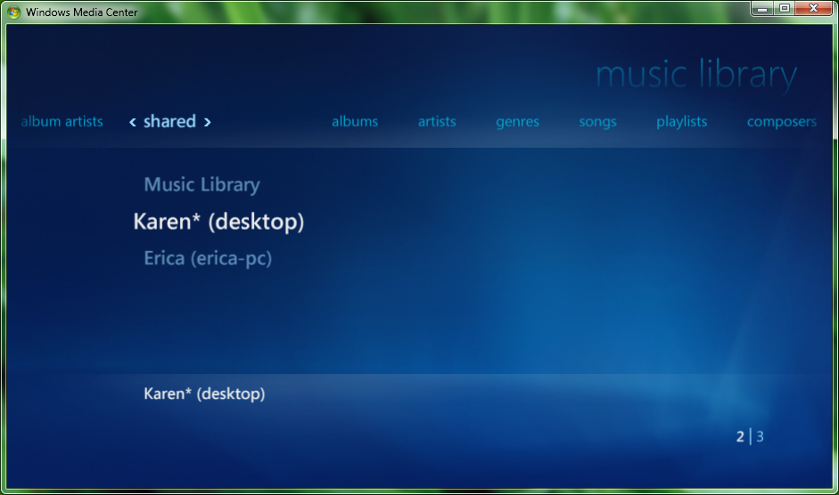
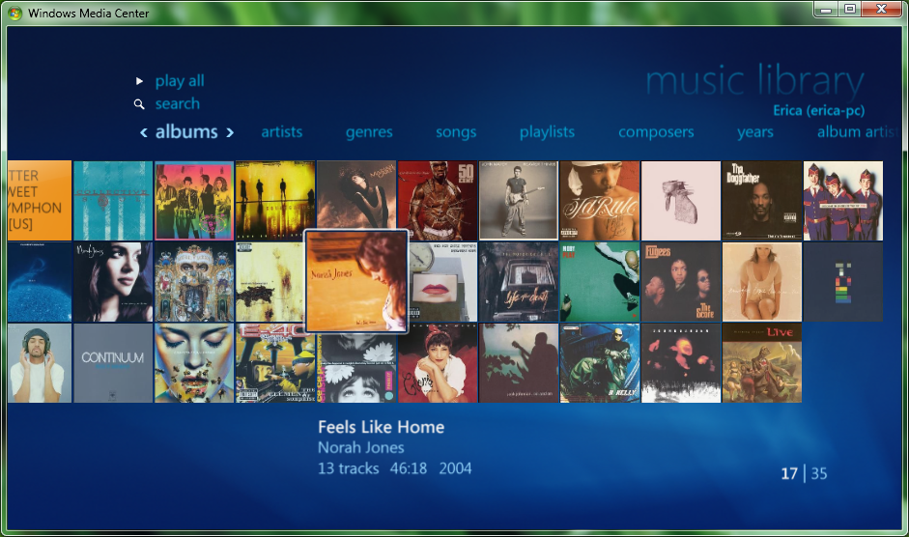
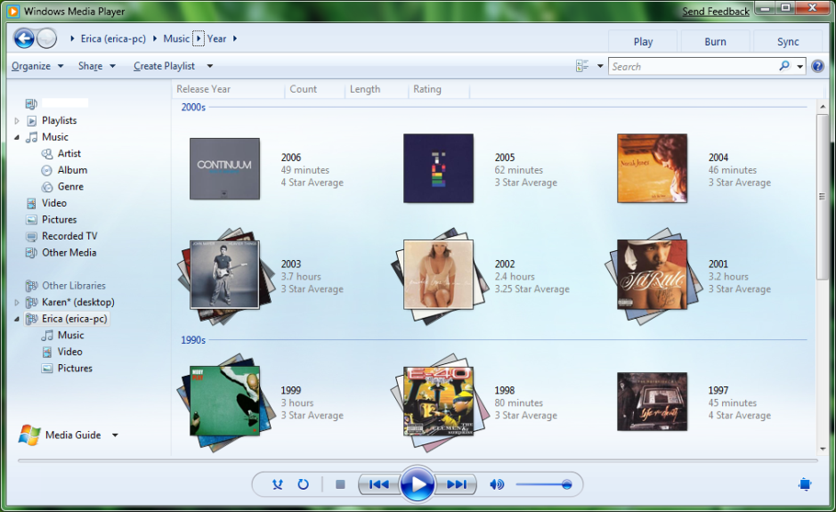
Windows 7 Sharing Features Digital Media Player & Renderer
Browsing a DMS

Slide 19
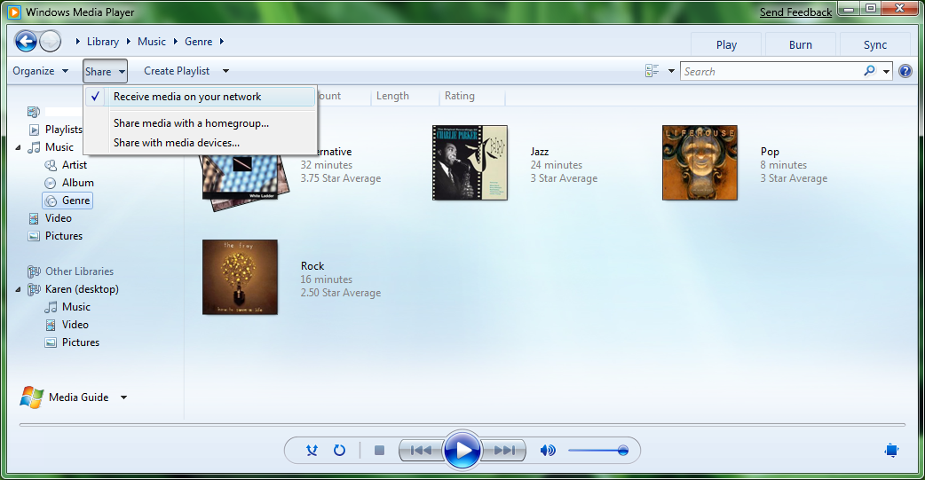
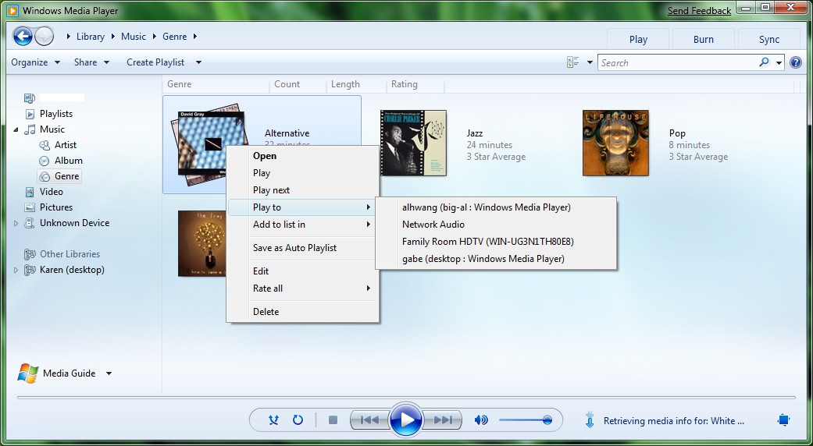
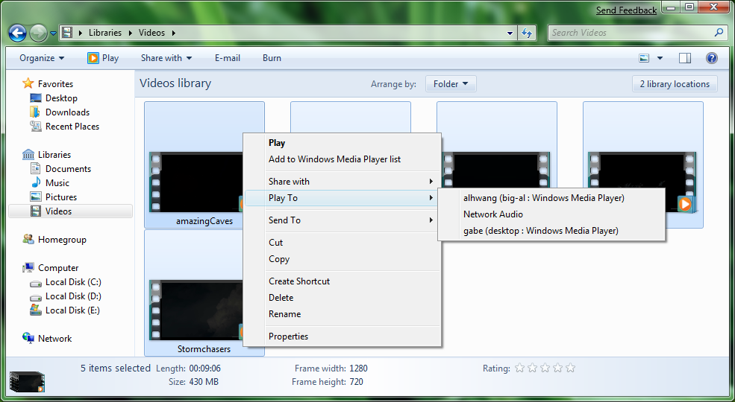
Windows 7 Sharing Features Digital Media Player & Renderer
Enable Player as a
DMR
Play To menu from Windows Explorer & Media Player
Works with DLNA 1.5 compliant DMS and DMR

Slide 20
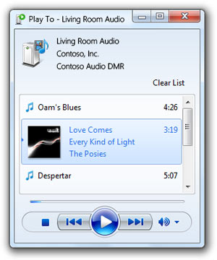
Windows 7 Sharing Features Digital Media Controllers
Windows 7 includes a DLNA compliant Digital Media Controller
Windows Play To experience
Automatic device authorization through Play To context menu
Play To enabled for all media types:
Music, Pictures, Videos, Recorded TV*
* Only unprotected content

Slide 21
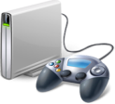
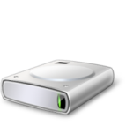

Windows 7 Logo Program
NMD General Device Function Tests
Platform and Certification
NMD Functional Requirements
Windows 7 Logo Program
Windows Media
WMDRM
Microsoft proprietary technologies
Device Specific / Rally
DLNA Certification and Specifications
DLNA
Digital Media Receiver
Digital Media Server
Digital Media Controller
DLNA Device Profiles

Slide 22



Windows 7 Logo Program 2009 Network Media Devices
DMR
DMS
DMC
LLTD
Wi-Fi supports 802.11a&g with N
DLNA 1.5 compliant
MSFT extensions
Wi-Fi supports WCN 2.0
LLTD
Wi-Fi supports 802.11a&g with N
DLNA 1.5 compliant
MSFT extensions
Wi-Fi supports WCN 2.0
DLNA 1.5 compliant
MSFT extensions
Wi-Fi supports WCN 2.0

Slide 23
2009 Logo Requirement Common to all devices
All devices must be DLNA 1.5 certified
Guarantees a baseline experience

Slide 24




2009 Logo Requirement Common to all devices
Wake On LAN (WoL) support
Devices must support WoL either by sending or responding to Magic Packets as appropriate
DMC must wake sleeping devices
DMS should wake within 20 seconds
Z Z Z
Z Z Z
Z Z Z
Z Z Z

Slide 25


2009 Logo Requirement Common to all devices
DMS must declare support for resume from low power
DDD of DMS that supports low power mode
<microsoft:X_magicPacketWakeSupported xmlns:microsoft="urn:schemas-microsoft-com:WMPNSS-1-0">
1
</ microsoft:X_magicPacketWakeSupported>
DDD of DMS with no low power mode
<microsoft:X_magicPacketWakeSupported xmlns:microsoft="urn:schemas-microsoft-com:WMPNSS-1-0">
0
</ microsoft:X_magicPacketWakeSupported>

Slide 26
2009 Logo Requirement Common to all devices
Device needs to declare support for waking a sleeping DMS via Magic Packet
Applies to DMC and DMR with MSCP
<microsoft:X_magicPacketSendSupported xmlns:microsoft="urn:schemas-microsoft-com:WMPNSS-1-0">
1
</ microsoft:X_magicPacketSendSupported>

Slide 27
2009 Logo Requirement Common requirements to all DMS & DMR
All devices must support Rally Technologies
Wi-Fi Protected Setup (WCN 2.0)
Link Layer Topology Discovery (LLTD)

Slide 28
2009 Logo Requirement Common requirements to all DMS & DMR
UPnP device description document (DDD) must contain metadata that Windows uses for discovery and configuration
<device>
<pnpx:X_compatibleId
xmlns:pnpx="http://schemas.microsoft.com/windows/pnpx/2005/11">
MS_DigitalMediaDeviceClass_V001
</pnpx:X_compatibleId>
<pnpx:X_deviceCategory
xmlns:pnpx="http://schemas.microsoft.com/windows/pnpx/2005/11">
MediaDevice.DMR
</pnpx:X_deviceCategory>
</device>

Slide 29
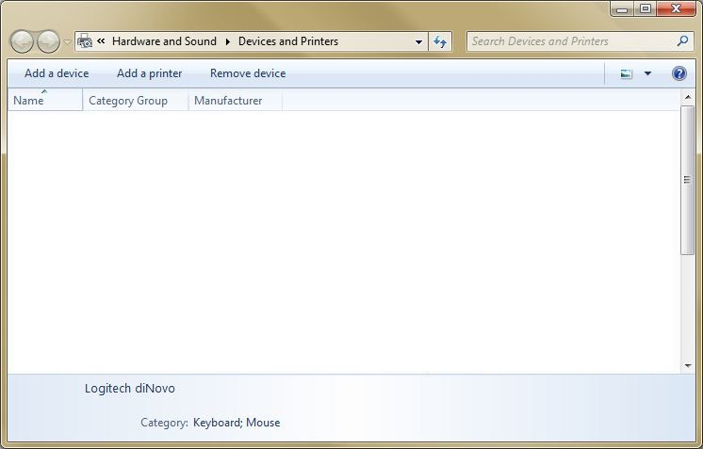

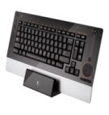
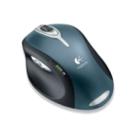
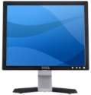

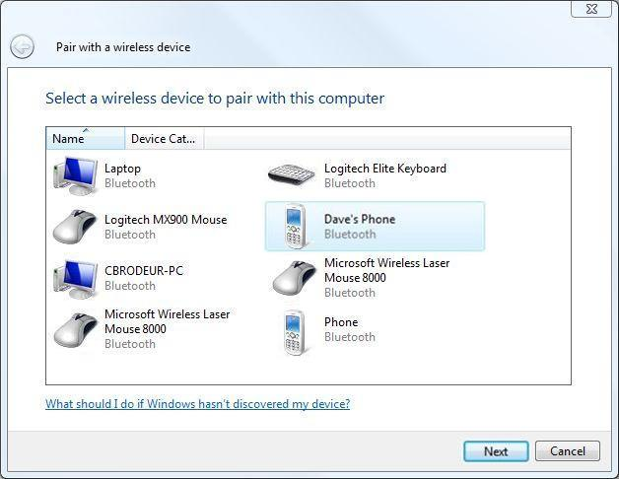
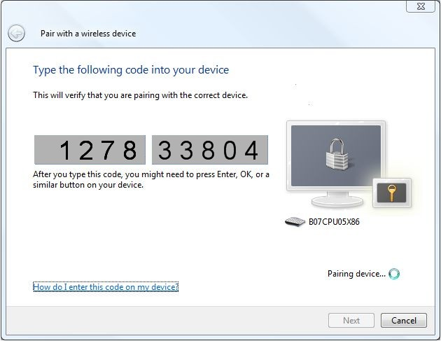
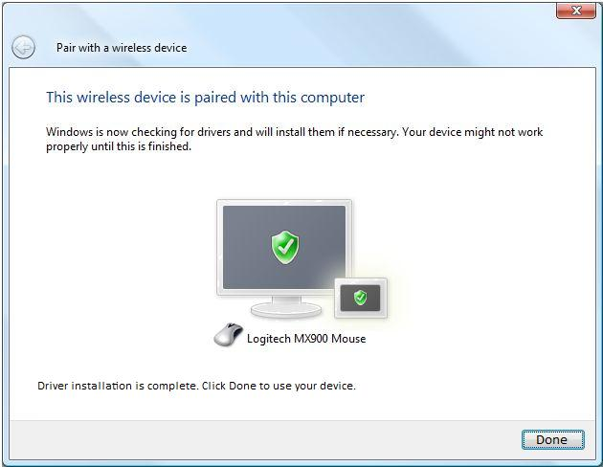


2009 Logo Requirement Device installation experience
1
Device Gallery
Dell XPS
Logitech diNovo
Logitech MX1000
Dell SE198FWP
Digion
Server
2
Discovery
3
Ceremony
4
Completion

Slide 30
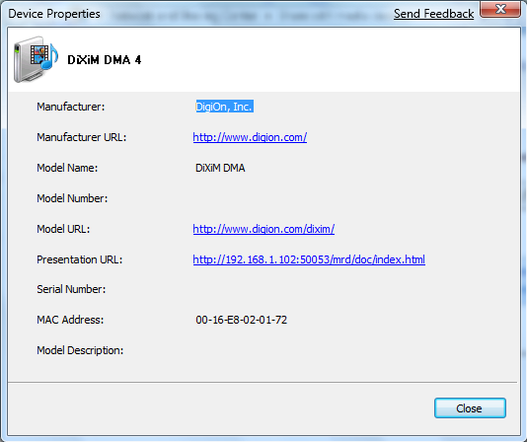
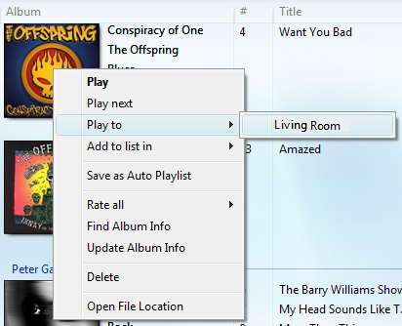
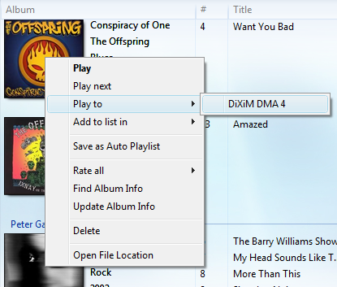
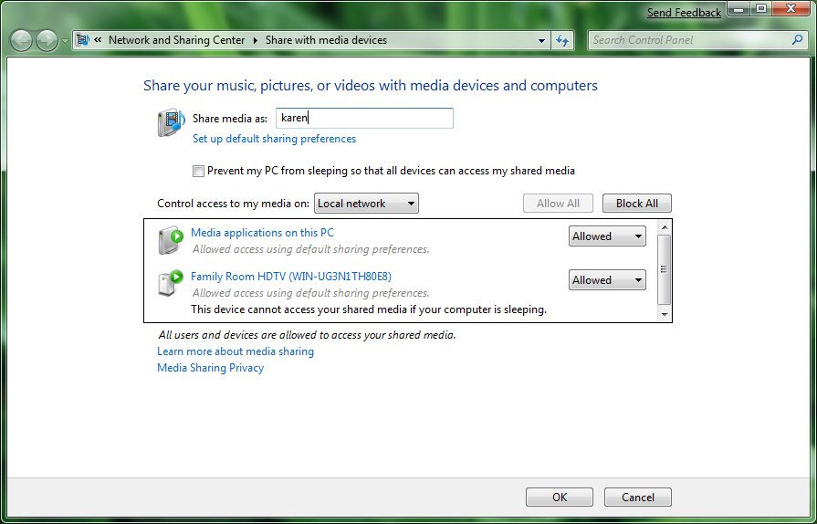
2009 Logo Requirement Common requirements to all DMS & DMR
All devices must allow the user to rename the device to a friendly name
One common location to rename your device through windows

Slide 31
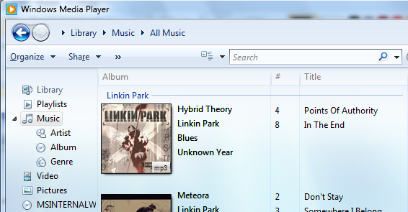
2009 Logo Requirement Common requirements to all DMS & DMR
All devices must support common metadata
Music metadata

Slide 32
2009 Logo Requirement Common requirements to all DMS & DMR
All devices must support basic transport support
DLNA requires play and stop
Windows Logo additionally requires pause and seek

Slide 33
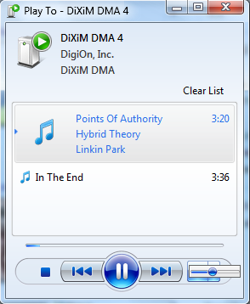


2009 Logo Requirement DMR only
All DMRs must support volume control

Slide 34
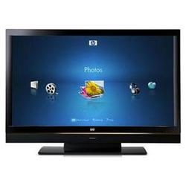
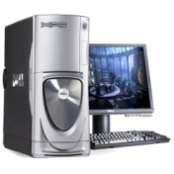



2009 Logo Requirement DMR only
DMRs must use best supported RES element
{
<res DIVX>
<res MPEG2 >
<res WMV >
<res WMV Small >
WMA
WMV
MPEG2
LPCM
.DiVX

Slide 35





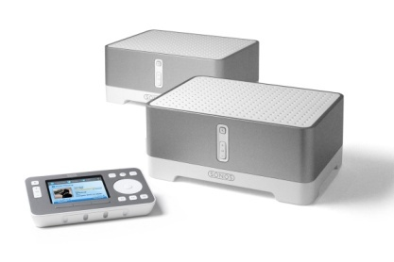

2009 Logo Requirement DMR only
DMRs should support WMDRM-ND

Slide 36
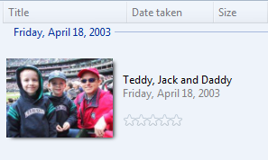
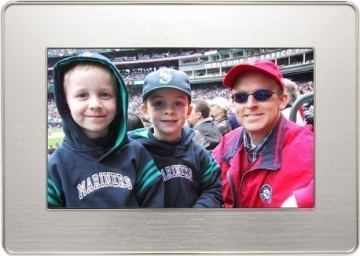




2009 Logo Requirement DMR only
DMR must support metadata Update Object

Slide 37
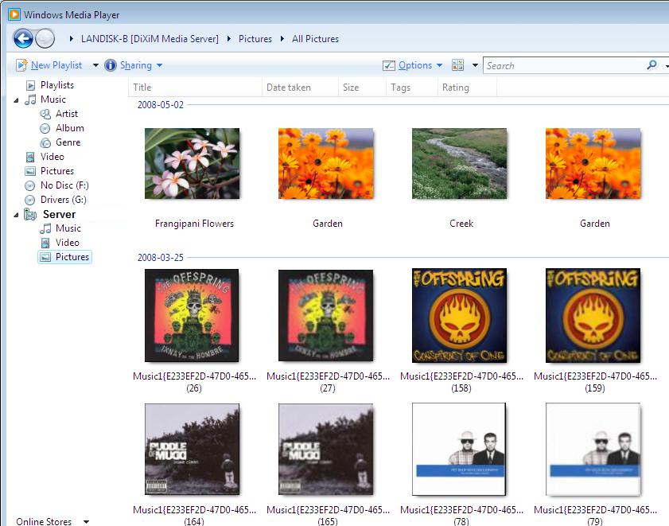
2009 Logo Requirement DMS only
DMS must not display album art as photos

Slide 38
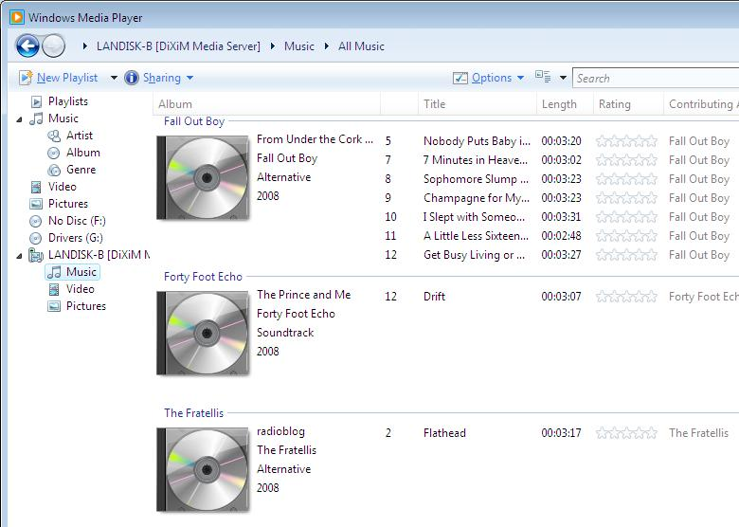
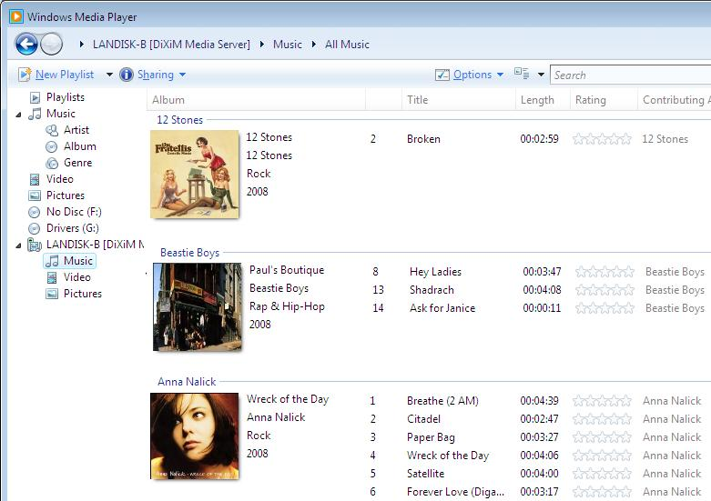
2009 Logo Requirement DMS only
DMS must provide album art when available

Slide 39
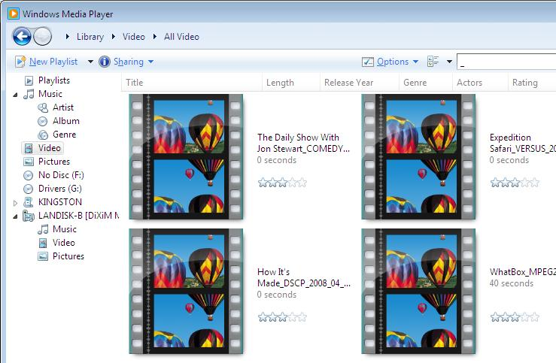
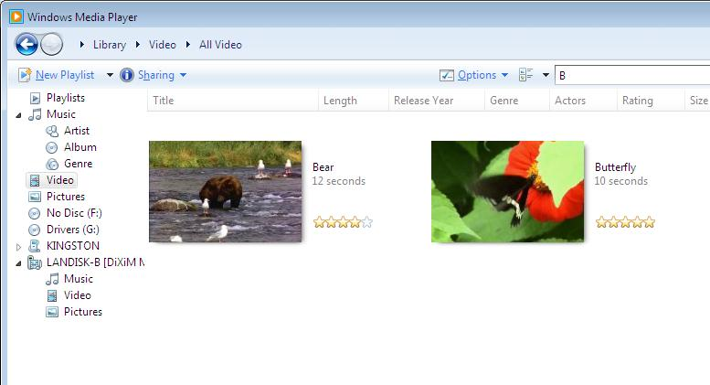
2009 Logo Requirement DMS only
DMR must provide video thumbnails when available

Slide 40
2009 Logo Requirement Overview
Key Windows 7 Logo Program benefits
Windows transcode support saves you money
Moving towards “green” devices with WoL
Plenty of room for differentiation!
Decreased customer support
Best user experience

Slide 41
Our Commitment To You
Windows 7 will seamlessly work with your DLNA compliant devices
Windows 7 will make configuring your device straight forward and simple
Windows 7 will make sharing content in the home painless
Windows 7 will save you money by providing transcoding to standards

Slide 42
Call To Action
Create DLNA 1.5 compliant devices
Investigate differentiating options
If you are developing a DMP, make sure it is a certified DMR as well
Deliver Windows 7 logo’d devices in 2009

Slide 43
Featured Partners
I-O DATA
DigiOn
Yoshi Hirano
General Manager
I-O Data Device, Inc.
Hiro Someya
Director of Marketing
DigiOn, Inc.

Slide 44
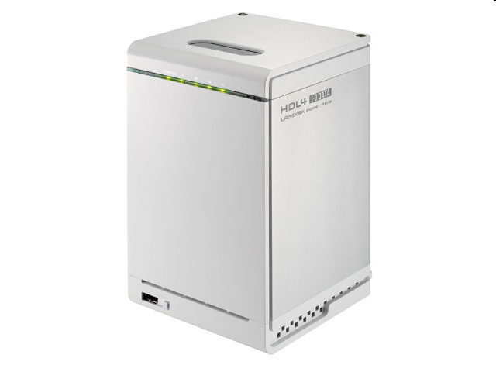
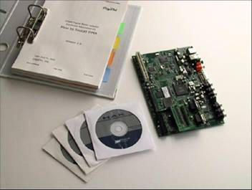


Product Line And Using Tools Demonstrating devices
DMR: AV-LS500W VPR Set Top Box
DMS: LANDISK Home (HDL-4)
Firmware: DigiOn DiXiM SDK new version

Slide 45


DigiOn's DiXiM SDK New Package Supporting Windows 7 Logo Requirement
Quality Proven Home Network SDK
Newly Featured Windows 7 Logo Req’ts
Available on Nov. 28th, 2008
DMR/DMS Testing Device – Option Available
Additional information : www.digion.com

Slide 46
Additional Resources
Web Resources:
Windows Hardware Developer Central
http://www.microsoft.com/whdc
Whitepapers:
Design Guidelines and Considerations for Building Windows Certified Network Media Devices: http://go.microsoft.com/fwlink/?LinkId=131088
Connected Digital Picture Frames: Analysis and Specifications http://go.microsoft.com/fwlink/?LinkId=131089
Other Resources:
“Building a Network Device Compatible with Microsoft Windows Media Player 11”: http://go.microsoft.com/fwlink/?LinkId=87957
UPnP MediaServer Media Controller and MediaRenderer-related specifications: http://www.upnp.org/standardizeddcps/mediaserver.asp
Windows Logo Requirements: http://www.microsoft.com/whdc/winlogo/default.mspx
DLNA Information: http://www.dlna.org

Slide 47
Additional Resources
Related Technical Sessions
Building Digital Picture Frames using Microsoft Technologies
Unifying the Wireless and Network Device Installation Experience in Windows 7
Related Chalk Talks on Friday
Chalk Talk: Windows Connect Now for Wireless Devices
Windows 7 Logo Program and Design Considerations for Network Infrastructure Devices
Contact Info: NMDInfo@Microsoft.com

Slide 48
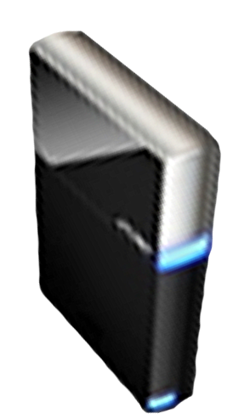


Please Complete A Session Evaluation Form Your input is important!
Visit the WinHEC CommNet and complete a Session Evaluation for this session and be entered to win one of 150 Maxtor® BlackArmor™ 160GB External Hard Drives 50 drives will be given away daily!
http://www.winhec2008.com
BlackArmor Hard Drives provided by:

Slide 49

© 2008 Microsoft Corporation. All rights reserved. Microsoft, Windows, Windows Vista and other product names are or may be registered trademarks and/or trademarks in the U.S. and/or other countries.
The information herein is for informational purposes only and represents the current view of Microsoft Corporation as of the date of this presentation. Because Microsoft must respond to changing market conditions, it should not be interpreted to be a commitment on the part of Microsoft, and Microsoft cannot guarantee the accuracy of any information provided after the date of this presentation. MICROSOFT MAKES NO WARRANTIES, EXPRESS, IMPLIED OR STATUTORY, AS TO THE INFORMATION IN THIS PRESENTATION.

