Slide 1
Building Digital Picture Frames using Microsoft Technologies
Cynthia Hagan
Program Manager
Microsoft Corporation
Edwin Heredia
Program Manager
Microsoft Corporation

Slide 2






Photos are Digital Memories

Slide 3
Technology Trends
Digital cameras
per family
Edge devices
ready to
consume
cloud and
PC services
Digital pictures
per family
Home networks

Slide 4
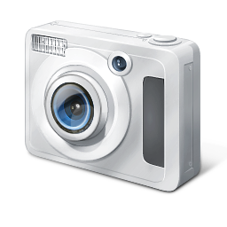



Today's Challenges
RSS
?

Slide 5
Networked Frames Scenarios
Sharing pictures with family and friends at home
Sharing pictures with family and friends worldwide

Slide 6
Software And Services Solution
Live Mesh
Windows Media Sharing
Windows Live FrameIt
Windows Connect Now
  Text Here
HD Photo
PhotoSynth
Expression Media
Photo Gallery

Slide 7
Sharing via the Web:
Windows Live FrameIt

Slide 8




Windows Live FrameIt
Enabling users to experience and share their up-to-date digital photos and content anytime, anyplace and on any display device
Windows Live™ Photo Gallery
News,
Weather,
At a glance
+
Gather and share content collections
Internet photo sharing sites
PC
Internet
FrameIt
Digital Picture Frame

Slide 9

Implementing FrameIt
Add Internet feature set
1
Connect to the web
Parse XML
Respect RSS TTL
Parse XML
Fetch JPG images
Respect RSS TTL
Make customer setup easy
2
Implement device registration
For one or multiple users in household
Respect user privacy; let them undo it too
Differentiate experience
3
Jump to categories
Refresh now
Get creative!

Slide 10



Device Registration
Frame calls GetCollectionInfo passing the
long-lived token. Service returns a list of the
user’s content collections.
User enters token via PC or mobile web browser. FrameIt ties a unique, long-lived token to the user’s Windows Live ID.
Frame calls GetClaimToken. Service issues a short-lived token to the device.
Frame calls DeviceBind. Service returns the long-lived ID to the device.
Frame displays the short-lived token
to the user.
User selects a collection and slideshow begins.
User confirms registration on device.
User selects FrameIt from device UI.

Slide 11
Demo
Windows Live FrameIt
  Device Registration
  Exploring the RSS feed

Slide 12
Connecting to Windows
in a Home Network:

Slide 13
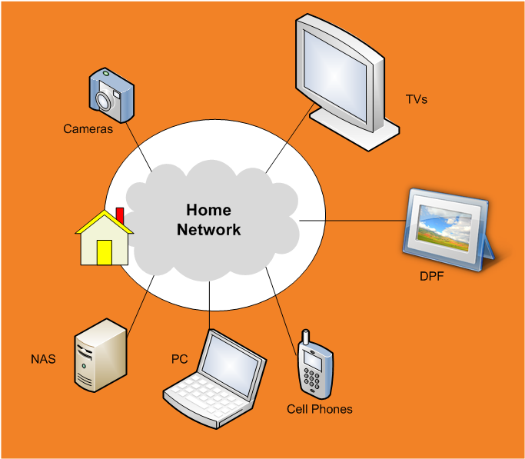

Joining The Digital Life…

Slide 14

The Picture Frame As A DMR
Organize and select pictures
Create playlists
Select a target DPF
UPnP actions
Get DPF info (formats, resolutions)
Prepare images (transcode,
scale, etc).
UPnP actions
Send URI and request to play
Request image and play
HTTP transfer

Slide 15
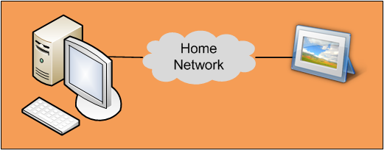
UPnP Actions From PCs To DPFs
Connection Manager Service (CMS)
GetProtocolInfo | Returns DPF supported media types (JPEG) – profiles: small, med, large
AVTransport Service (AVT)
Action Input
SetAVTransportURI | Prepares the DPF for an image
GetTransportInfo | Returns DPF state and status
GetPositionInfo | Returns current picture metadata in DPF
GetDeviceCapabilities | Returns DPF frame resolution (protocol extension)
Play | Starts rendering of an image
Stop | Stops rendering of an image
Action Output
Events
Rendering Control Service (RCS)
GetBrightness, SetBrightness | Gets and sets the value of brightness respectively
GetContrast, SetContrast | Gets and sets the value of contrast respectively

Slide 16
DPF Main State Transitions
NO_MEDIA_PRESENT
SetAVTransportURI
- empty -
SetAVTransportURI
- Non empty -
Play (network delay)
STOPPED
TRANSITIONING
Play
Stop
PLAYING

Slide 17
DPF Technology Components
FrameIt and Win7 Media Sharing
RSS 2.0
DLNA DMR
JPEG
Simplified XML parser
Parse specific SOAP and DIDL-Lite messages
HTTP
TCP/IP, UDP/IP
Ethernet or Wi-Fi or both

Slide 18
  Our Commitment To You
User experience innovation
  On the PC
    “Play to” in Windows Explorer and in Windows Media Player
    Sidebar gadget for DPFs
  On the web
    FrameIt web experience
    Diverse content catalog
Technical implementation support
  Code samples, white papers, etc.
  Developer support
Certified devices qualify for:
  Logo licensing and marketing collateral opportunities

Slide 19
Call To Action
Help us build the digital life of today and tomorrow
  Implement Windows Live FrameIt
    Enable device registration
    Respect FrameIt RSS TTL and content refresh requirements
  Implement a simplified or a full DMR
    Implement industry-standard protocols (DLNA)
    Prioritize Windows connections and implement whitepaper recommendations
Apply to be a Windows Live FrameIt certified partner
Get ready for the Windows Logo Program
(Networked Media Devices)

Slide 20
Additional Resources
Session whitepaper:
  C. Hagan and E. Heredia, “Connected Digital Picture Frames: Analysis and Specifications”, WinHEC 2008
    http://go.microsoft.com/fwlink/?LinkId=131089
Compatibility testing:
  Windows Live FrameIt; Email: frameit@microsoft.com
  Windows 7 Network Media Devices; Email: nmdinfo@microsoft.com
DPF Resource Kit:
  Sample gadget code, white papers, specifications, integration metadata, videos, etc.
    http://go.microsoft.com/fwlink/?LinkId=131253
Standards
  UPnP Specifications: http://www.upnp.org
  DLNA Specifications: http://www.dlna.org
  RSS 2.0: http://cyber.law.harvard.edu/rss/rss.html

Slide 21
demos

Slide 22
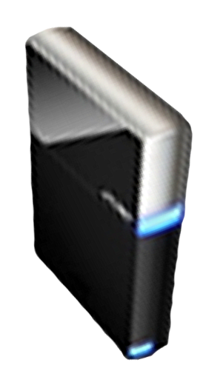


Please Complete A Session Evaluation Form
Your input is important!
Visit the WinHEC CommNet and complete a Session Evaluation for this session and be entered to win one
of 150 Maxtor® BlackArmor™ 160GB External Hard Drives
50 drives will be given away daily!
http://www.winhec2008.com
BlackArmor
Hard Drives provided by:

Slide 23


© 2008 Microsoft Corporation. All rights reserved. Microsoft, Windows, Windows Vista and other product names are or may be registered trademarks and/or trademarks in the U.S. and/or other countries.
The information herein is for informational purposes only and represents the current view of Microsoft Corporation as of the date of this presentation. Because Microsoft must respond to changing market conditions, it should not be interpreted to be a commitment on the part of Microsoft, and Microsoft cannot guarantee the accuracy of any information provided after the date of this presentation.
MICROSOFT MAKES NO WARRANTIES, EXPRESS, IMPLIED OR STATUTORY, AS TO THE INFORMATION IN THIS PRESENTATION.

Slide 24

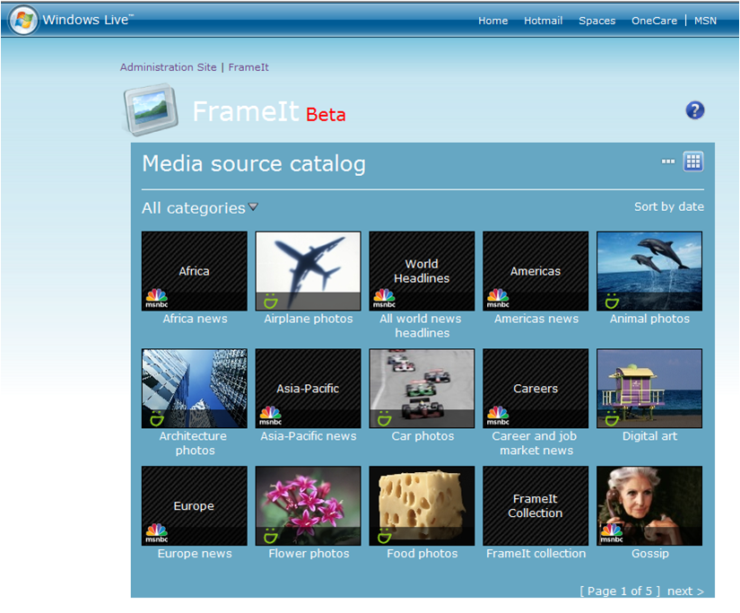

FrameIt Catalog
User’s photos
Information at
a glance

Slide 25
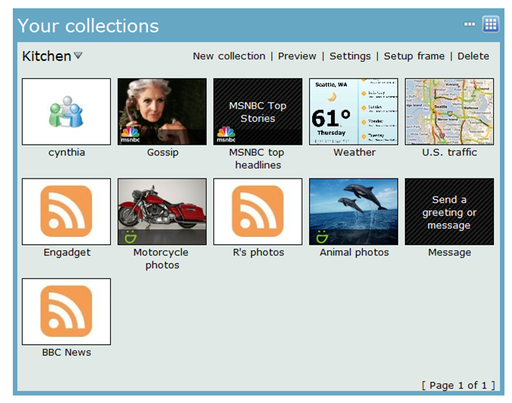
A Collection
Content chosen
by the user

Slide 26
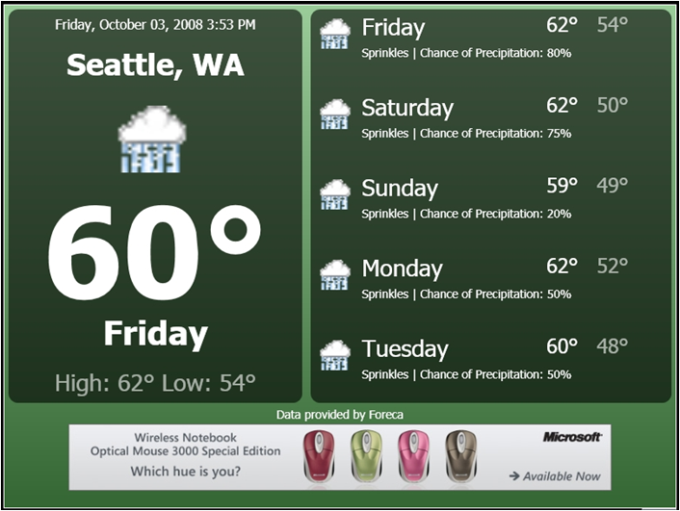
Generated images
Weather
News
Traffic
Stocks

Slide 27
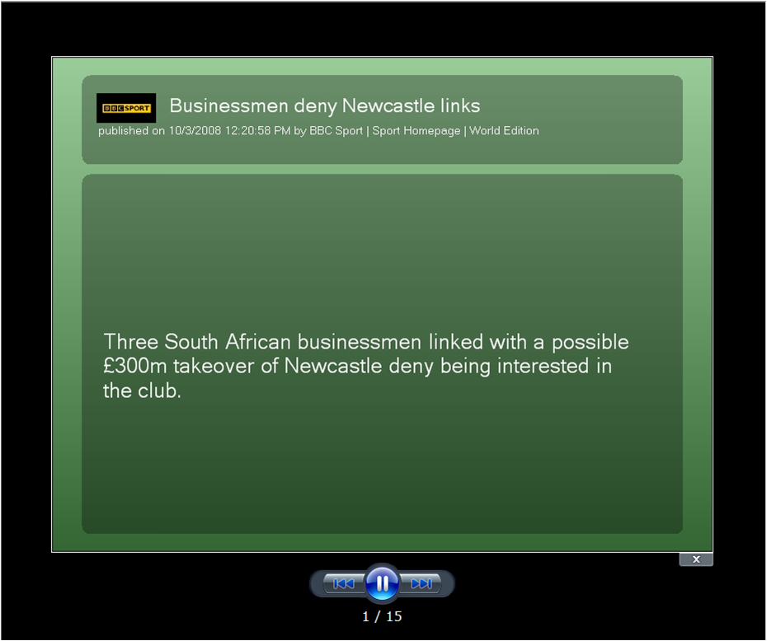
Online Previewer
Preview a collection

