Slide 2
Unifying the Wireless and Network Device Installation Experience in Windows 7
Dave Roth
Senior Program Manager
Microsoft Corporation

Slide 3
Wireless And Network Devices
Various technologies:
Wireless devices Network devices
Bluetooth WSD
Wireless USB UPnP
WiFi
Customers:
Love device innovations
Purchase as part of package
Purchase after market

Slide 4
Wireless And Network Device Installation
Concepts are complex
“Unrelated” technologies
Scattered across Windows
Install requirements unique per tech
Technical specific challenges
Impact:
Customer: Difficult to install/frustration
Industry: Slow adoption / returns / support calls

Slide 5


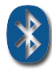


Problems With Installation
Concept of “Pairing” too complex
Too many technologies
Vendors implement differently
No generic Windows solution
Net result
High rate of returns
High customer service calls
Slow adoption of technology

Slide 6
Solution: "Add A Device" Wizard
Unified solution: One size fits all
Inbox wizard
Simple steps to discover/pair devices
Abstracts technology
Install “devices” not “technologies”
No tech-specific terminology
Enables end to end Rally Experience
Device install with no CDRom
Inbox drivers or Windows Update

Slide 7




Scenario: Device Pairing
Goal: Pair PC to a device
Discover devices
Associate/pair device with PC
Multiple technologies
Bluetooth
Wireless USB
Rally Experience (UPnP/WSD)

Slide 8


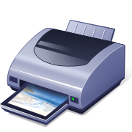



Scenario: WiFi Provisioning
Goal: Configure device to use WiFi network
Discover unprovisioned WiFi devices
Provision with WiFi network profile
Any WPS device
Access Point, Printer, etc

Slide 9
Scenario: Vertical Pairing
Goal: Pair WiFi device with PC
Discover unprovisioned WiFi device
Provision device with WiFi settings
Pair PC with device
Enables “Rally Experience”

Slide 10
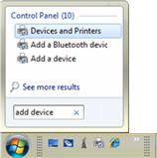
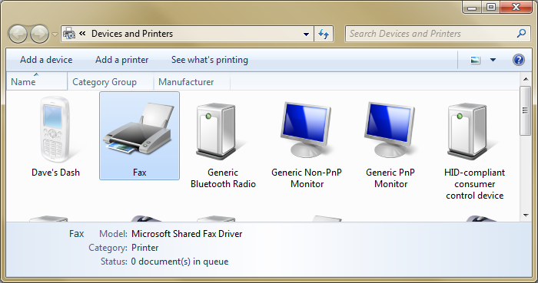
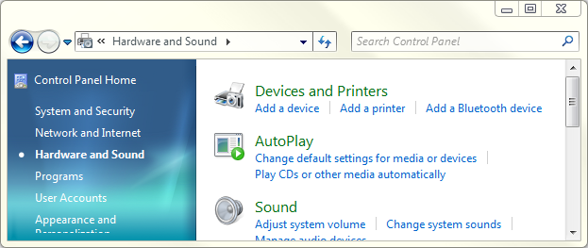
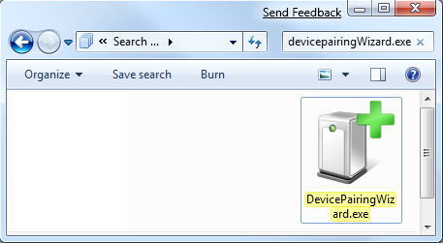
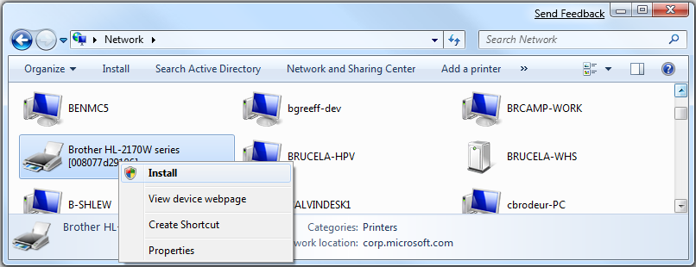
How To Launch
Search
Control Panel
Devices & Printers
Network Explorer
Device Pairing Wizard Exe

Slide 11
How Add A Device Wizard Works
Wizard with 3 phases:
Discovery
Ceremony
Completion
Post wizard
NCD Devices: PnP-X device presence detection
PnP driver loading
Management
Devices and Printers

Slide 12
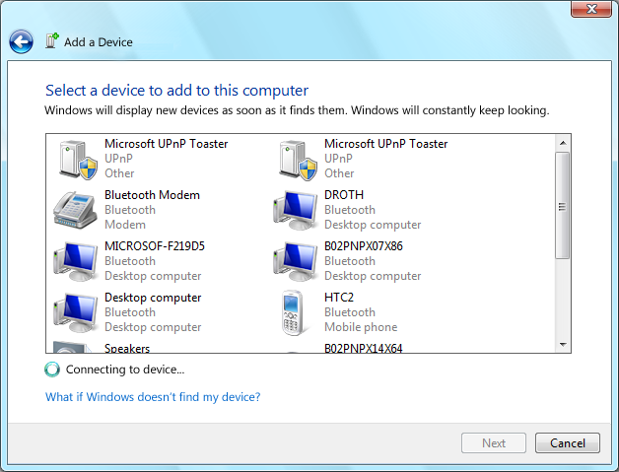
Add Device Wizard: Discovery
Displays all pairable devices
Continuously updates
Shell datasource – context menu options

Slide 13

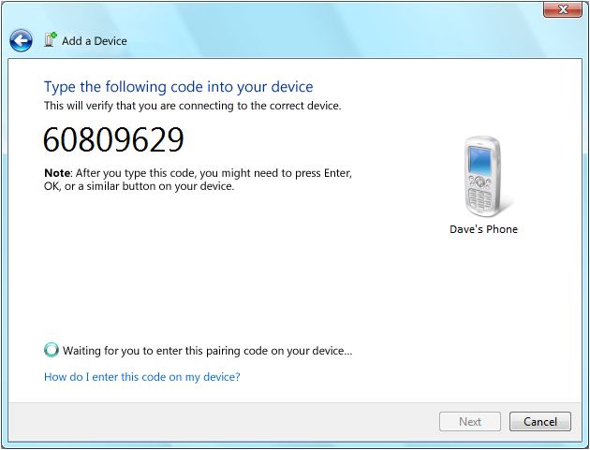
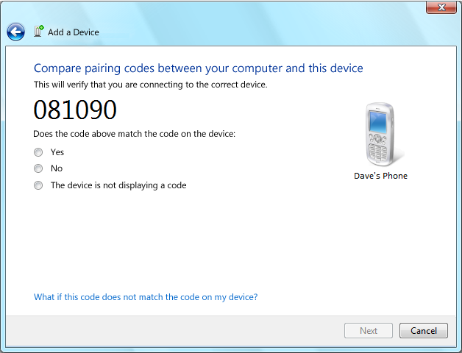
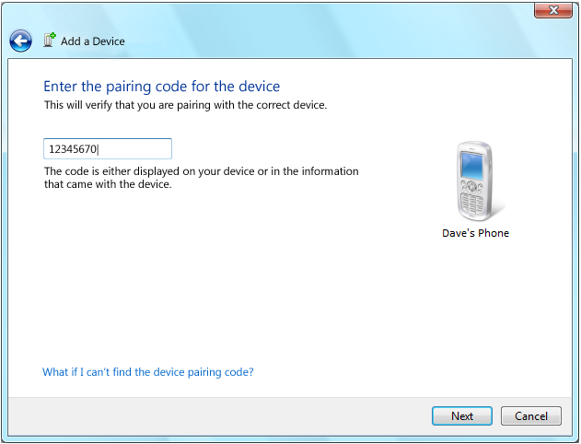
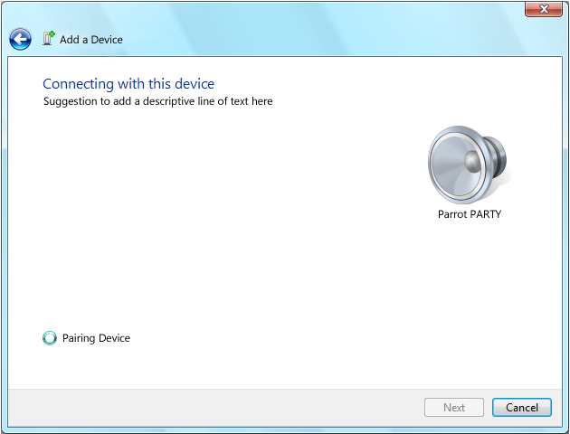
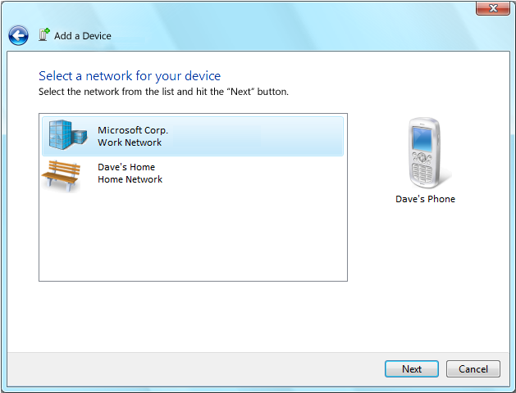

Add Device Wizard: Ceremony
Walks through pairing steps
Simple to use
Consistent across technologies
Just works
PIN Display
PIN Entry
Numeric Compare
WiFi Provisioning

Slide 14
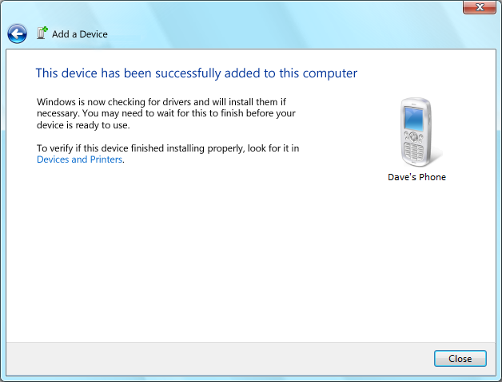
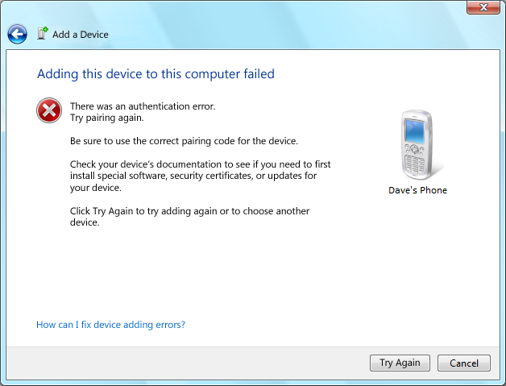
Add Device Wizard: Completion
Indicates pairing success or failure
Failure lists mitigation steps

Slide 15
Add Device Wizard: Post Pairing
Bluetooth/Wireless USB
PnP loads drivers
WSD/UPnP/WiFi
PnP-X detects device presence
PnP loads drivers

Slide 16
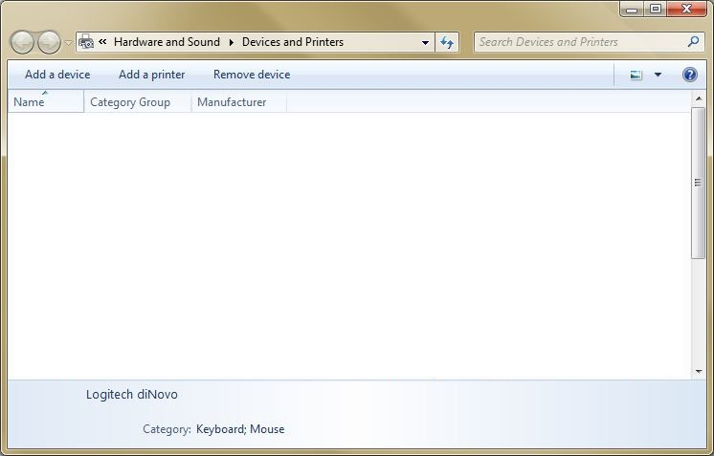

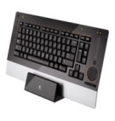
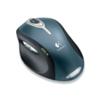
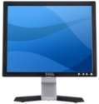




Unified Pairing UX Flow
1
Devices & Printers
Dell XPS
Logitech diNovo
Logitech MX1000
Dell SE198FWP
Dave’s Phone
2
Discovery
3
Ceremony
4
Completion

Slide 17
Device Management
Managed in “Devices and Printers”
Remove/Unpair device
Support for metadata
Photorealistic icon graphic
Make/Model/Description/etc
Device must support hardware/compat ID
Bluetooth: DeviceID profile
UPnP/WSD: PnP-X
WiFi provision-only devices not applicable

Slide 18
Add Device Wizard Extensibility
Wizard Discovery screen
Context menu
Property page sheet
Devices and Printers
Context menu
Property page sheet

Slide 19
Pairing a device
demo

Slide 20
Vertical Pairing
WiFi provisioning + device pairing
UX Parity between network and WiFi devices
User not imposed with WiFi nuances
Intuitive configuration
Prevents need for multiple wizard passes
Out of box end to end install
No install CD needed
Fetch drivers from Windows Update

Slide 21
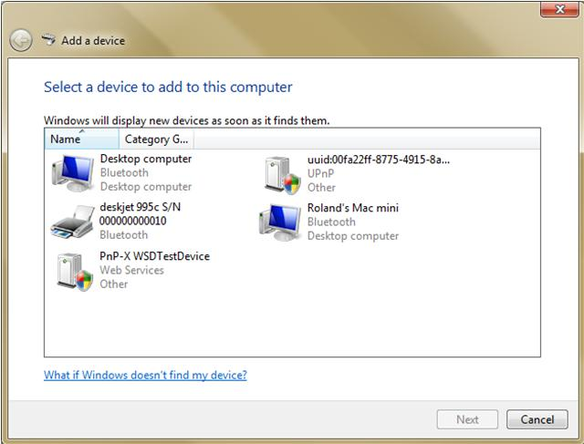
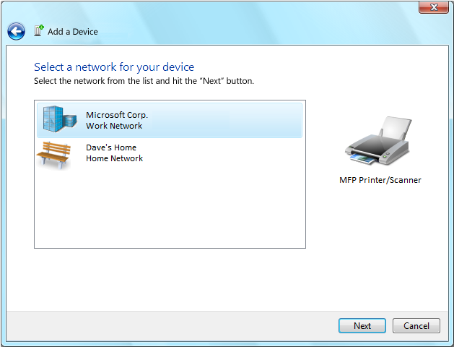
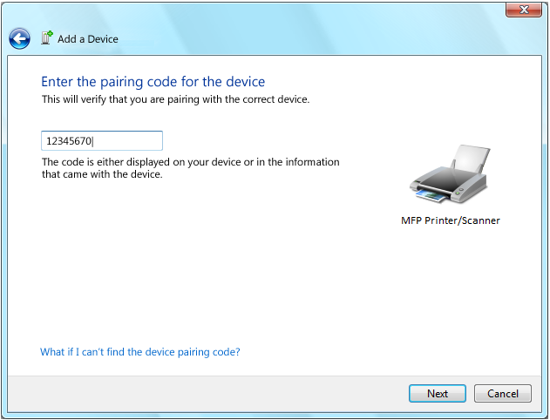

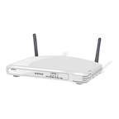


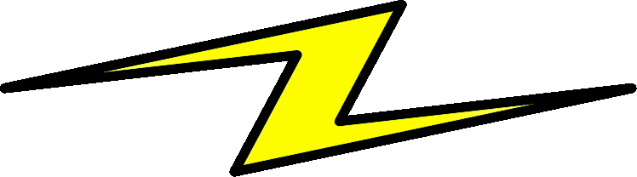

Vertical Pairing Flow
Discovery
Ceremony
WiFi provisioning
PnP-X pairing
Online presence detection
Driver loading
Devices and Printers update
Dell XPS
Logitech diNovo
Logitech MX1000
Dell SE198FWP
Dave’s Printer
DPWS Host
UUID
WS-Scan
WS-Print
Hello!
WiFi Settings
UUID
WiFi Radio
UUID
VE {WSD-UUID}

Slide 22
Vertical Pairing Requirements
WCN-NET
WiFi Protected Setup (WPS)
If no net detected boot into WPS
Protocols
Implement UPnP and/or WSD per specs
PnP-X support
Container ID
Device Drivers
Coinstallers

Slide 23
VP Requirement: WCN-NET
Support WiFi Protected Setup (WPS)
Vertical Pairing Vendor Extension
Specify supported protocols
UPnP and/or WSD
Specify service UUIDs
WSD UUID scheme prefix: “urn:uuid:”
UUID must be lowercase
Sent for M1 messages

Slide 24
VP Requirement: PnP-X
Rally devices must support PnP-X
Multifunction device must use ContainerID
Must support a driver
Can be inbox PnP-X “dummy” driver
Supports coinstallers

Slide 25
VP Requirement: Drivers
Must support driver
Inbox “dummy” driver
Inbox class driver
Device specific driver
Can be available via WU
Supports coinstallers
Post install UI supported
Elevated: Finish install actions
Non elevated: Autoplay handlers

Slide 26
Call To Action
Network Devices
Implement PnP-X support
WiFi devices
Add WPS
Support Vertical Pairing Vendor Extension
Bluetooth devices
Add DeviceID Profile
Enable out of box Rally Experience
Drivers Inbox or on Windows Updates
Create Devices and Printers metadata

Slide 27
WinHEC Sessions
WCN-NET
CON-C653 Windows Connect Now for Wireless Devices
CON-C654 Windows 7 Logo Program and Design Considerations for Network Infrastructure Devices
Device Experiences
CON-T532 Windows 7 Device Experience Part 1
CON-T533 Windows 7 Device Experience Part 2
CON-C649 Discussion: Device Center, Bluewire, and Device Installation
Bluetooth/WUSB
CON-T536 Bluetooth and Wireless USB Support in Windows 7
CON-C656 Discussion: 1394, Wireless USB and Bluetooth

Slide 28
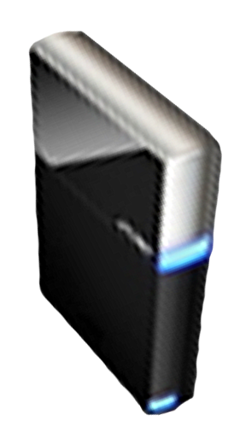


Please Complete A Session Evaluation Form Your input is important!
Visit the WinHEC CommNet and complete a Session Evaluation for this session and be entered to win one of 150 Maxtor® BlackArmor™ 160GB External Hard Drives 50 drives will be given away daily!
http://www.winhec2008.com
BlackArmor Hard Drives provided by:

Slide 29

© 2008 Microsoft Corporation. All rights reserved. Microsoft, Windows, Windows Vista and other product names are or may be registered trademarks and/or trademarks in the U.S. and/or other countries.
The information herein is for informational purposes only and represents the current view of Microsoft Corporation as of the date of this presentation. Because Microsoft must respond to changing market conditions, it should not be interpreted to be a commitment on the part of Microsoft, and Microsoft cannot guarantee the accuracy of any information provided after the date of this presentation. MICROSOFT MAKES NO WARRANTIES, EXPRESS, IMPLIED OR STATUTORY, AS TO THE INFORMATION IN THIS PRESENTATION.

