Slide 1
Print Driver Development Tools And Print Verifier
Ashwin Needamangala
Senior Test Development Lead
Microsoft Corporation

Slide 2
Agenda
Driver Quality Challenges
Print Driver Development Tools
Introduction to Print Verifier
Using Print Verifier
Print Verifier Demonstration
Other important tools
Call to action

Slide 3
Driver Quality Challenges
Print driver problems difficult
to troubleshoot
No native support for resource tracking
in print subsystem
No print-specific tools allowing extended runtime checks
High downstream bug discovery rate

Slide 4
Print Driver Development Tools
Print Verifier
IsXps
PTConform
LooksGood
INFGate
XPS Content Library

Slide 5
Print Verifier
Runtime verification tool
Catches violations in the act
Flags errors via debugger breaks
Supports both XPSDrv and GDI drivers
Ships as part of Application Verifier
Enabled in next release of WLK

Slide 6
High Level Architecture
Applications
Provided by
Microsoft
Print Verifier (PrintAPI layer)
ISV
Spooler APIs
IHV
Core Print Driver (unidrv, pscript, XPSDrv)
Print Verifier (PrintDriver layer)
Plug-in/XPSDrv Filter

Slide 7
Print Verifier Philosophy
100% certainty when issuing a stop

Slide 8
Setup And Configuration
Part of Application Verifier MSI package
  Easy, scriptable and configurable install
Enabled per-process
  For all verified processes, the presence of a debugger is required

Slide 9
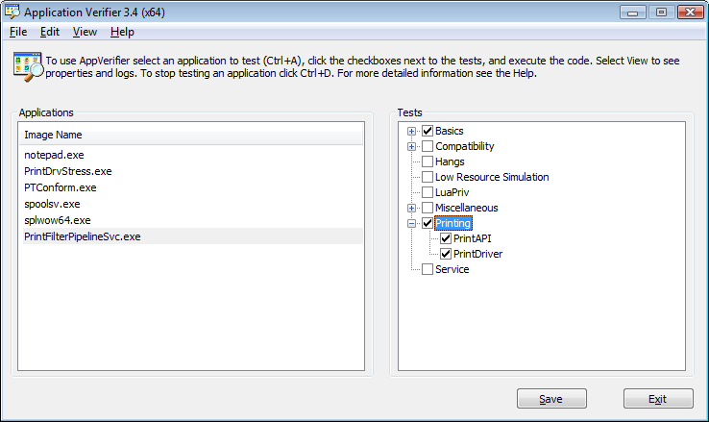
Setup And Configuration

Slide 10
Typical Workflow
Enable Print Verifier
Start Testing
Violation Detected
Verifier Stop → Debug Break
Refer Stop Code Documentation

Slide 11
Known Limitations
System processes (csrss, lsass)
not supported
Designed to verify native applications,
not .NET applications
  It works, but provides limited value

Slide 12
Recommended Settings
Enable Basics, Print Driver and
Print API layers for
  Spoolsv.exe
  (core print spooler service)
  PrintIsolationHost.exe
  (driver isolation process)
  PrintFilterPipelineSvc.exe
  (filter pipeline process)
  Splwow64.exe
  (thunk process for WoW64 printing)
  All test .EXEs you have

Slide 13
Print Verifier Demo

Slide 14
Additional Features
Individual layers under “Printing”
can be disabled
Individual stops can be downgraded
or disabled
Print Ticket verification (PTConform)
can be turned off
All off the above available from both App Verifier UI as well as command line

Slide 15
Additional Features
Fault injection
  Available in both Print API and Print
  Driver layers
  FaultRate property controls rate of
  fault injection
Logging
  Log is generated for every verifier stop
  Command line support to export logs to XML
  App Verifier UI has a link to Log Viewer

Slide 16
Print Verifier Fault Detection
Print resource tracking
  Printer handles, printer change notification handles, PRINTER_NOTIFY_INFO, spool file handles, HPTPROVIDER handles
Will issue a stop if the verified code is
  Leaking any of the above print resources
  Using already closed handles
  Using unknown/un-initialized handles
  Using handles in a thread-unsafe manner

Slide 17
Print Verifier Fault Detection
Invalid PrintTicket or PrintCapabilities objects crossing interface boundaries
  Application passing bad PrintTicket
  Driver/filter returning bad PrintTicket
Incorrect interface reference counting
  XPS filters, plug-ins
XPS filter making illegal call to the pipeline
  Example
    Two IPrintWriteStream: Close calls

Slide 18
Print Verifier Fault Detection
Incorrect implementation of AsyncNotification interfaces
XPS filter changing/removing common property from the property bag
XPS filter calling pipeline interface
out of order
Drivers/Filters causing
structured exceptions
Changing the security context in plug-in

Slide 19
Print Verifier Fault Detection
Bad DEVMODE buffer passed
Illegal API call made in DllMain
Driver/Filter calling ExitThread/TerminateThread
Slow expensive operations performed
by UI threads

Slide 20
Future Improvements
Considering additional support for
  Print processors
  Port monitors
  Language monitors
  Monolithic drivers
  Verifying drivers accessing registry

Slide 21
Other Important Tools
IsXps
  OPC and XPS conformance validation tool
  Easy-to-use command line interface
  Detailed error information helps quickly isolate bugs
  Ships in the Windows Driver Kit (WDK), Windows Logo Kit (WLK) and the Software Development Kit (SDK)

Slide 22
Other Important Tools
PTConform
  PrintSchema conformance validation tool
  Easy-to-use command line interface with detailed error information
  Ships in the WDK, WLK and SDK
  Integrated into Print Verifier for runtime PrintSchema conformance verification

Slide 23
Other Important Tools
LooksGood
  Automated rendering verification tool
  Uses Windows Presentation Foundation
  to render XPS to TIFF
  Ships in the WDK and WLK
INFGate
  Syntax checker for INF files of print
  and imaging drivers
  Ships in the WDK and WLK

Slide 24
Other Important Tools
XPS Content Library
  Conformant XPS content from
  diverse producers
  Non-conformant or invalid XPS content (Violate-One)
  Corrupted XPS content

Slide 25
Distribution Vehicles
 | WDK | WLK | SDK
IsXps | ✓ | ✓ | ✓
PTConform | ✓ | ✓ | ✓
LooksGood | ✓ | ✓
INFGate | ✓ | ✓
WLK Tests |  | ✓
XPS Content Library |  | ✓
WDK = Windows Driver Kit
WLK = Windows Logo Kit
SDK = Software Development Kit

Slide 26
Call To Action
Push quality assurance upstream
Get familiar with Application Verifier
and Print Verifier
Integrate Print Verifier into your development and test environments
Visit the Print Verifier blog
Post questions to Print Verifier newsgroup
  Feature requests more than welcome!

Slide 27
Additional Resources
Web Resources
  Blog
  http://blogs.msdn.com/PrintVerifier
  Download AppVerifier
  http://www.microsoft.com/downloads/details.aspx?FamilyID=bd02c19c-1250-433c-8c1b-2619bd93b3a2&DisplayLang=en
  WHDC for Print Devices
  http://www.microsoft.com/whdc/device/print/default.mspx
  XPS
  http://www.microsoft.com/xps
  Newsgroup: Microsoft.public.win32.programmer.tools on
  http://www.msdn.com
  Printing questions: prninfo@microsoft.com
  XPS questions: xpsinfo@microsoft.com
Related Sessions
  CON-T572: XPS Printer Driver Development in Windows 7
  CON-T607: Windows 7 Logo Program for Print and Document Devices
  CON-C652: Chalk Talk - Windows 7 Logo Program for Print, Scan, and Fax

Slide 28



Please Complete A Session Evaluation Form
Your input is important!
Visit the WinHEC CommNet and complete a Session Evaluation for this session and be entered to win one
of 150 Maxtor® BlackArmor™ 160GB External Hard Drives
50 drives will be given away daily!
http://www.winhec2008.com
BlackArmor
Hard Drives provided by:

Slide 29


© 2008 Microsoft Corporation. All rights reserved. Microsoft, Windows, Windows Vista and other product names are or may be registered trademarks and/or trademarks in the U.S. and/or other countries.
The information herein is for informational purposes only and represents the current view of Microsoft Corporation as of the date of this presentation. Because Microsoft must respond to changing market conditions, it should not be interpreted to be a commitment on the part of Microsoft, and Microsoft cannot guarantee the accuracy of any information provided after the date of this presentation.
MICROSOFT MAKES NO WARRANTIES, EXPRESS, IMPLIED OR STATUTORY, AS TO THE INFORMATION IN THIS PRESENTATION.

