Slide 1
Debugging Device Installation
Neil Sandlin
Principal SDE
Microsoft Corporation

Slide 2
Topics In This Session
Analyzing Setupapi log for
Driver store errors
Driver installation errors
Tools for diagnostics and development
Problem reports
Pnputil
WDK Toaster Driver sample

Slide 3
Driver Store Overview
Device driver installation done in 2 phases
Driver is staged to the “Driver Store”
Driver is installed from the Driver Store to the system
Driver Store is a secure local directory
Driver packages validated before staging
SetupApi logging illustrates these 2 phases

Slide 4

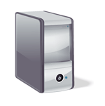
Driver Install (Earlier Windows) Comparison of driver installation with and without the Windows Vista driver store

Slide 5
Driver Install (Earlier Windows) Logical view of machine, no Driver Store
Windows XP System
Display Driver
Keyboard Driver
Mouse Driver

Slide 6

Driver Install (Earlier Windows) User plugs in new device
Windows XP System
Display Driver
Keyboard Driver
Mouse Driver

Slide 7
Driver Install (Earlier Windows) System searches for driver match
Windows XP System
Display Driver
Keyboard Driver
Mouse Driver

Slide 8
Driver Install (Earlier Windows) Best-ranked driver is selected
Windows XP System
Webcam
Driver Package
Display Driver
Keyboard Driver
Mouse Driver

Slide 9
Driver Install (Earlier Windows) Driver installed directly in user context
Windows XP System
Webcam Driver
Webcam
Driver Package
Display Driver
Keyboard Driver
Mouse Driver

Slide 10
Driver Install (Earlier Windows) New Driver Started
Windows XP System
Webcam Driver
Display Driver
Keyboard Driver
Mouse Driver

Slide 11
Driver Install (Windows Vista+)
Windows Vista System
Driver Store
Display Driver
Keyboard Driver
Mouse Driver

Slide 12
Driver Install (Windows Vista+) User plugs in new device
Windows Vista System
Driver Store
Display Driver
Keyboard Driver
Mouse Driver

Slide 13
Driver Install (Windows Vista+) System searches for driver match
Windows Vista System
Driver Store
Display Driver
Keyboard Driver
Mouse Driver

Slide 14
Driver Install (Windows Vista+) Best-ranked driver is selected
Windows Vista System
Webcam
Driver Package
Driver Store
Display Driver
Keyboard Driver
Mouse Driver

Slide 15
Driver Install (Windows Vista+) Driver validated and staged to driver store
Windows Vista System
Webcam
Driver Package
Driver Store
Display Driver
Keyboard Driver
Mouse Driver

Slide 16
Driver Install (Windows Vista+) Driver installed in system context
Windows Vista System
Webcam Driver
Driver Store
Display Driver
Keyboard Driver
Mouse Driver

Slide 17
Driver Install (Windows Vista+) New driver started
Windows Vista System
Webcam Driver
Driver Store
Display Driver
Keyboard Driver
Mouse Driver

Slide 18
Driver Store Key debugging considerations
Starting with Windows Vista, driver packages are copied in their entirety to the Driver Store
INF File references are treated more strictly and missing files result in an importation error

Slide 19
Walkthrough 1 Successful staging and install operation
The Toaster WDK sample is used to show the basic layout of SetupApi.dev.log
Toaster Bus Driver enumerates device
System prompts user for a driver
User supplies CD with Toaster Function Driver
Driver is first staged to the driver store, and then is installed on the device
Logging shows the two-step process
Log file: %windir%\INF\SetupApi.dev.log

Slide 20


Slide 21
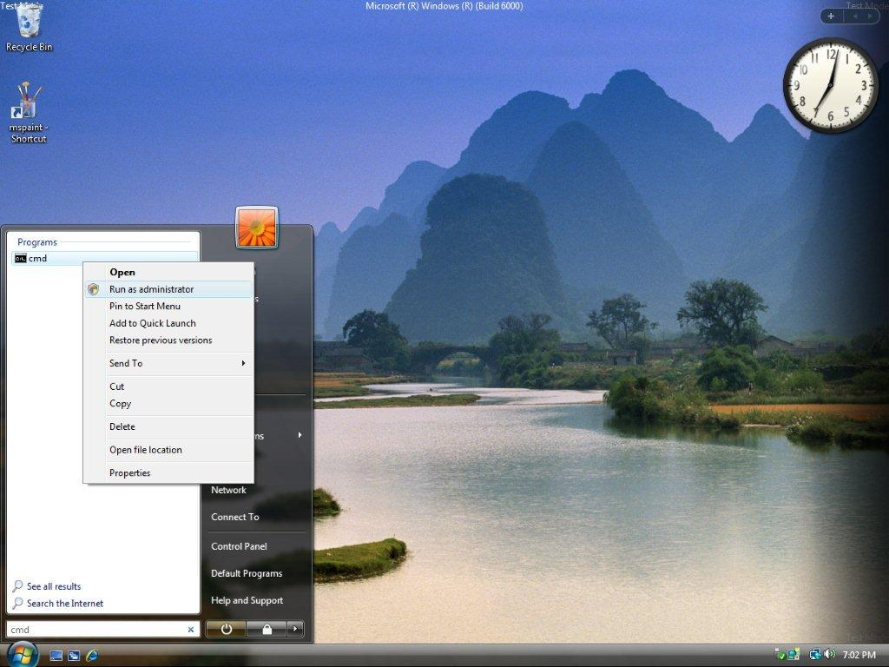

Slide 22
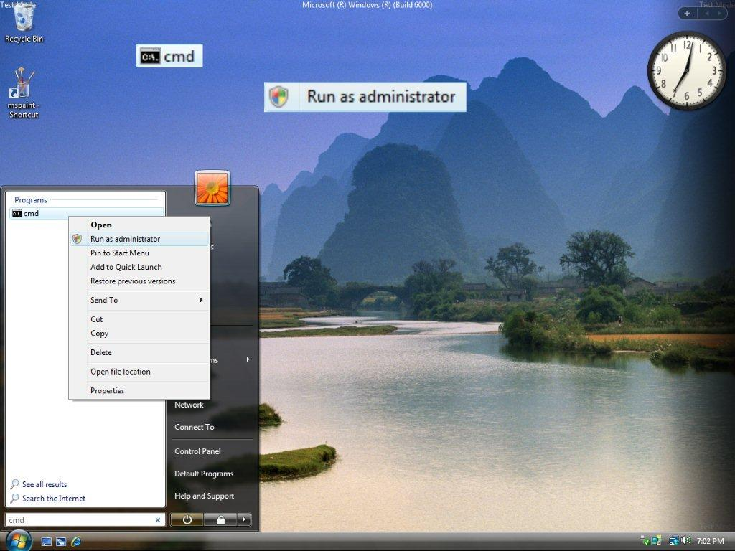

Slide 23
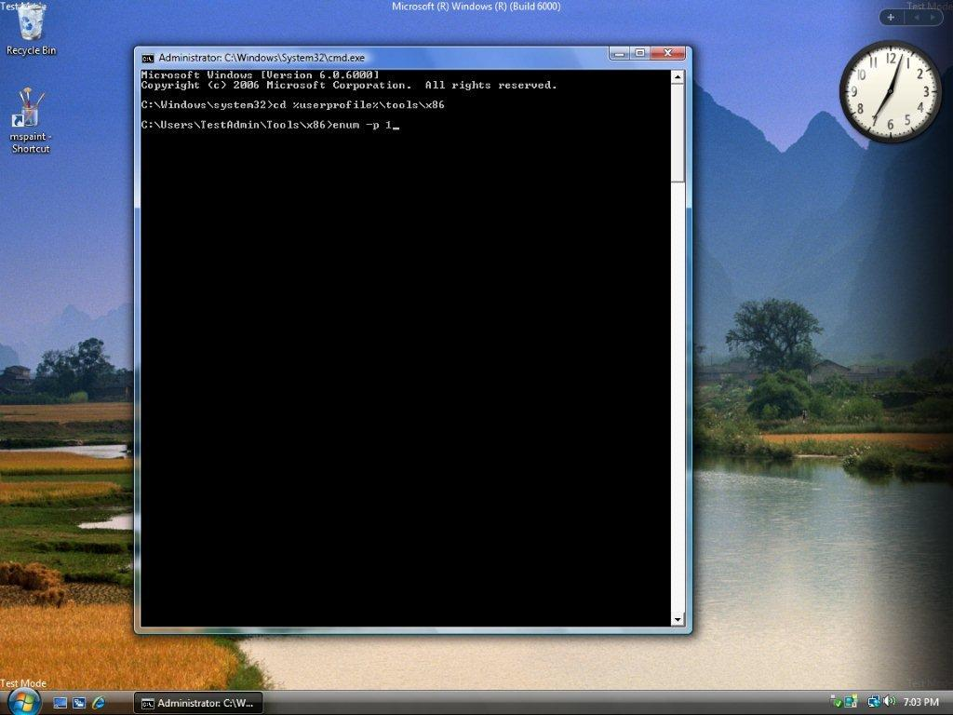

Slide 24


Slide 25
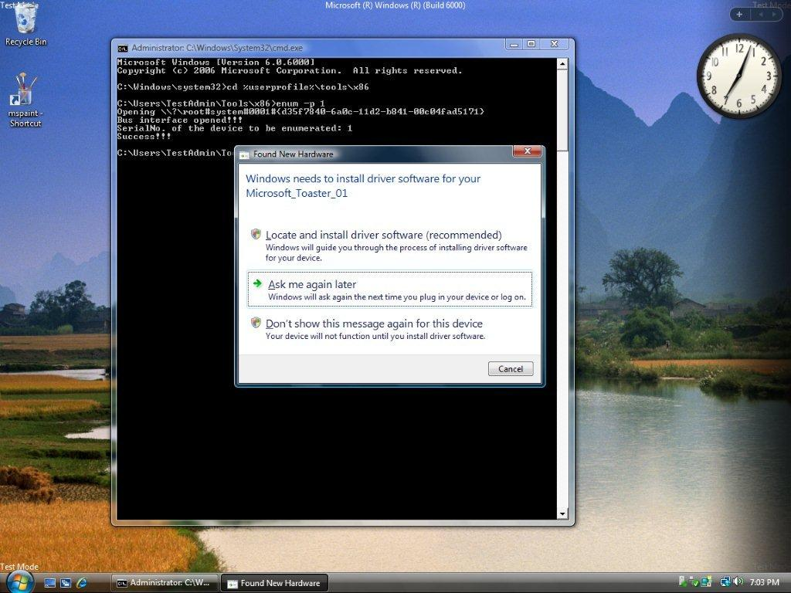

Slide 26


Slide 27
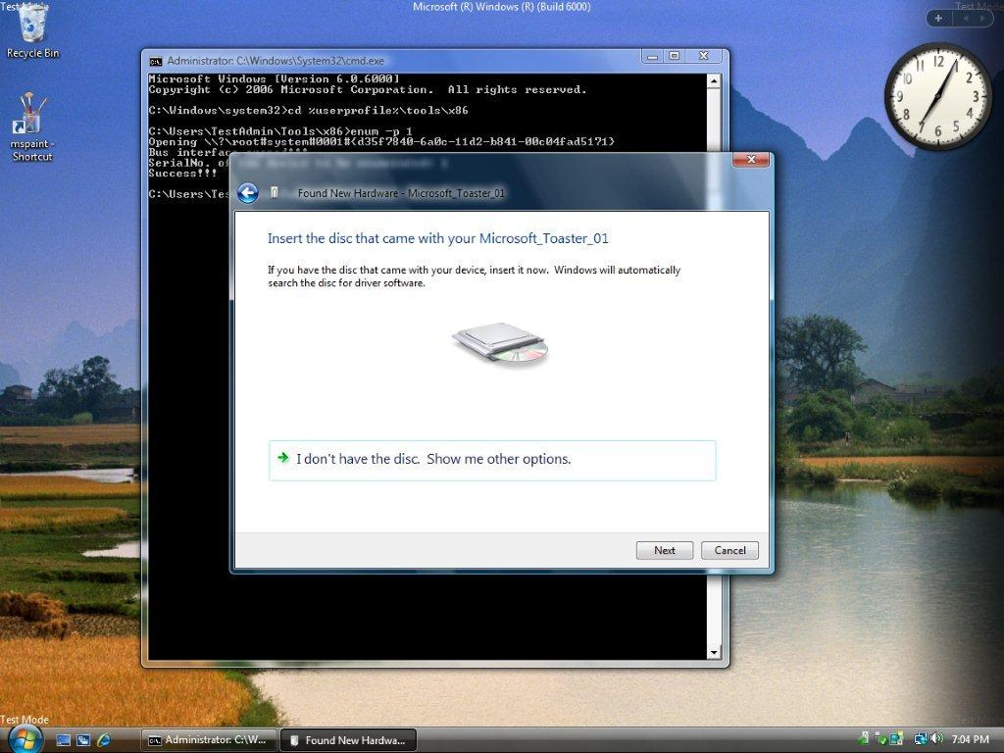

Slide 28
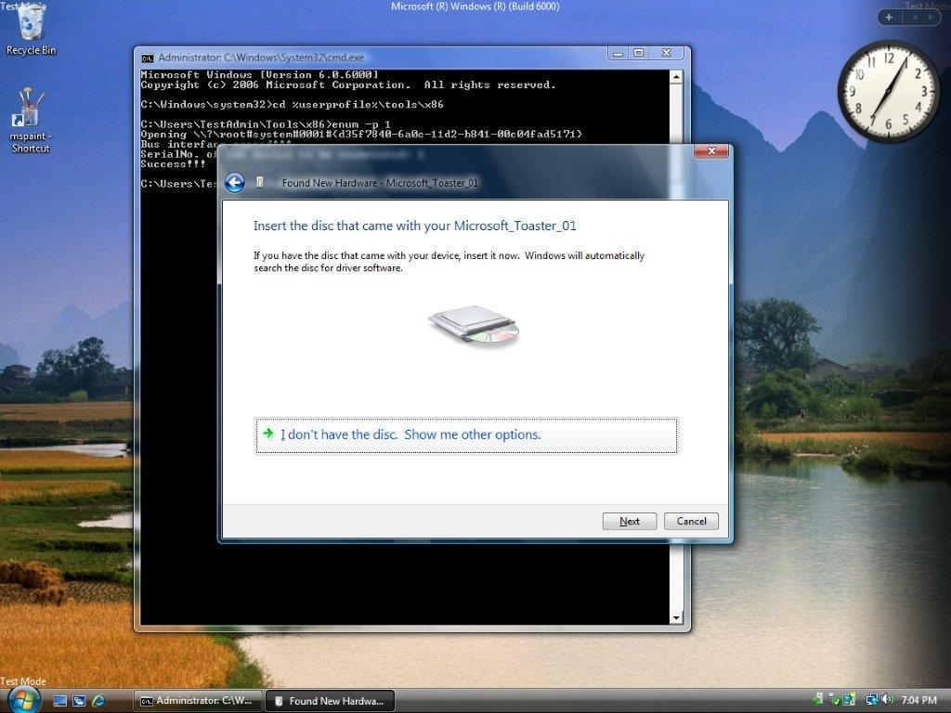

Slide 29
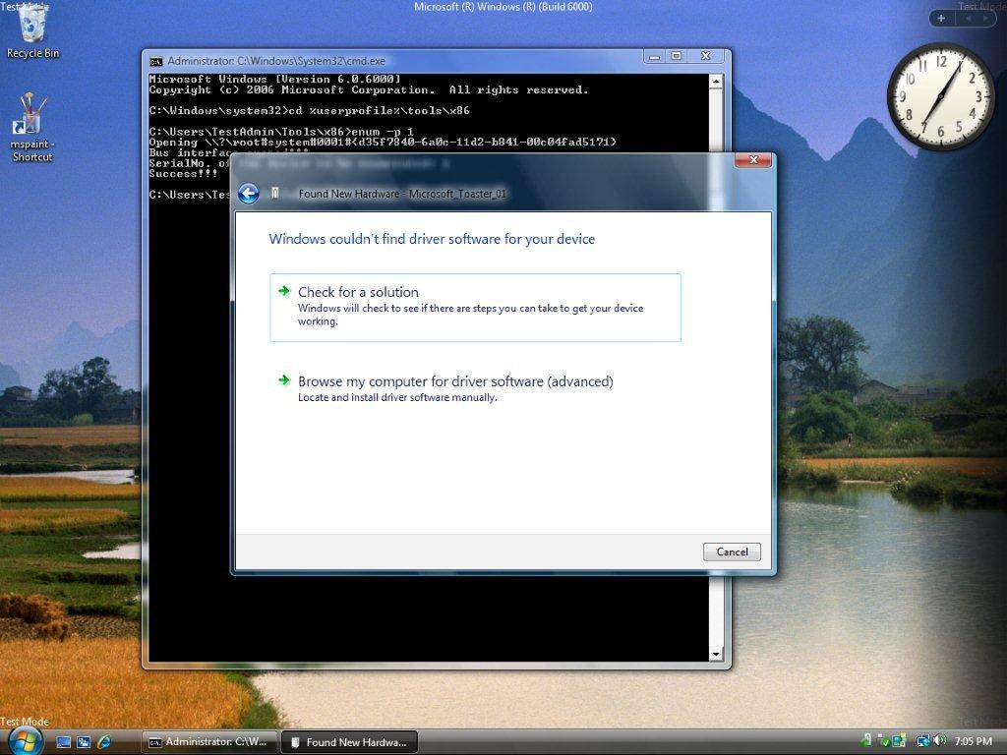

Slide 30
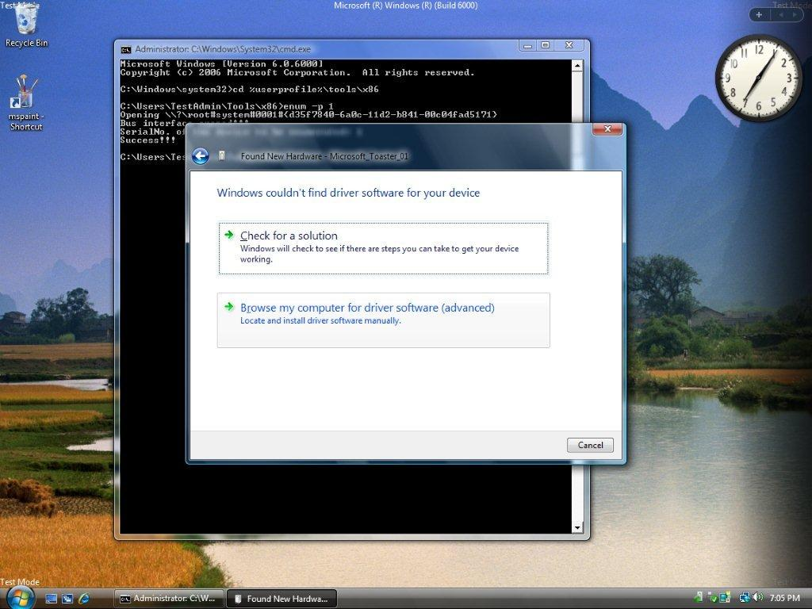

Slide 31
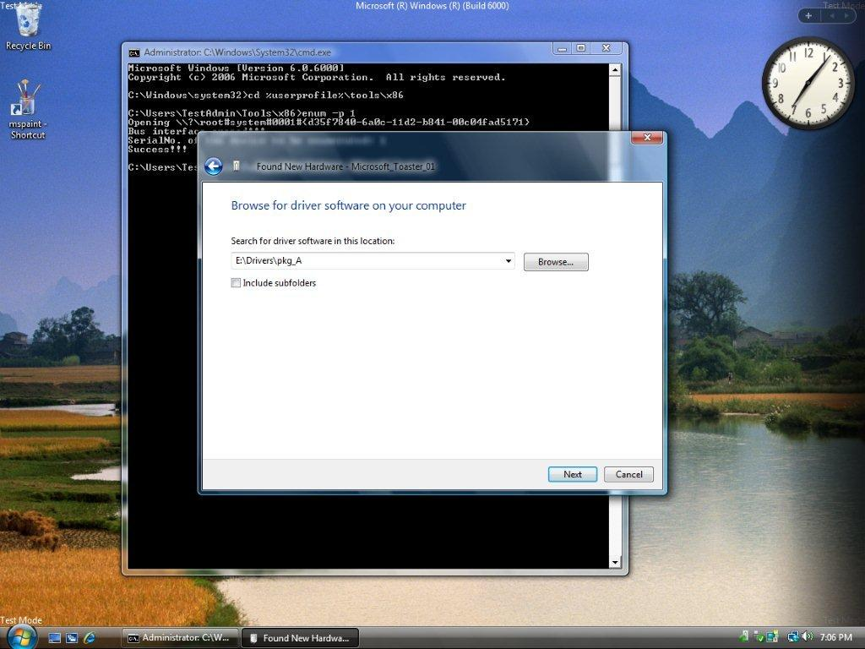

Slide 32
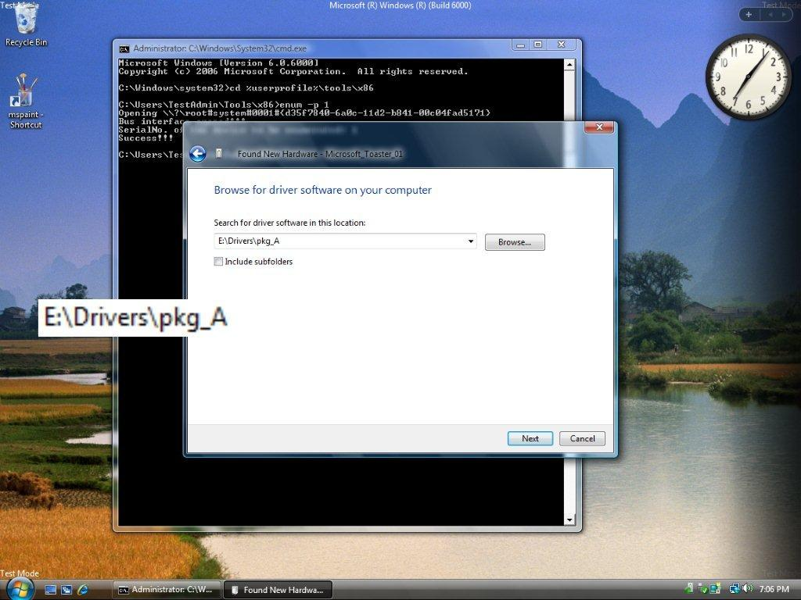

Slide 33


Slide 34


Slide 35


Slide 37
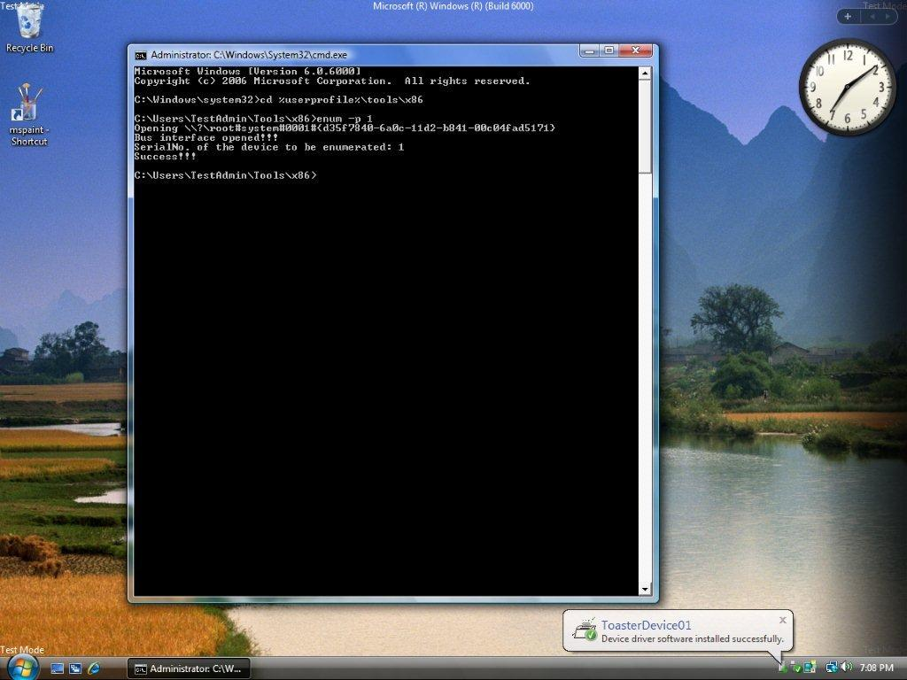

Slide 38
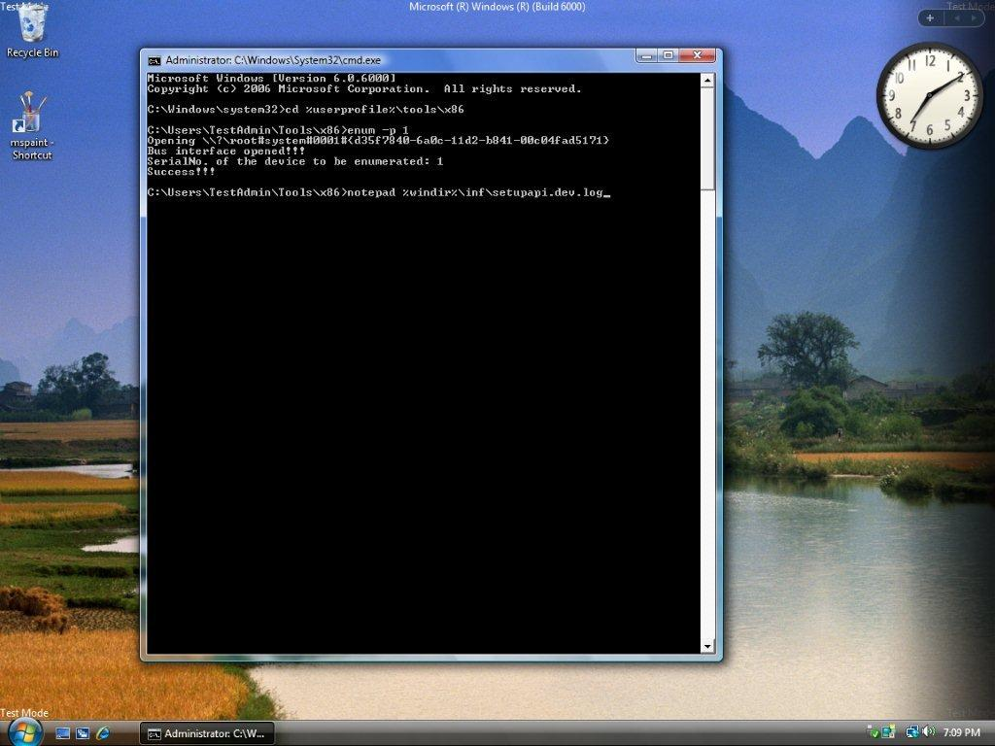

Slide 39


Slide 40
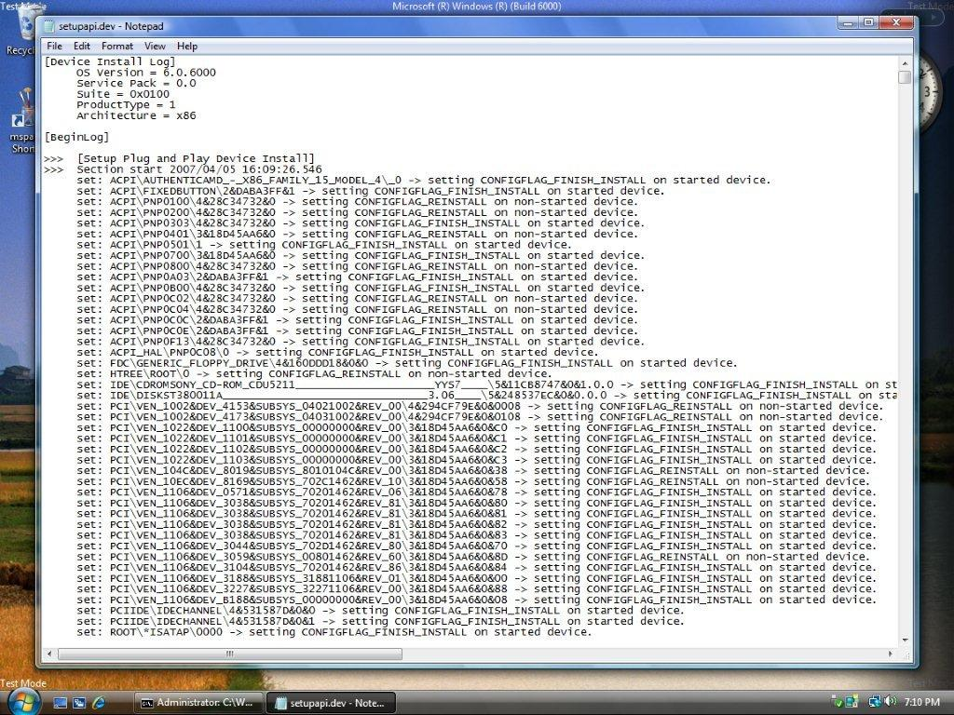

Slide 41
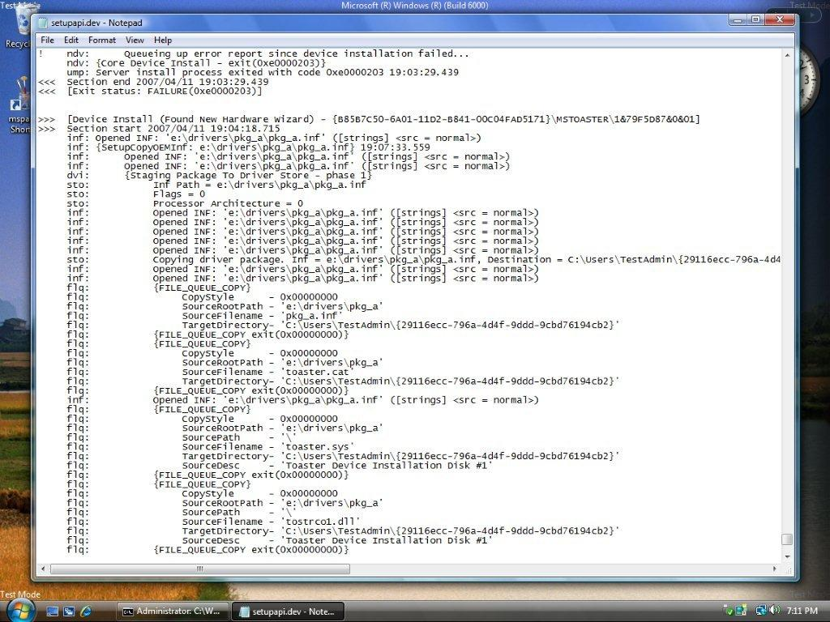

Slide 42
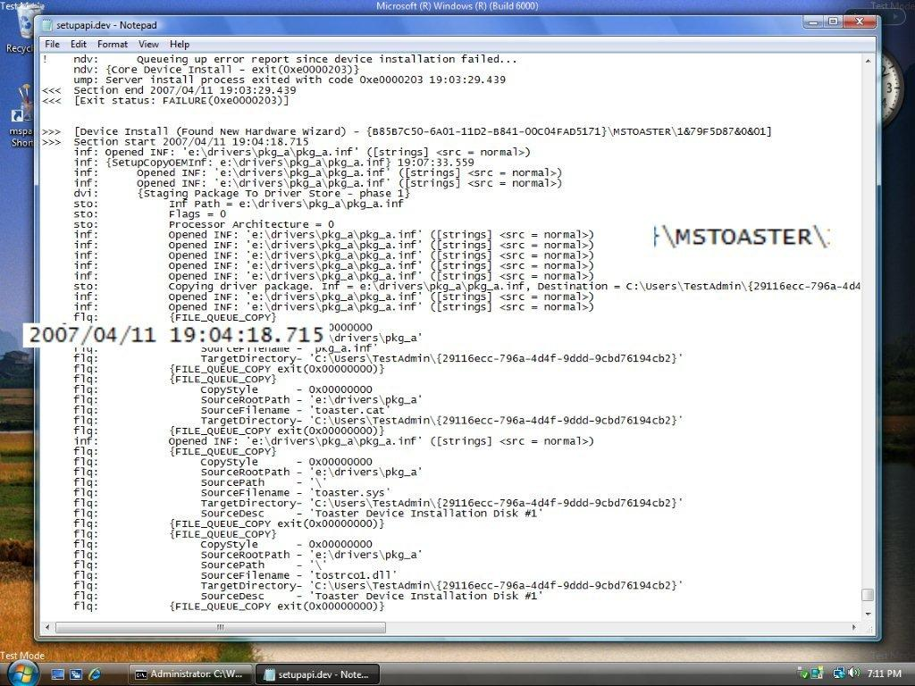

Slide 43
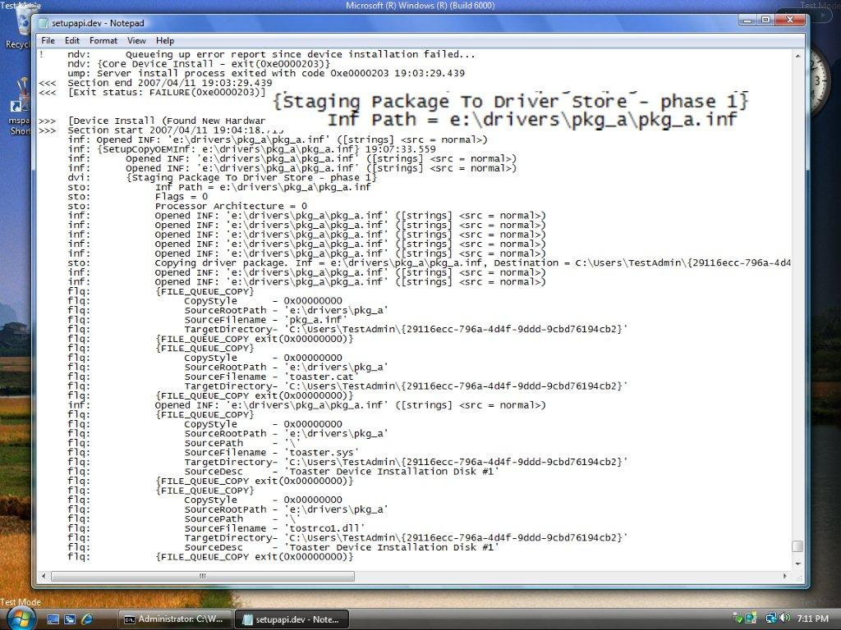

Slide 44
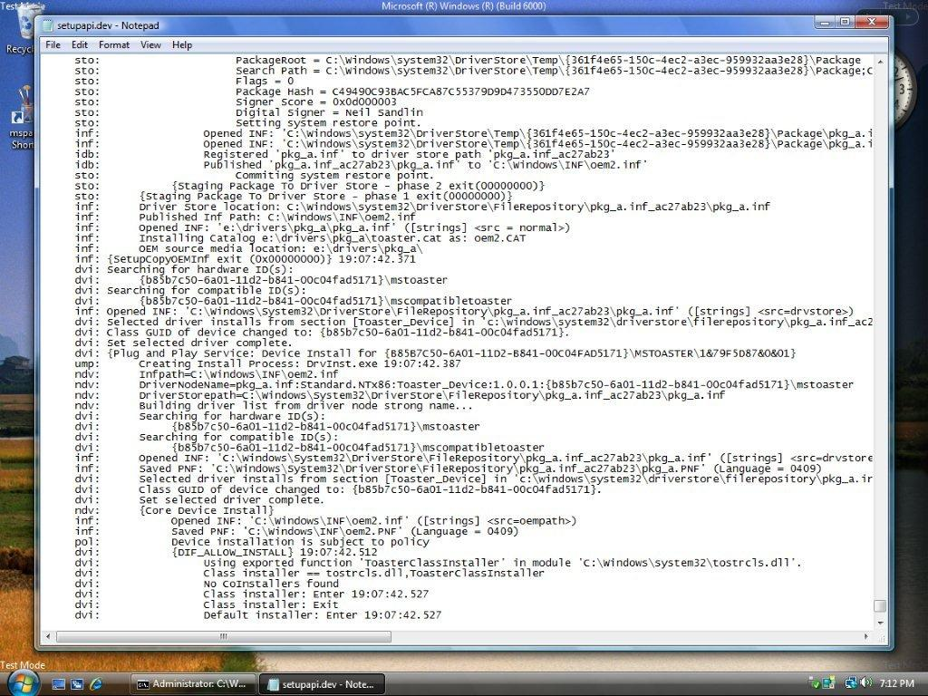

Slide 45
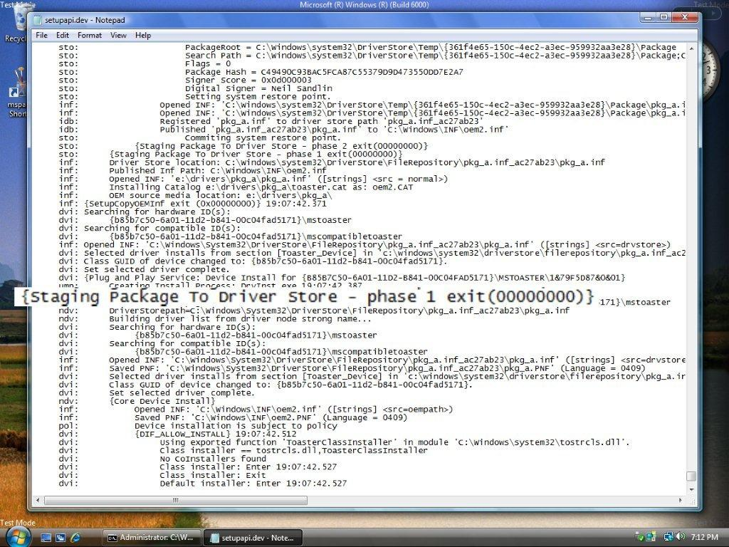

Slide 46
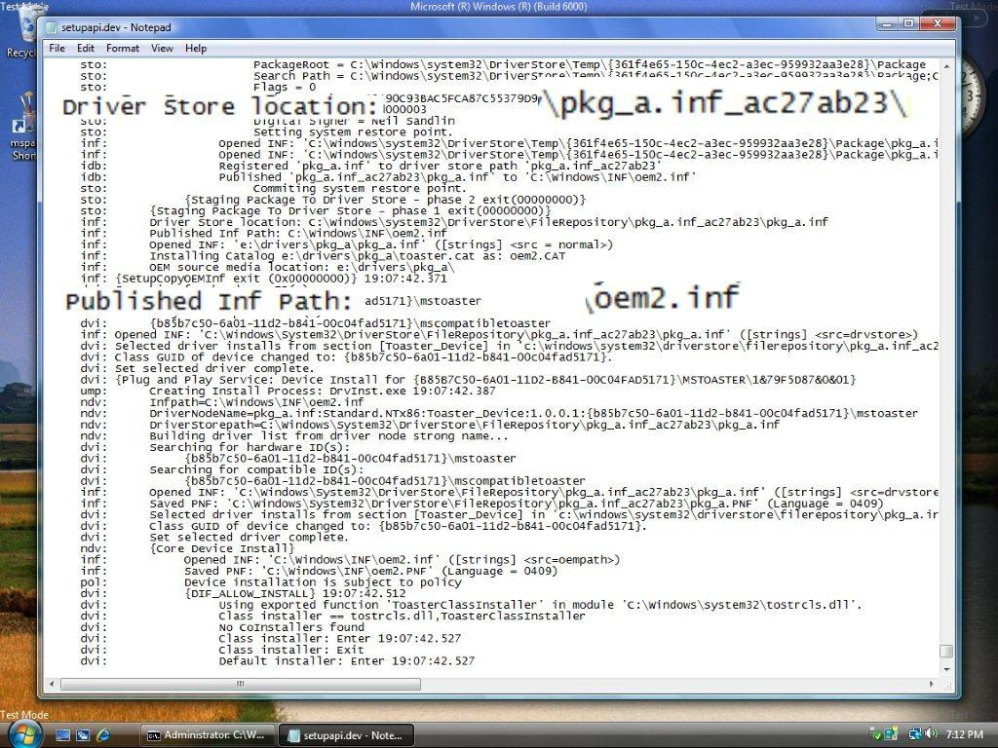

Slide 47
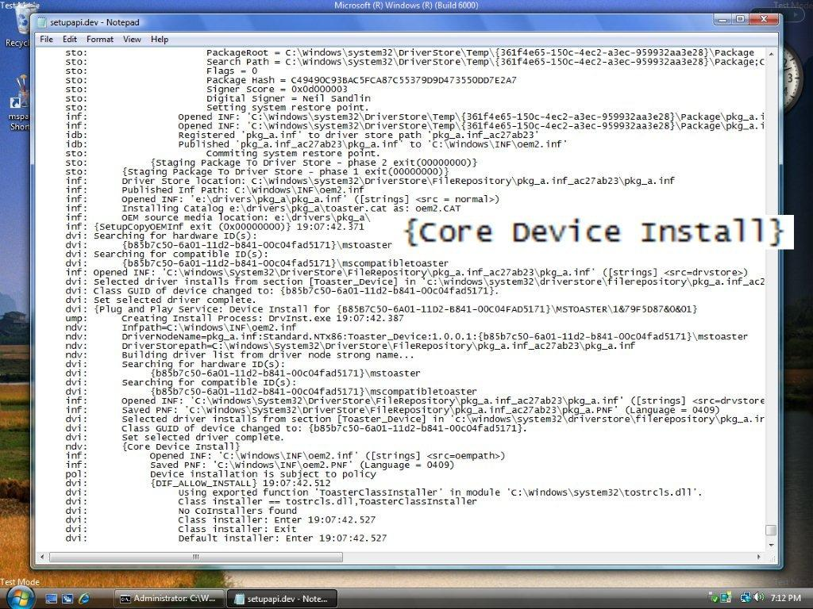

Slide 48
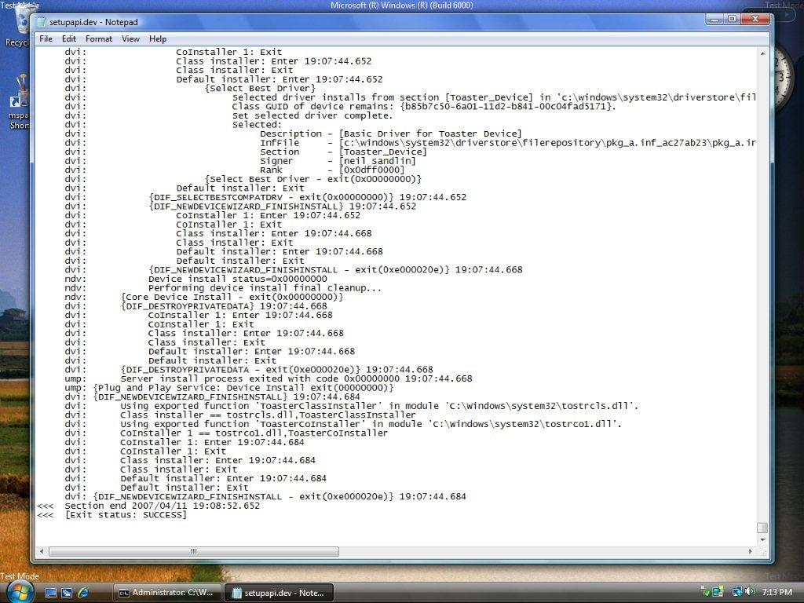

Slide 49
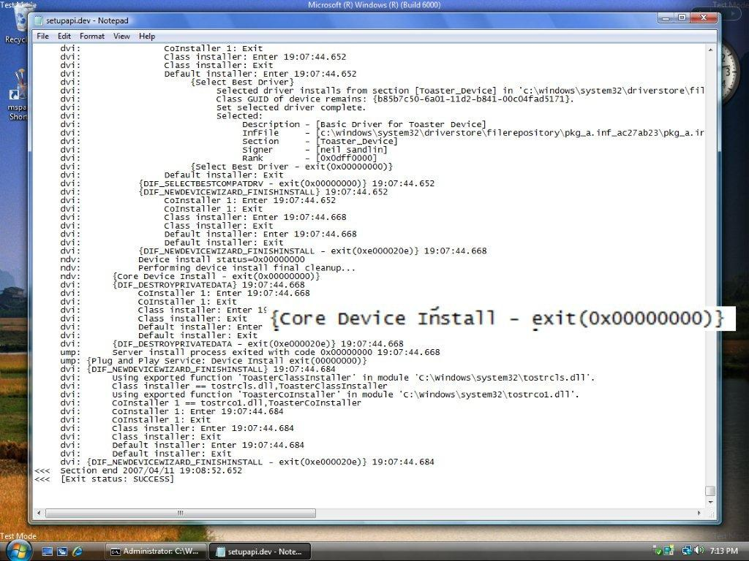

Slide 50
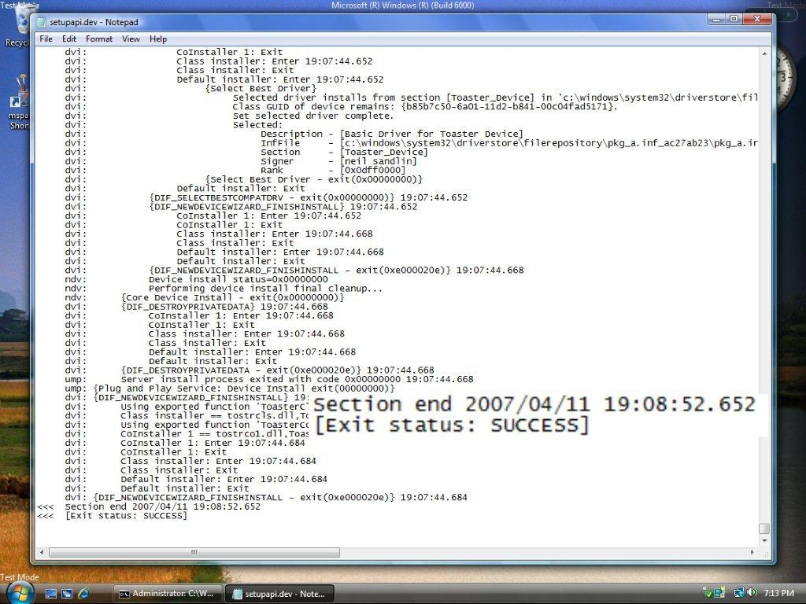

Slide 51
Walkthrough 2 Installing a pre-staged device driver
Setupapi log sample when driver is automatically found in the driver store
Driver from previous example is uninstalled from device
Uninstalling does not “unstage” a driver from the driver store
Verify the driver is still in the driver store with Pnputil
Device manager rescan triggers re-installation
Logging illustrates that driver installation occurs without needing to stage the driver

Slide 52
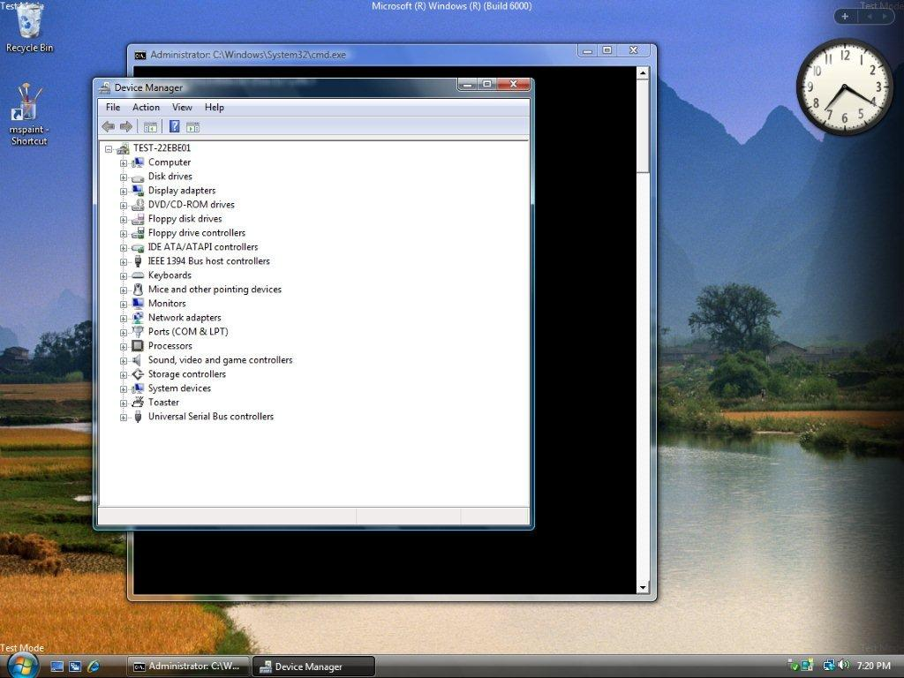

Slide 53
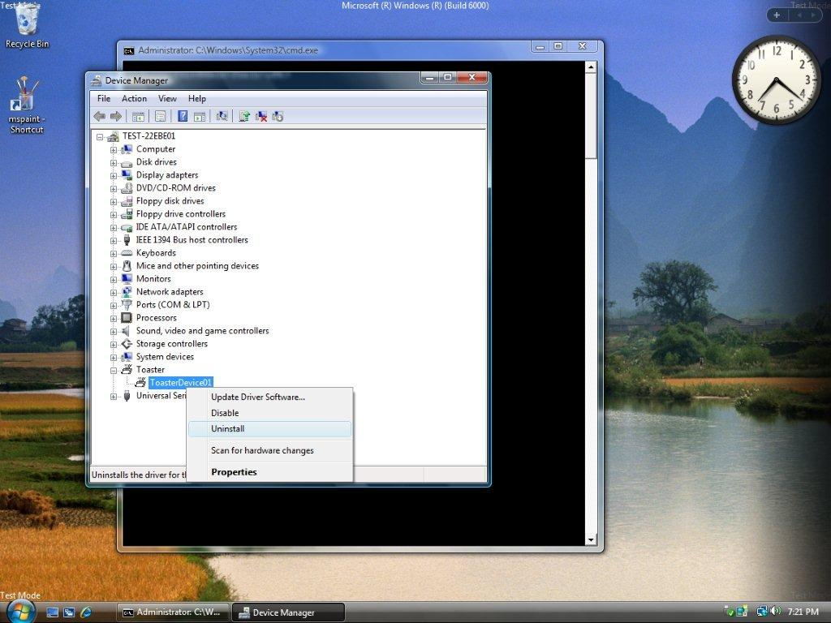

Slide 54
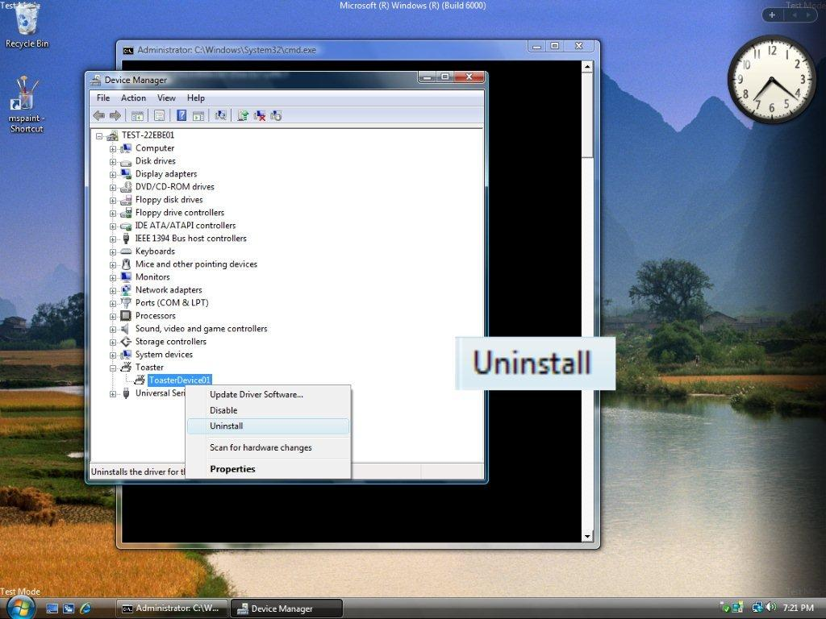

Slide 55
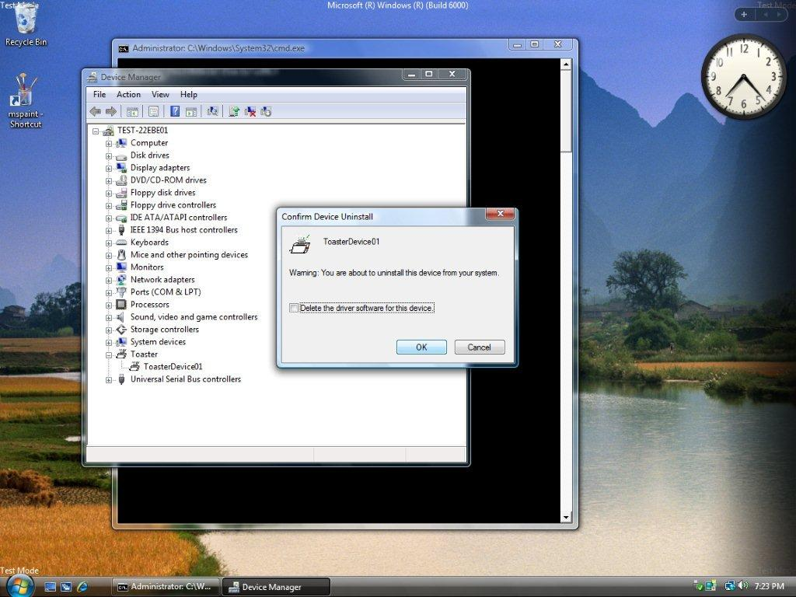

Slide 56
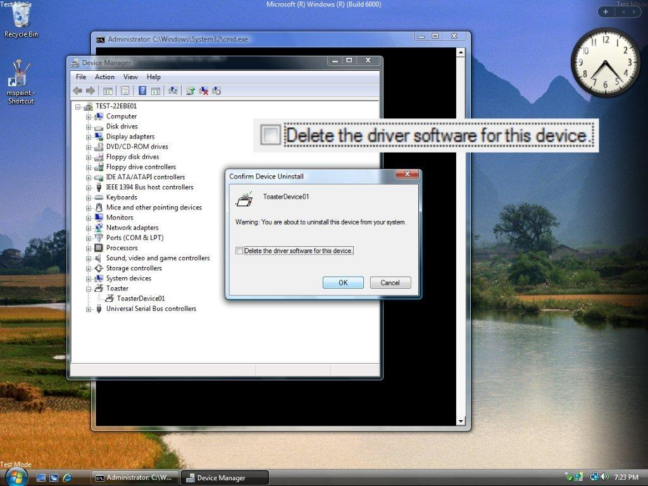

Slide 58


Slide 59
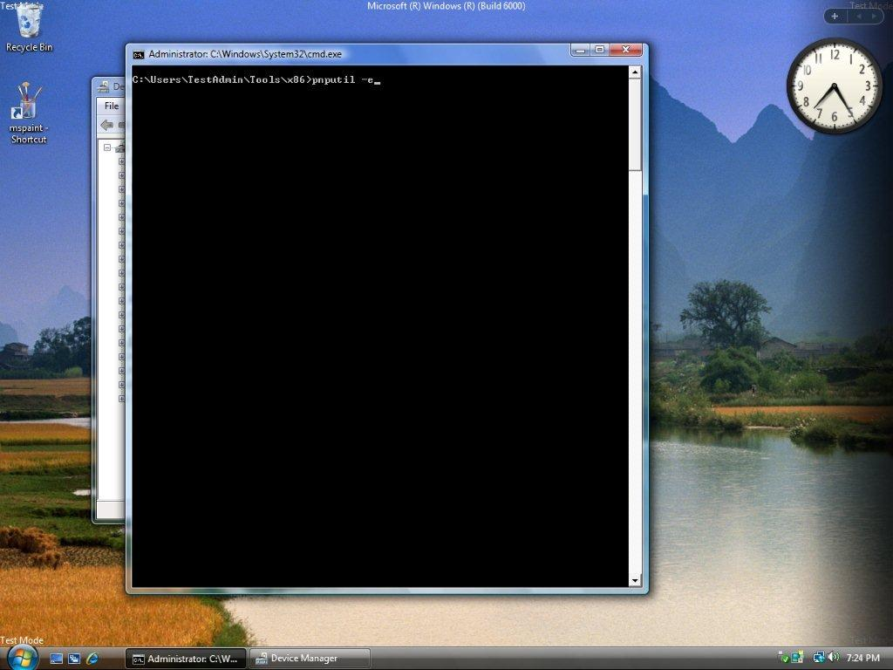

Slide 60
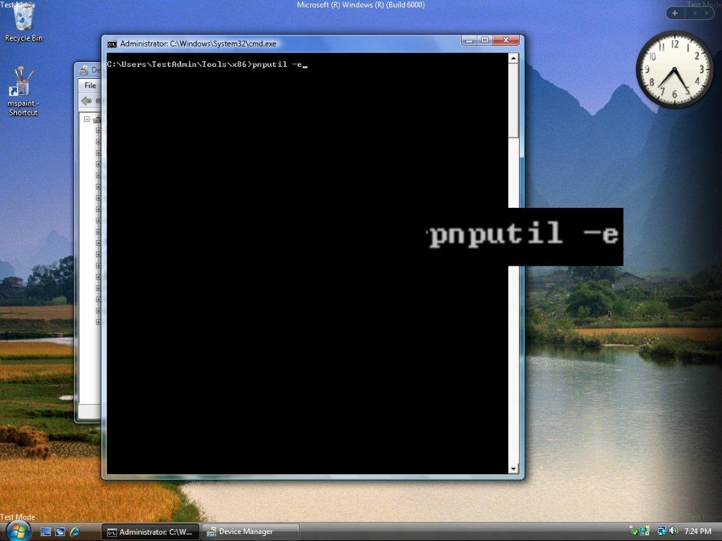

Slide 61
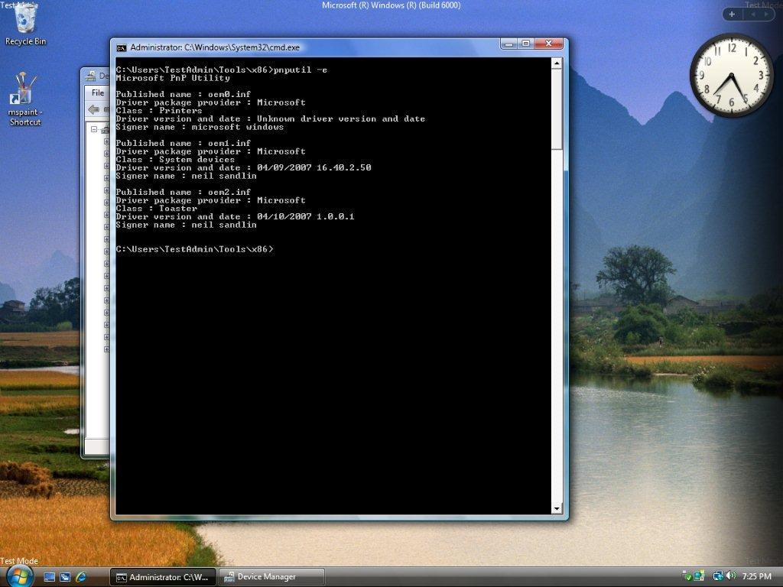

Slide 62
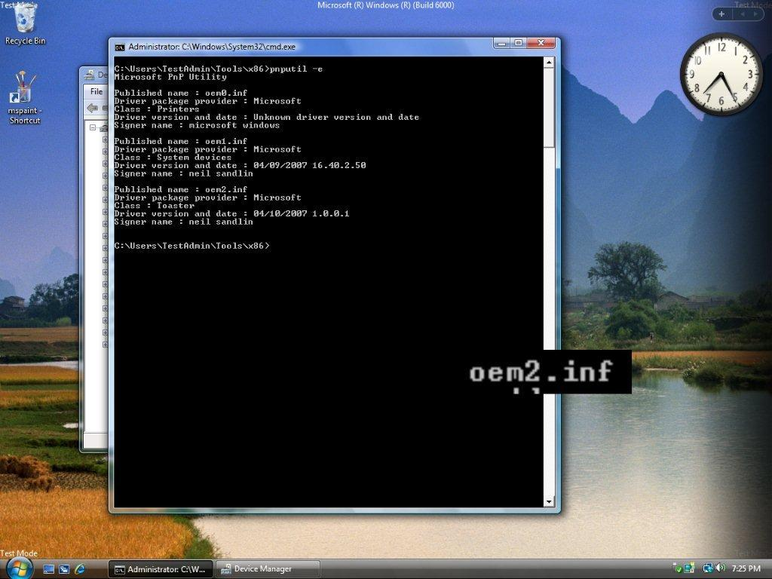

Slide 63


Slide 64


Slide 65


Slide 66
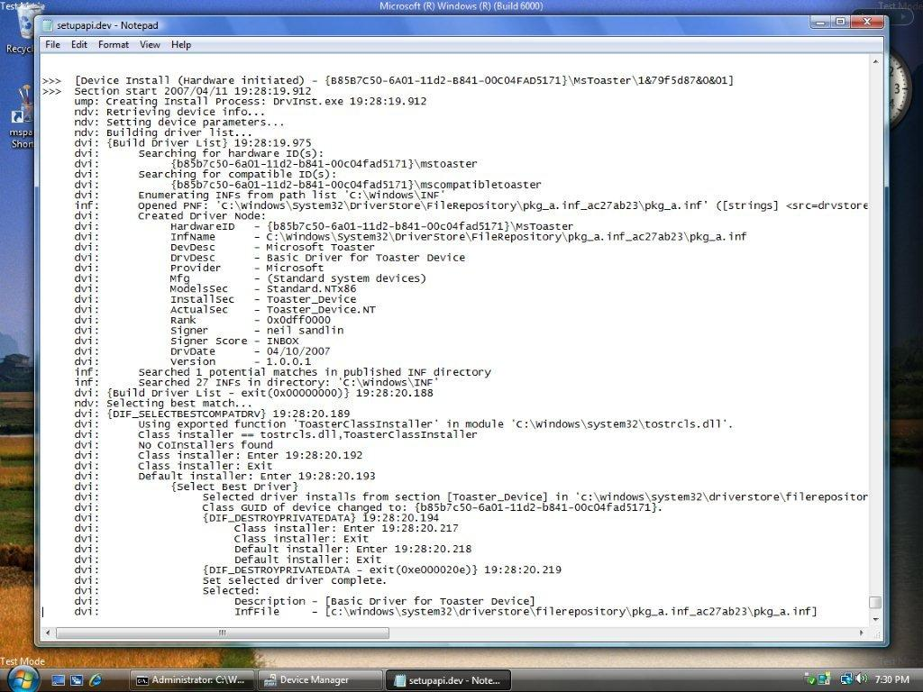

Slide 67
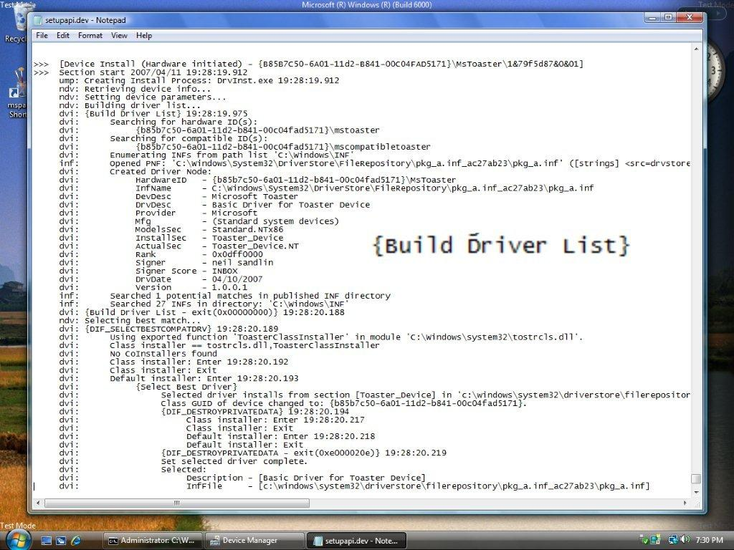

Slide 68
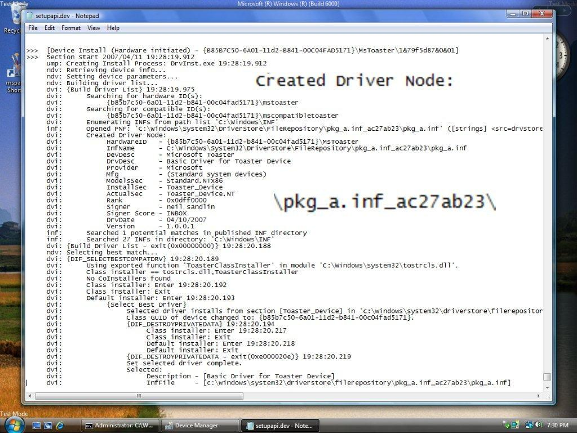

Slide 70
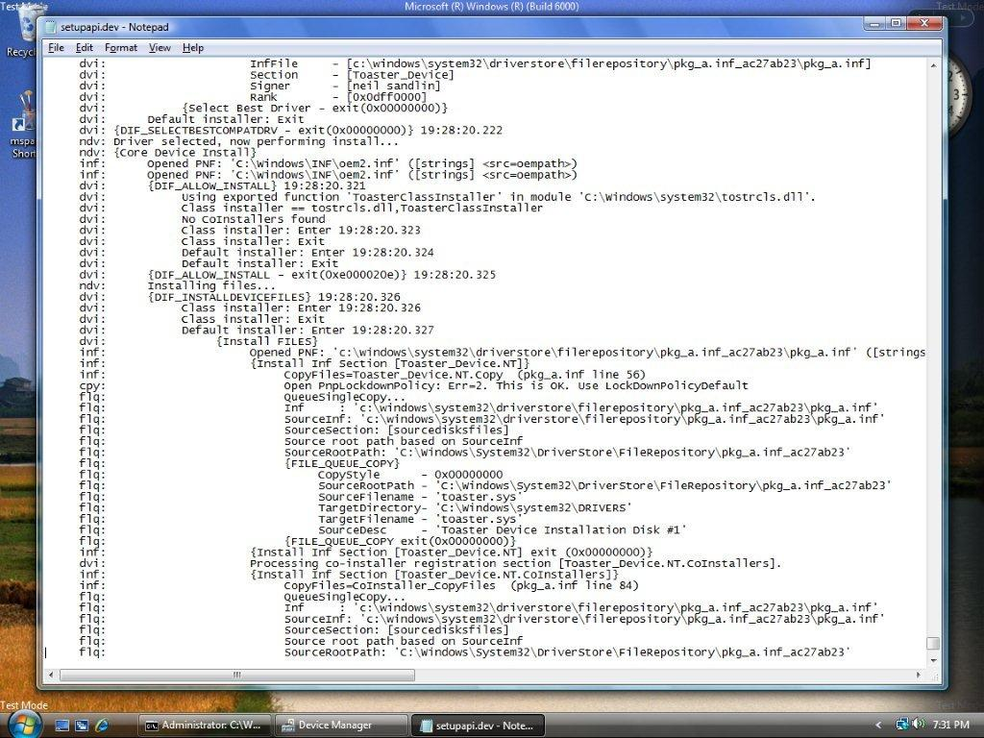

Slide 71
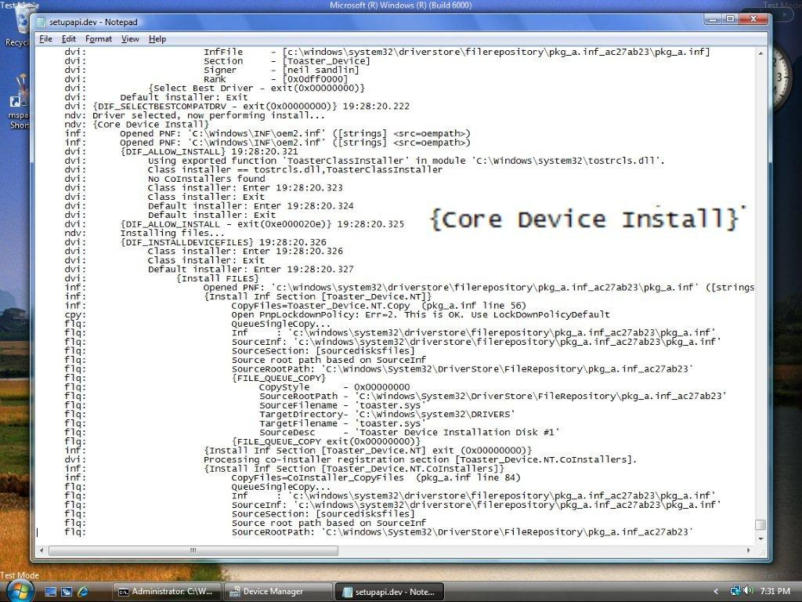

Slide 72
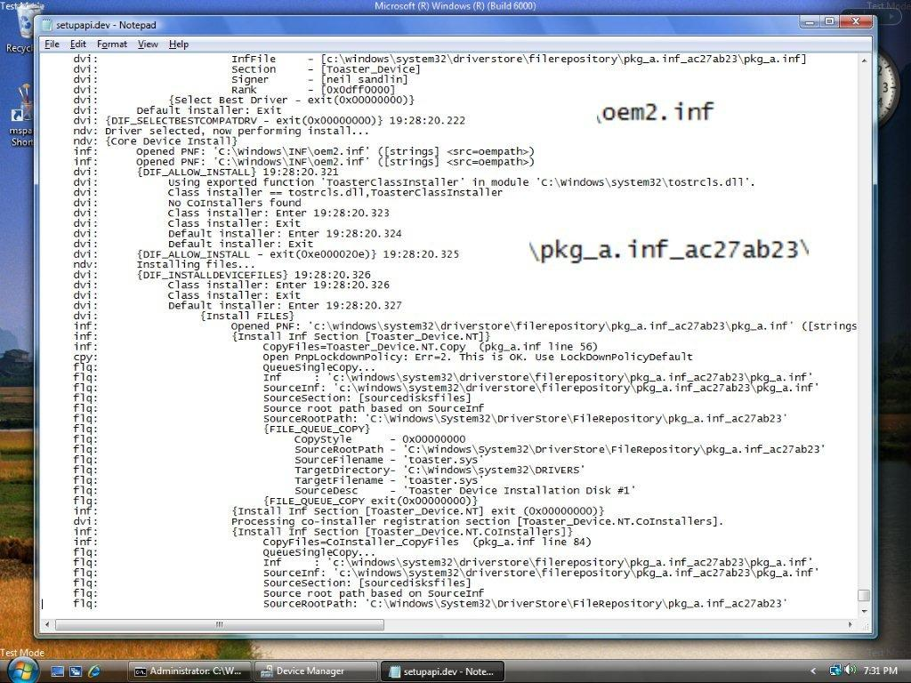

Slide 73
Walkthrough 3 Failure to find a driver
We show the log when no match is found in the driver store for a given device
Driver from previous example is uninstalled
Driver is also unstaged from the driver store
Device manager rescan results in driver prompt after no match is found
Logging shows the failure to find a driver

Slide 74


Slide 75
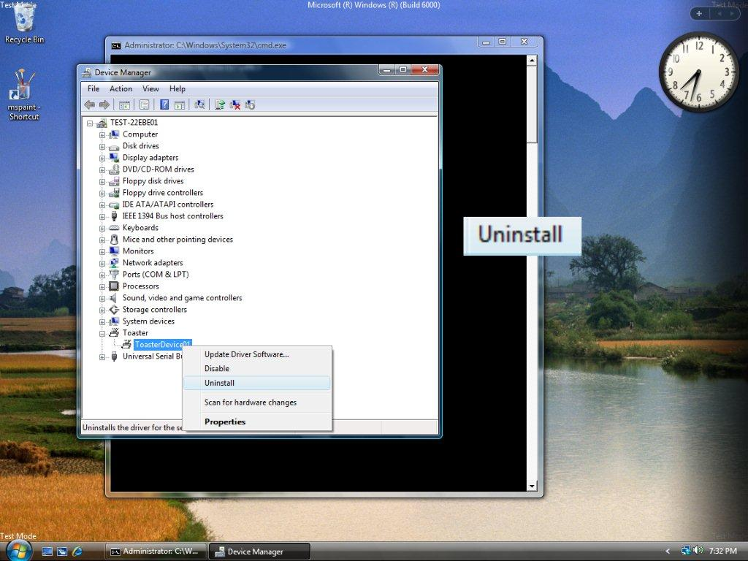

Slide 76
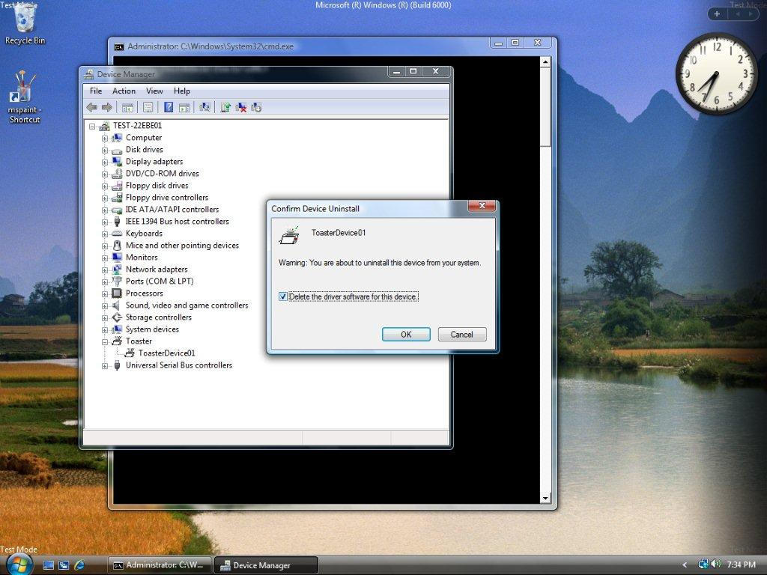

Slide 77
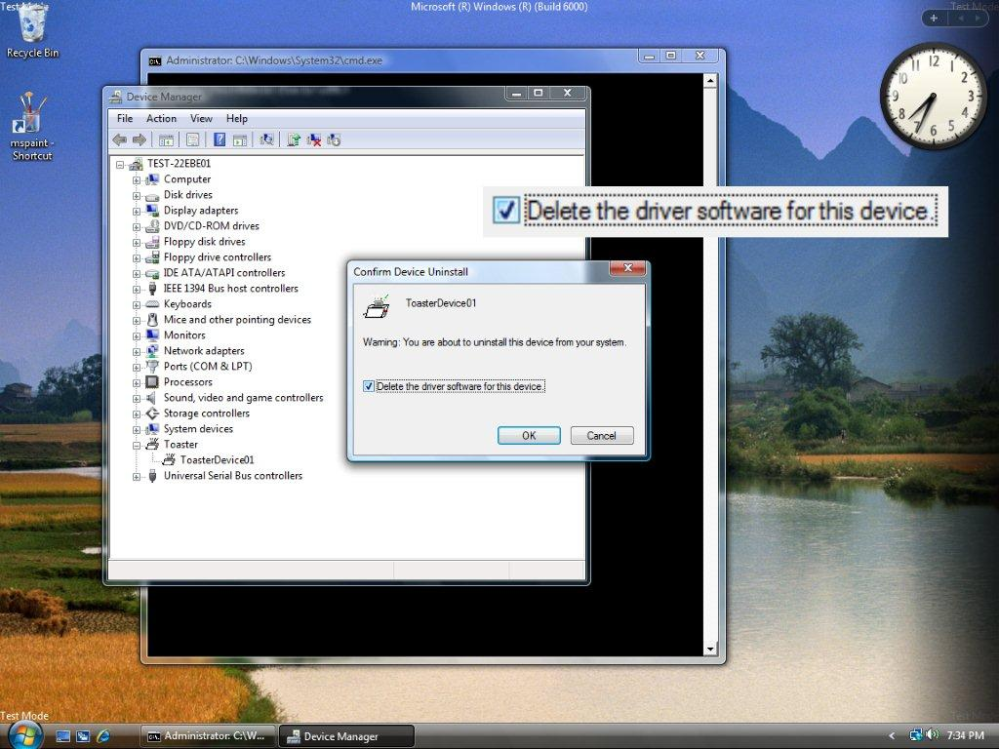

Slide 79


Slide 80


Slide 82
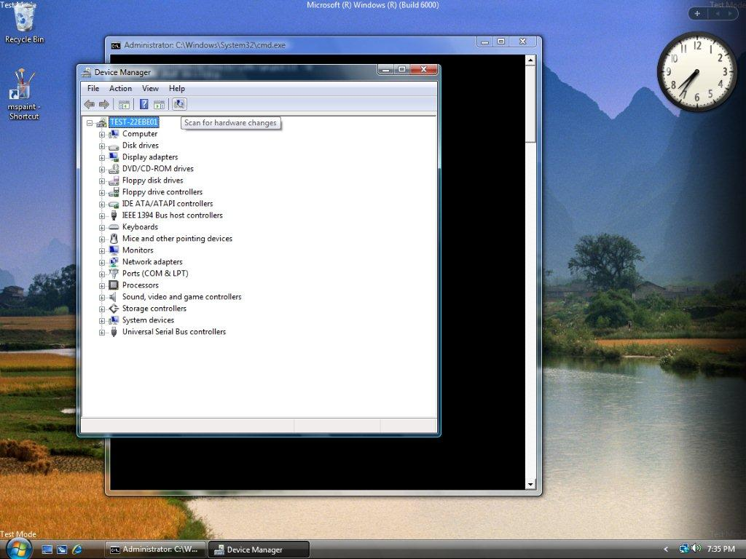

Slide 83
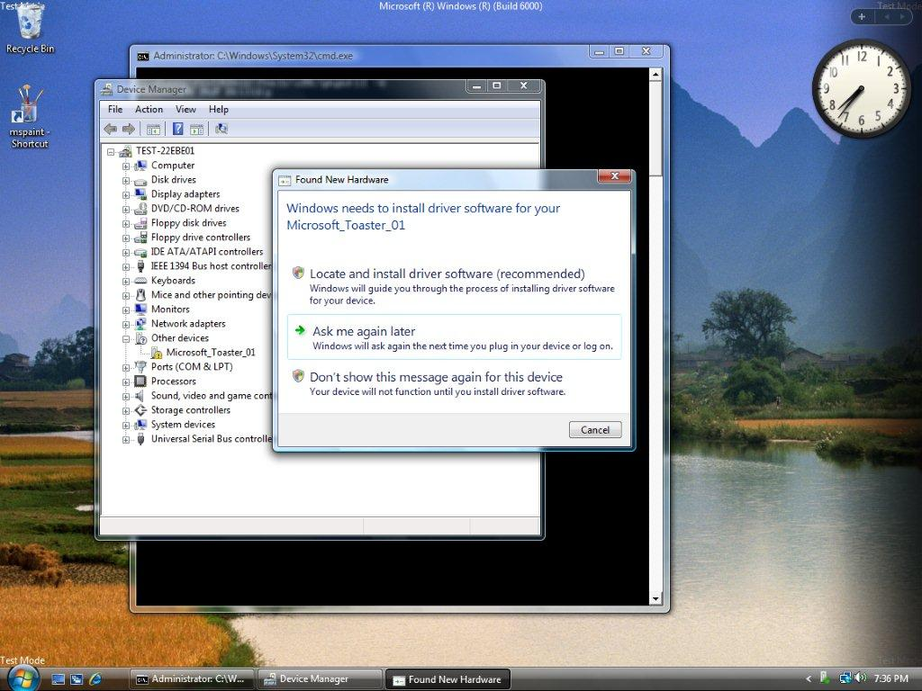

Slide 84
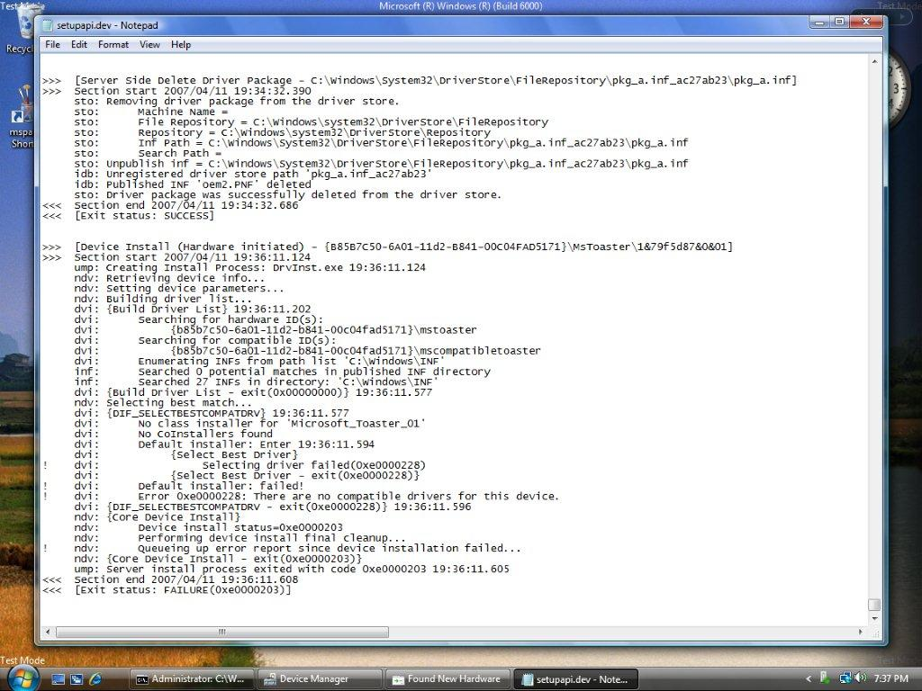

Slide 85
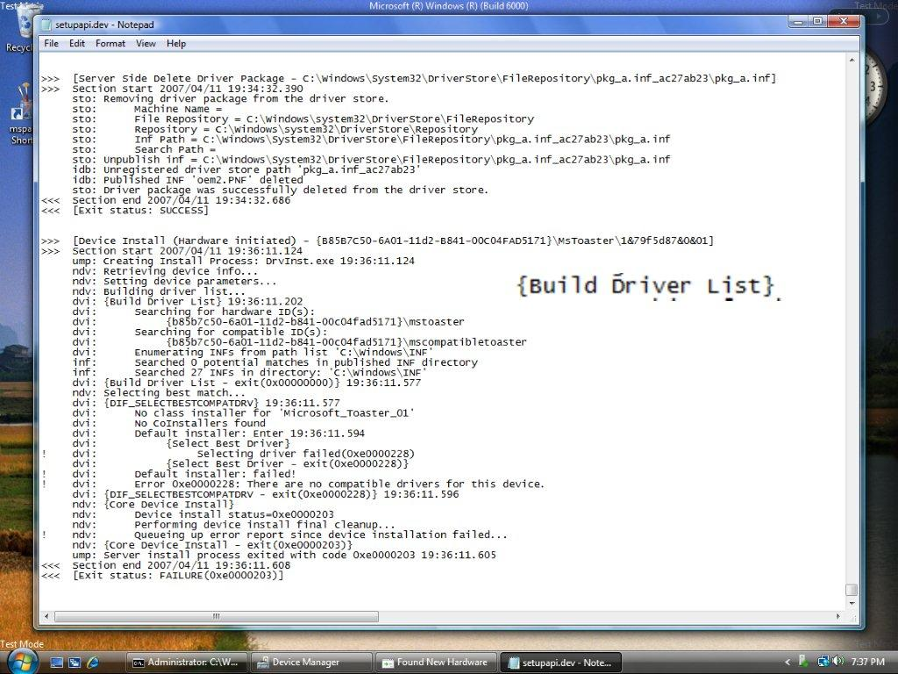

Slide 86
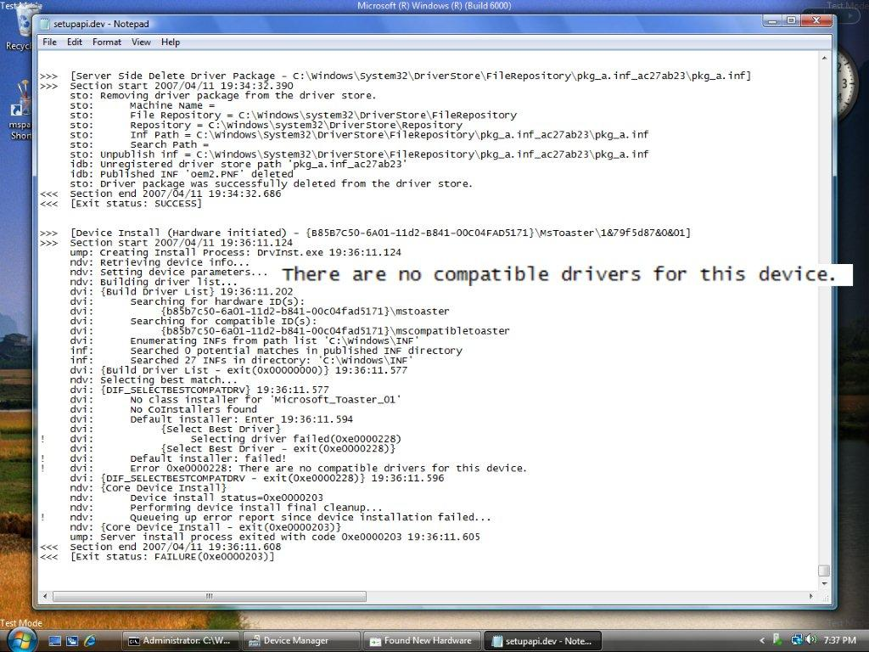

Slide 87
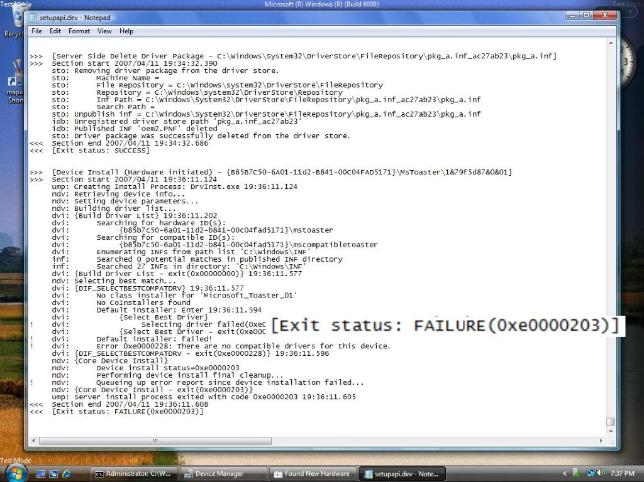

Slide 88
Walkthrough 4 Error staging driver to the driver store
We show the log after a failed attempt to stage a driver to the driver store
Use a modified Toaster Function Driver that has a bug (missing file)
Attempt to install the driver as in previous examples
Logging shows the staging process failure and which file is missing

Slide 89
Walkthrough 4 Error staging driver to the driver store
Bug introduced by specifying file in an INF CopyFiles= directive, but not adding the file to the package
[Toaster_Device.NT]
CopyFiles=Toaster_Device.NT.Copy
[Toaster_Device.NT.Copy]
toaster.sys
missingfile.dat ; ⬅ File not in package

Slide 90


Slide 91


Slide 92
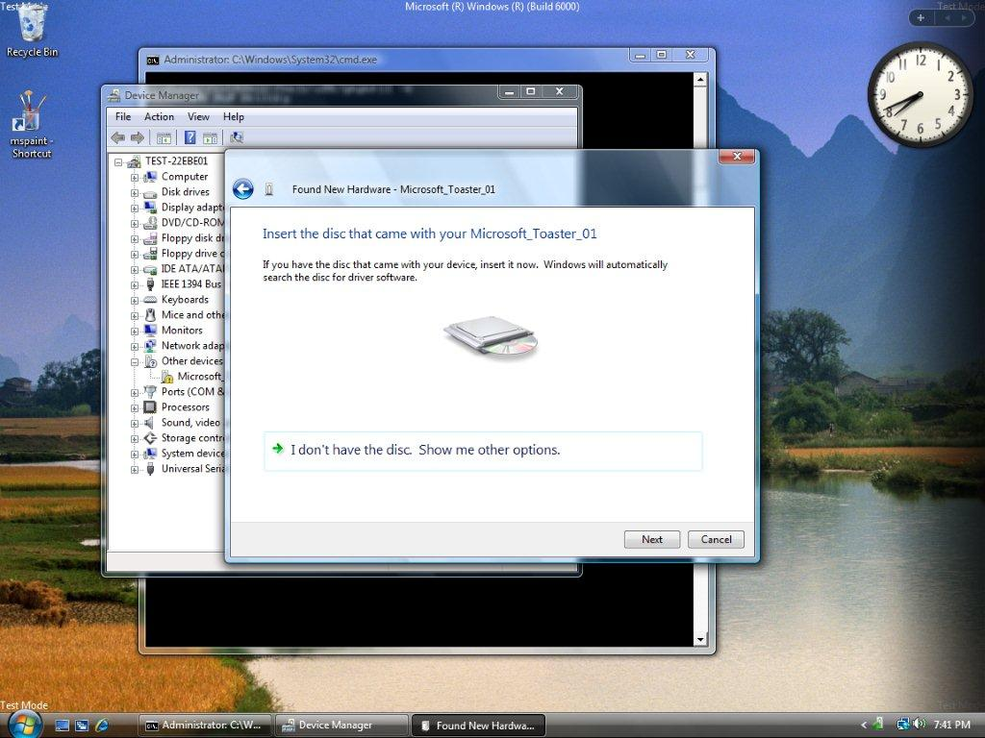

Slide 93


Slide 94


Slide 95


Slide 96


Slide 97
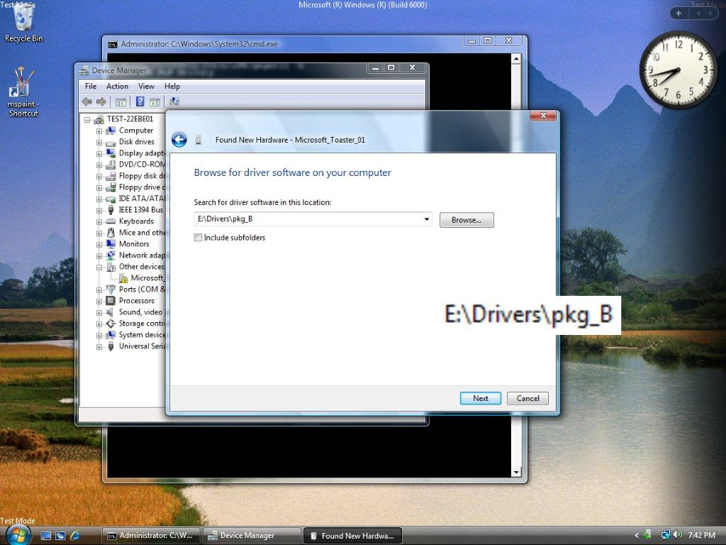

Slide 98


Slide 99


Slide 100


Slide 101


Slide 102


Slide 103


Slide 104


Slide 105


Slide 106


Slide 107


Slide 109


Slide 110


Slide 111
Device Driver Install Core device install overview
Non-interactive driver install process
Driver store is exclusive source for drivers
Class and co-installer stack is loaded and sent DIF_xxx code sequence
INF directives are translated to installation operations
File copies
Registry and Plug and Play properties
Service Control Manager

Slide 112
Device Driver Install Illustration of core device install
Windows Vista System
Driver Store
Display Driver
Keyboard Driver
Driver Install
Service
Mouse Driver

Slide 113
Device Driver Install Driver selected from driver store
Windows Vista System
Driver Store
Display Driver
Keyboard Driver
Driver Install
Service
Mouse Driver

Slide 114
Device Driver Install INF file of driver parsed for INF directives
Windows Vista System
Driver Store
Display Driver
Keyboard Driver
Driver Install
Service
INF
Mouse Driver

Slide 115
Device Driver Install Class installer loaded for device setup class
Windows Vista System
Driver Store
Display Driver
class
default
Keyboard Driver
Driver Install
Service
INF
Mouse Driver

Slide 116
Device Driver Install ”DIF_” code sequence sent to installers
Windows Vista System
Driver Store
Display Driver
class
default
Keyboard Driver
Driver Install
Service
INF
Mouse Driver

Slide 117
Device Driver Install DIF_INSTALLDEVICEFILES
Windows Vista System
Driver Store
Display Driver
class
default
Keyboard Driver
Driver Install
Service
INF
Mouse Driver

Slide 118
Device Driver Install DIF_REGISTER_COINSTALLERS
Windows Vista System
Driver Store
coinst
Display Driver
class
default
Keyboard Driver
Driver Install
Service
INF
Mouse Driver

Slide 119
Device Driver Install DIF_INSTALLDEVICE: Core operations
Windows Vista System
Driver Store
coinst
Display Driver
class
default
Keyboard Driver
Driver Install
Service
INF
Mouse Driver

Slide 120
Device Driver Install DIF_INSTALLDEVICE: Registry operations
Windows Vista System
Driver Store
coinst
Display Driver
class
default
Keyboard Driver
Registry
Driver Install
Service
INF
Mouse Driver

Slide 121
Device Driver Install DIF_INSTALLDEVICE: services added
Windows Vista System
Driver Store
Webcam Driver
coinst
Display Driver
class
default
Keyboard Driver
Service Control Manager
Driver Install
Service
INF
Mouse Driver

Slide 122
Device Driver Install DIF_INSTALLDEVICE: Device started
Windows Vista System
Driver Store
Webcam Driver
coinst
Display Driver
class
default
Keyboard Driver
Driver Install
Service
INF
Mouse Driver

Slide 123
Device Driver Install Core device installation complete
Windows Vista System
Driver Store
Webcam Driver
Display Driver
Keyboard Driver
Driver Install
Service
Mouse Driver

Slide 124
Device Driver Install Key debugging considerations
Driver install always runs in the
non-interactive system context, so no UI
No file prompts (missing file halts install)
No class or co-installer UI (hangs the install)
PnP terminates driver install process after 5-minute timeout
Class installers and co-installers are a trusted part of the install process

Slide 125
Walkthrough 5 Access violation in core device install
In this example we examine the log after a driver encounters an exception during core device install
Use a modified Toaster Function Driver that has a bug (Access Violation in the coinstaller)
Attempt to install the driver as in previous examples
Logging shows the driver successfully being staged, but encounters an exception when the coinstaller is called
Exception is handled by Setupapi, and the device installation fails

Slide 126
Walkthrough 5 Access violation in core device install
Bug is introduced by intentionally faulting on a null-pointer in the co-installer
case DIF_INSTALLDEVICE: {
LPTSTR NullPtrRefString = NULL;
NullPtrRefString[0] == L'A';
...

Slide 127


Slide 128


Slide 129


Slide 130


Slide 131


Slide 132


Slide 133


Slide 134


Slide 135


Slide 136


Slide 137


Slide 138


Slide 139


Slide 140


Slide 141


Slide 142


Slide 143


Slide 144


Slide 145


Slide 146


Slide 147


Slide 148


Slide 149


Slide 150


Slide 151


Slide 152


Slide 153


Slide 154
Walkthrough 6 Hang in core device install
In this example we show what appears in the log when a device driver installation hangs
Use a modified Toaster Function Driver that hangs during installation (co-installer tries to show UI in non-interactive context)
Attempt to install the driver as in previous examples
Logging shows the driver successfully being staged, but later hanging when the co-installer is called
Driver installation process is terminated after a timeout period

Slide 155
Walkthrough 6 Hang in core device install
Hang occurs because the co-installer attempts to display a message box during DIF_INSTALLDEVICE
case DIF_INSTALLDEVICE:
MessageBox(NULL,
"Hello?",
"Msg To Nobody",
MB_OK);
...

Slide 156


Slide 157


Slide 158


Slide 159


Slide 160


Slide 161


Slide 162


Slide 163


Slide 164


Slide 165


Slide 166


Slide 167


Slide 168


Slide 169


Slide 170


Slide 171


Slide 173


Slide 174


Slide 175


Slide 176


Slide 177


Slide 178


Slide 179


Slide 180


Slide 181


Slide 182


Slide 183


Slide 184


Slide 185


Slide 186


Slide 187
Walkthrough 6 continued Viewing WER data
Driver installation errors reported to Windows Error Reporting (WER)
WER data is stored locally on machine
At user’s option, can be sent to Microsoft for analysis
Files may be displayed by
WERCON.EXE (Windows Error Reporting console application)
Control Panel/System and Maintenance/Problem Reports and Solutions

Slide 188


Slide 189


Slide 190


Slide 191


Slide 192


Slide 193
Walkthrough 4
Walkthrough 5
Walkthrough 6

Slide 194


Slide 195


Slide 196


Slide 197


Slide 198


Slide 199


Slide 200


Slide 201


Slide 202
Class And Co-Installer Logging
Class installers and co-installers can integrate seamlessly into SETUPAPI.DEV.LOG
Log functions introduced on Vista
Use LoadLibrary/GetProcAddress to avoid link errors on older Setupapi versions
case DIF_INSTALLDEVICE: {
SP_LOG_TOKEN logToken = SetupGetThreadLogToken(); SetupWriteTextLog(
logToken,
TXTLOG_VENDOR,
TXTLOG_ERROR,
"Unable to configure widget settings!");
return ERROR_BAD_CONFIGURATION;

Slide 203


Slide 204


Slide 205
Call To Action
Use SETUPAPI.DEV.LOG to diagnose device installation issues
Use Pnputil to test and verify behavior of the driver store
To add logging in your installer DLLs, use
SetupGetThreadLogToken()
SetupWriteTextLogError()

Slide 206
Additional Resources
Web Resources
Installation on WHDC Web Site http://go.microsoft.com/fwlink/?LinkID=79354
Debugging Device Installation in Windows Vista: http://www.microsoft.com/whdc/driver/install/diagnose.mspx
Device Installation Rules for Windows Vista: http://go.microsoft.com/fwlink/?LinkID=79365
Device Installation on MSDN
Device Installation in the WDK http://go.microsoft.com/fwlink/?LinkID=79294
Setting SetupAPI Logging Levels http://msdn2.microsoft.com/en-us/library/ms791349.aspx

Slide 207



Please Complete A Session Evaluation Form Your input is important!
Visit the WinHEC CommNet and complete a Session Evaluation for this session and be entered to win one of 150 Maxtor® BlackArmor™ 160GB External Hard Drives 50 drives will be given away daily!
http://www.winhec2008.com
BlackArmor Hard Drives provided by:

Slide 208


© 2008 Microsoft Corporation. All rights reserved. Microsoft, Windows, Windows Vista and other product names are or may be registered trademarks and/or trademarks in the U.S. and/or other countries.
The information herein is for informational purposes only and represents the current view of Microsoft Corporation as of the date of this presentation. Because Microsoft must respond to changing market conditions, it should not be interpreted to be a commitment on the part of Microsoft, and Microsoft cannot guarantee the accuracy of any information provided after the date of this presentation. MICROSOFT MAKES NO WARRANTIES, EXPRESS, IMPLIED OR STATUTORY, AS TO THE INFORMATION IN THIS PRESENTATION.

