Slide 1
COR-T544 Intel Sponsor Session Making Technology and Products Matter for Developers
Jim Fister
Lead Strategist
Intel Corporation

Slide 2

This presentation is for informational purposes only. INTEL MAKES NO WARRANTIES, EXPRESS OR IMPLIED, IN THIS SUMMARY.
BunnyPeople, Celeron, Celeron Inside, Centrino, Centrino logo, Core Inside, Dialogic, FlashFile, i960, InstantIP, Intel, Intel logo, Intel386, Intel486, Intel740, IntelDX2, IntelDX4, IntelSX2, Intel Core, Intel Inside, Intel Inside logo, Intel. Leap ahead., Intel. Leap ahead. logo, Intel NetBurst, Intel NetMerge, Intel NetStructure, Intel SingleDriver, Intel SpeedStep, Intel StrataFlash, Intel Viiv, Intel vPro, Intel XScale, IPLink, Itanium, Itanium Inside, MCS, MMX, Oplus, OverDrive, PDCharm, Pentium, Pentium Inside, skoool, Sound Mark, The Journey Inside, VTune, Xeon, and Xeon Inside are trademarks or registered trademarks of Intel Corporation or its subsidiaries in the United States and other countries.
*Other names and brands may be claimed as the property of others.
Copyright © 2008, Intel Corporation. All rights reserved.

Slide 3
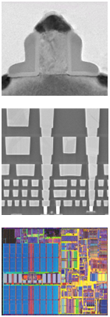
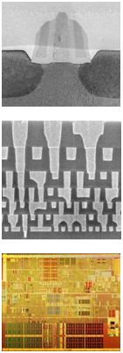
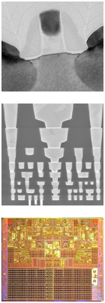
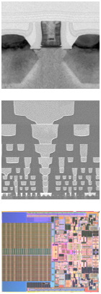
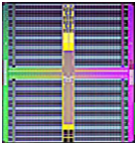
On-Time 2 Year Manufacturing Cycles The “Tick” of Tick-Tock
130 nm
2001
90 nm
2003
65 nm
2005
45 nm
2007
32 nm
2009*
291 Mbit
SRAM
2nd gen.
HK+MG
Sep. 2007
*Forecast.
Notes:
3
3

Slide 4
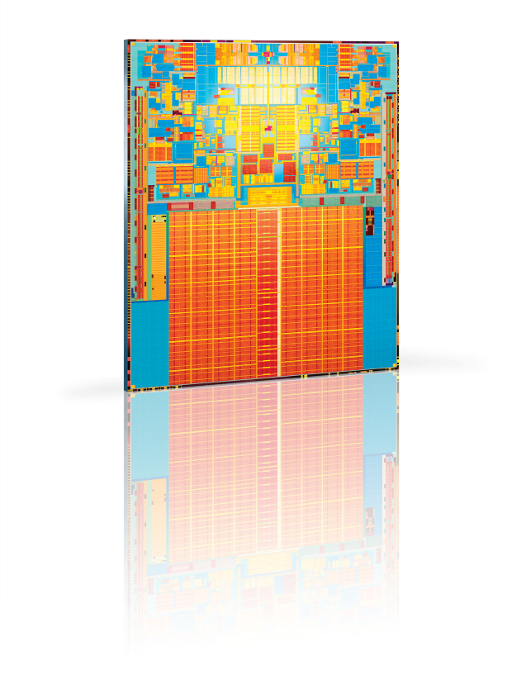
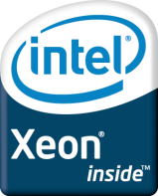

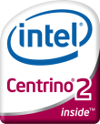
Boosting Performance, Lowering Power
Latest CPUs from Intel, built on industry-first 45nm
Eco-Friendly
Faster
‘Cooler’
Server
Desktop
Mobile
TIME
Voted one of “The Best Inventions of the Year” by Time Magazine, Nov. 2007
A 45nm transistor can switch on and off ~300 Billion times/second
Did you Know?
Light travels less than 1/10th of an inch in the time it takes a 45nm transistor to switch on and off

Slide 5
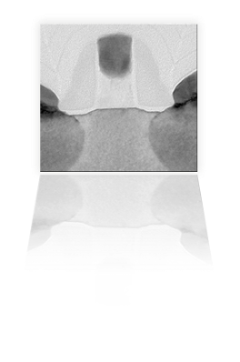
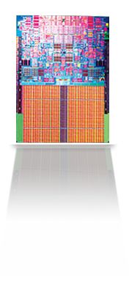
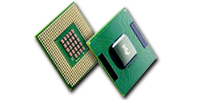
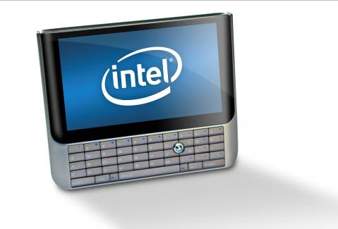
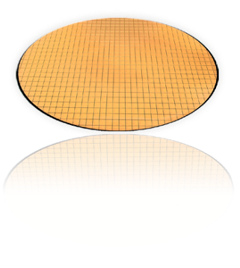
Investing In Technology Innovations
Silicon Process
Technology
Microarchitecture Design
Processor Technologies for Platforms
Platform
Technologies

Slide 6
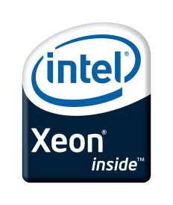
Generational Leaps Energy Efficiency: Mainstream servers
Exceptional Performance per Watt
Energy Efficient Quad-Core
Leading 45nm Hi-K Process Technology
Stable System Power (Watts) – Lower is better
Higher Performance
Higher is better
Measured System Power in Watts during benchmark steady state, relative results shown
Measured in Business Operations Per Second Higher is better SPECjbb*2005 benchmark
Xeon 3.80 – 64-bit Intel® Xeon® Processor 3.80GHz; Xeon 51xx – Dual-Core Intel® Xeon® Processor 51xx; Xeon 53xx – Quad-Core Intel® Xeon® Processor 53xx; Xeon 54xx – Quad-Core Intel® Xeon® Processor 54xx; Data source: Published/Measured/Submitted results as of Nov 12, 2007. See backup for details
Performance tests and ratings are measured using specific computer systems and/or components and reflect the approximate performance of Intel products as measured by those tests. Any difference in system hardware or software design or configuration may affect actual performance. Buyers should consult other sources of information to evaluate the performance of systems or components they are considering purchasing. For more information on performance tests and on the performance of Intel products, visit http://www.intel.com/performance/resources/limits.htm Copyright © 2007, Intel Corporation. * Other names and brands may be claimed as the property of others.
Notes:
6

Slide 7
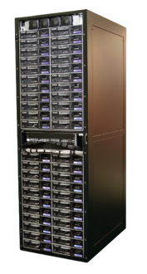
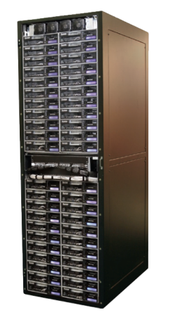

Moore’s Law In Action: DATA CENTER OPTIMIZATION
BUSINESS REQUIREMENT: Deliver 5.1 million business operations per second using 45nm Quad-Core Intel® Xeon® processor 5400
2004
5.1M bops
6 racks
126 Servers
240 sq ft
48 kW
Today
5.1M bops
1 rack
17 Blades
40 sq ft
6 kW
BOTTOM LINE BENEFITS for IT
Floor Space
83%
REDUCTION
Annual Energy Costs
87%
REDUCTION
Energy Savings
$53k
SAVINGS
Source: Comparison of SPECjbb2005 bops (business operations per second)

Slide 8


Intel® Enterprise Roadmap
2008
Future
Intel® Itanium®
9000 Sequence
(Mission Critical)
Itanium Processor
870 / OEM Chipset
Future MC Chipset
Kittson
Tukwila
Poulson
Intel® Xeon® MP
7000 Sequence
(Expandable)
Quad/Dual-core Xeon Processor
Intel® 7300 Chipset
Nehalem Processor
Future EX Chipset
Dunnington
Quad/Dual-core Xeon Processor
Intel® 5000 Chipset
Nehalem Processor
Future EP Chipset
Intel® Xeon® DP
5000 Sequence (Efficient Performance)
Quad/Dual-core Xeon Processor
Intel® 5100 Chipset
Nehalem Processor
Future EP Chipset
Intel® Xeon® UP 3000 Sequence
(Entry)
Quad/Dual-core Xeon Processor
Intel® 3200 Chipset
Nehalem Processor
Future EN Chipset
Intel® Xeon® WS
5000 Sequence (Workstation & HPC)
Quad/Dual-core Xeon Processor
Intel® 5400 Chipset
Nehalem Processor
Future WS Chipset
All dates, product features and plans are subject to change without notice.
Notes:
8
8

Slide 9
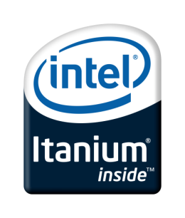
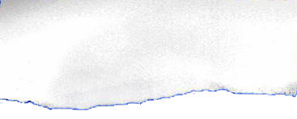
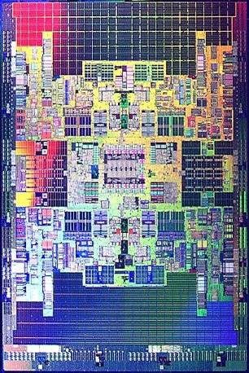
Itanium® Platform: Tukwila
“With Intel’s upcoming quad-core Tukwila processor, Windows Server solutions running on Itanium-based systems will provide an even more scalable, reliable, agile and dynamic datacenter foundation for our customers.”
—Bill Laing, GM Windows Server & Solutions Division, Microsoft
Quad-core with 30 MB cache
2 billion transistors
Multi-Threading Technology
Intel QuickPath interconnect
Dual Integrated Memory Ctrlrs
Estimate >2x* performance
‘Mainframe-class’ RAS
Itanium® Solutions Alliance. All rights reserved.
9
Notes:
9

Slide 10
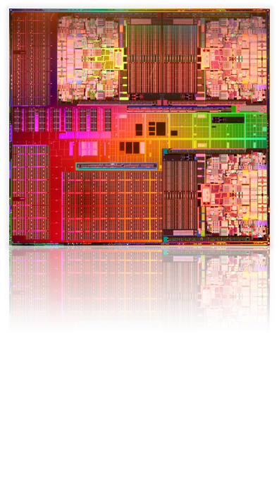
Xeon® Processor Expandable XPF 7400 Series Processor
6 core Processor
1.9 billion transistors
45nm Hi-K technology
16 MB L3 cache
Latest Intel virtualization capabilities
Socket compatible with existing platform
Available 2H’08
cores
cores
cache
system interface
cores
cache

Slide 11




Technologies to Address IT Challenges
Technologies to Enhance IT
Energy Efficient Performance
Dynamic Resource Pooling
Data Intensive Computing
Power Management
Virtualization
Performance

Slide 12
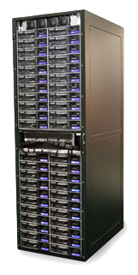
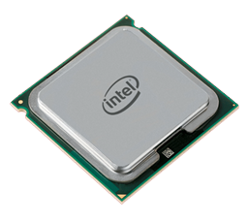


Enabling Datacenter Optimization Intel Approach to Energy Efficiency
Lower Power Components
Increasing Efficiency
Rack Optimization
Power Management
Core µArch
Quad-Core to 80W
LV to 50W
Virtualization
Accelerate refresh
Power Management
Cryptographic Acc.
Monitored power
Optimization tool
Set power limits
VM balancing
Rules based load balancing
20+ kW/rack
Enabling the Industry to meet the EPA’s Energy Star* Specification
PG&E Rebate program for Virtualization
Joined Green Grid Initiative
Industry
Involvement

Slide 13
Virtualization Evolution Key Usages
Virtualization 1.0
Virtualization 2.0+
Dynamic Data Center
Consolidation
Availability/Continuity
App
1
App
2
App
3
App
4
App
App
App
App
OS
OS
OS
OS
OS
OS
OS
OS
VMM
VMM
VMM
VMM
HW
HW
VMM
HW
HW
HW
Test & Development
R&D Production
Virtual Clients
Fault tolerance
App
App
OS
OS
App
App
App
OS
OS
VMM
OS
VMM
VMM
HW
VMM
HW
HW
HW

Slide 14
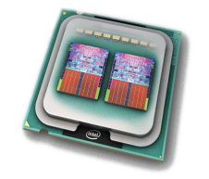

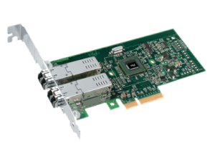
Intel’s Virtualization Innovation
Intel VT for Intel 64 and Itanium
FlexMigration for VM migration
FlexPriority for interrupt virtualization
Extended Page Tables
Virtual Processor IDs
Intel VT for Directed I/O
DMA Remapping
Interrupt Remapping
Address Translation Caching
Intel VT for Connectivity
VM Network device queues
Intel Active in Industry Standards
PCI-SIG I/O virtualization
Virtualization benchmarks
Processor
Core Platform
Network & Storage
Standards

Slide 15
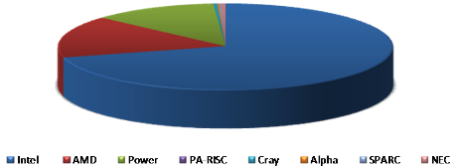
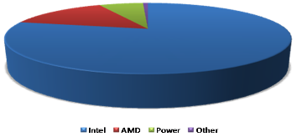
Intel Leading The Way In HPC
November 2007 Top500 Entries by Processor Brand
Intel supports >70% of the world’s fastest supercomputers
Source: Nov ’07 Top500.org
2007 Percent of Total Processors Shipped
In 2007, Intel supplied approximately 4 out of every 5 processors
Source: Q4’07 IDC Qview
Notes:
15

Slide 16
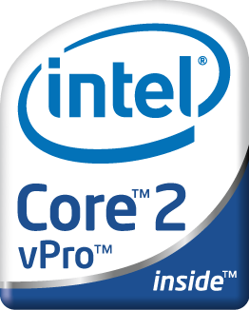
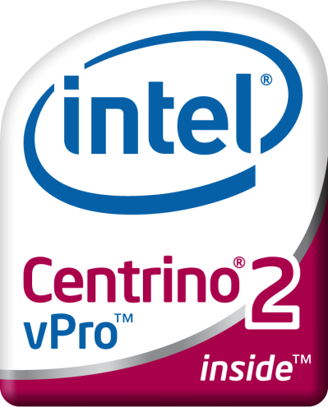
Clients Built For Business
Intel® Core™2 and Intel® Centrino® 2 processors with
Intel® vPro™ technology
Proactive Security
Built-in Manageability
Energy Efficient Performance
16

Slide 17
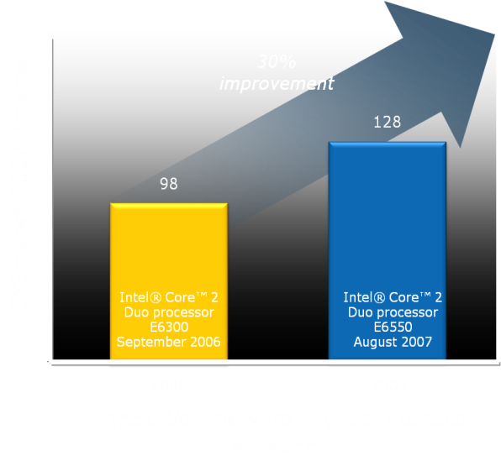
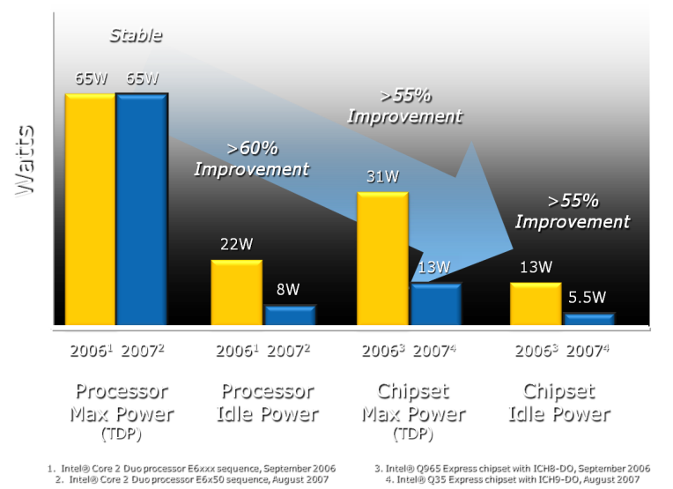
A Leap Forward In Performance…
Significant Reductions in Power
Even more power savings
Turn PCs off at night
Wake to patch
=
17
*Other brands may be claimed as the property of others.
Source: Intel. See Backup for system configurations and important information
Notes:
17

Slide 18
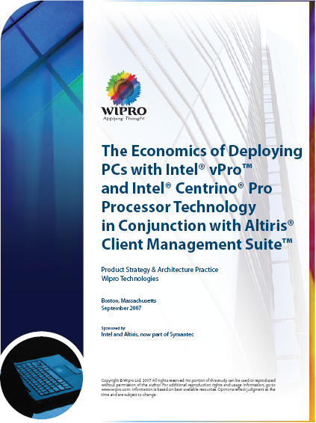
Demonstrated Customer Improvements
Enterprises with 30k desktop and 10k notebook on 3 yr refresh projected to save $16M+ with Intel vPro technology
Enterprises with 3k desktop and 1k notebooks on 3 yr refresh projected to save $1.5M
Incremental activation of Intel vPro technology-based PCs yields 50% better savings versus one-time activation
Time To Patch 1000 PCs 86%
Desk side Visits, Software Problems
91%
Time To Achieve
Patch Saturation
94%
User Downtime, Software Issue, Remote Site
98%
Successful After-hours System Inventory
94%
Sources: Case Studies with Intel® vPro™ processor technology, An Analysis of Early Testing of Intel® vPro™ processor technology in Large IT Departments, Charles Le Grand, Mark Salamasick, April 2007
The Economics of Deploying PCs with Intel® vPro™ and Intel® Centrino® Pro Processor Technology in Conjunction with Altiris® Client Management Suite™, WiPro Technologies, September 2007
18

Slide 19
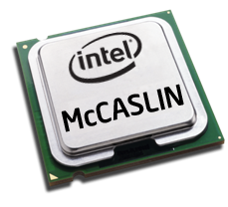
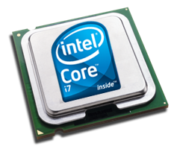
Nehalem Family
Server and
Workstation
Efficient Performance (2S)
Expandable (4S+)
Nehalem-EP
Nehalem-EX
Business and Consumer Clients
High End Desktop
Mainstream Client
Havendale
Lynnfield
Thin and Light Notebook
Auburndale
Clarksfield
Notes:
19
19

Slide 20
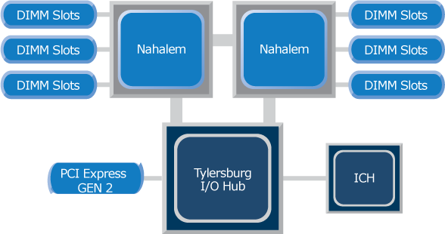
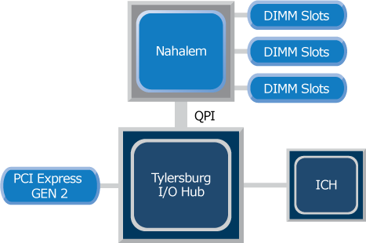
Efficient Performance Platforms (High End Desktop and Server/Workstation)
Server
Desktop
Intel® QuickPath Interconnect
New point to point interconnect
2 links per CPU socket
Up to 25.6 Gb/sec total bandwidth/link
Integrated Memory Controller
Next Gen DDR3 memory
3 channels per processor
Massive Bandwidth
Memory Latency Reduction
Latency Decrease and Bandwidth Increase over Prior Generation

Slide 21
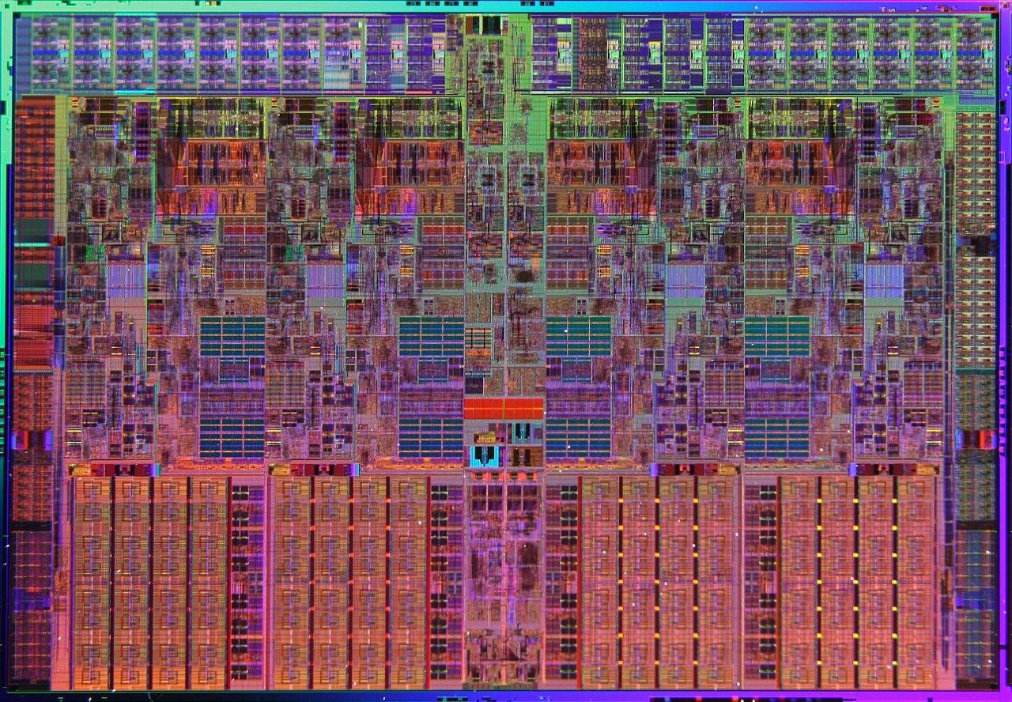
Nehalem Microarchitecture Dynamically Scalable and Innovative New Design
Scalable from 2 to 8 cores
Microarchitecture enhancements (4-wide)
2-way simultaneous multi-threading
Integrated memory controller
QuickPath interconnect
Shared Level-3 cache
Dynamic power management
SSE 4.2
Production: Q4’08
Integrated Memory Controller – 3 Ch DDR3
Core 0
Core 1
Core 2
Core 3
Q P I
Shared L3 Cache

Slide 22

Integrated Power Gate
VCC
Clock Gate
Standard in all Intel CPUs
Eliminates switching power
Leakage power remains
Power Gate: New
Eliminates switching and leakage power
Enables idle cores to go to near zero power (C6) independently
Transparent to platform and software
No incremental platform cost
Core0
Core1
Core2
Core3
Memory System, Cache, I/O
VTT

Slide 23
Turbo Mode W/Nehalem
Frequency (F) Steps
+1
+1
+1
+1
Base
Base
Base
Base
Thermal
Base
Base
Base
Base
Case Temp
Current
Core 0
Core 1
Core 2
Core 3
Core 0
Core 1
Core 2
Core 3
Turbo Mode converts thermal headroom into higher frequencies
Notes:
23

Slide 24
Turbo Mode W/Nehalem
+3
+3
+2
+2
Frequency (F) Steps
+1
+1
Base
Base
Base
Base
Thermal
Base
Base
Case Temp
Current
LFM
LFM
Core 0
Core 1
Core 2
Core 3
Core 0
Core 1
Core 2
Core 3
Enables higher performance for low threaded applications
Notes:
24

Slide 25
Nehalem − Efficient Performance
Outstanding Performance
Best in class bandwidth with QPI up to 25.6 GB/s
DDR3 and supports 18 DIMM up to 288 GB
Energy Efficient
Performance on demand with Turbo mode
Dynamic power management
Stream Bandwidth – Mbytes/Sec (Triad)
Higher Is Better
33376
3.4X
9776
6102
HTN 3.16/ BF1333/
HTN 3.00/ SB1600/
NHM 6.4 QPI/
667 MHz mem
800 MHz mem
1066 MHz mem
World’s Most Adaptable Server and Client Platforms
Source: Intel Internal measurements – August 2008

Slide 26

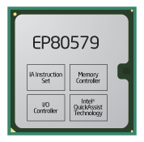
Faster Smaller Cooler Silicon For The Next Billion Connected Devices
Traditional Intel Architecture
New Low Power Intel Architecture & SOCs
Desktop
Server
Fan-less
Ultra Low Power (<5W)
Small Footprint
Launched Q2’08
Small Foot Print
Low Power
Integrated Comms
Purpose built
Launching Q3’08
Mobile
Smaller – Cooler - Faster
Notes:
26

Slide 27


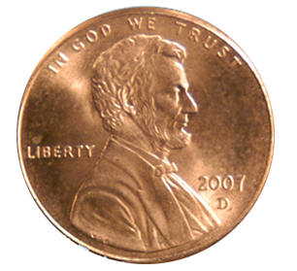
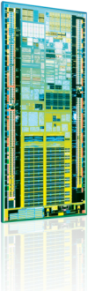
Intel® Atom™ Processor
Intel’s smallest processor built with the world’s smallest transistors
< 25 mm2 die size
45nm High-K CMOS
47 million transistors
Intel’s lowest power CPU
0.65-2.4 watts TdP1
Low average power2 (160-220mW)
Low idle power3(80-100mW)
Fastest processor in
sub 3W space
800MHz – 1.86Ghz
533MHz & 400MHz FSB
HT Technology1
Intel Digital Media Boost
Ground Up Design with Intel ®
Core™ 2 Duo ISA Compatibility
Intel Virtualization Technology
SSE3, SSSE3 Support
HT Technology can add 200mW of power above quoted TDP for HT SKUs when multi-threaded applications are run.
Average power is defined as measured CPU power whilst running BAPCo MobileMark’05 Office Productivity suite on Microsoft* Windows* XP for a period of 90min at 50°C .
Idle power is measured when running Windows Vista in idle at 50C

Slide 28
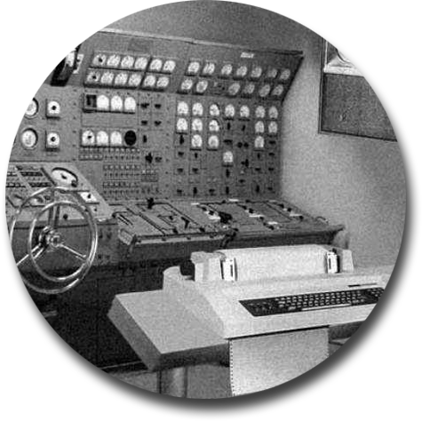

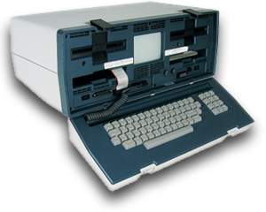
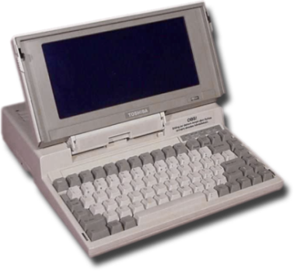

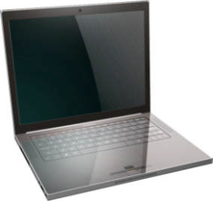
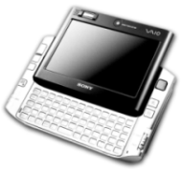
Carry Small/Live Large
A Vision of tomorrow’s mobile device
Carry essential computational resources
More compute & graphics power
Anytime, anywhere connectivity
Sensors to understand world around you
Platform-wide power efficiency
What devices will you be buying tomorrow?
Notes:
28

Slide 29
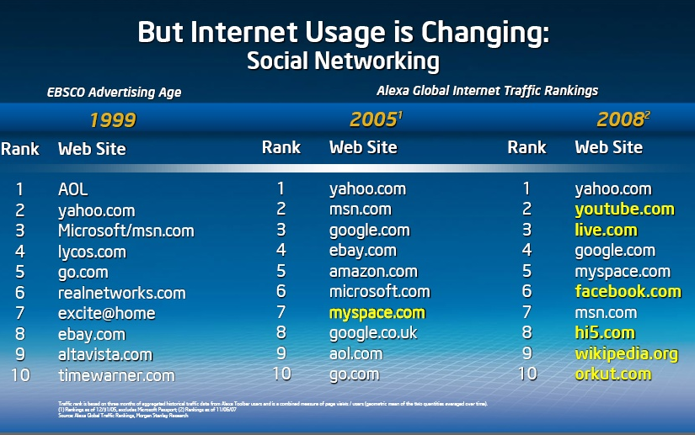

Slide 30
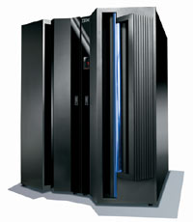



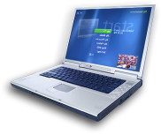


Cloud Computing Evolution
70s / 80s
Mid 90s / early 00s
Today +
Timesharing
ASPs
Cloud Computing
Mainframe
Hosting
Software as a Service
Platform as a Service

Slide 31

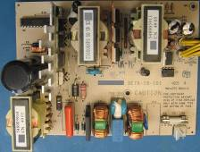



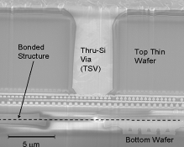

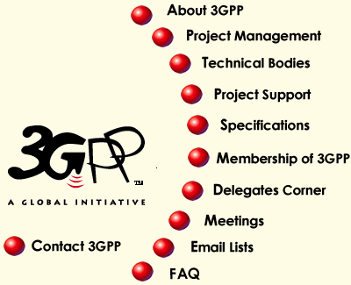



Driving Innovation Through Research
Energy Efficiency
New Device Classes
Wireless & Comms
Memory & Storage
TERA-SCALE
COMPUTING
Intel continues to invest in new technologies

Slide 32




Visual Computing Acquiring, Analyzing, Modeling and Synthesizing Visual Workloads
Photorealistic 3D Rendering
Immersive User Interface
High Definition Audio, Video
Computational Modeling
Programmable, Ubiquitous, and Unified Architecture

Slide 33

Seismic Imaging/Modeling Algorithms
Relative resources
(Mem., BW, Interconnect., I/O)
1000
Full waveform inversion
Memory BW
Sensitivity
100
RTM &/or 3D FD
(elastic)
High
Moderate
RTM &/or 3D FD
(acoustic)
10
LOG Scale
Low
RTM = Reverse Time Migration
FD = Finite Difference
Common Shot WEM
1.0
Common azimuth WEM
Kirchhoff
3D PsDM
Beam Migration
(Kirchhoff based)
0.1
PSTM
1995
2000
2005
2010
Time
Energy Simulation Science Stretching Processor, Bandwidth & Memory Technologies

Slide 34

Delivering Photo Realism at light speed
“Multi-threaded processors are enabling ray-tracing to reach new levels of realism, content generation, & quality previously unheard of in our industry.”
Richard Jones,
Vice President of Alias at Autodesk

Slide 35
















Intel Visualization Engine
Virtualization, QPI, FBD, IOAT, SMT, Cluster Ready
Chipsets
Networking
Storage
Silicon Tech
Industry Standards Leadership
Platform
Architecture
Multi Core Processors
New Instruction Extensions
A car deforms in an asymmetrical crash
Graphics
Intel® Core™ Microarchitecture
Compute
Larrabee
SW Development
Optimized algorithms
~ Ray tracing
~ Clash
Visualization of the vertical structure of a typical hurricane
Providing the tools to solve your greatest computing and visualization challenges

Slide 36


Vision Multi-Core And Many-Cores
Software works seamlessly across multi, many-core and future heterogeneous architectures
All Large Core
Mixed Large and
Small Core
All Small Core
Energy Efficient Performance with Multi-threaded Cores
Note: the above pictures don’t represent any current or future Intel products

Slide 37
Summary – Key Messages
Technology is providing tremendous gains in performance and energy efficiency
New server platforms deliver performance, virtualization, efficiency for IT’s needs
Client platforms deliver manageability, security, and efficient performance
Next-generation Nehalem processors advance the server and client platforms
The Atom processor will influence IT in the future to provide the next billion connected devices
Visual Computing requires new thinking in software and hardware implementations

Slide 38



Slide 39



Please Complete A Session Evaluation Form Your input is important!
Visit the WinHEC CommNet and complete a Session Evaluation for this session and be entered to win one of 150 Maxtor® BlackArmor™ 160GB External Hard Drives 50 drives will be given away daily!
http://www.winhec2008.com
BlackArmor Hard Drives provided by:

Slide 40


© 2008 Microsoft Corporation. All rights reserved. Microsoft, Windows, Windows Vista and other product names are or may be registered trademarks and/or trademarks in the U.S. and/or other countries.
The information herein is for informational purposes only and represents the current view of Microsoft Corporation as of the date of this presentation. Because Microsoft must respond to changing market conditions, it should not be interpreted to be a commitment on the part of Microsoft, and Microsoft cannot guarantee the accuracy of any information provided after the date of this presentation. MICROSOFT MAKES NO WARRANTIES, EXPRESS, IMPLIED OR STATUTORY, AS TO THE INFORMATION IN THIS PRESENTATION.

