Slide 2
Power-Performance Benchmarks Design Challenges
Rema Hariharan
Paul Muehr
Andy Rawson
Advanced Micro Devices, Inc.

Slide 3
Power-Performance Benchmark Design Presentation Overview
About the authors
Importance of Power-performance Benchmarking
Power-performance Benchmarks – Design Considerations
Power-Performance Benchmark Interpretation – Example
More Specific Issues
Design Decisions for SPECpower_ssjTM2008
SPECpower_ssj2008 - Measurement Setup
SPECPower_ssj2008 - Typical Run
SPECpower_ssj2008 – Observations
Call to Action
Additional Resources
Q & A
SPECpower_ssjTM is a trademark of the Standard Performance Evaluation Corporation

Slide 4
About the Authors
Rema Hariharan
AMD Senior Member Technical Staff, Performance COE
Chair, SPECweb committee
Paul Muehr
AMD Member Technical Staff, Performance COE
Member, SPECpower committee
Andy Rawson
AMD Senior Member Technical Staff, System Architecture
Member of The Green Grid Technical Committee and Leader of Data Center Productivity Taskforce

Slide 5
Importance of Power-performance Benchmarking
Historically power consumption was ignored in performance benchmarking
Recently power consumption has become a major issue
Power cost is now a significant component of TCO for a server
Government regulatory bodies are now focusing on power consumption
Trends in computing power: exponential power and performance increases
Can’t just cap power; need to look at performance as a function of power (performance / watt)

Slide 6
Importance of Power-performance Benchmarking (Continued)
Drive a more balanced trade-off between power consumption and performance in server design
Customers of new power-performance benchmarks
System vendors, IT equipment buyers, IT managers, energy policy makers (worldwide)
Used to help guide equipment selection process
Not necessarily useful in optimizing energy consumption after installation
This is where operational metrics like Data Center Infrastructure Efficiency and Data Center Energy Productivity become useful

Slide 7
Power-Performance Benchmarks Design Considerations
GOAL: Useful in predicting actual energy use and power demand in a real-world application
Servers don’t run at 100% of theoretical performance all of the time
Should address load fluctuations and less than 100% load conditions
Intermediate load points demonstrate performance as a function of power
Most servers spend significant time idling
Average server utilization in data centers is estimated to be 15%*
Under these conditions, power management capabilities have a real impact on average energy use
* EPA Report to Congress on Server and Data Center Energy Efficiency, August 2, 2007

Slide 8
Power-Performance Benchmarks Design Considerations (Continued)
Diversity in Server Types and Workloads
No “one size fits all” workload
Results depend on environmental conditions
Ambient temperature, humidity, air pressure, and flow rate
Caveats and Issues
For some workloads modulating demand is not natural
Limits data points to idle and peak load
Variance in actual power numbers
Multiple performance / power points creates the issue of how to summarize the benchmark in a single numerical score

Slide 9
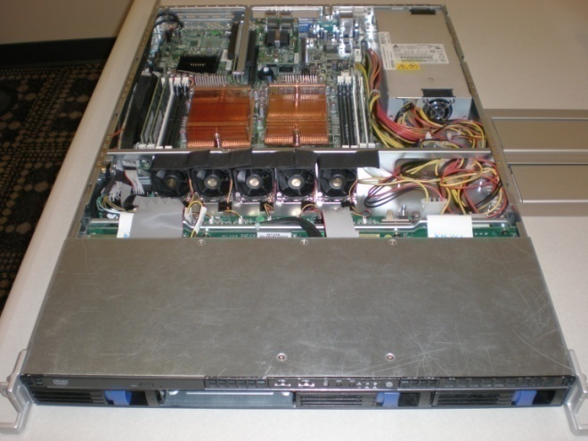
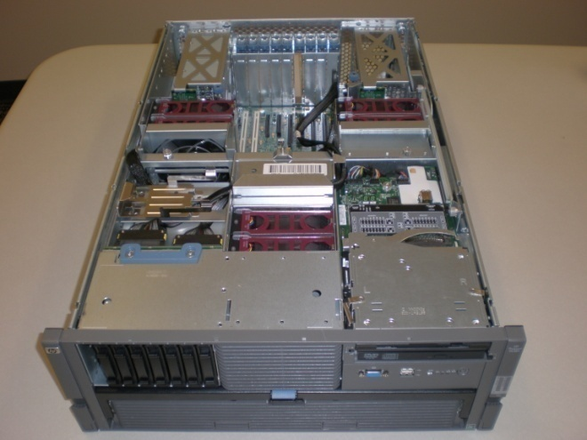
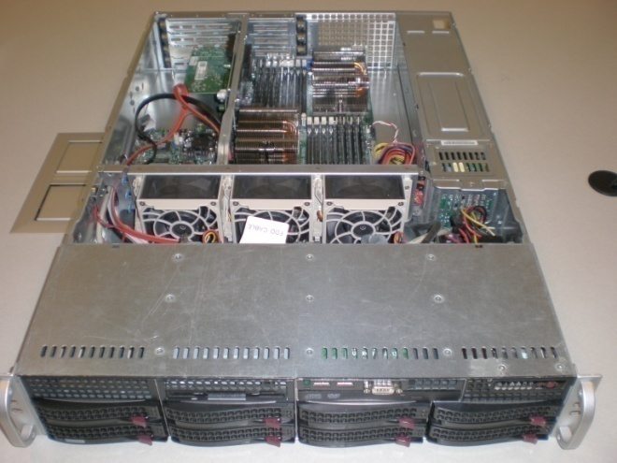
Power-Performance Benchmark Interpretation - Example
Differing Design Points
2U, 2 Processors Med, Redundant PSU* 16 DIMM slots
8 SATA Hardfiles
1U, 2 Processors Small, Single PSU 8 DIMM slots
4 SATA Hardfiles
4U, 4 Processors Large, Redundant PSU* 32 DIMM slots
8 SAS Hardfiles
*Capability; Single PSU shown

Slide 10
More Specific Issues
How to Measure Performance
Fixed Time or Fixed Workload?
Compare Performance to Power or Energy?
Often used interchangeably, power and energy are different but related physical quantities
Which quantity to use is determined by how performance is quantified
Need a methodology to determine peak loading and set intermediate load points
Well defined and reproducible procedure for determining system power at the different load points
Time correlation of two fundamentally different physical quantities (e.g., performance and power)

Slide 11
Design Decisions for SPECpower_ssjTM2008
Used the fixed time approach to measuring performance
Performance expressed in ssj_ops/sec, therefore measure power, not energy
Measure total system power (AC input power)
An automation program directs phases of the benchmark and gathers power measurements from power meters
First phase (calibration) establishes the request rate necessary to obtain the peak performance for the system under test (100% load reference point )
Sets load levels below 100% by modulating requests
Automates process of time correlating measurement

Slide 12
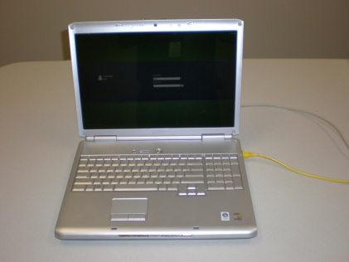
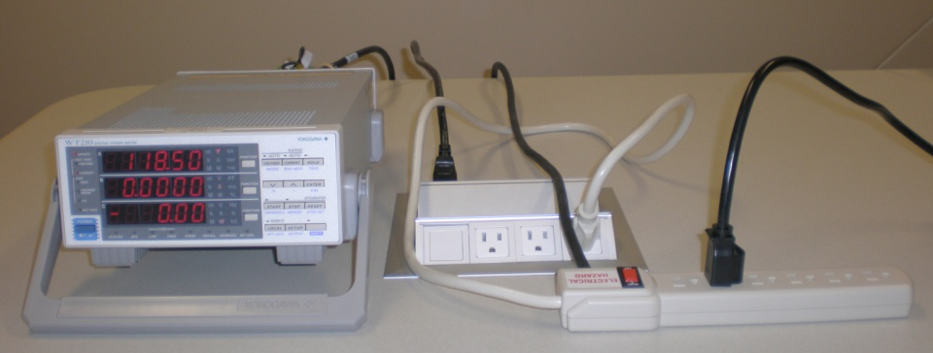
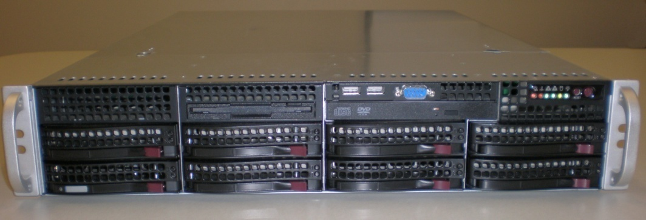
SPECPower_ssj2008 Measurement Setup
Test Monitor
Serial
Ethernet
SUT AC Line Cord
Power Meter
System Under Test

Slide 13
SPECPower_ssj2008 Typical Run
Power (Watts)

Slide 14
SPECpower_ssj2008 Observations
48 submissions have been published as of 9/30/08
Almost exclusively lightly configured
98% of submissions are 2P or less
SPECpower committee acknowledges that ssj is “only one workload” ...targeting “volume server class”
SPEC is helping other benchmarks incorporate power measurements

Slide 15
Call To Action
Understand Power-Performance Benchmarking
Hardware Engineers:
Establish your system’s power-performance design goals
Provide facilities for power management
Software Engineers / Programmers:
Use platform hardware capabilities to manage power
Provide power optimization policies
Future: Power-aware programming?

Slide 16
Additional Resources
For more on SPECpower_ssj2008:
Design Methodology: www.spec.org/power_ssj2008/docs/SPECpower-Methodology.pdf
Posted Results: http://spec.org/power_ssj2008/results/
For more on The Green Grid
See URL: http://www.thegreengrid.org/

Slide 17
Power-Performance Benchmark Design
Q & A

Slide 18
Scalable Windows In Mission Critical Environments With HP Integrity Servers
Nicole Saeger
Program Manager Hewlett Packard

Slide 19
Agenda
Benefits of Windows Integrity solutions
Unmatched MS/HP Relationship
Always Scalable
Leading Performance
Increased Scalability Announcement
Always Available
Compelling TCO/Consolidation
Closing/Questions

Slide 20



HP Integrity – Trusted Expertise, Proven Solutions For Enterprise Windows
Business-critical capabilities for your most demanding workloads
ALWAYS SCALABLE
Unmatched HP/Microsoft Partnership
Leading Windows scalability and performance for most demanding workloads
Superior solutions driven by deep enterprise
Windows expertise and experience
ALWAYS AVAILABLE
Mainframe-level Reliability, Availability, and Disaster Tolerance
COMPELLING TOTAL COST OF OWNERSHIP
Extensive manageability portfolio and flexible server utilization for business critical environments
Notes:
Presentation Title
20

Slide 21



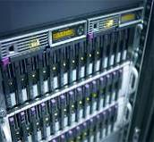
Integrity Servers With Windows/SQL Server Optimized For Business-critical Workloads
Driving Line of Business applications with a powerful, lower-TCO RISC/mainframe alternative
Database scale-up
OLTP workloads
BI/DW workloads
Server Consolidation
SAP on SQL Server
11 November 2008
21
Notes:
Presentation Title
21

Slide 22
Delivering Bottom-line Results Across A Range Of Demanding Workloads With HP Integrity And Windows
Consolidation
$1 million in savings in 2.5 years
Consolidated 15 servers to 9
4-hour reduction in nightly batch processing
Rapid deployment/reduced complexity in SAP upgrade
Kindred Healthcare
Healthcare, North America
SAP Migration
40% annual savings with move from mainframe & Sun solution
Saved €10.5 million a year via reduced staffing needs
Increased reliability, scalability and price/performance
PGGM
FSI, EMEA
Line of Business
83% faster critical batch process run times
Cut SAP R/3 response times in half
100 per cent Integrity uptime over first year
Indigo Lighthouse
Computer Services, EMEA
Scale-up
Real-time tracking of inventory, production cycles, stock mgmt.
Reduced total cost of ownership
Improved quality of service
HTL International Manufacturing, AP
BI
30-100+% performance improvement
Queries that took 22 hours now take 45 minutes
Used data mining to pinpoint most profitable accounts
Grew database from 6 to 12 TBs with Integrity
PREMIER Bankcard
FSI, North America
Notes:
Presentation Title
22

Slide 23
Unmatched HP/Microsoft Partnership
20+-year HP-Microsoft partnership with over a decade of joint development on Itanium® solutions
Joint Engineering to deliver robust Windows Itanium solution
Core enablement of OS across all Integrity platforms
Co-development of new features for further scale-up of Windows in the enterprise
Microsoft’s 64-bit Itanium development platform
Leverage engineering engagement s with Microsoft for Integrity customer benefit
SQL Server Performance and Scalability
Work with MS SQL Server team to ensure optimum scalability and performance with SQL Server 2008 on Integrity
Improve scalability of SQL Server add-ons like Analysis Services and Integration Services
Assist with POCs that occur in Microsoft Enterprise Engineering Center (EEC)
Three-time Microsoft "Global Enterprise Partner of the Year”
Notes:
Windows Integrity Tech Exchange, March 19 - 23, Cupertino CA

Slide 24
Scalable Performance Leadership With Integrity And Windows
OLTP Database | #1 Windows TPC-C¹ with Integrity Superdome at 1.2M+ tpmC¹
ERP and SCM | #1 32p/64c Windows SAP 2-Tier SD with Integrity Superdome⁵ #1 16p/32c Windows SAP 2-Tier SD with Integrity Superdome⁵ #1 Windows SAP 3-tier SD with Integrity Superdome⁵
BI and Data Analytics/OLAP | #1 Windows 10TB TPC-H with Integrity Superdome and SQL Server 2008² #1 32p/64c Windows 3TB TPC-H with Integrity Superdome⁸ (SQL Server 2005) #1 16p/32c Windows 1TB TPC-H with Integrity rx8640 ⁶ (SQL Server 2005)
¹ HP Superdome with Microsoft SQL Server 2005 (SP1), 1,231,433 tpmC @ $4.82/tpmC, available 6/05/06. See www.tpc.org.
² HP Integrity Superdome server with 32 Intel® Itanium® 9140n processors and SQL Server 2008 Enterprise Edition and Windows Server 2008 for Itanium-based systems, 63,650.9 QphH @ $38.54/QphH, available 8/30/08. See www.tpc.org.
⁵ For full details on SAP benchmarks, see www.sap.com/benchmark.
⁶ HP rx8640 with Microsoft SQL Server 2005 (SP1), 33,488 QphH @ $27.00/QphH, available 10/06. See www.tpc.org .
⁶ HP rx8640 with Microsoft SQL Server 2005 (SP1), 33,488 QphH @ $27.00/QphH, available 10/06. See www.tpc.org .
⁷ HP rx8640 Integrity server running Oracle 10gR2 Enterprise Edition with partitioning on Windows Server 2003 Data Center Edition SP1, 37,813 QphH @ $38.00/QphH, available 5/14/07. See www.tpc.org
⁸ HP Integrity Superdome server running SQL Server 2005 Enterprise Edition SP2 on Windows Server 2003 Datacenter Edition SP1, 60,359 QphH @ $32.60/QphH, available 5/21/07. See www.tpc.org
All results and comparisons as of 11/04/08
Notes:
Presentation Title
24
Presentation Title
24

Slide 25
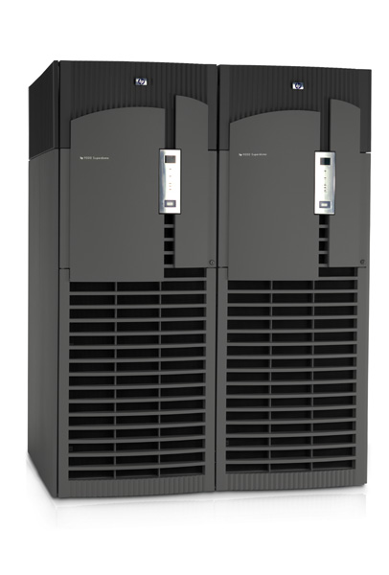
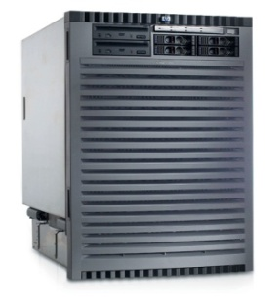
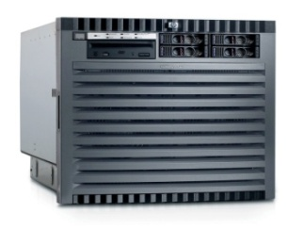

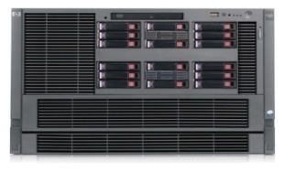
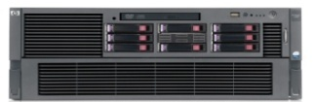
Windows On HP Integrity Always scalable
Increasing
Scalability
Scale to meet business requirements while leveraging the same proven capabilities, broad Windows support, and common management tools at every level!
Increasing Business Criticality
Superdome sx2000
rx7640
rx8640
rx6600
rx3600
rx2660
BL870c
BL860c
Increasing workload size or consolidation capacity
25
Notes:
25
25

Slide 26
Increased Scalability With Windows And Integrity
Today, Microsoft announced that 256 logical processors will be supported in Windows Server 2008 R2 and the next release of SQL Server.
Today HP’s Integrity Superdome server scales up to 128 cores/256 threads. With the increased scalability in Windows Server and SQL Server customers will be able to run up to 128 cores/256 threads in a single Windows partition.
With the ability to run up to 256 logical processors, HP customers will be able to scale up to more massive mission-critical SQL databases with exceptional performance utilizing the scalable, available HP Integrity servers.

Slide 27
256 threads running on HP Integrity Superdome
demo

Slide 28
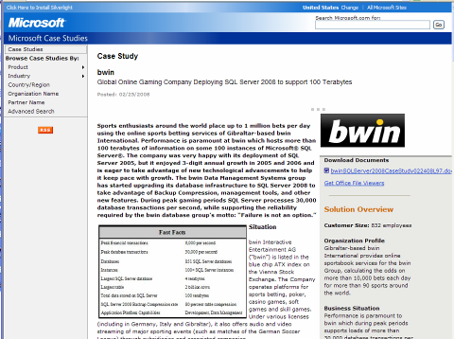
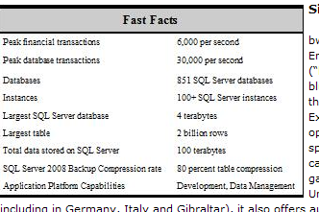
BWIN
http://www.microsoft.com/casestudies/casestudy.aspx?casestudyid=4000001470
Europe’s #1 on-line Betting Provider
“Failure is not an option!”

Slide 29

Windows On Integrity: Always Available
Achieved “four nines” reliability
Greene, Tweed
Achieved “four nines” reliability
100% uptime during first year
Indigo Lighthouse
100% uptime during first year
99.9% solution availability
99.9% solution availability
No unplanned outages since implementation
Ameren
No unplanned outages since implementation
Less than 12 minutes per year downtime
Finance Committee St. Petersburg
Less than 12 minutes per year downtime
Uninterrupted availability of data
Gaitame
La Lorraine
99.98% availability
RaceO
Continuous operation for a year; no lost transactions
11 November 2008
29
Notes:
Presentation Title
29

Slide 30
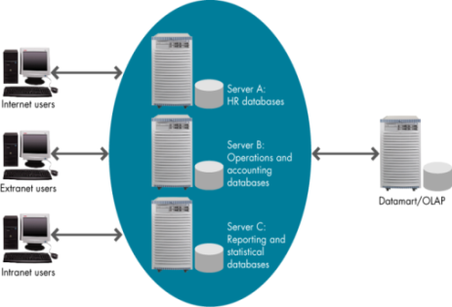
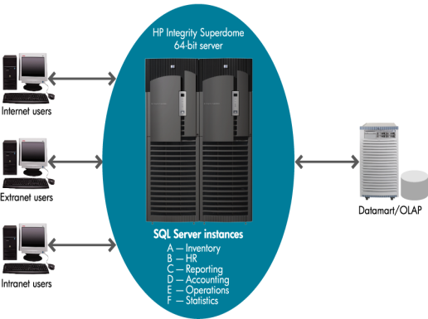
Server Consolidation With Integrity
Broad range of options and compelling TCO
Issues with server sprawl
Building, upgrading, and patching
Problem identification and resolution
Server monitoring costs
Server hosting costs
Storage requirements for backups and restores
Benefits of scale up with Integrity
Broad range of consolidation options -- from total isolation with hard partitions to maximum utilization with one large instance/multiple databases
Reduced operational costs
Maximum resource management flexibility
Greater hardware utilization
Simplified system management
Greater ROI on HW investment
11 November 2008
30

Slide 31
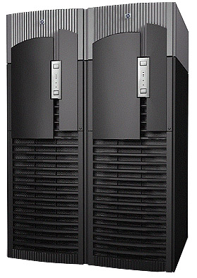
Broad Range Of SQL Consolidation Options On Integrity
SCENARIO 1 SQL Consolidation using Hard Partitions Multiple OS, Multiple SQL using hard partitions
Total isolation w/hard partitions
# of partitions limit # of instances
Can re-partition H/W resources as needed
No performance overhead
SCENARIO 2 SQL Consolidation with Virtualization Multiple guests with one or more SQL Instances
Isolation with guests
Flexibility to share resources across guests
Some trade off in performance overhead
SCENARIO 3
SQL Consolidation with native Resource Mgmt Single OS, Multiple SQL Instances
Flexibility to share resources across SQL instances
No Performance Overhead
Resource Mgt using native OS/SQL features
SCENARIO 4 SQL Instance Consolidation Single OS, Single SQL Instance, Many Databases
Maximum scale up/ resource utilization
Maximized performance - Eliminate multiple SQL instances - Eliminate redundant metadata
ISOLATION
UTILIZATION
Windows Server (24p)
Payroll Server
Windows Server (256lp)
SQL Server Manufacturing DB Marketing DB Payroll DB
Windows (8p)
Marketing Server
Windows Server (256lp)
Manufacturing Guest
Marketing Guest Payroll Guest
Windows Server (256lp) Manufacturing Instance Marketing Instance Payroll Instance
Windows Server (32p)
Manufacturing Server
UTILIZATION
Notes:
31
Presentation Title
31

Slide 32
Why HP Integrity For Windows/SQL Server Delivering business critical capabilities for database, LOB, and BI solutions
Most scalable Windows server in the industry
Uniquely suited for demanding workloads with large memory and I/O requirements
Compelling consolidation platform for reduced cost and improved service levels
Integrity Superdome is SQL Server 2008 reference platform for demanding BI/DW
Benchmarked performance leadership – including first 10TB TPC-H SQL Server result
Enterprise-class solutions for business critical environments
Benefits of standards-based solution combined with mainframe-level RAS
Robust solution-level integrated testing for maximum reliability/availability
Power one of world’s largest Windows SAP implementations at Air Products and largest single instance of SQL Server in North American at Premier Bankcard
Unmatched enterprise Windows expertise and experience
HP #1 market leader for Windows and Windows Itanium
20 year MS partnership, including over a decade of joint Windows Itanium engineering
Most extensive Windows expertise and services portfolio in the industry
HP Internal and Channel Partner Only

Slide 33
Ching Fung Apparel
“HP Integrity server offers a flexible, reliable, simple and cost-effective solution that exactly aligns with our business goals and infrastructure requirements. Much more than this, we believe its scalable server capacity can support our business growth for another five to six years, enabling us to gain even higher returns on our IT investment and further reducing the overall total cost of ownership.” -- Joe Chan, Business Consultant Ching Fung Apparel Accessories Co. Ltd.
HP Internal and Channel Partner Only

Slide 34
Additional Resources
Web Resources
HP Integrity Servers with Windows http://www.hp.com/go/integrity/windows
Windows Integrity demos http://www.hp.com/go/solutiondemoportal
For Windows Integrity demos, go to the “Servers and Storage” iBooth and pick “Integrity Servers”
Other Sessions
Windows Server Support for More than 64 Logical Processors - ENT-T554
Scaling More than 64 Logical Processors: A SQL Perspective - ENT-T555

Slide 35
Questions

Slide 36



Please Complete A Session Evaluation Form Your input is important!
Visit the WinHEC CommNet and complete a Session Evaluation for this session and be entered to win one of 150 Maxtor® BlackArmor™ 160GB External Hard Drives 50 drives will be given away daily!
http://www.winhec2008.com
BlackArmor Hard Drives provided by:

Slide 37


© 2008 Microsoft Corporation. All rights reserved. Microsoft, Windows, Windows Vista and other product names are or may be registered trademarks and/or trademarks in the U.S. and/or other countries.
The information herein is for informational purposes only and represents the current view of Microsoft Corporation as of the date of this presentation. Because Microsoft must respond to changing market conditions, it should not be interpreted to be a commitment on the part of Microsoft, and Microsoft cannot guarantee the accuracy of any information provided after the date of this presentation. MICROSOFT MAKES NO WARRANTIES, EXPRESS, IMPLIED OR STATUTORY, AS TO THE INFORMATION IN THIS PRESENTATION.

