Slide 2
Windows Hardware Logo Program Update
Avril Salter, Ph.D.
Lead Program Manager
Microsoft Corporation

Slide 3
Session Objectives
This session provides an overview of
The market impact of the Windows Hardware Logo Program
Changes in the Logo Program to support Windows 7
Timelines for Logo requirements refresh
Logo tool enhancements and driver quality data
Opportunity for detailed Q&A
“What’s new in the Windows Logo Program” COR-C644
Q&A=Questions and Answers

Slide 4
Outline
Delivering the promise of Windows Logo
Changes to the Windows Hardware Logo Program
Engagement plan for 2009
Key messages and call to action

Slide 5

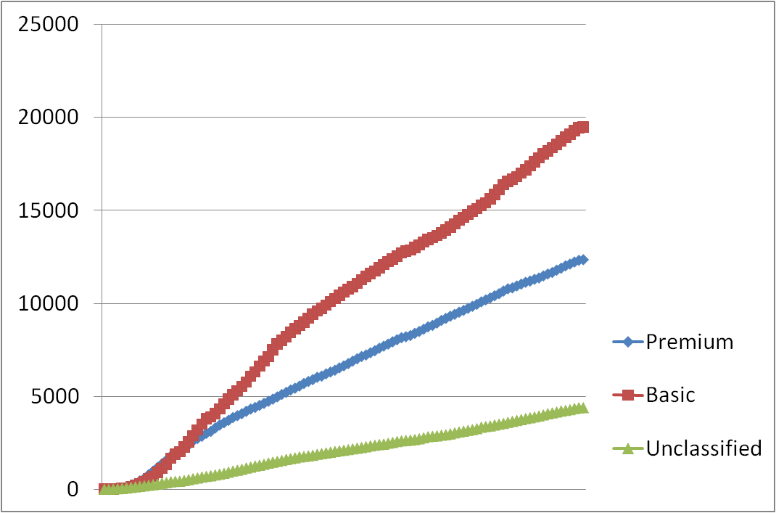

Thank You For Working With Us
Participation in the Windows Vista Logo Program shows:
Consistent growth
Growing market adoption
Over 7500 active WinQual accounts
Over 36,000 Windows Vista Logo submissions
* As of Oct 1, 2008

Slide 6
The Promise Of Windows Logo
Users define “It Works” as
Being able to “install” and “interconnect” their equipment
Initially, a “plug and play” standard
Today, we continue to focus on
Compatibility with Windows
Reliability/Stability
Works well with existing system(s)
Consistent performance
Chart based on Microsoft survey 2006

Slide 7
Outline
Delivering the promise of Windows Logo
Changes to the Windows Logo Program
Engagement plan for 2009
Key messages and call to action

Slide 8
Responding To Your Feedback
Top three Logo Program issues in 2008
Two Logos – Basic and Premium
Clarity of requirements
Mapping of requirements to user scenarios or experiences

Slide 9
Transitioning To A Single Logo
For partners
Streamlines and simplifies Windows Logo requirements
For customers
One Logo tier clarifies the promise of the Windows Logo
* Official artwork will be available after WinHEC in November 2008

Slide 10
Historical Requirements Structure
Requirements have evolved by categories, resulting in
Duplicate requirements
Inconsistencies
Lack clarity
WLAN
Premium
requirements
Display
adapter
Smart
card
Premium
requirements
Basic
requirements
Basic
requirements
Transfer
cable
Router
Basic
requirements
Basic
requirements
Premium
requirements
Connectivity
Un- classified
Connectivity
Custom
reliability
Basic
requirements
Reliability
Connectivity
Reliability
Reliability

Slide 11
The New Requirements Structure
Server
Client
High Availability
Fault Tolerance
Dynamic Partitioning
Power Management
Device stage
Windows Media Center
Windows Touch
Additional Qualifications
→ AQ Enabled
Device specific functionality
Storage
Imaging
Graphics
Audio
Printers
Network
Bus
Display
Modem
Core requirements
→ Logo
…
Connectivity
Device fundamental
e.g., 1394, PCI, BT, USB …
→ Signature
Reliability
AQ=Additional Qualification, BT=BlueTooth,
PCI=Peripheral Component Interconnect, USB=Universal Serial Bus

Slide 12
Existing Logo Requirements
Improvements | Specific Details | Benefit
Streamlined form factors | Retired Ultra Portable PC Introduced NetBooks* and Nettops | Supported changes in market evolution and terminology
Combined business and consumer | Similar fundamental requirements | Reduced duplication Improved clarity
Merged related requirements | Common requirements across categories System PCI requirements Duplicate client and server requirements | Clarified requirements Reduced the number of requirements
Removed irrelevant requirements | Telephony applications Color coding of audio jacks Consumer Infrared receivers | Eliminated requirements that do not sustain core Logo values**
* Ultra Low Cost PC, ** Reliability, performance and compatibility

Slide 13
Requirement Types
New requirements are posted on LogoPoint
For Windows Vista
For Windows 7
Feedback closes Nov 21, 2008
 | Requirement Type | Purpose
R | Required | Ensures products are compatible, reliable, and perform well on Windows
I | If Implemented | Ensures the implementation works well with Windows Only required if partners are implementing a specific technology and/or feature
WLK=Windows Logo Kit

Slide 14
New Logo Program Categories
Broadcast receiver
DVB-C, DVB-S, QAM tuner, ISDB-T
Communication Device
Digitizer Windows Touch
Media players
Mobile Broadband
Network Media Device
Digital Media Renderer, Controller and Server
Wired and Wireless
Security Software
Sensor Device
Wireless USB
Controller, DWA
Note: Not a complete list
DWA=Device Wireless Adapter, DVB=Digital Video Broadcasting, ISDB=Integrated Services Digital Broadcasting QAM=Quadrature Amplitude Modulation, USB=Universal Serial Bus

Slide 15
Additional Qualification (AQ)
The purpose of an AQ is to
Enable industry recognition of products that include a specific technology
Showcase a specific user scenario or experience
Help end users distinguish products that have advanced capabilities
AQs are optional
NOT required to attain Windows Logo
Allows you to market a device as “AQ enabled”

Slide 16
Expanding The Existing Logo Program
Partners may attain an AQ by
Testing against a defined suite of requirements defined in LogoPoint
 | Requirement Type | Purpose
R | Required | Ensures products are compatible, reliable, and perform well on Windows
I | If Implemented | Ensures the implementation works well with Windows Only required if partners are implementing a specific technology and/or features
AQ | Additional Qualification | Offers an enhanced user experience Optional for Windows Logo

Slide 17
Planned Additional Qualifications (AQs)
The current plan is to have
Four AQs for Windows Server 2008 R2
Three AQs for Windows 7 Client
Server IT Experiences
High Availability
Fault Tolerance
Dynamic Partitioning
Enhanced Power Management
Client User Experiences
Windows Media Center
Windows Touch
Device Stage

Slide 18
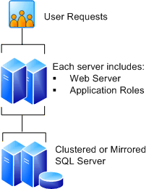



AQs for Windows Server 2008 R2
High Availability
Fault Tolerance
Promise of continuity where it matters the most
No single point of failure within
a system
Some rights reserved. Creative Commons Attribution-Noncommercial-Share Alike 3.0 License
Dynamic Partitioning
Enhanced Power Management
Service
Processor
Partition
1
Partition
Provides flexibility and RAS in server management
2
Maximizing the energy efficiency and reducing operational costs
Memory
Memory
Processor
Network
Processor
I
/
O Host
I
/
Bridge
O Host
AQ=Additional Qualification
Bridge
I/O Bus
I/O Bus

Slide 19
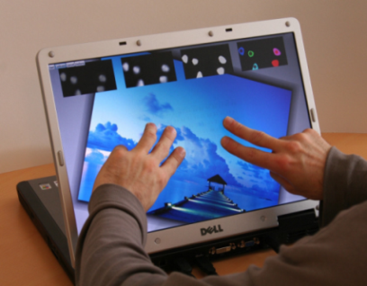


AQs For Windows 7 Client
Windows Touch
Device Stage
Distinguishes systems with this distinct user
interface
A simplified way of connecting and managing
add-on
devices
Windows Media Center
Manages all forms of media throughout the home with rich experience
AQ=Additional Qualification

Slide 20
Outline
Delivering the promise of Windows Logo
Changes to the Windows Logo Program
Engagement plan for 2009
Key messages and call to action

Slide 21

Windows Logo Requirements
Feedback closes
Nov 21, 2008
June
2009
New requirements go into effect
For Windows Vista
6 Months
Update existing requirements for drivers, aesthetics and usability
6 Months
Published Sept ‘08
6 Months
Most hardware requirements
Published July ‘08
Major chipset, architecture or chassis changes
Published Dec ‘07

Slide 22
We Are About To Start Again!
Annual process to align with your hardware refresh cycles
Next Logo requirements refresh
June
2010
6 Months
Planned for Dec 2009
Drivers, aesthetics and usability
6 Months
Planned for June 2009
6 Months
Hardware requirements
Planned for Dec 2008
Chipset, architecture or chassis changes

Slide 23
Windows Logo Tools
Tool | Major enhancements
WLK | June refresh of Logo requirements Windows 7 and AQs
LogoPoint | Improved search and notification
DDC | Additional Windows Update targeting capabilities
DQR | Analysis of driver failures by system
Early testing of
Windows 7
Identification of failures by system
For details:
Windows Logo Program & Tools COR-T520
Driver Quality Ratings (DQR) COR-C645
AQ=Additional Qualification, DQR =Driver Quality Rating,
DDC =Driver Distribution Center, WLK= Windows Logo Kit

Slide 24
Windows 7 Readiness
The problem:
End users upgrading to Windows 7 want seamlessly
Same or improved reliability
Existing interconnected devices to work
What we need to do:
Prior to Windows 7 launch
Ensure a good customer upgrade experience
Proactively identify and resolve compatibility problems
What we need you to do:
Conduct early testing
Windows 7 beta
Test logs to us
File bugs
What we plan to do:
Analyze Windows 7 test logs
Triage upgrade and test failures
Action resolution
Report findings back to you

Slide 25
Outline
Delivering the promise of Windows Logo
Changes to the Windows Logo Program
Engagement plan for 2009
Key messages and call to action

Slide 26
Key Messages
Improving your support
Restructured Logo requirements
Improved logo test tools
Improving end user experiences
Focus on compatibility
A single recognizable Logo
AQs that highlight key features and user experiences
Windows 7 readiness
Requirements are in LogoPoint
Partner to ensure a good user upgrade experience
WLK 1.3 is an opportunity to pretest with Windows 7 beta
AQ=Additional Qualification, WLK=Windows Logo Kit

Slide 27
Call To Action
Provide feedback on Windows Logo and AQ requirements
By November 21, 2008
Test your products with WLK 1.3 preview release
Identification of issues ahead of Windows 7 launch
Continue to improve driver quality
DQR data
Windows Update (WU)
Attend upcoming Logo ready events to get early assistance with Windows 7 testing
AQ=Additional Qualification, DQR=Driver Quality Ratings, WLK=Windows Logo Kit

Slide 28
Related Sessions
Code | Description | You should attend if you …
COR-C645 | Driver Quality Ratings (DQR) | Are interested in identifying problem drivers
COR-T520 | Windows Logo Program & Tools | Are involved in Windows Logo testing or submitting products
COR-C623 | Windows Logo Program Process & Policies | Work with logo compliance or have questions regarding the latest Logo process or policies
ENT-T610 | Windows Server Logo requirements and programs | Have questions on the new Windows Server Logo requirements
COR-C644 | What’s new in the Windows Logo Program | Have detailed questions on changes to Logo program including AQs
COR-C779 | Windows Quality Programs | Are interested in how HW, SW Logo and velocity programs relate
AQ=Additional Qualification, HW=Hardware, SW=Software

Slide 29
Additional Resources
Web resources
Windows Logo’d product list http://winqual.microsoft.com/hcl/
Compatibility center http://www.microsoft.com/windows/compatibility/
Windows Logo Program http://www.microsoft.com/whdc/winLogo/
Windows Quality Online Services (Winqual) https://winqual.microsoft.com/
Sign up for the Logo Program newsletter http://www.microsoft.com/whdc/newsreq.mspx#EEC
Email addressees
Logo feedback and policy: Logofb@microsoft.com
Winqual Web site winqual@microsoft.com
Logo’d product List winqual@microsoft.com
Windows Server Catalog wscat@microsoft.com
Logo related legal agreements whqlegal@microsoft.com
Windows Update whqlwu@microsoft.com

Slide 30
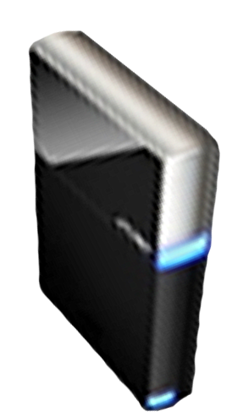


Please Complete A Session Evaluation Form Your input is important!
Visit the WinHEC CommNet and complete a Session Evaluation for this session and be entered to win one of 150 Maxtor® BlackArmor™ 160GB External Hard Drives 50 drives will be given away daily!
http://www.winhec2008.com
BlackArmor Hard Drives provided by:

Slide 31


© 2008 Microsoft Corporation. All rights reserved. Microsoft, Windows, Windows Vista and other product names are or may be registered trademarks and/or trademarks in the U.S. and/or other countries.
The information herein is for informational purposes only and represents the current view of Microsoft Corporation as of the date of this presentation. Because Microsoft must respond to changing market conditions, it should not be interpreted to be a commitment on the part of Microsoft, and Microsoft cannot guarantee the accuracy of any information provided after the date of this presentation. MICROSOFT MAKES NO WARRANTIES, EXPRESS, IMPLIED OR STATUTORY, AS TO THE INFORMATION IN THIS PRESENTATION.

