Slide 2
Windows Logo Program Tools: Overview and Directions
Craig Rowland
Senior Program Manager
Microsoft Corporation
Karl Froelich
Lead Program Manager
Microsoft Corporation

Slide 3
Agenda
Quick overview of the logo tools and what’s
new with Windows 7
  Using LogoPoint to understand your logo requirements
  Windows logo testing using the Windows Logo Kit (WLK)
  Submitting for a logo via Winqual
Using Winqual services to help maintain your driver
Leveraging Microsoft’s investments to sell more stuff

Slide 4
Overview Of Logo Tools
LogoPoint – review current logo requirements;
review and provide feedback on potential
future requirements
Windows Logo Kit – everything you need to
validate that your device meets the Windows
Logo Program requirements
Winqual Logo portal – upload your validation
results, sign legal agreements, and download
your signed drivers
Winqual applications for maintaining your driver –
Driver Distribution Center (DDC), Windows Error Reporting (WER) definitions, and much, much more

Slide 5
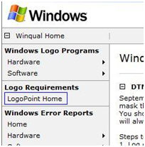
LogoPoint
Management tool used in the creation of logo requirement specifications
Allows partners to review and contribute feedback during the requirement creation process
View requirements via
  Dashboard on the home page
  Search requirements page
  Feedback lists
Give feedback on proposed requirements
Generate reports

Slide 6
Using The Windows Logo Kit
The WLK consists of two parts
  An industrial-strength, SQL-based automated test harness.
  This is referred to as the Device Test Manager (DTM)
  Tests that validate functionality and correctness. These are referred to as Content, and are developed by technology experts from all across Microsoft.
Because the WLK is industrial-strength it should not
be viewed as a one-off or an aside. Using the WLK
works best if there are committed resources tasked primarily to its usage.
The WLK can scale from testing 1 client up to 200

Slide 7
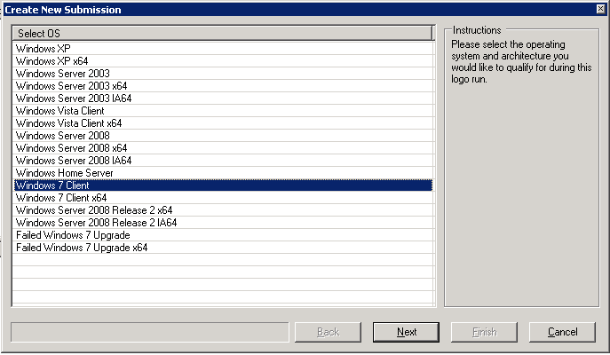
Windows 7 Submissions

Slide 8
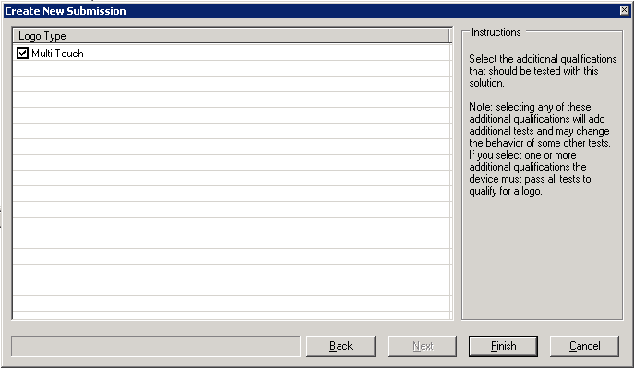
Windows 7 Additional Qualifications

Slide 9
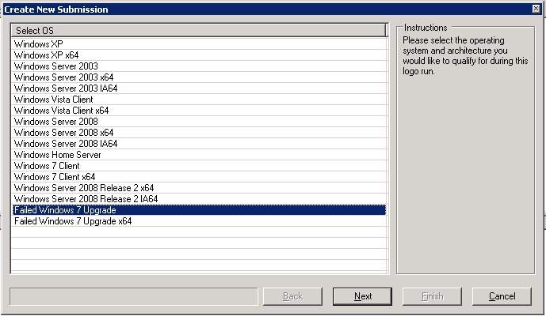
Windows 7 Upgrades

Slide 10
WLK: Things You Need To Know
Current kit
  WLK 1.2
  Currently required for all active logo programs
Next kit
  WLK 1.3
  Available late this year
  Will support all active logo programs
  Windows 7
    Will include beta versions of all Windows 7 logo tests and Additional Qualifications
    Will allow you to preview changes to the logo program for Windows 7
    Cannot be used to get a Windows 7 logo
After that
  WLK 1.4
  Will ship at same time as Windows 7 RC
  Can be used to get a Windows 7 logo and Additional Qualifications
  Will eventually replace all previous kits

Slide 11
WLK: How To Get It
Go to http://connect.microsoft.com and sign in
Generally we release preview builds about four
and eight weeks before a kit release
Establish a connection for the new Windows Logo
Kit program
Download the ISO and burn to a DVD
Also download the help file; it’s updated monthly
Filters: Go to http://winqual.microsoft.com
Quick fix engineering (QFEs) releases: go to http://www.microsoft.com/whdc

Slide 12
Submitting Via The Winqual Portal
Establish your Winqual account: requires a VeriSign certificate
Your company may already have an account; find your admin
Upload drivers
Sign legal agreements
Download signed drivers
Gotcha: Filters
Windows 7
  Additional Qualifications: Winqual/WST process is exactly the same
  with or without AQs
  Device Center: Add your icon and metadata via WST
  DXP: A special case
    DXP may be added to an existing logo via a separate portal on Winqual
    DXP will be required for specific devices

Slide 13
Online Crash Analysis
Identify driver issues and deliver solutions directly to the customers that are impacted
by them
Enhance your customer’s experience and perception of your product by delivering
fixes for specific issues
Use DQR to find the fires; use OCA to fight
the fires
WinHEC: The Driver Quality Rating Tool, Thursday 2PM, room 410
Walk-through

Slide 14
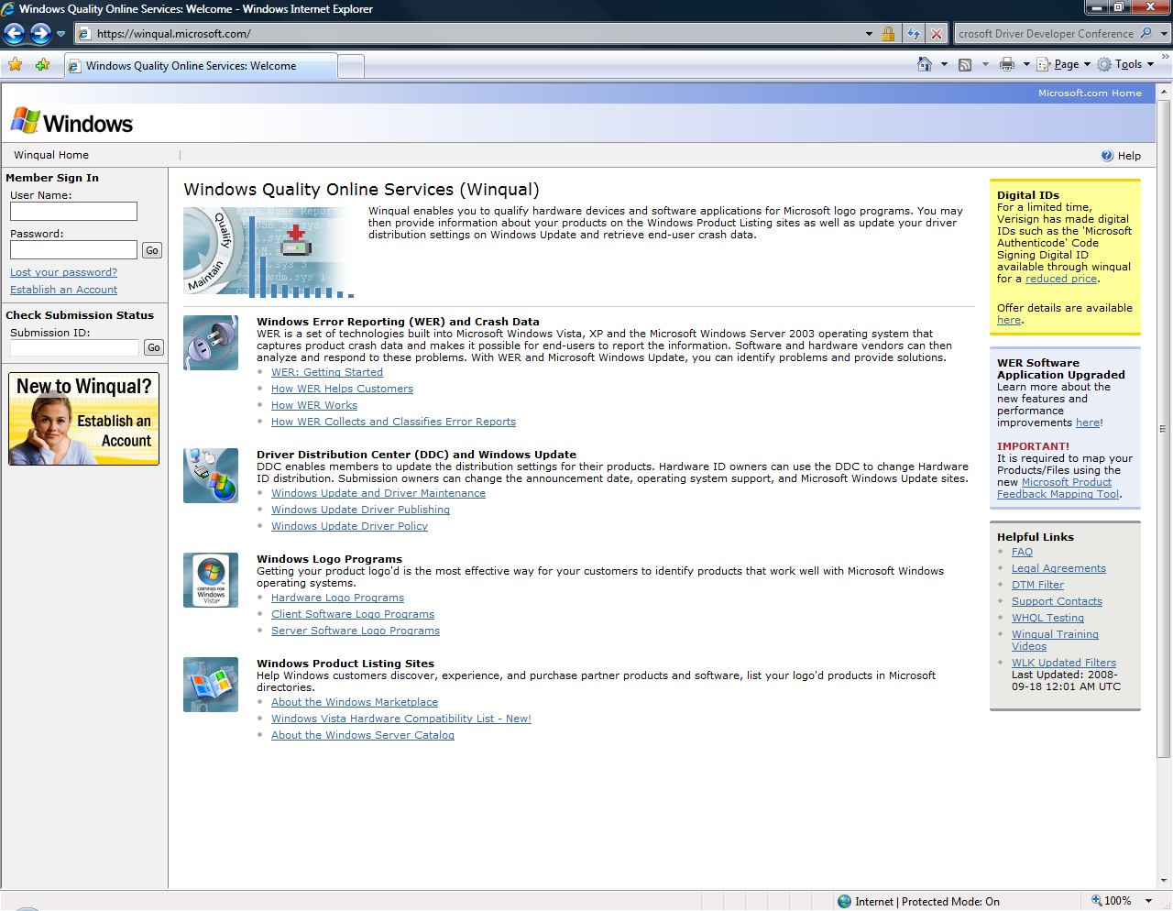

Slide 15
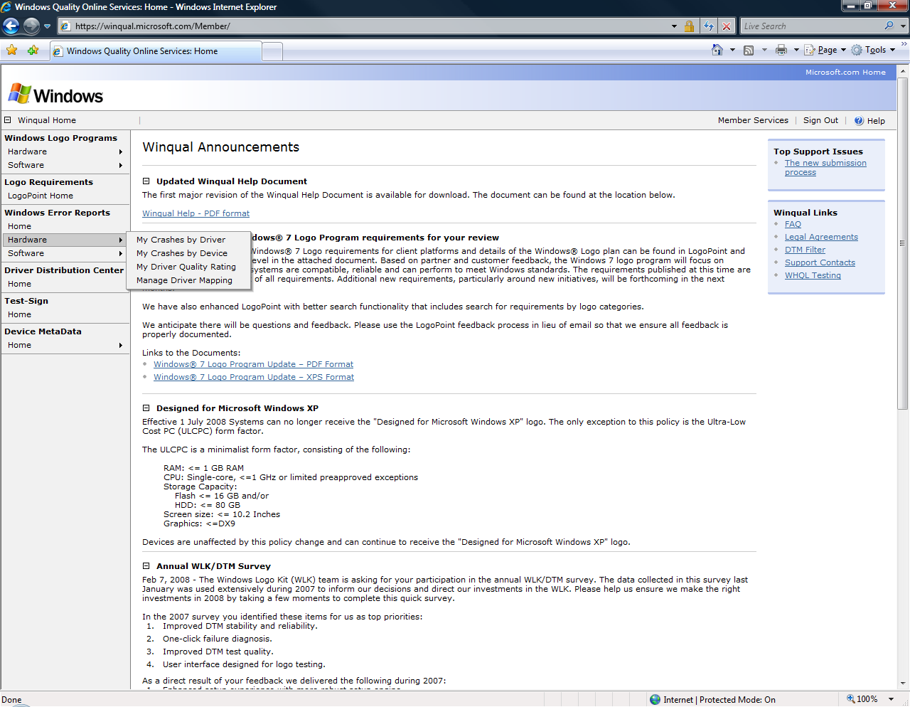

Slide 16
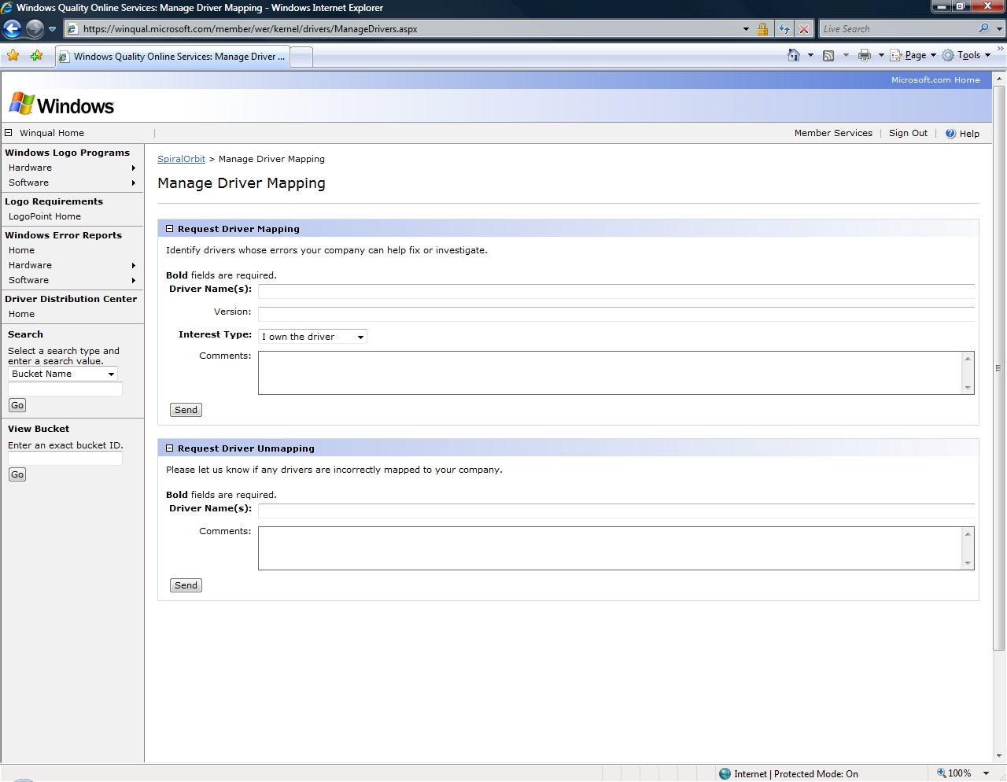

Slide 17
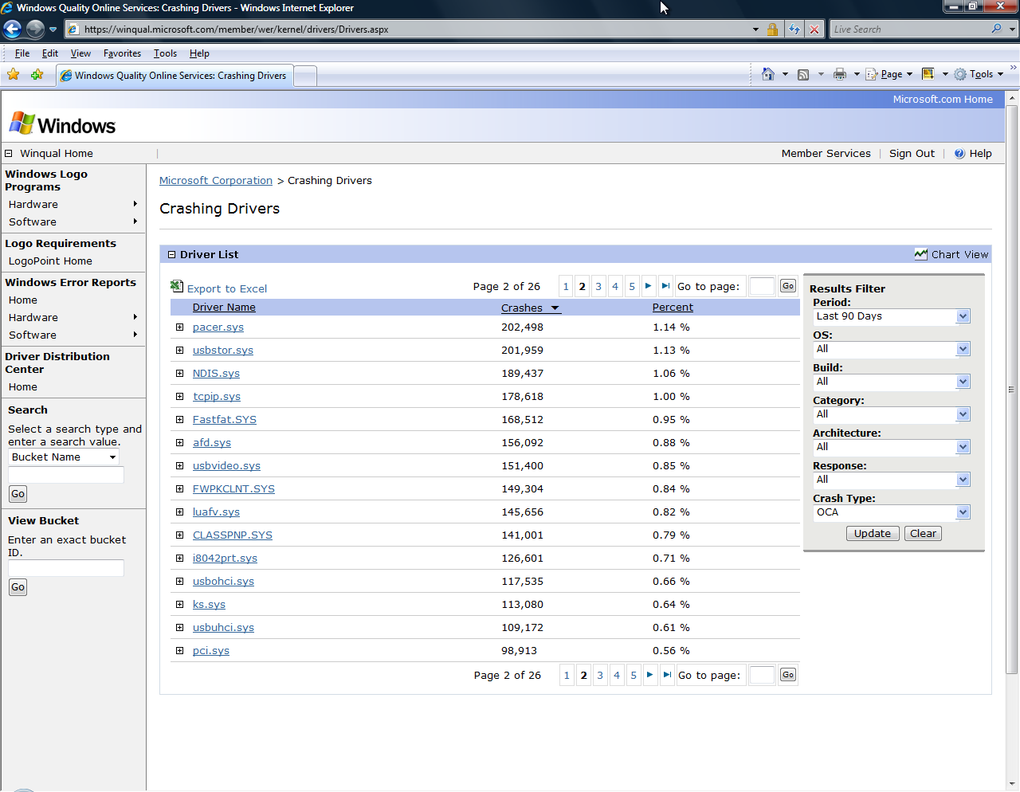

Slide 18
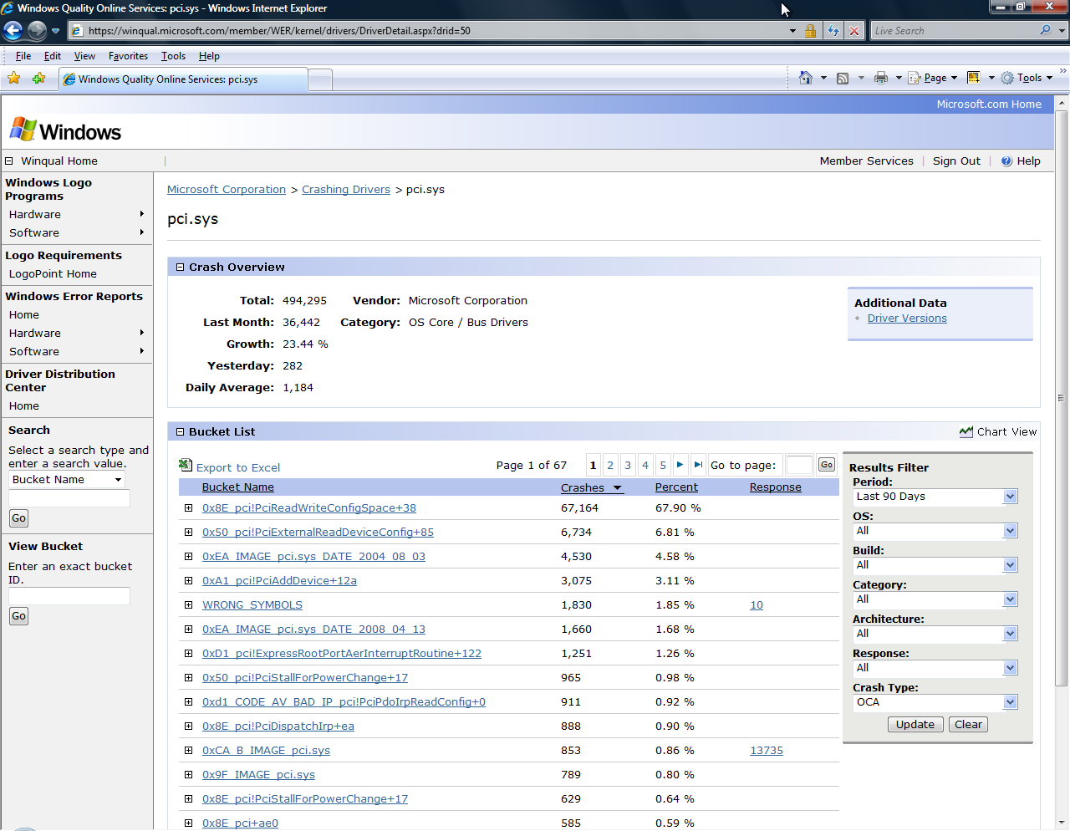

Slide 19
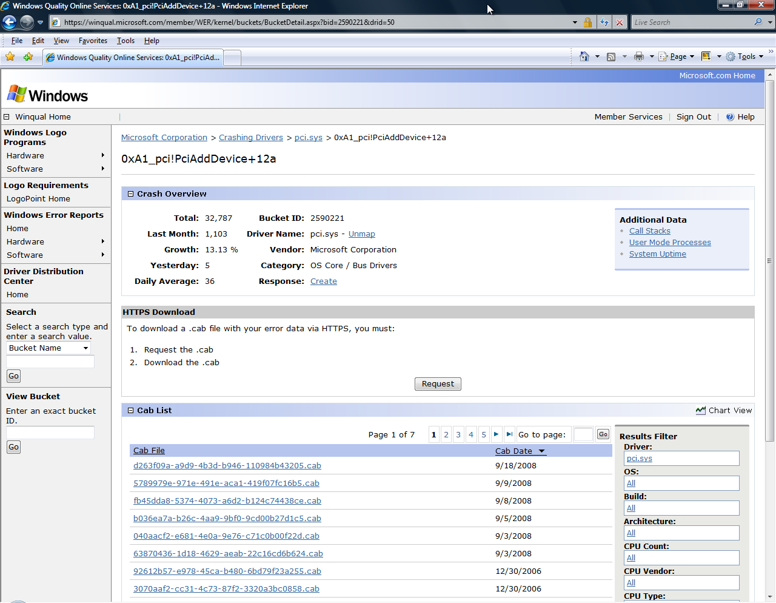

Slide 20
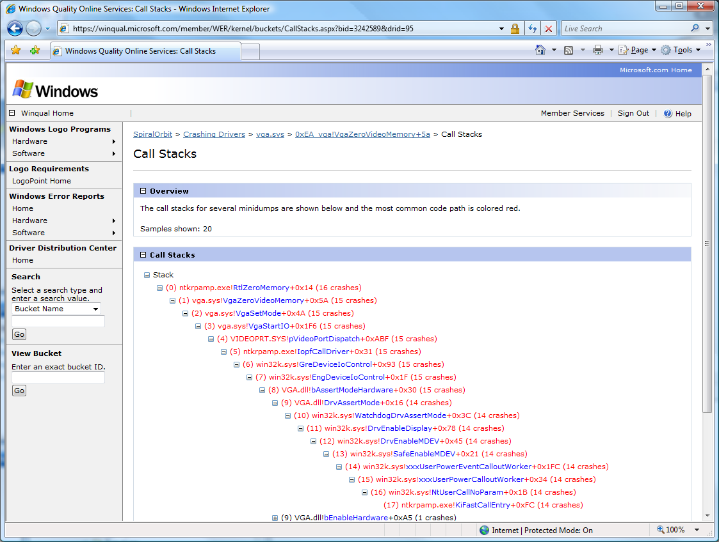

Slide 21
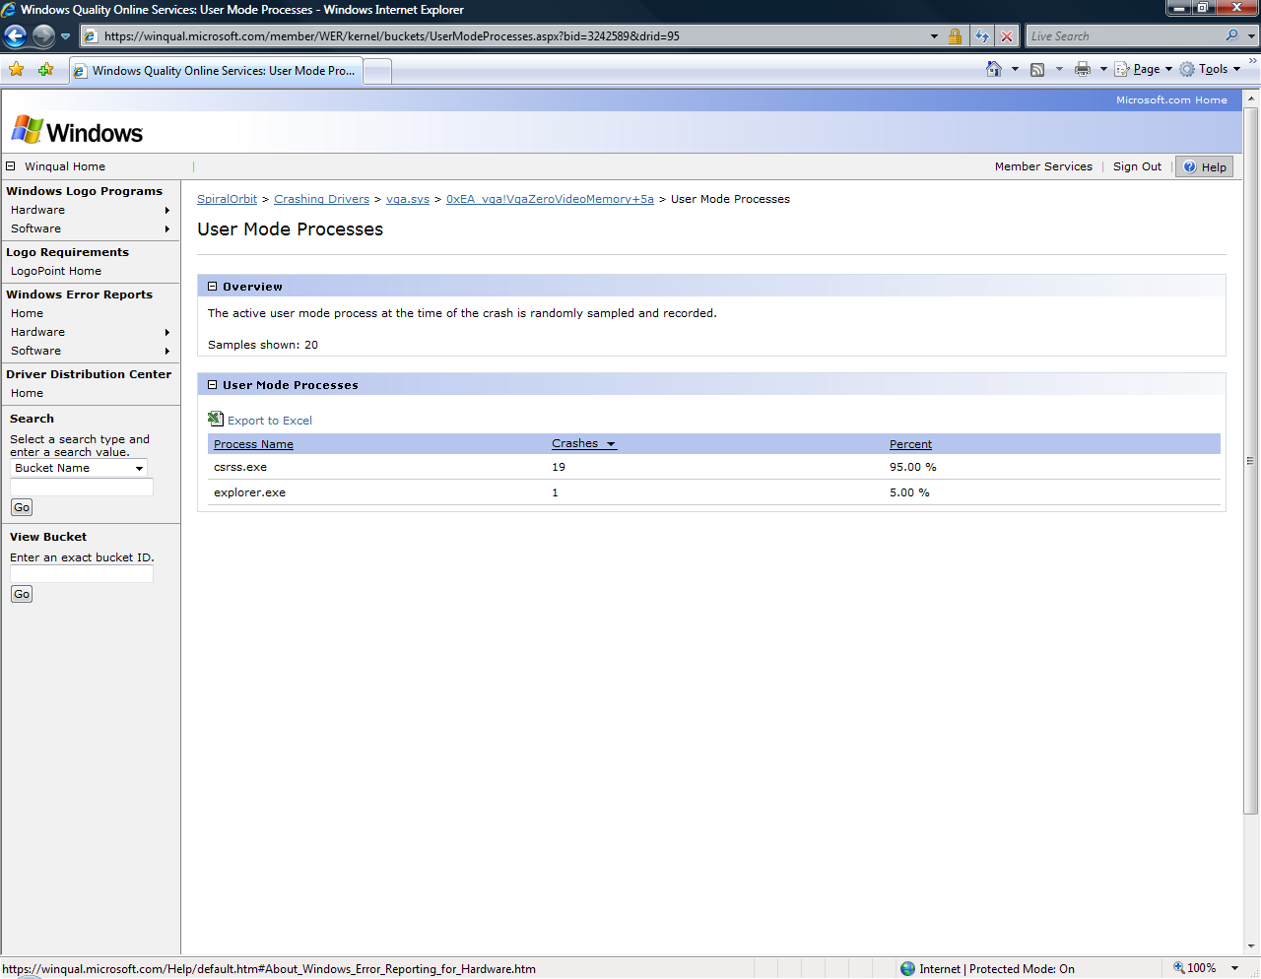

Slide 22
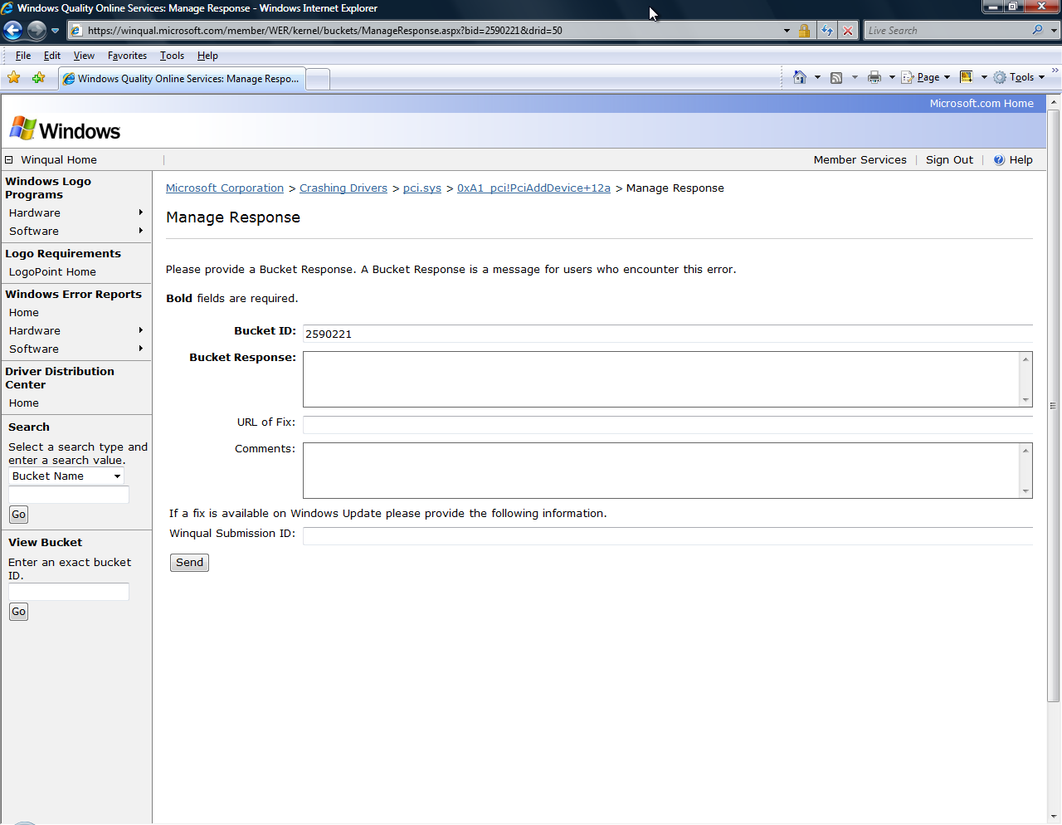

Slide 23
Get Your Drivers On Users’ Systems
Each week, millions of users worldwide
automatically update their systems at http://windowsupdate.microsoft.com
Best practice: Distribute your logoed drivers
through Windows Update
Manage settings for distributing your driver via
Driver Distribution Center (DDC) on Winqual
  View download statistics and WER data
  Use a co-installer to install applications with your driver
  For details, see Distributing Drivers on Windows Update
  www.microsoft.com/whdc/maintain/DrvUpdate.mspx

Slide 24
Sell More Stuff
Windows Logoed Products List
  Windows logoed hardware only
  List used as purchasing criteria for governments and Fortune 500 companies
  http://winqual.microsoft.com/hcl/
Windows Vista Compatibility Center
  Compatibility listing and logo status for devices and software sold at retail
  Leverage Microsoft’s marketing dollars behind compatibility and logo
  http://www.microsoft.com/compatibility
Windows Server Catalog
  Hardware and software certified for Windows Server
  Leverage the Windows Server Catalog link installed on Windows Server systems
  http://www.windowsservercatalog.com/
Sell to system vendors
Retail feeds
  Windows logos displayed next to your products on participating retail sites such as Amazon and Dell
  Cnet channel partners include 36 retailers in 9 countries

Slide 25
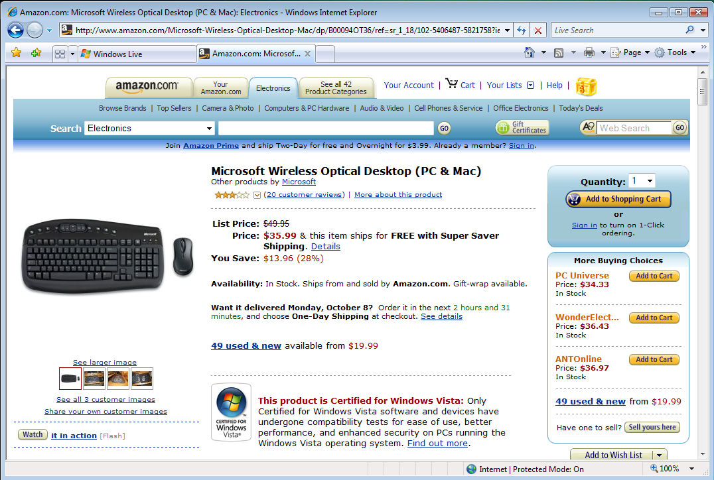
Windows Logo Retail Feeds

Slide 26
Call To Action
Plan ahead for Windows 7
  Preview Windows 7 content in WLK 1.3
  Understand Windows 7 additional qualifications
  Think about how you want your device to be
  displayed to users in Device Center
Become friends with OCA
Leverage Microsoft’s investments in marketing and distribution to sell more stuff and get stuff on end user’s systems

Slide 27
Resources
Related Sessions:
  Panel: Windows Logo Program and Tools, Today, 4:30PM, room 411/Theatre
  The Driver Quality Rating Tool, Thursday 2PM, room 410
  What’s New in the Windows Logo Program, Thursday 11AM, room 410
  Distributing Drivers on Windows Update, Thursday 3:15PM, Room 410
  Discussion: WLK Troubleshooting, Thursday, 4:30PM, room 410
  And much-much more
Links:
  Logopoint: http://winqual.microsoft.com/logopoint
  Winqual: http://winqual.microsoft.com
  Windows Logo Kit: http://Connect.microsoft.com – sign up for
  Windows Logo Kit

Slide 28
Questions

Slide 29
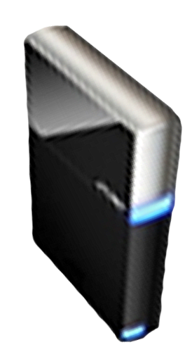


Please Complete A Session Evaluation Form
Your input is important!
Visit the WinHEC CommNet and complete a Session Evaluation for this session and be entered to win one
of 150 Maxtor® BlackArmor™ 160GB External Hard Drives
50 drives will be given away daily!
http://www.winhec2008.com
BlackArmor
Hard Drives provided by:

Slide 30


© 2008 Microsoft Corporation. All rights reserved. Microsoft, Windows, Windows Vista and other product names are or may be registered trademarks and/or trademarks in the U.S. and/or other countries.
The information herein is for informational purposes only and represents the current view of Microsoft Corporation as of the date of this presentation. Because Microsoft must respond to changing market conditions, it should not be interpreted to be a commitment on the part of Microsoft, and Microsoft cannot guarantee the accuracy of any information provided after the date of this presentation.
MICROSOFT MAKES NO WARRANTIES, EXPRESS, IMPLIED OR STATUTORY, AS TO THE INFORMATION IN THIS PRESENTATION.

