Slide 1
Improving Driver Quality Through Testing
Abdullah Ustuner
Test Manager
Microsoft Corporation

Slide 2
Outline
Driver Testing at a glance
Software Development Lifecycle
Design-time considerations
Static analysis during implementation
Effective runtime testing
Call to Action

Slide 3
Why Is Driver Testing Important?
Fundamental pieces of the platform
Enable rich user experiences with software and hardware
Low quality can lead to
  System crashes
  Data loss
  Huge support costs
  Devices not functioning

Slide 4
Why Is Driver Testing Difficult?
Drivers are inherently complex
  Many rules to obey
Low-level components
  Hardware/Kernel interaction
Reentrant and asynchronous nature
Support for multiple platforms at once (compatibility)

Slide 5
Software Development Lifecycle
Design
Implementation
Testing
Logo
Deployment
Maintenance
Testing
Testing

Slide 6
Benefits Of Testing Throughout
Detect problems early in the cycle
  Reduced overall development time, faster time to market
  More straightforward logo process
  Minimized sustainment costs post deployment
Establish quality standards for future projects
Tools become natural part of work

Slide 7
Testability
To have testable software, it needs to be designed that way
Design should enable
  Automation
  Exhaustive code coverage
  Proper instrumentation/tracing
  Well-defined data structures and interfaces
Leads to cost savings and higher quality

Slide 8
Compiler Warnings (W4)
Overview
Standard compiler setting in the WDK has been W3
W4 displays a wider set of warnings
Helps discover subtle but potentially critical bugs
  Infinite loops
  Potential crashes
  Data loss
Our Commitment
  Making WDK headers/samples clean of all W4 warnings for Windows 7

Slide 9
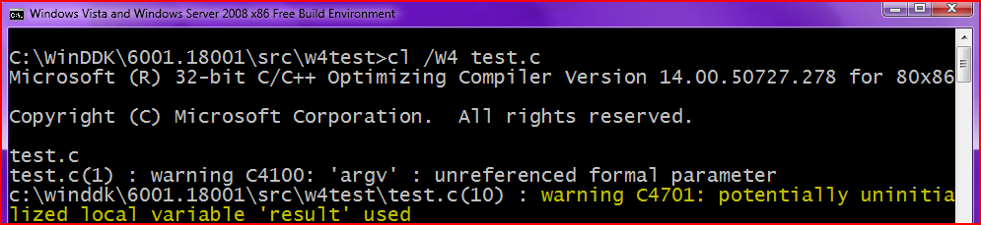
Compiler Warnings (W4)
Example
int main (int argc, char* argv[]) {
int result;
if (argc < 3)
result = 0;
return result;
}
MS08-014 – Security vulnerability could have been prevented by /W4 compilation

Slide 10
Compiler Warnings (W4)
How to use
Use throughout the Implementation phase
Use the following setting in sources file
  MSC_WARNING_LEVEL=/W4 /WX
Certain warnings can be safely suppressed
  For complete list, refer to WDK headers

Slide 11
PREfast For Drivers (PFD)
Overview
Compile-time source code analysis tool for drivers
Performs function-scope verification
Checks for common coding errors in drivers
Supports C/C++ and runs quickly
Relies on SAL annotations to define the rules
Our Commitment
  Making WDK headers annotated and samples clean of baseline set of PFD defects for Windows 7

Slide 12
PREfast For Drivers (PFD)
Example (disk.sys from WDK)
NTSTATUS
DiskIoctlReassignBlocksEx(IN PDEVICE_OBJECT DeviceObject, IN OUT PIRP Irp)
{
NTSTATUS status;
PSCSI_REQUEST_BLOCK srb;
srb = ExAllocatePoolWithTag(NonPagedPool,SCSI_REQUEST_BLOCK_SIZE,DISK_TAG_SRB);
if (srb == NULL) {
// ...
return STATUS_INSUFFICIENT_RESOURCES;
}
// ...
status = ClassSendSrbSynchronous(DeviceObject, srb, badBlocks, bufferSize,
TRUE);
return status;
}
Memory allocated for srb
srb is used
Function returns without freeing srb !
FREE_POOL (srb);

Slide 13
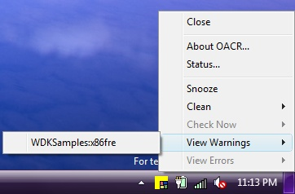


PREfast For Drivers (PFD)
How to use
Use throughout the Implementation phase as soon as your code starts to compile
Available in the WDK
Via command-line
  prefast build –cZ then prefast view
Via OACR (Automated Code Review Tool)
in Windows 7 WDK:

Slide 14
Static Driver Verifier (SDV)
Overview
Build-time source code analysis tool for drivers
Performs deep, inter-procedural verification
Checks for common complex problems in drivers
Supports WDM, KMDF and NDIS drivers, written in C
Our Commitment
  Making WDK samples clean of all SDV defects for Windows 7

Slide 15
Static Driver Verifier (SDV)
Example
NTSTATUS
DispatchRoutine(PDEVICE_OBJECT DeviceObject, PIRP Irp) {
UtilityRoutine(Irp);
// ...
IoCompleteRequest (Irp, IO_NO_INCREMENT);
return STATUS_SUCCESS;
}
NTSTATUS
UtilityRoutine(PIRP Irp) {
// ...
if (// ...) {
IoCompleteRequest (Irp, IO_NO_INCREMENT);
return STATUS_UNSUCCESSFUL;
}
return STATUS_SUCCESS;
}
2nd Completion of IRP !
1st Completion of IRP

Slide 16
Static Driver Verifier (SDV)
Example (Fixed)
NTSTATUS
DispatchRoutine(PDEVICE_OBJECT DeviceObject, PIRP Irp) {
NTSTATUS status = UtilityRoutine(Irp);
If (NT_SUCCESS (status)) {
IoCompleteRequest (Irp, IO_NO_INCREMENT);
}
return STATUS_SUCCESS;
}
NTSTATUS
UtilityRoutine(PIRP Irp) {
// ...
if (// ...) {
IoCompleteRequest (Irp, IO_NO_INCREMENT);
return STATUS_UNSUCCESSFUL;
}
return STATUS_SUCCESS;
}

Slide 17
Static Driver Verifier (SDV)
How to use
Use during late stages of the Implementation phase, once your code is functionally complete
Available in the WDK
Via command-line
  StaticDV /rule=*
  StaticDV /view

Slide 18
INF File Checker (ChkINF)
Overview
Verifies basic INF file structure and syntax
Supports all device classes
Run after INF dependency changes
To verify INCLUDES and NEEDS directives, run on INF target OS
When verifying a Unicode INF, save as text first

Slide 19
INF File Checker (ChkINF)
How to use
Use during late stages of the Implementation phase, once your INF file is ready
Available in the WDK and WLK
Via command-line
  chkinf c:\mydriver\mydriver.inf /b

Slide 20
Driver Verifier (verifier.exe)
Overview
Runtime tool that monitors kernel-mode drivers
Checks for illegal function calls and potential actions that can lead to system corruption
Supplements your testing process
Multiple drivers can be enabled simultaneously
Required for Logo
Our Commitment
  Making WDK samples clean of baseline set of issues found
  by Driver Verifier for Windows 7

Slide 21
Driver Verifier (verifier.exe)
How to use
Use during the Testing phase, always enabled while exercising your driver
Available in Windows itself (since Windows 2000)
Just launch by running
  verifier.exe (launches GUI)
  verifier.exe <args> (launches CMD)

Slide 22
Application Verifier
Overview
Runtime verification tool for native code
Checks for application’s interaction with Windows
Profiles use of kernel objects, registry, file system and Win32 APIs
For user-mode drivers, applications and services
Supplements your testing process
Enhanced I/O and Leak checks for Windows 7
Our Commitment
  Making WDK samples clean of baseline set of issues found
  by Application Verifier for Windows 7

Slide 23
Application Verifier
How to use
Use during the Testing phase, always enabled while exercising your user-mode drivers and applications
Available as a free download from
Microsoft Download Center
Required for Logo
Just launch by running
  appverif.exe (launches GUI)
  appverif.exe /verify <ApplicationName> (launches CMD)

Slide 24
Driver ReInstall Failures
Widespread at Vista SP1 update time with class driver changes
Drivers with inbox dependencies were forced
to reinstall
Install UI was completely suppressed so any “necessary” user-interaction did not occur
Future updates present possible repeat scenarios

Slide 25
ReInstall Test
Overview
ReInstall refers to uninstall - install sequence
Performs multiple install/uninstall/reinstall iterations
Iteration count can be configured
Command-line options allow testing of just one mode, typically reinstall

Slide 26
ReInstall Checks/Manual Steps
Test N-1, N, Current drivers with updates
  Using Windows Update mitigates this as users will usually have N version driver(s)
Ad-hoc testing to verify ALL devices working after updates
Test Service Pack installs more than once AND in more than one configuration

Slide 27
Reinstall Checks/Manual Steps
Eliminate all INF file dependencies not required
  Don’t assume that the sample implies
  you need the include
Save post-install user configuration for
re-application after updates
  Avoids the problem where user cannot interact with your setup at re-install time

Slide 28
Prevent Update Disasters
Run Reinstall test
  During all phases of testing
  Before any new driver updates released
Use ChkINF !
Check ALL INF dependencies, particularly if using a sample INF to develop from
  Make sure your driver uses these services since you’re taking the dependency
Needs= Toaster_Device.NT.Services

Slide 29
Concurrent Scenarios
Many common scenarios to think about
  Closing laptop lid
    While video playback running
    While removing USB device
  Disconnecting Audio playback device while
  suspending machine
  Unplugging HID device while hibernating machine

Slide 30
Concurrent PNP/IO/PM Tests
PNP Events
Driver Object(s)
Driver Stack I/O Events
Sleep State Transitions
System/Device Power States
Driver Object(s)
Driver IOCTls

Slide 31
Software Development Lifecycle
Revisited
Testability
Design
Implementation
Testing
Logo
Deployment
Maintenance
W4
PFD
SDV
ChkINF
Application Verifier
Driver Verifier
Reinstall
PnP/IO/PM

Slide 32
Call To Action
Integrate these tools and manual procedures as part of your development lifecycle
Run them early and often
Test both on 32-bit and 64-bit
Fix every issue being detected

Slide 33

Additional Resources
Web Resources
  Compiler Warnings (W4)
  http://msdn.microsoft.com/en-us/library/8x5x43k7(VS.80).aspx
  PREfast for Drivers (PFD) http://www.microsoft.com/whdc/devtools/tools/PREfast.mspx
  Static Driver Verifier (SDV) http://www.microsoft.com/whdc/DevTools/tools/SDV.mspx
  ChkINF
  http://msdn.microsoft.com/en-us/library/ms792443.aspx
  Driver Verifier
  http://www.microsoft.com/whdc/devtools/tools/drvverifier.mspx
  Application Verifier
  http://msdn.microsoft.com/en-us/library/aa480483.aspx
  MS08-014
  http://blogs.technet.com/swi/archive/2008/03/11/the-case-of-the-uninitialized-stack-variable-vulnerability.aspx
Related Sessions
  Thursday 2-3pm, Room 409A
    COR-C641 Discussion: Improving Driver Quality Through Testing
  Booth-228: Visit to see hardware for automating PNP/PM
  Email drvtest@microsoft.com

Slide 34
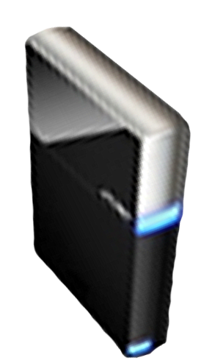


Please Complete A Session Evaluation Form
Your input is important!
Visit the WinHEC CommNet and complete a Session Evaluation for this session and be entered to win one
of 150 Maxtor® BlackArmor™ 160GB External Hard Drives
50 drives will be given away daily!
http://www.winhec2008.com
BlackArmor
Hard Drives provided by:

Slide 35


© 2008 Microsoft Corporation. All rights reserved. Microsoft, Windows, Windows Vista and other product names are or may be registered trademarks and/or trademarks in the U.S. and/or other countries.
The information herein is for informational purposes only and represents the current view of Microsoft Corporation as of the date of this presentation. Because Microsoft must respond to changing market conditions, it should not be interpreted to be a commitment on the part of Microsoft, and Microsoft cannot guarantee the accuracy of any information provided after the date of this presentation.
MICROSOFT MAKES NO WARRANTIES, EXPRESS, IMPLIED OR STATUTORY, AS TO THE INFORMATION IN THIS PRESENTATION.

