Slide 1
Enhanced Storage
Kiran Bangalore
Senior Program Manager
Microsoft Corporation

Slide 2

Windows Storage Device Investments
Non-Volatile Memory (NVM)
Security
Smart Storage Devices
Green Technologies
Virtualization
Optical Platform
Personal Storage
Core Storage
Storage Networking

Slide 3
Agenda
What is Enhanced Storage?
Architectural Overview and Windows
Enhanced Storage Extensibilities
Demo
Resources
Call to Action

Slide 4
What is Enhanced Storage?
Need
Smart Storage Devices
Platform for Storage Value-add
Seamless Windows Experience
for Smart Storage Devices
Platform is Bus/ Protocol Agnostic
  Currently implemented for USB devices
    Limited Release for Vista
    General Release for Windows 7
Extensibility Support for proprietary hardware/software applications

Slide 5

Industry Standards
Need
Smart Storage Devices
Enhanced Storage is uses the
IEEE 1667 standard as the device communication protocol
IEEE 1667: “Standard Protocol for Authentication in Host Attachments
of Transient Storage Devices”

Slide 6

Microsoft and Smart Storage
Need
Smart Storage Devices
Extensible platform
Industry Standard
Easily implementable
Platform is ready and implemented

Slide 7






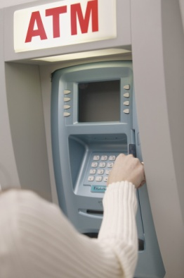
One Such Scenario!
Need
Smart Storage Devices
Photos
Tax Files
Medical
Banking
Travel

Slide 8

Lost Drive?
Need
Smart Storage Devices
Photos
Tax Files
Medical
Banking
Travel

Slide 9



Problems with
Current Solutions
Need
Smart Storage Devices
Non Standard
  Interoperability
More costly to maintain support
Not Manageable
One way security
Not extensible

Slide 10
Enhanced Storage Approach
Future
Enable
Technology
Possibilities!
Need
Windows 7 Support
Extensibility
IEEE 1667
Architecture
Smart Storage Devices
People, Process, Technology

Slide 11
IEEE 1667 Overview
Technology
IEEE 1667
Architecture
Storage Device Model for IEEE 1667
Windows Vista*, Windows 7 Support
ACT (Addressable Command Target)
Probe Silo
Cert Silo
Password Silo
Other Silo
User Data Area
LUN – ACT (Addressable Command Target)
Probe Silo is Required
Silo Model is extensible
* Limited release

Slide 12
IEEE 1667 Overview
Technology
IEEE 1667
Architecture
Storage Device Model for IEEE 1667
Windows Vista*, Windows 7 Support
ACT (Addressable Command Target)
Probe Silo
Cert Silo
Password Silo
Other Silo
User Data Area
LUN – ACT (Addressable Command Target)
Probe Silo is Required
Silo Model is extensible
Silo: A uniquely addressable receiver of commands on an ACT accessible
using the IEEE 1667 protocol
* Limited release

Slide 13
Key Experiences for
Windows 7
Technology
IEEE 1667
Architecture
Consumer Level Security
for removable devices
  USB transport only
  Native Shell Windows support for password access to the Enhanced Storage
Key Scenarios
  Simple USB Password protection
  Simple security for
    Parent/Child scenarios
    Small Business Admin/User scenarios

Slide 14
Enhanced Storage
Architecture
Technology
IEEE 1667
Architecture
Windows Shell Extensions
ISV Application(s)
3rd Party Application
Enhanced Storage I/F Layer (API)
Process Boundary
1667 Silo Drivers
3rd Party Silo Drivers
Kernel Boundary
Kernel Storage Stack
Host Boundary
Enhanced Storage Device
1667 Silo
3rd Party Silo

Slide 15

Enhanced Storage
Extensibility
Enable
Win dows 7 Support
Extensibility
Windows Shell Extensions
ISV Application(s)
3rd Party Vertical Application
Enhanced Storage I/F Layer (API)
1667 Silo Drivers
3rd Party Silo Drivers
Kernel Storage Stack
Enhanced Storage Device
1667 Silo Support
3rd Party Silo Support
Extend Windows
Auth Experience

Slide 16

Enhanced Storage
Extensibility
Enable
Win dows 7 Support
Extensibility
Windows Shell Extensions
ISV Application(s)
3rd Party Vertical Application
Enhanced Storage I/F Layer (API)
1667 Silo Drivers
3rd Party Silo Drivers
Kernel Storage Stack
Enhanced Storage Device
1667 Silo Support
3rd Party Silo Support
Create your
own Silo

Slide 17

Enhanced Storage
Extensibility
Enable
Win dows 7 Support
Extensibility
Windows Shell Extensions
ISV Application(s)
3rd Party Vertical Application
Differentiate
with Software
Enhanced Storage I/F Layer (API)
1667 Silo Drivers
3rd Party Silo Drivers
Kernel Storage Stack
Enhanced Storage Device
1667 Silo Support
3rd Party Silo Support

Slide 18
Enhanced Storage
demo
Kiran Bangalore
Senior Program Manager
Device and Storage Technologies

Slide 19
Backup
demo

Slide 20

Possibilities
Future
Possibilities!
Extension to other transports
Extension to other command sets
Extension to other storage hardware features
You tell us!

Slide 21
References/Support
Questions about IEEE 1667
  IEEE Website: http://www.ieee1667.com
  Microsoft Email: 1667stor@microsoft.com
Enhanced Storage Program
  Enh_stor@microsoft.com
  Enhanced Storage Microsoft Connect Site
Stop by the Microsoft booth!

Slide 22
Call To Action
Develop and work with Microsoft
on prototypes, co-developments
Develop against the IEEE specification
Download Enhanced Storage Simulator and tools from Connect site

Slide 23



Please Complete A Session Evaluation Form
Your input is important!
Visit the WinHEC CommNet and complete a Session Evaluation for this session and be entered to win one
of 150 Maxtor® BlackArmor™ 160GB External Hard Drives
50 drives will be given away daily!
http://www.winhec2008.com
BlackArmor
Hard Drives provided by:

Slide 24


© 2008 Microsoft Corporation. All rights reserved. Microsoft, Windows, Windows Vista and other product names are or may be registered trademarks and/or trademarks in the U.S. and/or other countries.
The information herein is for informational purposes only and represents the current view of Microsoft Corporation as of the date of this presentation. Because Microsoft must respond to changing market conditions, it should not be interpreted to be a commitment on the part of Microsoft, and Microsoft cannot guarantee the accuracy of any information provided after the date of this presentation.
MICROSOFT MAKES NO WARRANTIES, EXPRESS, IMPLIED OR STATUTORY, AS TO THE INFORMATION IN THIS PRESENTATION.

Slide 25
BackUp

Slide 26
Initial Exp
Create Enhanced Storage Password
Do you want to create a password for this device?
Device Name: FOO Flash Drive
This is an Enhanced Storage device, which supports the use of a password to help prevent other people from accessing your data. How does Enhanced Storage help to protect my data?
Don’t show this message again
Do no display this message again
Yes
No

Slide 27
Initial Exp
Set Enhanced Storage Password
Type a password for this device
Device Name: FOO Flash Drive
Type password:
Confirm password:
Type a word or a phrase to use as a password hint:
Add a recovery password
What is a recovery password?
Next
Cancel

Slide 28
Initial Exp
Set Enhanced Storage Password
Type a password for this device
Device Name: FOO Flash Drive
Type password:
Confirm password:
Type a word or a phrase to use as a password hint:
****
****
Which year was I born?
Add a recovery password
What is a recovery password?
Next
Cancel

Slide 29
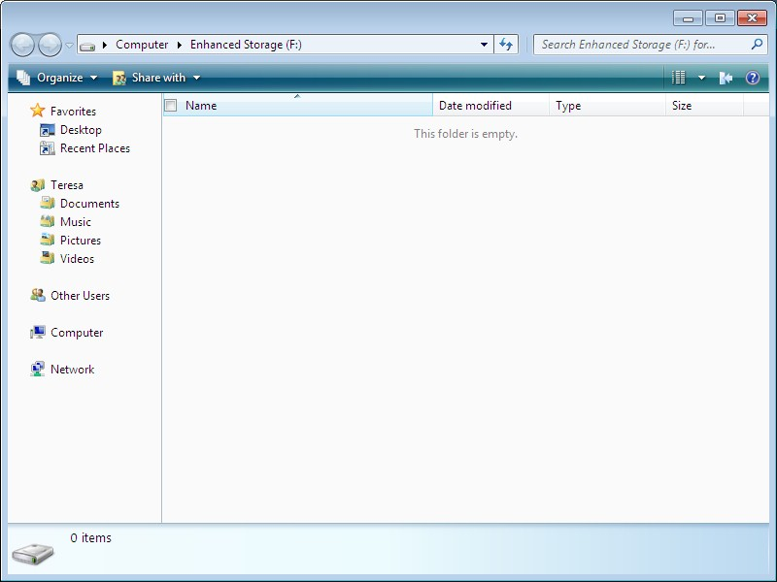
Initial Exp

Slide 30
Prior Experience
User plugs in a device with the password(s) set

Slide 31

Prior Exp
Unlock an Enhanced Storage Device
Type your password to unlock this device
Device Name: FOO Flash Drive
OK
Cancel

Slide 32
Prior Exp
Unlock an Enhanced Storage Device
Type your password to unlock this device
Device Name: FOO Flash Drive
****
OK
Cancel

Slide 33
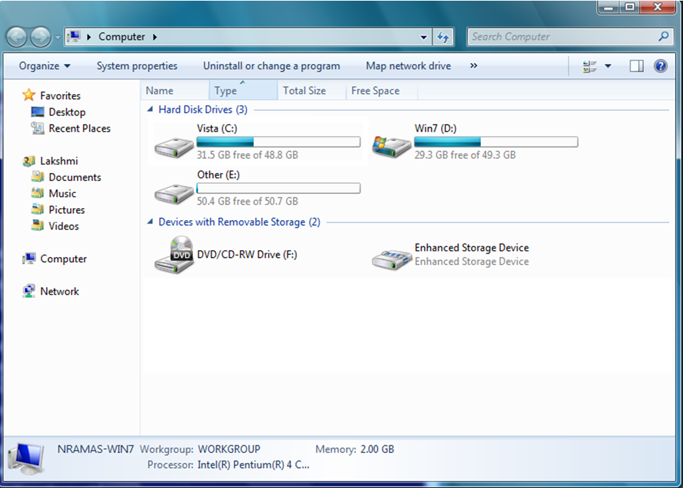

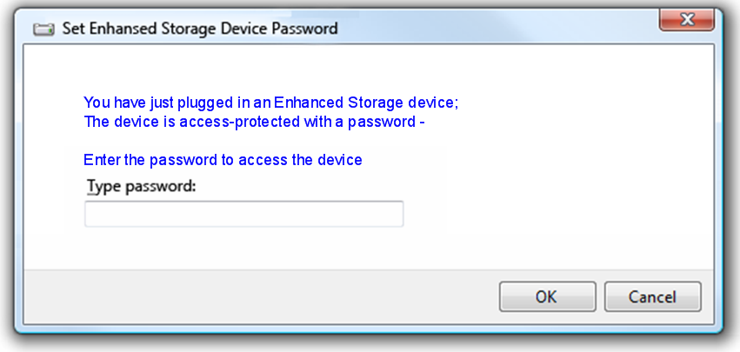
Prior Exp
My Computer Screen

Slide 34
User Forgets his Password and Enters the Wrong Password
User is presented with a few options
  Hint to remember his password
  Reset the device (loose his data)

Slide 35
Forgot PWD Exp
Unlock an Enhanced Storage Device
Type your password to unlock this device
Device Name: FOO Flash Drive
OK
Cancel

Slide 36
Forgot PWD Exp
Unlock an Enhanced Storage Device
Type your password to unlock this device
Device Name: FOO Flash Drive
****
OK
Cancel

Slide 37

Forgot PWD Exp
Unlock an Enhanced Storage Device
The password is not correct
Password Hint: What is my birth year?
Device Name: FOO Flash Drive
OK
Cancel

Slide 38
Password Retry Count
Forgot PWD Exp
Set to 50 times
After 3 attempts…

Slide 39
Forgot PWD Exp
Unlock an Enhanced Storage Device
The password is not correct
Password Hint: What is my birth year?
Device Name: FOO Flash Drive
****
OK
Reset Device
Cancel

Slide 40
Prior Exp
Unlock an Enhanced Storage Device
The password is not correct
Password Hint: What is my birth year?
Device Name: FOO Flash Drive
25 attempts left before the device must be reset
OK
Reset Device
Cancel

Slide 41
Prior Exp
Unlock an Enhanced Storage Device
The password is not correct
Password Hint: What is my birth year?
Device Name: FOO Flash Drive
4 attempts left before the device must be reset
OK
Reset Device
Cancel
After more attempts of failed passwords

Slide 42
Prior Exp
Unlock an Enhanced Storage Device
The password is not correct
Password Hint: What is my birth year?
Device Name: FOO Flash Drive
3 attempts left before the device must be reset
OK
Reset Device
Cancel

Slide 43
Prior Exp
Unlock an Enhanced Storage Device
The password is not correct
Password Hint: What is my birth year?
Device Name: FOO Flash Drive
2 attempts left before the device must be reset
OK
Reset Device
Cancel

Slide 44
Prior Exp
Unlock an Enhanced Storage Device
The password is not correct
Password Hint: What is my birth year?
Device Name: FOO Flash Drive
1 attempt left before
the device must be reset
OK
Reset Device
Cancel

Slide 45
Forgot PWD Exp
Prior Exp
Unlock an Enhanced Storage Device
You must reset the device
An incorrect password was entered too many times
Device Name: FOO Flash Drive
0 attempts left before the device must be reset
OK
Reset Device
Cancel

Slide 46
Prior Exp
Unlock an Enhanced Storage Device
You must reset the device
An incorrect password was entered too many times
Device Name: FOO Flash Drive
0 attempts left before the device must be reset
OK
Reset Device
Cancel

Slide 47
Forgot PWD Exp
Reset Enhanced Storage Device
Type the Security Identifier that is printed on the device
Before the device can be reset, you need to type the Security Identifier. What is Security Identifier?
Security Identifier:
Next
Cancel
Only displayed if the security ID is present on the device!
Need help content to explain where to find security ID?

Slide 48
Forgot PWD Exp
Reset Enhanced Storage Device
Type the Security Identifier that is printed on the device
Before the device can be reset, you need to type the Security Identifier. What is Security Identifier?
Security Identifier:
6Ab4czhefr3456
Next
Cancel

Slide 49
Forgot PWD Exp
Reset Enhanced Storage Device
Resetting the device
Do not remove the device until complete.
Close

Slide 50
Forgot PWD Exp
Reset Enhanced Storage Device
Resetting the device
Do not remove the device until complete.
Close

