Slide 1
The Windows 7
Windows Driver Kit
Jennifer Stepler
Program Manager, WDK
Microsoft Corporation
Keith Boyd
WDK Documentation Manager
Microsoft Corporation
Craig Ziegler
Test Lead, WDK
Microsoft Corporation

Slide 2
The Windows 7
Windows Driver Kit Updates
Jennifer Stepler
Program Manager, WDK
Microsoft Corporation

Slide 3
Agenda
Installation
Introducing Kit Servicing
Build Environment
Tools and Samples
Quality Improvements
Documentation
Q&A

Slide 4
WDK Installation Using Kitsetup
Supports servicing
Single UI for all kit components
Single EULA for all kit components
Documentation installation is part of complete kit installation

Slide 5
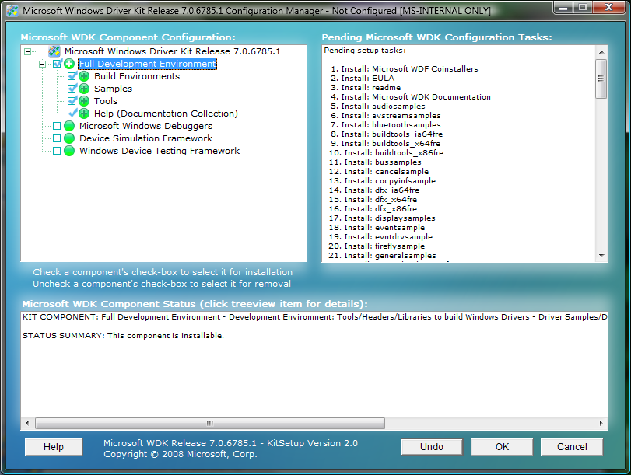
KitSetup

Slide 6
Introducing WDK Servicing
For Windows 7
  Individual “Hot Fixes” available on
  Microsoft Connect, as needed
  Scheduled Service Pack releases – feedback?
Beyond Windows 7 (feedback?)
  Combine Windows Software Development Kit with WDK
  Kit “in the clouds” – download/install/servicing

Slide 7
New Device Technologies
Biometrics
XPS Print
Hypervisor
Sensor/PC3
Windows Vista Display Driver
Model (WDDM) updates
Wave Real-Time (WaveRT)
Wireless Wide Area Network (WWAN) updates
Windows Driver Foundation (WDF) 1.9
And more…

Slide 8
Build Environment Changes
No Windows 2000 build environment
New build macros
  Use Binplace to target obj/bin directories
Microsoft Automatic Code Review (OACR)
  Runs by default in the WDK BE
  Runs PREfast for Drivers (PFD)
  in the background automatically
  Provides a Taskbar monitor

Slide 9
Build Environment Macros
ISSUE: During build, objects and binaries go under source.
Binplace used with TARGET_DESTINATION and PASS2_BINPLACE macros in the sources file allows objects and binaries to be redirected.
Benefits
  All objects and binaries that are built are stored separately
  Source code could be in read only location
  (stored on an external disk)
  Easy to cleanup the results of the build on
  object and binaries folders and start fresh
  Binaries folder designate a uniform target destination
  to binplace binaries in a common folder

Slide 10
Capabilities to Binplace Files
Binplace conveniently places all these in one directory:
The driver file, inf, co-installer, cat file.
The benefits
  Binplace creates a binplace.log and with
  the source and destination of the file
  Binplace can be used to organize a great number of files
  into the proper project directories or packages
  Binplace can be executed automatically by using macros in a sources file
  No need to execute a binplace from the command line
  each time you build your project
How it works?
  The binplace.exe utility is run on Pass2 of the build
  after all of the targets are built.
  Files can be binplaced by using TARGET_DESTINATION and
  PASS2_BINPLACE macros in the sources file.

Slide 11
Introducing OACR
demo

Slide 12
New Tools in the WDK
ComputerModelID (added)
OACR (added)
IRP Concurrency Coverage (proposed)
Service Discovery Profile (SDP)
Verifier (proposed)
CTRPP (proposed)

Slide 13
Sample Changes in the WDK
New Samples | Technology
WiFi, WLAN WiFi, Neterion 10G NDIS Miniport | Networking
miniSpy, nullFilter, passThrough, scanner, Metadata Manager, ctx, cdo, Encryption, Name Provider, Reparse Points, CancelSafe, swapBuffers | FileSystems
WpdBasicHardwareDriver, WpdServiceSampleDriver, WpdMultiTransportDriver (UMDF) | WPD
Consumer IR Receiver Sample Driver (smscir) (KMDF) | IR

Slide 14
The Windows 7
Windows Driver Kit Quality
Craig Ziegler
Test Lead, WDK
Microsoft Corporation

Slide 15
WDK Content Quality Efforts
QA efforts to improve the overall quality
of the samples and tools in the WDK
  Add header annotations to many WDK headers
  Run PREfast for Drivers (PFD) against sample sources
  Run Static Driver Verifier (SDV) against sample sources
  Check for /W4 warnings
    Compile with MSC_WARNING_LEVEL=/W4 /WX in sources
  Run Application Verifier against UMDF samples and driver tools
  Run Driver Verifier against samples
  Conduct code reviews of samples
  Remove obsolete and poor samples

Slide 16
Static Analysis Tools
Run Against WDK Samples
PREfast for Drivers
  112 bug fixes
  3110 PFD defects removed from samples
  Header annotations added to
  reduce false positives
Static Driver Verifier
  14 bug fixes
  Role type annotations added to samples

Slide 17
W4 Compiler Warnings
Found by setting MSC_WARNING_LEVEL=/W4 /WX in sources files
159 bug fixes
3934 warnings removed from samples
Typical errors include uninitialized variables, unreferenced parameters
MS08-014 – Security vulnerability could
have been prevented by /W4 compilation
Many Windows 7 samples will default
to /W4 in the sample sources file

Slide 18
Build Environment
Validation Testing
Internal testing tool developed to
validate the WDK build environment
Extracts API/Struct/Union/Enum information from headers
Validates that headers are
versioned properly
Finds discrepancies between headers
in WDK and documentation on MSDN

Slide 19
The Windows 7
Windows Driver Kit Documentation
Keith Boyd
Documentation Manager, WDK
Microsoft Corporation

Slide 20
WDK Documentation
Windows 7 docs coming at Beta
  Over two thousand new topics
  Biometrics, XPS, Hypervisor, WDDM, WaveRT, WWAN, WDF
  Complete technical review of all 802 topics in the Kernel-Mode Driver Architecture Reference
  Expanded requirements block
  for new DDIs
    OS version
    IRQL requirements
    Header/lib
  “Roadmaps” with basic steps to create drivers
WDK documentation monthly update on MSDN and WHDC
~1,000,000 million page views
per month on MSDN
~10,000 downloads
per month on WHDC
Increased visibility
  WDK Doc Blog
  (http://blogs.msdn.com/wdkdocs)
Notes:
20

Slide 21
We Take Your
Feedback Seriously!
Online and offline doc feedback triaged weekly
All Community Content (“MSDN Wiki”) is
reviewed and turned into a doc bug if merited,
removed if deemed unhelpful or inaccurate
We review metric data based on page views
and user ratings to identify areas for reinvestment
and improvement
All verbatim feedback is triaged and
fixed at appropriate intervals
We survey the community annually and
drive responses back into the documentation

Slide 22
2007 Feedback Initiatives
Results based on your feedback in annual surveys
Roadmaps
  Audio and WFP in WinHEC release, target completion by Dec. 2008
New doc viewer being built based on your feedback
Standalone CHM version of WDK content for Beta.
Requirements block implemented for new topics
Monthly refresh of WDK docs on WHDC
Better quality driver test descriptions in WLK docs
Better quality sample readmes in WDK docs
Side-by-side machine translation pilot
for WDK on MSDN

Slide 23
2008 WDK Doc Survey Results
357 responses! Thank you
50.6% indicated docs are getting better, 17.7% said worse
Kernel Mode Architecture
documentation and improved
index were top user priorities
Multifunction devices, imaging,
display, infrared, modem and storage
all identified as areas for reinvestment
More production quality samples!

Slide 24
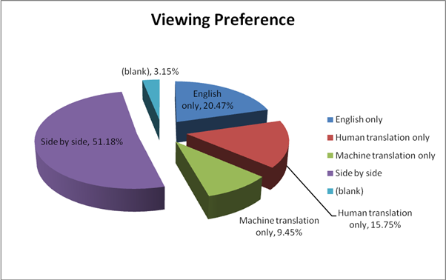
How Do You Like
Your Translation?

Slide 25
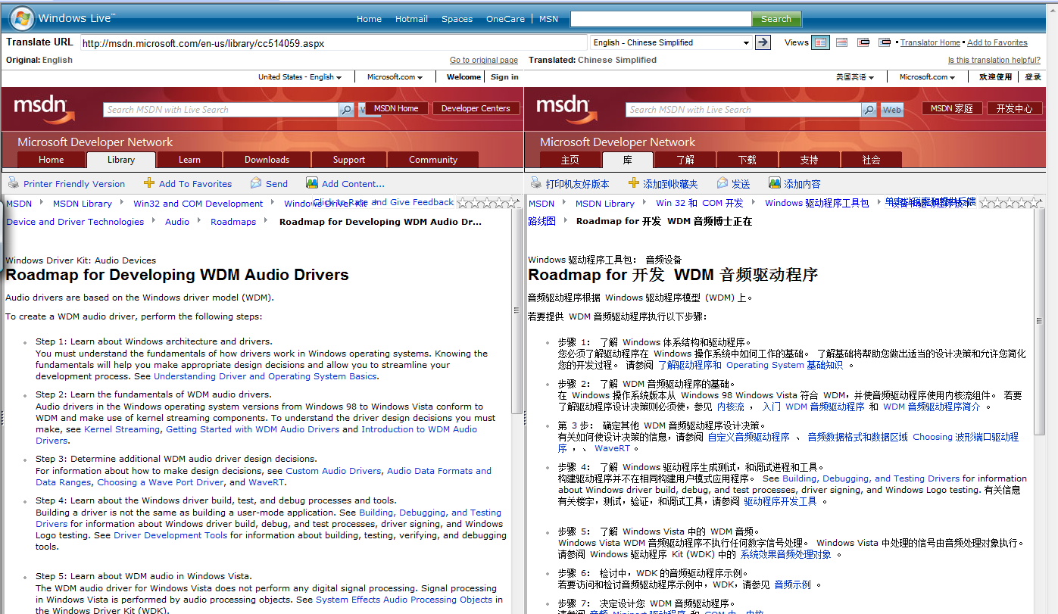
Side-by-Side Translation
    English to Simplified Chinese on http://translator.live.com

Slide 26
Translation Results and Plans
Machine Translation Beta participation
totaled 502,730 visits
  Pilot ran Oct. 1st, 2007 through Feb. 28th, 2008
Windows Driver Kit 3rd most viewed of 10 in pilot
Majority of our customers
non-native English speakers
Used survey data to prioritize target
languages for side-by-side translation
Content in some top languages
targeted by end of FY09
  Japanese, Chinese (Simplified), Chinese (Traditional),
  Russian, Korean, Portuguese, French, Spanish
Notes:
26

Slide 27
Call To Action
Send feedback on Servicing Plan, Docs, Build Environment, etc.
Try Microsoft Automated Code Review – tell us what you think
Try the new Macros

Slide 28
Additional Resources
  Contact the WDK Team:
  WDKPMFT@microsoft.com (WDK PM team)
  WDKQA@microsoft.com (WDK Test team)
  DDKSurv1@microsoft.com (WDK Docs team)
  Available online:
    WHDC website: http://www.microsoft.com/wdk
    Read the WDK Doc blog at http://blogs.msdn.com/wdkdocs/default.aspx
    Download monthly WDK doc refresh from http://www.microsoft.com/whdc/DevTools/WDK/WDKdocs.mspx
    Driver Development Newsgroup: http://msdn.microsoft.com/newsgroups/default.aspx?dg=microsoft.public.development.device.drivers&lang=en&cr=US

Slide 29
Questions?

Slide 30
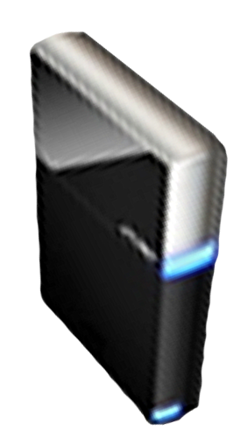


Please Complete A Session Evaluation Form
Your input is important!
Visit the WinHEC CommNet and complete a Session Evaluation for this session and be entered to win one
of 150 Maxtor® BlackArmor™ 160GB External Hard Drives
50 drives will be given away daily!
http://www.winhec2008.com
BlackArmor
Hard Drives provided by:

Slide 31


© 2008 Microsoft Corporation. All rights reserved. Microsoft, Windows, Windows Vista and other product names are or may be registered trademarks and/or trademarks in the U.S. and/or other countries.
The information herein is for informational purposes only and represents the current view of Microsoft Corporation as of the date of this presentation. Because Microsoft must respond to changing market conditions, it should not be interpreted to be a commitment on the part of Microsoft, and Microsoft cannot guarantee the accuracy of any information provided after the date of this presentation.
MICROSOFT MAKES NO WARRANTIES, EXPRESS, IMPLIED OR STATUTORY, AS TO THE INFORMATION IN THIS PRESENTATION.

