Slide 1
Windows Performance Analysis: Using Windows Performance Tools
Michael Milirud
Program Manager
Windows Fundamentals

Slide 2
Agenda
Motivation
Overview of Windows Performance Toolkit
Key Concepts
Case Studies
Conclusion

Slide 3
Objectives
When you complete this presentation, you'll
  Understand why performance is so critical
  How Windows enables performance analysis
  of a live production system
  What do WPT Kit, Performance Analyzer tool suite, and xperf tools have in common and where do you get them
You’ll also be able to do the following
  Collect a performance trace
  Do basic analysis of a performance trace

Slide 4
Why Care?
Motivation
Overview of Windows Performance Toolkit
Key Concepts
Case Studies
Conclusion

Slide 5
Without Good Performance…
Performance directly impacts
  Productivity
  Usability
  Support for larger scenarios
  Customer satisfaction

Slide 6
Ensuring Good Performance
Responsiveness
Unresponsive system → Customer dissatisfaction
Resource utilization
CPU, disk, memory, network, battery
Resources are limited and shared,
use them effectively
Good citizenship
It takes one component to impact system performance

Slide 7
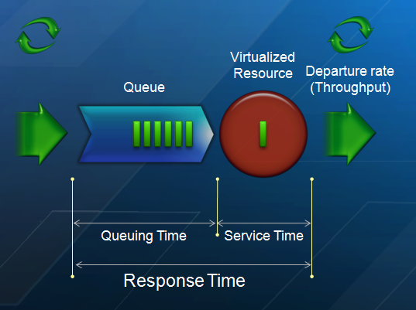
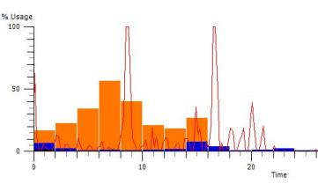
Modeling vs. Reality

Slide 8
Resource Usage Concepts
Resource usage point of view
  Low-level, close to the actual machine constraints (i.e., reality)
Each application/service/component uses
system resources to complete its requests
  Processor time
  Physical memory space
  Virtual address space
  Disk service time
  Disk space
  Network bandwidth
  Battery power
  …
Machine constraints = resource usage limits

Slide 9
I Get It, But Where Do I Get It?
Motivation
Overview of Windows Performance Toolkit
Key Concepts
Case Studies
Conclusion

Slide 10
Windows Performance Toolkit
The official kit for Windows performance analysis
  Built and used by the Windows organization
Wide support range
  Cross platform: Vista, Server 2008, Windows 7,
  Windows Server 2008 R2
  Cross architecture: x86, x64, and Itanium
Publicly available
Contains Performance Analyzer tool suite
  Expect to see more tools in Windows 7 Beta
Strategic ongoing investment to enable
performance analysis on Windows

Slide 11
Where is WPT Kit applied Today?
Bread and butter of
Windows Engineering group
The tool of choice for Windows 7 M3 Performance Push
Underlying technology for industry-wide OEM performance effort

Slide 12
What is Performance Analyzer?
Tools for capture, post-processing,
and analysis of performance traces
Very mature
  Over 10 years in development within
  the Windows Performance Team
  Currently in its fourth generation
Product quality code
  Enterprise grade level
  Core code reused inbox
  Dev/Test/PM/UA – the whole deal ☺
  Documentation on MSDN

Slide 13
Why Use Performance Analyzer?
Holistic performance analysis
  All processes/threads
  Both user and kernel mode
  Visibility into DPCs and ISRs, scheduling,
  disk and file I/O, memory usage, etc.
Analyze what customer experiences
  Catch the problem as it happens
  Capture-Anywhere-Decode-Anywhere
Very low overhead vs. other alternatives
  System-wide temporal “debugger”
    Traditional debugging gives us a logical view of system activity,
    but blinds us to its temporal effects

Slide 14
Issues Performance Analyzer Can Help Root-cause
Responsiveness issues
Long delays in applications
High CPU usage
High Disk usage
Slow On/Off transitions
Poor battery life
And much more!

Slide 15
The Big Picture
XML file
XPerfView
6. CLI trace analysis via actions
5. GUI trace analysis via graphs and summary tables
3. Controls logging sessions and enables/disables providers
Merged
ETL file
Action
XPerf
System and Symbol Information
Control/Status
Control/Status
Post Processing
Control/Status
4. Metadata injection
ETW
ETL file
Event Providers
ETW Session
Event Providers
1. Collection of configurable in-memory buffers that is managed by the kernel
2. Any component that has been instrumented with Event Tracing API
Control/Status
Data flow

Slide 16
How Does Performance Analyzer Pull This Off?
ETW is the magic behind the curtains
  ETW stands for Event Tracing for Windows
Core component since Windows 2000
High performance, low overhead, highly scalable
  ~2.5% CPU usage for sustained rate of
  10,000 events/sec on a 2GHz CPU
For details, please see “Event Tracing” on MSDN
Also check out the Events and Counters: Writing Instrumentation to Monitor, Diagnose, and Debug Your Application talk from the ETW team!

Slide 17
You Got My Attention –
What’s Next?
Motivation
Overview of Windows Performance Toolkit
Key Concepts
Case Studies
Conclusion

Slide 18
Capture a Performance Trace
A performance trace is a persisted form
of a (complex) performance measurement
…Perform the scenario in question…
> xperf –start perf!GeneralProfiles.InSequentialFile
> xperf –stop perf!GeneralProfiles.InSequentialFile trace.etl

Slide 19
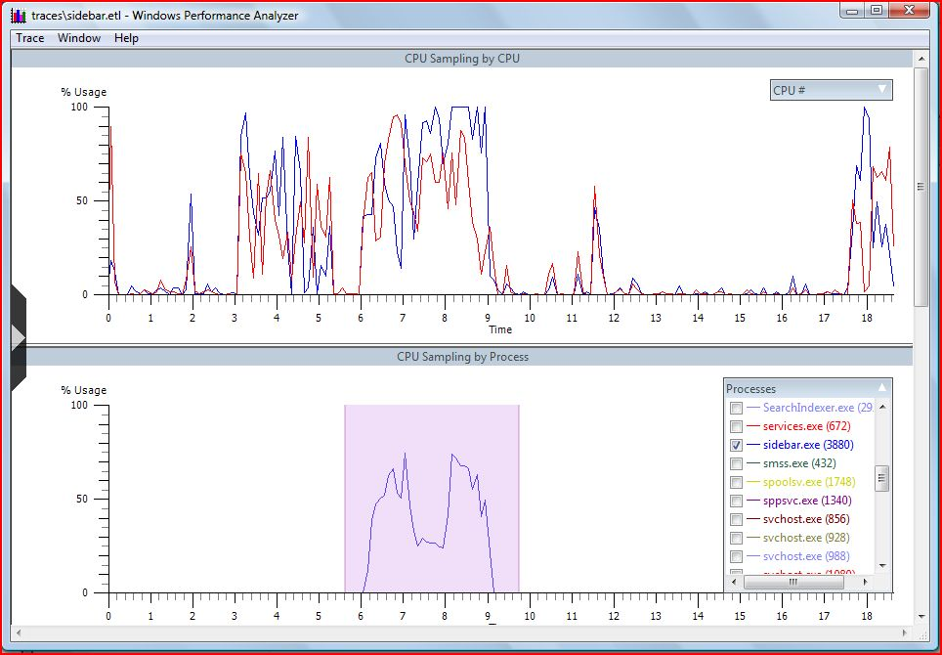
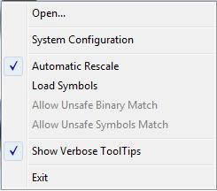
What is CPU Time Spent On?
xperf trace.etl

Slide 20
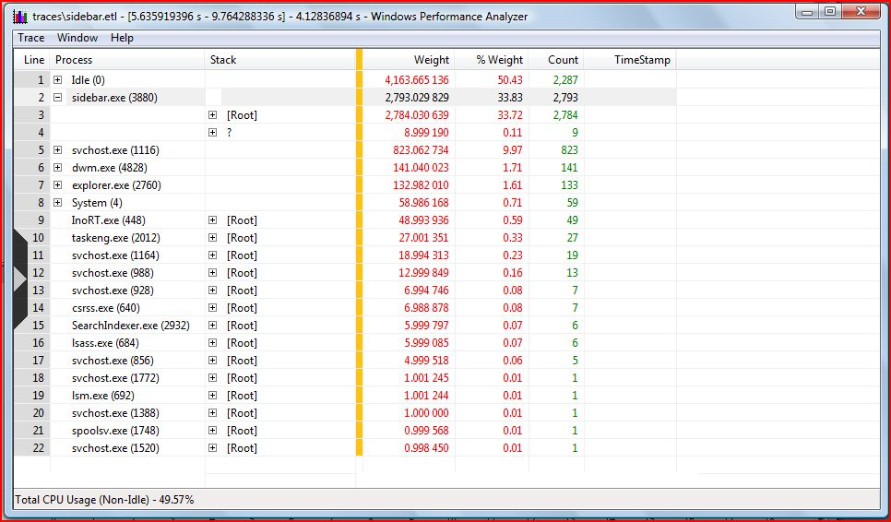
CPU Summary Table
Grouping columns
Aggregated columns

Slide 21
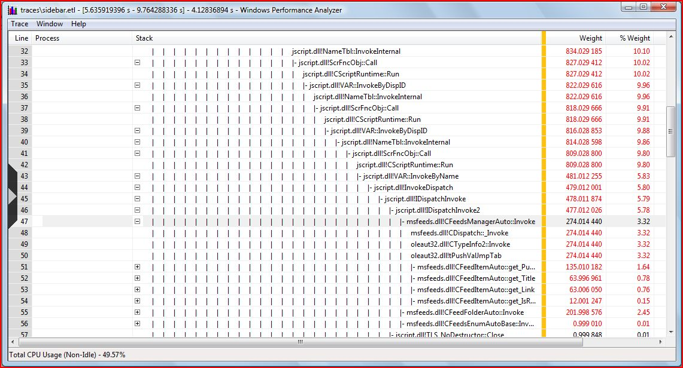
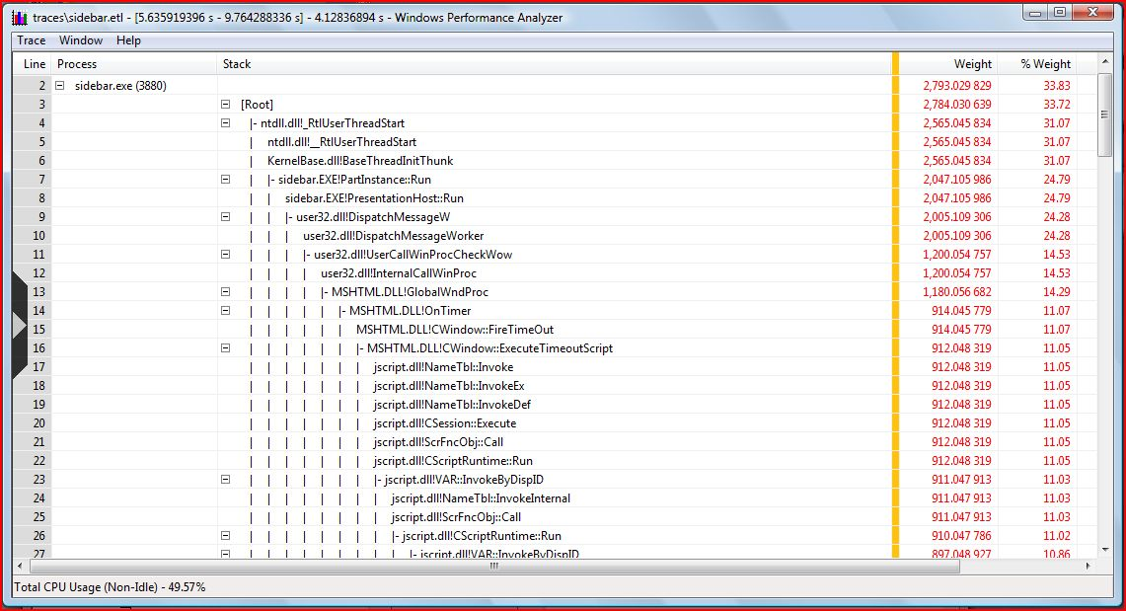
CPU Summary Table

Slide 22
Now Show Me Some Action
Motivation
Overview of Windows Performance Toolkit
Key Concepts
Case Studies
Conclusion

Slide 23
Case Study #1
CPU Usage

Slide 24
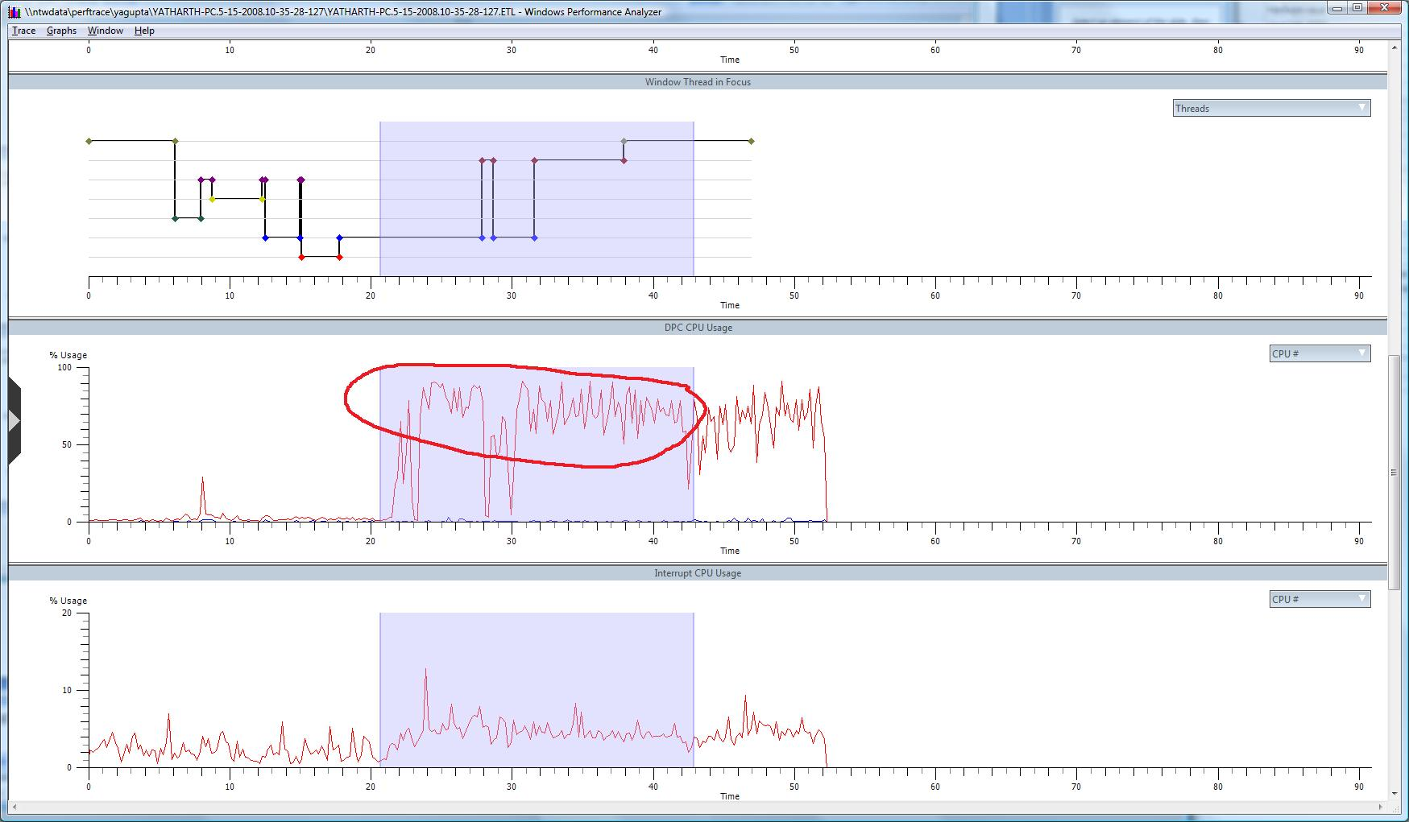
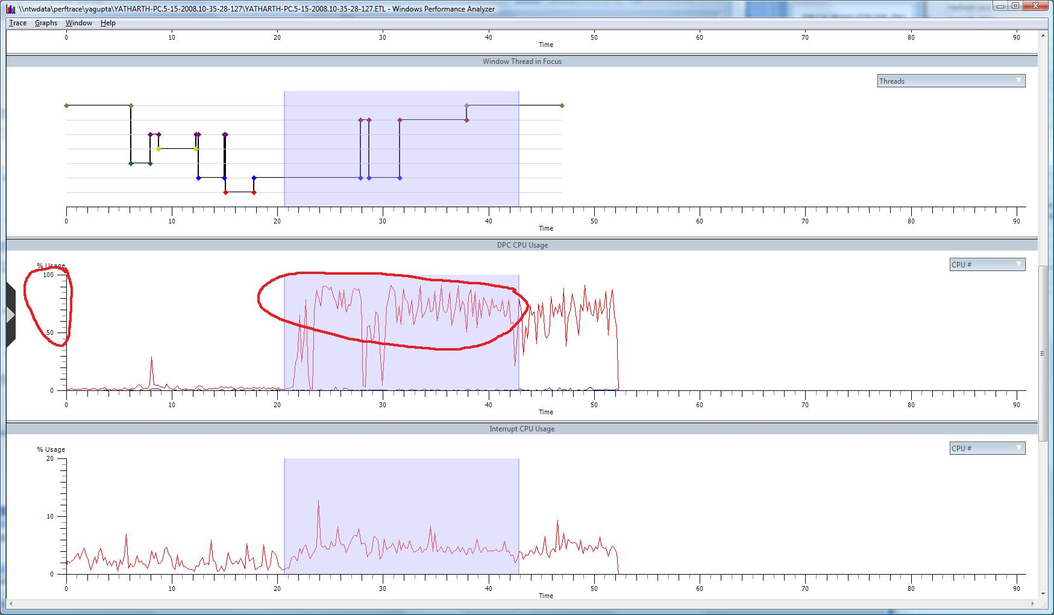
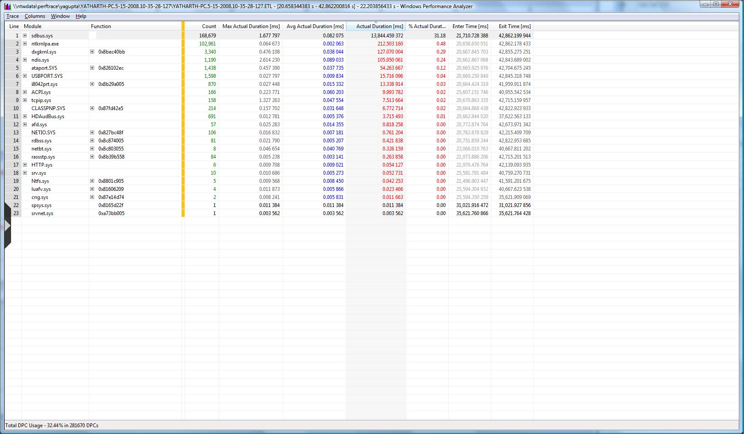
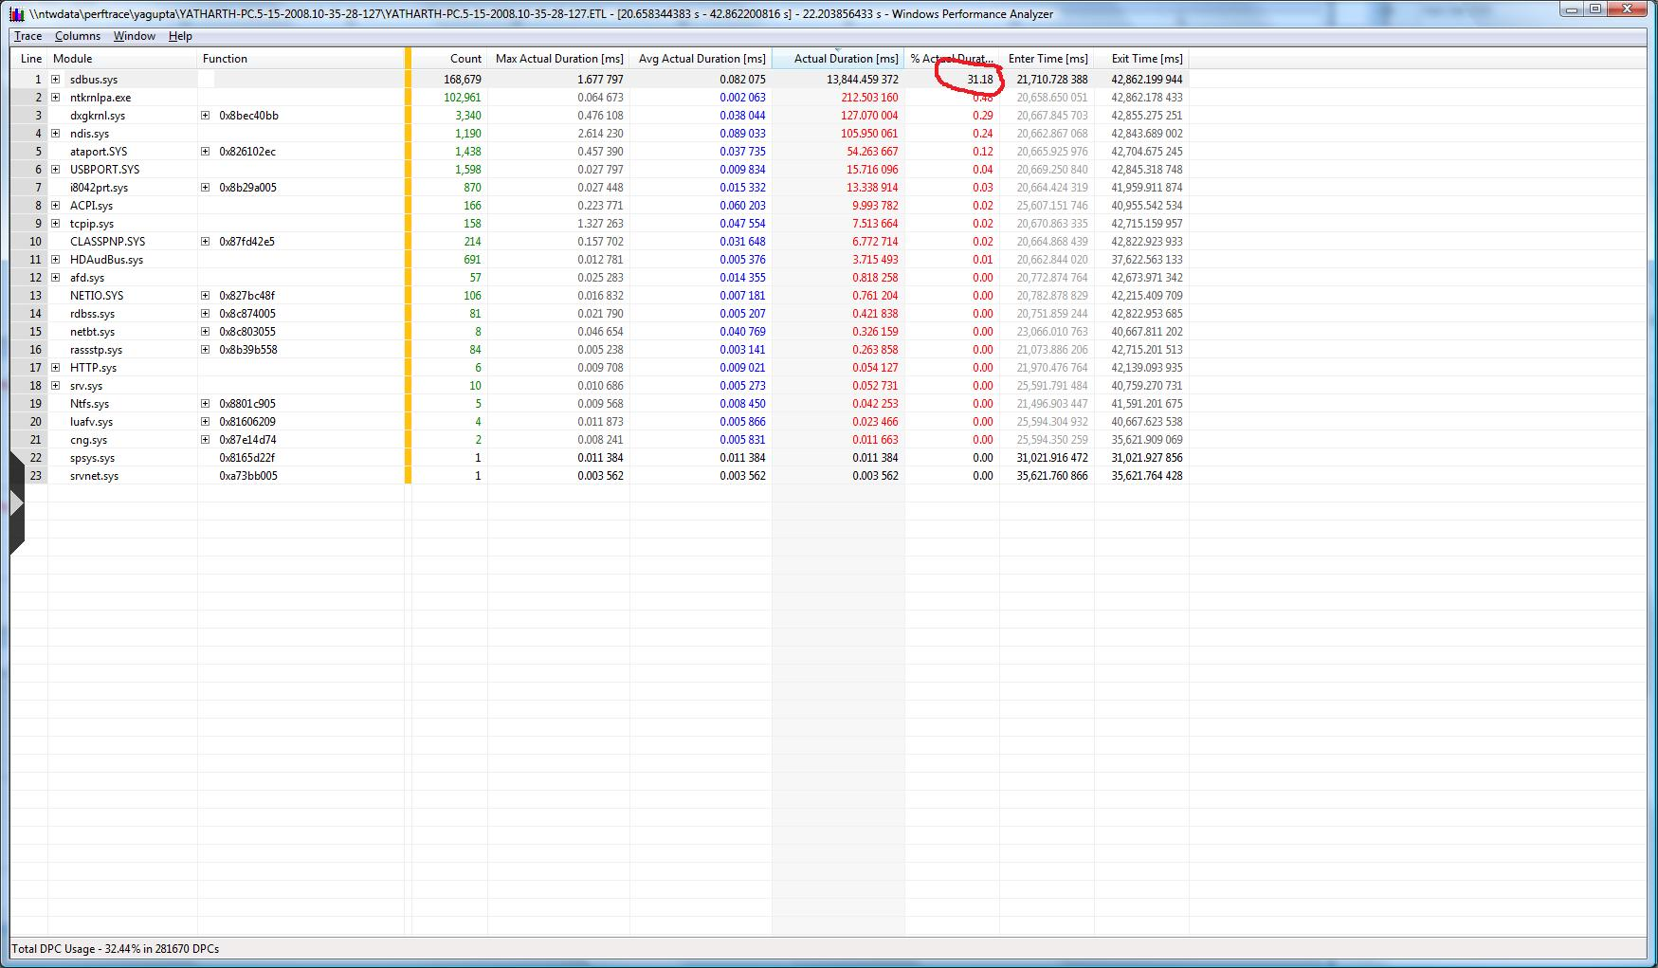
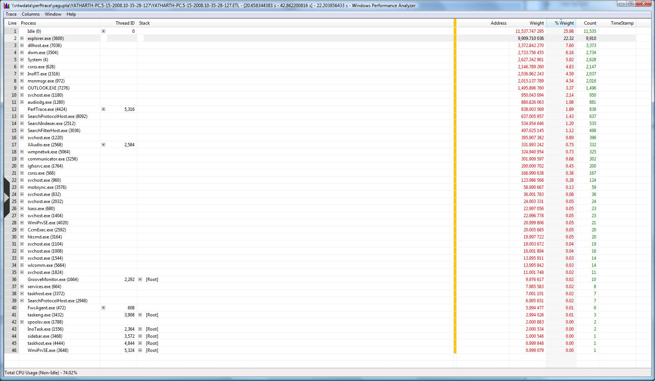
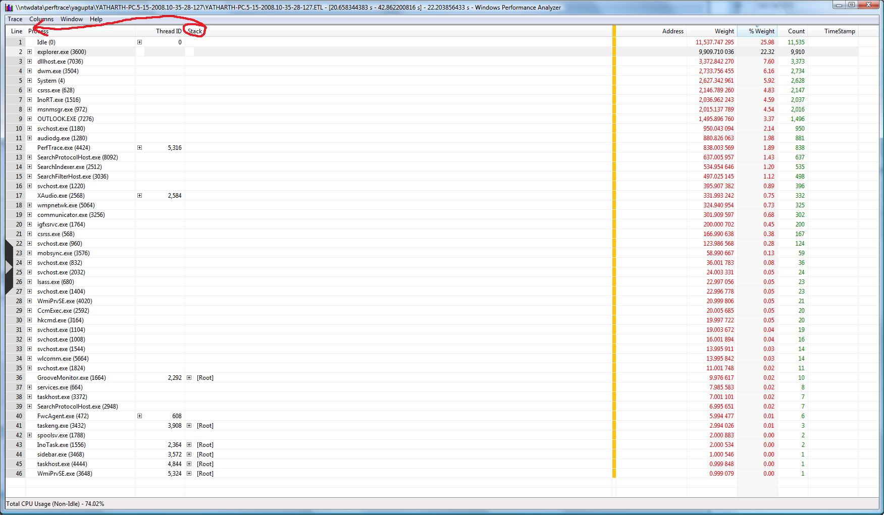
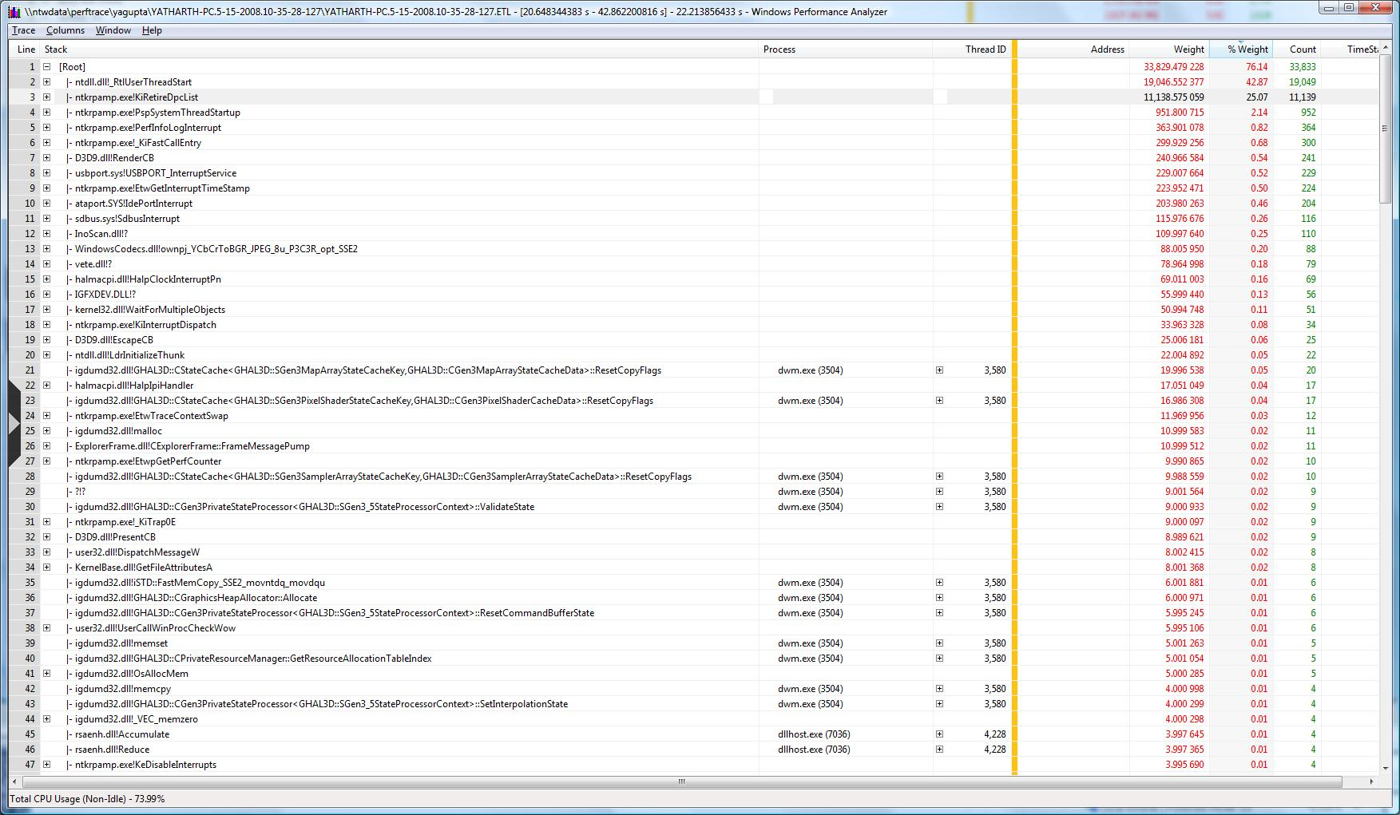
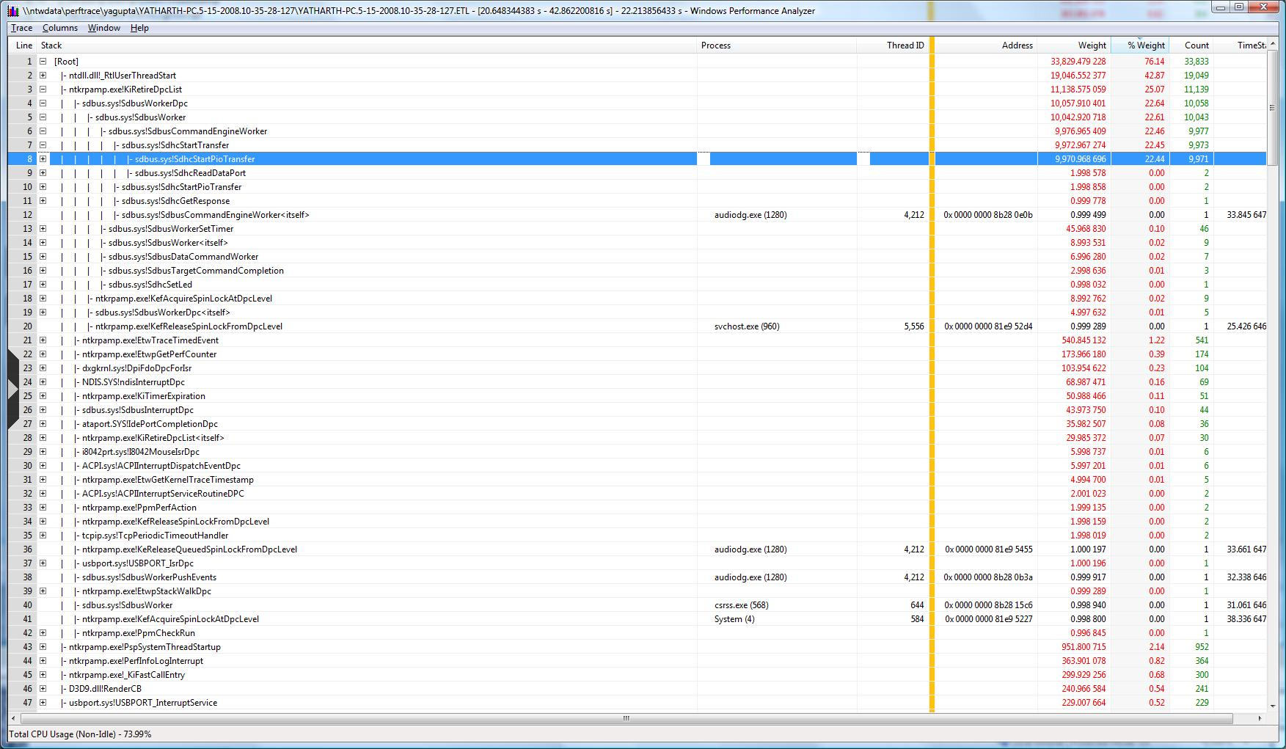
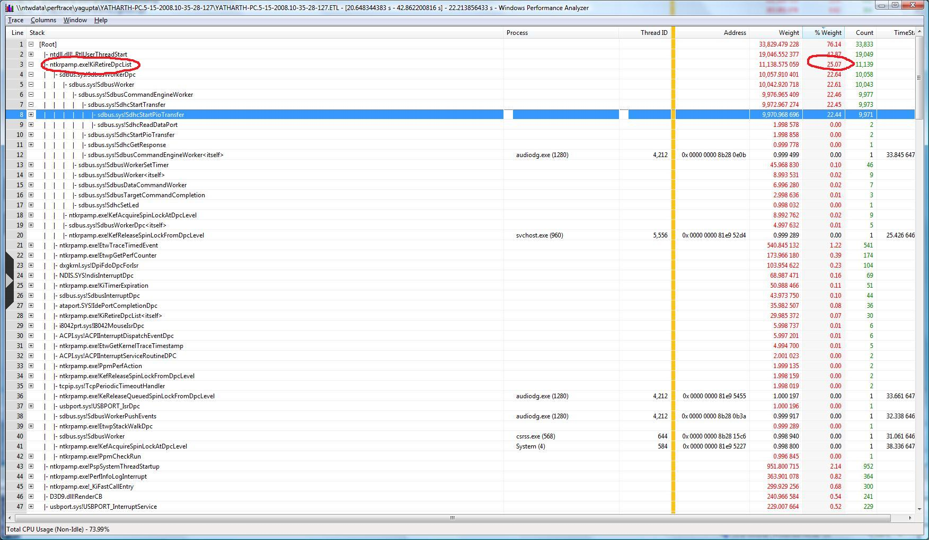
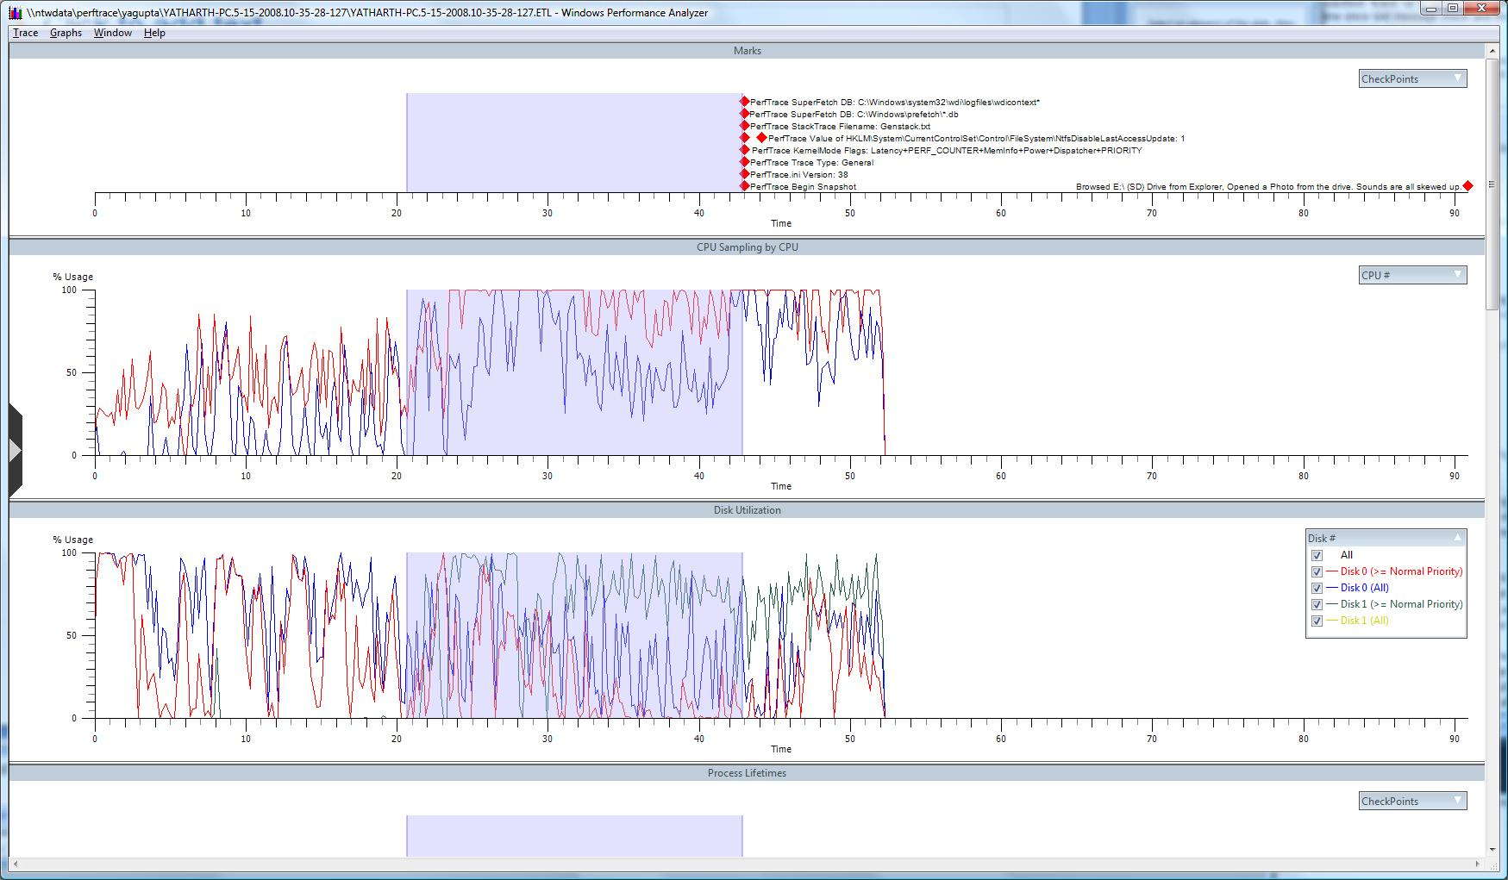
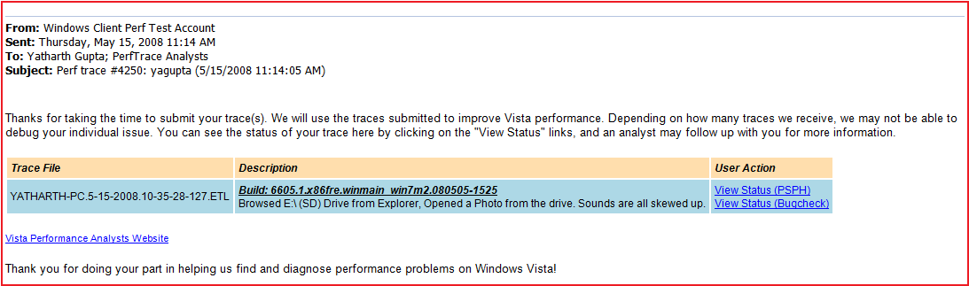
User browsed E:\ (SD) drive from Explorer and opened
a photo from the drive. Audio playback glitched.

Slide 25
CPU Case Study Summary
One bad component can disrupt
numerous good components
High usage of any single resource
can cause performance issues
Spending too much CPU at DPC
impacts performance
Use DMA instead of PIO when
transferring data

Slide 26
Case Study #2
Disk Usage

Slide 27
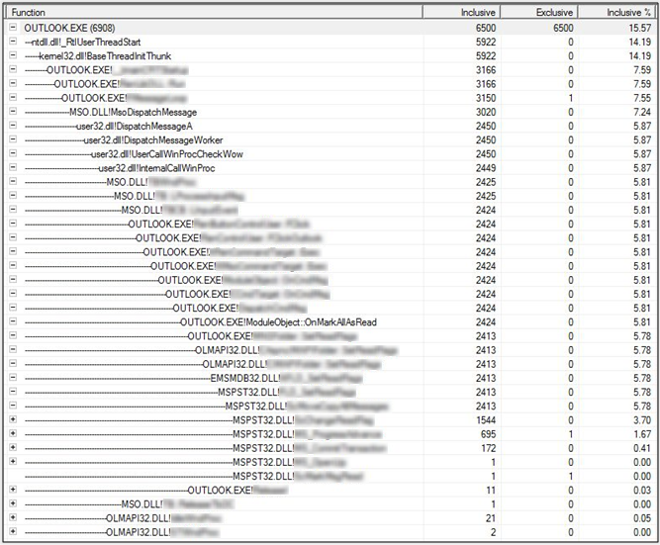
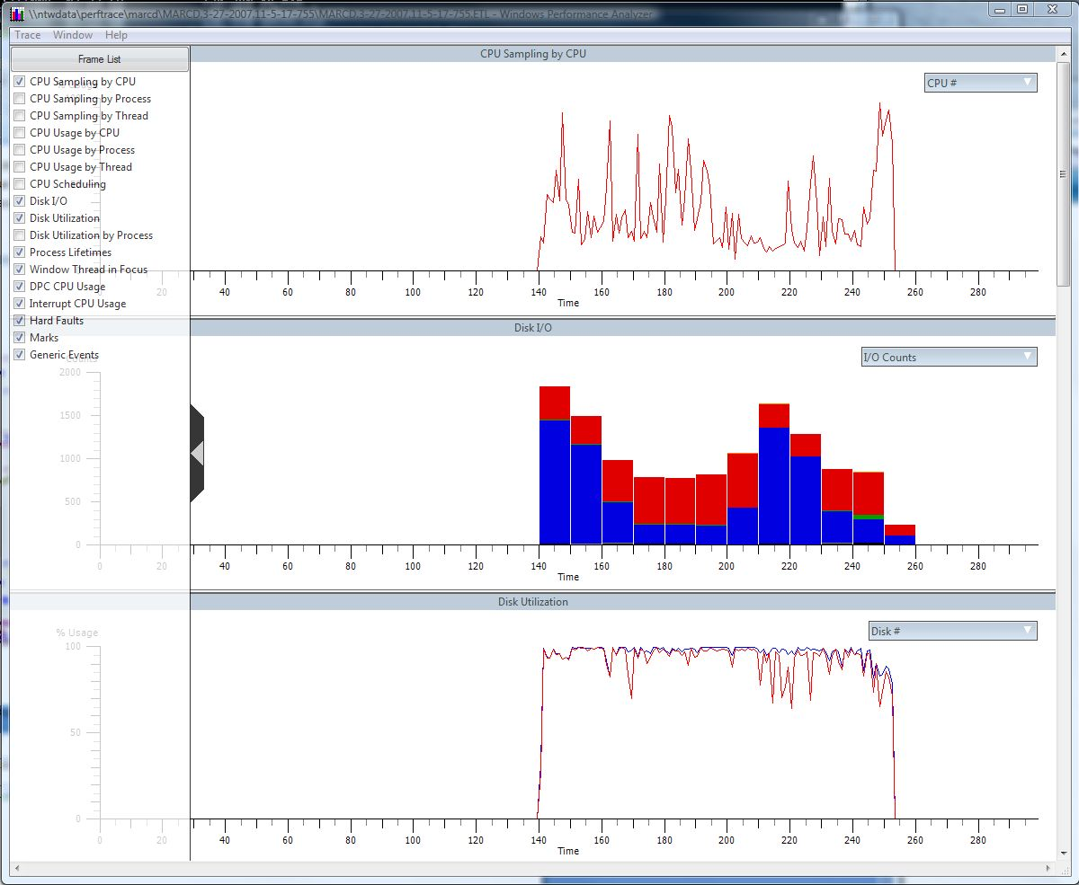
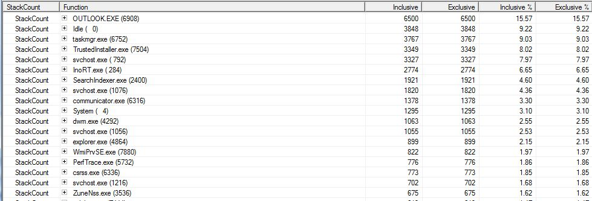
Marking 875 messages in Outlook 2007
folder as read is terribly slow

Slide 28
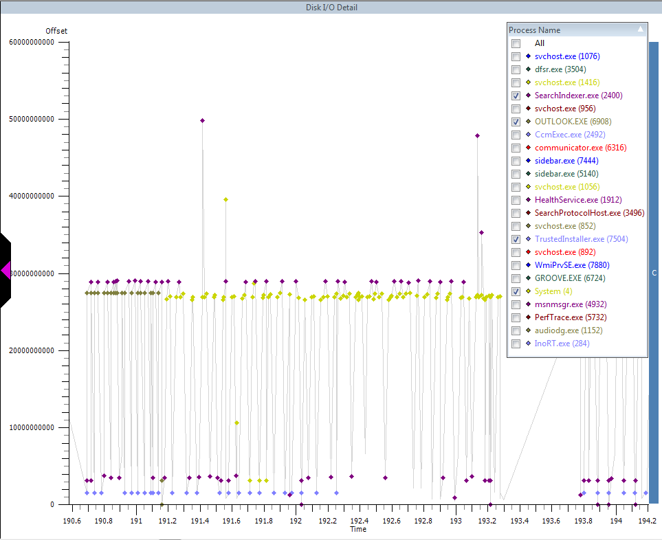
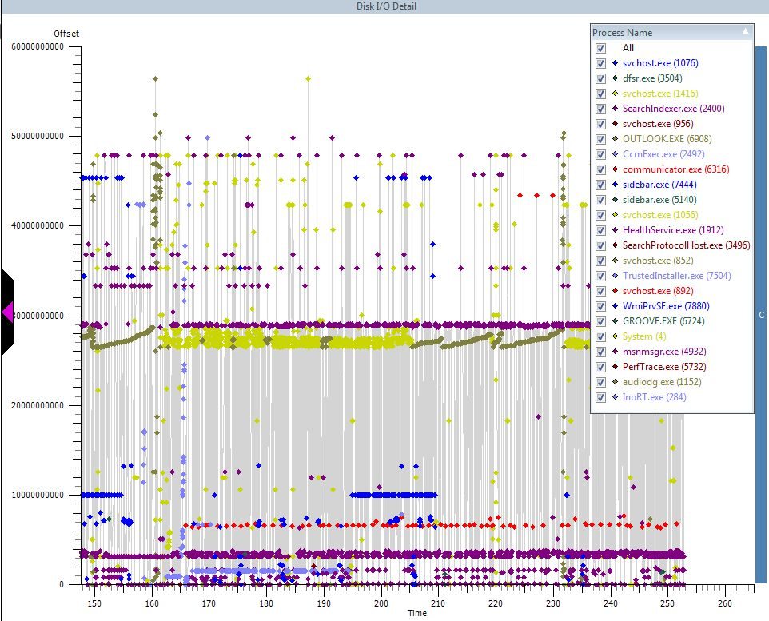
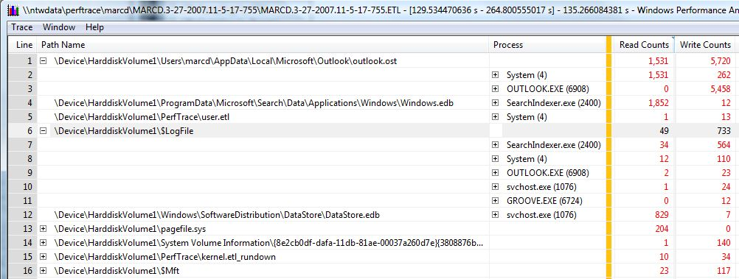
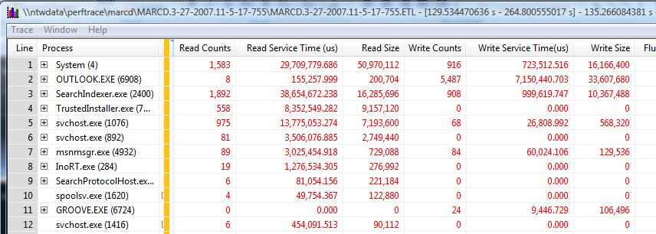
Marking 875 messages in Outlook 2007
folder as read is terribly slow
Throughput can be cut by 90%

Slide 29
Disk Case Study Summary
Multiple components working well in isolation could impact performance
when executed in parallel
Fighting over disk dramatically impacts performance for all involved
  Disk seeks can cut throughput by 90%
Schedule all work that can wait
as Idle tasks
  See Task Scheduler documentation on MSDN

Slide 30
What Have We Learned?
Motivation
Key Concepts
Overview of Windows Performance Toolkit
Case Studies
Conclusion

Slide 31
Best Practices
Resource efficiency across all scenarios
CPU, GPU, memory, disk, network
Minimize footprint (e.g., working set size, file sizes)
Responsiveness
How responsive is your component
under adverse conditions?
Lack of responsiveness impacts customer satisfaction
Good Citizenship
One component can impact overall system performance
Adapt to system environment
Defer or coalesce non-critical activity

Slide 32
Summary
Performance is critical for customer satisfaction
Windows Performance Toolkit are the official performance tools from/for Windows
Performance Analyzer
  xperf:
  Trace capture, processing, and command-line analysis
  xperfview:
  Visual trace analysis
  xbootmgr:
  On/Off transition trace capture

Slide 33
Call to Action
Download WPT Kit (see resources)
Capture traces across key scenarios
Evaluate resource utilization
Identify resource bottleneck
Invest in ETW instrumentation
in your applications
Visit Windows Performance Analysis Dev Center
Ask questions on the forum

Slide 34
Resources
Windows Performance Analysis Dev Center:
http://msdn.microsoft.com/en-us/performance
Windows Performance Toolkit MSDN docs:
http://msdn.microsoft.com/en-us/library/cc305187.aspx
Windows Performance Analysis forum:
http://social.msdn.microsoft.com/Forums/en-US/wptk_v4/threads/
Event Tracing for Windows MSDN docs:
http://msdn2.microsoft.com/en-us/library/aa363787.aspx
Windows Internals
  “Windows Internals” by Mark Russinovich and David Solomon
  4th edition is out, 5th edition due out soon

Slide 35
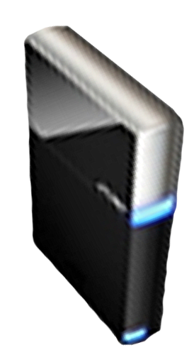


Please Complete A Session Evaluation Form
Your input is important!
Visit the WinHEC CommNet and complete a Session Evaluation for this session and be entered to win one
of 150 Maxtor® BlackArmor™ 160GB External Hard Drives
50 drives will be given away daily!
http://www.winhec2008.com
BlackArmor
Hard Drives provided by:

Slide 36


© 2008 Microsoft Corporation. All rights reserved. Microsoft, Windows, Windows Vista and other product names are or may be registered trademarks and/or trademarks in the U.S. and/or other countries.
The information herein is for informational purposes only and represents the current view of Microsoft Corporation as of the date of this presentation. Because Microsoft must respond to changing market conditions, it should not be interpreted to be a commitment on the part of Microsoft, and Microsoft cannot guarantee the accuracy of any information provided after the date of this presentation.
MICROSOFT MAKES NO WARRANTIES, EXPRESS, IMPLIED OR STATUTORY, AS TO THE INFORMATION IN THIS PRESENTATION.

