Slide 2
Using Static Analysis Tools When Developing Drivers
Adam Shapiro
Senior Program Manager
Static Analysis Tools
Microsoft Corporation

Slide 3
Session Outline
Static analysis tools
What they are
Benefits
What’s new for the next version of Windows
PREfast for Drivers (PFD)
Core PREfast annotations
Static Driver Verifier (SDV)
RoleTypes
Summary

Slide 4
What Is Static Analysis?
Compile-time analysis of the source program
Like code inspection, but performed by a tool
Compile-time type-checking a simple example
Looks for violations of well-defined constraints
Procedure contracts or API contracts

Slide 5
Examples of Bugs Found by Static Analysis
f() requires p to be non-NULL:
Completing the same IRP twice:
p = NULL;
…
f(p);
IoCompleteRequest (Irp);
...
IoCompleteRequest (Irp);

Slide 6
Why Use Static Analysis?
Cheap Bugs!
Rule of thumb
“A defect that costs $1 to fix on the programmer’s desktop costs $100 to fix once it is incorporated into a complete program and many thousands of dollars if it is identified only after the software has been deployed in the field.”
“Building a Better Bug Trap” — The Economist June 2003

Slide 7
Tools Make You More Effective
Push-button technology
100% path coverage
At little cost (let a computer do it)
Quickly (minutes or hours versus weeks)
Defects are discovered early
Even before device hardware is available
Before designing test cases
Often while still coding
Defect reports are easy to use
A direct reference to the defective path (or point) in the source code reduces cost of debugging

Slide 8
Static Analysis How does it work?
Builds an abstract model of a driver and exhaustively inspects execution along all paths
The abstract model is simpler: It’s reduced...
It’s so much simpler that it’s possible to have it inspected (“simulated”) exhaustively
Over-approximation of the driver
The control part remains the same
All paths are preserved and treated equally
The data state is over-approximated
If argument x is not constrained, assume any value
If (x>0) guards the point of interest, keep track of Boolean (x>0), but not integer value of x: Boolean is simpler than integer
If (x > 0) { IoCompleteRequest (Irp); }

Slide 9
Static Analysis Not a silver bullet
Does not replace functional testing
Targets violations of a given set of well-defined constraints
Principal limitation
It doesn’t know about every possible error
Algorithms are based on source code abstraction and heuristics
Results in both false positives and false negatives
It is a useful tool

Slide 10

Comparing Static Tools
 | PREfast for Drivers | Static Driver Verifier
Driver Models | Any | WDM KMDF NDIS
Language | C and C++ | C only
Issues found | Local defects Easy to fix High volume | Global defects Harder to fix Low volume
Scope | Procedure level Local violations | Inter-procedural Finds deep bugs
Development Cycle | Apply early: “When the driver compiles” Runs in minutes, so run often | Apply later: “When the basic structure of the driver is in place” Run periodically, after fixes KMDF avg. verification = 20 min WDM avg. verification = 40 min

Slide 11
Static Tools Work Together
Two complementary technologies provided in the WDK
PREfast for Drivers: Look inside every procedure for possible violations
Static Driver Verifier: Look along paths, cross inter-procedural boundaries

Slide 12
Static Tools Work Together Example
ReadFoo ( PIRP Irp )
{
...
status = Bar (Irp);
if (status) {
IoCompleteRequest(Irp);
}
}
ReadFoo ( PIRP Irp )
{
PIRP p = NULL;
...
if (status) {
IoCompleteRequest(p);
}
}
X
X
Bar ( PIRP Irp )
{
...
IoCompleteRequest(Irp);
return STATUS_SUCCESS;
}

Slide 13
What’s New for PFD
“PFD Clean” initiative inside Microsoft
For Windows 7 – Microsoft-owned inbox drivers and WDK samples are PFD Clean
Microsoft drivers and WDK public headers are annotated
Internal engine improvements
Broader range of expressions
Supports Const, member names, side-effect-free C expressions
Better annotation error checking
Part of Microsoft Automated Code Review (OACR) in the WDK

Slide 14
What’s New for SDV
Inbox drivers and WDK KMDF, WDM samples are SDV Clean
SDV for NDIS – Great collaboration with NDIS team
39 new rules for NDIS Drivers
Expanded rule set for WDM and KMDF
Reliability, security, IRQL levels, synchronization, correct object creation rules
Role types for WDM, KMDF, and NDIS drivers
Pre-condition rules
Per-entry verification
Engine improvements
Improved performance, scalability, and accuracy
Reduced NUR (non-useful result) especially for all rules

Slide 15
PREfast for Drivers
Fast (typically 2–5x compile time)
Finds a lot of “inadvertent” errors and some “hard” ones
Works on code that compiles; doesn’t need to run

Slide 16
PREfast for Drivers
Some errors PREfast can find
Null pointer, uninitialized variable (along an unusual path)
Local leaks (memory, resource)
Mismatched parameters
Failure to check result
Format/list mismatch
Misuse of some IRQLs
Various special cases that are easily missed
For example, Cancel IRQL
Proper use of callback/function pointers

Slide 17
Problem: Driver-Specific Resource Leak
void LeakSample(BOOLEAN Option1)
{
NTSTATUS Status;
KIRQL OldIrql;
BufInfo *pBufInfo;
KeAcquireSpinLock(MyLock,&OldIrql);
//...
if (Option1) {
pBufInfo = ExAllocatePoolWithTag(NonPagedPool, sizeof(BufInfo), 'fuB_');
if (NULL==pBufInfo) {
return STATUS_NO_MEMORY;
}
//...
KeReleaseSpinLock(MyLock, OldIrql);
return STATUS_SUCCESS;
}
//…
#include <wdm.h>
PKSPIN_LOCK MyLock;
typedef struct {
char buff[100];
} BufInfo;

Slide 18
Applying PFD: Driver-Specific Resource Leak
void LeakSample(BOOLEAN Option1)
{
NTSTATUS Status;
KIRQL OldIrql;
BufInfo *pBufInfo;
KeAcquireSpinLock(MyLock,&OldIrql);
//...
if (Option1) {
pBufInfo = ExAllocatePoolWithTag(NonPagedPool, sizeof(BufInfo), 'fuB_');
if (NULL==pBufInfo) {
return STATUS_NO_MEMORY;
}
//...
KeReleaseSpinLock(MyLock, OldIrql);
return STATUS_SUCCESS;
}
//…
#include <wdm.h>
PKSPIN_LOCK MyLock;
typedef struct {
char buff[100];
} BufInfo;
warning 8103: Leaking the resource stored in 'SpinLock:MyLock‘.

Slide 19
Solution: Driver-Specific Resource Leak
void LeakSample(BOOLEAN Option1)
{
NTSTATUS Status;
KIRQL OldIrql;
BufInfo *pBufInfo;
KeAcquireSpinLock(MyLock,&OldIrql);
//...
if (Option1) {
pBufInfo = ExAllocatePoolWithTag(NonPagedPool, sizeof(BufInfo), 'fuB_');
if (NULL==pBufInfo) {
KeReleaseSpinLock(MyLock, OldIrql);
return STATUS_NO_MEMORY;
}
//...
KeReleaseSpinLock(MyLock, OldIrql);
return STATUS_SUCCESS;
}
//…
#include <wdm.h>
PKSPIN_LOCK MyLock;
typedef struct {
char buff[100];
} BufInfo;

Slide 20
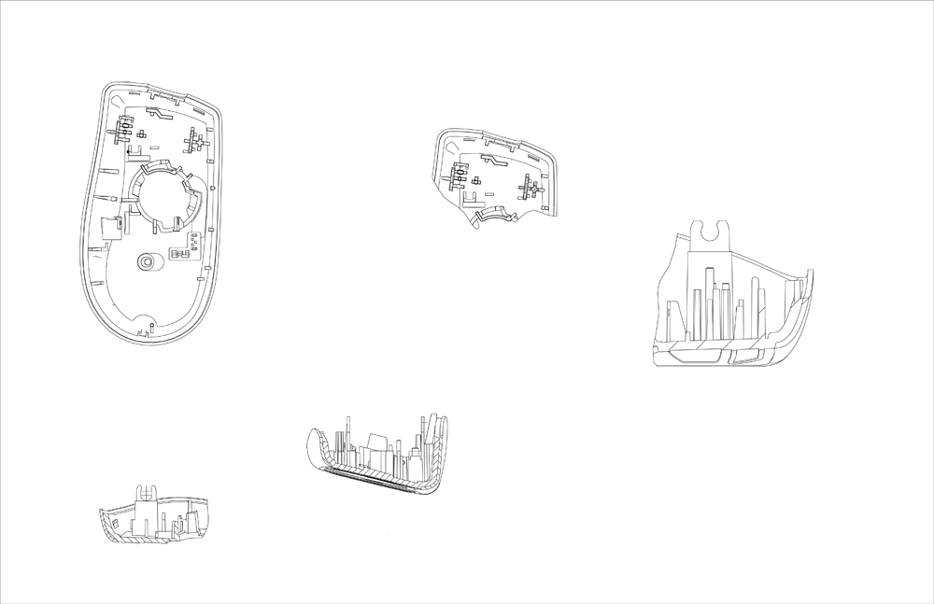

Slide 21
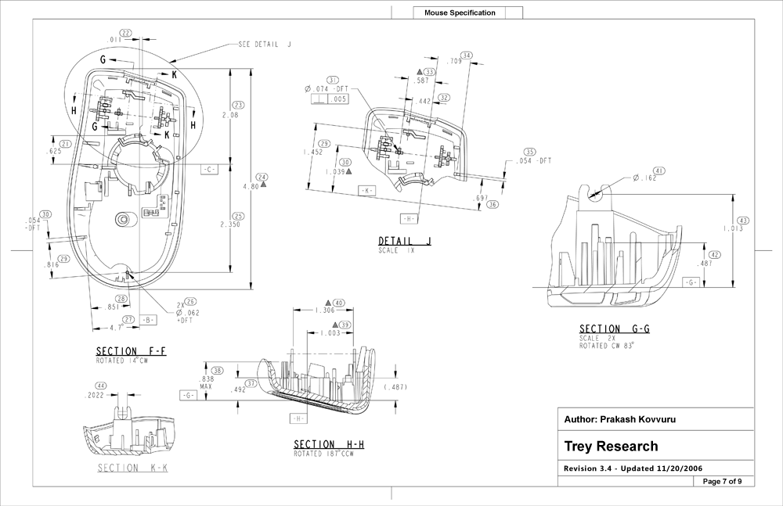

Slide 22
Why Annotate? Good engineering practice
Precisely describe the “part” you’re building and the contract that represents
Enable automatic checking. Tells tools things they can’t infer
Effective (and checked) documentation
Programmers don’t have to guess/experiment
Code and documentation don’t drift apart
Comments are nice, but…

Slide 23
Annotation Benefits
Record and express the contract
Developers know what the contract is
Is the contract a good one?
Automatic checking: That is, “cheap” bugs
The sooner a bug is found, the less expensive it is
Annotated code finds many more bugs (with less noise) than un-annotated code
Code that enters test with fewer “easy” bugs makes testing far more efficient—less wasted time for find/fix on easy bugs

Slide 24
Example Annotations
wchar_t * wmemset(
__out_ecount(s) wchar_t *p,
__in wchar_t v,
__in size_t s);
__in: The parameter is input to the function
__out: The parameter is output from the function
__out_ecount(s): The parameter is a buffer with s elements
If the parameter p doesn’t contain at least s elements, PFD will yield a warning

Slide 25
Annotations __in_opt, __out_opt…
NTKERNELAPI
BOOLEAN
IoIs32bitProcess(
__in_opt PIRP Irp
);

Slide 26
SDV Rules
SDV comes with
86 WDM rules
75 KMDF rules
39 NDIS rules
Each rule captures an aspect of an interface requirement
Rules are written in a C-like language and define
State declarations in form of C-style variables
Events that are associated with DDI functions

Slide 27
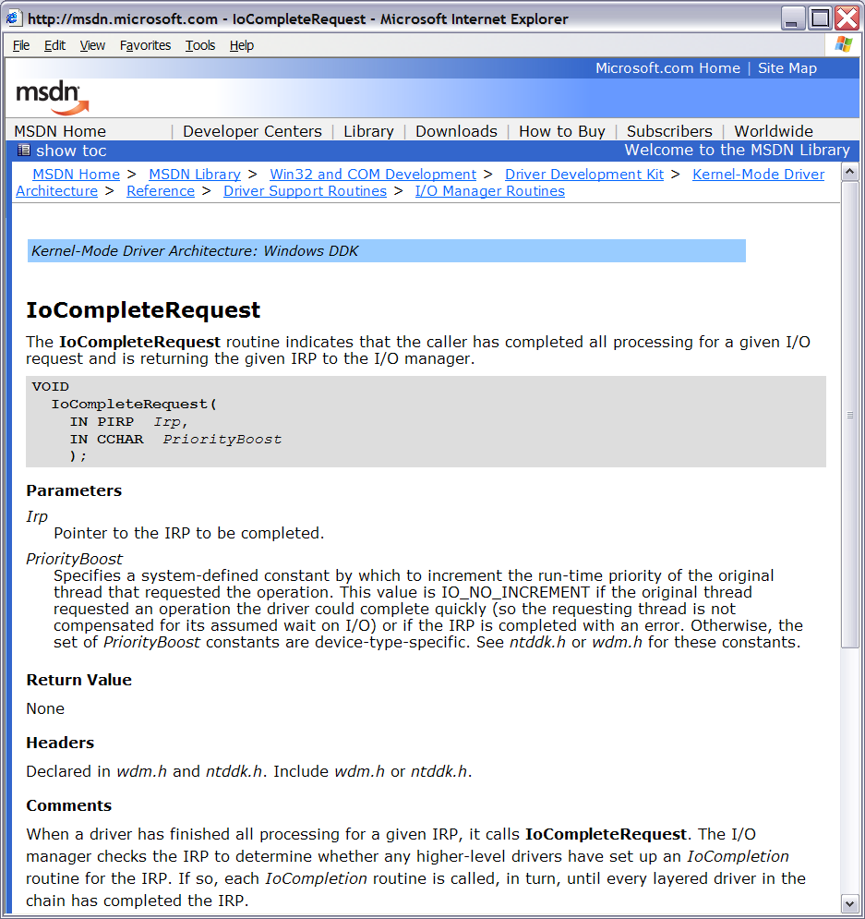
Example
I/O System
Irp
Driver
Callback
Irp
Irp
IoCompleteRequest
Device Driver
Interface

Slide 28
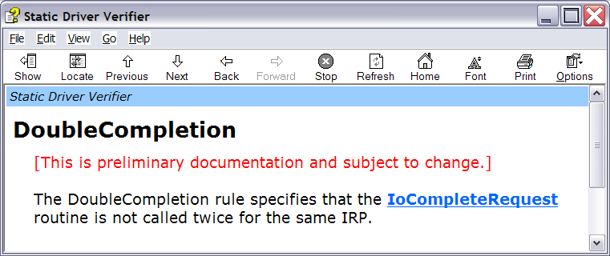
Example
I/O System
Irp
Driver
Callback
X
Irp
Irp
IoCompleteRequest
Device Driver
Interface

Slide 29
Verification Sandwich
Callback driven
Harnesses
c1
c2
c3
c4
c5
c6
c7
c8
c9
Without Role types
c1
c2
c3
c4
c5
c6
With Roletypes
KMDF Driver
KMDF and WDM stubs

Slide 30
Role Type Declarations
Type def on a function
Pure C declaration, not a source annotation language (SAL) annotation
Can be used by client drivers to help static analysis tools identify the specific role of the function in relation to the driver model
Enables identification of specific callbacks in your driver
SDV is a callback driver verification tool
See WDK documentation in MSDN for a list of role types
160 for KMDF
60 for WDM
40 for NDIS

Slide 31
Role Types in the KMDF UsbSamp Driver
DRIVER_INITIALIZE DriverEntry;
EVT_WDF_DRIVER_DEVICE_ADD UsbSamp_EvtDeviceAdd;
EVT_WDF_DEVICE_PREPARE_HARDWARE UsbSamp_EvtDevicePrepareHardware;
EVT_WDF_DEVICE_RELEASE_HARDWARE UsbSamp_EvtDeviceReleaseHardware;
EVT_WDF_DEVICE_FILE_CREATE UsbSamp_EvtDeviceFileCreate;
EVT_WDF_IO_QUEUE_IO_READ UsbSamp_EvtIoRead;
EVT_WDF_IO_QUEUE_IO_WRITE UsbSamp_EvtIoWrite;
EVT_WDF_IO_QUEUE_IO_DEVICE_CONTROL UsbSamp_EvtIoDeviceControl;
EVT_WDF_REQUEST_CANCEL UsbSamp_EvtRequestCancel;
EVT_WDF_REQUEST_COMPLETION_ROUTINE SubRequestCompletionRoutine;
EVT_WDF_REQUEST_COMPLETION_ROUTINE ReadWriteCompletion;

Slide 32
Static Analysis Can…
The business case
Reduce risk of expensive after-deployment bugs
Reduce time to market
Reduce cost of code review and testing
Improve code quality
Achieve higher test coverage
The development case
Find and prevent bugs earlier
More directly and obviously
Find and prevent “hard to test” bugs
Make you more efficient

Slide 33
Call To Action
Run static analysis tools early and often
Especially after modifying a driver
Use static analysis tools in addition to the debugger to identify runtime issues
Use static analysis tools wisely!
It doesn’t know about all possible errors
It doesn’t make testing unnecessary
Both false positives and false negatives can be misleading
Static Analysis Tools complement testing

Slide 34
Additional Resources
White papers on the WHDC Web site
PREfast step-by-step http://www.microsoft.com/whdc/DevTools/tools/PREfast_steps.mspx
PREfast annotations http://www.microsoft.com/whdc/DevTools/tools/annotations.mspx
How to Use Function typedefs in C++ Driver Code to Improve PREƒast Results http://go.microsoft.com/fwlink/?LinkId=87238
Blog: http://blogs.msdn.com/staticdrivertools/default.aspx
PREfast for Drivers in WDK documentation on MSDN http://msdn.microsoft.com/en-us/library/aa468782.aspx
Chapter 23, Developing Drivers with the Windows Driver Foundation http://www.microsoft.com/MSPress/books/10512.aspx
E-mail sdvpfdex @ microsoft.com

Slide 35



Please Complete A Session Evaluation Form Your input is important!
Visit the WinHEC CommNet and complete a Session Evaluation for this session and be entered to win one of 150 Maxtor® BlackArmor™ 160GB External Hard Drives 50 drives will be given away daily!
http://www.winhec2008.com
BlackArmor Hard Drives provided by:

Slide 36


© 2008 Microsoft Corporation. All rights reserved. Microsoft, Windows, Windows Vista and other product names are or may be registered trademarks and/or trademarks in the U.S. and/or other countries.
The information herein is for informational purposes only and represents the current view of Microsoft Corporation as of the date of this presentation. Because Microsoft must respond to changing market conditions, it should not be interpreted to be a commitment on the part of Microsoft, and Microsoft cannot guarantee the accuracy of any information provided after the date of this presentation. MICROSOFT MAKES NO WARRANTIES, EXPRESS, IMPLIED OR STATUTORY, AS TO THE INFORMATION IN THIS PRESENTATION.

