Slide 1

OPK and Extensibility
Arne Gaenz, Senior Program Manager
Microsoft Corporation

Slide 2





















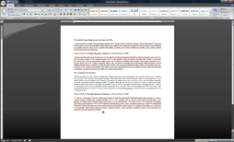
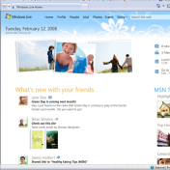



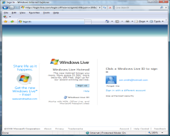





Next release of Windows Live
Rich apps that light-up Windows - Essentials
Leading Services
Hotmail
Home.live.com
Groups
Photos
Calendar
Events
Sync
SkyDrive
Spaces
Mail
Photo Gallery
Movie Maker
Messenger
Toolbar
Family Safety
Writer
Keep your life in sync
Faster, more flexible ways to communicate and share
Easier to integrate and manage all your digital stuff
Optimized experiences for the PC, Mobile and Web
5

Slide 3

The Complete Experience Windows and Windows Live – Life without Walls
Windows
Rich Applications
Leading Services
Provides the foundation for the broadest set of experiences across applications and devices
Expect major releases every few years to maximize stability
Moving our communication and sharing applications to Windows Live to deliver rapid innovation
Provides the best Windows applications for consumer communication and sharing experiences – not just for WL
Expect major releases about every year
Partner opportunity to ship the Windows Live suite to complete the Windows experience
Provides faster, flexible , and integrated communication and sharing services
Expect updates every quarter
Completes the consumer experience across the web, Windows PC, and phone
Cloud platform and runtime for devices, people, activities, and storage
Core PC Platform
1

Slide 4

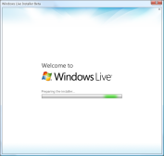

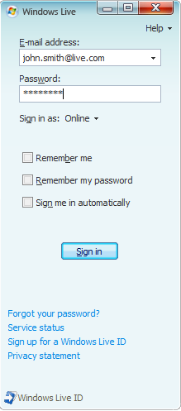
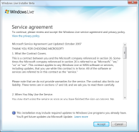


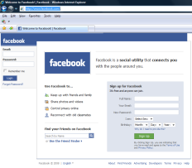

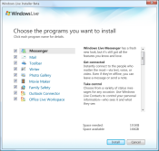
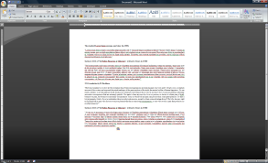



OEM Value from Windows Live
Consumer
Demand
Differentiation
Platform to allow Monetization
Support top PC scenarios
Strong consumer demand
More than 367 million product downloads in less then a year
The #1 instant messaging service
Better PC-web-mobile
experience than iLife
MS marketing commitment
Configuration options to support search and home page deals
Option to set default Photo Gallery and Movie Maker partners
460 Million Active Users #1 instant Messaging Service with 8.2B messages per day
11% of all time online #2 Mail Service with 271M Hotmail messages per day
4

Slide 5





Windows Live Essentials (WLE)
Core Pack
Optional
Mail
Photo Gallery
Messenger
Writer
Family Safety
Toolbar
+
Office Live Add in
Outlook Connector
Silverlight
IE8 Web Accelerators
SkyDrive upload control for IE

Slide 6
Customize and Dist. WLE
WLE Extensibility Options
  Because it adds value to your offering
Installation Experience Customizations
  How to create a install experience that fits your customers
MUI (Multilingual User Interface)
  What do we offer for WLE?

Slide 7


WLE Extensibility options
Windows Live Photo Gallery
  Publishing Plug-in (Photo sharing sites)
  Printing Plug-in (Printing service providers as default)
  Extras Plug-ins (Client applications)
Windows Live Messenger
  Application Plug-in (games, sharing apps, etc)
Windows Live Mail
  Aggregation (POP)

Slide 8
WLE – Why is it easy to Deploy?
Partner Deployment is *Image* friendly
  No Per-User Settings
  Not Hardware specific
All Dependencies included in the OPK
Configure from the command line
Silent Installation
  Now with Progress feedback!!

Slide 9
Configuration
Full Client Suite Install Options
  Install upon PC start-up
  Suppress all post installation UI
  Windows Live Toolbar optional
  Family Safety Settings optional
  Suppress Web search in Messenger
3

Slide 10
Command Line Parameters
  -appselect:[app] or ![app]
  -config:[location and name of config.cab] URL??
  -log:log_location
  -NOCEIP (to not opt into CEIP)
  -NOhomepage (to not set home page defaults)
  -nolaunch
  -oemid:oemid
  -nomu
  -q
  -?

Slide 11
Demo

Slide 12
MUI
MUI is not here yet. Tenant for next release
Suggestions for working around MUI
Demo

Slide 13
Ship Windows Live Essentials!!!!
How do you point your customers to Windows Live after they install??

Slide 14
Questions?

Slide 15



Please Complete A Session Evaluation Form
Your input is important!
Visit the WinHEC CommNet and complete a Session Evaluation for this session and be entered to win one
of 150 Maxtor® BlackArmor™ 160GB External Hard Drives
50 drives will be given away daily!
http://www.winhec2008.com
BlackArmor
Hard Drives provided by:

Slide 16

© 2008 Microsoft Corporation. All rights reserved. Microsoft, Windows, Windows Vista and other product names are or may be registered trademarks and/or trademarks in the U.S. and/or other countries.
The information herein is for informational purposes only and represents the current view of Microsoft Corporation as of the date of this presentation. Because Microsoft must respond to changing market conditions, it should not be interpreted to be a commitment on the part of Microsoft, and Microsoft cannot guarantee the accuracy of any information provided after the date of this presentation.
MICROSOFT MAKES NO WARRANTIES, EXPRESS, IMPLIED OR STATUTORY, AS TO THE INFORMATION IN THIS PRESENTATION.

