Slide 2
Design Tradeoffs for SSD Performance
Ted Wobber
Principal Researcher
Microsoft Research, Silicon Valley

Slide 3
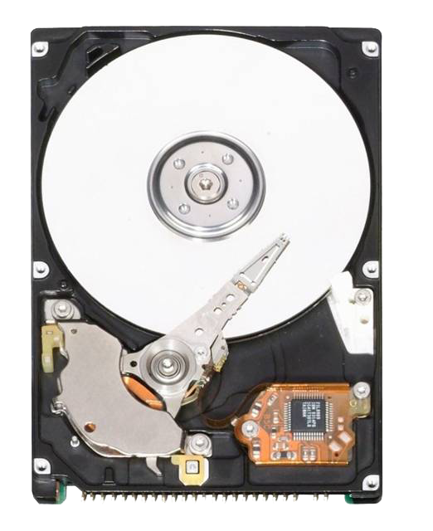
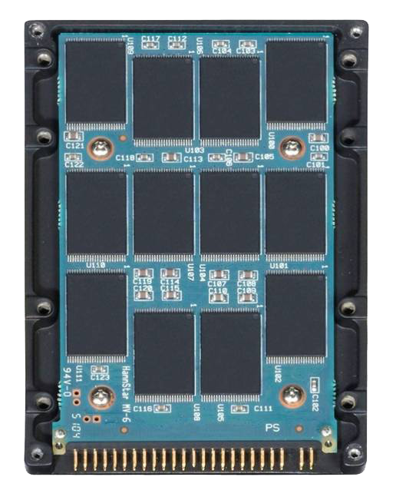
Rotating Disks vs. SSDs
We have a good model of how
rotating disks work… what about SSDs?

Slide 4
Rotating Disks vs. SSDs Main take-aways
Forget everything you knew about rotating disks. SSDs are different
SSDs are complex software systems
One size doesn’t fit all

Slide 5



A Brief Introduction
Microsoft Research – a focus on ideas and understanding

Slide 6
Will SSDs Fix All Our Storage Problems?
Excellent read latency; sequential bandwidth
Lower $/IOPS/GB
Improved power consumption
No moving parts
Form factor, noise, …
Performance surprises?

Slide 7
Performance/Surprises
Latency/bandwidth
“How fast can I read or write?”
Surprise: Random writes can be slow
Persistence
“How soon must I replace this device?”
Surprise: Flash blocks wear out

Slide 8
What’s in This Talk
Introduction
Background on NAND flash, SSDs
Points of comparison with rotating disks
Write-in-place vs. write-logging
Moving parts vs. parallelism
Failure modes
Conclusion

Slide 9
What’s *NOT* in This Talk
Windows
Analysis of specific SSDs
Cost
Power savings

Slide 10
Full Disclosure
“Black box” study based on the properties of NAND flash
A trace-based simulation of an “idealized” SSD
Workloads
TPC-C
Exchange
Postmark
IOzone

Slide 11

Background NAND flash blocks
A flash block is a grid of cells
4096 + 128 bit-lines
Erase: Quantum release for all cells
Program: Quantum injection for some cells
Read: NAND operation with a page selected
1
1
1
0
1
1
1
0
1
0
1
1
64 page lines
Can’t reset bits to 1 except with erase

Slide 12
Background 4GB flash package (SLC)
Serial out
Data Register | 4 KB
Page Size | 4 KB
Block Size | 256 KB
Plane | 512 MB
Die Size | 2 GB
Erase Cycles | 100K
Page Read | 25μs
Page Program | 200μs
Serial Access | 100μs
Block Erase | 1.5ms
Register
Plane 0
Plane 1
Plane 2
Plane 3
Plane 0
Plane 1
Plane 2
Plane 3
Reg
Reg
Reg
Reg
Reg
Reg
Reg
Reg
Plane
Block
’09?
20μs
Die 0
Die 1
MLC (multiple bits in cell): slower, less durable

Slide 13
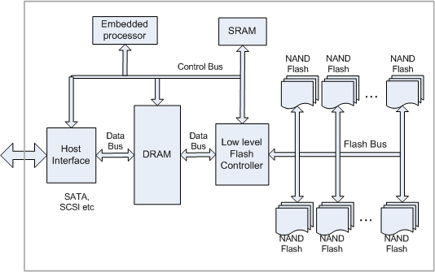
Background SSD Structure
Flash Translation Layer
(Proprietary firmware)
Simplified block diagram of an SSD

Slide 14
Write-in-place vs. Logging (What latency can I expect?)

Slide 15
Write-in-Place vs. Logging
Rotating disks
Constant map from LBA to on-disk location
SSDs
Writes always to new locations
Superseded blocks cleaned later

Slide 16
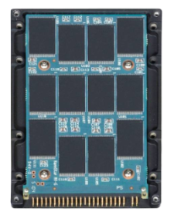
Log-based Writes Map granularity = 1 block
Flash Block
LBA to Block Map
P
P
P₀
P₁
Write order
Block(P)
Pages are moved – read-modify-write, (in foreground):
Write Amplification

Slide 17
Log-based Writes Map granularity = 1 page
LBA to Block Map
P
Q
P
P₀
Q₀
P₁
Page(P)
Page(Q)
Blocks must be cleaned (in background):
Write Amplification

Slide 18
Log-based Writes Simple simulation result
Map granularity = flash block (256KB)
TPC average I/O latency = 20 ms
Map granularity = flash page (4KB)
TPC-C average I/O latency = 0.2 ms

Slide 19
Log-based Writes Block cleaning
LBA to Page Map
P
Q
R
P
Q
R
P₀
Q₀
R₀
P₀
Q₀
R₀
Page(P)
Page(Q)
Page(R)
Move valid pages so block can be erased
Cleaning efficiency: Choose blocks to minimize page movement

Slide 20
Over-provisioning Putting off the work
Keep extra (unadvertised) blocks
Reduces “pressure” for cleaning
Improves foreground latency
Reduces write-amplification due to cleaning

Slide 21
Delete Notification Avoiding the work
SSD doesn’t know what LBAs are in use
Logical disk is always full!
If SSD can know what pages are unused, these can treated as “superseded”
Better cleaning efficiency
De-facto over-provisioning
“Trim” API:
An important step forward

Slide 22
Delete Notification Cleaning Efficiency
Postmark trace
One-third pages moved
Cleaning efficiency improved by factor of 3
Block lifetime improved

Slide 23
LBA Map Tradeoffs
Large granularity
Simple; small map size
Low overhead for sequential write workload
Foreground write amplification (R-M-W)
Fine granularity
Complex; large map size
Can tolerate random write workload
Background write amplification (cleaning)

Slide 24
Write-in-place vs. Logging Summary
Rotating disks
Constant map from LBA to on-disk location
SSDs
Dynamic LBA map
Various possible strategies
Best strategy deeply workload-dependent

Slide 25
Moving Parts vs. Parallelism (How many IOPS can I get?)

Slide 26
Moving Parts vs. Parallelism
Rotating disks
Minimize seek time and impact of rotational delay
SSDs
Maximize number of operations in flight
Keep chip interconnect manageable

Slide 27
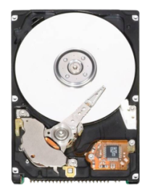
Improving IOPS Strategies
Request-queue sort by sector address
Defragmentation
Application-level block ordering
Defragmentation
for cleaning efficiency is unproven: next write might re-fragment
One request at a time
per disk head
Null seek time

Slide 28
Flash Chip Bandwidth
Serial interface is performance bottleneck
Reads constrained by serial bus
25ns/byte = 40 MB/s (not so great)
8-bit serial bus
Reg
Reg
Reg
Reg
Reg
Reg
Reg
Reg
Die 0
Die 1

Slide 29
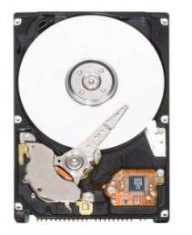
SSD Parallelism Strategies
Striping
Multiple “channels” to host
Background cleaning
Operation interleaving
Ganging of flash chips

Slide 30
Striping
LBAs striped across flash packages
Single request can span multiple chips
Natural load balancing
What’s the right stripe size?
Controller
0 8
16 24 32 40
1 9
17 25 33 41
2 10
18 26 34 42
3 11
19 27 35 43
4 12
20 28 36 44
5 13
21 29 37 45
6 14
22 30 38 46
7 15
23 31 39 47

Slide 31
Operations in Parallel
SSDs are akin to RAID controllers
Multiple onboard parallel elements
Multiple request streams are needed to achieve maximal bandwidth
Cleaning on inactive flash elements
Non-trivial scheduling issues
Much like “Log-Structured File System”, but at a lower level of the storage stack

Slide 32
Interleaving
Concurrent ops on a package or die
E.g., register-to-flash “program” on die 0 concurrent with serial line transfer on die 1
25% extra throughput on reads, 100% on writes
Erase is slow, can be concurrent with other ops
Reg
Reg
Reg
Reg
Reg
Reg
Reg
Reg
Die 0
Die 1

Slide 33
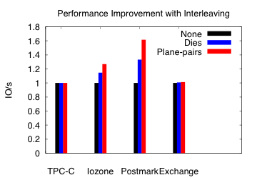
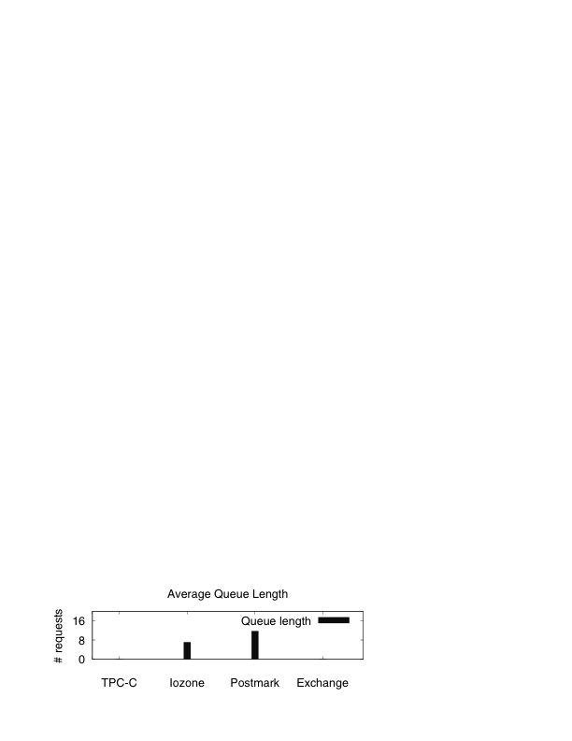
Interleaving Simulation
TPC-C and Exchange
No queuing, no benefit
IOzone and Postmark
Sequential I/O component results in queuing
Increased throughput

Slide 34
Intra-plane Copy-back
Block-to-block transfer internal to chip
But only within the same plane!
Cleaning on-chip!
Optimizing for this can hurt load balance
Conflicts with striping
But data needn’t cross serial I/O pins
Reg
Reg
Reg
Reg

Slide 35
Cleaning with Copy-back Simulation
Workload | Cleaning efficiency | Inter-plane (time in msec) | Copy-back (time in msec)
TPC-C | 70% | 9.65 | 5.85
IOzone | 100% | 1.5 | 1.5
Postmark | 100% | 1.5 | 1.5
Copy-back operation for intra-plane transfer
TPC-C shows 40% improvement in cleaning costs
No benefit for IOzone and Postmark
Perfect cleaning efficiency

Slide 36
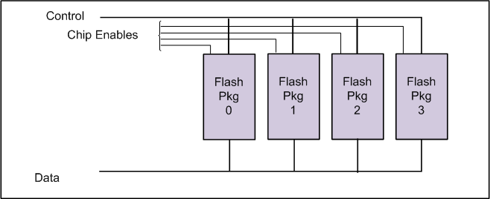
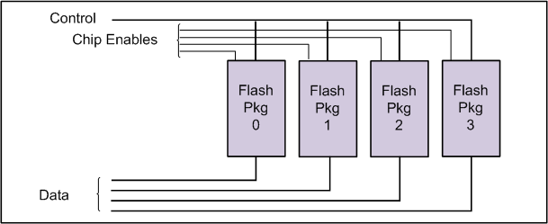
Ganging
Optimally, all flash chips are independent
In practice, too many wires!
Flash packages can share a control bus with or/without separate data channels
Operations in lock-step or coordinated
Shared-bus gang
Shared-control gang

Slide 37
Shared-bus Gang Simulation
 | No Gang | 8-gang | 16-gang
I/O Latency | 237μs | 553μs | 746μs
IOPS per gang | 4425 | 1807 | 1340
Scaling capacity without scaling pin-density
Workload (Exchange) requires 900 IOPS
16-gang fast enough

Slide 38
Parallelism Tradeoffs
No one scheme optimal for all workloads
Highly sequential | Striping, ganging (for scale), and interleaving
Inherent parallelism in workload | Independent, deeply parallel request streams to the flash chips
Poor cleaning efficiency (no locality) | Background, intra-chip cleaning
With faster serial connect, intra-chip ops are less important

Slide 39
Moving Parts vs. Parallelism Summary
Rotating disks
Seek, rotational optimization
Built-in assumptions everywhere
SSDs
Operations in parallel are key
Lots of opportunities for parallelism, but with tradeoffs

Slide 40
Failure Modes (When will it wear out?)

Slide 41
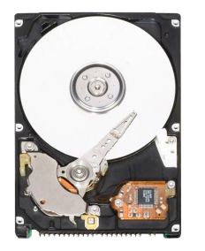
Failure Modes Rotating disks
Media imperfections, loose particles, vibration
Latent sector errors [Bairavasundaram 07]
E.g., with uncorrectable ECC
Frequency of affected disks increases linearly with time
Most affected disks (80%) have < 50 errors
Temporal and spatial locality
Correlation with recovered errors
Disk scrubbing helps

Slide 42
Failure Modes SSDs
Types of NAND flash errors (mostly when erases > wear limit)
Write errors: Probability varies with # of erasures
Read disturb: Increases with # of reads
Data retention errors: Charge leaks over time
Little spatial or temporal locality (within equally worn blocks)
Better ECC can help
Errors increase with wear: Need wear-leveling

Slide 43

Wear-leveling Motivation
Example: 25% over-provisioning to enhance foreground performance

Slide 44
Wear-leveling Motivation
Premature worn blocks = reduced over-provisioning = poorer performance

Slide 45
Wear-leveling Motivation
Over-provisioning budget consumed : writes no longer possible!
Must ensure even wear

Slide 46



Wear-leveling Modified "greedy" algorithm
Expiry Meter
for block A
Cold content
Block A
Block B
Q
R
P
Q
R
Q₀
R₀
P₀
Q₀
R₀
If Remaining(A) < Throttle-Threshold, reduce probability of cleaning A
If Remaining(A) < Migrate-Threshold,
clean A, but migrate cold data into A
If Remaining(A) >= Migrate-Threshold,
clean A

Slide 47
Wear-leveling Results
Fewer blocks reach expiry with rate-limiting
Smaller standard deviation of remaining lifetimes with cold-content migration
Cost to migrating cold pages (~5% avg. latency)
Algorithm | Std. Dev. | Expired Blocks
Greedy | 13.47 | 223
+Rate-limiting | 13.42 | 153
+Migration | 5.71 | 0
Block wear in IOzone

Slide 48
Failure Modes Summary
Rotating disks
Reduce media tolerances
Scrubbing to deal with latent sector errors
SSDs
Better ECC
Wear-leveling is critical
Greater density  more errors?

Slide 49
Rotating Disks vs. SSDs
≠
Don’t think of an SSD as just a faster rotating disk
Complex firmware/hardware system with substantial tradeoffs

Slide 50
SSD Design Tradeoffs
Techniques | Positives | Negatives
Striping | Concurrency | Loss of locality
Intra-chip ops | Lower latency | Load balance skew
Fine-grain LBA map | Lower latency | Memory, cleaning
Coarse-grain map | Simplicity | Read-modify-writes
Over-provisioning | Less cleaning | Reduced capacity
Ganging | Sparser wiring | Reduced bandwidth
Write amplification  more wear

Slide 51
Call To Action
Users need help in rationalizing workload-sensitive SSD performance
Operation latency
Bandwidth
Persistence
One size doesn’t fit all… manufacturers should help users determine the right fit
Open the “black box” a bit
Need software-visible metrics

Slide 52
Thanks for your attention!

Slide 53
Additional Resources
USENIX paper: http://research.microsoft.com/users/ vijayanp/papers/ssd-usenix08.pdf
SSD Simulator download: http://research.microsoft.com/downloads
Related Sessions
ENT-C628: Solid State Storage in Server and Data Center Environments (2pm, 11/5)

Slide 54
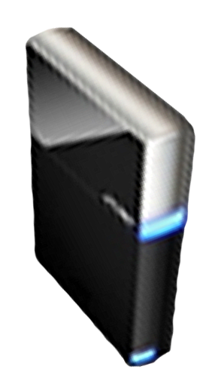


Please Complete A Session Evaluation Form Your input is important!
Visit the WinHEC CommNet and complete a Session Evaluation for this session and be entered to win one of 150 Maxtor® BlackArmor™ 160GB External Hard Drives 50 drives will be given away daily!
http://www.winhec2008.com
BlackArmor Hard Drives provided by:

Slide 55


© 2008 Microsoft Corporation. All rights reserved. Microsoft, Windows, Windows Vista and other product names are or may be registered trademarks and/or trademarks in the U.S. and/or other countries.
The information herein is for informational purposes only and represents the current view of Microsoft Corporation as of the date of this presentation. Because Microsoft must respond to changing market conditions, it should not be interpreted to be a commitment on the part of Microsoft, and Microsoft cannot guarantee the accuracy of any information provided after the date of this presentation. MICROSOFT MAKES NO WARRANTIES, EXPRESS, IMPLIED OR STATUTORY, AS TO THE INFORMATION IN THIS PRESENTATION.

