Slide 2
Devices Profile for Web Services in Windows 7
Rob Williams
Program Manager
Microsoft Corporation

Slide 3
Agenda
Web Services (WS) in business
Microsoft Platform Advances with WS
Enterprise and Vertical Scenarios
Logo Testing for your Implementation

Slide 4
Device Protocol Requirements
Robust and standards based
Secure
Flexible
Scalable
Interoperable
Web Services!

Slide 5

Web Services is
Software Talking to Software

Slide 6

Who Is Solving These Challenges?
WS-SEC. CONV.
SOAP/WSDL
WS-SECURITY
MTOM
WS-TRUST
Service Orientation
Support for Enterprise Scenarios
Support for Consumer Scenarios
Interoperable
Messaging
Security
Microsoft Corporation | ü | ü
Oracle | ü | ü
IBM | ü | A
BEA Systems, Inc. | ü | A
Sun Microsystems, Inc. | ü | ü
Google | ü
Amazon.com | ü
eBay, Inc | ü
Apache | ü | ü
White Mesa Software | ü | ü
gSOAP | ü | ü
Ricoh | ü | 
Epson Corporation | ü | 
HP | ü | 
Xerox | ü | 
Intel Corporation | ü | 
Canon Inc. | ü | 
Microsoft Corporation | ü | ü | ü
Oracle | ü |  | 
IBM | ü |  | ü
BEA Systems, Inc. | ü | A | 
RSA Security Inc. | ü |  | 
Systinet Corporation | ü |  | 
Apache | ü |  | 
Layer7 Technologies | ü | A | ü
Computer Associates International, Inc. | ü | A | A
Sun Microsystems, Inc. | ü
SAP AG | ü
Tibco Software, Inc. | ü
IONA Technologies | ü
WebMethods, Inc. | ü
Nokia | ü
Cape Clear | ü
gSOAP | ü
Netegrity |  | A | A
Verisign, Inc. |  | A | A
WS-RM
WS-Policy
Assurances
WS-AT
Metadata
MEX
Microsoft Corporation | ü | ü
Oracle | 
IBM | ü | ü
BEA Systems, Inc. | ü | A
Sun Microsystems, Inc. | ü
Cape Clear | ü
Systinet Corporation | ü
Blue Titan Software, Inc | ü
IONA Technologies |  | ü
Arjuna Technologies |  | ü
Choreology Ltd |  | ü
Apache | ü | ü
Microsoft Corporation | ü | ü
Oracle |  | 
IBM |  | 
BEA Systems, Inc. | A | ü
SAP AG | A | 
Sun Microsystems, Inc. | ü | ü
Verisign Inc. |  | A
Sonic Software |  | A
Computer Associates International, Inc. | A
WebMethods, Inc. | A
gSOAP |  | ü
ü | Released product
 | Public interop
A | Co-Author only

Slide 7







Standards Based Approach
a<?xml version="1.0" encoding="UTF-8" ?>
- <wsdl:definitions targetNamespace="http://www.example.org/discoveryproxy" xmlns:tns="http://www.example.org/discoveryproxy" xmlns:wsd="http://schemas.xmlsoap.org/ws/2005/04/discovery" xmlns:wsa="http://schemas.xmlsoap.org/ws/2004/08/addressing" xmlns:wsdl="http://schemas.xmlsoap.org/wsdl/" xmlns:xs="http://www.w3.org/2001/XMLSchema">
<wsdl:import namespace="http://schemas.xmlsoap.org/ws/2005/04/discovery" location="http://schemas.xmlsoap.org/ws/2005/04/discovery/ws-discovery.wsdl" />
- <wsdl:types>
- <xs:schema>
<xs:import namespace="http://schemas.xmlsoap.org/ws/2005/04/discovery" schemaLocation="http://schemas.xmlsoap.org/ws/2005/04/discovery/ws-discovery.xsd" />
</xs:schema>
- <xs:schema targetNamespace="http://www.example.org/discoveryproxy" xmlns:tns="http://www.example.org/discoveryproxy">
- <xs:complexType name="PassThroughType">
- <xs:sequence>
<xs:any minOccurs="0" maxOccurs="unbounded" />
</xs:sequence>
</xs:complexType>
<xs:element name="PassThrough" type="tns:PassThroughType" />
</xs:schema>
</wsdl:types>
- <wsdl:portType name="DiscoveryProxy">
- <wsdl:operation name="Hello">
<wsdl:input message="wsd:HelloMsg" wsa:Action="http://schemas.xmlsoap.org/ws/2005/04/discovery/Hello" />
</wsdl:operation>
- <wsdl:operation name="Bye">
<wsdl:input message="wsd:ByeMsg" wsa:Action="http://schemas.xmlsoap.org/ws/2005/04/discovery/Bye" />
</wsdl:operation>
- <wsdl:operation name="Probe">
<wsdl:input message="wsd:ProbeMsg" wsa:Action="http://schemas.xmlsoap.org/ws/2005/04/discovery/Probe" />
<wsdl:output message="wsd:ProbeMatchMsg" wsa:Action="http://schemas.xmlsoap.org/ws/2005/04/discovery/ProbeMatches" />
</wsdl:operation>
- <wsdl:operation name="Resolve">
<wsdl:input message="wsd:ResolveMsg" wsa:Action="http://schemas.xmlsoap.org/ws/2005/04/discovery/Resolve" />
<wsdl:output message="wsd:ResolveMatchMsg" wsa:Action="http://schemas.xmlsoap.org/ws/2005/04/discovery/ResolveMatches" />
</wsdl:operation>
</wsdl:portType>
</wsdl:definitions>

Slide 8
Standards Based Approach
IT managers
  No single vendor lock-in
Application developers and intigrators
  Engineering community designed
Device manufactures
  Royalty free licensing
Everyone
  Interoperability

Slide 9

Secure
Enterprise grade cryptography
Protects high value services
  Transport layer security
  Signed discovery messages
TLS transport security
x.509 client and service authentication
Cryptographically secured discovery

Slide 10

Flexible and Reusable
Services oriented world demands flexibility in use and reuse
Web services are composable to meet changing business needs
Services able to meet needs for wide range of different applications

Slide 11




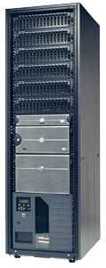



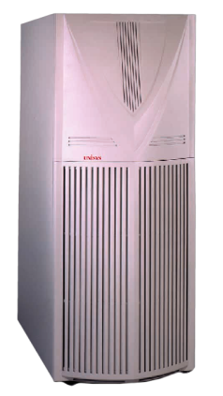
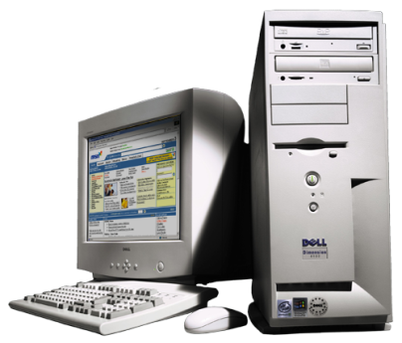
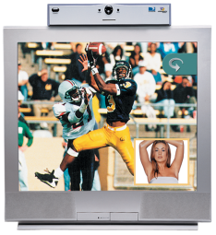
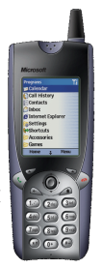
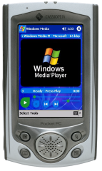
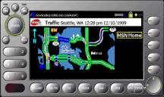
Scalable
“Scales in the Cloud”
spans organizations and geographies
“Scales Out”
In clusters
“Scales Up”
on large systems
“Scales In”
on a machine
“Scales Down”
to devices

Slide 12


Scalable
“Scales in the Cloud”
spans organizations and geographies
“Scales Out”
In clusters
“Scales Up”
on large systems
“Scales In”
on a machine
“Scales Down”
to devices
“Scales Micro”
to sensors

Slide 13
Scalable
Distributed cloud services
Enterprise business applications
Device input and output
Sensor data networks

Slide 14
Devices as Part of Business Flow
Devices are becoming deeply integrated into business process
Devices are computers that offer a specialty service
Devices are computers that should be lower in cost to manage and integrate

Slide 15
Windows 7
Server 2008 R2
Platform
Enhancements

Slide 16
Enhancements to the Platform
Windows 7 and Windows Server 2008 R2
  Discovery remote extensions
  Security enhancements
Windows Embedded CE6R2
  Windows CE
    Windows Network Projector
    Full DPWS support
.NET Micro Framework
    Full DPWS support
    New code generation tool

Slide 17
Cross Subnet Discovery
Directed discovery
  Install Web Services device by name
Discovery remote extensions
  Browse for PCs, people, and Web Services across entire organization
  Publish anything with Publication Services
  Faster response than NETBios

Slide 18
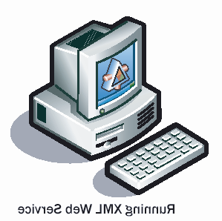


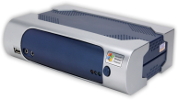

Cross Subnet Discovery
ProbeMatches
Unicast Probe
Print
Discovery Proxy

Slide 19
Discovery Remote Extensions
Benefits
  Cross subnet discovery
  Multicast traffic suppression
WS-Discovery proxy based design
Proxy can publish other resources
Type and scope matching
increasing in importance!

Slide 20
Enhancements to the Platform
Windows 7 and Windows Server 2008 R2
  Discovery remote extensions
  Security enhancements
Windows Embedded CE6R2
  Windows CE
    Windows Network Projector
    Full DPWS support
.NET Micro Framework
    Full DPWS support
    New code generation tool

Slide 21
Security Enhancements
Compact Signature Signed Discovery
  Prohibits discovery denial of service attacks
Flexibility in certificate model
  UUID based Common Name (CN) validation
    No longer tied to DNS Cname or IP Address

Slide 22
Enhancements to the Platform
Windows 7 and Windows Server 2008 R2
  Discovery remote extensions
  Security enhancements
Windows Embedded CE6R2
  Windows CE
    Windows Network Projector
    Full DPWS support
.NET Micro Framework
    Full DPWS support
    New code generation tool

Slide 23
Enabled
Scenarios

Slide 24
Inbox Applications of WS
WS Hosts, Publishing Resources
WS Print, Secure Print, Scan
WS Enterprise Scan Manager
WS Network Projection

Slide 25

Distributed Scan Management
Office imaging systems are WS client
Windows Server 2008 R2 Scan Manager Web Service
Integration into complex workflow

Slide 26
Distributed Scan Management
Health management organization
Medical record retention requirements
  Local collection (scan)
  Central storage
  Secure authentication and transport
  Privacy is the law!

Slide 27

Windows Network Projection
Web Services moving into
projector and display systems
  Meeting room presentations
  Digital signage
  Operations center display walls

Slide 28
Windows Network Projection Scenario
Network operations center displays
  Organization’s critical state to be monitored
  Virtual Machine Desktop remoted
  Local or cross-WAN systems displayed

Slide 29



WS in Vertical Markets
IP camera
  Industry moving toward a single protocol
RFID
  Biztalk Server 2008
Point of sale
  ARTS working on WSPOS
Industrial control
  SOCRADES

Slide 30
DPWS Platform
Advances in Windows
Summary
Windows 7 infrastructure investments
  Discovery proxy support
  Security enhancements
Application investments
  Enterprise Scan Server Role
  RFID readers in BizTalk
Platforms
  Micro Framework code generation tools

Slide 31
Building Devices
DPWS Stack options
  All of Microsoft Embedded OS’s
  Reference stacks
    gSOAP, SOA4D, eSOL, Levitate
  Full in-house implementation
Device description and methods
  Microsoft
  Industry standards

Slide 32
New Logo Requirements
New tests required in June 2009
  Device Fundamental category
  Discovery Robustness is focus
  Devices are good Network Citizens
Run tests early
Work with Microsoft to resolve issues
Incorporate tests into regression suites

Slide 33
Call To Action
Test devices with new
Web Services logo requirements
Build Web Services into your devices to increase security, flexibility, and utility
Work with your industry to define
device methods and WSDLs

Slide 34
Additional Resources
Web Resources
  http://www.microsoft.com/Rally
OASIS WS-DD
  http://www.oasis-open.org/committees/ws-dd/
Developer’s Blog
  http://blogs.msdn.com/dandris/default.aspx
MSDN Forum
  http://www.microsoft.com/communities/newsgroups/enus/default.aspx?dg=microsoft.public.windows.devices.wsdapi

Slide 35
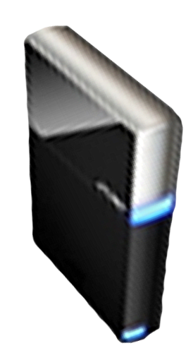


Please Complete A Session Evaluation Form
Your input is important!
Visit the WinHEC CommNet and complete a Session Evaluation for this session and be entered to win one
of 150 Maxtor® BlackArmor™ 160GB External Hard Drives
50 drives will be given away daily!
http://www.winhec2008.com
BlackArmor
Hard Drives provided by:

Slide 36


© 2008 Microsoft Corporation. All rights reserved. Microsoft, Windows, Windows Vista and other product names are or may be registered trademarks and/or trademarks in the U.S. and/or other countries.
The information herein is for informational purposes only and represents the current view of Microsoft Corporation as of the date of this presentation. Because Microsoft must respond to changing market conditions, it should not be interpreted to be a commitment on the part of Microsoft, and Microsoft cannot guarantee the accuracy of any information provided after the date of this presentation.
MICROSOFT MAKES NO WARRANTIES, EXPRESS, IMPLIED OR STATUTORY, AS TO THE INFORMATION IN THIS PRESENTATION.

