Slide 1
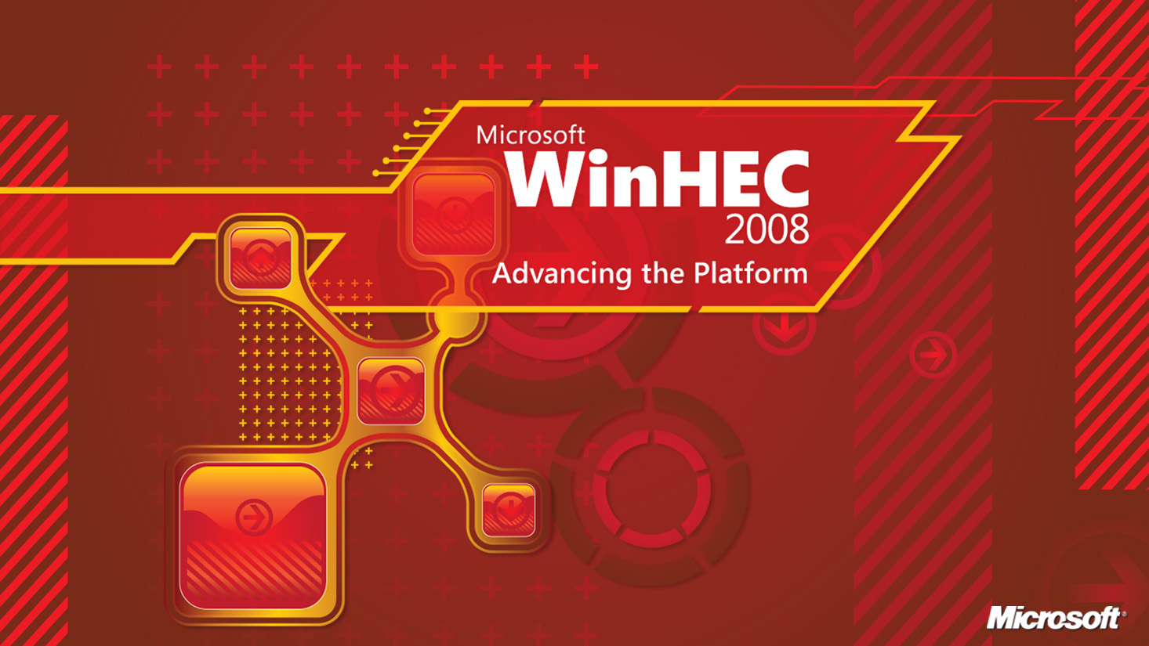

Slide 2
Windows Server Power Management Overview
Stephen Berard
Senior Program Manager – Windows Kernel
Microsoft Corporation

Slide 3
Agenda
Problems and motivations around server
energy consumption
Windows Server energy efficiency vision
Power management in Windows Server 2008
Windows Server 2008 R2 power management features
Windows Server Enhanced Power Management logo
Summary
Call to Action

Slide 4
Industry Trends and Requirements
Energy consumption and efficiency are major issues
  EPA report estimates 1.5% of U.S. power is used by data centers
  Current trend estimates energy use to double every 5 years
Government agencies around the world are increasing their scrutiny on energy and environmental impact
  EPA ENERGY STAR Specification for Servers
  European Code of Conduct
Wasted Energy = Wasted Money
  Opportunity to reduce the total cost of ownership

Slide 5
Windows Server Core Energy Vision
Scalable Node
  Energy efficiency at the server level
  Server energy consumption scales according to workload
Dynamic Data Center
  Energy efficiency at the data center level
  Coordination across data center components to scale infrastructure and computing according to business needs
Standardized workloads and energy efficiency metrics are required to enable data drive optimization
and to quantify the value proposition for both the Scalable Node and the Dynamic Data Center

Slide 6
The Scalable Node – Problem
Today power consumption does not scale in line with server utilization
  Typical servers consume 50-70% of the maximum power when completely idle
    Idle servers have low efficiency due to high idle levels
    Efficiency rises with utilization
  Tremendous opportunities exist for reducing energy needs
    Reduce power when full performance is not required
    Leverage virtualization solutions to increase server utilization
    Power down servers when they are not needed

Slide 7
The Scalable Node – Vision
Work with partners to provide the best power and performance by managing the system efficiently to the workload within power policy with Windows
Deliver this through improvements to
Windows Power Management
  Build on existing infrastructure and extend Windows value
  Enhancements to processor power management
  Focus on runtime idle improvements
  Support for device performance states

Slide 8
The Dynamic Data Center – Problem
Addressing energy consumption in the data center requires a holistic approach spanning all infrastructure not just the computing nodes
Many factors affect how a data center consumes energy
  Hardware, workload, time of day/week/year, locality, etc.
  Data centers are generally configured for peak load (statically)
Tremendous opportunities for reducing waste and optimizing performance exist
  Scaling and migrating workloads across groups of machines
  Coordination with power and cooling systems

Slide 9
The Dynamic Data Center – Vision
Enable the management of aggregate servers in conjunction with data center infrastructure
Deliver this through building platform
and management infrastructure
  Power metering and budgeting
  Virtualization and workload migration
  Standards-based management technologies
  Coordination between in-band and out-of-band management systems

Slide 10
Windows Server 2008 – Power Management
Windows Server 2008 is the first Server OS to enable power management features by default
  Delivers energy savings to customers automatically
Service Pack 2 provides improved power settings
  Takes advantage of advances in server platform hardware
  Improves power efficiency
  Power policy changes can be applied to RTM without incurring downtime

Slide 11
Power Efficiency Comparision

Slide 12
Windows Server 2008 R2 – Power Management
Focus on improving idle operating efficiency
  Many client power management features translate directly to server scenarios
  Continued focus on the biggest hitter
  Processor power management
Remote manageability of power policy via WMI
In-band power metering and budgeting support
Additional qualification logo to indicate enhanced power management support

Slide 13
Improvements To Idle Operating Efficiency
Power policy changes
  Changes inline with WS08 SP2 and reflect the latest hardware and power efficiency findings
Intelligent Timer Tick Distribution (Tick Skipping)
  Extends processor sleep states by not waking the
  CPU unnecessarily
  BSP handles the periodic system timer tick; other processors are signaled as necessary
  Non-timer interrupts will still wake sleeping processors

Slide 14
Improvements To Idle Operating Efficiency
Processor Core Parking
  Achieves power savings by scaling the number of active processor
  cores in active use
  Inactive cores are parked
    System refrains from scheduling work on parked cores
    Cores are put into a low power C-state
  Extension of Windows’ processor performance state engine
    Configurable via power policy settings
Idle improvements extend to Hyper-V
  Significant reduction in platform interrupt activity
  Enables power savings and greater scalability

Slide 15
Remote Manageability Via WMI
Windows Server 2008 R2 supports the configuration of power policy via Windows Management Infrastructure
  Enables local and remote management via WMI
  Adheres to DMTF conventions for setting data
  Scriptable
Includes support for reading and writing of all power plan and setting data
Active power plan can get changed remotely

Slide 16
Power Budgeting Concepts
Microsoft recommends a collaborative model
for power budgeting
  Platform is responsible for guaranteeing that the server operates within the allocated budget (HW Failsafe)
    Notifies OS via ACPI when under budget constraints
  OS scales according to workload, respects
  platform notifications

Slide 17
Power Metering And Budgeting
Windows Server 2008 R2 introduces the ability to report power
consumption and budgeting information
  Server platform reports this in-band to the OS via ACPI
  No additional drivers are required, only platform support
  Solution does not require hardware changes
Power information is exposed via WMI
  Adheres to the DMTF Power Supply Profile v1.01
Power budget information is reported to the OS
  Optional support for configuring the budget from within Windows
Extendable to enable per-device metering
  WDM driver interface available

Slide 18
Coordinated Processor Clocking Control
Windows Server 2008 R2 introduces support for a new
processor performance state interface
Feature enables OS and platform coordination of
processor power management (PPM)
  Platform is in direct control of t- and p-states
  OS specifies processor performance requirements
    Per-processor basis as a percentage of maximum frequency
  Platform is responsible for delivering requested performance
    In some cases, like a power budget condition, the platform can deliver less
  Interface is described via ACPI

Slide 19
Enhanced Power Management Logo
Windows Server 2008 R2 will include an Additional Qualification logo for “Enhanced Power Management” that indicates support for the following
  Processor power management through Windows
  Power metering and budgeting
  Power On/Off via WS-Management (SMASH)

Slide 20
Summary
Windows Server 2008 and 2008 R2 deliver real energy savings for the data center
New features deliver enhanced power efficiency and better manageability
  Improvements to idle operating efficiency
  Management of power policy via WMI
Power metering support provides energy consumption information from within Windows

Slide 21
Call To Action
Attend the Windows Server Power Management Implementation Details (ENT-T552) session
Deploy Windows Server 2008 Service Pack 2 in your enterprise to realize power savings today
Build energy efficient platforms and solutions
Get the Enhanced Power Management logo

Slide 22
Additional Resources
Whitepapers
  Windows Server 2008 Power Savings
  http://download.microsoft.com/download/4/5/9/459033a1-6ee2-45b3-ae76-a2dd1da3e81b/Windows_Server_2008_Power_Savings.docx
  Recommendations for Power Budgeting with Windows Server http://www.microsoft.com/whdc/system/pnppwr/powermgmt/Svr_PowerBudget.mspx
Other Resources
  Windows Hardware Developer Central – Power Management
  http://www.microsoft.com/whdc/system/pnppwr/
Related Sessions
  ENT-T552 Windows Server Power Management Implementation Details
  ENT-T587 Microsoft Hyper-V
  ENT-T610 New Windows Server Logo Requirements and Programs
Email: Server Power Feedback (srvpwrfb@microsoft.com)

Slide 23



Please Complete A Session Evaluation Form
Your input is important!
Visit the WinHEC CommNet and complete a Session Evaluation for this session and be entered to win one
of 150 Maxtor® BlackArmor™ 160GB External Hard Drives
50 drives will be given away daily!
http://www.winhec2008.com
BlackArmor
Hard Drives provided by:

Slide 24


© 2008 Microsoft Corporation. All rights reserved. Microsoft, Windows, Windows Vista and other product names are or may be registered trademarks and/or trademarks in the U.S. and/or other countries.
The information herein is for informational purposes only and represents the current view of Microsoft Corporation as of the date of this presentation. Because Microsoft must respond to changing market conditions, it should not be interpreted to be a commitment on the part of Microsoft, and Microsoft cannot guarantee the accuracy of any information provided after the date of this presentation.
MICROSOFT MAKES NO WARRANTIES, EXPRESS, IMPLIED OR STATUTORY, AS TO THE INFORMATION IN THIS PRESENTATION.

Slide 25
Backup

Slide 26
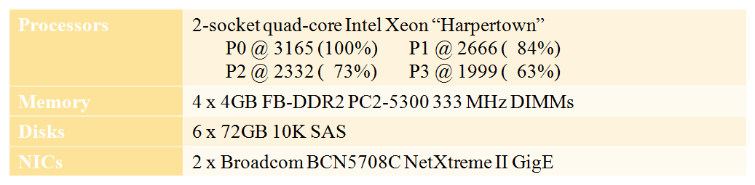
Two-Socket Quad-Core Intel Server
(HP DL360G5)

