Slide 1
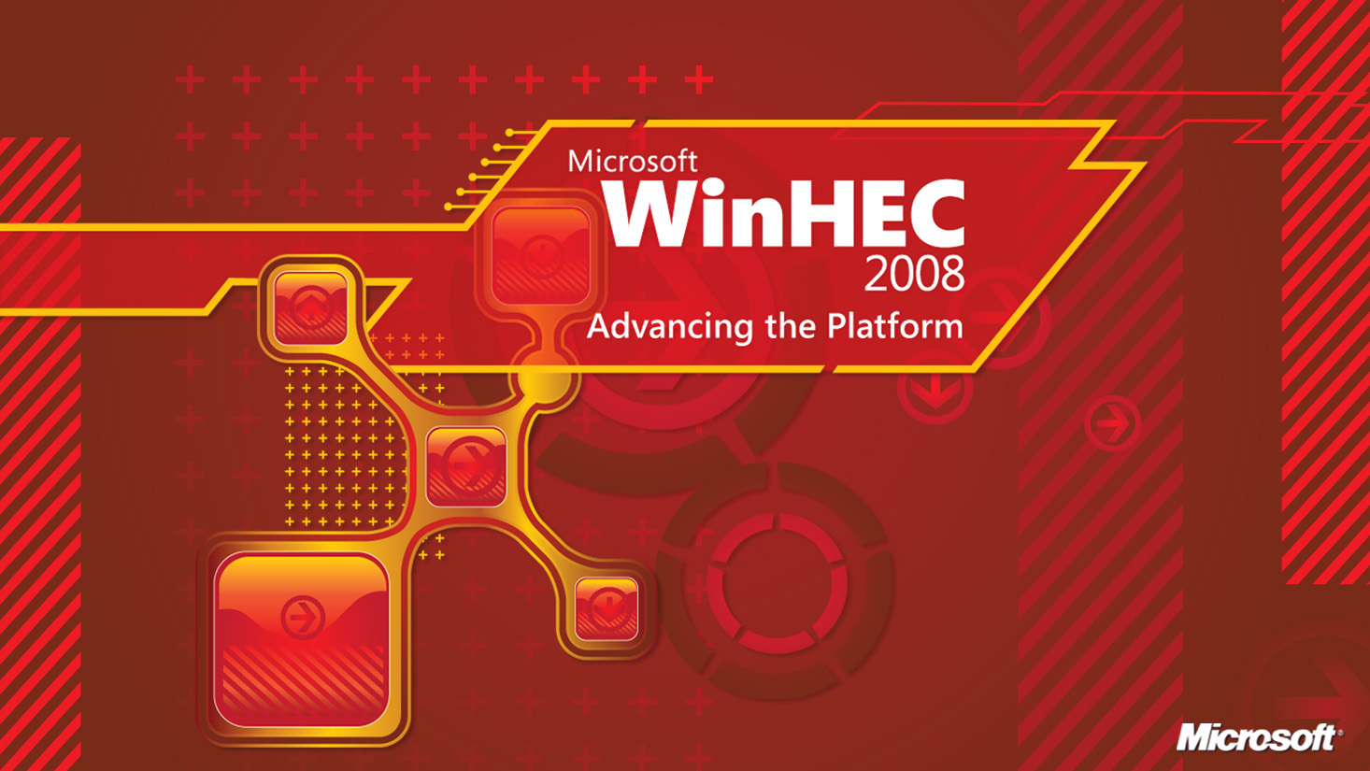

Slide 2
Windows Server Power Management Implementation Details
Johnson Cheng
Software Design Engineer – Windows Kernel
Microsoft Corporation

Slide 3
Agenda
Brief Overview
Windows Server 2008
  Management through Power Policies
Windows Server 2008 R2
  Idle Operating Efficiency – Core Parking Explained
  Power Metering and Budgeting
  Remote Power Management thru WMI
Call To Action

Slide 4
Brief Overview
Vision
Windows Server 2008
  SP2 – More power efficient by default
Windows Server 2008 R2
  Idle Operating Efficiency
  Power Meter and Budgeting
  Remote Power Manageability

Slide 5
Agenda
Brief Overview
Windows Server 2008
  Management through Power Policies
Windows Server 2008 R2
  Power Metering and Budgeting
  Remote Power Management thru WMI
Call To Action

Slide 6
Windows Server 2008
More efficient P-state parameters in SP2
Customizable power policy in Windows Server 2008
  Scriptable via the command line with powercfg.exe
Release | Step up Time | Step down Time | Domain Accounting Policy | Step up Policy | Step down Policy
Windows Server 2008 RTM | 100 ms | 300 ms | On | Jump to Ideal | Single Step
Windows Server 2008 SP2 | 100 ms | 100 ms | Off | Single Step | Jump to Ideal

Slide 7
PowerCFG.EXE Example
Configure power setting within a specific power scheme
  Set AC, DC values for individual settings
    Every power setting belongs to a Subgroup
    -setdcvalueindex used for battery scenario
C:\> powercfg.exe –setacvalueindex
<SCHEME> <SUBGROUP> <SETTING> <VALUE>
C:\> powercfg.exe –setacvalueindex
SCHEME_BALANCED SUB_SLEEP STANDBYIDLE 0

Slide 8
Agenda
Brief Overview
Windows Server 2008
  Management through Power Policies
Windows Server 2008 R2
  Power Metering and Budgeting
  Remote Power Management thru WMI
Call To Action

Slide 9
Power Metering and Budgeting
Design goals
  Standard hardware and software interfaces
  Native infrastructure, easily extendable
  Leverages existing platform technology
Power budgeting model
  Cooperative between OS and Platform (see whitepaper in Resources)
  Platform responsible for hard guarantees, hardware fail safe
  OS scales based on workload and react to platform notifications
  OS exposes node level metering information, for centralized management

Slide 10
demo
Power Metering and Budgeting

Slide 11

Power Budgeting and Metering
WMI Consumers
User-mode Power Service
WMI Namespace
root\cimv2\power
  Power Supply class
  Power Meter class
  Power Meter Events
Management tools
Admin scripts
Power WMI providers
System Center
.
.
.
Standard Windows IOCTL interface
In-box ACPI-based implementation
Other vendor specific implementations…
Implemented
in Windows 7
Vendors provide ACPI code in firmware
BMC hardware
Hardware

Slide 12
Power Metering and Budgeting – WMI
Based on the DMTF management profiles
New power namespace – root\cimv2\power
1) Power Supply Device
  Inventory information
  Capabilities/characteristics
  Redundancy information
CIM_PowerSupply
CIM_NumericSensor
_ExtrinsicEvent
Win32_PowerSuppy
Win32_PowerMeter
Win32_PowerMeterEvent
Win32_PowerSupplyEvent

Slide 13
Power Metering and Budgeting – WMI
2) Power meter device
  Inventory information
  Capabilities/characteristics
  Latest meter measurements
  OS-Configurable trip-points
  Configurable platform enforced limit
3) Power supply/meter events
  Notification for changes in configuration and capabilities
  Notification for trip-points crossed and platform limit enforced

Slide 14
Power Metering and Budgeting – Usage
Statistical/inventory/auditing
Data center can monitor power consumption across nodes
Administrator can write scripts to control power policies and receive power condition events
Model can be extended to per-device meters
Another set of metrics for virtualization and consolidation

Slide 15
Power Metering and Budgeting – WDM
Standard Windows driver IOCTL interface
Event model based on pending IO requests (IRPs)
2 separate device interfaces
Consumed by the WMI providers
An alternative to the ACPI implementation
Future direction – potentially consumed
by the kernel power manager
Documented on MSDN (link)

Slide 16
Power Metering and Budgeting – ACPI
Rationale
  Works as the abstraction layer to the underlying platform technology (IPMI, WSMAN, etc.)
  Scales across different platforms
  Does not require special drivers
  Requires only firmware updates
Currently being proposed to the ACPI 4.0 specification
Delegate tasks to the BMC (e.g., rolling average calculation, polling for events, etc.)

Slide 17
Power Metering and Budgeting – ACPI
Power supply device
  Extends the current power source device
  Control method to publish capabilities
Power meter device
  Similar to control method batteries
  A set of control methods to get capabilities
  and set configuration parameters, trip points,
  and configure hardware enforced limits
  Event notification via Notify codes

Slide 18
Power Metering and Budgeting – ACPI
Windows Server 2008 R2 will provide
  In-box driver to support power meter device(s) described in ACPI
  In-box IPMI operation region handler as part of the Microsoft IPMI driver – allowing ACPI control methods to communicate with IPMI using the KCS protocol
    Format similar to the SMBUS OpRegion
    3rd-party IPMI drivers can register OpRegion handler
    for other IPMI protocol(s)
    Also proposed to ACPI 4.0 specification

Slide 19
Architecture Details
User-mode Power Service
Power policy provider
Power policy feedback
User mode
Power supply provider
Power meter provider
IOCTLs
IOCTLs
Event feedback
Power supply interface
Power meter interface
Power Manager
WDF drivers
acpipsu.sys
xyzpsu.sys
acpipmi.sys
xyzpmi.sys
Kernel mode
acpi.sys
IPMI handler
IOCTLs
Microsoft IPMI driver (ipmidrv.sys)
Interprets
IPMI OpRegion encountered
IPMI KCS protocol
ACPI control methods
E.g., Query power supply information, Set power meter trip points, Get power meter capabilities
Firmware
BMC hardware

Slide 20
Agenda
Brief Overview
Windows Server 2008
  Management through Power Policies
Windows Server 2008 R2
  Power Metering and Budgeting
  Remote Power Management thru WMI
Call To Action

Slide 21
Remote Power Manageability
Windows Server 2008 R2 supports power policy via Windows Management Infrastructure (WMI)
  Conforms to DMTF conventions for settings data
  Enables local and remote management via WMI
  Scriptable
Includes support for reading and writing
of all power plan and setting data
Active power plan can get changed remotely
Power Action can be carried out (sending a node to S3)

Slide 22
Remote Power Manageability
Win32_PowerPlan
Win32_PowerSettingSubgroup
Win32_PowerSettingDataIndexInPlan
Win32_PowerSettingInSubgroup
Class relationship
Win32_PowerSettingDataIndex
objects
Win32_PowerSetting
association
Win32_PowerSettingElementDataIndex
Win32_PowerSettingCapabilities
Win32_PowerSettingDefinition
Win32_PowerSettingDefineCapabilities
Win32_PowerSettingDefineCapabilities
Win32_PowerSettingDefinitionPossibleValue
Win32_PowerSettingDefinitionRangeData

Slide 23
Remote Power Manageability
Get the Active Plan:
Set objWMIService = GetObject("WinMgmts:\\.\root\cimv2\power")
Set PowerPlans = objWMIService.InstancesOf("Win32_PowerPlan")
For Each PowerPlan in PowerPlans
If PowerPlan.IsActive Then
wscript.echo "Current Plan: " & PowerPlan.ElementName
End If
Next
Set the Active Plan:
PowerPlan.Activate()

Slide 24
Remote Power Manageability
Get all power settings in the Active Plan:
(Continued with PowerPlan)
EscapedInstanceID = Replace(PowerPlan.InstanceID, "\", "\\")
Set PowerSettingIndexes = objWMIService.ExecQuery(
"ASSOCIATORS OF {Win32_PowerPlan.InstanceID=" & chr(34) &
EscapedInstanceID & chr(34) & "}")
For Each PowerSettingIndex in PowerSettingIndexes
EscapedInstanceID = Replace(PowerSettingIndex.InstanceID, "\", "\\")
Set PowerSettings = objWMIService.ExecQuery(
"ASSOCIATORS OF {Win32_PowerSettingDataIndex.InstanceID=" & chr(34) &
EscapedInstanceID & chr(34) & "} WHERE ResultClass = Win32_PowerSetting")
For Each PowerSetting in PowerSettings
wscript.echo “Power Setting: “ & PowerSetting.InstanceID
wscript.echo “Description: “ & PowerSetting.Description
wscript.echo “Index Value: “ & PowerSettingIndex.SettingIndexValue

Slide 25
WMI – Set Power Settings
Set the value of a power settings in the Active Plan:
TargetSetting = "Microsoft:PowerSetting\\{3c0bc021-c8a8-4e07-a973-6b14cbcb2b7e}" 'display blank timeout
Set objWMIService = GetObject("WinMgmts:\\.\root\cimv2\power")
Set SettingIndices = objWMIService.ExecQuery(“ASSOCIATORS OF {“ & chr(34) &
“Win32_PowerSetting.InstanceID=“ & chr(34) & TargetSetting &
chr(34) & “} WHERE ResultClass = Win32_PowerSettingDataIndex”)
For Each SettingIndex in SettingIndices
Set Plan = objWMIService.ExecQuery(“ASSOCIATORS OF {“ & chr(34) &
SettingIndex.InstanceID & “} WHERE ResultClass = Win32_PowerPlan”)
If Plan.IsActive THEN
SettingIndex.SettingIndexValue = 120 ‘2 seconds
SettingIndex.Put_
Plan.Activate()

Slide 26
Call To Action
Ensure drivers and applications work
with core parking enabled
Review the cooperative power budgeting
white paper to work well with Windows
Speak with Microsoft about creating
ACPI-based power meter and supply devices
Try out Windows 2008 R2 M3 bits to familiarize with
the power policies and power meter WMI classes

Slide 27
Additional Resources
Web Resources
  Whitepapers: http://www.microsoft.com/whdc/system/pnppwr/powermgmt/Svr_PowerBudget.mspx
  Other Resources: http://www.acpi.info
Related Sessions
  ENT-T551 – Windows Server Power Management Overview
E-mail
  Server Power Feedback alias:
  Srvpwrfb@microsoft.com

Slide 28



Please Complete A Session Evaluation Form
Your input is important!
Visit the WinHEC CommNet and complete a Session Evaluation for this session and be entered to win one
of 150 Maxtor® BlackArmor™ 160GB External Hard Drives
50 drives will be given away daily!
http://www.winhec2008.com
BlackArmor
Hard Drives provided by:

Slide 29


© 2008 Microsoft Corporation. All rights reserved. Microsoft, Windows, Windows Vista and other product names are or may be registered trademarks and/or trademarks in the U.S. and/or other countries.
The information herein is for informational purposes only and represents the current view of Microsoft Corporation as of the date of this presentation. Because Microsoft must respond to changing market conditions, it should not be interpreted to be a commitment on the part of Microsoft, and Microsoft cannot guarantee the accuracy of any information provided after the date of this presentation.
MICROSOFT MAKES NO WARRANTIES, EXPRESS, IMPLIED OR STATUTORY, AS TO THE INFORMATION IN THIS PRESENTATION.

