Slide 1
Windows Support For Greater Than 64 Logical Processors
Arie van der Hoeven
Windows Kernel Team
Senior Program Manager
Microsoft Corporation

Slide 2
Agenda
Hardware Evolution
Greater than 64 Logical Processors Support
Non-Uniform Memory Architecture (NUMA)
  Optimizing for Topology
Performance Tools
Intel Enterprise Roadmap
Scale Up Futures

Slide 3
The Future Of Server Is Scale Up
Processors can’t continue
to get faster and hotter
  …but Moore’s law still rules
The Big Iron of today is the
commodity server of tomorrow
How does Windows play?
  Bet on scale up?
  Bet on Virtualization?
  Both

Slide 4

Scale Up Terminology
Processor / Package / CPU / One physical processor – may consist of one or more cores
Core: One processing unit – may consist of one or more logical processors
Logical Processor / Thread: One logical computing engine in the OS, application and driver view
NUMA: Non-Uniform Memory Architecture
NUMA Node: Group of logical processors and cache that are in proximity to each other
Group <new>: Logical grouping of up to 64 logical processors
Processor / Package / CPU Socket: ne physical processor – may consist of one or more cores
Core: One processing unit – may consist of one or more logical processor
Logical Processor / Thread: One logical computing engine in the OS, application and driver view
NUMA: Non-Uniform Memory Architecture
NUMA Node: Group of logical processors and cache that are in proximity to each other
Group <new>: Logical grouping of up to 64 logical processors

Slide 5
Scale Up Terminology
128 Logical Processor System
Group
(up to 64 logical processors)
NUMA Node
Socket
Core
Logical Processor

Slide 6
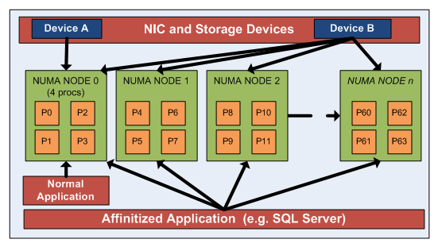
Hardware Evolution
Industry is moving towards segmented
processing complexes
  CPUs share internal caches between cores
  CPU and memory are a “node”, connected via links to other nodes
“Close” versus “far” hardware can be determined easily

Slide 7
Windows Server 2008 R2 Focus
Support up to 256 processors
  Single image LOB Applications: SQL Server, SAP, etc.
Refactoring of hot locks
Driver stack enlightenment
New APIs for >64LP and locality
Tools and UI for viewing hundreds of logical processors and locality

Slide 8
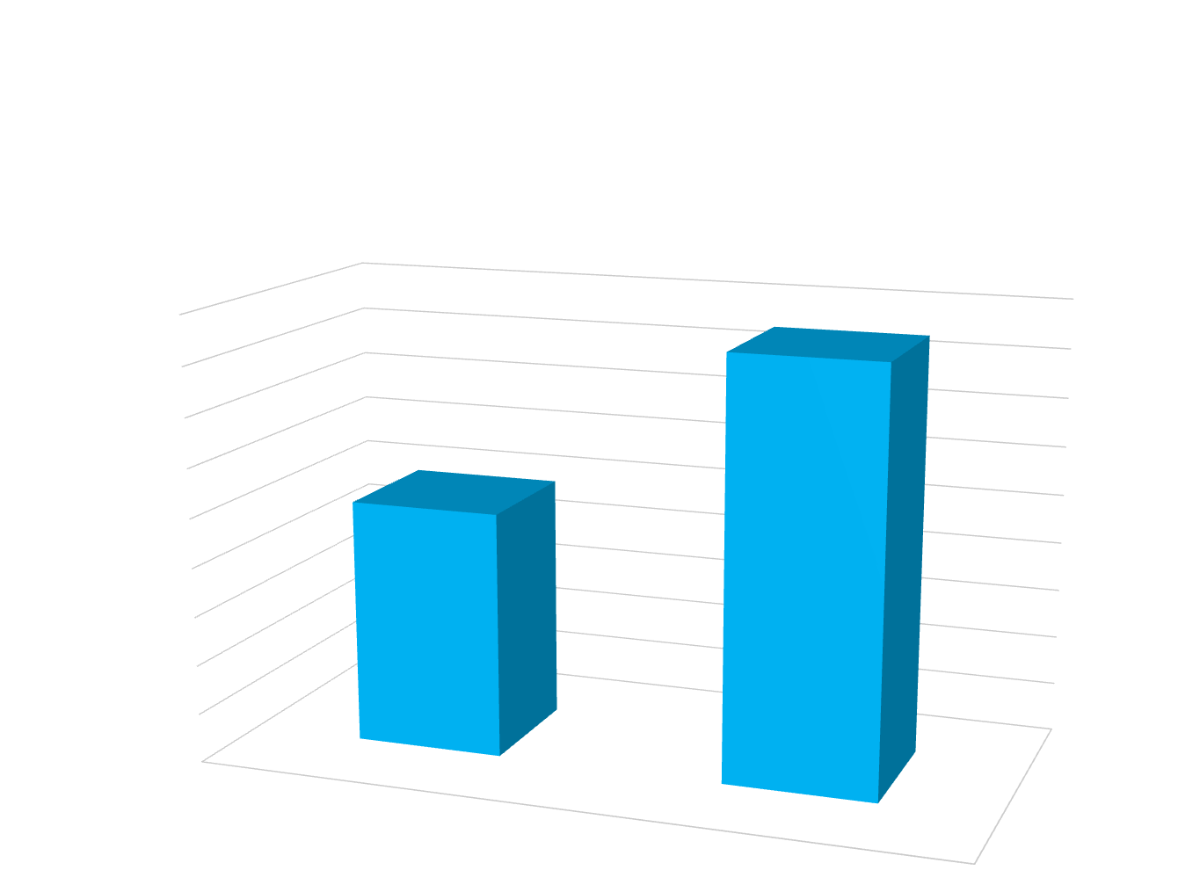
OLTP Scaling 64P To 128P
1.7X
1.3X
64P
128P
Windows Server Performance team benchmark lab results

Slide 9
Additional Scale Up Features
Windows Hardware Error
Architecture (WHEA)
Server Power Management
  Core parking
Virtualization and Hypervisor

Slide 10
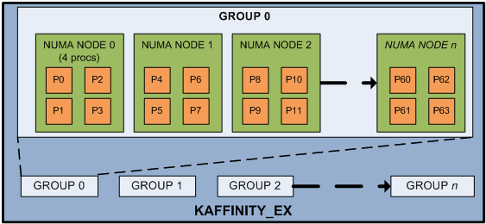
Greater Than 64LP Support
Segmented specification – “groups” of CPUs
  CPUs identified in software by Group#: CPU#
  Allows backward compatibility with 64-bit affinity
  New applications have full CPU range using new APIs
  Permits better locality during scheduling than a
  “flat” specification

Slide 11
Greater Than 64LP Support
Up to 64 CPUs per group
Groups may span multiple NUMA nodes,
but each node must be fully contained in
a single group
A thread belongs to a single group
at any point in time, but a process
can span groups
Interrupt may be directed to any single CPU, but if directed to a set of CPUs, they must be in the same group

Slide 12
Engagements
Today – focus on server and single
LOB applications
  Intel, AMD, HP, Unisys, IBM, NEC, Fujitsu
  SQL Server, SAP
  NICs
  Storage
Tomorrow – client and the larger driver and application ecosystem

Slide 13
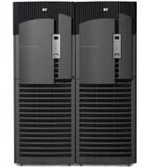


HP Superdome Hardware Configuration
64 dual-core hyper-threaded “Montvale” 1.6 GHz Itanium2
w/ 24 GB LLC
30 HP SmartArray P600 HBAs (x4 3Gb SAS)
60 HP MSA70 Disk Arrays
1440 72GB 2.5” 15Krpm Disks
1 TB Memory,
4 dual-port 1GB NICs
A 64-core configuration can achieve 200,000 IOps for 8-64 KB requests

Slide 14
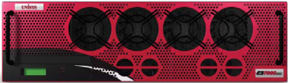

Unisys ES7000 Hardware Configuration
32 dual-core hyper-threaded “Tulsa” 3.4 GHz Xeon
w/16 GB LLC
24 Emulex LP10002 dual-port FC HBAs
48 HP MSA1000/1500 Disk Arrays
1540 36GB 3.5” 15Krpm Disks
256 GB Memory

Slide 15
OLTP Run On 128P System
video

Slide 16
What Is Non-Uniform Memory Access (NUMA) I/O?
A picture is worth a 1000 words!

Slide 17
Bad Case Disk Write
Unoptimized driver
Locked out for I/O Initiation
(6)
(2)
Locked out for I/O Initiation
ISR
DPC
(7)
I/O Initiator
P₁
P₂
P₃
P₄
Cache₁
Cache₂
(0)
Cache₃
Cache₄
(5)
(3)
Node Interconnect
(1)
(4)
Cache(s)
I/O Buffer Home
Mem_{A}
Disk_{A}
Disk_{B}
Mem_{B}

Slide 18
Windows Server 2008 R2
Driver Optimization for Topology
I/O Initiator
ISR
DPC
(3)
ISR
P₁
P₂
(2)
P₃
P₄
Cache₁
Cache₂
Cache₃
Cache₄
Node Interconnect
(3)
(2)
Cache(s)
Mem_{A}
Disk_{A}
Disk_{B}
Mem_{B}

Slide 19
System Topology APIs
Processor topology exposed (user/kernel)
  NUMA nodes → Sockets → Cores → Logical Processors (e.g., hyper-threads)
  Includes details of CPU caches (L0/L1/L2)
Memory topology exposed
Device location exposed (e.g., network and storage controllers)
  Determine associated NUMA node(s) via ACPI Proximity Domains (BIOS support required)

Slide 20
System Tools
Performance Monitor
  Processor to node relationship information
  Total system processor utilization
Task Manager
  Average CPU utilization
  Average CPU utilization for a given node

Slide 21
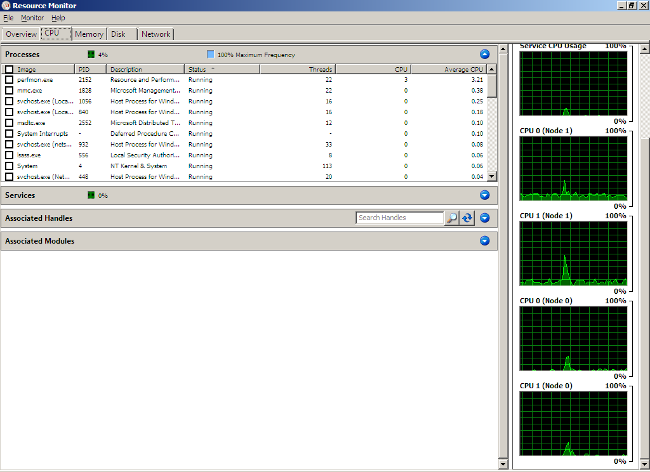
System Tools
Resource Monitor

Slide 22


Intel® Enterprise Roadmap
2008
Future
Intel® Itanium®
9000 Sequence
(Mission Critical)
Itanium Processor
870 / OEM Chipset
Future MC Chipset
Kittson
Tukwila
Poulson
Intel® Xeon® MP
7000 Sequence
(Expandable, MC)
Quad/Dual-core Xeon Processor
Intel® 7300 Chipset
Nehalem Processor
Future EX Chipset
Dunnington
Quad/Dual-core Xeon Processor
Intel® 5000 Chipset
Nehalem Processor
Future EP Chipset
Intel® Xeon® DP
5000 Sequence
(Efficient Performance)
Quad/Dual-core Xeon Processor
Intel® 5100 Chipset
Nehalem Processor
Future EP Chipset
Intel® Xeon® UP
3000 Sequence
(Entry)
Quad/Dual-core Xeon Processor
Intel® 3200 Chipset
Nehalem Processor
Future EN Chipset
Intel® Xeon® WS
5000 Sequence
(Workstation & HPC)
Quad/Dual-core Xeon Processor
Intel® 5400 Chipset
Nehalem Processor
Future Windows Chipset
All dates, product features and plans are subject to change without notice.
Notes:
22
22

Slide 23

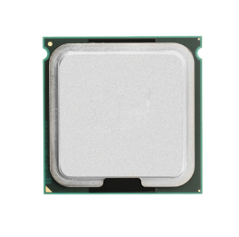
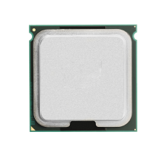
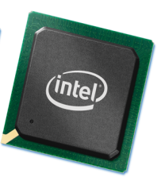




Nehalem Based System Architecture
Nehalem
Nehalem
Nehalem
Nehalem
I/O
Hub
I/O
Hub
I/O
Hub
PCI Express*
DMI
Nehalem
Nehalem
PCI
Express*
PCI
Express*
ICH
Intel QuickPath Interconnect
2, 4, 8 Cores per socket, two logical processors per core
Expect large Nehalem-EX systems with up to 1024 logical processors
Intel® QuickPath Architecture
Integrated Memory Controller
Buffered or Un-buffered Memory
*Optional Integrated Graphics
Notes:
23

Slide 24
Interrupt Addressing
xAPIC has been meeting interrupt architecture needs since P4, for Intel Architecture
  8 bit APIC ID addresses
  Physical addresses limited to 0 – 254 APIC IDs
  Logical addresses limited to 60 processors
  Flat addresses limited to 8 processors
xAPIC interrupt address limits reached on Nehalem-EX
  xAPIC can address up to 8 Nehalem packages, up to 128 processors
Intel’s Next Generation Interrupt Architecture
allows scaling to 32 bit APIC IDs starting with Intel’s
Nehalem-EX processors

Slide 25
x2APIC
x2APIC is Intel’s next generation interrupt architecture designed to meet interrupt address scaling for future
  32-bit APIC ID enables systems with very large number of Logical Processors (4G)
  Compatible with existing PCI-E/PCI Devices and IOxAPICs
Requires Platform HW and BIOS enabled for interrupt remapping using Intel® Virtualization Technology for Directed I/O
  ACPI 4.0 augmented to enumerate x2APIC
  OS/VMMs support for x2APIC and interrupt remapping
  Minimal SW impact otherwise

Slide 26
Future
Server and client
Virtualization and Hypervisor
continue to scale
Continued power
management innovations
WHEA for Client?
ManyCore* 100s of cores

Slide 27
Future
Applications and Resource Management
Support for parallel programming paradigms in Visual Studio 2010
Resource Management and Scheduling for concurrent workloads (Microsoft Concurrency Runtime)
Programming models, libraries and tools for managed and native developers
More Information: http://msdn.microsoft.com/concurrency

Slide 28
Enabling Concurrency Runtimes
Reducing kernel intervention
in thread scheduling with User Mode Scheduling (UMS)
Non-running threads
Core 2
User
Thread
3
User
Thread
4
User
Thread
5
User
Thread
6
Core 1
Core 2
Core 1
User
Thread
1
Thread
4
Thread
5
Thread
1
Thread
2
Thread
3
Thread
6
User
Thread
2
Kernel
Thread
1
Kernel
Thread
2
Kernel
Thread
3
Kernel
Thread
4
Kernel
Thread
5
Kernel
Thread
6

Slide 29
Call To Action
Reduce support and maintenance costs
by scaling up on Windows 2008 R2
Leverage the topology APIs to build scalable applications and drivers
Enlighten applications and tools to monitor system performance on >64P machines
Implement Support for x2APIC on >128 logical processor Nehalem-EX platforms
Questions? Email GT64P@microsoft.com

Slide 30
Resources
Whitepaper on how to develop applications and drivers
for >64P support
  http://www.microsoft.com/whdc/default.mspx or
  http://go.microsoft.com/fwlink/?LinkId=131250
Windows Server Performance Team Blog
  http://blogs.technet.com/winserverperformance/
Concurrency Programming models, libraries and tools
  More info: http://msdn.microsoft.com/concurrency
Intel® 64 Architecture x2APIC Specification
  http://download.intel.com/design/processor/specupdt/318148.pdf
Intel® Virtualization Technology for Directed I/O
  http://download.intel.com/technology/computing/vptech/Intel(r)_VT_for_Direct_IO.pdf

Slide 31
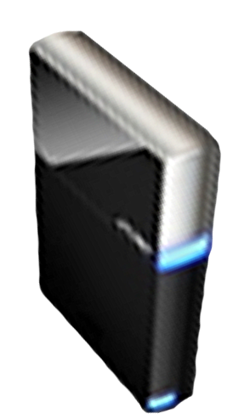


Please Complete A Session Evaluation Form
Your input is important!
Visit the WinHEC CommNet and complete a Session Evaluation for this session and be entered to win one
of 150 Maxtor® BlackArmor™ 160GB External Hard Drives
50 drives will be given away daily!
http://www.winhec2008.com
BlackArmor
Hard Drives provided by:

Slide 32


© 2008 Microsoft Corporation. All rights reserved. Microsoft, Windows, Windows Vista and other product names are or may be registered trademarks and/or trademarks in the U.S. and/or other countries.
The information herein is for informational purposes only and represents the current view of Microsoft Corporation as of the date of this presentation. Because Microsoft must respond to changing market conditions, it should not be interpreted to be a commitment on the part of Microsoft, and Microsoft cannot guarantee the accuracy of any information provided after the date of this presentation.
MICROSOFT MAKES NO WARRANTIES, EXPRESS, IMPLIED OR STATUTORY, AS TO THE INFORMATION IN THIS PRESENTATION.

