Slide 2
Windows Server EnterpriseNetworking Scale For Efficiency
Ganesh Srinivasan
Program Manager
Windows Core Networking Team
Microsoft Corporation

Slide 3
Agenda
Need for system scalability solutions
Receive Side Scaling (RSS)
History of RSS
RSS improvements in Windows Server 2008 R2
RSS diagnostics tools and demo
RSS performance results
Call to action

Slide 4
Need For System Scalability
Servers are getting larger and more parallel
Network I/O conventionally bottlenecked by a single CPU
Single CPU handles receive side network processing
Cannot receive 10 Gbps with a single CPU
Need for technology that distributes network load across multiple CPUs
Solution
Receive Side Scaling (RSS) – our solution for non-virtualized workloads
Virtual Machine Queue (VMQ) for virtualized workloads

Slide 5
Receive Side Scaling (RSS)
Distributes receive side network processing across multiple CPUs
Affinitizes connections to a single CPU
RSS capability available in most server class NICs (both 1Gbps and 10Gbps)
RSS is enabled by default in all Windows Server OS’
Can be globally enabled/disabled using netsh commands
Can be enabled/disabled in the advance NIC properties for each NIC
Diagnostics tools available

Slide 6
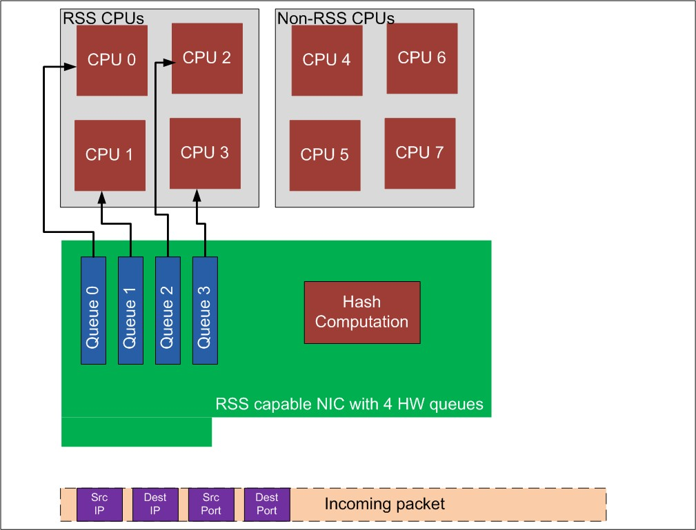
RSS Hardware And Hashing

Slide 7
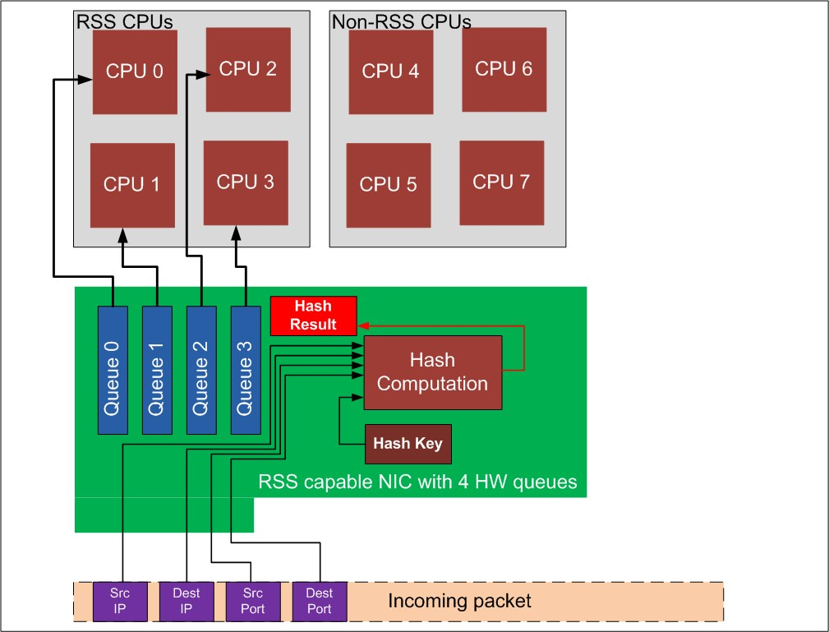
RSS Hardware And Hashing

Slide 8
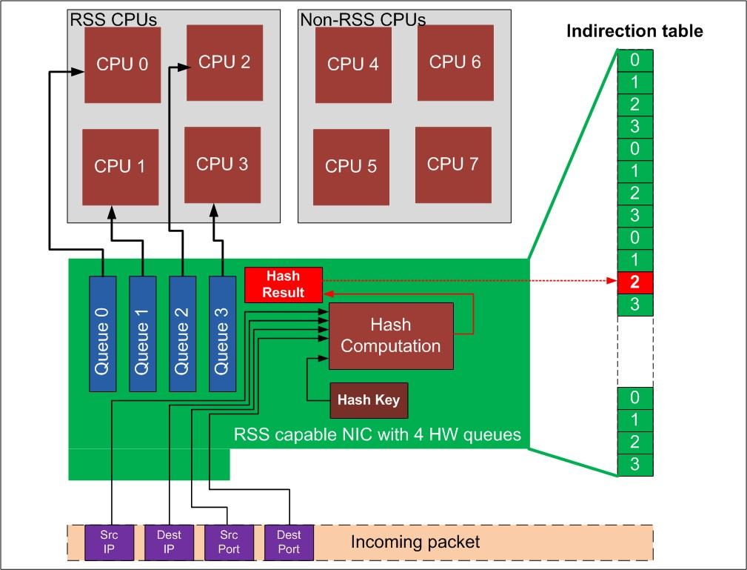
RSS Hardware And Hashing

Slide 9
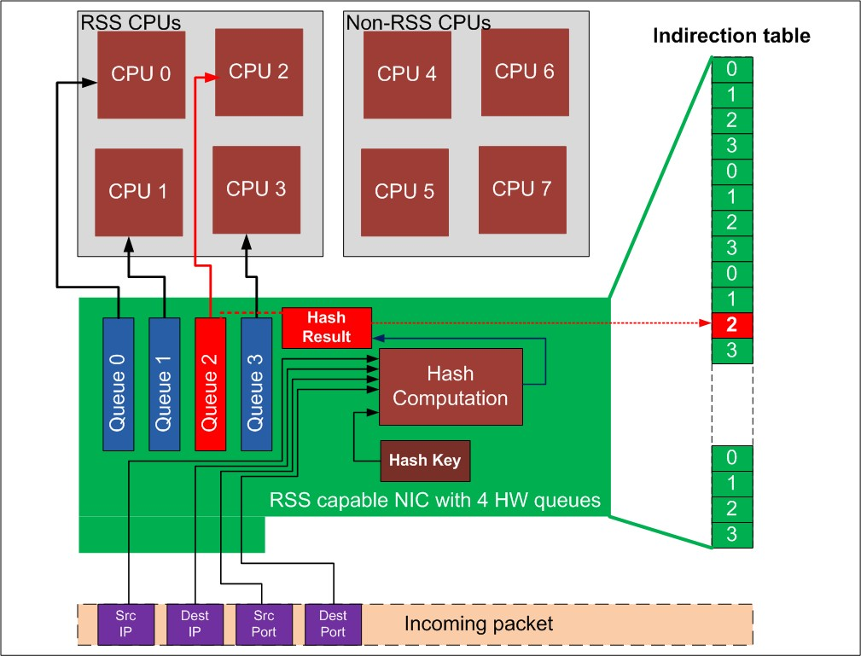
RSS Hardware And Hashing

Slide 10
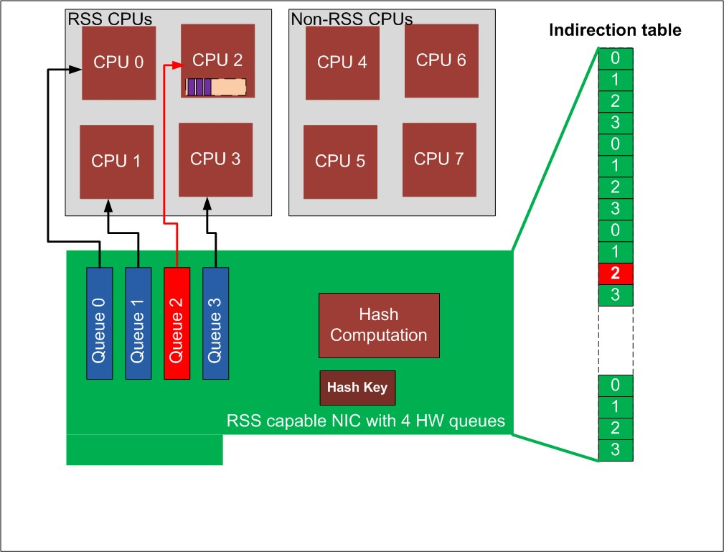
RSS Hardware And Hashing

Slide 11
History Of RSS
First introduced as part of Scalable Networking Pack (SNP) for Windows Server 2003
Enhanced functionality introduced in Windows Server 2008
Improved load balancing algorithm
Concurrent interrupts (support for MSI-X)
Dynamic MSI-X resource configuration for RSS
Manageability - netsh command to enable/disable RSS

Slide 12
RSS Enhancements In Windows Server 2008 R2
Support for additional scenarios (ex., IPsec)
2-tuple hashing
Improved network load distribution in multiple network interface scenarios
Easier for IHVs to implement support for multi-port NICs
One indirection table per interface
Non Uniform Memory Access (NUMA) awareness
Memory topology information considered when selecting CPUs for RSS
Processor topology and RSS information made available to drivers

Slide 13
RSS Enhancements In Windows Server 2008 R2
Improved RSS defaults
Example: NIC bandwidth considered while assigning RSS CPUs
More flexibility in configuring defaults
Configurations can be set on a per interface basis
Maximum number of RSS processors
Controlled by standardized keyword
Default RSS processor
Controlled by standardized keyword
Control over selecting CPUs assigned to work with RSS
New diagnostics tools

Slide 14
Diagnostics And Tools
Per-processor performance counters (Perfmon)
Interrupts and DPCs
Received packets/sec
Enable/disable RSS through netsh
netsh int tcp set global rss=enabled/disabled
NICSTATS tool
Shows MSI-X info
RSS capabilities and parameters
Indirection table
NIC and RSS statistics

Slide 15
Diagnostics and Tools for RSS
demo

Slide 16
NIC Stats Demo #1
E:\>nicstats -aGetRSSCaps -i18
Adapter: Intel(R) 10 Gigabit XF SR Dual Port Server Adapter #2
RSS capabilities:
RSS Capabilities Revision: 1
MSI Supports: Yes
Classification at ISR: Yes
Classification at DPC: NO
TCP/IPv4 Support: Yes
TCP/IPv6 Support: Yes
IPv6 extension headers support: NO
Number of interrupt messages: 4
Number of RSS receive queues: 2

Slide 17
NIC Stats Demo #2
E:\>nicstats -a GetRSSParams -i17
Adapter: Intel(R) 10 Gigabit XF SR Dual Port Server Adapter
RSS Parameters:
RSS Parameters Revision: 1
RSS current state: On
RSS Hash function: Toeplitz
RSS hash fields: IPv4, TCP/IPv4
Hash secret key size: 40
Indirection Table Size: 64
Indirection Table:
0 1 2 3 4 5 6 1 0 1 2 3 4 5 6 2
0 1 2 3 4 5 6 3 0 1 2 3 4 5 6 4
0 1 2 3 4 5 6 5 0 1 2 3 4 5 6 6
0 1 2 3 4 5 6 0 0 1 2 3 4 5 6 1

Slide 18
NIC Stats Demo #3
E:\>nicstats -aGetHardwareInfo -i17
Adapter: Intel(R) 10 Gigabit XF SR Dual Port Server Adapter
Driver NDIS version: 6.20
Interrupt type: Message interrupts
MSI supported
MSI Enabled
MSI-X Supported. MSI-X table entries: 18
MSI-X messages: 18
MSI-X message affinity:
Message 0 Affinity: 0000000000000001
Message 1 Affinity: 0000000000000002
Message 2 Affinity: 0000000000000004
Message 3 Affinity: 0000000000000008
Message 4 Affinity: 0000000000000010
Message 5 Affinity: 0000000000000020
Message 6 Affinity: 0000000000000040
Message 7 Affinity: 0000000000000080
Message 8 Affinity: 0000000000000001
Message 9 Affinity: 0000000000000002
Message 10 Affinity: 0000000000000004
Message 11 Affinity: 0000000000000008
Message 12 Affinity: 0000000000000010
Message 13 Affinity: 0000000000000020
Message 14 Affinity: 0000000000000040
Message 15 Affinity: 0000000000000080
Message 16 Affinity: 0000000000000001
Message 17 Affinity: 0000000000000001
MSI capabilities reported in PCI configuration space:
MSI capabilities information record was found
MultipleMessageCapable 0, Number of messages 1
MultipleMessageEnable: 0, Number of messages: 1
CapableOf64Bits: 1
PerVectorMaskCapable: 0
MSI-X capabilities reported in PCI Configuration Space:
MSI-X capabilities information record was found
Number of MSI-X table entries: 18
MSIXEnable: 1
PCI information:
Device type: PCI Express Endpoint
Legacy PCI current speed and mode: NOT applicable
Max payload size: 256
Max read request size: 512
Current link speed: 2.5 Gbps
Current link Width: 8
Max link speed: 2.5 Gbps
Max link width: 8
PCI Express version: PCI Version 1.1
Interrupt support information from PCI bus driver:
Line Based interrupts Supported
MSI interrupts Supported
MSI-X interrupts Supported
Number of interrupt messages: 18

Slide 19
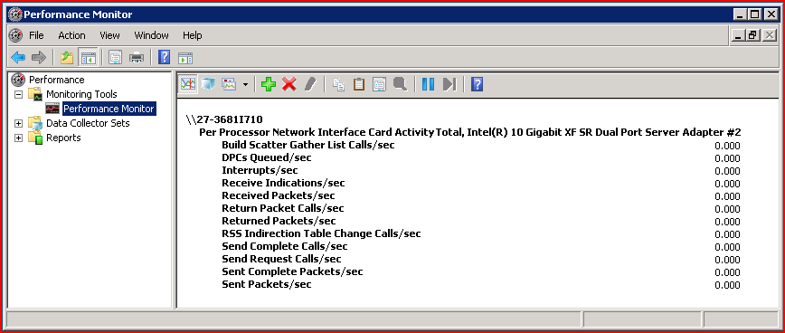
New Performance Counters

Slide 20
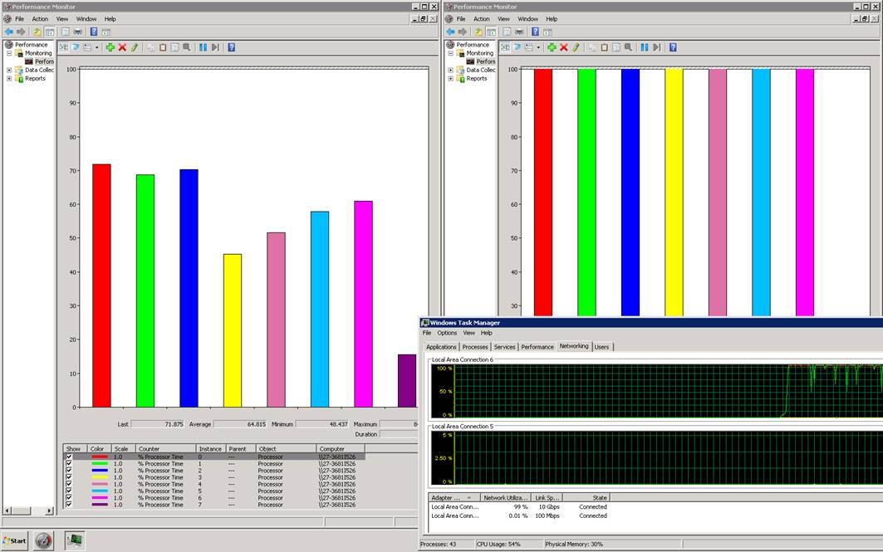
RSS In Action Demo

Slide 21
RSS In Enterprise Workloads
Performance Analysis

Slide 22
File Servers
Data gathered using Intel(R) 10 Gigabit XF SR Adaptor

Slide 23
Web Servers

Slide 24
RSS Coexistance With Offloads
Offloads (TCP chimney, stateless offloads) help reduce CPU utilization for network processing
Network processing limited to single CPU
Throughput still bottlenecked by single CPU
RSS is designed to work in conjunction with offloads
TCP Chimney
IPsec task offload
Stateless offloads
Use RSS with offloads to scale better

Slide 25
Conclusion
Performance Gains
Helps achieve maximum network utilization in 10 Gbps networks
File Server
Up to 3 fold increase in number of clients serviced
Web Server
Up to 4.5 fold improvement in throughput and in number of clients serviced for non-SSL workloads
Up to 2 fold improvement in throughput and in number of clients serviced for SSL workloads
Customers will experience maximum scalability when RSS is deployed in conjunction with other offloads

Slide 26
Call To Action
IHVs
Upgrade drivers NDIS 6.20 to take advantage of new features introduced in Windows Server 2008 R2
Build RSS capable NICs with as many RSS queues as possible
Design the hardware and software such that other offloads coexist with RSS
OEMs
Ensure RSS coexists with other offloads on the NICs you are shipping
Ship server systems with RSS and offloads enabled by default

Slide 27
Additional Resources
Web resources
Whitepapers
Scalable Networking with RSS: http://www.microsoft.com/whdc/device/network/ndis_rss.mspx
Related sessions
ENT-T 557: Windows Server Enterprise Networking: Offload Technologies
ENT-T 589: Improving Networking Performance for Hyper-V Virtual Machines
HSN Website: http://technet.microsoft.com/en-us/network/dd277644.aspx
RSS support: Ndis6fb @ microsoft.com

Slide 28



Please Complete A Session Evaluation Form Your input is important!
Visit the WinHEC CommNet and complete a Session Evaluation for this session and be entered to win one of 150 Maxtor® BlackArmor™ 160GB External Hard Drives 50 drives will be given away daily!
http://www.winhec2008.com
BlackArmor Hard Drives provided by:

Slide 29

© 2008 Microsoft Corporation. All rights reserved. Microsoft, Windows, Windows Vista and other product names are or may be registered trademarks and/or trademarks in the U.S. and/or other countries.
The information herein is for informational purposes only and represents the current view of Microsoft Corporation as of the date of this presentation. Because Microsoft must respond to changing market conditions, it should not be interpreted to be a commitment on the part of Microsoft, and Microsoft cannot guarantee the accuracy of any information provided after the date of this presentation. MICROSOFT MAKES NO WARRANTIES, EXPRESS, IMPLIED OR STATUTORY, AS TO THE INFORMATION IN THIS PRESENTATION.

