Slide 2
BitLocker™
Protecting data In Windows 7 and Windows Server 2008 R2
Troy Funk
Program Manager
Microsoft Corporation

Slide 3


Why Data Protection Matters
“Some of the largest and medium-sized U.S. airports report close to 637,000 laptops lost each year, according to the Ponemon Institute survey released Monday.”
—PC World June 2008
“More than 100 USB memory sticks, some containing secret information, have been lost or stolen from the Ministry of Defense since 2004, it has emerged.”
—BBC News July 2008

Slide 4
Agenda
Review of BitLocker in Windows Vista
and Windows Server 2008
Protecting laptops, desktops, and
servers with BitLocker™ in Windows 7
and Wndows Server 2008 R2
Protecting Removable Drives with BitLocker™ in Windows 7 and Windows Server 2008 R2
Demo

Slide 5
Review of BitLocker in Windows Vista and Windows Server 2008

Slide 6
BitLocker Architecture
Static root of trust measurement of early boot components

Slide 7




Disk Layout and Key Storage
Operating System Volume
Contains
Encrypted OS
Encrypted page file
Encrypted temp files
Encrypted data
Encrypted hibernation file
Where’s the Encryption Key?
SRK (Storage Root Key) contained in TPM
SRK encrypts the VMK (Volume Master Key)
VMK encrypts FVEK (Full Volume Encryption Key) – used for the actual data encryption
FVEK and VMK are stored encrypted on the Operating System Volume
VMK
FVEK
2
SRK
Operating System Volume
3
1
4
System Volume
Contains
MBR
Boot Manager
Boot Utilities
System

Slide 8
BitLocker™ in Windows Vista and Windows Server 2008
Drive Type | Unlock Methods | Recovery Methods | Management | Other requirements
Operating System Drives | TPM TPM+PIN TPM+Startup key TPM+PIN+ Startup Key* Startup key | Recovery password Recovery key Active Directory backup of recovery password | Group policy controlled options presented to users | Use of the BitLocker Drive Preparation Tool to create a system partition where boot files are located System partition size: 1.5GB System partition assigned a drive letter NTFS file system
Fixed Data Drives* | Automatic unlocking | Same as OS drive | No policies | Operating System drive must be encrypted NTFS file system
*Introduced in Windows Vista SP1

Slide 9
Protecting Laptop,
Desktops, and Servers with BitLocker™ in Windows 7 and Windows Server 2008 R2

Slide 10
Operating System Drive Overview
Drive Type | Unlock Methods | Recovery Methods | Management | Other requirements
Operating System drives | TPM TPM+PIN TPM+Startup key TPM+PIN+ Startup key Startup key | Recovery password Recovery key Active Directory backup of recovery password Data Recovery Agent | Robust and consistent group policy enforcement Minimum pin length | Drive preparation fully integrated in BitLocker setup. System partition size: 200MB without WinRE 400MB with WinRE System partition letterless NTFS file system

Slide 11
Setup and Configuration Improvements
Windows 7 is BitLocker ready
  A separate system partition is
  standard in Windows 7
  System partition is now letterless and hidden
  BitLocker Drive Preparation Tool now integrated into the BitLocker setup experience
Upgrade scenarios
  Windows Vista to Windows 7 upgrades are possible without decrypting the OS partition

Slide 12
Protecting Removable Drives with BitLocker™ in Windows 7 and Windows Server 2008 R2

Slide 13
Requirements of Roaming
Work on existing removable drives
Easy to use
Meet varied security needs
Shouldn’t rely on IT departments centrally provisioning drives
Recovery
Roam everywhere – home, work, clients

Slide 14
BitLocker on Removable Drives
Drive Type | Unlock Methods | Recovery Methods | Management | Other requirements
Removable data drives E.g.: USB flash drives External hard drives | Passphrase Smart card Automatic unlocking | Recovery password Recovery key Active Directory backup of recovery password Data Recovery Agent | Robust and consistent group policy controls Ability to mandate encryption prior to granting write access | File systems: NTFS FAT FAT32 ExFAT

Slide 15



New Unlock Methods
Roaming using a Passphrase
No specific hardware requirement
Easily roam inside
and outside domains/organizations
Complexity and length requirements managed
by Group Policy

Slide 16

New Unlock Methods
Roaming using Smart Cards
  Leverages existing
  PKI infrastructure
  Requires specific hardware
  Can roam to any computer running
  Windows 7 or Windows Server 2008 RC2
  Uses much stronger keys than passphrase

Slide 17
New Recovery Mechanism
Data Recovery Agents (DRA)
  Certificate-based key protector
    A certificate containing a public key is distributed through Group Policy and is
    applied to any drive that mounts
    The corresponding private key is held by a
    data recovery agent in the IT department
  Allows IT department to have a way to unlock all protected drives in an enterprise
  Saves space in AD –
  same Key Protector on all drives

Slide 18
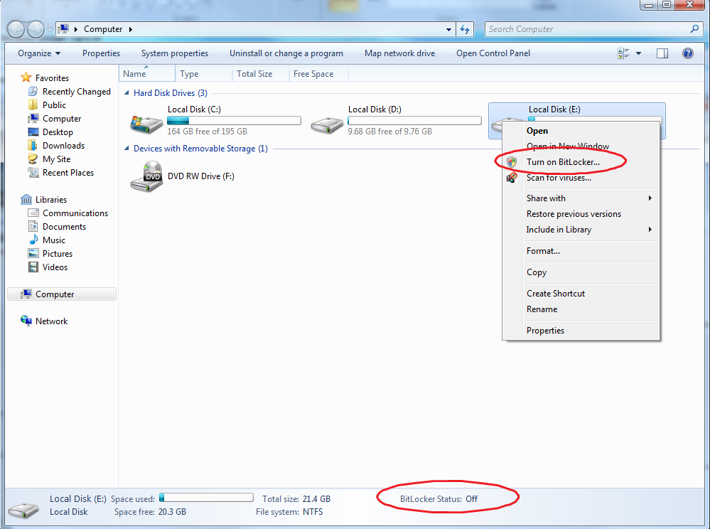
Integration
Control BitLocker from Windows Explorer
Right click drives in Windows Explorer to
  Turn on BitLocker
  Unlock a drive
  Manage BitLocker

Slide 19
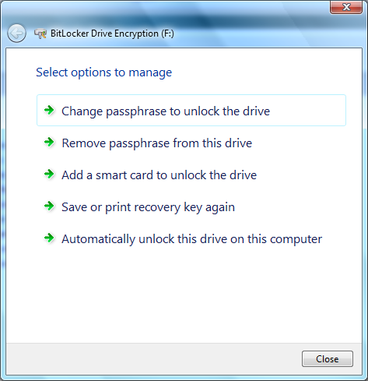
Managing BitLocker
Data Drives
Add, remove, or change their passphrase
Add or remove a smart card
Add or remove automatic unlocking
Duplicate their recovery key/password
OS Drives
Duplicate their recovery key/password
Reset their PIN
Duplicate their startup key

Slide 20
Mandating BitLocker on Removable Drives
Requiring BitLocker for
removable data drives
  When this policy is enforced, all removable drives will require BitLocker protection in order to have write access
  As soon as a drive is plugged into a machine, a dialog is displayed to the user to either enable BitLocker on the device or only have read-only access

Slide 21
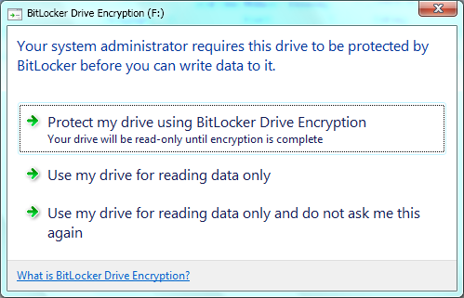
Mandating BitLocker on Removable Drives
The user gets full RW access only after
encryption is completed
Users can alternatively enable BitLocker at a later time

Slide 22
BitLocker on Removable Drives
Demo

Slide 23
Initial Conversion Performance

Slide 24
Call To Action
IHVs and ODMs have an opportunity to optimize their drives for BitLocker by improving read/write speeds
IT departments can begin to purchase drives with read/write speeds in mind

Slide 25
Additional Resources
Web Resources
  Whitepapers: http://technet.microsoft.com/en-us/windows/aa905065.aspx
  Other Resources: http://blogs.technet.com/bitlocker/
Email
  bdeinfo@microsoft.com

Slide 26
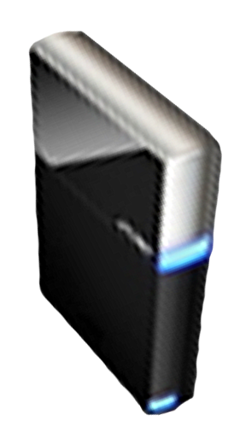


Please Complete A Session Evaluation Form
Your input is important!
Visit the WinHEC CommNet and complete a Session Evaluation for this session and be entered to win one
of 150 Maxtor® BlackArmor™ 160GB External Hard Drives
50 drives will be given away daily!
http://www.winhec2008.com
BlackArmor
Hard Drives provided by:

Slide 27


© 2008 Microsoft Corporation. All rights reserved. Microsoft, Windows, Windows Vista and other product names are or may be registered trademarks and/or trademarks in the U.S. and/or other countries.
The information herein is for informational purposes only and represents the current view of Microsoft Corporation as of the date of this presentation. Because Microsoft must respond to changing market conditions, it should not be interpreted to be a commitment on the part of Microsoft, and Microsoft cannot guarantee the accuracy of any information provided after the date of this presentation.
MICROSOFT MAKES NO WARRANTIES, EXPRESS, IMPLIED OR STATUTORY, AS TO THE INFORMATION IN THIS PRESENTATION.

Slide 28
BitLocker on Removable Drives
Appendix

Slide 29
Smartcard Authentication for Data Volumes
Supported Certificates for smart card authentication
A certificate is considered valid for BitLocker if
the following conditions are met for Key Usage
  No KU is present
  KU is present and contains one of the following keyEncipherment bits
    CERT_DATA_ENCIPHERMENT_KEY_USAGE
    CERT_KEY_AGREEMENT_KEY_USAGE
    CERT_KEY_ENCIPHERMENT_KEY_USAGE
A certificate is considered valid for BitLocker if the
following conditions are met for Extended Key Usage:
  No EKU is present
  EKU is present and contains BitLocker OID
  EKU is set to anyExtendedKeyUsage

Slide 30
BitLocker in Windows 7 at a Glance
Drive Type | Unlock Methods | Recovery Methods | Management | Other requirements
Operating System Drives | TPM TPM+PIN TPM+Startup key TPM+PIN+ Startup Key Startup key | Recovery password Recovery key Active Directory backup of recovery password Domain Recovery Agent | Robust and consistent group policy enforcement Minimum pin length | Drive preparation fully integrated in BitLocker setup System partition size: 200MB without WinRE 400MB with WinRE System partition letterless NTFS file system
Data Drives Includes fixed and removable | Passphrase Smart Card Automatic unlocking | Same as OS drive | Robust and consistent group policy controls Ability to mandate encryption prior to granting write access | File systems: NTFS FAT FAT32 ExFAT

