Slide 1
Microsoft Hyper-V
Randy Campbell
Sr. Principal Engineer
Intel Corporation
Bryon Surace
Senior Program Manager
Virtualization
Microsoft Corporation

Slide 2
Agenda
Windows Server 2008 Hyper-V
How did we arrive at the Windows Server 2008 R2 POR?
Overview of Windows Server 2008 R2 Hyper-V Plan-of-Record
Q & A
Please keep questions to the end

Slide 3
Windows Server 2008 Hyper-V Requirements
Description
Hypervisor based virtualization platform
Windows Server 2008 x64 Edition technology
Standard, Enterprise and Datacenter Editions
Hardware Requirements
x64 server with hardware assisted virtualization
AMD AMD-V or Intel VT
Hardware enabled Data Execution Prevention (DEP) required
AMD (NX no execute bit)
Intel (XD execute disable)
Note: Enabling these BIOS features requires powering down (not rebooting) the server to take effect

Slide 4
Windows Server 2008 Hyper-V Capabilities
32-bit (x86) & 64-bit (x64) VMs
Large memory support (64 GB) per VM
SMP VMs (up to 4 cores)
Integrated cluster support for HA & Quick Migration
BitLocker: Seamless, secure data encryption
Live Backup: Volume Shadow Service integration
Pass-through disk access for VMs
Virtual Machine snapshots
New hardware sharing architecture (VSP/VSC/VMBus)
Disk, networking, input, video
Robust networking: VLANs and NLB
Based on DMTF for WMI management interface
Support for Full or Server Core installations

Slide 5










Overview - Windows Server 2008 R2 Hyper-V
Building on the rock-solid architecture of Windows Server 2008 Hyper-V
Integration with new technologies
Enabling new dynamic scenarios:
Increased Server Consolidation
Dynamic Data Center
Virtualized Centralized Desktop

Slide 6
Windows Server 2008 R2 How did we get to POR?
Customer input
Partner input
Review schedule
Repeat
Let’s dive in…

Slide 7
Live Migration

Slide 8
Live Migration
#1 Customer Request
Moving a virtual machine from one server to another without dropped network connection or user perceived downtime
Enables dynamic datacenter scenarios
Servicing
Load balancing VMs for power
Load balancing VMs for CPU

Slide 9
Live Migration
Live Migration via Failover Cluster Manager
In box UI
Live Migration via System Center Virtual Machine Manager
Orchestrate migrations via policy
Moving from Quick to Live Migration:
Guest OS limitations?: No
Changes to VMs needed?: No
Changes to Storage infrastructure: No
Changes to Network Infrastructure: No
Update to Hyper-V: Yes

Slide 10



Quick Migration vs. Live Migration
Quick Migration
(Windows Server 2008 Hyper-V)
Save state
Create VM on the target
Write VM memory to shared storage
Move virtual machine
Move storage connectivity from source host to target host via Ethernet
Restore state & Run
Take VM memory from shared storage and restore on Target
Run
Live Migration
(Windows Server 2008 R2 Hyper-V)
VM State/Memory Transfer
Create VM on the target
Move memory pages from the source to the target via Ethernet
Final state transfer and virtual machine restore
Pause virtual machine
Move storage connectivity from source host to target host via Ethernet
Resume
Host 1
Host 2
Host 1
Host 2

Slide 11
Migration & Storage
Today: Windows Server 2008 Hyper-V
Management Overhead one VM per LUN
100 VMs = 100 LUNs
Drive letter limitations
Solutions:
Use drive GUIDs
Use partner solutions

Slide 12
Migration & Storage
Windows Server 2008 R2 Hyper-V
NEW Cluster Shared Volumes (CSV)
Required for Live Migration
CSV provides a single consistent file name space; All Windows Server 2008 R2 servers see the same storage
Easy setup; Uses NTFS
No reformatting SANs
Create one big data store
No more drive letter problems
Existing tools just work

Slide 13

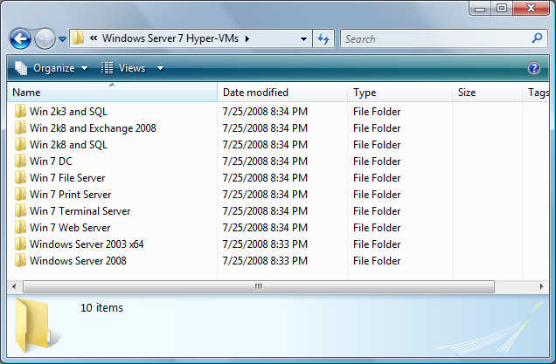

Cluster Shared Volumes
All servers “see” the same storage

Slide 14
Live Migration (LM)
demo

Slide 15
New Processor Feature Support

Slide 16
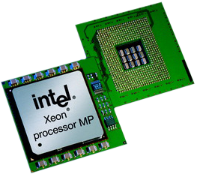

New Processor Feature Support
Second Level Address Translation (SLAT)
Uses new processor features to improve performance and reduce load on Windows Hypervisor
AMD: Nested Page Tables (NPT)
Intel: Extended Page Tables (EPT)
Benefits
Improve memory management performance
Reduce in memory copies
Memory usage will decrease from ~5% to 1% of total physical memory
Most improvement with large working sets (TS/SQL)

Slide 17

Windows Server 2008 R2 Core Parking
Overview
Scheduling virtual machines on a single server for density as opposed to dispersion
This allows “park/sleep” cores by putting them in deep C states
Benefits
Significantly enhances Green IT by being able to reduce power required for CPUs

Slide 18
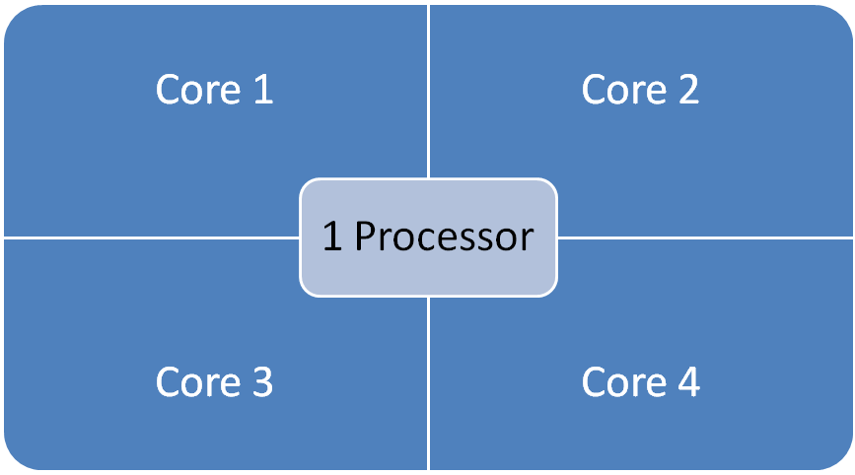

Windows Server 2008 16 LP Server

Slide 19
Windows Server 2008 R2 Core Parking 16 LP Server
Processor is “parked”
Processor is “parked”

Slide 20
Virtual Storage

Slide 21
Hot Add/Remove Storage
Overview
Add and remove VHD and pass-through disks to a running VM without requiring a reboot.
Hot-add/remove disk applies to VHDs and pass-through disks attached to the virtual SCSI controller
Benefits
Enables storage growth in VMs without downtime
Enables additional datacenter backup scenarios
Enables new SQL/Exchange scenarios

Slide 22
Networking

Slide 23
Networking
Extending TCP Offload support for Virtual machines
TCP/IP traffic in a VM can be offloaded to a physical NIC on the host computer.
Benefits
Reduce CPU burden
Networking offload to improve performance
Live Migration is supported with TCP Offload

Slide 24
Networking
Virtual Machine Queue (VMQ) Support
Overview
NIC can DMA packets directly into VM memory
VM Device buffer gets assigned to one of the queues
Avoids packet copies in the VSP
Avoids route lookup in the virtual switch (VMQ Queue ID)
Allows the NIC to essentially appear as multiple NICs on the physical host (queues)
Benefits
Host no longer has device DMA data in its own buffer resulting in a shorter path length for I/O (performance gain)

Slide 25
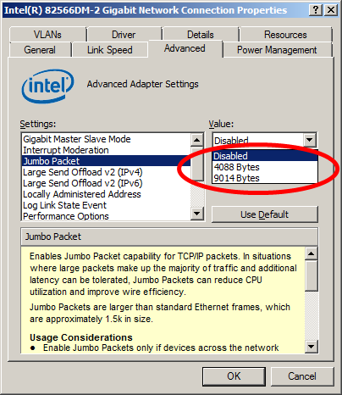
Networking
Jumbo Frame Support
Ethernet frames >1,500 bytes
Ad hoc standard is ~9k
Overview
Enables 6x larger payload per packet
Benefits
Improves throughput
Reduce CPU utilization of large file transfers

Slide 26
Hosted Desktops

Slide 27
Terminal Services –Virtualization
Overview
TSV - Virtualized “Centralized Desktop” provisioning, access and management solution on top of Hyper-V
Unified user and admin experience for traditional TS (session per user) and TSV (VM per user).
Deployment Scenarios
Temporary (until Logoff) VM per user Assignment
Permanent VM per user assignment
Built-in solution for low complexity deployments
Features and management are tuned for Entry Level deployments. Example: 4 TS/TSVM Servers with few apps.

Slide 28
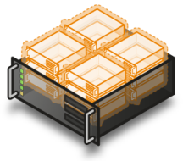


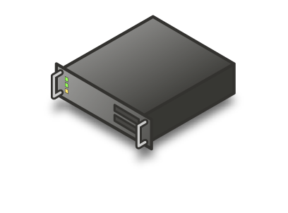




Connection Broker Infrastructure
TS Gateway
TS Session Broker
TS Users
Remote
TS Farm
Storage
Hosted Desktop
Users (Remote)
Hyper-V Farm
Hosted Desktop Users
TS Users

Slide 29
Intel/Microsoft Collaboration
partner
Randy Campbell
Sr. Principal Engineer
Intel Corp.

Slide 30
Intel® VT Transition Latency Reduction
Intel® VT Transition Latencies for Intel Xeon® Processor Family
Transition latency = cycle cost (VM exit + VM reads + VM writes + VM entry) + TLB flushing costs
Transition latency continues downward trend
Hyper-V optimizations
Optimized for VMCS caching
Favor VM-resume over VM-launch
2004
2005
2006
2007
2008
Round-trip Intel® VT transition latency
Intel® VT transition latency improvements
benefit Hyper-V performance

Slide 31
Intel® VT FlexPriority: Performance Benefits
Windows XP SP3
Ntttcp Throughput
Legacy 32-bit guests frequently access MMIO TPR during IO intensive workloads
Eliminates most VM exits due to guest TPR access, reducing virtualization overhead and improving IO throughput.
10.7
Relative Performance
10.7x
1
w/o Intel® VT
FlexPriority
w/ Intel® VT
FlexPriority
Intel® VT FlexPriority improves performance
of 32-bit guests running IO workloads
Source: Intel. Performance measured using the Ntttcp benchmark comparing network performance of a 2 VP Windows* XP SP3 32-bit guest running with and without Intel® VT FlexPriority feature. System configuration: 2x 3.20GHz Quad-Core Intel® Xeon® processor X5386 on Stoakley platform with Intel® 5400 chipset, Intel® Pro/1000 MT Dual Port Server Adapter. Actual performance may vary.

Slide 32
Hyper-V Power Management
Windows Server 2008*, first Windows Server* with power management enabled by default
Hyper-V supports full P-state and C-state Power management
C-state: utilizes low power states during idle times
P-state: utilizes Enhanced Intel Speedstep® Technology to adjust voltage and frequency in response to processor load
Hypervisor and root partition work together to manage P-states and C-states
Hyper-V optimized for
Intel® Xeon® Processor power management

Slide 33
Hyper-V Scheduler Optimizations
Hyper-V scheduler is optimized for throughput on multi-core systems.
VP scheduling decisions are based on NUMA and CPU topology.
VP scheduler is optimized to make the best use of idle cores and SMT threads.
Long running collaboration between
Intel and Microsoft producing great results

Slide 34
Hyper-V Performance Compared to Virtual Server
+21%
+107%
+178%
Requests / Sec
Requests / Sec
Requests / Sec
Disk
intensive
CPU
intensive
Network
intensive
WS03 guests / Virtual Server
WS03 guests / Hyper-V
Source: Microsoft*. Performance measured using the Web Fundamentals (WF) benchmark comparing 16x 1VP Windows Server 2003 SP2 guests running on Virtual Server to the same guests running on Hyper-V*. Actual performance may vary.

Slide 35
Windows Server 2008 Hyper-V vConsolidate Scaling
1.03x
1.08x
1.20x
1.40x
1.91x
Source: Principled Technologies, http://www.principledtechnologies.com/Clients/Reports/Intel/vConHV4Sys0908.pdf
Intel S7000FC4UR quad-processor w/ Intel Xeon® Processors X7460 (6-core, 2.66GHz, 16MB L3, 1066MHz FSB)

Slide 36
Summary
Hyper-V is high-performance and deployed in massive scale production environments.
Long running collaboration between Intel and Microsoft is producing great results.
Great Hyper-V scaling and IO performance on Intel® Xeon® processors.

Slide 37
Additional sources of information on this topic:
Visit the Microsoft and Intel websites:
www.microsoft.com/virtualization
www.intel.com/technology/virtualization
Virtualizing TechNet & MSDN Whitepaper
http://download.microsoft.com/download/6/C/5/6C559B56-8556-4097-8C81-2D4E762CD48E/MSCOM_Virtualizes_MSDN_TechNet_on_Hyper-V.docx

Slide 38
Call To Action
Ensure drivers installation package work with Server Core
Validate drivers work on Windows Server 2008 R2 with Hyper-V role
Storage vendors
Test your storage solutions with clustering and Hyper-V

Slide 39
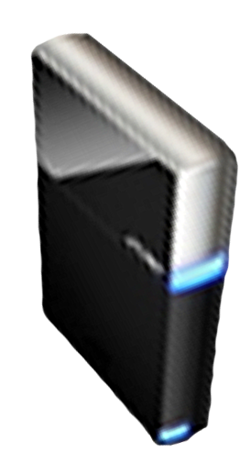


Please Complete A Session Evaluation Form Your input is important!
Visit the WinHEC CommNet and complete a Session Evaluation for this session and be entered to win one of 150 Maxtor® BlackArmor™ 160GB External Hard Drives 50 drives will be given away daily!
http://www.winhec2008.com
BlackArmor Hard Drives provided by:

Slide 40


© 2008 Microsoft Corporation. All rights reserved. Microsoft, Windows, Windows Vista and other product names are or may be registered trademarks and/or trademarks in the U.S. and/or other countries.
The information herein is for informational purposes only and represents the current view of Microsoft Corporation as of the date of this presentation. Because Microsoft must respond to changing market conditions, it should not be interpreted to be a commitment on the part of Microsoft, and Microsoft cannot guarantee the accuracy of any information provided after the date of this presentation. MICROSOFT MAKES NO WARRANTIES, EXPRESS, IMPLIED OR STATUTORY, AS TO THE INFORMATION IN THIS PRESENTATION.

