Slide 1
Windows Virtualization And Cluster Shared Volumes
Jeff Mastro
Program Manager
Failover Clustering
Microsoft Corporation
Bryon Surace
Program Manager
Hyper-V
Microsoft Corporation

Slide 2
Agenda
Overview of Hyper-V Live Migration
Challenges Hyper-V faces with today’s cluster model
How CSV delivers on these challenges
Additional resiliency CSV provides
CSV Direct I/O – Overview and Example
Configure and Test CSV
Call To Action – Additional Resources

Slide 3

Hyper-V With Failover Clustering
Failover Clustering is the foundation
that enhances Hyper-V by providing
  High Availability
  Disaster Recovery
  Quick Migration
  Live Migration

Slide 4







Live Migration
Initiate Migration
I want to Migrate this VM to another physical machine
Client accessing VM
SAN
IT Admin initiates a Live Migration to
move a VM from one host to another
VHD

Slide 5
Live Migration
Memory Copy: Full Copy
Memory content is copied to new server
VM pre-staged
SAN
First initial copy is of all
in memory content
VHD

Slide 6
Live Migration
Memory Copy: Dirty Pages
Client continues accessing VM
Pages are being dirtied
SAN
Client continues to access VM, which results in memory being modified
VHD

Slide 7
Live Migration
Memory Copy: Incremental Copy
Recopy of changes
Smaller set of changes
Hyper-V tracks changed
data, and re-copies over incremental changes
Subsequent passes get faster
as data set is smaller
SAN
VHD

Slide 8
Live Migration
Final Transition
Partition State copied
VM Paused
SAN
Window is very small
and within TCP
connection timeout
VHD

Slide 9
Live Migration
Post-Transition: Clean-up
Client directed to new host
Old VM deleted once migration is verified successful
ARP issued to have routing devices update their tables
Since session state is maintained, no reconnections necessary
SAN
VHD

Slide 10
Live Migration
demo

Slide 11
Agenda
Overview of Hyper-V Live Migration
Challenges Hyper-V faces with today’s cluster model
How CSV delivers on these challenges
Additional resiliency CSV provides
CSV Direct I/O – Overview and Example
Configure and Test CSV
Call To Action – Additional Resources

Slide 12
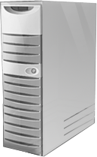


Failover Clustering Today
Failover Clustering has implemented a “shared nothing” storage model for the last decade
Each Disk is owned by a single node at any one time, and
only that node can perform I/O to it
Only one node accesses a LUN at a time
SAN
Shared Storage

Slide 13

SAN Management Complexity
Flexibility
LUN is the smallest unit of failover
Scalability
Complexity with drive letters
Capacity
Poor SAN space utilization
Manageability
MPIO and Masking of large numbers of LUN’s

Slide 14
Agenda
Overview of Hyper-V Live Migration
Challenges Hyper-V faces with today’s cluster model
How CSV delivers on these challenges
Additional resiliency CSV provides
CSV Direct I/O – Overview and Example
Configure and Test CSV
Call To Action – Additional Resources

Slide 15
Cluster Shared Volume Overview
Concurrent access to a single file system
SAN
Disk5
Single Volume
VHD
VHD
VHD

Slide 16
Cluster Shared Volumes
Guest VMs can be moved without requiring any drive ownership changes
  No dismounting and remounting of volumes is required
Enabling multiple nodes to concurrently access
a single ‘truly’ shared volume
From hundreds of LUN’s to a handful…
Validate times from all night long, to minutes…
Real browse-able paths, no more GUID’s…

Slide 17

CSV Value Proposition
Improves Hyper-V Live Migration
Simplified cluster configurations
Simplifies SAN/VM management
Improved Fault Tolerance

Slide 18
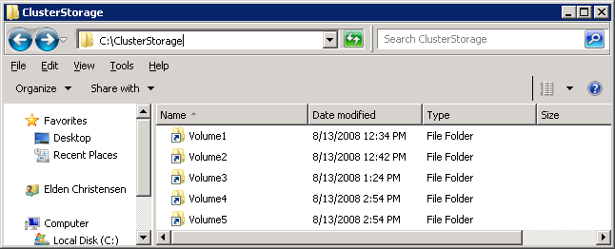
Single Name Space
CSV provides a single consistent file name space
  Files have the same name and path when viewed from any
  node in the cluster
  CSV volumes are exposed as directories and subdirectories under
  the “ClusterStorage” root directory
    C:\ClusterStorage\Volume1\<root>
    C:\ClusterStorage\Volume2\<root>
    C:\ClusterStorage\Volume3\<root>

Slide 19
Compatibility
No special hardware requirements
No special application requirements
No file type restrictions
No directory structure or depth limitations
No special agents or additional installations
No proprietary file system
  Uses well established traditional NTFS
It just works!

Slide 20
Agenda
Overview of Hyper-V Live Migration
Challenges Hyper-V faces with today’s cluster model
How CSV delivers on these challenges
Additional resiliency CSV provides
CSV Direct I/O – Overview and Example
Configure and Test CSV
Call To Action – Additional Resources

Slide 21

Increasing Availability
CSV also delivers far more value in
making Clusters more resilient to a wide variety of failure conditions
  Value prop beyond just solving the storage management challenges
99.9%
99.99%
99%
99.999%

Slide 22


Node Fault Tolerance
Coordination Node
VM running on Node 2 is unaffected
Brief queuing of I/O while volume ownership is changed
SAN
Volume relocates to a healthy node
VHD

Slide 23

Dynamic I/O Redirection
CSV implements a mechanism where I/O can be rerouted based on connection availability
Let’s route to the optimal available path
I/O dynamically redirected based on path availability
Remote Node
Local Volume

Slide 24
I/O Connectivity Fault Tolerance
I/O Redirected via network
VM running on Node 2 is unaffected
Coordination Node
SAN
SAN Connectivity Failure
VM’s can then be Live Migrated to another node with zero downtime
VHD

Slide 25
Network Fault Tolerance
Rerouted to redundant network
VM running on Node 2 is unaffected
Coordination Node
Network Path Connectivity Failure
SAN
Fault-Tolerant TCP connections make a path failure seamless
VHD

Slide 26
Agenda
Overview of Hyper-V Live Migration
Challenges Hyper-V faces with today’s cluster model
How CSV delivers on these challenges
Additional resiliency CSV provides
CSV Direct I/O – Overview and Example
Configure and Test CSV
Call To Action – Additional Resources

Slide 27
How Direct I/O Works
HyperV Host
Cluster Node A
HyperV Host
Cluster Node B
Move VM
VM 1
VM 2
VM 2
CSV Filter
NTFS
NTFS
Storage
Storage
CSV Volume
VHD 1
VHD 2

Slide 28
How Direct I/O Works
HyperV Host
Cluster Node A
HyperV Host
Cluster Node B
VM 1
VM 2
Network
CSV Filter
CSV Filter
Direct I/O
NTFS
NTFS
NTFS
Storage
Storage
Storage
CSV Volume
VHD 1
VHD 2

Slide 29
CSV Backup
HyperV Host
Cluster Node A
HyperV Host
Cluster Node B
VM 2
VM 3
Backup App
VM 1
Network
CSV Filter
CSV Filter
Direct I/O
NTFS
NTFS
NTFS
Storage
Storage
Storage
PrepareVolumeForSnapshotSet
CSV Volume
VHD 1
VHD 2
VHD 3

Slide 30
CSV Backup
HyperV Host
Cluster Node A
HyperV Host
Cluster Node B
VM 2
VM 3
Backup App
VM 1
CSV Filter
Network
CSV Filter
NTFS
NTFS
NTFS
Storage
Storage
Storage
CSV Volume
All I/O to this CSV volume is sent over network (SMB) until snapshot is complete
VHD 1
VHD 2
VHD 3

Slide 31
Backup ISV Considerations
Backup/Restore Interoperability Considerations
  File backups involving VSS can only be performed on the coordination node
  New VSS API for CSV
    Performs necessary actions to allow snapshot of the volume
    Replaces GetVolumePathName() and GetVolumeNameForVolumeMountPoint()
STDMETHOD(IVssBackupComponentsEx3 ::PrepareVolumeForSnapshotSet)
(__in_z VSS_PWSZ pwszPathName,
__out BSTR *pbstrVolumePathName,
__out BSTR *pbstrVolumeName);

Slide 32
What does the API do?
1. Is this backup running on a cluster node?
  If so, is the path to this data on a volume managed by the cluster?
    If so, do anything needed to make the volume available for taking the snapshot
2. Retrieves the volume name and mount point

Slide 33
When is the API called?
Find backup components (GatherWriterMetadata)
Obtain a list of components
(IVssWMComponent)
Initialize the snapshot set (StartSnapshotSet)
Determine Volumes (PrepareVolumeForSnapshotSet)
Add volumes to snapshot set and proceed normally

Slide 34
Agenda
Overview of Hyper-V Live Migration
Challenges Hyper-V faces with today’s cluster model
How CSV delivers on these challenges
Additional resiliency CSV provides
CSV Direct I/O – Overview and Example
Configure and Test CSV
Call To Action – Additional Resources

Slide 35
Enabling Cluster Shared Volumes
CSV is only supported in with Hyper-V
  Is disabled by default
For Alpha Testing
  CSV can be manually enabled via a cluster wide property with PowerShell:
  PS C:\> Add-Module FailoverClusters
PS C:\> Get-FailoverCluster | %{$_.EnableSharedVolumes=1

Slide 36
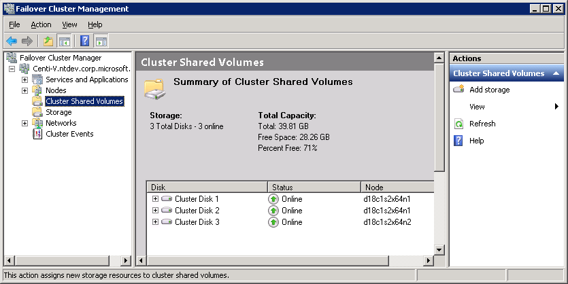
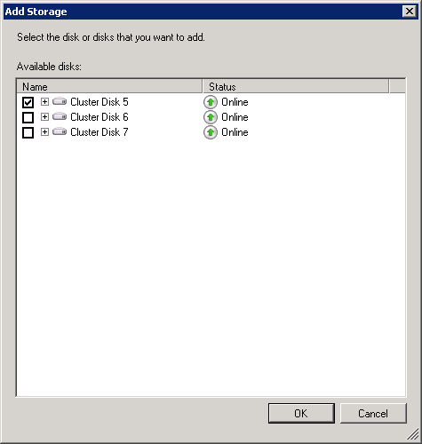
Create A CSV Disk
Select the Disk

Slide 37
Using Cluster Shared Volumes
Setup a cluster like you normally would
Enable CSV feature via PowerShell cmdlet
Within CluAdmin.msc click on “Cluster Shared Storage” and click “Add storage”
Create a VM and place VHD under the C:\ClusterStorage directory structure
Use CluAdmin.msc to make the VM
highly available

Slide 38
Agenda
Overview of Hyper-V Live Migration
Challenges Hyper-V faces with today’s cluster model
How CSV delivers on these challenges
Additional resiliency CSV provides
Configuring and Test Cluster Shared Volumes
Configure and Test CSV
Call To Action – Additional Resources

Slide 39
Filter Driver Interoperability
Do you have a filter driver above or below?
  Virus Scanners, etc…
  http://msdn.microsoft.com/en-us/library/aa488218.aspx
CSV is incompatible with data
transformation drivers
  Encryption or compression filters
Upper FS mini-filter
Altitude of 404900
CSVFilter.sys
Filter Manager

Slide 40


Replicated Storage Considerations
CSV is not compatible with replicated storage as all nodes assume they can simultaneously write to a LUN
  Windows Server 2008 R2 will continue to support the storage model of the past, which will work with multi-site clusters
  Live Migration is not dependent on CSV
Site A
Site B
Replica
Sync/Async Replication
Read/Write
Read/Only

Slide 41
Call To Action
IHV’s
  Replication vendor considerations
ISV’s – Test, Test, Test…
  Filter Drivers
    Depending on where you are on the stack, you
    may be impacted
  Backup/Restore
    CSV will introduce new considerations
    Call PrepareVolumeForSnapshotSet() for all scenarios
      Replaces GetVolumePathName() and GetVolumeNameForVolumeMountPoint()

Slide 42

Summary
Consolidation of storage with fewer LUNs
  Simplifies Storage and Server Management
Removes barriers to Live Migration times
Seamlessly integrated with well established Failover Cluster technology
Compatibility
Scalability
Reliability
  No new hardware requirements
  No new application requirements
  Completely transparent
  Scales to large clusters, large numbers of LUN’s, and no restrictions beyond base OS
  High Performance
  I/O access
  Node Failures are transparent for all Guests that are not hosted on failed node
  Increased resiliency and high availability

Slide 43
Additional Resources
Web Resources
  Whitepapers – Windows Server 2008 Failover Clustering
  http://www.microsoft.com/Windowsserver2008/en/us/clustering-home.aspx
  Webcasts
  Build High-Availability Infrastructures with Windows Server 2008 Failover Clustering
  http://msevents.microsoft.com/CUI/EventDetail.aspx?EventID=1032364827&Culture=en-US
  Cluster Validation in Windows Server
  http://msevents.microsoft.com/CUI/WebCastEventDetails.aspx?culture=en-US&EventID=1032336490&CountryCode=US
  Cluster Team Blog – http://blogs.msdn.com/clustering/
E-Mail
  clushelp@microsoft.com

Slide 44
Appendix
CSV Test Scenarios

Slide 45
Test Deployment Scenarios
Deployment scenarios
  Large numbers of nodes…
  Large numbers of LUN’s…
  Push the limits, kick the tires…
Use a variety of VHD types
  Dynamic
  Fixed size
  Differencing
  Pass-through disks do not leverage CSV

Slide 46
Scale Out Nodes
Scale out Nodes – Stress the
coordination node
  Large number of nodes each hosting VM’s
  Single LUN
Single Volume

Slide 47
Scale Out Number Of Disks
Scale out disks – Stress cross node coordination
  Large number of nodes each hosting VM’s
  Multiple LUN’s (at least 1 per node)

Slide 48
Scale Up Nodes
Maximum VM’s per Machine
  Each host multiple VM’s, the more
  nodes the better
  Smaller number of LUN’s

Slide 49
Stress it!
Combine real world tasks
  Migrations of VM’s
  VM’s under load – Both I/O and Network

Slide 50
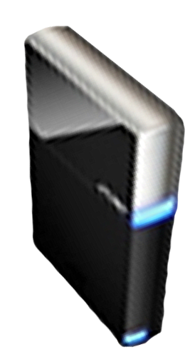


Please Complete A Session Evaluation Form
Your input is important!
Visit the WinHEC CommNet and complete a Session Evaluation for this session and be entered to win one
of 150 Maxtor® BlackArmor™ 160GB External Hard Drives
50 drives will be given away daily!
http://www.winhec2008.com
BlackArmor
Hard Drives provided by:

Slide 51

© 2008 Microsoft Corporation. All rights reserved. Microsoft, Windows, Windows Vista and other product names are or may be registered trademarks and/or trademarks in the U.S. and/or other countries.
The information herein is for informational purposes only and represents the current view of Microsoft Corporation as of the date of this presentation. Because Microsoft must respond to changing market conditions, it should not be interpreted to be a commitment on the part of Microsoft, and Microsoft cannot guarantee the accuracy of any information provided after the date of this presentation.
MICROSOFT MAKES NO WARRANTIES, EXPRESS, IMPLIED OR STATUTORY, AS TO THE INFORMATION IN THIS PRESENTATION.

