Slide 2
Windows Boot From Virtual Hard Disk
Paul Rambo
Program Manager
Microsoft Corporation
Peter Brundrett
Program Manager
Microsoft Corporation

Slide 3
Agenda
Background on Virtual Hard Disks
Targeted scenarios
VHD operations
Sample deployment flow
Important details
Performance

Slide 4
VHD Image Containers
Used by Hyper–V to host virtual machine system images
Extending use to physical machine images
Strategic direction for Windows images in a managed enterprise environment or data center
Image management using single tool set and process
Machine repurposing without installing a new operating system role and applications
Rapid image replacement
Support virtual or physical machine deployment

Slide 5
Advantages Of Using VHDs
Consistency
Image management
Virtualization
Deployment
Backup and restore
Common standard format
Native support enables re-use of existing Windows technologies and tools
Security, compression, FS management tools
ISVs focus on adding value rather than building container expertise
Avoid fragmenting container formats

Slide 6
Native Virtual Hard Disk Support
Virtual Hard Disk (VHD) recognized by core operating system components
Boot environment
Core file system
Virtual Disk Service (VDS)
Disk Management tools
Windows Deployment Services (WDS)
Does not require Hyper–V Server role

Slide 7
Multiple Virtual Hard Disk Types
Fixed
File size is the size of VHD defined at creation
Size limited by underlying filesystem
Dynamic
File is only as large as the blocks written to it plus header and footer
Maximum size equals 2040 GB (2TB)
Differencing
Contains modified blocks relative to a read-only parent VHD
Parent can be a fixed, dynamic, or differencing disk (differencing chain)

Slide 8
New VHD Support In Windows
Virtual Disk Service (VDS) supports surface and remove
Physical boot from Virtual Hard Disk (VHD) image
Disk management VHD file operations
Win32 APIs for VHD management and operations
VDS APIs and DCOM Remote interface
WDS support for VHD image cataloging and deployment

Slide 9
High-Level Scenarios
Image Consolidation
Single, standard image format
Rapid provisioning and repurposing
Image copy with no ‘install’
Easily transition between cached workloads
Generalized image for all physical and virtual machines
Single maintenance and deployment process

Slide 10
Targeted Scenarios
Focusing on managed environments
Common image for either virtual or physical machine
Reference image deployment
Rapid machine redeployment
Simplify multiple boot configuration
Offline image management

Slide 11
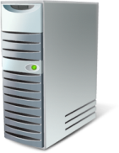


Image Conversion
Virtual Hard Disk Images
Hyper-V Virtual machine
Reference Machines
c:\windows
c:\windows
Hyper-V
c:\windows
Generalize and Capture
Deploy
c:\windows
Virtual Hard Disk Boot
c:\windows
c:\windows
Generalize

Slide 12

Managed Environments
In-House Solution
Retail Solution
Develop and maintain tools and solutions in-house
Lots of resident expertise
Typically rely on broad, large-scale automation
Rely on retail management solutions
Little or no internal development
Largest customer environments drive requirements

Slide 13
Basic VHD Steps
Create Virtual Hard Disk (VHD) file
Surface VHD
Now shows up as a disk drive
Create and format a partition in the VHD
Apply a .wim image to the VHD partition
Unsurface VHD
Copy to target system
Configure for VHD boot

Slide 14
Creating A Vhd-based Machine Image
demo

Slide 15
System and Virtual Hard Disk Partitions
System Partition
Primary Partition
Bootmgr
D:
C:\Windows
D:
BCD
C:\pagefile.sys
D:
C:\vhd\Windows7Dynamic.vhd
VHD Boot
C:\Windows
Parent volume of the VHD is available after boot with a different volume letter

Slide 16
Limitations In This Release
Tools and management support limited in first release
Hyper-V role required for WMI provider
No in-box PowerShell cmdlets
Manual image creation process
No Setup support
Deployment support in WDS
Volume snapshot restrictions
Volume level backup support only for boot Virtual Hard Disks
Host volume cannot reside in the same snapshot set as boot VHD
Lots of partner opportunities

Slide 17
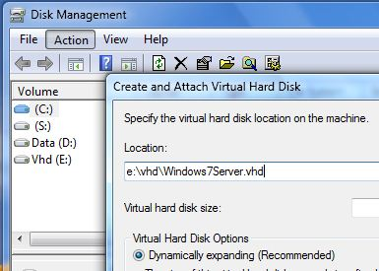
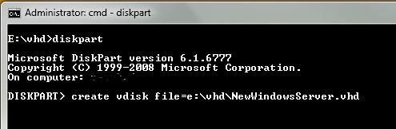
Managing Virtual Hard Disks
WMI
DCOM
Virtual Disk Service (VDS) VHD APIs
Hyper-V WMI
Win32 VHD APIs

Slide 18
New VHD Operations
Win32 APIs for Virtual Hard Disk (VHD) files
Primary operations
Create, Surface, and Unsurface
Meta operations
Compact, Merge, Expand
Informational APIs
Get/SetVirtualDiskInformation()
Physical/virtual size, block size, parent path and identifier

Slide 19
Hyper-V VHD WMI Provider
WMI can be used to remotely manage VHDs
Hyper-V provider wraps Win32s
Msvm_ImageManagementService Class
CreateDynamicVirtualHardDisk, CreateFixedVirtualHardDisk,
CreateDifferencingVirtualHardDisk
MergeVirtualHardDisk, CompactVirtualHardDisk,
ExpandVirtualHardDisk
GetVirtualHardDiskInfo
Mount, Unmount

Slide 20

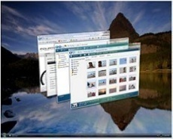


Image Creation With WDS
Windows Server 2008 R2 Server running WDS
Create Virtual Hard Disk (VHD)
Boot WinPE on reference systems
Partition and format disk
Create empty VHD
Apply WIM
Boot and configure
Sysprep Image
Copy back to management server
Catalog in image library

Slide 21
Image Deployment With WDS
Windows Server 2008 R2 Server running WDS
Deployment
Deploy at scale

Slide 22
VHD Boot Guidelines
Requires Windows 7 Boot Manager (bootmgr) and bcdedit utility
Use BCDboot.exe from surfaced VHD
Pagefile and boot manager are outside Virtual Hard Disk (VHD)
Boot supported only on Server and Enterprise client SKUs

Slide 23
VHD Boot Guidelines
Fixed Virtual Hard Disks (VHD) recommended in production
Dynamic VHDs are pre-expanded by default
User sets max size at Create
Plan physical disk free space accordingly
Differencing chain must reside on a single partition
Non-boot VHDs are not auto-mounted
Don’t put application data on the VHD host volume
Use a separate data volume
Host volumes should not be part of backup set for performance reasons

Slide 24
Performance
Throughput and Latency
Fixed Virtual Hard Disk (VHD) performance very close to physical volume performance
Throughput follows typical IO performance curve
Increases with queue depth, IO block size
Sequential and random IO operations
Fixed VHD versus Raw Disk

Slide 25
Performance Sequential read throughput

Slide 26
Performance Random read throughput

Slide 27
Performance Sequential write througput

Slide 28
Performance Random write throughput

Slide 29
Call To Action
Validate the native Virtual Hard Disk features
Create VHDs from WIMs using OPK tools
Deploy and boot VHDs on physical machines
Try Fixed, Dynamic, and Differencing VHDs
WDS cataloging and deployment
Management Solution ISV Opportunities
Support VHDs in data center management solutions
Support VHDs in backup solutions

Slide 30
Additional Resources
Web Resources
Windows Server 2008 VHD Test Drive Program
Windows Server Hyper-V WMI Provider http://msdn.microsoft.com/en-us/library/cc136766(VS.85).aspx
Native VHD Alias
vhdboot@microsoft.com

Slide 31
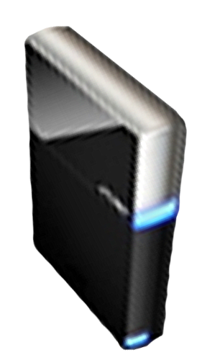


Please Complete A Session Evaluation Form Your input is important!
Visit the WinHEC CommNet and complete a Session Evaluation for this session and be entered to win one of 150 Maxtor® BlackArmor™ 160GB External Hard Drives 50 drives will be given away daily!
http://www.winhec2008.com
BlackArmor Hard Drives provided by:

Slide 32

© 2008 Microsoft Corporation. All rights reserved. Microsoft, Windows, Windows Vista and other product names are or may be registered trademarks and/or trademarks in the U.S. and/or other countries.
The information herein is for informational purposes only and represents the current view of Microsoft Corporation as of the date of this presentation. Because Microsoft must respond to changing market conditions, it should not be interpreted to be a commitment on the part of Microsoft, and Microsoft cannot guarantee the accuracy of any information provided after the date of this presentation. MICROSOFT MAKES NO WARRANTIES, EXPRESS, IMPLIED OR STATUTORY, AS TO THE INFORMATION IN THIS PRESENTATION.

