Slide 2
Direct Access Anywhere Access With Windows
Sean Siler
Senior Program Manager
Microsoft Corporation

Slide 3

I’m a PC, And I'm Your Presenter

Slide 4
Agenda
Secure Access Landscape
DirectAccess Solution
Benefits
Deployment Models
Deployment considerations
Demo
Questions and Answers

Slide 5

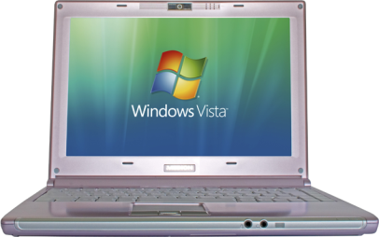
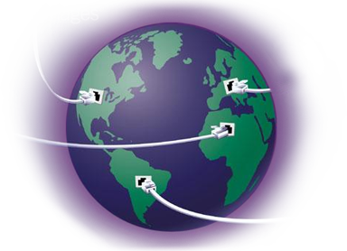
Mobile workforce
Increasingly porous perimeter
Mobile data
Globalization

Slide 6

DirectAccess
Providing seamless, secure access to enterprise resources from anywhere

Slide 7
demo

Slide 8
DirectAccess Benefits
Always-on
Adapts to changing networks
Secure
Encrypted by default
Allows management of remote clients
Lower TCO
Simplified edge policies
Wizard-based installation and policy creation
No need for per–application gateways
Reduced user overhead
Policy-based Application or Server level controls
Connects automatically
Internet connectivity equals Enterprise connectivity
Fully supports smartcard authentication
Manageable

Slide 9

Always On
Always connected
No user action required
Not application specific

Slide 10

Secure
Encrypted by default
Works with Smartcards
Granular access control through Server and Domain Isolation
Servers or Apps available to certain users
Servers or Apps NOT available when remote
Coexists with existing edge, health, and access policies

Slide 11


Manageable
Wizard-based installation
Reach out to previously untouchable machines
Allows clients to process Group Policies
NAP integration for health compliance

Slide 12

Lower Cost Of Ownership
Whether inside or out
Same policies
Policies based on identity not location
Same user experience
Reduces complexity for the user
Reduces helpdesk calls
No need for application specific gateways

Slide 13



Internet
DirectAccess Client
DirectAccess Server
Tunnel over IPv4 UDP, HTTPS, etc.
Encrypted IPsec+ESP
Encrypted IPsec+ESP
Native IPv6
IPsec Gateway
6to4
Teredo
IP-HTTPS

Slide 14

Enterprise Network
DirectAccess Server
Line of Business Applications
No IPsec
IPsec Integrity Only (Auth)
IPsec Gateway
IPsec Integrity + Encryption

Slide 15




Industry Trends
Assume the underlying network is always unsecure
Redefine corporate edge to cocoon the datacenter and business critical resources
Enterprise Network
Users are remote at all times
DirectAccess Server
Internet
Data Center and Business Critical Resources
Local User
Remote User

Slide 16

DirectAccess Client
Runs on Windows 7 Client
Must be domain joined

Slide 17


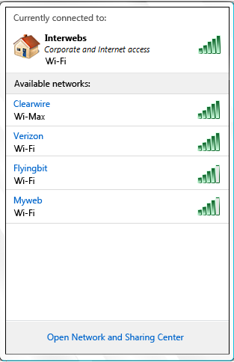



DirectAccess User Interface
DirectAccess is available!
1
Built-in Troubleshooting

Slide 18
DirectAccess Server
Runs on Windows Server 2008 R2
Sits on network edge
Can be a single box
Provides client management

Slide 19

DirectAccess Setup Wizard
Simplifies DirectAccess Deployment
Can export scripts

Slide 20
Why Windows 7 Only?
Significant component changes for DirectAccess
Name Resolution Policy Table
IP-HTTPS
Group Policy changes
And others…

Slide 21


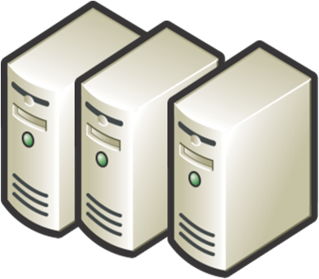
Deployment Requirements
DirectAccess Clients
DirectAccess Servers
Application Servers
Requires Windows 7
Requires Windows Server 2008 R2
End-to-end encryption requires Windows Server 2008 or later
Other models can use Windows Server 2003 or later
Must have an IPv6 address

Slide 22

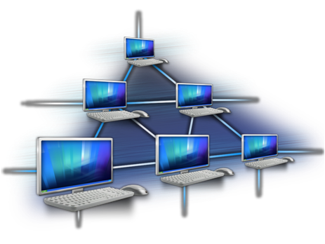
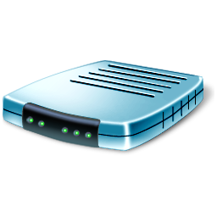
Deployment Requirements
DC/DNS
Network Infrastructure
NAT-PT
DA Clients will query DNS on ISATAP interface
Some DNS Servers must be listening on ISATAP interface
Two Factor Auth requires Windows Server 2008 R2 Domain Functional Lvl
Can be IPv4 because we roll out ISATAP with DirectAccess
Can be used to provide access to IPv4-only resources

Slide 23

Business Opportunities IPsec Offload
Challenge: IPsec encryption can limit scalability of DirectAccess Servers and Application Servers
Opportunity: Improved IPsec offload support in network interface cards

Slide 24

Business Opportunities Load balancing
Challenge: Hardware load balancers must support IPv6 and IPsec to work with DirectAccess
Opportunity: Improved support for Load Balancers with IPv6 and IPsec support

Slide 25
Business Opportunities NAT-PT
Challenge: Lack of IPv6 support on legacy servers require translation technologies
Opportunity: Support NAT-PT as a translation technology

Slide 26

Business Opportunities IPv6 routing
Challenge: Customers are not ready to route IPv6 internally
Opportunity: Support ISATAP routing and line-speed IPv6 routing

Slide 27

Business Opportunities IPv6 Tools
Challenge: Monitoring and management tools for IPv6 and IPsec are lacking
Opportunity: Provide parity with IPv4 monitoring and management tools and support IPsec monitoring applications

Slide 28

Business Opportunities Security
Challenge: Security tools for IPv6 are lacking (firewalls, proxies, IDS/IPS, IPsec termination and inspection)
Opportunity: Provide parity with IPv4 security tools. Provide full support for transition technologies (Teredo, ISATAP, 6to4 etc.) Provide IPsec termination/inspection

Slide 29
It Works Today, Simply
Evolution, not revolution
Built on a solid foundation of existing technologies
Active Directory
Group Policy
IPv6
IPsec
Server and Domain Isolation
Network Access Protection

Slide 30
Call To Action
Take advantage of the business opportunities available
Let us know how we can help you
Work with us to help our customers get IPv6 deployed

Slide 31
Additional Resources
Web Resources
IPv6: http://www.microsoft.com/ipv6
Server and Domain Isolation: http://technet.microsoft.com/en-us/network/bb545651.aspx
Related Sessions
Chalk Talk – Branch Caching
Server and Domain Isolation (Two sessions ago) ☺

Slide 32



Please Complete A Session Evaluation Form Your input is important!
Visit the WinHEC CommNet and complete a Session Evaluation for this session and be entered to win one of 150 Maxtor® BlackArmor™ 160GB External Hard Drives 50 drives will be given away daily!
http://www.winhec2008.com
BlackArmor Hard Drives provided by:

Slide 33

© 2008 Microsoft Corporation. All rights reserved. Microsoft, Windows, Windows Vista and other product names are or may be registered trademarks and/or trademarks in the U.S. and/or other countries.
The information herein is for informational purposes only and represents the current view of Microsoft Corporation as of the date of this presentation. Because Microsoft must respond to changing market conditions, it should not be interpreted to be a commitment on the part of Microsoft, and Microsoft cannot guarantee the accuracy of any information provided after the date of this presentation. MICROSOFT MAKES NO WARRANTIES, EXPRESS, IMPLIED OR STATUTORY, AS TO THE INFORMATION IN THIS PRESENTATION.

Slide 34
Appendix

Slide 35
DirectAccess Versus Remote Access Solutions
Scenario | Traditional VPN | SSL VPN | TS gateway | Outlook Web Access | DirectAccess
Always on | No | No | No | No | Yes
Remote management | Limited | Limited | No | No | Yes
Applications supported | All | All | IT Pro published | Email only | All
Per app server policy | No | Maybe | Yes | No | Yes
Edge policies | Complex | Complex | Medium | Simple | Simple
Managed/ Unmanaged PCs | Both | Both | Primarily unmanaged | Primarily unmanaged | Managed only
DirectAccess complements other remote access solutions

