Slide 2
SMI-S
Support for Windows Server Products
Alan Warwick
Development Manager
Microsoft Corporation

Slide 3
Agenda
What is Storage Management Initiative (SMI-S)?
Related standards
SMI-S profiles for Windows Storage Components

Slide 4
What Is SMI-S?
Industry standard for describing and managing enterprise storage components
Wide industry adoption
Goal is interop and manageability
  Technical working groups
  Conformance Testing Program (CTP)
  Regular plugfests
Broad and deep coverage for storage devices

Slide 5
What Is SMI-S?
Models for management of
storage devices
SMI-S providers are components that expose management information
for devices
  May be local to device or proxied
SMI-S clients are apps that use
SMI-S information

Slide 6
SMI-S Profiles
Related classes of information that
model a device or device function
  For example
  Array, MultiComputer System
SMI-S providers typically implement
a set of related profiles
Classes are described by Common Information Model (CIM)
  Same kinds of classes exposed
  by WMI in Windows

Slide 7
Hardware Devices
SMI-S Providers
Servers
  Volume managers/File systems
  Host Bus Adapters (FC, iSCSI, SAS, etc.)
  Snapshots
Storage networking components
  FC switches

Slide 8
Hardware Devices
SMI-S providers
Storage devices
  Arrays (FC and iSCSI)
  NAS devices
  Tape libraries
  Virtualization devices

Slide 9
SMI-S Clients (Software)
Configuration discovery
Provisioning and trending
Security
Asset management
Compliance and cost management
Event management
Data protection

Slide 10
Common SMI-S Profiles
FC Switch
Array (FC, iSCSI)
Initiator Ports
  FC, iSCSI, SAS, SATA, even SCSI
Computer System
NAS
Copy Services
Virtualization

Slide 11
Standards Based
Investigate adding SMI-S support based on
  SMI-S v1.3
  DMTF CIM 2.15
  DMTF WS-Management Specifications
    WS-Management 1.0 [DMTF-DSP0226]
    WS-CIM Mapping 1.0 [DMTF-DSP0230]
    WS-Management – CIM binding [DMTF-DSP0227]

Slide 12
Windows-Management
WS-Management is a standard that has been ratified final by DMTF in April 2008
Builds on top of existing web
service standards
  SOAP, WSDL, WS-Addressing, WS-Transfer,
  and WS-Enumeration
  Compatible with CIM (through WS-CIM mapping)
WinRM (Windows Remote Management)
is the Microsoft implementation of
WS-Management Protocol

Slide 13
SMI-S Providers On Windows
  Current effort is investigation and prototyping
    No specific product plans as yet
  SMI-S Profiles are implemented as WMI
  (Windows Management Instrumentation) providers
  WMI in combination with WinRM allows SMI-S profiles
  to be implemented as WMI Providers

Slide 14
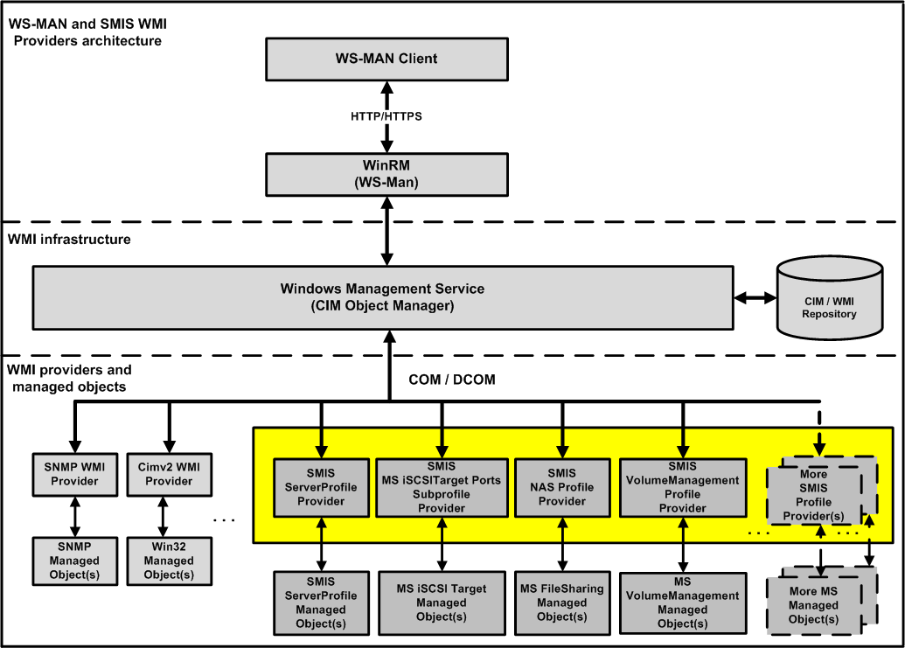
SMI-S WMI Providers

Slide 15
SMI-S Profiles For Windows Storage Components
SMI-S servers required profiles
    Server
    Profile registration
File Sharing Management (NAS)
Disk and Volume management
Initiator Ports (iSCSI, FC, SAS)
Copy services
Windows Failover Cluster Environment

Slide 16
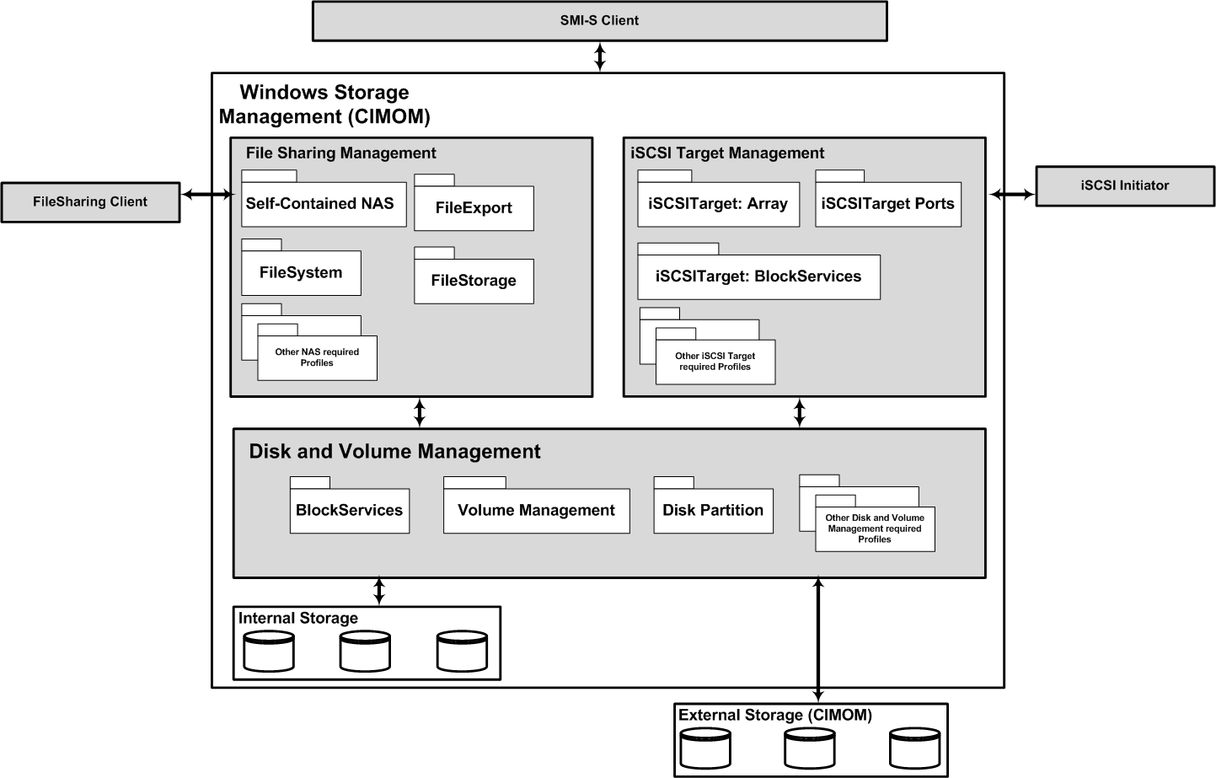
Architectural View

Slide 17
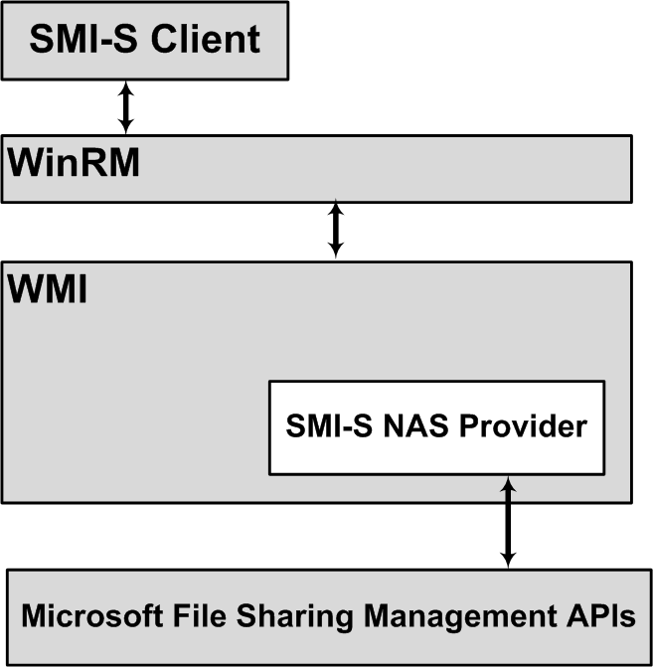
NAS Provider Architectural View

Slide 18
Microsoft File Sharing Management Profiles
Self-Contained NAS
Indication
File System
File Storage
File Export
Physical Package
Block Services
Health
File Export Manipulation

Slide 19
Microsoft File Sharing Active Management
SMI-S methods for Microsoft File Sharing
  File Export Manipulation
    CIM_FileExportService
      CreateExportedShare
      ModifyExportedShare
      ReleaseExportedShare

Slide 20
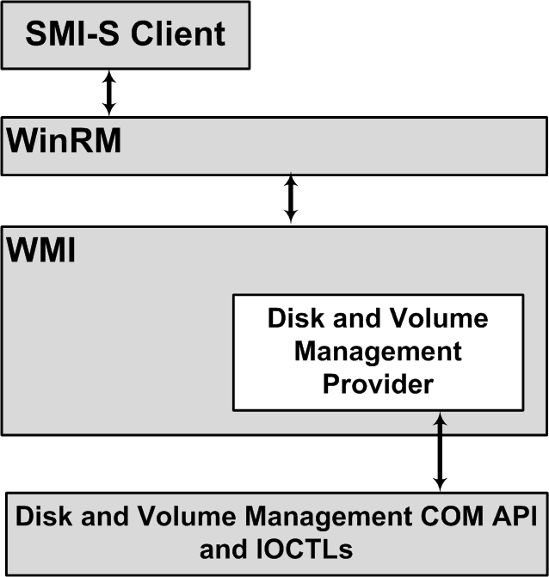
Disk And Volume Management

Slide 21
Disk And Volume Management
SMI-S Profiles being prototyped
for Disks and Volumes
Host Elements
  Disk Partition
Block Devices
  Block Services Package
  Disk Drive
  Disk Drive Lite
  Extent Composition

Slide 22
Disk And Volume Management
Block Devices
  Extent Mapping
  Pool Management Policy
  Volume Composition
  Block Storage Views
  Block Server Performance
  Copy Services

Slide 23
Disk And Volume Management
Block Devices
  Disk Sparing
  Block Server Performance
  PoolManagement Policy
File Systems
  File Storage
  File System Quota

Slide 24
Disk And Volume Management
Windows Object | SMI-S/CIM Object
Disk Pack or Disk Group: A logical grouping of disks. For basic disks, the relationship between a disk and its pack is one to one. For dynamic disks, a pack may contain multiple disks | CIM_StoragePool (Concrete)
Disk : An OS disk device exposed by Windows PNP. May be backed by an internal disk drive, direct attached storage, or, a LUN exposed by a HW array | CIM_StorageExtent CIM_SystemDevice
Disk Partition: A contiguous set of bytes on an OS disk device. May be a Primary partition or and Extended partition | CIM_GenericDiskPartition CIM_StorageVolume (on basic disks only) CIM_SystemDevice

Slide 25

Disk And Volume Management
Windows Object | SMI-S/CIM Object
Logical Disk A contiguous set of bytes on an OS disk device. A type of disk partition with the characteristic that it is contained within an Extended partition | CIM_LogiocalDisk CIM_StorageVolume CIM_SystemDevice

Slide 26
Disk And Volume Management
Windows Object | SMI-S/CIM Object
Volume A volume object as seen by the Windows operating system. Windows volumes are composed of disk extents. A basic disk volume is composed of a set of contiguous bytes on a single disk. A dynamic disk volume may have multiple extents located on multiple disks | CIM_StorageExtent CIM_StorageVolume CIM_SystemDevice
LUN A logical unit of storage exposed by a HW array or PCI RAID card | CIM_StorageExtent (OS provider view) CIM_StorageVolume (HW array provider view)

Slide 27
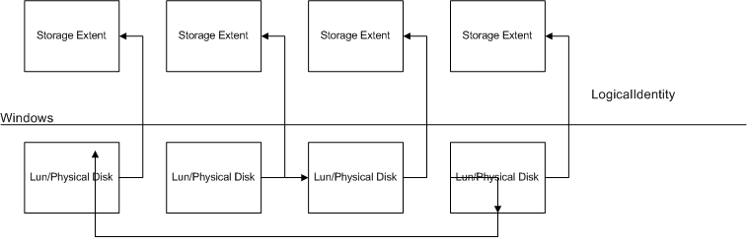
  Transition Points
  LUN to OS Disk
  LUNs are represented as instances of CIM_StorageVolumes by the HW providers
  Disk and Volume Management provider storage pools will be composed of extents associated with LUNs and IDE disks
  LUNs are represented using the CIM_StorageExtent object by the Disk and Volume Management provider
  OS Disks are mapped to LUNs using the CIM_LogicalIdentity association
    The Disk and Volume Management provider will build the CIM_LogicalIdentity association by matching OS disks to their underlying LUNs using the mode page 80/83 information

Slide 28
Transition Points
OS Volume To NAS
OS Volume directories are represented using the CIM_LogicalFile object by the NAS provider
OS Volume extents are represented using the CIM_LogicalDisk and CIM_StorageVolume objects by the Disk and Volume Management provider
OS Volumes may be associated with a CIM_LocalFileSystem object. The Disk and Volume Management provider makes this association when it is present
CIM_LocalFileSystem objects are mapped to the NAS provider’s CIM_LogicalFile using the FileStorage association

Slide 29
Call To Action
Enterprise storage vendors
  Implement SMI-S profiles for your devices
Enterprise storage management app vendors
  Leverage SMI-S profiles in your applications

Slide 30
Additional Resources
Web Resources
  Specs http://www.snia.org/tech_activities/standards/curr_standards/smi/
  Technology Forum http://www.snia.org/forums/smi/tech_programs/smis_home
  Tutorial
  http://www.snia.org/education/tutorials/2008/spring/storage-management/Warren-R_Introduction_to%20Managing_Storage.pdf
For Email addresses: DO create an alias. DON’T use your
individual mail address
Note that the email addresses should be in a text field
(not in the bullet-point outline) to avoid being caught
by search engines. Align to look like other bullet-points
  Example: youremail@company.com

Slide 31
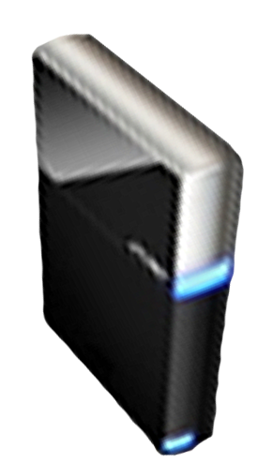


Please Complete A Session Evaluation Form
Your input is important!
Visit the WinHEC CommNet and complete a Session Evaluation for this session and be entered to win one
of 150 Maxtor® BlackArmor™ 160GB External Hard Drives
50 drives will be given away daily!
http://www.winhec2008.com
BlackArmor
Hard Drives provided by:

Slide 32

© 2008 Microsoft Corporation. All rights reserved. Microsoft, Windows, Windows Vista and other product names are or may be registered trademarks and/or trademarks in the U.S. and/or other countries.
The information herein is for informational purposes only and represents the current view of Microsoft Corporation as of the date of this presentation. Because Microsoft must respond to changing market conditions, it should not be interpreted to be a commitment on the part of Microsoft, and Microsoft cannot guarantee the accuracy of any information provided after the date of this presentation.
MICROSOFT MAKES NO WARRANTIES, EXPRESS, IMPLIED OR STATUTORY, AS TO THE INFORMATION IN THIS PRESENTATION.

