Slide 2
The Direct3D11 Compute Shader
Chas. Boyd
Architect
Microsoft
Mike Schmit
Video and Media
Advanced Micro Devices

Slide 3
GRA-T517 Session Description
The DirectX 11 Compute Shader for Stream Computing
DirectX 11 introduces the Compute Shader as a way to access the computational capability of the GPU in a more flexible way. This talk covers its key features, and how they can be used by developers to target applications including image and video processing. A case is made that video processing meets the criteria for consumer value and technical feasibility. Descriptions of video algorithms are presented with hardware mappings are described and compared. Presented by Chas. Boyd, Graphics Architect, Windows and Mike Schmit, Manager of Digital Video Software and Stream SDK, Advanced Micro Devices.

Slide 4
Overview
Graphics -> Data Parallel Computing
The Compute Shader
Advantages
Key Features
Target Applications
Video Processing Example

Slide 5
Graphics -> Data Parallel Computing
GPU Performance continues to grow
More algorithms want this performance
Apps can scale to massive parallelism without tricky code changes
General recognition that this model is applicable beyond just rendering
Although that is our primary target
Deliver scalable performance
Code scales with core count with no changes

Slide 6
Introducing: Compute Shader
A new processing model for GPUs
Data–parallel programming for mass markets
Supports more general constructs
Cross-thread data sharing
Un-ordered access I/O operations
Enables more general data structures
Irregular arrays, trees, etc.
Enables more general algorithms
Far beyond shading

Slide 7
Optimized For Client Scenarios
Simpler setup syntax
Balance between power and simplicity
Real-time rendering of results
Working to reduce cost of transition from compute mode to graphics mode
Better integration with media data types
Pixels, samples, text, vs only floats
Consistent implementations
Across vendors and across generations

Slide 8
Target Applications
Image/Post processing
Image Reduction, Histogram, Convolution, FFT
Video transcode, superResolution, etc.
Effect physics
Particles, smoke, water, cloth, etc.
A-Buffer/OIT
Ray-tracing, radiosity, etc.
Gameplay physics, AI

Slide 9
Compute Shader Features
Predictable Thread Invocation
Regular arrays of threads: 1-D, 2-D, and 3-D
Don’t have to ‘draw a quad’ anymore
Shared registers between threads
Reduces register pressure
Can eliminate redundant compute and i/o
Scattered Writes
Can read/write arbitrary data structures
Enables new classes of algorithms
Integrated with Direct3D resources

Slide 10
Graphics Programming Model
For imaging or GPGPU
Pure data-parallel model
Millions of threads
Each can only write to it’s own destination
No write contention
No inter-thread communication
No random-access I/O

Slide 11
Compute Shader Programming
Millions of threads
1000s of thread groups
Registers shareable within each group
Arbitrary access writes to video memory

Slide 12
Direct Thread Invocation
The ability to explicitly launch a known number of threads onto the GPU
pD3D11Device->Dispatch( … numThreads… );
Analogous to graphics DrawPrimitive() calls
Enables algorithms to execute the optimal number of threads
Not how many vertices are read, or pixels written
Current thread id is available to shader code
sv_ThreadID.x
Analogous to sv_PrimitiveID system value
Enables predictable memory access and register usage

Slide 13
Shared Register Class
New register type/variable storage class
groupshared float sfFoo;
A whole group of threads can access the same memory
Enables uses like user-controlled cache
Max 32kB can be shared in DirectX11
8k floats or 2k float4s
Vs 64kB of temporary registers available
16k floats or 4k float4s
Using fewer is usually faster

Slide 14
Barrier Intrinsics
GroupMemoryBarrier
GroupMemoryBarrierWithGroupSync
DeviceMemoryBarrier
DeviceMemoryBarrierWithGroupSync
AllMemoryBarrier
AllMemoryBarrierWithGroupSync

Slide 15
Sub Blocking
Not all threads in the call can/should share registers with each other
Sharing threads are broken down into subsets or groups of threads
Thread indices are available to shader
sv_ThreadID
sv_ThreadGroupID
sv_ThreadIDinGroup

Slide 16
Atomic Intrinsics
Enable parallel operations on 32-bit values in memory without requiring full synchronization
Either video memory or shared registers
Can be used to implement higher-level synch constructs
Semaphores, etc.
Not intended for heavy lifting
Support an immediate return argument
At some performance cost

Slide 17
Atomic Operator Intrinsics
Enables basic operations:
InterlockedAdd( rVar, val );
InterlockedMin( rVar, val );
InterlockedMax( rVar, val );
InterlockedOr( rVar, val );
InterlockedXOr( rVar, val );
InterlockedCompareWrite( rVar, val );
InterlockedCompareExchange( rVar, val );

Slide 18
Random Access I/O Operations
HLSL ‘resource variables’
Declared in the language
DXGI resources
Enables out-of-bounds memory checking
Returns 0 on reads
Writes are No-Ops
Improves security, reliability of shipped code

Slide 19
Unordered I/O
For fastest performance when ordering of records need not be preserved
Both reads and writes:
Append( ResourceVar, val);
Consume( ResourceVar, val);
Requires buffer allocated before-hand

Slide 20
Integrated With Direct3D
Fully supports all Direct3D resources
Targets graphics/media data types
Evolution of DirectX HLSL
Graphics pipeline updated to emit general data structures
Which can then be manipulated by compute shader
And then rendered by D3D again

Slide 21
Integration With Pipeline
Input Assembler
Render scene
Write out scene image
Use Compute for image post-processing
Output final image
Vertex Shader
Tessellation
Geometry Shader
Rasterizer
Data Structure
Pixel Shader
Output Merger
Final Image
Scene Image
Compute Shader

Slide 22
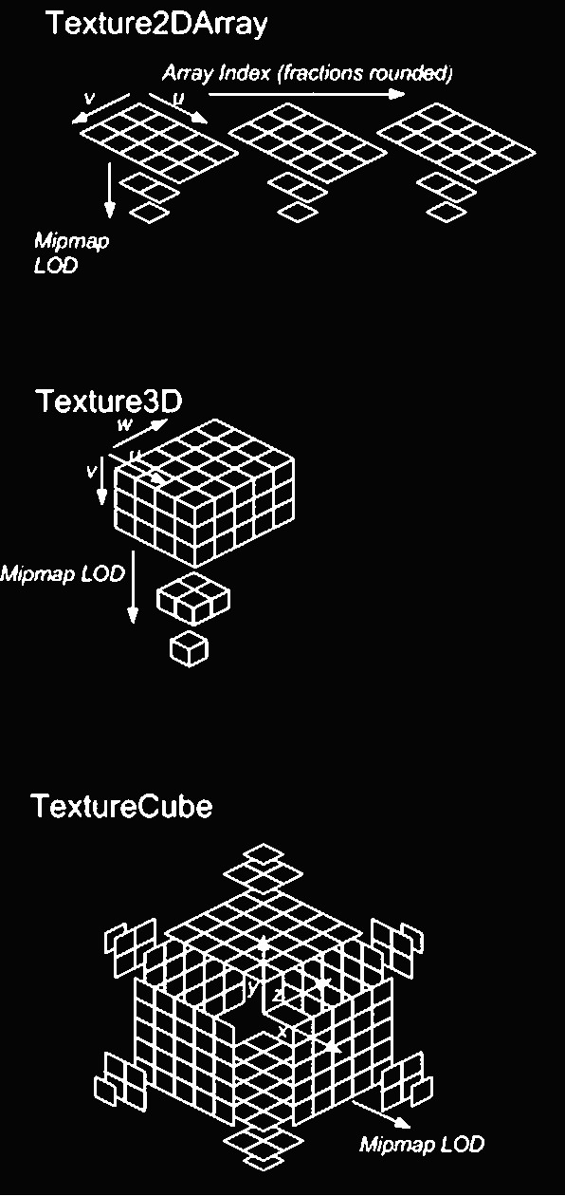
Texture Sampling
Compute Shader reads all 1-D, 2-D, 3-D and cube map resource topologies

Slide 23
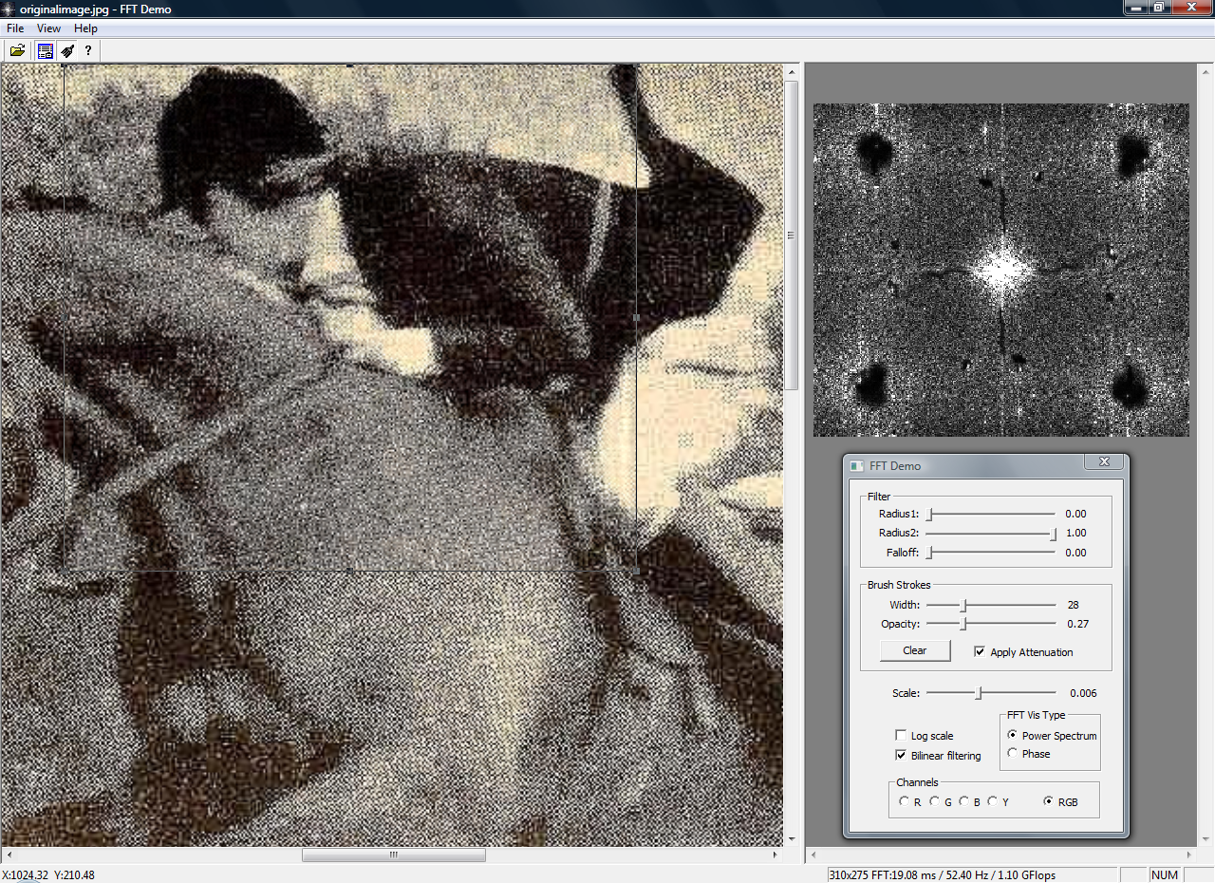
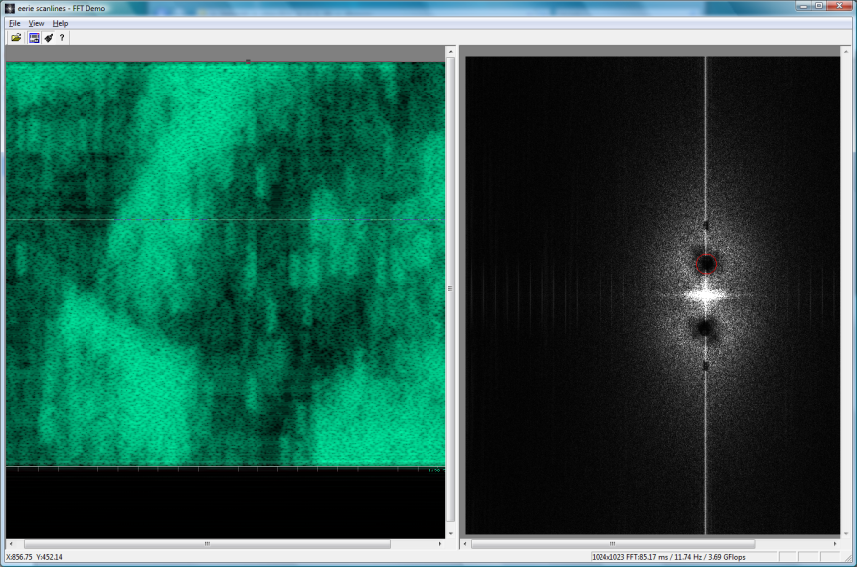
After

Slide 24
FFT Performance
Complex 1024x1024 2-D FFT
Software 42ms 6 GFlops
Direct3D9 15ms 17 GFlops 3x
CUFFT 8ms 32 GFlops 5x
Prototype DX11 6ms 42 GFlops 6x
Latest chips 3ms 100 Gflops
Shared register space and random access writes enable ~2x speedups

Slide 25
FFT Performance Evolution
12x
6x
3x

Slide 26
Hardware Support
DirectX11 Compute Shader runs on most current DirectX10 and 10.1 (4.x) parts
Explicit thread Dispatch()
Random-access I/O via resource variables
Private Write/Shared Read on groupshared data
New DirectX11-class (5.x) hardware adds
Arbitrary accesses to groupshared data
Atomic intrinsic operators
Hardware format conversion on i/o
More streaming i/o methods

Slide 27
Component Relationships
Applications
Media playback or processing, media UI, recognition, etc.
Domain Libraries
Domain Languages
Accelerator, Brook+, Rapidmind, Ct
MKL, ACML, cuFFT, D3DX, etc.
Compute Languages
DirectX11 Compute, CUDA, CAL, OpenCL, LRB Native, etc.
Processors
CPU, GPU, Larrabee
nVidia, Intel, AMD, S3, etc.

Slide 28
Summary
Compute Shader is coming in Direct3D11
GPU performance for more applications
Scalable parallel processing model
Code should scale for several generations
Increased generality will enable both
Improved performance on existing GPU tasks
More CPU tasks can switch to DP cores
Full cross-vendor support
Enables broadest possible installed base

Slide 29
Application GPU Video Processing
Mike Schmit
Advanced Micro Devices

Slide 30
Introduction
PC Consumer video processing provides a major opportunity for hardware acceleration
Widely available Programmable GPU hardware offers compelling performance gains for video computing
This talk will highlight the areas of the video processing pipeline, specifically
Algorithms that map well to the GPU compute shader architecture
A case study of difficult algorithms

Slide 31

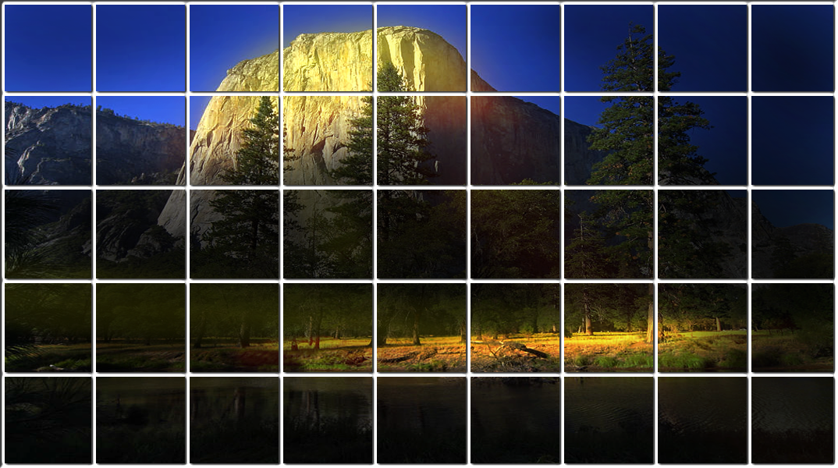
Data Mapping To HW
Each data element becomes a “thread” on the GPU and processed by a thread processor
The domain of execution is the array of all data elements…could be a pixel, a macroblock, etc.
one of many SIMD cores
(16 thread processors per SIMD core)

Slide 32
SMT In Each Thread Processor
Each thread processor (TP) actually runs multiple threads, time-slicing between them to hide memory latency
4, 8 or more threads run on each TP
* SMT equals simultaneous multi-threading

Slide 33







CPU-based Video Encoding

Slide 34
GPU Video Encoding

Slide 35


Division Of Video Algorithms
The design of video codecs is generally for maximum compression ratio, not for parallel processing – they have many serial dependencies
We divide video algorithms into these broad categories
No dependencies
Pseudo dependencies
Hard dependencies

Slide 36
Algorithms With No Dependencies
De-noise filters, such as a simple median
Bilinear or bicubic upscale and downscale

Slide 37
Algorithms With Hard Dependencies
H.264 in-loop deblocking, decode and encode
Decoding of intra-coded macroblocks
Entropy encode and decode (especially CABAC)
IBP frame decode order
Can decode two B frames at the same time
However P must follow I/P
B must follow I/P and P references
In H.264 there can be two from numerous references

Slide 38
Algorithms With Pseudo-Dependencies
Encoders have many quality/bitrate tradeoffs
Generally, more parallelism limits the amount of sequential dependencies to take advantage of…codecs are intentionally designed to take advantage of spatial similarity
Optimum encoding relies on differential coding – i.e., what is the delta from my neighbor
There is no requirement for paying attention to this, just less optimum not to
Motion Search
Many cycles can be removed by predicting MV_{n} from MV_{n-1}

Slide 39
Example: H.264 Deblocking
A typical 16x16 pixel macroblock with 16 internal 4x4 blocks

Slide 40
Example: H.264 Deblocking
Four levels of parallelism
Vertical edges within a macroblock
Horizontal edges within a macroblock
Limited ability to process multiple macroblocks at once
Luma and chroma can be processed simultaneously

Slide 41

H.264 Deblocking (Simple Case)
deblocked pixel
source pixels

Slide 42
H.264 Deblocking (Difficult Case)
Simplified example with two 4x4 blocks
The filter reads 6 pixels wide
Output is two pixels on each side of the boundary
dependency

Slide 43
Deblocking (Macroblock Parallelism)
1 | 2 | 3 | 4 | 5 | 6 | 7 | 8 | 9 | 10 | 11 | 12 | 13 | 14 | 15 | 16 | 17 | 18 | 19 | 20
2 | 3 | 4 | 5 | 6 | 7 | 8 | 9 | 10 | 11 | 12 | 13 | 14 | 15 | 16 | 17 | 18 | 19 | 20 | 21
3 | 4 | 5 | 6 | 7 | 8 | 9 | 10 | 11 | 12 | 13 | 14 | 15 | 16 | 17 | 18 | 19 | 20 | 21 | 22
4 | 5 | 6 | 7 | 8 | 9 | 10 | 11 | 12 | 13 | 14 | 15 | 16 | 17 | 18 | 19 | 20 | 21 | 22 | 23
5 | 6 | 7 | 8 | 9 | 10 | 11 | 12 | 13 | 14 | 15 | 16 | 17 | 18 | 19 | 20 | 21 | 22 | 23 | 24
6 | 7 | 8 | 9 | 10 | 11 | 12 | 13 | 14 | 15 | 16 | 17 | 18 | 19 | 20 | 21 | 22 | 23 | 24 | 25
7 | 8 | 9 | 10 | 11 | 12 | 13 | 14 | 15 | 16 | 17 | 18 | 19 | 20 | 21 | 22 | 23 | 24 | 25 | 26
8 | 9 | 10 | 11 | 12 | 13 | 14 | 15 | 16 | 17 | 18 | 19 | 20 | 21 | 22 | 23 | 24 | 25 | 26 | 27
9 | 10 | 11 | 12 | 13 | 14 | 15 | 16 | 17 | 18 | 19 | 20 | 21 | 22 | 23 | 24 | 25 | 26 | 27 | 28
10 | 11 | 12 | 13 | 14 | 15 | 16 | 17 | 18 | 19 | 20 | 21 | 22 | 23 | 24 | 25 | 26 | 27 | 28 | 29
11 | 12 | 13 | 14 | 15 | 16 | 17 | 18 | 19 | 20 | 21 | 22 | 23 | 24 | 25 | 26 | 27 | 28 | 29 | 30
12 | 13 | 14 | 15 | 16 | 17 | 18 | 19 | 20 | 21 | 22 | 23 | 24 | 25 | 26 | 27 | 28 | 29 | 30 | 31
13 | 14 | 15 | 16 | 17 | 18 | 19 | 20 | 21 | 22 | 23 | 24 | 25 | 26 | 27 | 28 | 29 | 30 | 31 | 32
14 | 15 | 16 | 17 | 18 | 19 | 20 | 21 | 22 | 23 | 24 | 25 | 26 | 27 | 28 | 29 | 30 | 31 | 32 | 33
15 | 16 | 17 | 18 | 19 | 20 | 21 | 22 | 23 | 24 | 25 | 26 | 27 | 28 | 29 | 30 | 31 | 32 | 33 | 34
Macroblocks for a 320x240 resolution image
Dependencies require processing in numerous passes along the diagonals

Slide 44
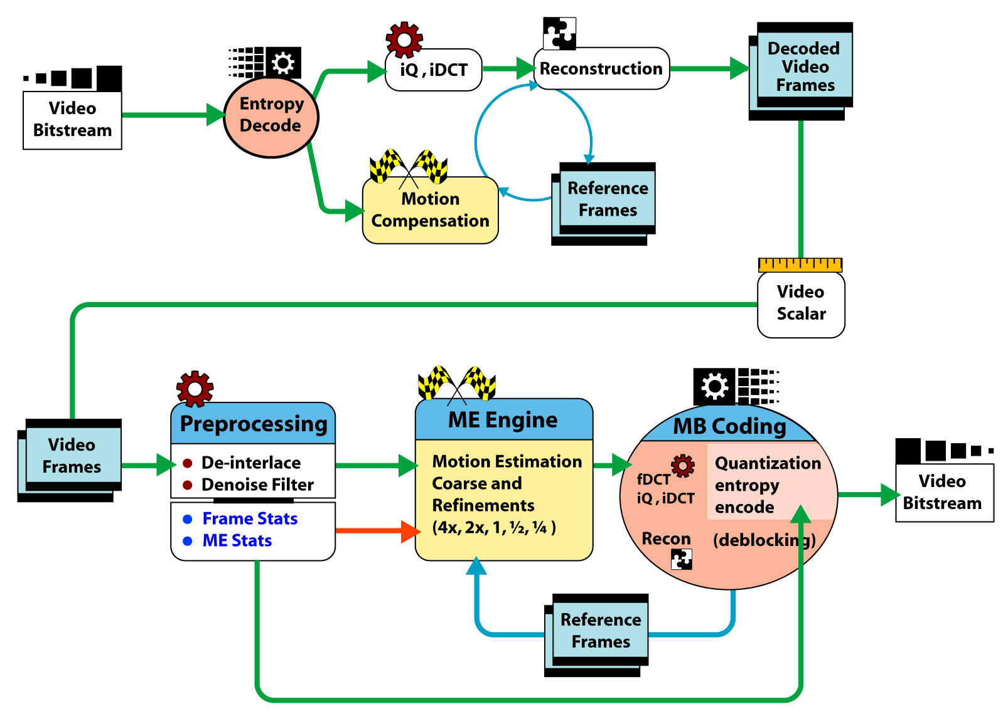
Video Transcoding Pipeline
Notes:
44

Slide 45
Easy Example: DCT/iDCT
DCT: Discrete Cosine Transform
8x8 pixels into 8x8 coefficients
One 8x8 block has many internal dependencies
1920x1080 image has 8100 16x16 macroblocks
YUV 420 colorspace has six 8x8 blocks per macroblock
48600 8x8 blocks per image
CPU: ~300 cycles per block @ about 3 GHz equals 5 msec
equivalency on 4 cores, about 1.2 msec (CPU)
latest GPU, processes 160 at a time…in about 300 groups
~350 cycles per group @ about 750 MHz equals .14 msec (GPU)
About a 8.5x speedup
Notes:
45

Slide 46
Questions And Comments
Thank you

Slide 47
Disclaimer And Attribution
DISCLAIMER
The information presented in this document is for informational purposes only and may contain technical inaccuracies, omissions and typographical errors.
The information contained herein is subject to change and may be rendered inaccurate for many reasons, including but not limited to product and roadmap changes, component and motherboard version changes, new model and/or product releases, product differences between differing manufacturers, software changes, BIOS flashes, firmware upgrades, or the like. AMD assumes no obligation to update or otherwise correct or revise this information. However, AMD reserves the right to revise this information and to make changes from time to time to the content hereof without obligation of AMD to notify any person of such revisions or changes.
AMD MAKES NO REPRESENTATIONS OR WARRANTIES WITH RESPECT TO THE CONTENTS HEREOF AND ASSUMES NO RESPONSIBILITY FOR ANY INACCURACIES, ERRORS OR OMISSIONS THAT MAY APPEAR IN THIS INFORMATION.
AMD SPECIFICALLY DISCLAIMS ANY IMPLIED WARRANTIES OF MERCHANTABILITY OR FITNESS FOR ANY PARTICULAR PURPOSE. IN NO EVENT WILL AMD BE LIABLE TO ANY PERSON FOR ANY DIRECT, INDIRECT, SPECIAL OR OTHER CONSEQUENTIAL DAMAGES ARISING FROM THE USE OF ANY INFORMATION CONTAINED HEREIN, EVEN IF AMD IS EXPRESSLY ADVISED OF THE POSSIBILITY OF SUCH DAMAGES.
ATTRIBUTION
© 2008 Advanced Micro Devices, Inc. All rights reserved. AMD, the AMD Arrow logo, ATI, the ATI logo, Radeon and combinations thereof are trademarks of Advanced Micro Devices, Inc. Microsoft, Windows and Vista are registered trademarks, of Microsoft Corporation in the United States and/or other jurisdictions. Other names are for informational purposes only and may be trademarks of their respective owners.
47
Notes:
47

Slide 48
Call To Action
Developers Improve app performance by using Compute Shader on graphics hardware
OEMs Ship systems with good Compute Shader performance capability
IHVs Optimize performance of Compute Shader implementations (drivers and silicon)

Slide 49
Questions?

Slide 50
Additional Resources
Microsoft DirectX SDK site
DirectX10 SDK and DirectX11 CTP
Ships next week
Included in Windows 7 Whitepaper
http://www.microsoft.com/whdc/display
Other Presentations
GRA-T516 Direct3D11 – previous talk
COR-T522 The Many-Core Shift – next talk
GRA-P581 Panel on Many-Core applications – Thurs 4:30
GRA-T584 Working with the Windows 7 Graphics Architecture – Friday 11:00-12:00
Microsoft Demo Booth!

Slide 51



Please Complete A Session Evaluation Form Your input is important!
Visit the WinHEC CommNet and complete a Session Evaluation for this session and be entered to win one of 150 Maxtor® BlackArmor™ 160GB External Hard Drives 50 drives will be given away daily!
http://www.winhec2008.com
BlackArmor Hard Drives provided by:

Slide 52


© 2008 Microsoft Corporation. All rights reserved. Microsoft, Windows, Windows Vista and other product names are or may be registered trademarks and/or trademarks in the U.S. and/or other countries.
The information herein is for informational purposes only and represents the current view of Microsoft Corporation as of the date of this presentation. Because Microsoft must respond to changing market conditions, it should not be interpreted to be a commitment on the part of Microsoft, and Microsoft cannot guarantee the accuracy of any information provided after the date of this presentation. MICROSOFT MAKES NO WARRANTIES, EXPRESS, IMPLIED OR STATUTORY, AS TO THE INFORMATION IN THIS PRESENTATION.

