Slide 2
Display Driver Interface changes for Windows 7
Ameet Chitre
Senior Program Manager
Microsoft Corporation

Slide 3
Session Goals
Enumerate Display Driver Interface
(DDI) changes in Windows 7
Explain the motivations
  Performance achievements
Highlight the functionality
  Required capabilities
  Optional capabilities

Slide 4
Agenda
Windows 7 Display Driver Support
Functionality enabled by Windows 7
optimized drivers
  Performance Improvements
  Window Manager Improvements
  Direct2D API support
  Connecting & Configuring Displays
  Improved Diagnosability
  Video Improvements
Logo Changes

Slide 5


Display Drivers In Windows 7
WDDM v1.1
  Display Drivers Optimized for Windows 7
  Best experience on Windows 7
WDDM v1
  Windows Vista Display Drivers
  Go with the absolutely latest available drivers
XPDM
  Many features will not work (e.g. lack of Aero)
  Legacy driver model: being phased out

Slide 6
Graphics User Experience
DirectX 10 gaming performance improvements
A performant Aero Glass desktop
Higher performance for Direct2D applications
New Aero Glass colorization
WDDM v1.1 - Optimized for Windows 7
Highest Level of Performance
WDDM v1 – Windows Vista drivers
Vista Aero + new features
New Windows taskbar
Reduced Aero Glass Memory Footprint
Better viewing experience on TVs and widescreen laptops
Window Movement animations
New Win-P hotkey for laptop projection
New thumbnail previews
DirectX version | WDDM version | Graphics hardware
DirectX 10.x | WDDM v1.1 | nVidia: GeForce 8300, 8400, 8600, 8800 (G80, G8x family) AMD: Radeon HD 2xxx and newer; FireGL V6xxx\V8xxx and newer Intel: i4G, i45GM, G35, i965GM and newer
DirectX 9 | WDDM v1 | nVidia: GeForce 6xxx and 7xxx AMD: Radeon 9800, X300 – X1900 series Intel: i965, i950, i945, G3x

Slide 7


Overview Of WDDM v1.1
“v1.1” - Incremental Driver Model change
  Set of DDI changes for WDDM drivers
WDDM v1.1 Feature Set
  Required capabilities
  Optional capabilities
Required for Windows 7 Logo

Slide 8
WDDM v1.1 Feature Set
Performance
Enhanced end-user experience
Improved Reliability

Slide 9
WDDM v1.1 Feature Set
Performance
System memory savings for
running Aero
High-performance Direct3D10 Aero Glass Windows desktop
Performant
Direct2D API
Enhanced end-user experience
Improved Reliability
Performance gains in gaming scenarios

Slide 10
WDDM v1.1 Feature Set
Performance
System memory savings for
running Aero
High-performance Direct3D10 Aero Glass Windows desktop
Performant
Direct2D API
Enhanced end-user experience
Improved Reliability
Performance gains in gaming scenarios
Improved video overlay presentation
Better viewing experience on TVs and widescreen laptops

Slide 11
WDDM v1.1 Feature Set
Performance
System memory savings for
running Aero
High-performance Direct3D10 Aero Glass Windows desktop
Performant
Direct2D API
Enhanced end-user experience
Improved Reliability
Standardization of High-definition composition
GPU content protection through standardized solutions
Improved diagnosability
Performance gains in gaming scenarios
Improved video overlay presentation
Better viewing experience on TVs and widescreen laptops

Slide 12

Graphics Performance
System Memory Savings

Slide 13
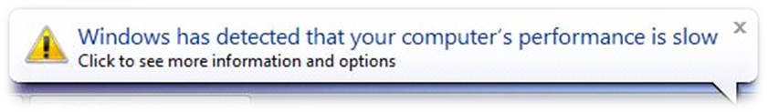
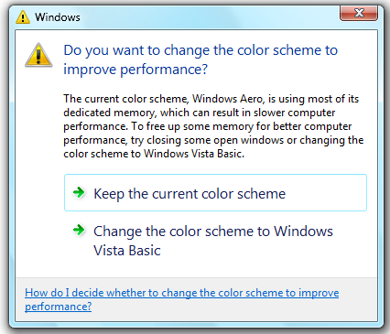
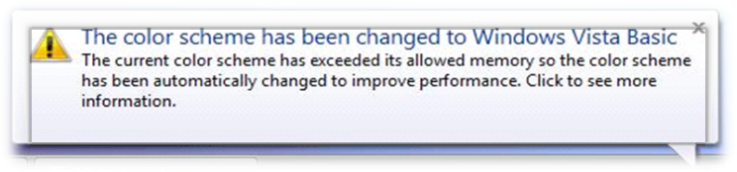
Benefit
Considerable system
memory savings
Better responsiveness for
same workload
Configurations that benefit
  Systems with less system memory
    Glass does not shut down after
    opening few windows
    System memory available to
    other applications
  Large Monitors
    Scales to higher resolutions
    Better advantage of desktop real estate

Slide 14
Application Scenarios
Factors determining Memory Savings
  Class of application
  Number of windows Open
  Size of the window
  Screen resolution
Class of Application
  Applications which use both GDI & DirectX
  GDI Applications

Slide 15
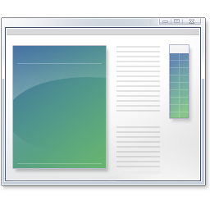
Memory Usage In Windows Vista
Case 1 – Window with both GDI & DirectX content
System memory allocation
1
GDI
DirectX application
2
3
GDI video memory allocation
DX video memory allocation
WDDM
Graphics stack
Provided by:
Microsoft
Display driver
ISV
DWM Composition
IHV

Slide 16
Memory Usage In Windows 7
Case 1 – Window with both GDI and DirectX content
System memory allocation
1
GDI
DirectX application
1
3
GDI video memory allocation
DX video memory allocation
WDDM
Graphics stack
Provided by:
Microsoft
Display driver
ISV
DWM Composition
IHV

Slide 17
Memory Usage In Windows Vista
Case 2 – Window with GDI content
System memory allocation
1
GDI
2
GDI video memory allocation
Provided by:
Microsoft
ISV
DWM Composition
IHV

Slide 18
Memory Usage In Windows 7
Case 2 – Window with GDI content
System memory allocation
1
GDI
1
GDI video memory allocation
WDDM
Provided by:
Microsoft
Display driver
ISV
DWM Composition
IHV

Slide 19
Memory savings
GDI Application windows
More open windows, more savings
Memory Saving: One system memory surface per window
{System memory consumed by 1 window} =
{Horizontal screen resolution} X {Vertical screen resolution} X 4 Bytes
# of Windows ---------------------- Screen Resolution | 5 windows | 15 windows | 30 windows
1024 x 768 | 15 MBytes | 45 MBytes | 90 MBytes
1280 x 1024 | 25 MBytes | 75 MBytes | 150 MBytes
1600 x 1200 | 36.5 MBytes | 109.5 MBytes | 219 MBytes

Slide 20
WDDM v1.1 Requirement
GDI Hardware Acceleration Interfaces
Support for common 2D operations:
  Drawing operations:
    BitBlt, ColorFill, AlphaBlend etc
  Cleartype font support
Support for common ROPs
Support for Linear Heaps
Texture size of 8K X 8K

Slide 21
Memory Savings
demo
Ameet Chitre
Senior Program Manager
Desktop Graphics Technologies

Slide 22
Results
Note: The above data compares system memory consumption only.
Preliminary data gathered on Windows 7 pre-release builds and subject to change

Slide 23

DirectX Benefits
Window Manager Changes
Direct2D Layering

Slide 24
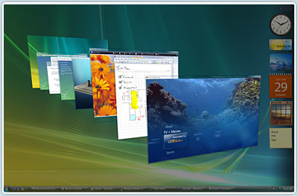
BGRA Format Support
WDDM v1.1 drivers require BGRA support
Enables clients to run on Direct3D10
  Desktop Window Manager
  Direct2D
WDDM v1 drivers
  DWM will run on “10Level9”

Slide 25
Desktop Running On Direct3D10
DWM Core
DWM Core
Direct3D9
Direct3D10
DXGI
Provided by:
Microsoft
ISV
D3D9 UMD
10Level9
IHV
DWM utilizes the D3D10API on DX10 or DX9 hardware
  Native D3D10 API on DX10 hardware
  Runs through 10Level9 on DX9 hardware
D3D9 UMD
D3D10 UMD

Slide 26
Direct2D Layering
Direct2D
Application
Direct2D
Provided by:
Microsoft
Direct3D10
DXGI
ISV
IHV
10Level9
D3D9 UMD
D3D10 UMD

Slide 27
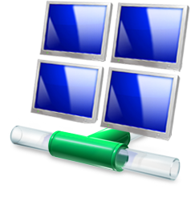
Connecting and
Configuring Displays

Slide 28
CCD – WDDM v1.1 Improvements
Better Aspect Ratio Scaling
  New API for control panel applets
  Three modes of scaling
    Centered
    Stretched
    Aspect Ratio preserving Stretched
Reliable “always present” monitor modes
  Most common modes needed when…
    …there is no EDID
    …there is a Switchbox connected
  OS asks driver for a set of modes
Better synchronization with IHV applets

Slide 29



Improved Diagnosability

Slide 30
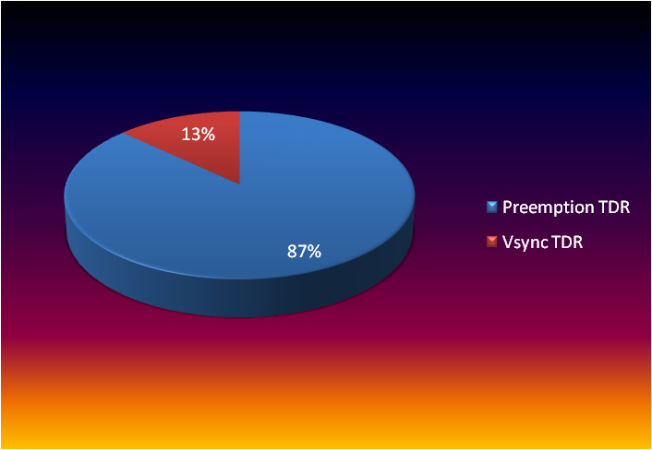
Improved Diagnosability - TDRs
TDR Data breakout per category
Two categories of TDRs
  Preemption TDRs
    GPU is unable to complete a task
    within the sanctioned time
  VSync TDRs
Cause of VSync TDRs –
  Issues related to the VSync Interrupt
  Common scenarios –
    Clone Mode, Multi-monitor
  OS or WDDM driver bugs
  Relatively easy to
  fix once found
Hurdle - Lack of diagnosability data!
Source: Opt-in Customer data from Windows Error Reporting; data snapshot: September 2008

Slide 31
Data Collection Requirement
Field | Description
VidPnSourceId | The VidPnSourceId where GPU scheduler detected timeout as flip queue does not make progress.
VSyncState | The state of current vsync on VidPnSource where timeout is detected. This must be 1 (VIDSCH_VSYNC_ENABLED). If this value is other than 1, then it indicates a bug in GPU scheduler itself, not IHV’s driver.
ProcessName | The name of process who own the VidPnSource.
FlipMode | The current flipping mode.
FlipQueueEntry | The dump of each flip queue entry. This is striped and packed version of VIDSCH_FLIP_QUEUE_ENTRY.
MonitorPowerState | The power state of the monitor, each bit represents each VidPnSource. 1 is for monitor ON, 0 for monitor OFF. Least significant bit is for VidPnSource 0 and up to 31.
VidPnTargetList | The array contains matching id for VidPnTarget index with id of VidPnSource. For example, VidPnTargetList[2] contains the id for VidPnTarget connected to VidPnSourceId 2.
MaxSupportedVidPnSourceId | The number of VidPnSource(s) supported by the adapter.

Slide 32
FPO Optimizations
FPO (Frame Pointer Omission) Optimization
needs to be disabled
Problem with FPO Optimization
  Very difficult or almost impossible to debug
  Example - Performance analysis
  Stack frames on key events lost
Requirement
  WDDM v1.1 drivers be built with the FPO
  Optimization flag disabled
    Applicable only for the Kernel Mode driver

Slide 33
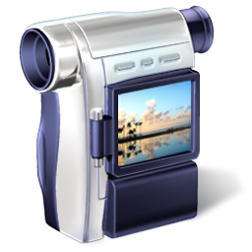
Video Playback Enhancements

Slide 34
Video Playback
Decode
GPU Based Content Protection
  Enable MCE in windowed mode with Aero (DWM) On
Standardized AES 128 bit Encryption
  APIs for Encryption between CPU and GPU
Video
Processing
DXVA-HD
  Unified Interface for HD Video Playback
Presentation
Overlay DDI
  Improved Performance
  Enables ISV players with AERO (DWM) On
Output
Protection
OPM DDI
  Usable outside Media Foundation

Slide 35
Multi-Adapter Configurations
Definitions
Homogeneous Multi-Adapter
  Two or more graphics adapters
  All adapters use the same display driver
  E.g. two adapters from the same IHV
Heterogeneous Multi-Adapter
  Two or more graphics adapters
  Each adapter uses a different display driver
  E.g. each adapter is from a different IHV

Slide 36
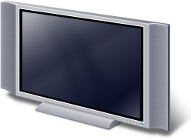



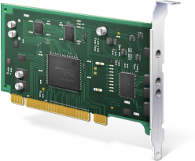

Multi-Adapter Scenario
Heterogeneous Graphics Adapters
Windows Vista
Windows 7
IHV A
IHV B
IHV A
IHV B

Slide 37
Multi-Adapter Behaviour
Could be homogeneous or heterogeneous
No Memory Savings benefit
Driver Model
  All WDDM v1.1-capable
    DWM and D2D will use Direct3D10
  At least one WDDM v1-capable
    DWM and D2D will use 10Level9

Slide 38
Phasing Out XPDM
XPDM will not get a Win7 client logo
Win7 UMPCs can ship with WDDM v1
XPDM allowed for Win7 Server logo
XPDM allowed to install on Win7
  Signed drivers required for X64
  Signed for Windows Server 2008 or Vista
  Unsigned allowed only for x86

Slide 39
Proposed Logo Requirements
Windows 7 Feature Name | WDDM v1.1 Feature Requirement | Mandatory/Optional Requirement
System Memory Savings for Aero | GDI Hardware Acceleration | Mandatory
High Performance Desktop running on Direct3D10 | BGRA support | Mandatory
A Performance Direct2D API layered over Direct3D10 | BGRA support | Mandatory
A better viewing experience on TVs and widescreen laptops | CCD DDI | Mandatory
Improved diagnosability of stability problems | VSync Data Reporting | Mandatory
Improved diagnosability of performance problems | FPO Disable | Mandatory
Specifies method of encryption that should be performed for premium content over the UAB | Standardized AES 128 support | Optional
Standardized mechanism for High-Definition composition through DXVA-HD | DXVA-HD DDI | Optional

Slide 40
Call To Action
Build systems with DirectX 10.x/11 GPUs
Test with pre-release WDDM v1.1 drivers
Test custom driver packages for mobiles
Test DirectX games with WDDM v1.1 drivers
Refer to Win7 proposed Logo requirements
Test variety of hardware configurations
Maintain complete 64-bit parity

Slide 41
Additional Resources
See us at the DirectX booth in the Expo Hall
Web Resources
  Whitepapers: http://www.microsoft.com/whdc/display
  Other Resources: http://msdn.microsoft.com/directx
Related Sessions
  GRA-T515: DirectX – Core Graphics for Windows 7
  GRA-T516: DirectX11
  GRA-T517: GPU Compute
  GRA-T584: Working with the Windows 7 Graphics Architecture
  GRA-T585: Video Improvements in Windows 7
  GRA-T634: GPU Performance and GPU/CPU Interactions in Windows 7
  GRA-P581: Panel: Application of General Purpose Compute
  GRA-C640: Validating Graphics Scenarios in Windows 7
  MBL-T579: Connecting Projectors and Using Docking Stations with Windows 7
  GRA-C666: Connecting and Configuring Displays in Windows 7
Contact information
  Directx @ Microsoft.com

Slide 42
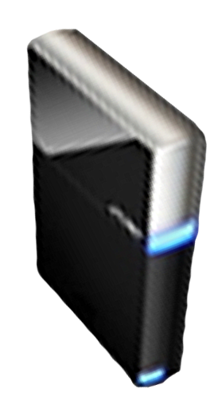


Please Complete A Session Evaluation Form
Your input is important!
Visit the WinHEC CommNet and complete a Session Evaluation for this session and be entered to win one
of 150 Maxtor® BlackArmor™ 160GB External Hard Drives
50 drives will be given away daily!
http://www.winhec2008.com
BlackArmor
Hard Drives provided by:

Slide 43


© 2008 Microsoft Corporation. All rights reserved. Microsoft, Windows, Windows Vista and other product names are or may be registered trademarks and/or trademarks in the U.S. and/or other countries.
The information herein is for informational purposes only and represents the current view of Microsoft Corporation as of the date of this presentation. Because Microsoft must respond to changing market conditions, it should not be interpreted to be a commitment on the part of Microsoft, and Microsoft cannot guarantee the accuracy of any information provided after the date of this presentation.
MICROSOFT MAKES NO WARRANTIES, EXPRESS, IMPLIED OR STATUTORY, AS TO THE INFORMATION IN THIS PRESENTATION.

Slide 44
Using Subtitles
Subtitle color
Example of a slide with a subtitle
  Set the slide title in “Title Case”
  Set subtitle in “Sentence case”
  Generally set subtitle to 36pt or smaller
  so it will fit on a single line
  The subtitle color is defined for this
  template but must be selected;
  On the font color palette, select the
  color to the right of title color

Slide 45
Code Sample
How to show code in a slide
Call out in a box
Use 14pt Lucida Console
Make sure your code will compile
using System;
public class Class1 {
public static void Main () {
Console.WriteLine (“Hello World!”);
}
}

Slide 46
Example Diagram
Applications
Provided by:
User
Microsoft
ISV
Kernel
Device Class Driver
Device Class Driver
Device Class Driver
IHV
OEM
Minidriver
ACPI Driver
Bus Class Driver
Core (Fixed)
System hardware
Value-added
System hardware
Non-std
Dev.
Std Dev.
Non-std. Dev.

