Slide 2
Windows 7 Next-Generation Camera Support
Mehmet Kucukgoz
Program Manager
Microsoft Corporation

Slide 3
Agenda
Windows 7 support for Advanced Video Codec High Definition (AVCHD) cameras
Windows support for Universal Video Class (UVC) version 1.1
New extensibility model video class driver
Media Foundation (MF) capture support

Slide 4
AVCHD Support

Slide 5



Windows 7 AVCHD Support
What is AVCHD?
AVCHD is a
high-definition recording format
for use in digital camcorders
It was announced jointly by Sony and Panasonic in May 2006
AVCHD is gaining momentum

Slide 6
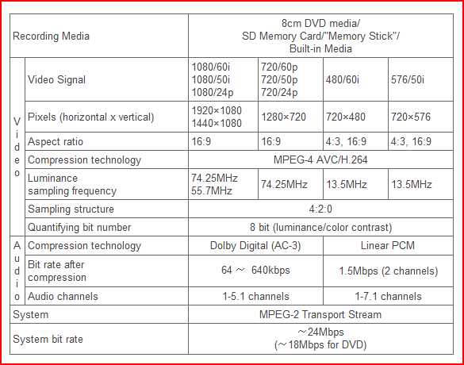
Windows 7 AVCHD Support
AVCHD Standard
Video: MPEG-4 AVC/H.264.
Audio: Dolby AC-3 or LPCM.
Audio, video and subtitle streams are encapsulated into MPEG-2 Transport stream

Slide 7

Windows 7 AVCHD Support
Windows Media Player Support
Windows Media Player in Windows 7 can play AVCHD content
  .m2ts, .mts, and .m2t file extensions are registered
  out of the box
  WMP Library indexes these
  file extensions
  Windows Explorer recognizes these files, creates thumbnails etc.

Slide 8
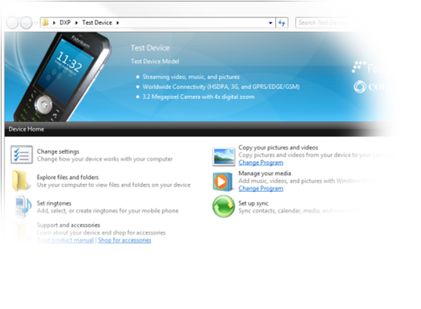
Windows 7 AVCHD Support
File Transfer Support
If the camera is certified by Device Stage ™, transferring files to the PC will be super easy.
(Talk info provided)

Slide 9
Windows 7 AVCHD Support
A few notes…
Other camcorder formats might become popular. Windows is not picking sides, but just supporting what’s in the marketplace
  This is in line with our codecs and media format support
  (Talk info provided)
LPCM is not widely used so it is not supported yet
Given their low utilization in camcorders, bitmap streams and closed captioning are not supported yet

Slide 10
Demo For AVCHD Support

Slide 11
Call To Action
Please use the supported file extensions
in order to ensure compatibility
with Windows 7
Test your camera with Windows 7

Slide 12
UVC1.1 Support

Slide 13
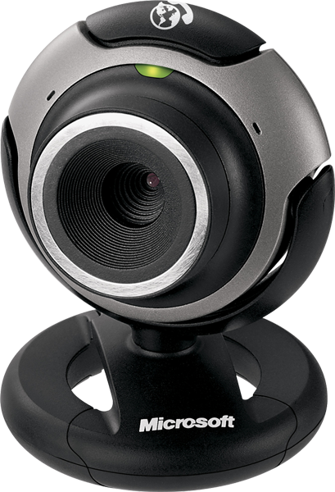
UVC Driver Support
What is UVC?
The USB video device class (also USB video class or UVC) is a USB device class that describes devices capable of streaming video like webcams
UVC 1.0 spec was supported by Windows XPSP2 and Windows Vista
UVC1.1 spec added support for temporal compressions (stream based payloads)

Slide 14
UVC Driver Diagram
Provided by:
Applications
Microsoft
ISV
Ksproxy.ax or MF Video Capture Source
Property Page Plug-in
Node Property Plug-in
IHV
FilterProperty Plug-in
User
Ks.sys
UsbVideo.sys
Kernel
USB Stack
IHV Hardware

Slide 15

UVC Driver Support
Vista (UVC1.0 based) driver supports...
Capture
  Uncompressed, MJPEG, DV (bulk and isoch)
  MPEG-2 TS (isoch)
Render (to device)
  DV (isoch)
Controls
  Processing Unit and Camera Terminal controls
  (filter-based and node-based KS properties)
  Selector Unit controls, Extension Units and vendor defined controls
  (only node-based KS properties)
  Media Transport Terminal controls including trick play modes
  (node-based and filter-based KS properties)
EOF and FID bits for MPEG-2 TS payload headers

Slide 16
UVC Driver Support
Vista (UVC1.0 based) driver does not support…
MPEG-1, MPEG-2 PS, MPEG-4 SL,
vendor based payloads
MPEG-2 TS
  On bulk pipes
  Application specific APT
Dynamic format changes
VS_GENERATE_KEY_FRAME_CONTROL, VS_UPDATE_FRAME_SEGMENT_CONTROL, VS_SYNCH_DELAY_CONTROL

Slide 17
UVC Driver Support
Why support UVC1.1?
End users are asking for HD webcams
Why need compression?
  Limited USB bandwidth
  Potentially lower latency if streaming without a decode/re-encode
Vendor based payload was not properly supported in Vista class driver (UVC1.0)
  UVC1.1 supports generic frame based and stream based formats

Slide 18
UVC Driver Support
Windows 7 (UVC1.1 based) driver supports…
Capture of frame-based formats
  Bulk and isoch
Capture of stream-based formats
  Isoch
Dynamic frame interval supported by default
  In UVC 1.0 you need to use a registry mask (WORKAROUNDS_VARIABLE_FRAME_RATE_MASK)
New probe-commit structures

Slide 19
Call To Action
If you are building HD camera, please use the UVC 1.1 driver
  It will make your life easier…

Slide 20
Extensibility Model

Slide 21

Extensibility For Video Class Driver
Advantages of using class driver
Provides a guaranteed basic user experience
  User buys a webcam, hooks up to the PC, it just works!
Increases video capture experience and overall system stability
  Less crashes
No driver development cost to IHV
No driver deployment cost to IHV/OEM

Slide 22


Extensibility For Video Class Driver
Purpose
We would like to increase UVC driver adaption
Class driver is pretty vanilla
  Class driver is a goodness but IHVs want to add value and differentiate: Face tracking, orientation adjustment, background replacing
  We received a lot of requests for an extensibility model

Slide 23

Extensibility For Video Class Driver
What is it?
Simple to write
  User mode
  Model is sample in, sample out
Plug-in provided by IHV, loaded
by the class driver
  Plug-in will only be loaded for the associated device
Supported by both Media Foundation and DShow Platforms

Slide 24
Extensibility Model Diagram
Applications
Provided by:
Microsoft
DSHOW PLATFORM
MF PLATFORM
Ksproxy.ax
Plug-in
Process Output
ISV
Process Input
Decoder
MediaSource
Process Input
Process Output
IHV
DevProxy
Plug-in
User
Ks.sys
UsbVideo.sys
Kernel
USB Stack
IHV Hardware

Slide 25
Extensibility For Video Class Driver
Interface (1/3)
typedef struct {
HANDLE hCompletionEvent;
HRESULT hr;
} AsyncStatus;
interface __declspec(uuid("2EFC7721-05DA-4ac6-8300-635E373D839E")) IKsVideoProcessing;
interface IKsVideoProcessing : public IUnknown {
STDMETHOD(SetInputMediaTypeList)(
PKSDATAFORMAT* ppMediaTypeList,
PVOID* ppConfigCaps,
UINT32 NumMediaTypes
) = 0;
STDMETHOD(GetInputMediaTypeList)(
PKSDATAFORMAT** pppMediaTypeList,
UINT32* pNumMediaTypes
) = 0;
STDMETHOD(GetOutputMediaTypeList)(
PKSDATAFORMAT** pppMediaTypeList,
PVOID** pppConfigCaps,
UINT32* pNumMediaTypes
) = 0;

Slide 26
Extensibility For Video Class Driver
Interface (2/3)
STDMETHOD(GetMatchingOutputMediaType)(
PKSDATAFORMAT pMediaType,
PKSDATAFORMAT* ppMatchingMediaType
) = 0;
STDMETHOD(SetOutputMediaType)(
PKSDATAFORMAT pMediaType
) = 0;
STDMETHOD(GetOutputMediaType)(
PKSDATAFORMAT* ppMediaType
) = 0;
STDMETHOD(GetInputMediaType)(
PKSDATAFORMAT* ppMediaType
) = 0;
STDMETHOD(GetPreferredAllocatorProperties)(
BOOL *pbInplaceTransform,
ALLOCATOR_PROPERTIES* pInputAllocatorProperties,
ALLOCATOR_PROPERTIES* pOutputAllocatorProperties
) = 0;
STDMETHOD(SetAllocatorProperties)(
BOOL bInplaceTransform,
ALLOCATOR_PROPERTIES* pInputAllocatorProperties,
ALLOCATOR_PROPERTIES* pOutputAllocatorProperties
) = 0;

Slide 27
Extensibility For Video Class Driver
Interface (3/3)
STDMETHOD(UpdateOutputBufferStride)(
UINT32 BufferWidth,
UINT32 BufferSize
) = 0;
STDMETHOD(ProcessInput)(
PKSSTREAM_HEADER pData,
AsyncStatus* pStatus
) = 0;
STDMETHOD(ProcessOutput)(
PKSSTREAM_HEADER pData,
AsyncStatus* pStatus
) = 0;
STDMETHOD(Flush)(
) = 0;
};
interface __declspec(uuid("6B3CF435-BF7E-4ae7-B420-8E84166353FA")) IKsSetControlInterface;
interface IKsSetControlInterface : public IUnknown {
STDMETHOD(SetKsControl)(
IKsControl* pKsControl
) = 0;
};

Slide 28
Extensibility For Video Class Driver
INF File and Registry Entry
[Manufacturer]
“Cool IHV”=IHV
[IHV]
“Cool IHV Device”=Device,USB\VID_XXX&PID_XXXX&MI_XX
[Device.NT.Interfaces]
AddInterface=%KSCATEGORY_CAPTURE%,GLOBAL,Device.Interface
[Device.Interface.AddReg]
; the "1" after CustomVidProcHandler indicates that this is REG_BINARY
HKR,,CustomVidProcHandler,X,XX,XX,XX,XX,XX,XX,XX,XX,XX,XX,XX,XX,XX,XX,XX,XX
[HKEY_LOCAL_MACHINE\SYSTEM\CurrentControlSet\Control\DeviceClasses\{XXXXXXXX-XXXX-XXXX-XXXX-XXXXXXXXXXXX} \##?#USB#VID_XXX&PID_XXXX&MI_XXXXXXXXXXXXXX#{XXXXXXXX-XXXX-XXXX-XXXX-XXXXXXXXXXXX}\#GLOBAL\Device Parameters]
"CustomVidProcHandler"=hex:XX,XX,XX,XX,XX,XX,XX,XX,XX,XX,XX,XX

Slide 29
Call To Action
Make use of class driver with extensibility model instead of implementing your
own driver
Even if you develop your own driver, make sure your device works well with the
class driver

Slide 30
MF Capture Support

Slide 31
Media Foundation Capture Support
What is Media Foundation?
Microsoft Media Foundation (MF) is a multimedia framework pipeline and infrastructure platform
It is the intended replacement for Microsoft DirectShow, Windows Media SDK, DirectX Media Objects (DMOs) and all other legacy multimedia APIs
All of our future media platform investments will be on Media Foundation

Slide 32
Media Foundation Capture Support
What is new?
Media Foundation Capture Source
  Enables capture in Media Foundation
Source Reader
  Much simpler to code, no need for MF session, no real topology, no ‘render pins’
Simpler device enumeration

Slide 33
Media Foundation Capture Support
Capture Support In Windows 7
Application
Provided by:
Microsoft
MF PLATFORM
Source Reader(Video)
ISV
Sink (EVR)
Media Source
IHV
Decoder
CS Converter
User
Ks.sys
UsbVideo.sys
Kernel
USB Stack
IHV Hardware

Slide 34
Media Foundation Capture Support
How to enumerate?
HRESULT CreateCaptureSource( __out IMFMediaSource **ppSource )
{
HRESULT hr = S_OK;
IMFAttributes* pAttributes = NULL;
IMFActivate** ppSourceActivates = NULL;
UINT32 cSourceActivates = 0;
// Create attributes used to control the enumeration
CHECK_HR( hr = MFCreateAttributes( &pAttributes, 10 ) );
CHECK_HR( hr = pAttributes->SetGUID( MF_DEVSOURCE_ATTRIBUTE_SOURCE_TYPE, MF_DEVSOURCE_ATTRIBUTE_SOURCE_TYPE_VIDCAP_GUID ) );
// Enumerate capture sources
CHECK_HR( hr = MFEnumDeviceSources( pAttributes, &ppSourceActivates, &cSourceActivates ) );
// Create capture source (take the first one we enumerated)
CHECK_HR( hr = ppSourceActivates[0]->ActivateObject( IID_IMFMediaSource, (void**)ppSource ) );
done:
// Cleanup
SAFE_RELEASE( pAttributes );
for (DWORD i = 0; i < cSourceActivates; i++)
{
SAFE_RELEASE( ppSourceActivates[i] );
}
CoTaskMemFree( ppSourceActivates );
return hr;
}

Slide 35
Media Foundation Capture Support
How to use the source reader?
HRESULT CreateSourceReader( __in IMFMediaSource* pSource, __out IMFSourceReader **ppReader )
{
HRESULT hr = S_OK;
IMFMediaType* pUncompressedType = NULL;
// Create source reader from the capture source
CHECK_HR( hr = MFCreateSourceReaderFromMediaSource( pSource, NULL, ppReader ) );
// Configure the source reader to output uncompressed RGB32 samples
CHECK_HR( hr = MFCreateMediaType( &pUncompressedType ) );
CHECK_HR( hr = pUncompressedType->SetGUID( MF_MT_MAJOR_TYPE, MFMediaType_Video ) );
CHECK_HR( hr = pUncompressedType->SetGUID( MF_MT_SUBTYPE, MFVideoFormat_RGB32 ) );
CHECK_HR( *ppReader->SetCurrentMediaType( 0, // stream index
NULL,
pUncompressedType ) );
done:
// Cleanup
SAFE_RELEASE( pUncompressedType );
return( hr );
}

Slide 36
Media Foundation Capture Support
Bringing it all together…
HRESULT ReadSamples()
{
HRESULT hr = S_OK;
IMFMediaSource* pSource;
IMFSourceReader* pSourceReader = NULL;
IMFSample* pSample = NULL;
// Create capture source
CHECK_HR( hr = CreateCaptureSource( &pSource ) );
// Create and configure the source reader
CHECK_HR( hr = CreateSourceReader( pSource, &pSourceReader );
// Read 1000 uncompressed RGB samples from the capture source
for(DWORD i = 0; i < 1000; i++)
{
DWORD dwActualStreamIndex = 0;
DWORD dwStreamFlags = 0;
SAFE_RELEASE( pSample );
CHECK_HR( hr = pSourceReader->ReadSample( 0, // stream index
0, // control flags
&dwActualStreamIndex, // actual stream index
&dwStreamFlags, // stream flags (e.g. format change)
&pSample ) );
}
done:
// Cleanup
SAFE_RELEASE( pSource );
SAFE_RELEASE( pSourceReader );
SAFE_RELEASE( pSample );
return hr;
}

Slide 37
Call To Action
If you are writing a new capture application, please use MF Capture

Slide 38
Demo For MF Capture

Slide 39
Additional Resources
Related Sessions
  CON-T566 Authoring a Device Experience for Portable Devices: 6th, 11am, Room 151
  GRA-T585 Video Improvements in Windows 7: 7th 1:15pm, Room Petree C
UVC Discussion email: uvcdisc@microsoft.com
MF Discussion email: mfchat@microsoft.com

Slide 40
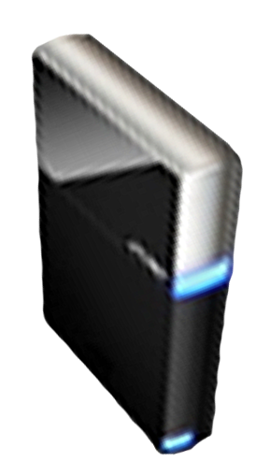


Please Complete A Session Evaluation Form
Your input is important!
Visit the WinHEC CommNet and complete a Session Evaluation for this session and be entered to win one
of 150 Maxtor® BlackArmor™ 160GB External Hard Drives
50 drives will be given away daily!
http://www.winhec2008.com
BlackArmor
Hard Drives provided by:

Slide 41

© 2008 Microsoft Corporation. All rights reserved. Microsoft, Windows, Windows Vista and other product names are or may be registered trademarks and/or trademarks in the U.S. and/or other countries.
The information herein is for informational purposes only and represents the current view of Microsoft Corporation as of the date of this presentation. Because Microsoft must respond to changing market conditions, it should not be interpreted to be a commitment on the part of Microsoft, and Microsoft cannot guarantee the accuracy of any information provided after the date of this presentation.
MICROSOFT MAKES NO WARRANTIES, EXPRESS, IMPLIED OR STATUTORY, AS TO THE INFORMATION IN THIS PRESENTATION.

