Slide 2
Display Technologies
Chas. Boyd
Architect
Microsoft Corporation
David Glen
AMD Fellow
Advanced Micro Devices

Slide 3
Overview
HDMI benefits for PCs
  HDMI issues for PC Evolution
DisplayPort
  DisplayPort 1.1 advantages
  DisplayPort 1.2 preview
Windows 7 display support
High-color (xvYCC, 10-bit sRGB, etc.)

Slide 4
HDMI Benefits For PCs
HDMI a great success in TVs
Perfect for home theater PCs
Big screen slideshows and
presentations on TV
Smaller connector and cable than DVI
  Helping make PCs more user friendly
Deep color and wide gamut ability
  What Chas has been talking about
Integrated digital audio

Slide 5
HDMI Issues For PCs – TV Focus
HDMI by and for the TV industry
  Closed specification that PC industry
  can not evolve
  Constraints on licensing and royalties to pay
Can’t be used internally within PCs
  Through laptop hinge to panel not allowed
  Within all-in-one PC not allowed
  Forces other interface into GPUs

Slide 6
HDMI Issues – Bandwidth
Data bandwidth sufficient for full HD TV
  Old Transition Minimized Differential Signaling system near its limits for 60 Hz
  full HD and deep color
If using deep color mode then:
  No room for 120 Hz full HD
  No room for stereo display
    Also no stereo signaling on HDMI cable
Two qualities of cables
  Bandwidth worse for category 1 cables

Slide 7
HDMI Bandwidth Detail
HDMI mode | Data rate, Gbps | Comment
1080i, 720p 24 bpp | 1.782 | Limit of category 1 cable
“Full HD” 24 bpp | 3.564 | Category 2 cable req
“Full HD” 36 bpp | 5.346 | Most HDMI ports still slower
FHD 120 Hz 24 bpp | 7.128* | Difficult in reality
If you want 1080p full HD,
be sure to buy category 2 HDMI cable
Even with right cable, most HDMI ports today limited to full HD 24 bpp
* Cat 2 cable can go slightly faster, but no HDMI modes defined above this rate

Slide 8
HDMI Issues – Signal Wires
HDMI signal count does not scale
with required data bandwidth
  1280×800 panel uses under 25% of peak HDMI data bandwidth
  But still requires all four signal pairs
  with power and EMI costs
  Forces cables for low cost monitors
  to carry all signal lines inside
  Less interesting for internal display,
  even if it was allowed

Slide 9
Other HDMI Issues For PCs
HDMI uses high voltage swing and
DC coupling
  Does not scale well to
  future silicon processes
  32 nm, 22 nm, and so on
Lack of positive cable latching with HDMI
  HDMI cables tend to fall out easily
  when devices move or cables pulled

Slide 10
HDMI Summary
HDMI has a future in PCs as the interface to drive TVs
  But it doesn’t provide right answer for
  PC displays in the long term
So PC industry got together and developed their own solution…

Slide 11

DisplayPort Is The Future
PC industry focus and control
Great bandwidth with room for growth
Strong compliance testing and
good interoperability
Legacy mode interop for connection to current displays

Slide 12
DisplayPort Ideal For PCs
DisplayPort by and for the PC industry
  VESA® open to all to join
    www.vesa.org
  Meetings open to all members
  DisplayPort licensing is hassle free
No usage restrictions for DisplayPort
  Internal or external connections
  No dedicated GPU ports for internal

Slide 13
DisplayPort Bandwidth
 | Data rate, Gbps | Comment
Full DP 1.1 | 8.618 | Normal speed
Slow DP 1.1 | 5.171 | Long cable use – 15m +
HDMI “Full HD” | 3.564 | Category 2 cable req
HDMI 120 Hz | 7.128 | Difficult in reality
Table shows useful data rates
  Raw bit rates 25% higher than data rates
  Reminder: Few HDMI devices able to operate at maximum speed today
All PC DisplayPort Tx devices work at full speed

Slide 14
DisplayPort Cables
All 2 meter DisplayPort cables full bandwidth
All cables up to 15 m at least
60% full bandwidth
  Beats HDMI category 1 cables
  Enables full 1080p in deep color (30 bpp)
  Better 15 m DisplayPort cables are 100% full bandwidth
Captured cables that come with monitors
can remove unused signals
  1366×768 monitor needs only 1 of 4 data
  signal pairs
  Thinner cables and lower costs

Slide 15
DisplayPort 1.1 Ready For More
DisplayPort 1.1 has bandwidth room now for more
  Pixel resolution
    Beyond 2560×1600 at 60 Hz and 24 bpp
  Deeper color depth
    30 bpp at 2560×1600 at 60 Hz
    36 bpp at 1920×1200 at 60 Hz
  Higher refresh rate
    120 Hz at 1920×1200 and 24 bpp
Ready to grow to more bandwidth in the future…

Slide 16
Embedded DisplayPort – eDP
 | LVDS 18 bpp | LVDS 24 bpp | DP 18 bpp | DP 24 bpp
1280×800 | 8 | 10 | 2 | 2
1680×1050 | 16 | 20 | 2 | 4
1920×1200 | 16 | 20 | 4 | 4
Data and clock wires over interface cable
Use only needed DisplayPort lanes
  Lower power and simpler cables
eDP panels starting to sample now
  Early results show good power reduction

Slide 17

DisplayPort Compliance
VESA approved certification labs opening around the world
Open compliance procedure and
self-certification options
Regular plug testing events with interoperability issues fed back into compliance test updates

Slide 18
Other DisplayPort Benefits
Includes digital audio
Supports stereo signaling
Low signal swings and AC coupling
  Well suited to future silicon technology
  32 nm and beyond
Internal latching in connector
  Hard for cables to shake loose

Slide 19

DisplayPort Legacy Support
Simple and cheap cable adaptors allow connection to HDMI or DVI devices
Full HDMI capabilities possible
Look for DP++ logo to indicate legacy mode support
Available on all AMD DisplayPort outputs
  Board build option to enable

Slide 20
DisplayPort’s Future
VESA working on next generation version of DisplayPort now
Standard adoption expected in 2009
Several future features planned, one of which is video data bandwidth increase

Slide 21
Speeding Up DisplayPort
DisplayPort designed from the start to
go much faster
Derived from PCIe electrical layer
2.7 Gbps used in DP 1.1 to reduce barrier to entry and cost of parts
Exact speed increase is TBD by VESA
  AMD target is twice DP 1.1 speed
Goal is same connectors and cables
for speed increase

Slide 22
DP 1.1 Bandwidth Good Now
16:9 panel
60 Hz refresh
~100 pixels/inch
Lots of room for 25% bandwidth increase of 30 bpp
36 bpp mostly
okay too

Slide 23
Trouble For 120 Hz
16:9 panel
120 Hz refresh
~100 pixels/inch
Twice DP 1.1 bandwidth works for all cases

Slide 24
Little Higher Pixel Density?
16:9 panel
60 Hz refresh
~122 pixels/inch
  About 50% more pixels per square inch over 100 ppi
30" monitor needs more bandwidth than DP 1.1

Slide 25
Higher Pixel Density And 120 Hz
16:9 panel
120 Hz refresh
~122 pixels/inch
Twice DP 1.1 bandwidth works for all put
30" cases

Slide 26
Even Higher Pixel Density?
16:9 panel
60 Hz refresh
~140 pixels/inch
  About twice pixels per square inch of 100 ppi
Again twice DP 1.1 bandwidth works

Slide 27
Good For Notebooks Too
60 Hz refresh
Higher speed enables 24 bpp on all notebook panel resolutions to use only one DP lane
Simpler cabling
Lower power
Lower EMI
Lower costs

Slide 28
Why Not Good Old VGA?
Analog VGA served well for CRTs
Re-digitizing VGA in monitor limits useful data bandwidth
  2.0 to 2.5 MP practical 60 Hz limit
  Too much analog noise for 30 bpp
Issues with wide aspect ratios on VGA
Hassles of image tuning and cut-off edges
Low cost DP to VGA converters to drive existing displays

Slide 29
DVI Issues
Poor bandwidth above 24 bpp
No ability to change from
DVI 1.0 specification
Massive connector and thick cables

Slide 30
Summary
Advancement of display technologies forcing evolution in display interfaces
HDMI good for TV connection
  Eventually too limited for PC evolution
DisplayPort 1.1 and DP++ a good alternative to HDMI today
Future DisplayPort versions expected
to enable monitors to further improve
as we all want

Slide 31
Call To Action
Phase out old display interfaces like DVI and analog TV output in system designs
Change LVDS to eDP for lower power
Go digital!
  HDMI possible for short term
  DisplayPort and DP++ long term, or right now
If you want a feature in future DisplayPort versions, then get involved in VESA

Slide 32
Windows 7 Display Support
Display opportunities
OS API updates
High-color (xvYCC, 10 bit sRGB, etc.)
What is not supported

Slide 33
Color Opportunites
New display protocols and devices
  HDMI 1.3, DisplayPort
New content sources
  Blu-Ray, JPEG-XR, HDR photography
Enable increases in
  Color gamut for new levels
  of color saturation
  Bit-depth/precision for fewer artifacts
PCs should at least keep pace with CE

Slide 34
%NTSC Gamut
Color space Technology %NTSC # of colors
sRGB Std. 72% 0.833M
Dell 2407 HC LCD WCG CCFL 93% 1.07M
AdobeRGB 1992 LED 97% 1.21M ←
NTSC 1954 CRT 100% 1.30M
Current HC panels LED 112% 1.45M
AdobeWide Laser 166% 2.16M
Visual system Wetware 180% 2.38M

Slide 35
Windows 7 Color Investments
WCS update
WIC integration
DCCW
DXGI update

Slide 36
Currently Unsupported
USB display is not supported by the
operating system
  Current graphics stack assumes local GPU
Requiring or assuming display port link training
is not recommended
  Transition to optical should eliminate this
  Never happens outside lab anyway
Surface sharing with OpenGL is up to the driver vendor
    a proprietary gl extension is probably required on that end

Slide 37
New WCS Features For Windows 7
Display Color Calibration Wizard
Display Color Calibration Loader
New pixel formats to support High Color

Slide 38
The Color Pipeline
Software Color Space Correction
Application reads High Color content
  WIC file converters
Application queries monitor color space
  Gets profile from calibration
Application adjusts color space of content
  Apply WCS or other ICC profiles
Application displays content
  8-bit as today
  10-bit, fp16 in fullscreen view – no XR

Slide 39
Managed Color Workflows
Inputs
Outputs
Camera
Monitor
Scanner
HD TV
Network
Printer
Windows color system

Slide 40
Display Color Calibration Wizard
Entry level – no instrument involved
Presents visual calibration targets
for brightness, contrast, gamma and
color balance
Targets sRGB color space
Produces an ICC profile enclosing a WCS profile containing the calibration data
We’d hoped to use MCCS commands to adjust displays, but that proved unreliable

Slide 41
Display Color Calibration Loader
Runs after logon
Loads WCS display calibration data produced by the wizard as well as ‘vcgt’ tags from ICC profiles
Changing default profile for a display now results in an immediately visible change
Can be enabled/disabled via the Color Management control panel
Can be programmatically disabled by third party calibration tools to avoid conflicts

Slide 42

Default sRGB Workflow
Inputs
Outputs
Camera
Monitor
Scanner
HD TV
Network
sRGB
Printer

Slide 43
Concerns
Need higher precision
  For medical and photography
Need larger color gamut
  For new capture and display devices
Need more dynamic range (intensity)
  For HDR displays and media
These are all issues with the encoding
  So we introduce new encodings for sRGB

Slide 44
High-Color Formats
Low (16-bit), medium (24-bit)
  Supported in XP,Vista, sRGB color space
High precision (30-bit)
  Color space sRGB but 2 more bits
Extended range (30-bit)
  sRGB primaries and γ, range [-0.75 .. 1.25]
Highest (48-bit)
  All the above + HDR displays, scRGB

Slide 45
High-Color Pixel Formats
Direct3D/DXGI Formats
  DXGI_FORMAT_R10G10B10A2_UNORM
  DXGI_FORMAT_A2B10G10R10_XR_BIAS
  DXGI_FORMAT_R16G16B16_A16
WIC Codec BMFORMATs
  BM_R10G10B10A2,
  BM_R10G10B10A2_XR,
  BM_R16G16B16A16_FLOAT
WCS Color COLORDATATYPEs
  COLOR_10b_R10G10B10A2
  COLOR_10b_R10G10B10A2_XR
  COLOR_FLOAT16

Slide 46
General Rule For Windows
Floating point color channel formats are never gamma-corrected
  They are always assumed to be linear light intensities by default
“Gamma is a property of the encoding, not the space”

Slide 47
High Precision (30-Bit)
DXGI_FORMAT_R10G10B10X2
Support for 10-bit monitors
  VGA, DVI-D (dual link), HDMI, DisplayPort
B&W photography, medical,
web authoring, pre-press, etc.
Just like 8-bit works today
  sRGB color space: Primaries, gamma, etc.
Targeted by future Microsoft applications
  Using full screen display modes

Slide 48
10-bit
8-bit
6-bit

Slide 49
Extended Range (30-Bit)
DXGI_FORMAT_R10G10B10_XR_BIAS_A2
10-bits per channel
  Integer 1.9 fixed-point with -.75 bias
  Dynamic range [-0.75 to 1.25]
Same primaries, white point, and gamma
Support for extended color gamut
  HDMI xvYcc: Cameras, Blu-Ray, TVs
  DisplayPort: LED monitors, JPEG-XR, VC1-FX
Color photography, games, movies, etc.

Slide 50
%NTSC Gamut
Color space Technology %NTSC # of colors
sRGB Std. 72% 0.833M
Dell 2407 HC LCD WCG CCFL 93% 1.07M
AdobeRGB 1992 LED 97% 1.21M ←
NTSC 1954 CRT 100% 1.30M
Current HC panels LED 112% 1.45M
AdobeWide Laser 166% 2.16M
Visual system Wetware 180% 2.38M

Slide 51
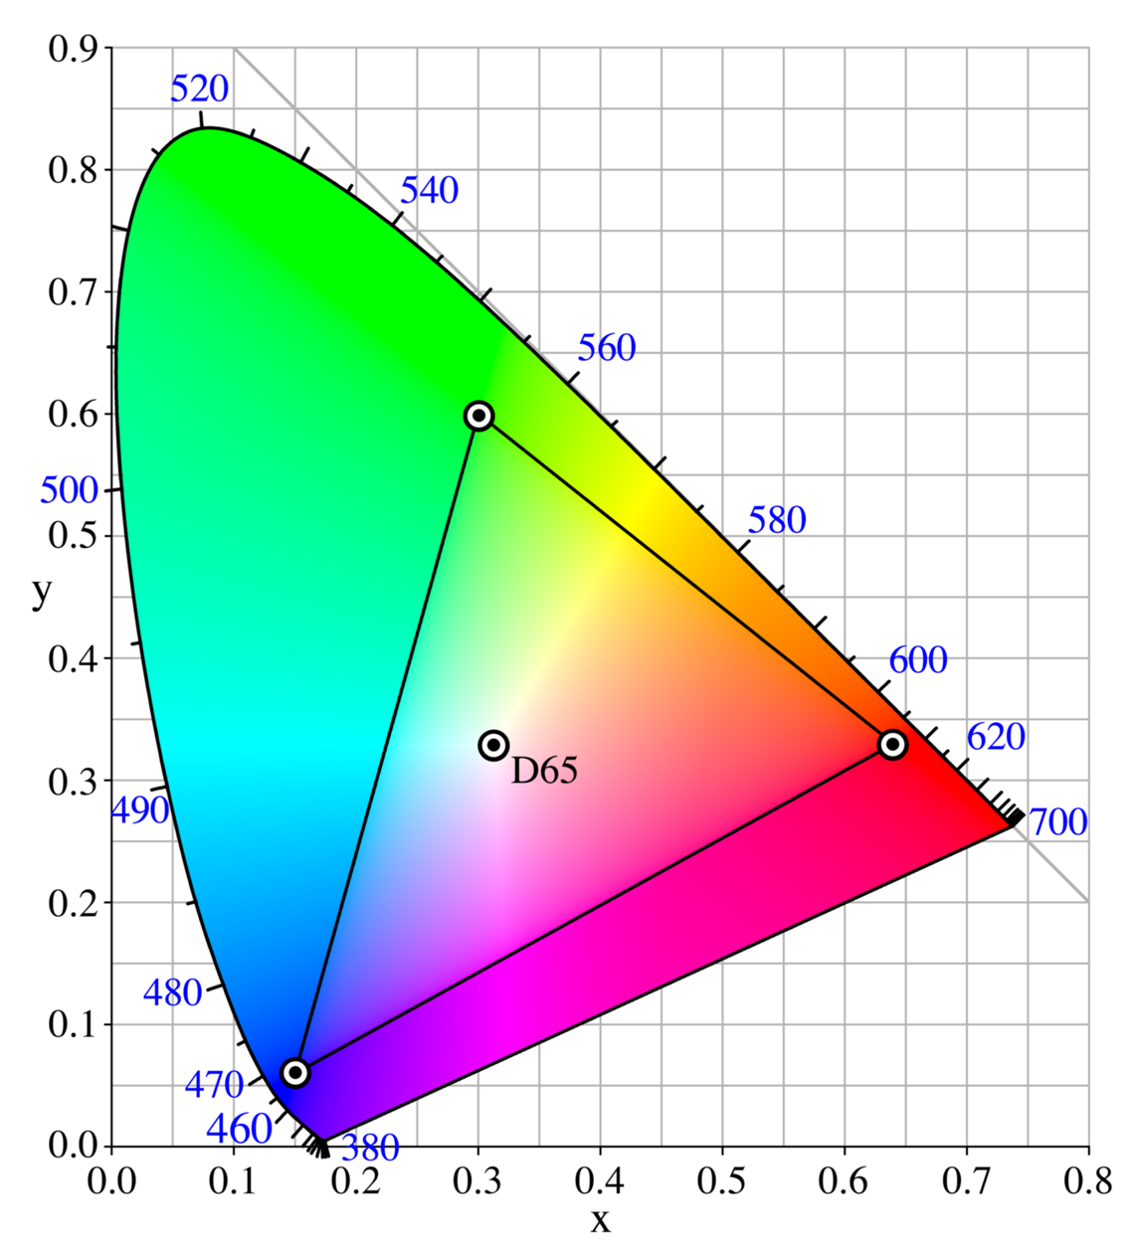
sRGB vs. NTSC vs. Laser

Slide 52


Slide 53


Slide 54
10-Bit XR Format
No change to hardware required/expected
  Driver change only
Mode changes
SetGammaRamp()
SetCursorImage()
Range covers gamut of human vision
  [-0.75 to 1.25] in sRGB is [-0.5 to 1.5] linear
Efficient extended range gamut for mobile

Slide 55
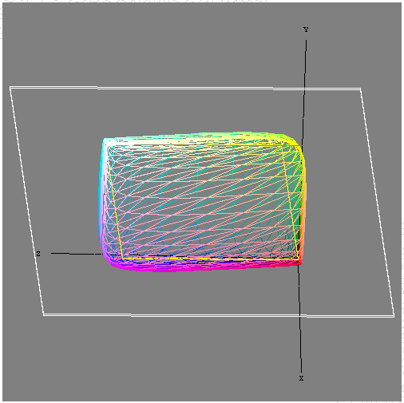
10-Bit XR Gamut In XYZ Space

Slide 56
10-Bit XR Encoding

Slide 57
Highest (48-Bit) Float16
This now assumes a linear encoding
  Same primaries, white point as sRGB
  Linear: gamma = 1.0 (as in scRGB)
  Range [-32K..32K]
Supports all above application scenarios
Plus support for HDR monitors
  New devices capable of >25× overbright
Never have to deal with gamma or clipping again!
  “Float16 is the new ‘byte’

Slide 58
The Color Pipeline
‘Automatic’ color correction
Application reads HighColor content
  WIC file convertors
All content assumes sRGB Primaries and γ
  No profile needs to be applied
  XR content may have values outside [0..1]
Application displays high-color content
in full screen view
  Live Photo Gallery: 10-bit/fp16 preview
  Screensaver 8-bit sRGB and 10-bit XR

Slide 59
Color Pipeline – Scan-Out
GPU scans out framebuffer
  8-bit – as today
  10-bit sRGB – as today
  10-bit XR – bias and scale gamma ramp
  16-bit float – apply gamma correction
For HDMI 1.3 – does colorspace conversion
  Convert to Yuv
  Rescale [0..1] to [16-235] without clamping
  Emit as xvYcc
  Can use video overlays

Slide 60
Color Pipeline – Scan-Out
Can use high color formats in:
  Full screen exclusive mode
Or video overlays
  Now available per-window in Windows 7
  Format is opaque to OS
  Could be xvColor directly
  Or use 10-bit XR if blending/compositing

Slide 61
Color Pipeline – Scan-Out
Display is high-gamut, but cannot convert
  E.g., integrated panel in laptop
  Low-end monitor with large gamut
GPU must convert
  Add color conversion unit for scan-out
  Degamma, 3×3 fp16 matmul, re-gamma
  Emit via std DVI, DP, LVDS, etc.
  This is a new hardware request

Slide 62
Call To Action
Ship displays with higher bit depth & color gamut
  LED and WG-CCFL backlights
  Laser, OLED, Plasma, etc.
  Applications can use them if EDID is right!
Provide accurate information in EDID
  Absolute white point, absolute black point, gammas, and primaries
Provide robust support for monitor control
  Brightness, contrast, gamma, white point, and color saturation via ACPI, DDC/CI, MCCS, etc.
  Reliable programmatic control of display state will become even more vital over time

Slide 63
Asks For Partners
Participate in standards like DisplayPort
PCs should at least keep pace with CE
  If not drive standards ahead
IHV Driver Writers: If you touch display gamma, be sure to save and restore unless the user commits to the new gamma

Slide 64
Additional Resources
Web resources
  Video Electronics Standard Association (VESA): http://www.vesa.org
  DisplayPort web site: http://www.displayport.org
  HDMI web site: http://www.hdmi.org
  Windows white papers: http://www.microsoft.com/whdc/display
  DirectX SDK: http://msdn.microsoft.com/directx
Related sessions
  High Dots-Per-Inch: The Key To Readability GRA-T582
  (presented earlier)
  Next talks in this room:
  Working With The Windows 7 Graphics Architecture GRA-T584
  Video Improvements In Windows 7 GRA-T585

Slide 65



Please Complete A Session Evaluation Form
Your input is important!
Visit the WinHEC CommNet and complete a Session Evaluation for this session and be entered to win one
of 150 Maxtor® BlackArmor™ 160GB External Hard Drives
50 drives will be given away daily!
http://www.winhec2008.com
BlackArmor
Hard Drives provided by:

Slide 66


© 2008 Microsoft Corporation. All rights reserved. Microsoft, Windows, Windows Vista and other product names are or may be registered trademarks and/or trademarks in the U.S. and/or other countries.
The information herein is for informational purposes only and represents the current view of Microsoft Corporation as of the date of this presentation. Because Microsoft must respond to changing market conditions, it should not be interpreted to be a commitment on the part of Microsoft, and Microsoft cannot guarantee the accuracy of any information provided after the date of this presentation.
MICROSOFT MAKES NO WARRANTIES, EXPRESS, IMPLIED OR STATUTORY, AS TO THE INFORMATION IN THIS PRESENTATION.

