Slide 2
Windows Media Center
The best experience for TV
Mike Seamons
Product Marketing Director
Connected TV Division

Slide 3
Windows Media Center Consumer Scorecard
180M Windows Vista licenses
7M unique
monthly users
70% TV feature usage
 | WMC in Windows Vista | Hulu | ABC.com
Unique users/month | 7,100,000 | 9,779,000 | 3,972,000
Minutes/visit | 85.7 | 50 | 36
Total minutes/month | 2,500,000,000 | 489,000,000 | 143,000,000
Microsoft Internal Data and CommScore July 2008

Slide 4
Windows Media Center Consumer Personalities
 | Digital Media mainstreamer | Consummate movie streamer | Media maven
Gender | 39% male, 61% female | 50% male, 50% female | 34% male, 66% female
Age | Average age: 44.05, with slightly more being 35 to 44 | Average age: 39.5, with significantly more being 25 to 34 | Average age: 40.71, with more being 25 to 44
Income | $69K | $72K | $72K
Household status | 18% single 61% married 37% with kids in household | 21% single 62% married 47% with kids in household | 17% single 62% married 49% with kids in household
Computer hardware spending per year | $250 | $350 | $500
Personality traits | Witty, wise/rationale, friendly, open minded, confident, efficient, tech-savvy, info seekers, organizers, planners | Confident, innovative, info seeker, trend setter, social/friendly, risk taker, aggressive, adventurous | Artistic, intellectual, carefree/free-spirited, tech-savvy, adventurous confident, impulsive
Internet versus TV | 97% spend more time on the Internet than on the TV, but 52% spend more than 16 hours a week watching TV When watching TV on the computer, 70% say that it is their main focus. | 98% spend more time on the Internet than on the TV, but 57% spend more than 16 hours a week watching TV. When watching TV on the computer, 61% say that it is their main focus. | 99% spend more time on the Internet than on the TV, but 47% spend more than 16 hours a week watching TV. When watching TV on the computer, 72% say that it is their main focus.
DVR Traits | 22% prefer to watch TV on their DVR so they can watch it on their own schedule 39% (top box) are interested the DVR feature of Windows Media Center | 22% prefer to watch TV on their DVR so they can watch it on their own schedule 42% (top box) are interested the DVR feature of Windows Media Center | 27% prefer to watch TV on their DVR so they can watch it on their own schedule 50% (top box) are interested the DVR feature of Windows Media Center
Microsoft Internal Habits and Practices Study 2008

Slide 5
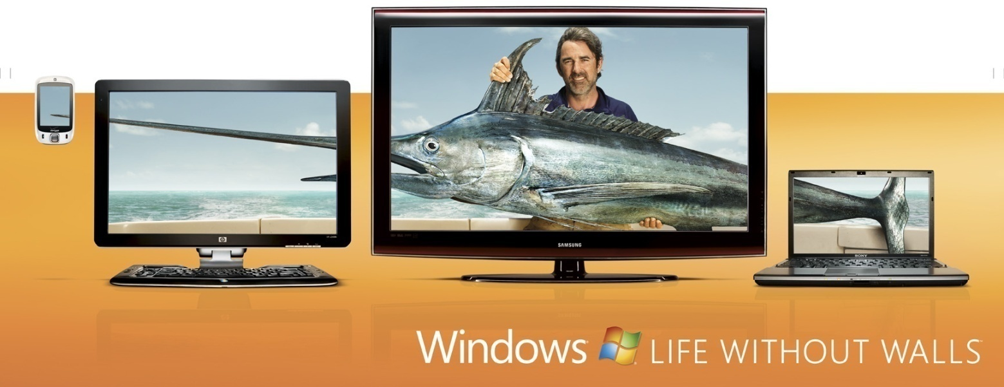
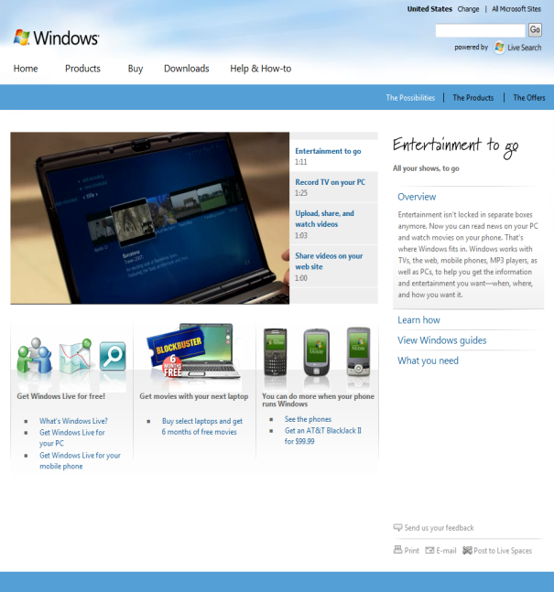
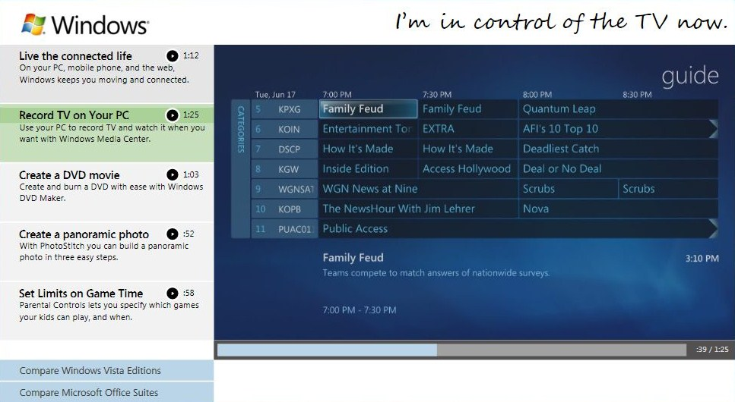
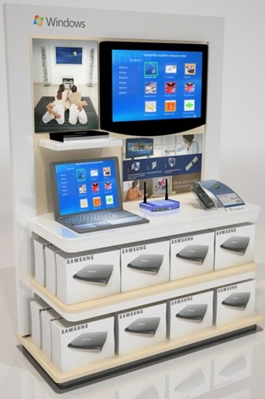
Windows Media Center Consumer Marketing

Slide 6
Consumer Trends – Laptops
Worldwide home PC shipments – Desktop versus laptop, FY06 – FY11
IDC PC Tracker Sept 07

Slide 7
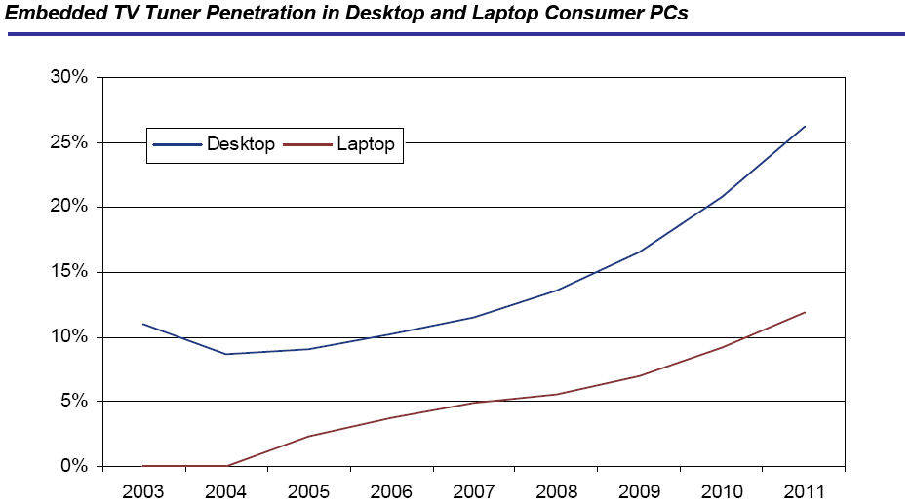
Consumer Trends – TV Tuners
PC TV Tuner Market Outlook, ABI Research 2007

Slide 8
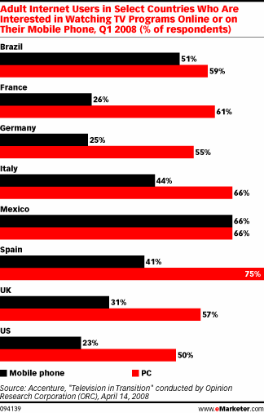
Consumer Trends – OTT Video
The PC is becoming a “TV screen” where users seek to consume
TV content whenever and wherever they choose.
The PC as a secondary TV screen for the
mass market
14% of the U.S. television population report viewing a full-length TV episode online in 2008
70% of online TV users are doing so to catch-up
on TV they missed on the main screen in their living room
The PC as the only TV screen for younger demos
80% of 13–24 year olds in U.S. say that their PC
has become more of an entertainment device
than their TV
57% of gen Yers 57 go online while watching TV, compared with 37% of the general population
53% of users under 25 do not believe they will
use traditional pay-TV to get full-length
TV programming

Slide 9
Evolution Of Windows Media Center
Dorm PC
Living room PC
Extender
TV on your PC
WebTV

Slide 10

Anyone | Anytime | Anywhere

Slide 11
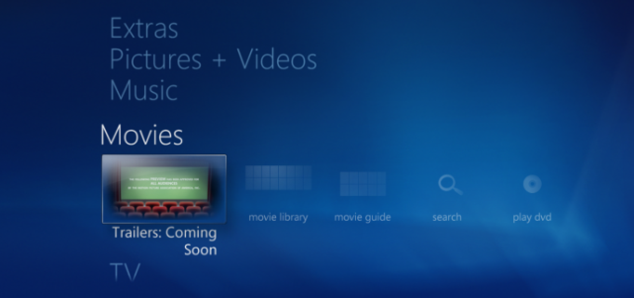
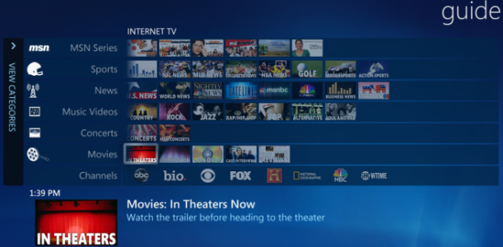
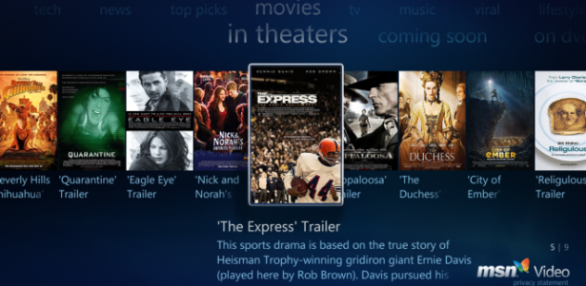
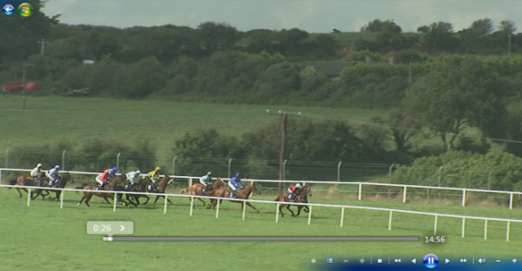
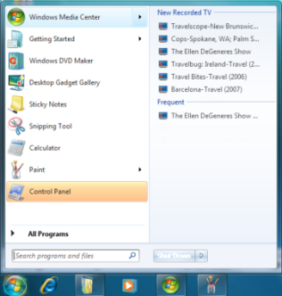
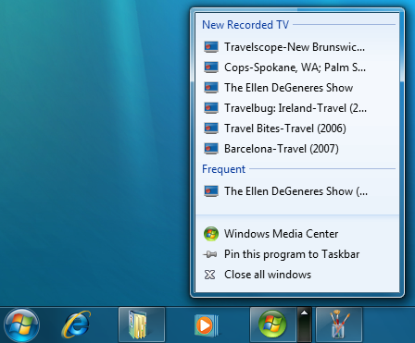
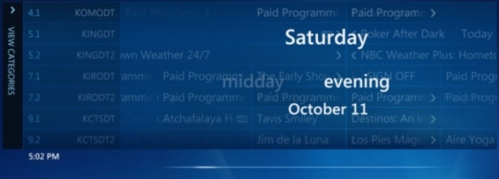


TV For Anyone
My guide to Internet TV
Multiple providers over broadband
One place for playback
Start menu, taskbar, gadget, TurboScroll, and seek

Slide 12
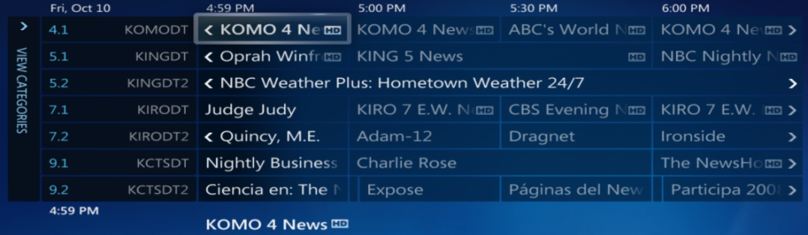
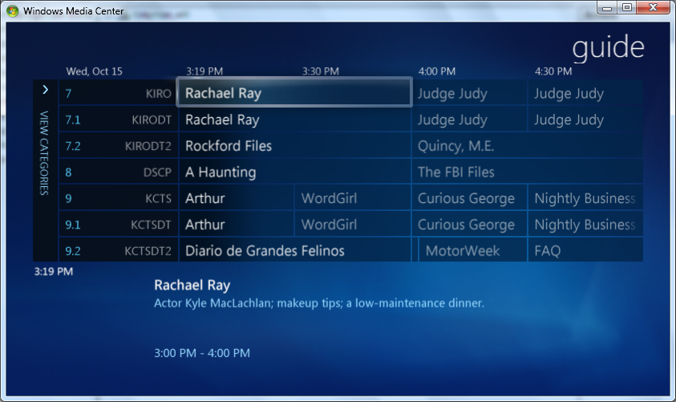
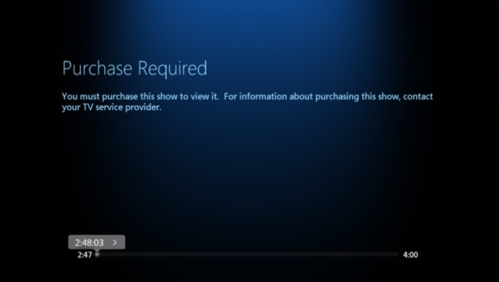
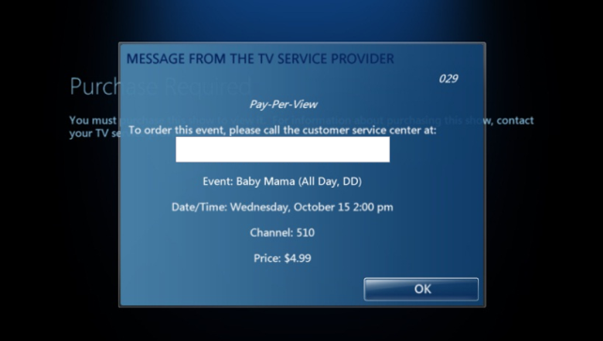
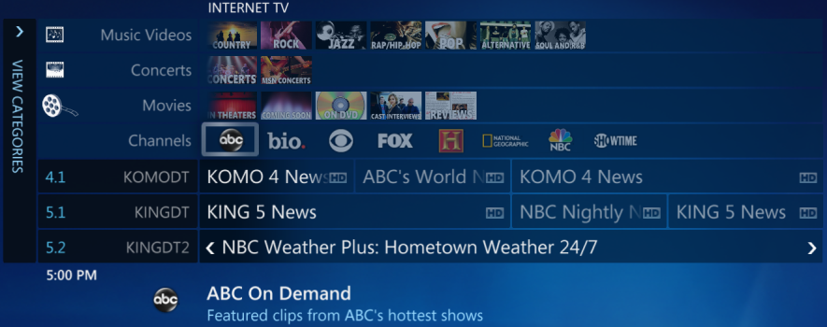
TV Anytime
My PC is my DVR
Live News, Live Sports, HD TV | QAM, DVB-T/S, ISDB-T/S | Heterogeneous tuner support in Win7
Pay and proprietary TV services
OTT subscriptions, PBDA
Single guide for broadband and broadcast

Slide 13
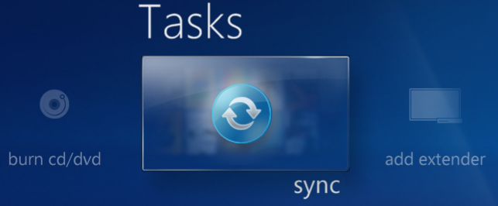
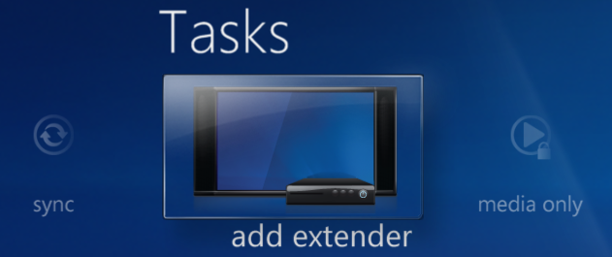

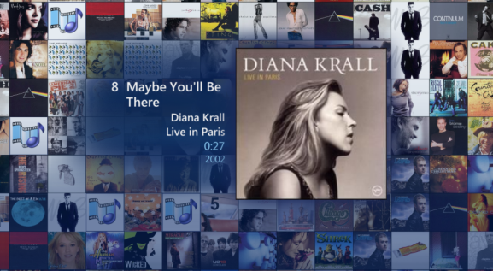
TV Anywhere
Home group with Copy To
Extenders and mobile devices
Pictures and music mosaic

Slide 14
Call To Action
Broadband content partners
  Give us your content metadata
TV tuner partners
  WHQL tuner drivers on Windows update
  Simplify your OOB materials
  Utilize PBDA and Pay TV technologies
OEM partners
  Create entertainment enhanced laptops

Slide 15
Additional Resources
Web resources
  http://www.windows.com
  http://www.windowsmediacenter.com
Related sessions
  Today @ 9:45 AM: GRA-T601 - Perspectives on the
  Windows TV Tuners Ecosystem
  Today @ 11:00 AM: GRA-T597 - Protected Broadcast Driver Architecture in Windows 7
  Today @ 2:30 PM: GRA-T600 - Overview of TV Tuners and
  Remotes Logo Program

Slide 16



Please Complete A Session Evaluation Form
Your input is important!
Visit the WinHEC CommNet and complete a Session Evaluation for this session and be entered to win one
of 150 Maxtor® BlackArmor™ 160GB External Hard Drives
50 drives will be given away daily!
http://www.winhec2008.com
BlackArmor
Hard Drives provided by:

Slide 17


© 2008 Microsoft Corporation. All rights reserved. Microsoft, Windows, Windows Vista and other product names are or may be registered trademarks and/or trademarks in the U.S. and/or other countries.
The information herein is for informational purposes only and represents the current view of Microsoft Corporation as of the date of this presentation. Because Microsoft must respond to changing market conditions, it should not be interpreted to be a commitment on the part of Microsoft, and Microsoft cannot guarantee the accuracy of any information provided after the date of this presentation.
MICROSOFT MAKES NO WARRANTIES, EXPRESS, IMPLIED OR STATUTORY, AS TO THE INFORMATION IN THIS PRESENTATION.

