Slide 2
Overview Of TV Tuner And Remote Control Logo Programs
Ed Keith, Test Lead
Mathew Bockus, Program Manager
Microsoft Corporation

Slide 3


Logo Types
System
OEM
Device
Retail
Windows update

Slide 4
Why Logo Your TV Solution?
Lower your support costs
Increase end user satisfaction
  A retail card works out of the box
Logos help grow the ecosystem and increase its health
869 tuner and remote logos granted since January 2006!

Slide 5
Logopoint
A means to jointly develop standards
Ideas are generated
New requirements are published
Feedback from industry is
reviewed weekly
Preview content is implemented
and shipped

Slide 6
Logoable Broadcast Standards
Available now
Added to next Logo Kit
ATSC
NTSC_M_J
DVB-C
ISDB-S
DVB-T
PAL
DVB-S
QAM
ISDB-T
SECAM
NTSC

Slide 7
New Preview Content
Jointly developed with partners
In the next release of the Windows Logo Kit
Includes
  PBDA
  Resume from hibernate
  Uptime
  Multiple channel changes
  Hybrid and combo implementation and runtime
  Device surprise-removal

Slide 8
Tuner Logo Troubleshooting
New tools for the logo kit
MCDiag
  Collects all logs in one file
    Windows update download
    Driver installation
    TV tuner pipeline diagnostics
  Rich system snapshot
    Devices installed
Automated Windows TV test suite
  Enable partners to reproduce issues found at Microsoft
  Allow partners to supplement their existing test suites

Slide 9
Remote Control And IR Receiver Logo Updates
Mathew Bockus
Program Manager
Microsoft Corporation

Slide 10
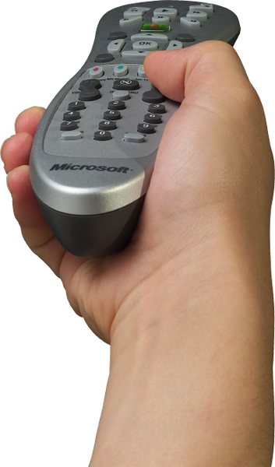
Focus Of Logo Changes
Logo updates
Addressing worldwide needs
Driver robustness
Improve usability
for consumers
Maintain backwards
compatibility

Slide 11
Remote Control
Logo updates
No new requirements but more options
  Microsoft SMK Quatro Pulse (QP) IR protocol
  Button labeling
  New optional buttons
  How TV standards affect remote design

Slide 12
Remote Control
Test updates
No change in how tests are run
Fixed self test for troubleshooting
Now reports remote control protocol type
  Added QP support

Slide 13
IR Receiver
Logo updates
New requirements
  Support the version 2 Device Driver Interface (DDI)
  Wake from both Microsoft RC6 and
  Microsoft SMK QP IR protocols
  One emitter per analog tuner
Optional updates
  No IR emitter required on laptops
  Additional non-consumer IR(HID) code support

Slide 14
IR Receiver
Test updates
Version 2 DDI support
  Windows 7 logo must be v2 capable devices
  Tests are based on reported capabilities instead of device type
Support for Microsoft SMK QP Protocol
Device reliability tests
Test execution improvements

Slide 15
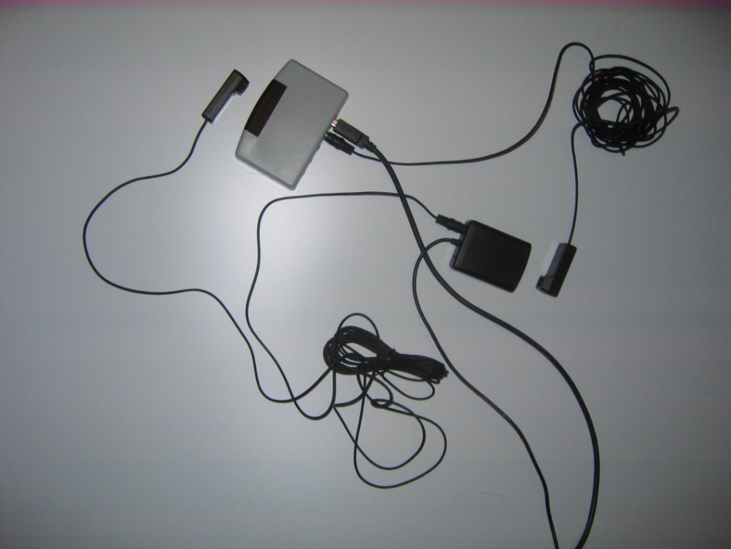
Receiver Logo Troubleshooting
Logo’ed device to use as control device
Strong IR emitter
Placement of IR emitter

Slide 16


Remote Control/Receiver
Documentation
One document!
  The Windows Media Center remote control and receiver-transceiver specification

Slide 17
Call To Action
Participate in
logo requirement definitions
Expand the ecosystem
  Logo devices and post to Windows update
  Start building v2 IR receivers

Slide 18
Additional Resources
Logo resources
  Review and comment on requirements
    http://www.microsoft.com/whdc/winlogo/hwrequirements.mspx
  Download and run the logo tools
    http://www.microsoft.com/whdc/winlogo/default.mspx
  WinQual - Submit device for logo and post on Windows update
    https://www.winqual.microsoft.com
Related sessions
  COR-T519: Windows Logo Program Update
  COR-T520: Windows Logo Program Tools: Overview and Directions
  COR-T526: Improving Driver Quality Through Testing

Slide 19
Additional Resources
Today’s related sessions
  GRA-T601 (9:45 AM): Perspectives on the Windows TV Tuners Ecosystem
  GRA-T598 (11:00 AM): Protected Broadcast Driver Architecture in Windows 7
  GRA-C665 (1:00 PM): Windows Media Center Chalk Talk with the Experts
  GRA-T600 (2:30 PM): Overview of TV Tuners & Remotes Logo Program
Web resources
  Specifications, white papers, developer toolkits, and other information http://www.microsoft.com/whdc/device/broadcast/bda/default.mspx
  Windows media for professionals
  http://www.microsoft.com/windows/windowsmedia/forpros/default.mspx

Slide 20
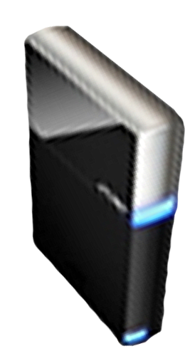


Please Complete A Session Evaluation Form
Your input is important!
Visit the WinHEC CommNet and complete a Session Evaluation for this session and be entered to win one
of 150 Maxtor® BlackArmor™ 160GB External Hard Drives
50 drives will be given away daily!
http://www.winhec2008.com
BlackArmor
Hard Drives provided by:

Slide 21


© 2008 Microsoft Corporation. All rights reserved. Microsoft, Windows, Windows Vista and other product names are or may be registered trademarks and/or trademarks in the U.S. and/or other countries.
The information herein is for informational purposes only and represents the current view of Microsoft Corporation as of the date of this presentation. Because Microsoft must respond to changing market conditions, it should not be interpreted to be a commitment on the part of Microsoft, and Microsoft cannot guarantee the accuracy of any information provided after the date of this presentation.
MICROSOFT MAKES NO WARRANTIES, EXPRESS, IMPLIED OR STATUTORY, AS TO THE INFORMATION IN THIS PRESENTATION.

Slide 22
Logopoint IDs
Available now
Added to next Logo Kit
Stream-0010
Stream-0011
Stream-0012
Stream-0014
Stream-0015
Stream-0016
Stream-0017
Stream-0021
Stream-0024
Stream-0025
Stream-0028
Stream-0029
Stream-0056
Stream-0057
Stream-0060
Stream-0061
Stream-0062
Stream-0063
Stream-0064
Stream-0065
Stream-0066
Stream-0067
Stream-0068
Stream-0069
Stream-0070
Stream-0071
Stream-0072
Stream-0073
Stream-0074
Stream-0076
Stream-0077
Stream-0078
Stream-0079
Stream-0080
Stream-0081
Tuners
Remotes
and
receivers
Input-0006
Input-0007
SysFund-0042
  Input-0045

