Slide 2
Perspectives On The Windows TV Tuners Ecosystem
Gunter Logemann
Tobi Zielinski
Program Managers
Microsoft Corporation

Slide 3
Agenda
Progress since Windows Vista
TV tuner landscape
Worldwide digital TV solutions in
Windows Media Center
Introduction to Protected Broadcast Driver Architecture (PBDA)
  Overview and value proposition
  Features and target applications
  Resources

Slide 4
Progress Since Windows Vista
Continued engagement with
industry partners
Worked on Windows Media Center platform strategy for broadcast TV
Shipped Windows Media Center
TV Pack 2008
  Delivered PBDA
  Support for new world-wide standards
Working on Windows 7

Slide 5
TV Tuner Landscape

Slide 6
TV Tuner Landscape
Move to digital terrestrial
Analog terrestrial switch off is underway with major markets completing in 2012
  Analog cable still relevant for key markets
The move to digital terrestrial broadcasts presents new challenges
  Additional services layered on the broadcast
  Pay TV or encrypted services on terrestrial

Slide 7
TV Tuner Landscape
Opportunities for TV on the PC
OEMs and IHVs
  Hybrid and combo tuners can ease
  the transition for free to air services
  Single consumer investment allows switching between free to air sources
Broadcasters and content providers
  The PC offers a great platform for integrating broadcast and broadband delivered content

Slide 8
TV Tuner Landscape
Hybrid/combo – definition
Combo tuner
Multiple independent physical devices with different standards
on one tuner card
Hybrid tuner
One physical device can be configured for different standards – sharing of the tuner, connectors, or other hardware parts that make only one stream possible
Analog
Tuner
TS output
Analog
Tuner
TS output
Digital
Tuner
TS output
Digital
TS: Transport Stream

Slide 9
TV Tuner Landscape
A new platform for new opportunities
Pay TV adds a layer of complexity, so…
A platform solution provides
big opportunities
  Single hardware scales to multiple solutions
    Additional requirements handled in software and drivers for the tuner
  Proprietary standards and broadcaster requirements can be met with a
  feature-rich platform

Slide 10
TV Tuner Landscape
PBDA for Windows Media Center
Empowers PC-TV ecosystem to build
tuners and integrate broadcast services
not natively supported by Windows
Media Center
Supersedes BDA as a worldwide solution
for digital TV within Windows Media Center including protected broadcast content
Provides a solution for Pay TV services
  More on this later…

Slide 11
Worldwide TV
Solutions In
Windows Media Center

Slide 12
Windows Media Center
Windows 7 – Overview
Key focus on providing a TV platform allowing customized solutions in Windows Media Center
  Enables the transition to digital
  Scalable and rich premium content story
  Allow the ecosystem to bring new TV Standards support
Enable optimized hardware to reduce cost
  Microsoft provided software MPEG 2 encoder
  Microsoft provided H.264 decoder

Slide 13
Windows Media Center
Windows 7 – TV features
Includes Windows Media Center TV pack 2008
features and
  H.264 support to enable HD content across all digital TV standards
  Framework for launching iTV applications
    MCML and alternative middle-ware style
  Japan
    ISDB-S support
    BML in recorded TV
  Europe
    DVB-S2 support

Slide 14
Windows Media Center
Windows 7 – Hybrid tuners
Heard demand from partners for a crossover solution
to bridge the analog/digital transition
  Offers flexibility to users without changing out hardware
Worked to enable shipping hardware solutions
that are in the market today
  Hybrid tuner implementation imposes no new hardware
  or driver requirements
  Windows Media Center recommends 1 digital + analog signal source per tuner
Worldwide tuner support

Slide 15
Protected Broadcast Driver Architecture
(PBDA)

Slide 16
Windows Media Center PBDA
What is PBDA?
Protected Broadcast Driver Architecture
Microsoft’s worldwide TV platform
for Windows Media Center
  Announced at IBC 2008
  Integrates broadcast TV services into
  Windows Media Center
  Free or premium (encrypted) TV services
PBDA license covers tuner development
  Builds on existing BDA investment

Slide 17

Windows Media Center PBDA
History of PBDA
1995
Windows Driver Model
2008+
Protected Broadcast
Driver Architecture (PBDA)
2001
Broadcast Driver Architecture (BDA) in
Windows XP MCE v1
  Empowers PC-TV ecosystem to build tuners and integrate any broadcast service which WMC does not support out-of-the-box
  Adds to BDA a worldwide solution for
  flow of protected broadcast content
  Connection type agnostic (PCIe, USB, IP, …)
  Standardizes crypto APIs (i.e. simpler hardware development and software integration)
  Uses industry-approved WMDRM
  Supports license management by device or
  by Windows Media Center
  Generalizes DRI (i.e. broadcast network and
  CA independent)
Clear Analog
2007
Digital Receiver Interface (DRI) in Windows Vista

Slide 18
Windows Media Center PBDA
Key features
Premium and pay TV content on the PC
Extensible tuning model
Extensible first run experience
Flexible electronic program guide
Parental controls
IP Proxy through the PC
Messages (MMI)
Branding opportunities for broadcasters

Slide 19
Windows Media Center PBDA
Content protection
Possible, but not required
Allows operators to provide the richness of
Windows Media Digital Rights Management (WMDRM)
to their CA protected content
  License expiration
  License renewal and revocation
  Flexible output protection
  Export capabilities
  Copy count
Requires WMDRM development license

Slide 20
Windows Media Center PBDA
Scenarios
Existing implementations
  ISDB-T in Windows Media Center TV pack 2008
Possible Implementations
  Satellite Pay TV
  DVB-C
  Free-to-consumer digital terrestrial
    Geographies not natively supported by
    Windows Media Center – ex. DTMB in China
  Etc…

Slide 21


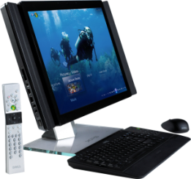

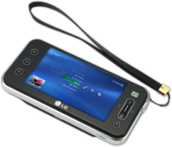
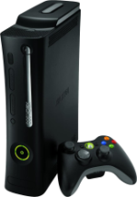
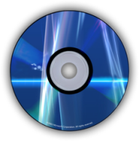
Windows Media Center PBDA
Data flow
Tuner
DRM, Guide Data
Demodulator
Windows Media Center PC
CA⁻¹
WMDRM
Capture
.WTV
Playback
Optional

Slide 22
Windows Media Center PBDA
Scaling solutions
Full implementation
2nd implementation
Services
Required
Optional
Tuner
MUX
Scanning
CAS
GDDS
Implemented
DRM
Debug
3rd implementation
Omitted
Eventing
LBIGS
Encoder
GPNVS
…
Reuse of assets, flexibility to solutions, shortened time to go to market

Slide 23






Windows Media Center PBDA
Partners announced at IBC

Slide 24
Call To Action
Adopt digital TV formats
Embrace PBDA for your Windows Media Center digital TV solutions
  Get the PBDA specification
  License the Windows Media Digital Rights Management porting kit
  Develop your PBDA capable tuners
Engage now to be ready for Windows 7

Slide 25
Additional Resources
Today’s related sessions
  GRA-T598 (11:00 AM): Protected Broadcast Driver Architecture in Windows 7
  GRA-C665 (1:00 PM): Windows Media Center Chalk Talk with the Experts
  GRA-T600 (2:30 PM): Overview of TV Tuners and Remotes Logo Program
Web resources
  Specifications, white papers, developer toolkits, and other information http://www.microsoft.com/whdc/device/broadcast/bda/default.mspx
  Windows Media for professionals
  http://www.microsoft.com/windows/windowsmedia/forpros/default.mspx
Email us your questions to tvpbda@microsoft.com

Slide 26
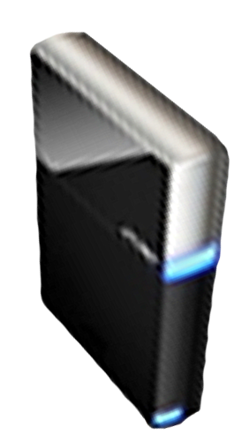


Please Complete A Session Evaluation Form
Your input is important!
Visit the WinHEC CommNet and complete a Session Evaluation for this session and be entered to win one
of 150 Maxtor® BlackArmor™ 160GB External Hard Drives
50 drives will be given away daily!
http://www.winhec2008.com
BlackArmor
Hard Drives provided by:

Slide 27


© 2008 Microsoft Corporation. All rights reserved. Microsoft, Windows, Windows Vista and other product names are or may be registered trademarks and/or trademarks in the U.S. and/or other countries.
The information herein is for informational purposes only and represents the current view of Microsoft Corporation as of the date of this presentation. Because Microsoft must respond to changing market conditions, it should not be interpreted to be a commitment on the part of Microsoft, and Microsoft cannot guarantee the accuracy of any information provided after the date of this presentation.
MICROSOFT MAKES NO WARRANTIES, EXPRESS, IMPLIED OR STATUTORY, AS TO THE INFORMATION IN THIS PRESENTATION.

