Slide 2
GPU Performance And GPU/CPU Interactions In Windows 7
Steve Pronovost
Principle Development Lead
Microsoft Corporation

Slide 3
CPU And GPU Threading
Many performance issue are the results of inefficient threading between CPU cores and/or GPU engines
It is often hard to realize these problems exist using conventional performance tools
This is an area where Event Tracing for Windows (ETW) can provide critical information in understanding performance issues

Slide 4
ETW Traces
ETW traces (file with .ETL extension) are generated using the XPerf tools
ETL file may be view using various tools
  XPerf – Powerful general purpose analysis tools
  GPUView – Timeline view of a trace with emphasis on CPU/GPU interaction. Will be available with Windows 7 Beta SDK

Slide 5
GPUView Is One More Tools
GPUView doesn’t replace F1, IceCap, SPU, Vtune, PIX, GPU PerfStudio, NVPerfHUD…
GPUView’s strength is in CPU/CPU, CPU/GPU and GPU/GPU interaction
GPUView makes it easy to see if the CPU core and GPU engines are being threaded efficiently and if so where to look at next to improve performance

Slide 6
CPU Threading
CPU

Slide 7
Threading Basics
Main()
{
for (i=0; i<1000, i++)
{
DoSomething()
}
}
Start
End

Slide 8
Instrumentation
Main()
{
for (i=0; i<1000, i++)
{
DoSomething()
}
}
Main EntryTime
DoSomething ExitTime
Main ExitTime
DoSomething EntryTime
Main: 1000000cycles
DoSomething: 999000 cycles
Start
End

Slide 9
Sampling Analysis
Main()
{
for (i=0; i<1000, i++)
{
DoSomething()
}
}
Main: 0.1%
DoSomething: 99.9%
Start
DoSomething()
End

Slide 10
CPU Optimization
We want to reduce the time it takes to execute the task. We care about the absolute time between Start and End
F1, IceCap, SPU, Vtune allow us to drill down into the problem
  Change algorithm
  Use better instruction
  Reordering loop
  Be more mindful of cache misses
  …

Slide 11
Optimized Thread
Main()
{
for (i=0; i<100, i++)
{
DoSomething()
}
}
Start
End

Slide 12
Multi-tasking Environment
The threads being monitored for performance aren’t the only threads running on the system other threads or driver (ISR/DPC) might interfere
BadThread
MyThread
MyThread is preempted and not executing
Start
End

Slide 13
Device Interaction
A thread might interact with other thread or with a device and may be put into a wait state waiting for something to happen on another thread or device
GPU
MyThread
MyThread is waiting on GPU and not executing
Start
End

Slide 14
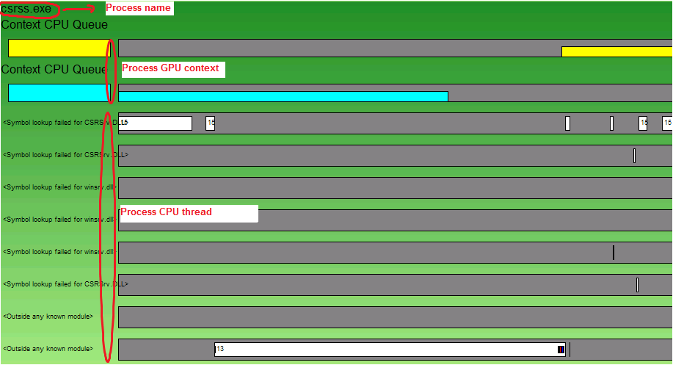
GPUView Process View

Slide 15
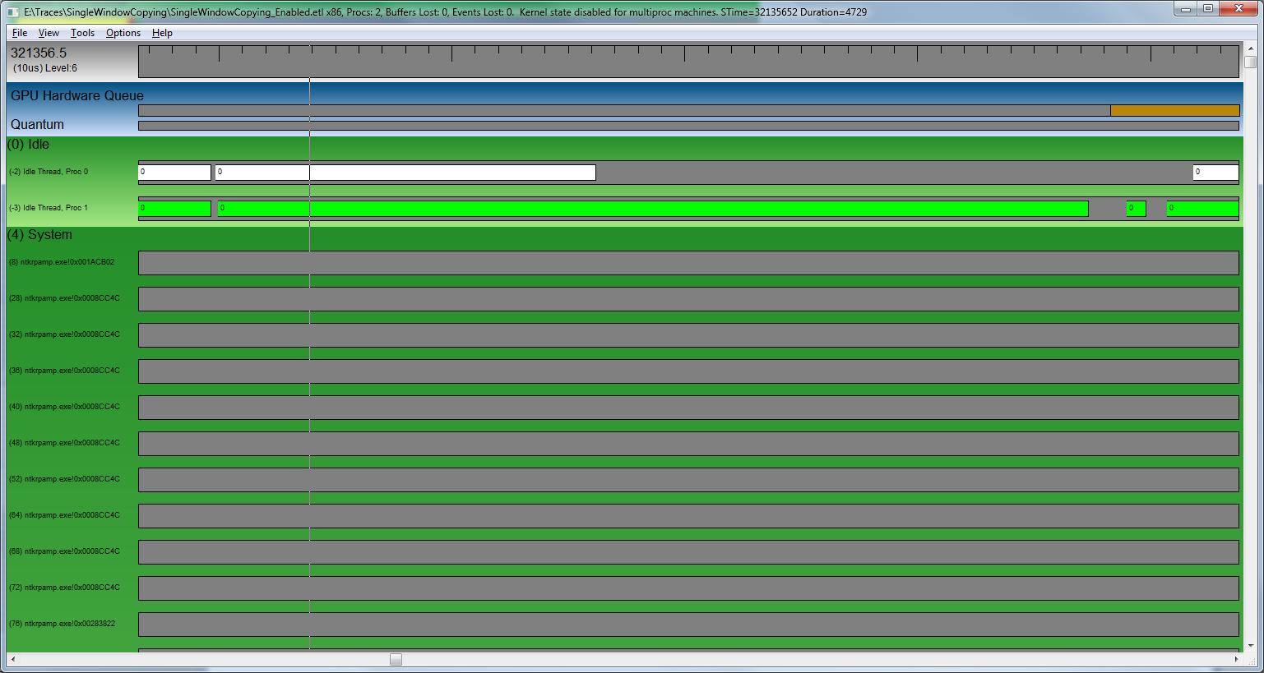
Idle Thread
Every CPU core execute a particular thread at any given time; When Idle, a core execute the idle thread

Slide 16
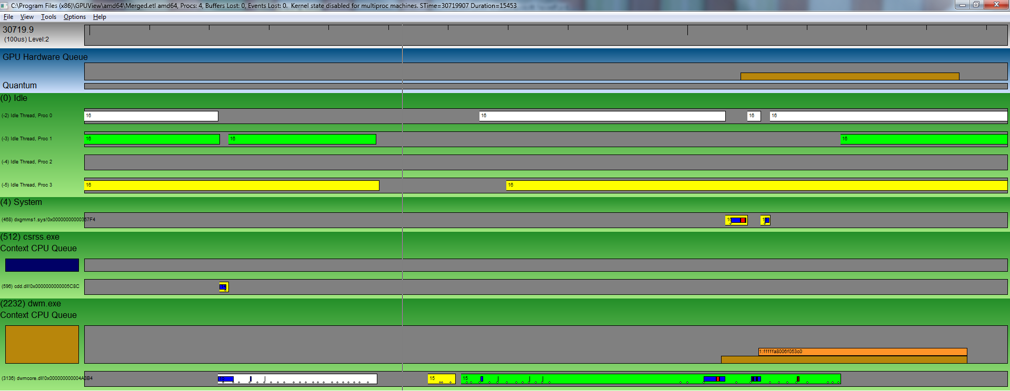
CPU Core
Every CPU core gets assigned a color, thread are colored from the core they are executing on

Slide 17
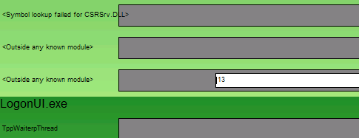
Thread Priority
The priority at which a thread segment is executing is displayed in the left portion of that segment; If the segment isn’t large enough, zoom in

Slide 18

Thread Execution
Thread segments are colored to
help identified what the thread is
currently doing
  Light blue: Thread in kernel mode
  (only if syscall events were enabled as tracing option, not available on MP system)
  Dark blue: Thread in dxgkrnl
  Red: Thread in KMD

Slide 19
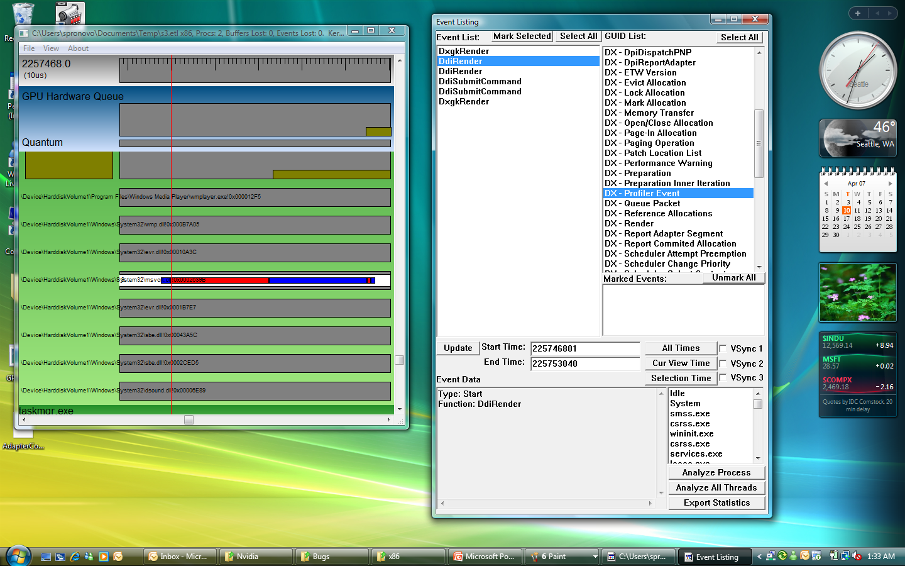
Thread Profiler Events

Slide 20
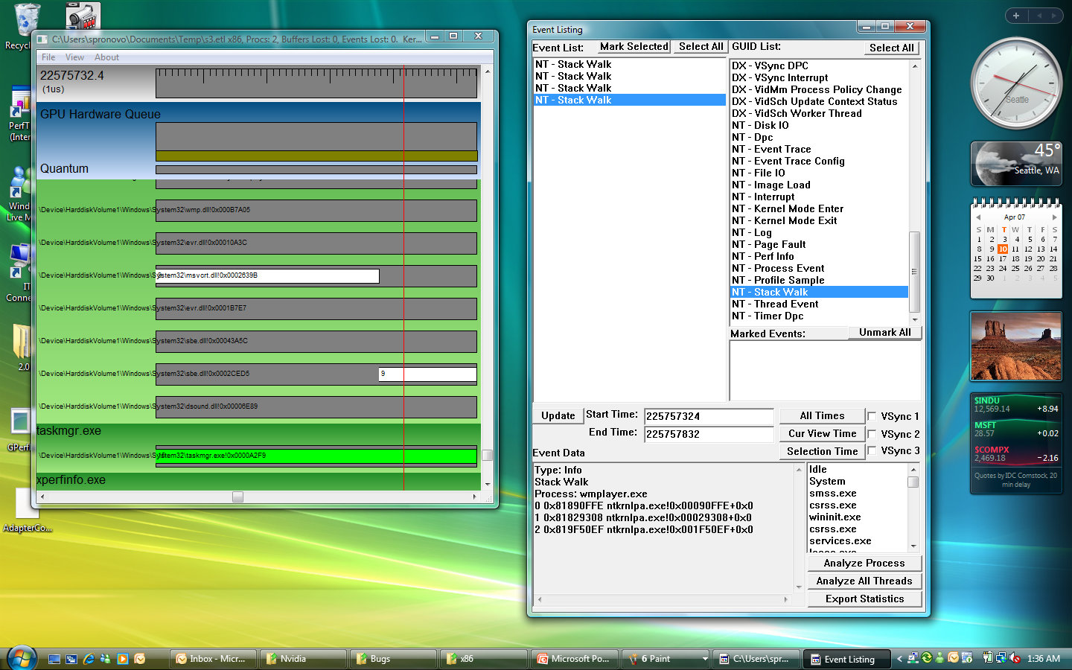
Context Switch Stack

Slide 21
Capturing ETW Trace And Basic Navigation
In GPUView
demo

Slide 22
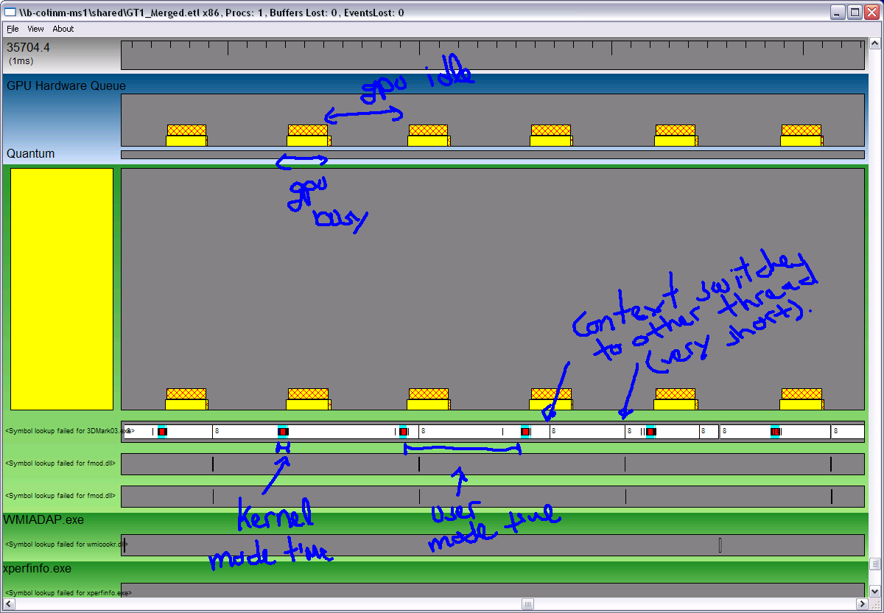
Example: CPU Bound Game

Slide 23
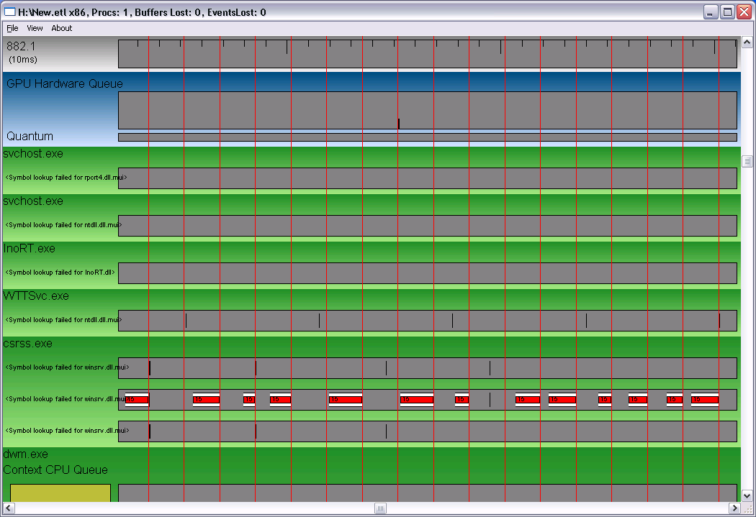
Example: Interference

Slide 24
GPU Threading
GPU

Slide 25
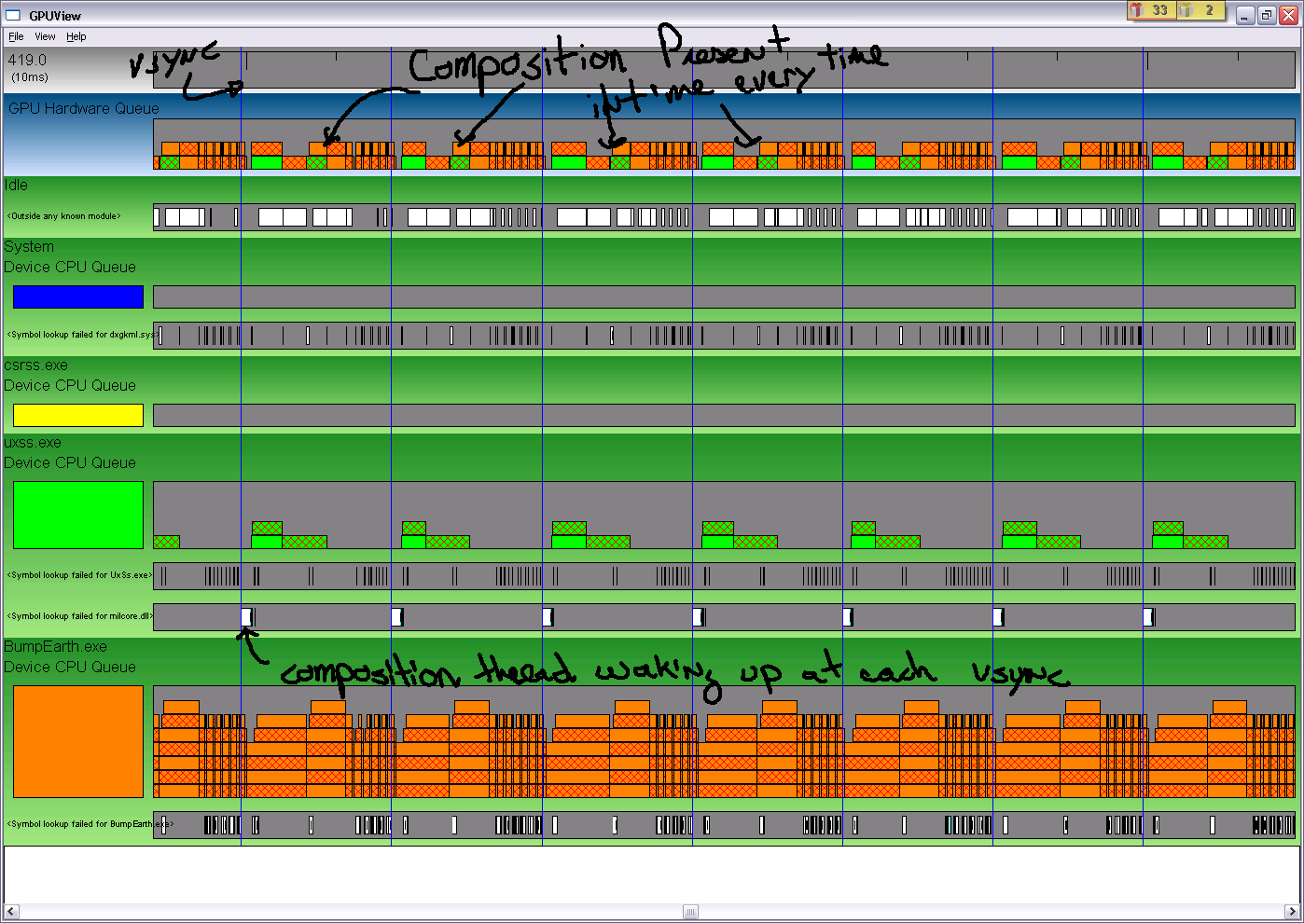
GPU Context And Engine Queue

Slide 26
Context Queue
The device queue (also referred to as the software queue or QueuePacket queue) represent the accumulation of work submitted by a process to a particular GPU Context
A process can have multiple GPU context (ex: Multi D3D Device, LDA, Video…)

Slide 27
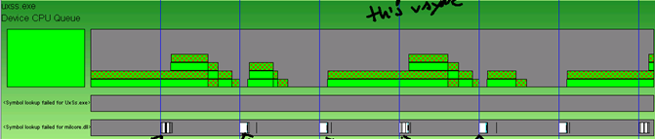
Context Queue
Queue is represented through time
as an histogram
On submission of work by the UMD the histogram grows up, on completion of work by the GPU the histogram goes down

Slide 28
Queue Packet
Various type of packet may be queued
  Orange: MMIO flip
  Diag-Cross Hatch: Present through DMA
  Cross Hatch: Deferred Command
  Light Pink: WaitForSynchronizationObject
  Dark Pink: SignalSynchronizationObject

Slide 29

MMIO Flip
Completion of the packet indicate the flip was pushed to the flip queue
Flips are dequeued from the flip queue:
  At VSYNC for synchronized flip
  Immediately for immediate flip
The content of the flip queue isn’t currently displayed by GPUView
Packet contain two pieces of information
  VidPnSource : PrimaryAllocationHandle

Slide 30
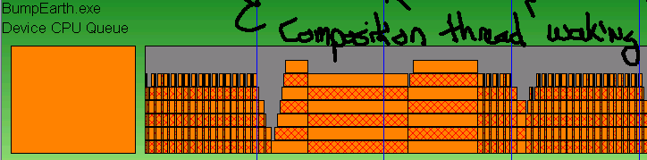
Present Through DMA
Three types of present through DMA
  DWM Redirection
  Blit to back buffer
  Immediate flip (through DMA)

Slide 31
Deferred Command
Mechanism used by VidMm to schedule work synchronously with a context execution; Ex:
  Handle complex lock
  Close allocation
You don’t usually have to worry
about those

Slide 32
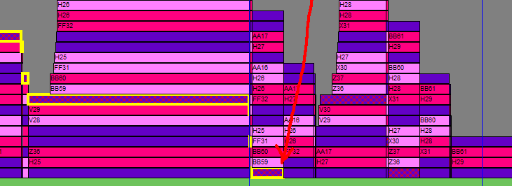
Synchronization Primitive
Packet inserted when UMD call Wait/SignalSynchronizationObject
Packet contain that allow pairing of Wait/Signal; Signal of A3 will unwait Wait of A3

Slide 33

GPU Engine Queue
Also referred as hardware queue or DMAPacket queue
Represent work (DMA Buffer) submitted to a particular GPU engine for execution
Each exposed engine has exactly ONE engine queue

Slide 34
DMA Packet
Various type of DMA packet may be submitted to the GPU
  Red: Paging
  Black: Preemption
  Diag-cross hatch: Present (through DMA)
  Other: DMA payload from QueuePacket

Slide 35
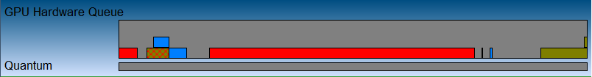
Paging Buffer
Submitted as a result of a paging operation
Cause of paging operation is usually the preparation of a DMA buffer; Look at the DMA packet following the paging operation
Some exception
  Pinning allocation
  Evict allocation as a result of a DxLock
  …

Slide 36
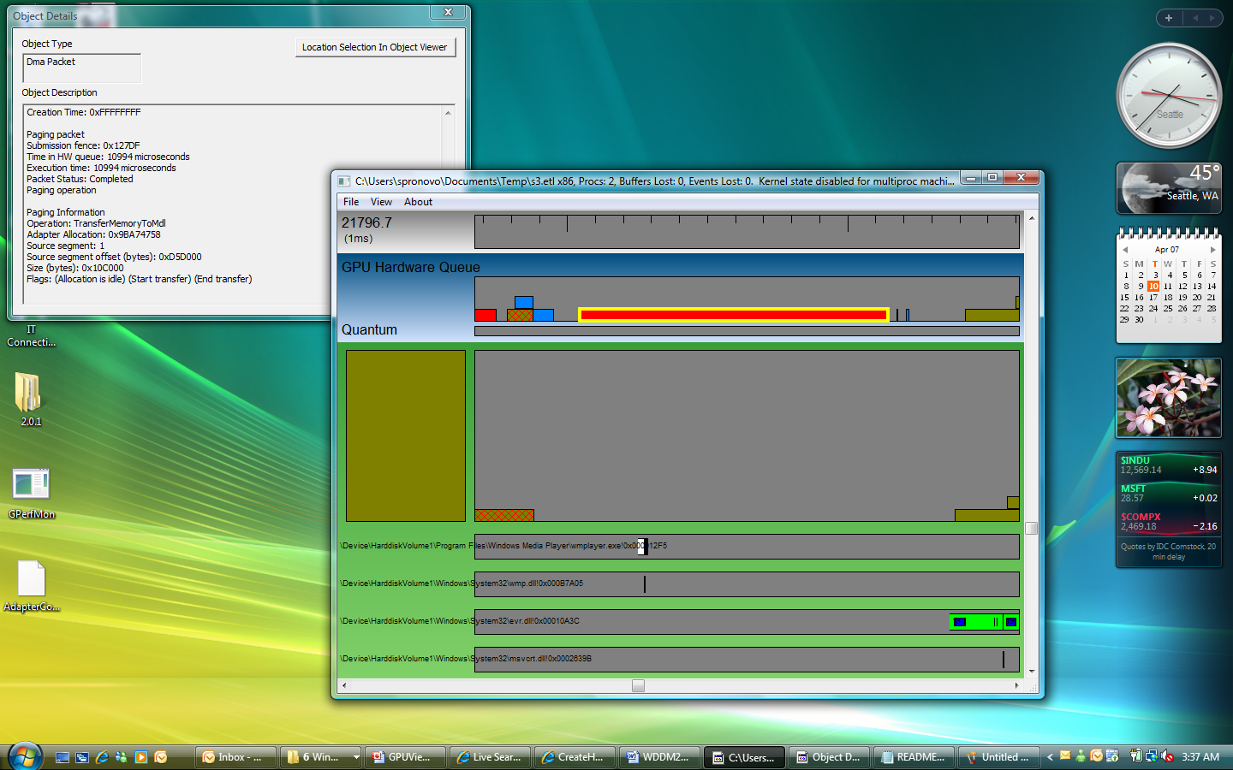
Paging Details

Slide 37
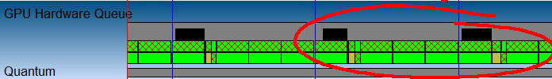
Preemption
Represent request by the schedule to preempt the DMA packet currently in the engine queue
Preemption request don’t have actual payload; Their completion indicate
GPU acknowledgement of the
preemption request

Slide 38
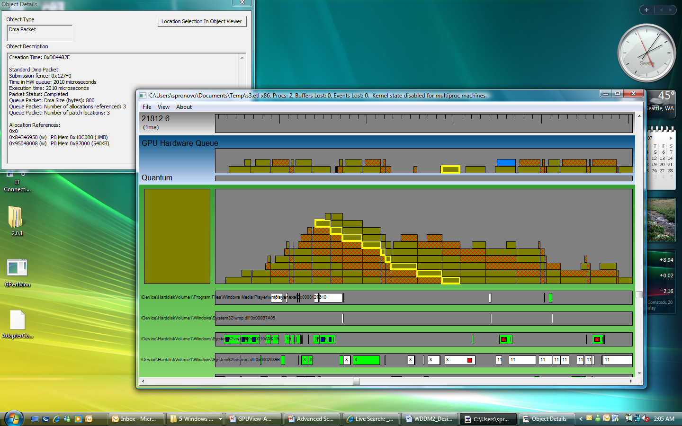
QueuePacket With DMA Payload

Slide 39
GPU Usage In GPUView
demo

Slide 40
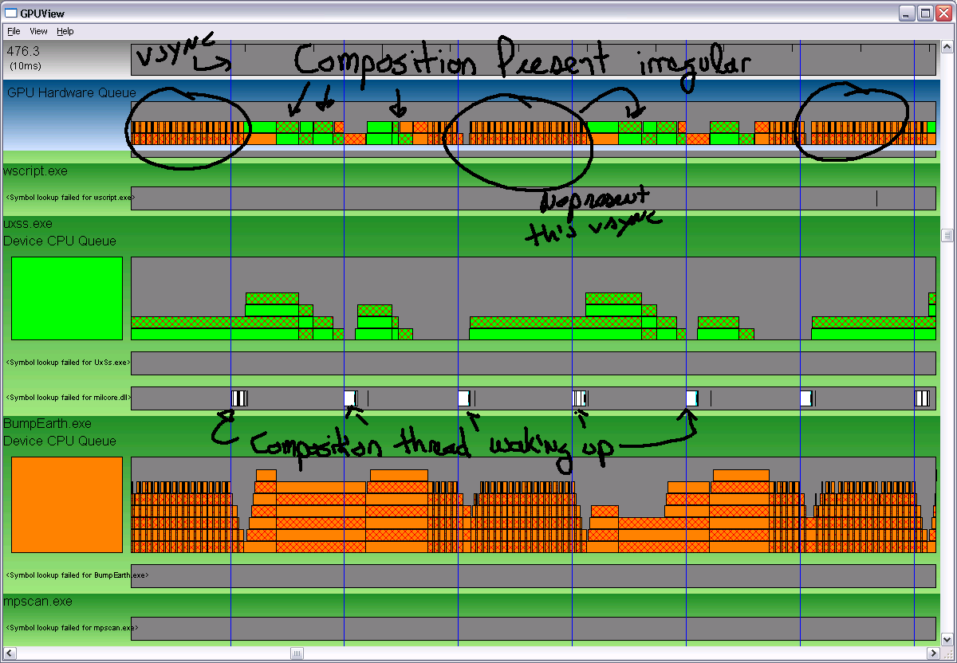
Ex: DWM Regular GPU Priority

Slide 41
Ex: DWM High GPU Priority

Slide 42
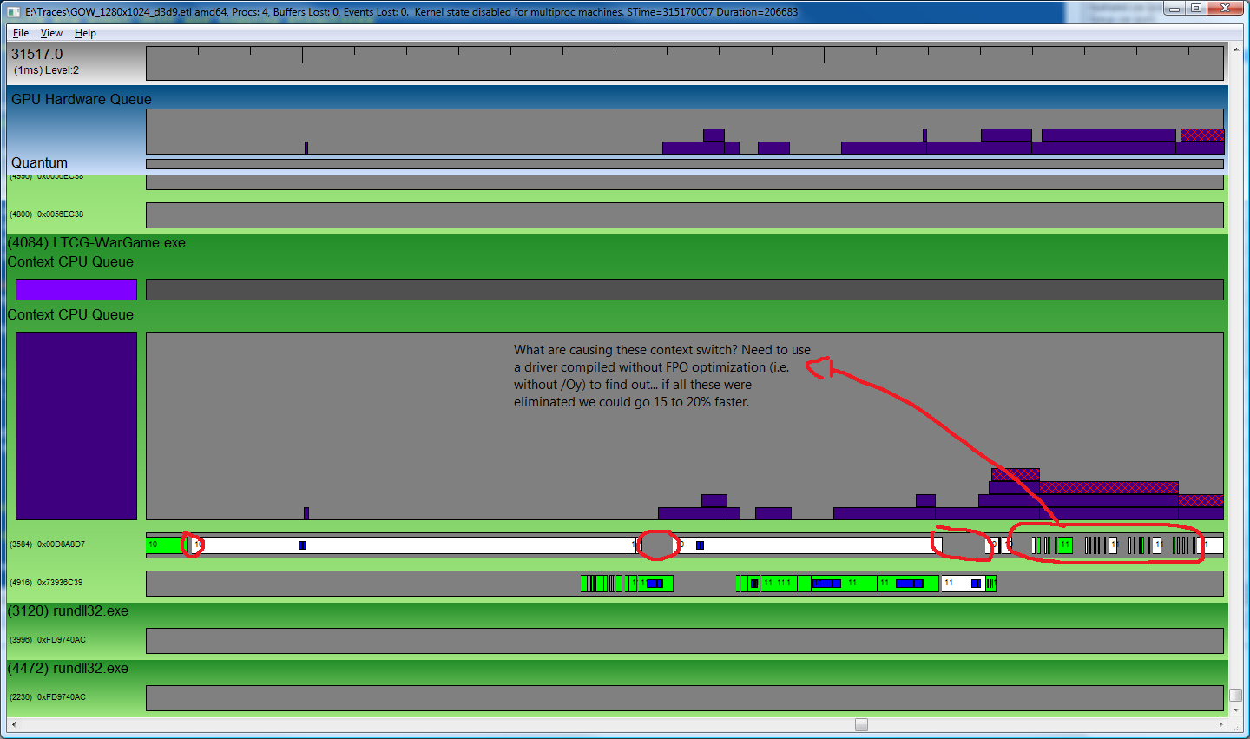
Ex: Available Resources

Slide 43
Call To Action
The many core era is coming, add multi-threading support to your application to take advantage of new CPU
Use Xperf and GPUView along with your current set of performance tools to better understand your threading efficiency and enhanced the performance of your Windows application

Slide 44
Additional Resources
XPerf
  Available now as the WPT Kit which is part of the Windows 7 SDK
  Older version also available online at
    http://www.microsoft.com/whdc/system/sysperf/perftools.mspx
  Xperf documentation very useful to get started generating and analyzing ETW traces
    http://msdn.microsoft.com/en-us/library/aa139734.aspx
GPUView
  Will be made available in Windows 7 Beta SDK as part of the WPT Kit
Related Sessions
  COR-T594 – “Introduction to Performance Analysis using Windows Performance Toolkit”
For feedback and questions on GPUView use the following alias
  gpuviewf@microsoft.com

Slide 45
Appendix

Slide 46
WDDM GPU Scheduling
GPU Scheduler Database
GPU Engine
1
2
Wait
DMA Buffer
Win32k and dxgkrnl
KMD
Scheduling Thread
Kernel Mode
Process Lock
User Mode
D3D Runtime
UMD
D3D Runtime
UMD
Application #1
Command Buffer
Application
#2
Command Buffer

Slide 47
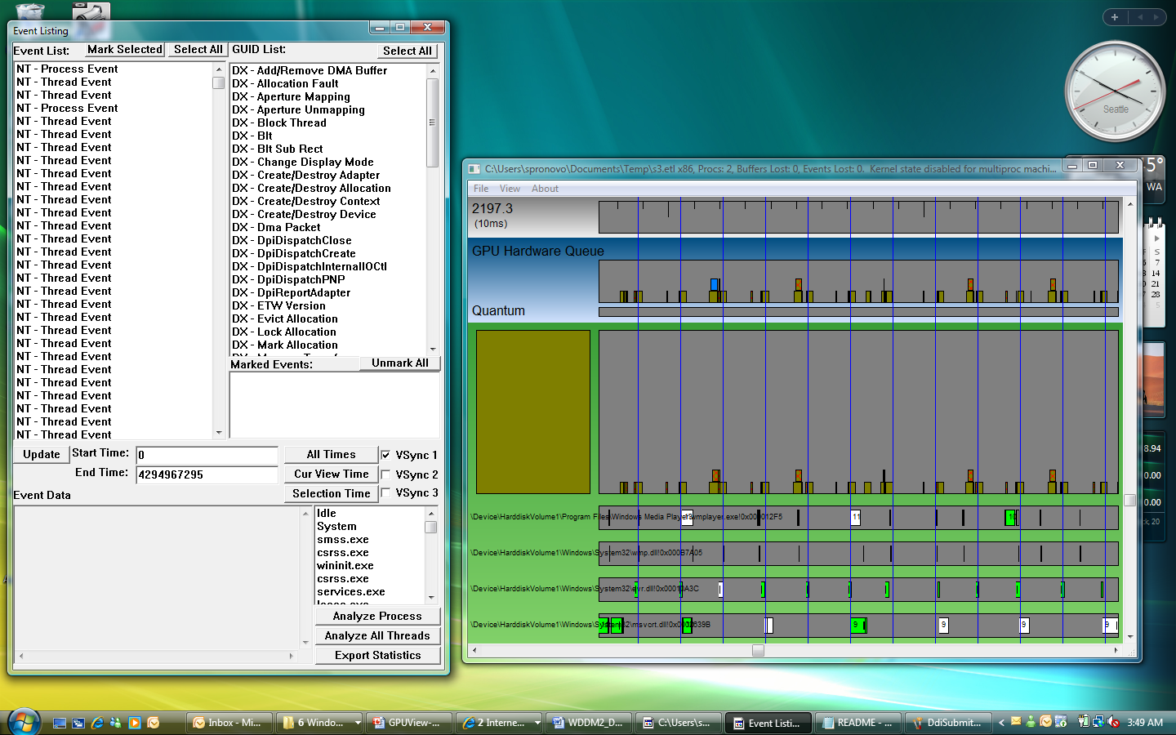
VSync

Slide 48
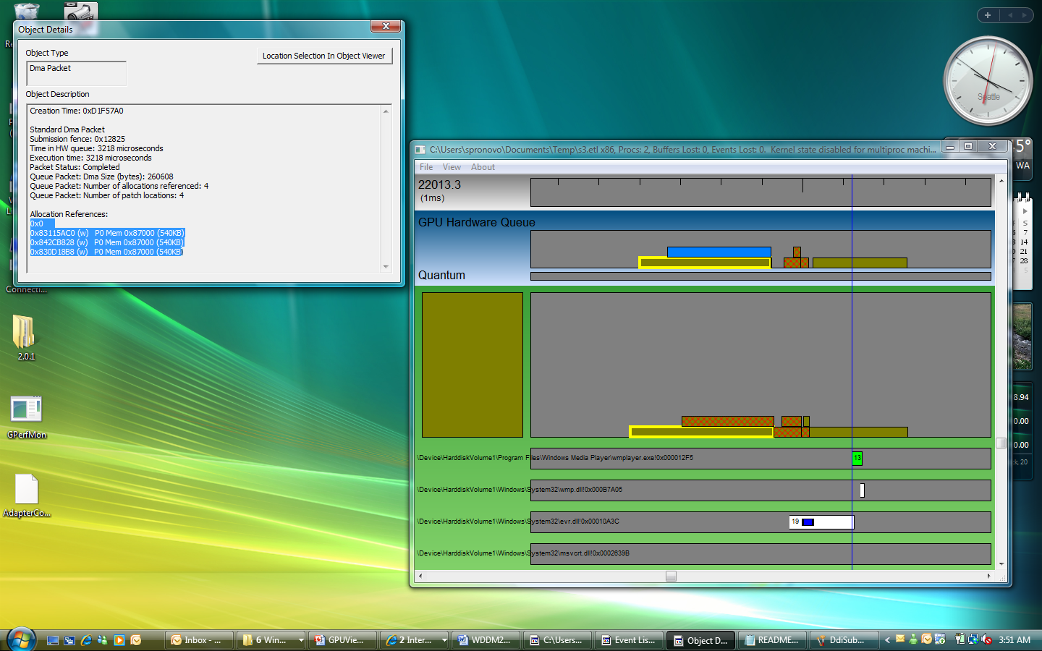
AllocationList And Placement

Slide 49
AllocationList And Placement
0x83115AC0 (w) P0 Mem 0x87000 (540KB)
Handle: Global identifier for the allocation
Operation: (w) indicate a write operation. The default is read
Relative priority: Where the allocation was placed relative to its priority
Mem/App: Memory segment or Aperture Segment
Size of allocation

Slide 50
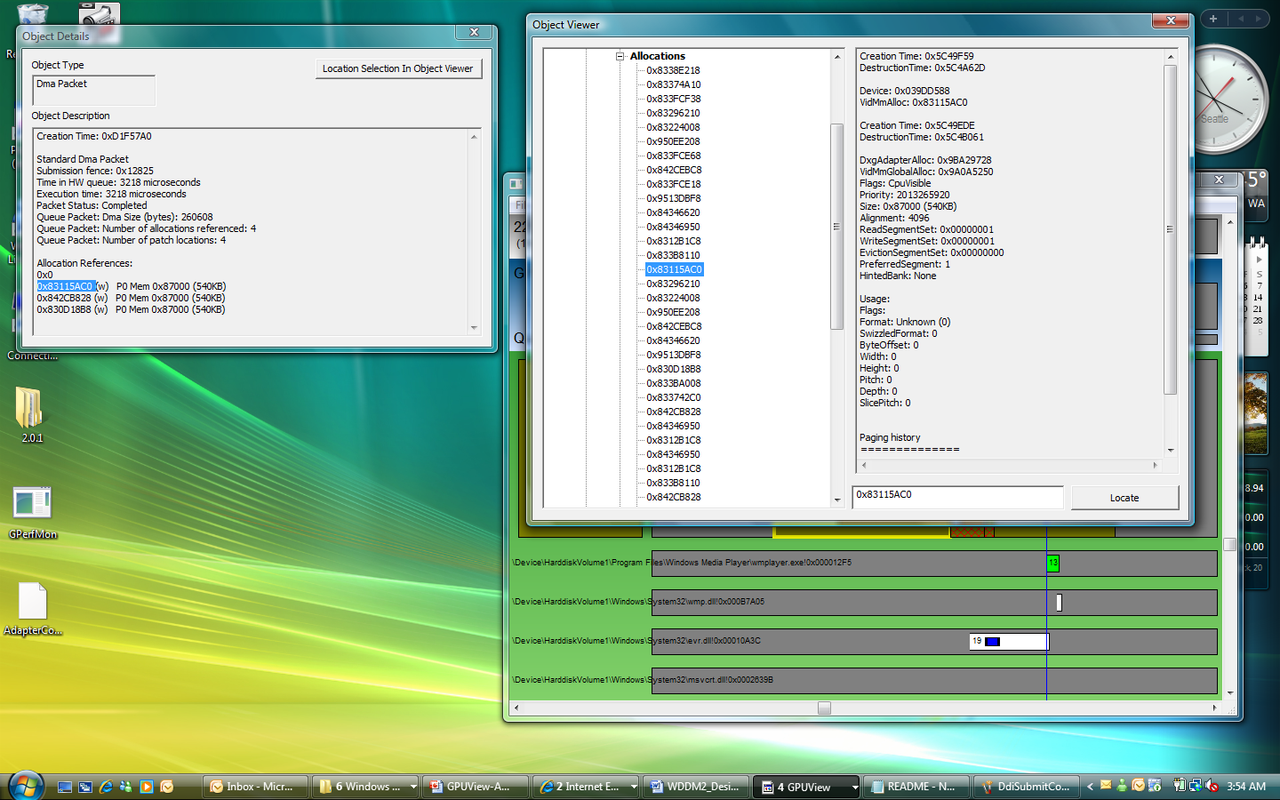
More Details On Allocation

Slide 51



Please Complete A Session Evaluation Form
Your input is important!
Visit the WinHEC CommNet and complete a Session Evaluation for this session and be entered to win one
of 150 Maxtor® BlackArmor™ 160GB External Hard Drives
50 drives will be given away daily!
http://www.winhec2008.com
BlackArmor
Hard Drives provided by:

Slide 52


© 2008 Microsoft Corporation. All rights reserved. Microsoft, Windows, Windows Vista and other product names are or may be registered trademarks and/or trademarks in the U.S. and/or other countries.
The information herein is for informational purposes only and represents the current view of Microsoft Corporation as of the date of this presentation. Because Microsoft must respond to changing market conditions, it should not be interpreted to be a commitment on the part of Microsoft, and Microsoft cannot guarantee the accuracy of any information provided after the date of this presentation.
MICROSOFT MAKES NO WARRANTIES, EXPRESS, IMPLIED OR STATUTORY, AS TO THE INFORMATION IN THIS PRESENTATION.

