Slide 2
Windows 7 Sensor
And Location Platform
Gavin Gear
Program Manager
Microsoft Corporation

Slide 3
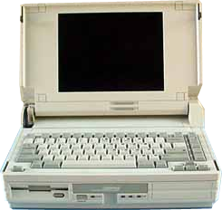
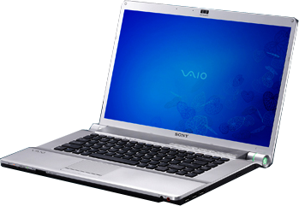
Laptops: 20 Years of Progress
1988: Compaq SLT/286
2008: Sony VAIO
What has changed:
  400x increase in CPU
  1700x increase in disk storage
  5000x increase in RAM
What has not changed?
  GPS interface: COM port
  Integration of other sensors

Slide 4
About Sensors
Sensors measure a physical phenomenon or a physical interaction
Sensors of interest
  Location sensors
    GPS, Wi-Fi/cell tower triangulation, IP resolver
  Ambient Light Sensors (ALS)
  Other sensors
    Accelerometers, Human presence, RFID, others

Slide 5
Dealing With Sensors
And Location Today
Sensors are integrated as vertical solutions
  Applications need to know sensor hardware specifics
  Limited adoption and scope
Location devices are exposed as virtual COM ports
  Exclusive application access
  Not secure
  Proprietary data formats (NMEA, others)

Slide 6
Sensor And Location Platform New For Windows 7
announcing

Slide 7
Sensor And Location Platform
Implements native support for sensor
and location devices on Windows
Provides a standard way to expose location and sensor hardware
Provides standard APIs for location
and other sensor devices
Provides security for sensors

Slide 8
Sensor Components
Application
Application
Sensor API
Location and other sensors CPL
Software
Hardware
UMDF sensor driver
Sensor class extension
Sensor MCU
Sensor
hardware
Developer tools
Windows 7 WDK
Windows 7 SDK

Slide 9
Location Components
Gadget or script
Application
Location Scripting Interface
Location API
Location and other sensors CPL
Sensor API
Software
Hardware
UMDF sensor driver
Sensor class extension
Developer tools
Sensor MCU
Location
hardware
Windows 7 WDK
Windows 7 SDK

Slide 10
Sensor And Location Enabled Applications
demo

Slide 11
Location Platform Benefits
One API call to get the PC’s location
One API for all location providers
Automatic transition between providers
Concurrent access for any application
Privacy controls
Support for multiple API surfaces

Slide 12
Location-Awareness Opportunities
Useful local information
Location based search for points of interest
Mapping/navigation based on
current location
PC recovery service
Where are my friends and family?

Slide 13
Integrating Location Sensors
PnP driver that natively support
the sensor platform
Don’t use virtual COM ports
Support the location API data fields
Virtual providers (such as Wi-Fi look-up) are excellent compliments to GPS devices

Slide 14
Ambient Light Sensors And Adaptive Brightness In Windows
Class driver support in box for ACPI
light sensors
Adaptive brightness feature supported end to end in Windows 7
Light-aware applications can use
these sensors to optimize UI content
for various lighting conditions

Slide 15
ALS Brightness Control – Suggested Vista Implementation
Red = OEM implemented
Sensor monitor service
Configuration UI
WMI
Software
Hardware
ACPI ALS drivers
WDDM supported dimmable display
Sensor MCU
ACPI ALS Hardware

Slide 16
Adaptive Brightness Windows 7 Components
Light-aware application
Sensor monitor service
Blue = In Windows 7
Sensor API
Advanced power configuration CPL
WMI
Software
Hardware
ACPI ALS drivers
WDDM supported dimmable display
Sensor MCU
ACPI ALS Hardware

Slide 17
Adaptive Brightness
Hardware Requirements
One or more light sensors integrated through ACPI, compliant with ACPI 3.0b specification, including
  _ALI method (with notifications)
  _ALR method
  Sensor enumerates with ACPI0008 PNP ID
Brightness control using WDDM, options
  ACPI brightness methods
  WDDM support in video driver

Slide 18
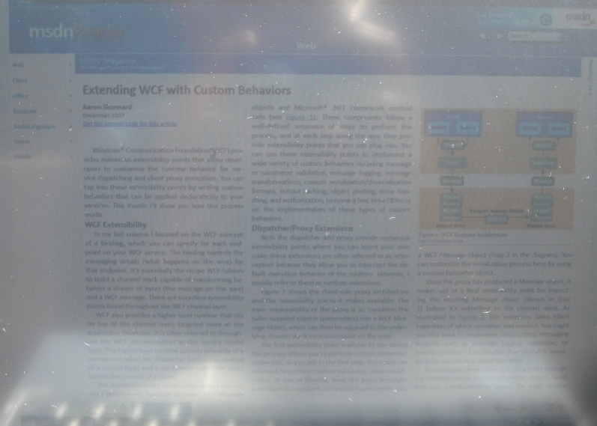
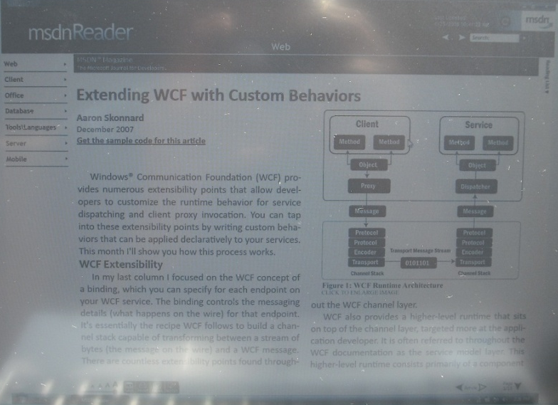
Light-Aware Applications (Part A)
Photos taken in direct sunlight
UI without light-awareness,
40% screen brightness
UI with light-awareness,
100% screen brightness

Slide 19

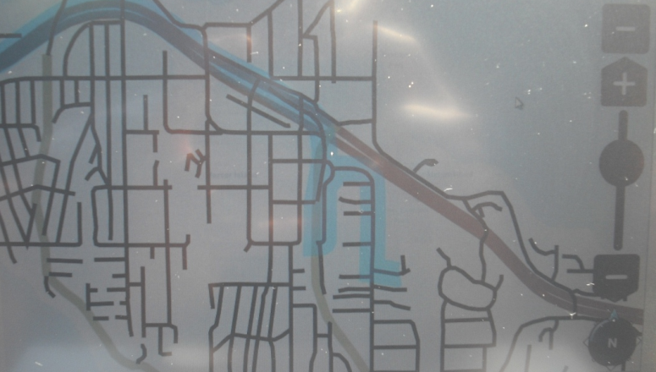
Light-Aware Applications (Part B)
Photos taken in direct sunlight
Navigation UI:
without light-awareness
Navigation UI:
with light-awareness

Slide 20
Adaptive Brightness And Light-Aware UI
demo

Slide 21
Optimizing Adaptive Brightness
Multiple sensors give a better approximation of lighting conditions
Proper part selection and
placement are critical
Registry parameters can be used
to specify behavior
  Ambient light response curve
  Display Response Interval
  Illuminance Change Sensitivity

Slide 22
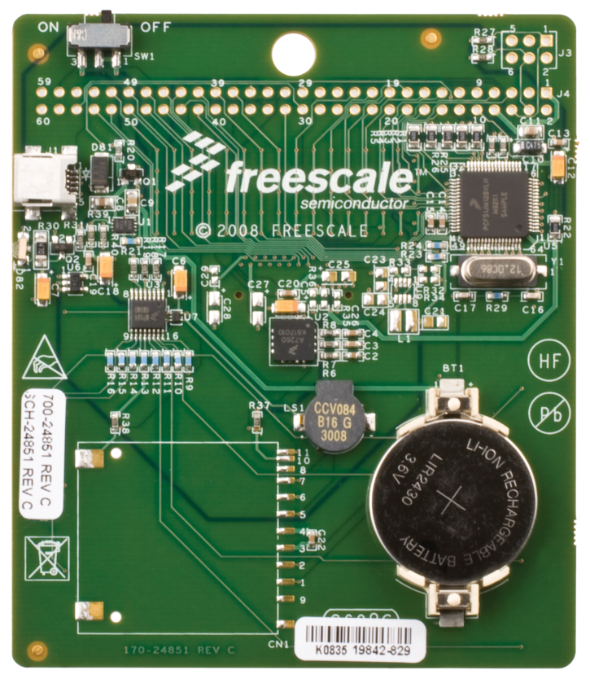
Sensor Development Kit
Based on Freescale JM128
Badge Board (HID)
Sensors
  Ambient light sensor
  3D accelerometer
  Dual touch strip sensors
Developer tools
  Sample firmware code
  Sample driver code
  Diagnostic and sample applications
    Light-aware MSDN reader
    Marble game
Limited quantities
available in the
Windows 7 booth!

Slide 23
Logo Requirements And Tests
Requirements are listed under
  Input 048 Apply to all sensor devices
  Input 049 Apply to location devices only
  Input 050 Apply to ambient light sensor devices only
Requirements are focused around
  Exposing proper data fields
  Exposing properties correctly

Slide 24
Call To Action
Location
  Select chipsets with drivers that integrate with Windows 7 Sensor and Location platform
  Update your existing location device driver to support the Windows 7 Sensor and Location platform
Ambient light sensors/adaptive brightness
  ACPI 3.0b compliance
  WDDM/ACPI brightness control
  Smooth display transitions
Get a Windows 7 Sensor Development Kit

Slide 25
Resources
Location and sensors WHDC site
www.microsoft.com/whdc/sensors
Inquiry aliases
  sensext@microsoft.com
  locext@microsoft.com
White papers see WHDC site
  Sensor platform overview
  ALS and light-aware applications
  ALS hardware and adaptive brightness

Slide 26
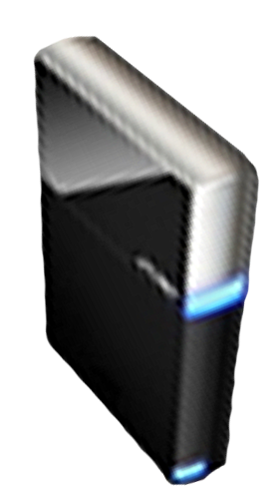


Please Complete A Session Evaluation Form
Your input is important!
Visit the WinHEC CommNet and complete a Session Evaluation for this session and be entered to win one
of 150 Maxtor® BlackArmor™ 160GB External Hard Drives
50 drives will be given away daily!
http://www.winhec2008.com
BlackArmor
Hard Drives provided by:

Slide 27


© 2008 Microsoft Corporation. All rights reserved. Microsoft, Windows, Windows Vista and other product names are or may be registered trademarks and/or trademarks in the U.S. and/or other countries.
The information herein is for informational purposes only and represents the current view of Microsoft Corporation as of the date of this presentation. Because Microsoft must respond to changing market conditions, it should not be interpreted to be a commitment on the part of Microsoft, and Microsoft cannot guarantee the accuracy of any information provided after the date of this presentation.
MICROSOFT MAKES NO WARRANTIES, EXPRESS, IMPLIED OR STATUTORY, AS TO THE INFORMATION IN THIS PRESENTATION.

