Slide 2
Designing Flash-based Netbooks For Windows 7 Operating System
Leon Braginski
Sn. Lead PM
Microsoft Corporation
Dilesh Dhokia
Sn. Dev Lead
Microsoft Corporation

Slide 3

Agenda And Vision
a

Slide 4




Pillars Of The Best Netbooks
Usability
Mobility
Power Consumption
Most Important Storage Pillars
ENDURANCE
PERFORMANCE
INTERFACE
CAPACITY

Slide 5


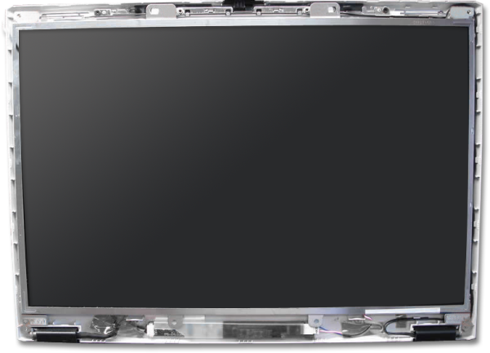
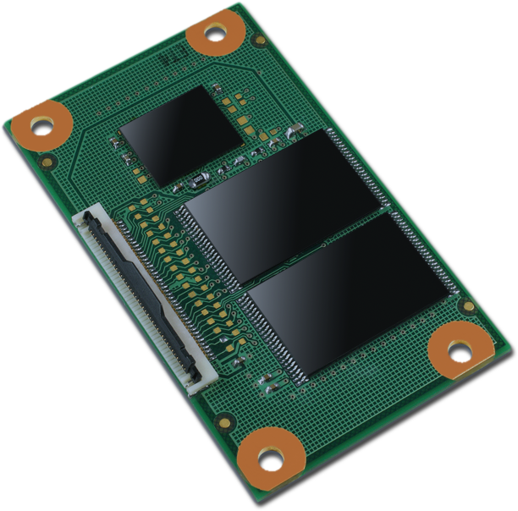
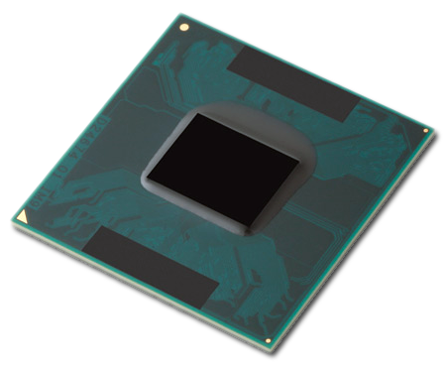
Areas Covered
Screen
Storage Considerations
CPU

Slide 6
Storage Considerations

Slide 7


Windows 7 Disk Footprint
Windows 7 disk footprint smaller than Vista
“Installed footprint” includes logs, memory dumps, caches, restore points, pagefile, hiberfil
Balance: Managing growth while providing new features
Windows 7 will run well on 16GB systems
~50% of drive used by Windows over life of PC
Daily use, including growth and footprint per above
~50% of drive available
Applications
Media storage
Working space for installs

Slide 8
Why Flash Storage For Netbooks?
Non-volatile memory is an excellent fit for Netbooks
Resistant to shock, dust, temperature, humidity, lower power, small form factor
Lower cost for low-end devices
-- --160 GB ----
-- --320 GB ----
-- --500 GB ----
Graph Created By Microsoft
Source: Market Statistics: History, Market Share and Forecast, HDDs, Worldwide, 2003-2012 , Gartner June 2008, John Monroe
Semiconductor Forecast Worldwide--Forecast Database [SEQS-WW-DB-DATA], Gartner August 2008, Joe Unsworth

Slide 9

Is Flash Ideal?
No
Limited lifetime
Limited data retention
Slow writes
Latency caused by wear leveling
YES
Smaller form factor
Less power consumption
Fast reads
Cheaper cost
More resistant to environmental stresses

Slide 10
NAND Flash Performance And Endurance
NAND Flash
Single Level Cell (SLC)
Multi Level Cell (MLC)
Limited lifetime
More bits per cell = shorter lifetime
Design for expected lifetime and best Windows 7 experience

Slide 11

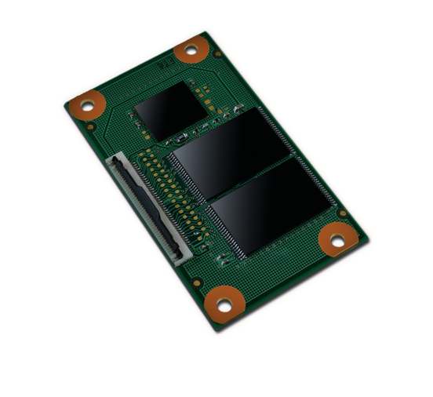
In An Ideal World…
10,000 Erase Cycles
x 16 GB storage
160,000 GB Write Capability

Slide 12

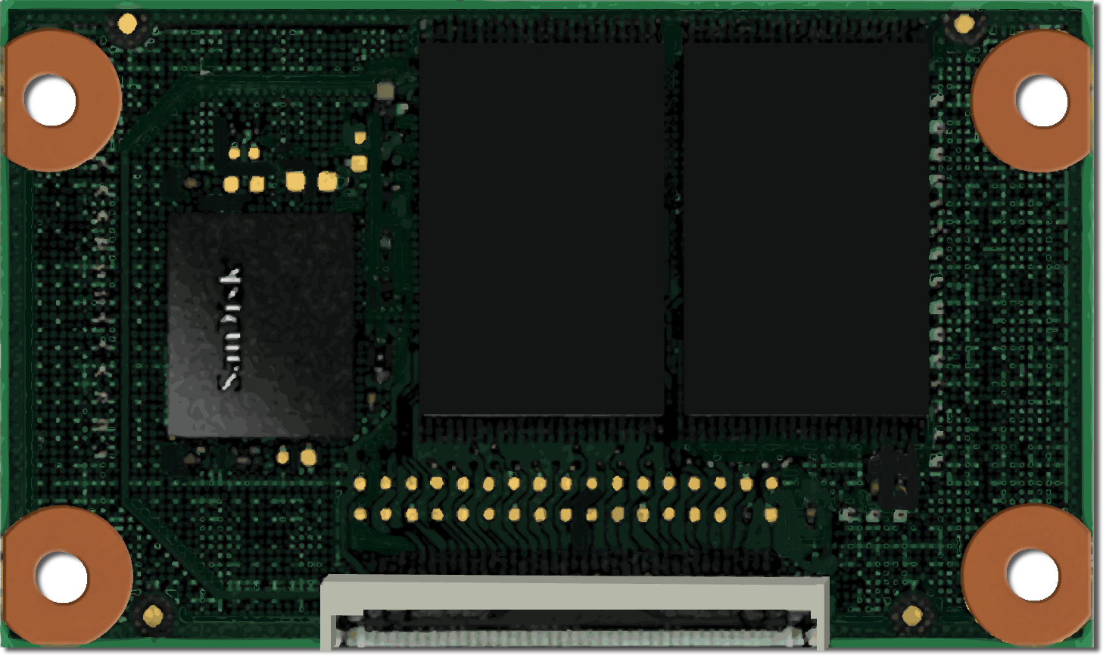
Reality Of Flash
Solid State Drive
(Flash)
Application
Data Written
Data Written
Data To Write
More writes generated then requested:
Write Amplification and Reclaim Efficiency
Wear Leveling

Slide 13
Reclaim Efficiency
video
Leon Braginski
Sn. Lead PM
Microsoft Corporation
Dilesh Dhokia
Sn. Dev Lead
Microsoft Corporation

Slide 14

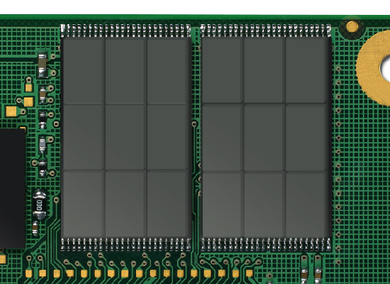
Wear Leveling
Attempt to wear all blocks evenly

Slide 15
Flash Storage Lifetime
Lifetime is increased by better
hardware and larger storage
Actual Write Capacity (GB)
Life (Year)
=
Write Rate (GB/Year)
Lifetime is increased by smaller workloads

Slide 16
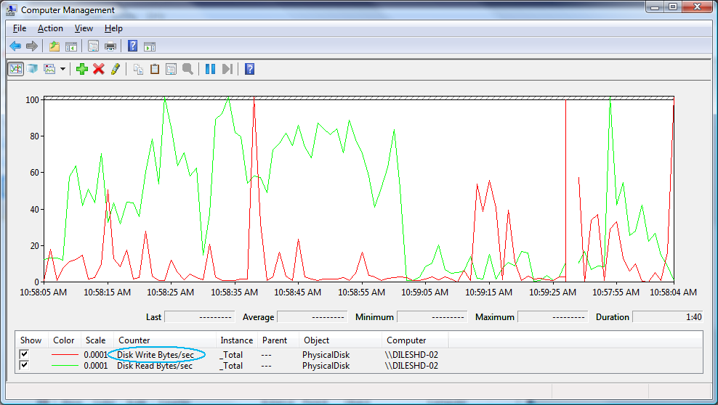
Calculating Write Rate
Our test: Write rate from 10 people over 4 weeks
Write Rate (95% population) = 6.5 TB per year

Slide 17
Example
Life (Year) = = ~ 4.97 years
Actual Write Capacity (IHV provided)
(32000 GB)*
Write Rate
(6436 GB/Year)
32000
6436
*Collaborate with IHV to obtain Actual Write Capacity. 32000 GB is an example used to demonstrate a concept

Slide 18
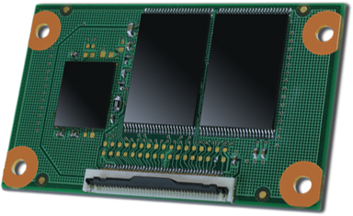

Using Multiple Flash Types
SLC
Highly dynamic
data
SLC
Highly dynamic
data
MLC
Highly
static
data
MLC
Highly static
data
Balance cost and lifetime

Slide 19
Other Storage Considerations
Storage Mounting
Housing
Discrete Components
Controller & Flash are separate modules
Internal Mounting
Removable media is mounted inside casing
Self Contained
Controller & Flash are contained in a single module
 | ATA | USB (not supported)
Crash dump | ✓ | ✗
Page file | ✓ | ✗
Hibernation file | ✓ | ✗

Slide 20
CPU Considerations

Slide 21
Performance I/O balancing speed consideration
Random I/O speed affects Windows experience
Faster I/O speed equals faster boot time
Ask your SSD IHV for random speed

Slide 22
Performance CPU and I/O balancing
Unbalanced System
Balanced System
Target: CPU utilization & Disk I/O balance

Slide 23
Screen Considerations

Slide 24
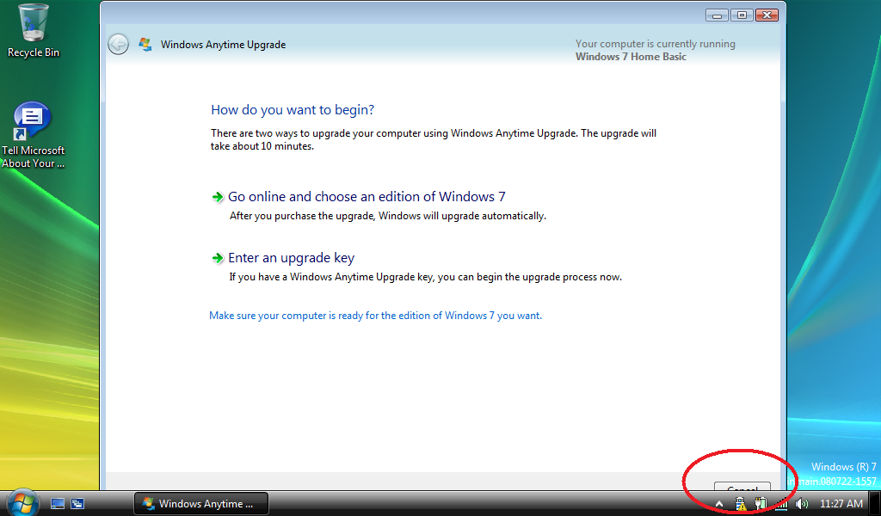
Screen Considerations
Don’t let this happen to you!
Ensure applications meet minimum resolution requirements

Slide 25
Our Commitment
We are committed to help netbook manufacturers offer best products
We provide:
Technologies to optimize Windows 7 for flash storage
Guidance: Flash PC design guide
OPK tools

Slide 26
Windows 7 Flash Technologies
Non spinning disk (SSD) detection
No scheduled defrag
Trim command
OS will notify device when file is deleted
Better wear leveling and early garbage collection
Partition alignment to reduce writes
Logo requirements for SSD performance

Slide 27
Flashed Based Netbook Design Guide
Not a Reference Design
Helps reduce development costs and time to market
Offers guidance on how to build for best Windows experience

Slide 28
Call To Action
Use Design Guide to optimize your Netbook for Windows experience
Estimate the endurance of your Netbook, ask your SSD IHV for help
IHVs: collaborate on the standard way to measure SSD endurance

Slide 29
Additional Resources Related sessions
COR-T558 “Windows 7 Enhancements for Solid-State Drives”
ENT-T539 “Design Tradeoffs for Solid-State Disk Performance”
COR-T559 “System Integrated Flash Storage”
COR-P777 “Panel: How Windows and SSDs Can Provide the Best User Experience”
Web Resources
Design Tradeoffs for SSD Performance: http://research.microsoft.com/users/vijayanp/papers/ssd-usenix08.pdf

Slide 30



Please Complete A Session Evaluation Form Your input is important!
Visit the WinHEC CommNet and complete a Session Evaluation for this session and be entered to win one of 150 Maxtor® BlackArmor™ 160GB External Hard Drives 50 drives will be given away daily!
http://www.winhec2008.com
BlackArmor Hard Drives provided by:

Slide 31


© 2008 Microsoft Corporation. All rights reserved. Microsoft, Windows, Windows Vista and other product names are or may be registered trademarks and/or trademarks in the U.S. and/or other countries.
The information herein is for informational purposes only and represents the current view of Microsoft Corporation as of the date of this presentation. Because Microsoft must respond to changing market conditions, it should not be interpreted to be a commitment on the part of Microsoft, and Microsoft cannot guarantee the accuracy of any information provided after the date of this presentation. MICROSOFT MAKES NO WARRANTIES, EXPRESS, IMPLIED OR STATUTORY, AS TO THE INFORMATION IN THIS PRESENTATION.

