Slide 2
Connecting Projectors And Using Docking Stations With Windows 7
Akshay Agrawal
Program Manager
Microsoft Corporation

Slide 3

Agenda
Improved multi-monitor support in Windows 7
  What is “Connecting and Configuring Displays” ?
  What does the + ‘P’ key do?
  New display control panel
  Improvements to the graphics stack
Microsoft recommendations and guidelines
for the PC eco-system
  System OEMs, graphics vendors, display manufacturers, cable/KVM manufacturers

Slide 4
Connecting And Configuring Displays

Slide 5
Introduction
“… is the new Windows 7 feature for
end-to-end multi-monitor support.”
Scenarios
  Laptops
    Connecting a projector or TV
    Docking stations with multiple monitors
  Desktop
    Connecting multiple monitors
    Connecting a TV

Slide 6
Why Is This Important
Need to provide a simple user experience
Has been historically challenging
Increase in transient display scenarios
  Laptops more popular than desktops
Increased multi-monitor popularity
  LCD panels are now very affordable
  Gain in productivity

Slide 7
Display Eco-System

Slide 8
The Eco-System
PC software
Windows operating system
Graphics driver
PC hardware
Laptops
Display devices
Monitors
Cables/KVM
OEM and IHV value add applications
Desktops
Graphics adapters
Projectors
TV
Display cable
KVM switchbox
Extender box

Slide 9
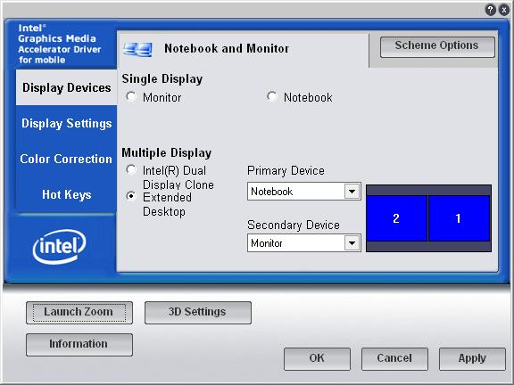
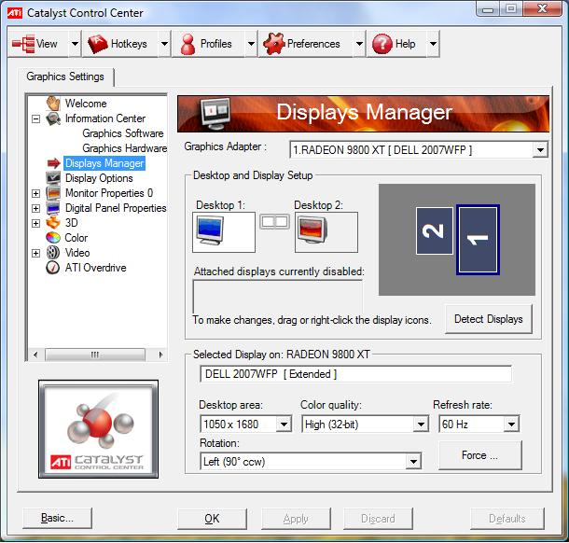
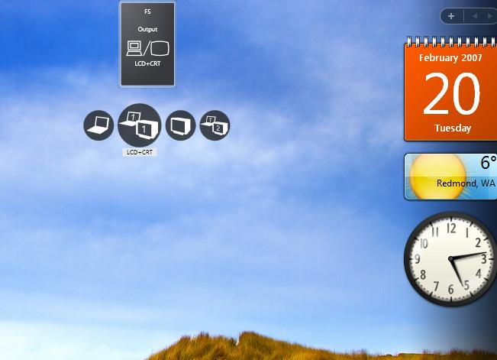
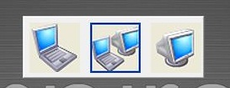
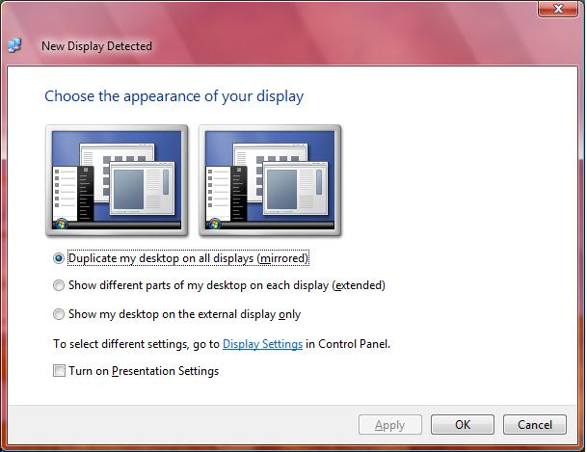
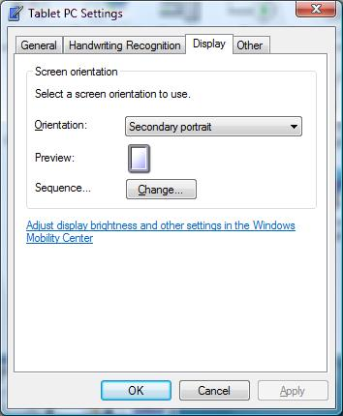
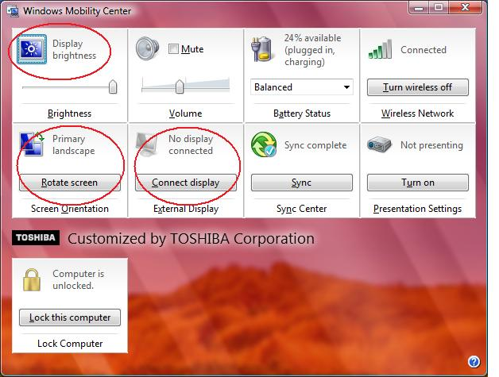

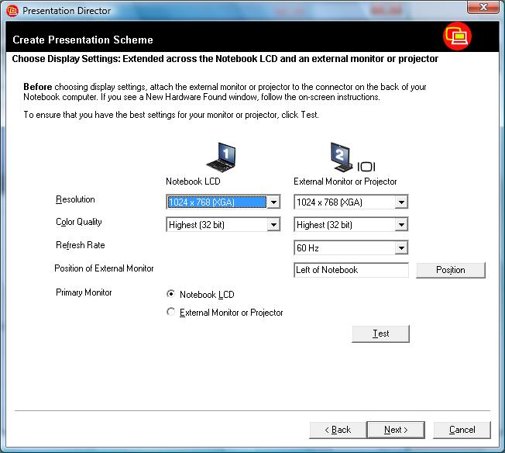
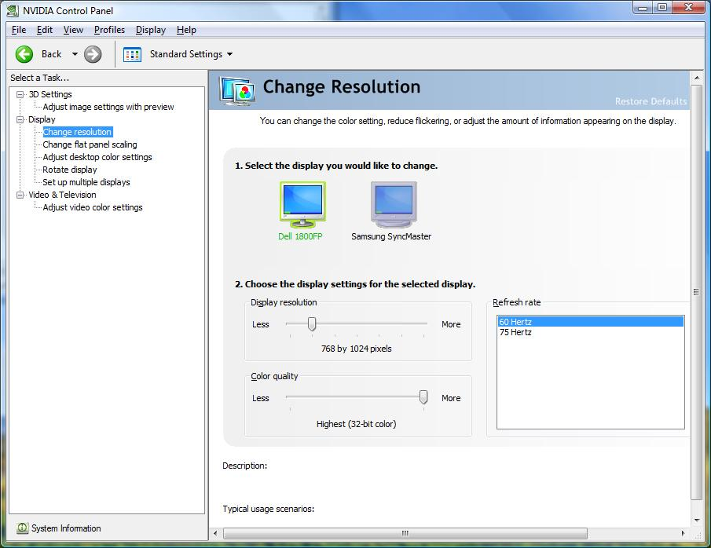
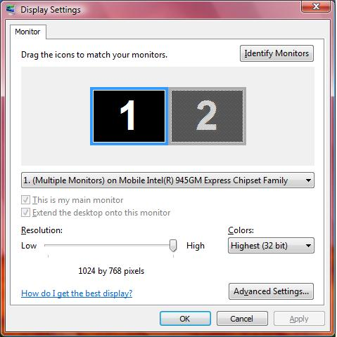

Confusing User Experience

Slide 10
Too Many Solutions
Provided by:
Windows -
user mode components
OEM value add
Microsoft
Gfx IHV
IHV value add
Hardware
PC OEM
User mode graphics driver
User Mode
Kernel Mode
Windows – Kernel mode components
Kernel mode graphics driver
OEM ACPI
hot key
Graphics hardware

Slide 11


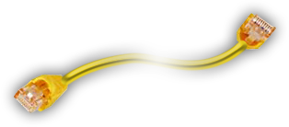
Display Devices With An EDID
Display Devices Without An EDID
Hello,
I am a PC
Hello, I am
a Monitor

Slide 12

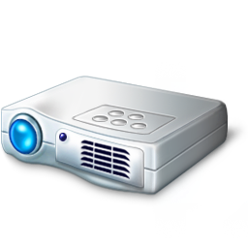
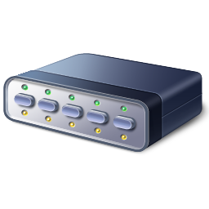

Cable/KVM Don’t Pass EDID
Hello, I am
a Projector
Hello,
I am a PC
Hello, I am a KVM or Cable Extender

Slide 13
What Is Success?
Display scenarios should “just work”
  Easy to understand behavior and UI
  Streamlined user experience
  Hardware agnostic user experience
  Reliable and robust solution

Slide 14
Windows 7 Improvements

Slide 15
What's Done In Windows7
Improve end user experience
  Provide consistent and predictable UX
  Automatically configure the display device
Improve reliability
  Address areas of potential failures
Provide infrastructure for the partners
  New APIs, DDIs, persistence database

Slide 16
Consistent And Predictable UX
Same user experience on
desktops and laptops
Hardware agnostic user experience
Address all scenarios end to end
Eliminate duplicate UI

Slide 17
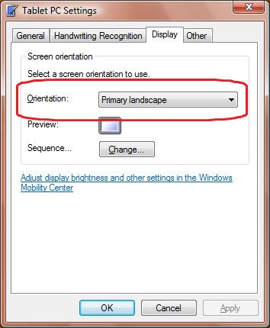
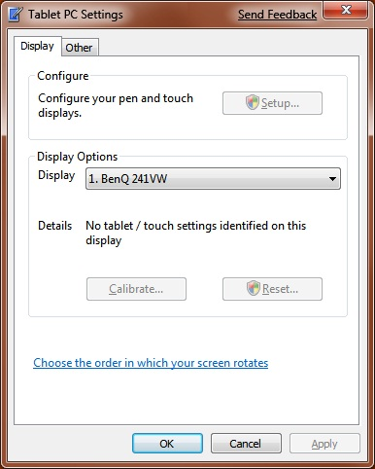
Tablet PC Settings
Vista
Windows 7

Slide 18
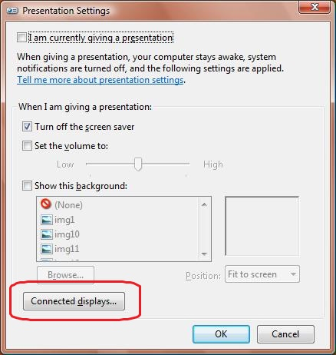
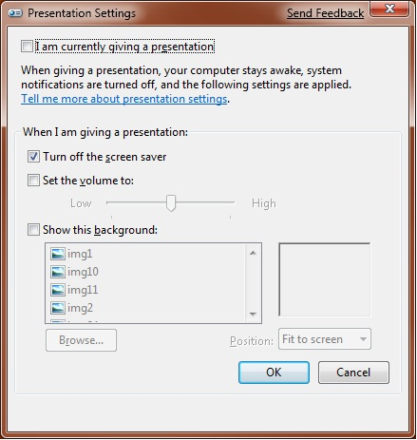
Presentation Settings
Vista
Windows 7

Slide 19
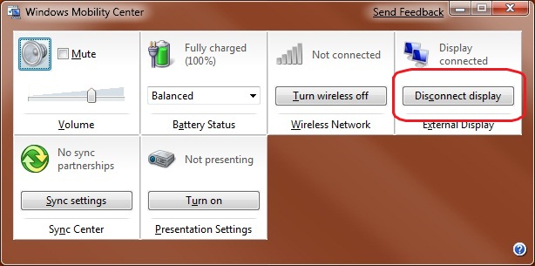
Mobility Center
Vista
Windows 7

Slide 20
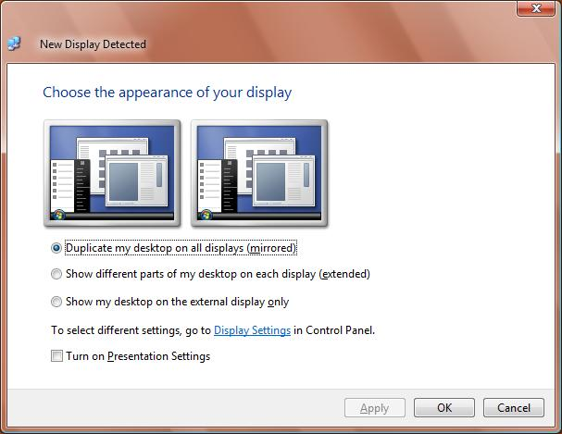
Transient MultiMonitor Manager
Vista
Windows 7

Slide 21
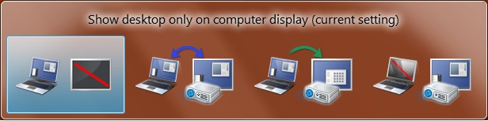
Projection Hot Key
Introduction
Windows 7 provides a new projection hot key
Press and hold the key and tap the ‘P’ key

Slide 22
Projection Hot Key
Features
Simple keyboard combination
Windows key + (P)rojection key
Works the same on
ALL laptops and desktops
Always provides the same options
Available even before user logs in
Works for more than 2 displays
Works with the new persistence database

Slide 23
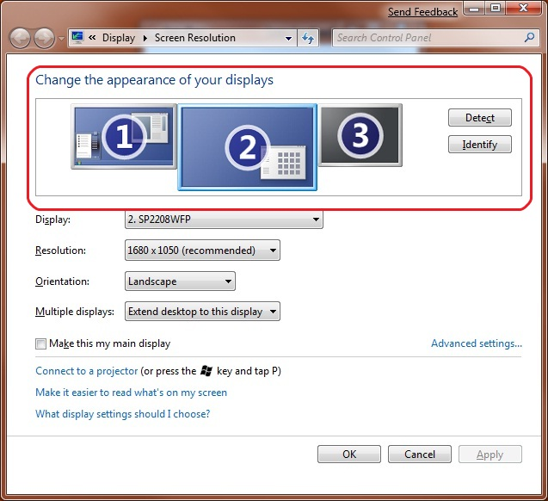
Display Control Panel
All displays are shown

Slide 24
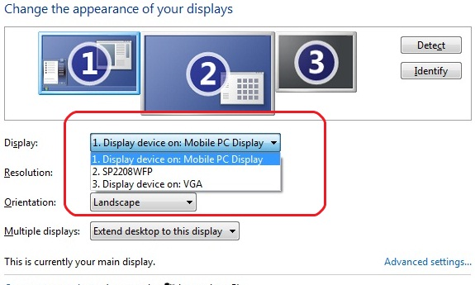
Display Control Panel
Monitor name

Slide 25
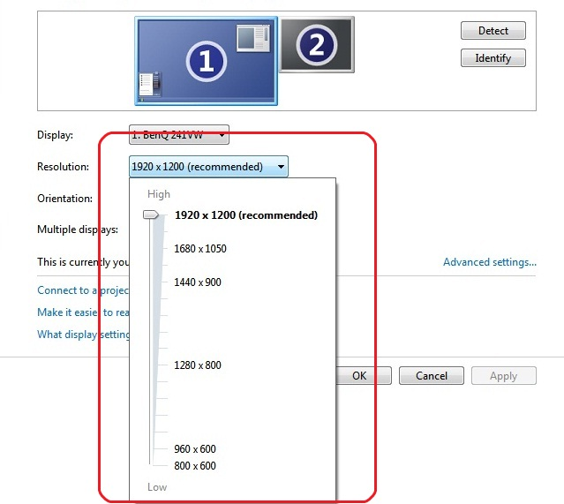
Display Control Panel
Native resolution

Slide 26
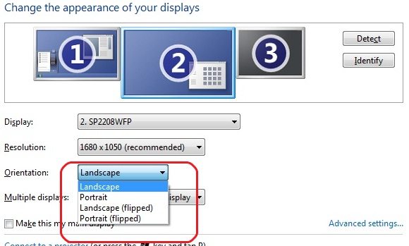
Display Control Panel
Monitor rotation

Slide 27
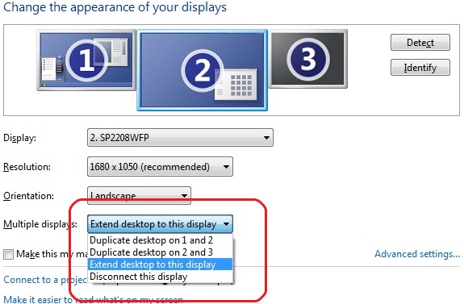
Display Control Panel
Multi-monitor support

Slide 28
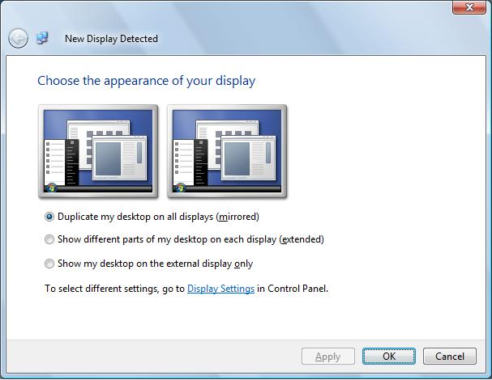
Automatic Configuration
Automatically enables a display device
on connection
Optimum display settings applied based on EDID

Slide 29
New Persistence Database
Remembers display settings and re-applies
Settings based on EDID data
Changes made via Display Control Panel
are persisted
Projection hot key uses same data
Settings applied even before
logon screen is displayed
Any application that uses the new APIs
can take advantage of this

Slide 30
Reliability And Robustness
Integrated solution into
the Windows kernel
More reliable detection of display devices
Improved the infrastructure to eliminate
  Black screens
  Wrong display settings
  Screen swaps

Slide 31
Docking Station Support
Docking station scenarios are
part of design – not special case
Takes advantage of new persistence database and optimum setting algorithm
Call to action
  System BIOS must implement
  ACPI-based docking notification
  Graphics driver must report accurate
  state of display connectivity

Slide 32
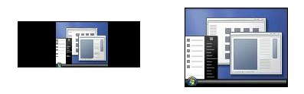
New Aspect Ratio Scaling
Common scenarios
  Widescreen laptop with standard projector
  Standard laptop with widescreen TV
New “aspect ratio preserving” scaling mode
is used as default on WDDM 1.1 drivers
Also accessible via new APIs

Slide 33
Graphics Driver Support
Windows 7 drivers
  Driver model optimized for Windows 7
  Additional support for aspect ratio scaling
  Better support for TV resolutions
Vista drivers
  + ‘P’ and other features are designed to work on
  Windows Vista signed drivers
  User who upgrade from Vista, will get the benefits of
  Windows 7 features
XP drivers
  No new capabilities exposed

Slide 34
Working With
The Ecosystem

Slide 35
Graphics Hardware Vendors
New WHQL requirements
  Must not override operating system defaults
  Report accurate display connectivity
  Support new aspect ratio scaling
  Set ITC bit for HDMI TV
Provide unified driver package that
align with the Windows 7 design goals
Implement automatic detection
for analog connectors

Slide 36
PC System Manufacturers
Provide Windows 7 optimized graphics drivers
Well formed EDID for laptop panel
Docking support
  System BIOS must implement ACPI based docking notification
  Graphics driver must report accurate state of display connectivity
Highly recommend
  … modifying ACPI hot key to display Windows 7 projection hot key
  … avoid stand alone UI for display scenarios – extend the display control panel UI

Slide 37
Display Manufacturers
New WHQL requirements
  Well formed and accurate EDID
    Native panel resolution = “Preferred timing”
    User friendly name
    Unique manufacturer ID and serial number
    Accurate physical dimensions
All devices must support a “PC mode”
  No overscan
  No video processing
  No edge enhancement

Slide 38
Cable And KVM Manufacturers
Cables
  Always transmit the EDID
    Pin used is 12 and 15 for VGA
  Cable length and noise shielding based on
  VESA and HDMI standards
KVM switchbox
  Accurate EDID from display device
  Awareness of display device presence
  No hot plug on console switch
  I2C commands supported

Slide 39
Additional Resources
Web resources
  White papers
  http://www.microsoft.com/whdc/display
  Other resources
  http://msdn.microsoft.com/directx
Related sessions
  GRA-C666: Connecting and Configuring Displays
  in Windows 7
Contact information
  directx@microsoft.com

Slide 40
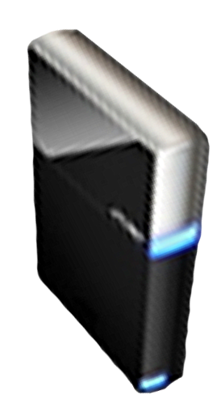


Please Complete A Session Evaluation Form
Your input is important!
Visit the WinHEC CommNet and complete a Session Evaluation for this session and be entered to win one
of 150 Maxtor® BlackArmor™ 160GB External Hard Drives
50 drives will be given away daily!
http://www.winhec2008.com
BlackArmor
Hard Drives provided by:

Slide 41


© 2008 Microsoft Corporation. All rights reserved. Microsoft, Windows, Windows Vista and other product names are or may be registered trademarks and/or trademarks in the U.S. and/or other countries.
The information herein is for informational purposes only and represents the current view of Microsoft Corporation as of the date of this presentation. Because Microsoft must respond to changing market conditions, it should not be interpreted to be a commitment on the part of Microsoft, and Microsoft cannot guarantee the accuracy of any information provided after the date of this presentation.
MICROSOFT MAKES NO WARRANTIES, EXPRESS, IMPLIED OR STATUTORY, AS TO THE INFORMATION IN THIS PRESENTATION.

