Slide 2
Windows 7: Mobile Broadband APIs For Application Development
Anurag Choudhary
Program Manager
Wireless WAN
Microsoft Corporation

Slide 3
Agenda
Mobile Broadband in Windows 7
API Overview
Supported Functionality
API Object Model
Call to Action
Demo

Slide 4
Mobile Broadband Devices In Windows Vista
Network Adapter
Modem
Connection Manager #1
Connection Manager #2
Connection Manager #N
. . .
Device #1
Device #2
Device #N
No standard programming interface
  Connection managers need to be re-written for each type of device
No standard mechanism for device interface
  Some device appear as Network adapter
  Some devices appear as modem

Slide 5
Terminology
Mobile Broadband is also referred as
  Wireless WAN
  WWAN
  MB
Mobile Broadband Driver is also referred as
  IHV Miniport Driver
  MB Driver
  Miniport Driver

Slide 6
Mobile Broadband In Windows 7
Network connectivity through packet switched (3GPP/3GPP2) technologies
New Feature in Windows 7
New Driver Model for Mobile
Broadband devices
New logo program for Mobile
Broadband devices
New API for application development

Slide 7
Windows 7 Mobile Broadband Architecture
View Available
Network UI
Connection Flow
Experience UI
Properties UI
3rd Party
Connection Manager
Command
Line Interface
User Mode
Mobile Broadband API
Session 0
Profiles
WWAN Service
NDISUIO
Provided by:
Kernel Mode
Microsoft
Mobile Broadband Driver Model
ISV
WWAN Miniport Driver
WWAN Miniport Driver
IHV
MB Miniport Driver
OEM

Slide 8
Overview
Device agnostic application programming interface to manage Mobile Broadband connectivity
COM based API
  Will be available as part of Windows7 SDK
  Can be directly called from unmanaged
  applications (C++)
  Can be called from managed applications (C#)
  through COM interoperability

Slide 9


Supported Functionality
Device management
Radio state management
Connectivity management
Profile management
SMS
PIN
Custom Activation
Vendor specific operation
Profile API provides branding opportunity for operators
Custom service activation
  Pass-through API for vendor specific service activation
  Payload data is passed through to Mobile Broadband Driver
  Needs support from MB driver

Slide 10
Custom Features
Framework provides vendor-specific API to implement custom features
WWAN Service provides a pass-through control path for Windows 7 applications to communicate with IHV drivers
Usage Example
  SIM Tool Kit Commands
  USSD Commands
  Phone Book Commands
  Voice Commands
  And more…
3rd Party Apps/Connection Managers
Set VendorSpecific
OnEventNotification
WWAN Service
OID_WWAN_VENDOR_SPECIFIC
NDIS_STATUS_WWAN_
VENDOR_SPECIFIC
MB Miniport Driver

Slide 11
API Object Model
Entities involved in MB API
MB API Library
  API library code hosting the COM objects
  Runs as part of application process
API defines three types of COM interfaces
  Manager Object Interface
  Function Object Interface
  Call back Interface
3rd Party
Connection Manager
MB API Library
WWAN Service
MB Miniport Driver

Slide 12
Manager Object Interface
//Initialize Interface Manager
hr = CoCreateInstance(CLSID_MbnInterfaceManager, NULL, CLSCTX_ALL, IID_IMbnInterfaceManager, (void**)&pMbnInterfaceMgr);
...
// Enumerate the Object
pMbnInterfaceMgr->GetInterface(InterfaceID, &pMbnInterface);
// Register the callback interface for notification
hr = pMbnInterfaceMgr->QueryInterface(IID_IConnectionPointContainer,
reinterpret_cast<VOID**>(&pcpc));
hr = pcpc->FindConnectionPoint(IID_IMbnRegistrationEvents, &pcp);
hr = pcp->Advise(pCTestMbnSinks, &dwCookie);
Root of object hierarchy
Provides methods to enumerate function objects
Provides mechanism to register for change notification

Slide 13
Function And Callback Interface
// Get and Set method call
pMbnRegister->GetRegisterState(&RegisterState);
pMbnRegister->SetRegisterMode(MBN_REGISTER_MODE_MANUAL, providerID, 0, pReqId);
// Callback functions
OnSetRegisterModeComplete(newObject, reqID, Status) {
// Call back function on set operation completion
}
OnRegisterStateChange(newObject) {
//Callback function to notify about register state change
}
Function Object Interface
  Provides methods to manage Mobile Broadband functionality
  Logically divided into multiple interfaces based on functionality
Callback Interface
  Set of functions implemented by application to receive notifications
    Asynchronous operation completion
    State change notification

Slide 14
Get Operation Flow
Application
MB API LIB
WWAN Service
GetInterface()
Object Created
Object Created
Object State Cached in Lib
GetRegisterState()
Return MBN_REGISTER_STATE_ROAMING
MB API Library caches the state of object
Get operations complete synchronously
Returns the cached state of the object

Slide 15
Set Operation Flow
Application
MB API LIB
WWAN Service
SetRegisterMode()
Synchronous response
ReqID = X
Req to Driver
OnSetRegisterModeComplete(newObject, ReqID)
Response from Driver
ReqID = X
Application releases cached object
Use updated Object
Asynchronous operation for interacting with slower MB devices
ReqID assigned to identify the request
On completion, application’s callback function is called
ReqID and updated object is passed in the callback function

Slide 16
State Change Notification
Application
MB API LIB
WWAN Service
State Change Notification
State Change notification from Driver
OnRegisterStateChange(newObject)
API Lib updates cached object
Application releases cached object
Use updated Object
Notification for device state change
API library creates new object based on state update
New object is passed in application’s callback function
Application should release the older object and start using the new object

Slide 17
Call To Action
Develop your applications using Mobile Broadband API
Contact us at win7mb@microsoft.com

Slide 18
Additional Resources
MSDN Online Documentation
  COM Overview: http://msdn.microsoft.com/en-us/library/ms680573(VS.85).aspx
  .NET interoperability with unmanaged code http://msdn.microsoft.com/en-us/library/sd10k43k%28VS.80%29.aspx
Resources part of Win7 beta release
  SDK
    Mobile Broadband API documentation
    Sample code for Mobile Broadband API
  WHDC Web site at http://www.microsoft.com/whdc/default.mspx
    White Paper: Using Mobile Broadband API from managed code
  WinHEC 2008 Resources
    TS 602: Mobile Broadband Driver Development in Windows 7

Slide 19
Related Sessions
Session | Date and Time
MBL-C660: New Windows Logo Program for Mobile Broadband Devices | 7th Nov Fri. 11 AM–12 Noon

Slide 20
Demo Windows 7 Mobile Broadband with Option products
Ray Octaviano
Director Field Engineering
OPTION N.V.

Slide 21
Windows 7 and Option products
Option partnered with Microsoft in development of Mobile Broadband drivers for Option devices for Windows 7
All new Option products can be controlled by Windows 7 built-in Mobile Broadband connection
  See overview of current portfolio on the next page
  Watch the news for announcement of new products in the coming months
All existing Option products are made compatible with Windows 7 by using Option Connection Manager for Windows 7

Slide 22
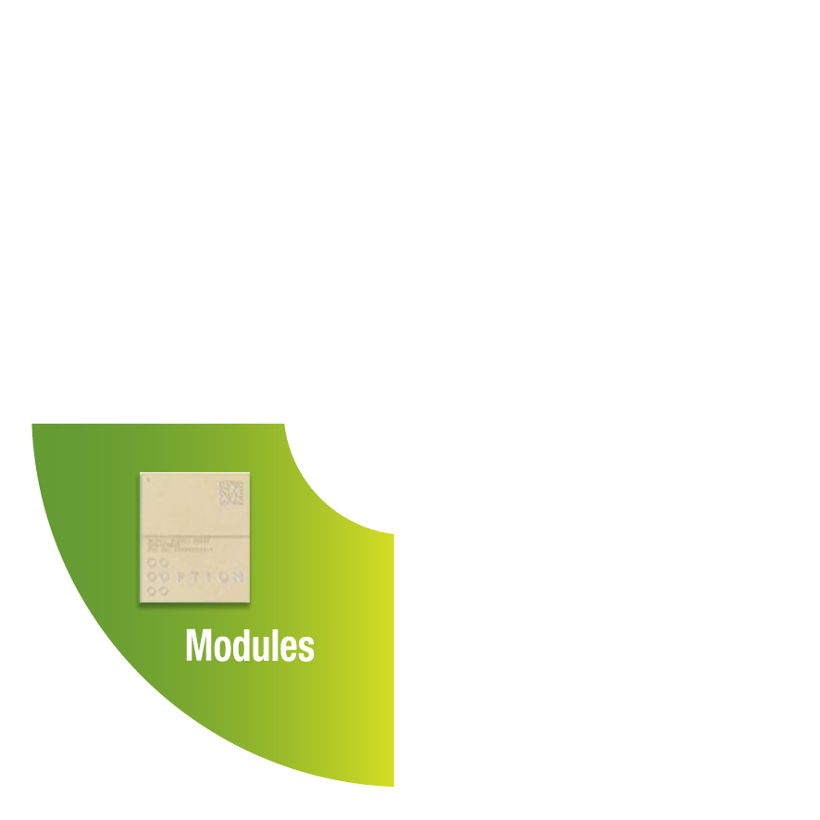



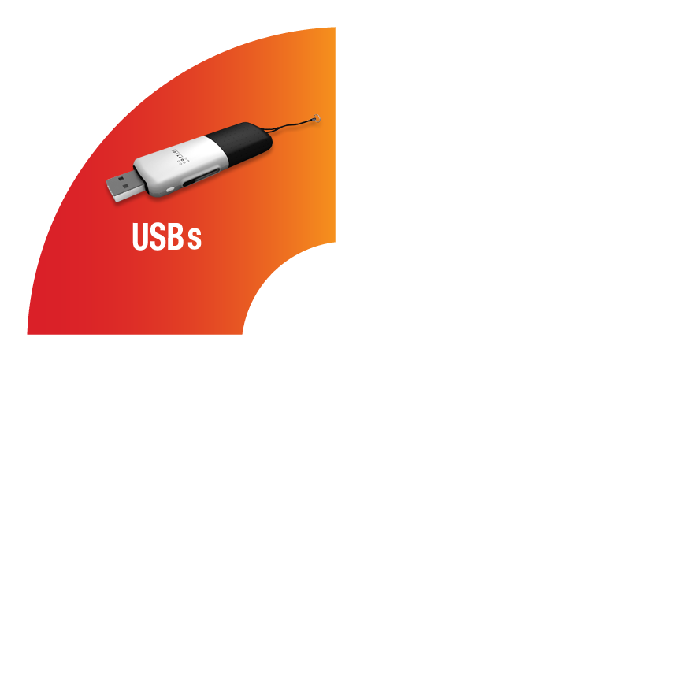
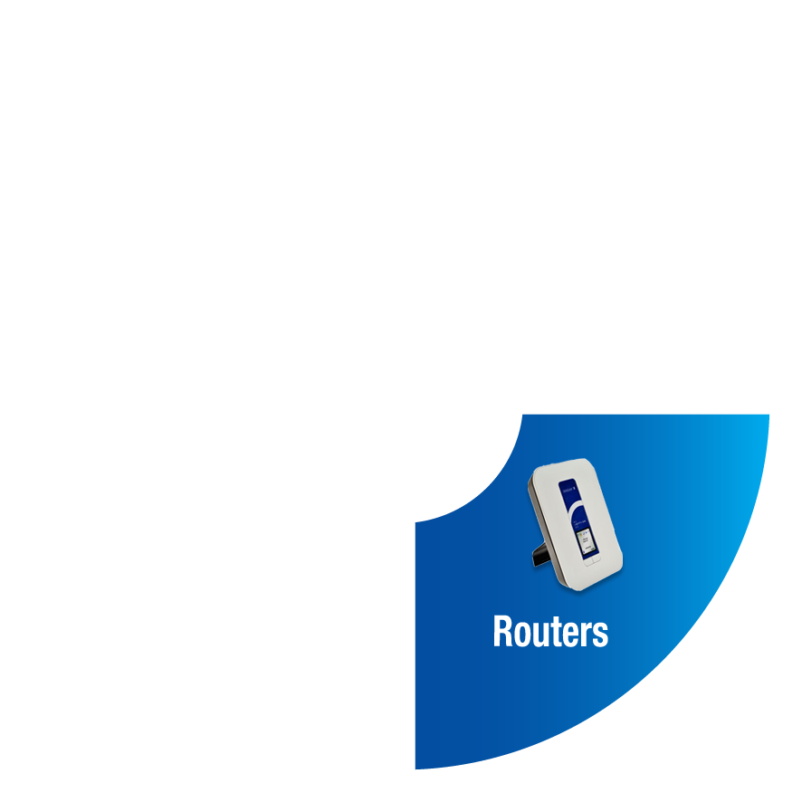
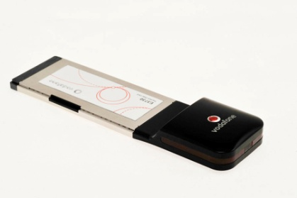

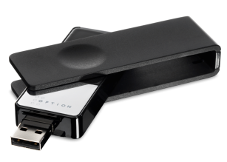

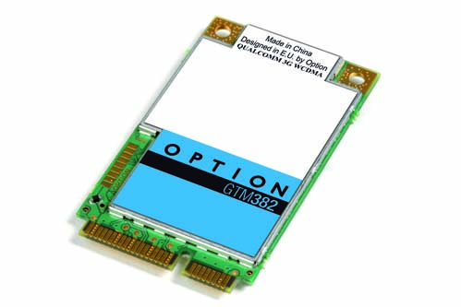
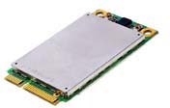
Option Portfolio Overview
Option offers state-of-the-art wireless modem products for all…
iCON401
Quad Band EDGE
Triple band 3G
(850 or 900/2100/1900)
HSUPA 2Mbps HSDPA 7.2 Mbps
GT Express 421
Quad Band EDGE
Triple band 3G (900/2100/1900)
HSUPA 2Mbps HSDPA 7.2 Mbps
GTM382
Quad Band EDGE
Quad band 3G
(900/2100/1900/AWS)
HSUPA 2Mbps HSDPA 7.2 Mbps
Voice - GPSOneXTRA

Slide 23
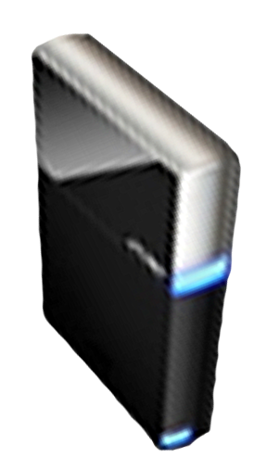


Please Complete A Session Evaluation Form
Your input is important!
Visit the WinHEC CommNet and complete a Session Evaluation for this session and be entered to win one
of 150 Maxtor® BlackArmor™ 160GB External Hard Drives
50 drives will be given away daily!
http://www.winhec2008.com
BlackArmor
Hard Drives provided by:

Slide 24


© 2008 Microsoft Corporation. All rights reserved. Microsoft, Windows, Windows Vista and other product names are or may be registered trademarks and/or trademarks in the U.S. and/or other countries.
The information herein is for informational purposes only and represents the current view of Microsoft Corporation as of the date of this presentation. Because Microsoft must respond to changing market conditions, it should not be interpreted to be a commitment on the part of Microsoft, and Microsoft cannot guarantee the accuracy of any information provided after the date of this presentation.
MICROSOFT MAKES NO WARRANTIES, EXPRESS, IMPLIED OR STATUTORY, AS TO THE INFORMATION IN THIS PRESENTATION.

