Slide 1

SQL Server 2008 Fast Track Data Warehouse 2.0
Accelerate your data warehouse roadmap

Slide 2



Microsoft Data Warehouse Vision
Make SQL Server the gold standard for data warehousing offering customers
Massive Scalability at Low Cost
Hardware Choice
Improved Business Agility and Alignment
Democratized Business Intelligence

Slide 3
Customer Challenges
Approximate data volume managed by data warehouse
Increased volumes of data
Need to reduce costs
Increased adoption of DW appliances
Move to MPP
Demand for flexibility and mixed workloads across the enterprise
Desire for real-time analytics
Growing importance of data quality
Today
In 3 Years
Less than 500 GB
21%
5%
500 GB – 1 TB
20%
12%
1 – 3 TB
21%
18%
3 – 10 TB
19%
25%
More than 10 TB
17%
34%
Don’t Know
2%
6%
Source: TDWI Report – Next Generation DW
Notes:
Now let’s take a look at the challenges facing data warehouse industry as a whole. The Data Warehouse Institute (TDWI) recently published a report entitled “Next Generation Data Warehouse Platforms”, which identified a number of common challenges.
Increased Volumes of Data – today’s largest data warehouses are in the 100’s of terabytes scale, but data volumes in many organizations are rising dramatically. Within 3 years, there will be significantly more organizations with 100’s of terabytes of data, and many organizations will be breaking into the petabyte range.
Need to reduce costs – The global economic recession of 2009 has affected companies of all sizes all over the world. Now more than ever, budgets are being squeezed and there is a growing requirement for IT services to do more with less.
Increased adoption of hardware appliances – more and more organizations are purchasing data warehouse appliances rather than building their own bespoke data warehouse server infrastructure and installing software.
Move to Massively Parallel Processing (MPP) – while symmetric multi-processing works well for today’s data warehouses and data marts, as data volume and data warehouse utilization grows, many organizations are looking to MPP processing architectures to increase scalability and performance.
Demand for flexibility and mixed workloads – Data Warehouses are now serving an increasing range and number of user groups, each with their own requirements and workloads. Organizations are trying to find ways to meet the needs of a diverse range of users while maintaining the overall consistency of enterprise data an the ability to adapt to changes in the business.
Desire for real-time analytics – While historical reporting and analysis continue to be important, organizations are increasingly looking for real-time analysis solutions that will enable them to be more responsive and informed when making critical business decisions.
Growing importance of data quality – Organizations are increasingly aware of the need for the data in their data warehouse to be accurate and consistent, so many data warehouse professionals are looking for data quality tools that will help them improve the overall quality of their data.

Slide 4
Customer Challenges
Increased volumes of data
Need to reduce costs
Increased adoption of DW appliances
Move to MPP
Demand for flexibility and mixed workloads across the enterprise
Desire for real-time analytics
Growing importance of data quality
Effect of current recession on DW teams and projects
Budget reduced
57%
Hiring frozen
41%
Approved projects on hold
30%
Priorities shift to short-term gains
31%
No impact so far
27%
New tool and platform acquisitions frozen
25%
Some team members laid off
19%
Focus shifted from new dev to admin of old solutions
18%
Other
3%
Source: TDWI Report – Next Generation DW
Notes:
Now let’s take a look at the challenges facing data warehouse industry as a whole. The Data Warehouse Institute (TDWI) recently published a report entitled “Next Generation Data Warehouse Platforms”, which identified a number of common challenges.
Increased Volumes of Data – today’s largest data warehouses are in the 100’s of terabytes scale, but data volumes in many organizations are rising dramatically. Within 3 years, there will be significantly more organizations with 100’s of terabytes of data, and many organizations will be breaking into the petabyte range.
Need to reduce costs – The global economic recession of 2009 has affected companies of all sizes all over the world. Now more than ever, budgets are being squeezed and there is a growing requirement for IT services to do more with less.
Increased adoption of hardware appliances – more and more organizations are purchasing data warehouse appliances rather than building their own bespoke data warehouse server infrastructure and installing software.
Move to Massively Parallel Processing (MPP) – while symmetric multi-processing works well for today’s data warehouses and data marts, as data volume and data warehouse utilization grows, many organizations are looking to MPP processing architectures to increase scalability and performance.
Demand for flexibility and mixed workloads – Data Warehouses are now serving an increasing range and number of user groups, each with their own requirements and workloads. Organizations are trying to find ways to meet the needs of a diverse range of users while maintaining the overall consistency of enterprise data an the ability to adapt to changes in the business.
Desire for real-time analytics – While historical reporting and analysis continue to be important, organizations are increasingly looking for real-time analysis solutions that will enable them to be more responsive and informed when making critical business decisions.
Growing importance of data quality – Organizations are increasingly aware of the need for the data in their data warehouse to be accurate and consistent, so many data warehouse professionals are looking for data quality tools that will help them improve the overall quality of their data.

Slide 5
Customer Challenges
Increased volumes of data
Need to reduce costs
Increased adoption of DW appliances
Move to MPP
Demand for flexibility and mixed workloads across the enterprise
Desire for real-time analytics
Growing importance of data quality
DW Processing Architectures
Have Today
Would Prefer
Symmetrical Multiprocessing (SMP)
61%
27%
Massively Parallel Processing (MPP)
33%
68%
Other
6%
5%
Source: TDWI Report – Next Generation DW
Notes:
Now let’s take a look at the challenges facing data warehouse industry as a whole. The Data Warehouse Institute (TDWI) recently published a report entitled “Next Generation Data Warehouse Platforms”, which identified a number of common challenges.
Increased Volumes of Data – today’s largest data warehouses are in the 100’s of terabytes scale, but data volumes in many organizations are rising dramatically. Within 3 years, there will be significantly more organizations with 100’s of terabytes of data, and many organizations will be breaking into the petabyte range.
Need to reduce costs – The global economic recession of 2009 has affected companies of all sizes all over the world. Now more than ever, budgets are being squeezed and there is a growing requirement for IT services to do more with less.
Increased adoption of hardware appliances – more and more organizations are purchasing data warehouse appliances rather than building their own bespoke data warehouse server infrastructure and installing software.
Move to Massively Parallel Processing (MPP) – while symmetric multi-processing works well for today’s data warehouses and data marts, as data volume and data warehouse utilization grows, many organizations are looking to MPP processing architectures to increase scalability and performance.
Demand for flexibility and mixed workloads – Data Warehouses are now serving an increasing range and number of user groups, each with their own requirements and workloads. Organizations are trying to find ways to meet the needs of a diverse range of users while maintaining the overall consistency of enterprise data an the ability to adapt to changes in the business.
Desire for real-time analytics – While historical reporting and analysis continue to be important, organizations are increasingly looking for real-time analysis solutions that will enable them to be more responsive and informed when making critical business decisions.
Growing importance of data quality – Organizations are increasingly aware of the need for the data in their data warehouse to be accurate and consistent, so many data warehouse professionals are looking for data quality tools that will help them improve the overall quality of their data.

Slide 6
Customer Challenges
Increased volumes of data
Need to reduce costs
Increased adoption of DW appliances
Move to MPP
Demand for flexibility and mixed workloads across the enterprise
Desire for real-time analytics
Growing importance of data quality
Techniques used in primary data warehouse solution
Today
In 3 years
Mixed Workloads
46%
72%
Advanced Analytics
(e.g. data mining/predictive)
38%
85%
Source: TDWI Report – Next Generation DW
Notes:
Now let’s take a look at the challenges facing data warehouse industry as a whole. The Data Warehouse Institute (TDWI) recently published a report entitled “Next Generation Data Warehouse Platforms”, which identified a number of common challenges.
Increased Volumes of Data – today’s largest data warehouses are in the 100’s of terabytes scale, but data volumes in many organizations are rising dramatically. Within 3 years, there will be significantly more organizations with 100’s of terabytes of data, and many organizations will be breaking into the petabyte range.
Need to reduce costs – The global economic recession of 2009 has affected companies of all sizes all over the world. Now more than ever, budgets are being squeezed and there is a growing requirement for IT services to do more with less.
Increased adoption of hardware appliances – more and more organizations are purchasing data warehouse appliances rather than building their own bespoke data warehouse server infrastructure and installing software.
Move to Massively Parallel Processing (MPP) – while symmetric multi-processing works well for today’s data warehouses and data marts, as data volume and data warehouse utilization grows, many organizations are looking to MPP processing architectures to increase scalability and performance.
Demand for flexibility and mixed workloads – Data Warehouses are now serving an increasing range and number of user groups, each with their own requirements and workloads. Organizations are trying to find ways to meet the needs of a diverse range of users while maintaining the overall consistency of enterprise data an the ability to adapt to changes in the business.
Desire for real-time analytics – While historical reporting and analysis continue to be important, organizations are increasingly looking for real-time analysis solutions that will enable them to be more responsive and informed when making critical business decisions.
Growing importance of data quality – Organizations are increasingly aware of the need for the data in their data warehouse to be accurate and consistent, so many data warehouse professionals are looking for data quality tools that will help them improve the overall quality of their data.

Slide 7
Data Warehouse Industry Trends
100%
Good growth, good commitment
Broad Commitment
Advanced Analytics
Flat growth, good/moderate commitment
Centralized EDW
Analytics within EDW
Data Quality
✓
75%
✓
HA for DW
✓
✓
64-bit
MDM
Analytics Outside EDW
Blades in Racks
DBMS Built for DW
Web Services
✓
✓
Real-time DW
MPP
Security
Plan to Use
50%
DBMS Built for Transactions
SMP
✓
Streaming Data
SOA
Low-Power Hardware
DW Appliance
✓
✓
Good growth, moderate commitment
Mixed Workloads
Server Virtualization
Data Federation
DW Bundles
Columnar DBMS
In-Memory DBMS
25%
SaaS
Open Source OS
Open Source
Reporting
Good growth, small commitment
Declining usage despite commitment
Narrow Commitment
Software Appliance
Open Source
Data Integration
Public Cloud
Open Source DBMS
0%
-50%
-25%
0%
25%
50%
75%
100%
Decreasing Usage
Anticipated Growth in the next 3 Years
Increasing Usage
✓ Areas of strategic investment for Microsoft
Source: TDWI
Notes:
This chart, taken from the TDWI Next Generation Data Warehouse Platforms report, shows data warehouse features and techniques plotted for delta (growth) and plan to use (commitment).
As you’ll see in the rest of this presentation, Microsoft’s strategy for data warehousing aligns extremely well with the features and techniques that have broad commitment and good growth. The green ticks show specific technology areas Microsoft is strategically investing in.

Slide 8
SQL Server Fast Track Data Warehouse
Solution to help customers and partners accelerate their data warehouse deployments
A method for designing a cost-effective, balanced system for Data Warehouse workloads
Reference hardware configurations developed in conjunction with hardware partners using this method
Best practices for data layout, loading and management

Slide 9
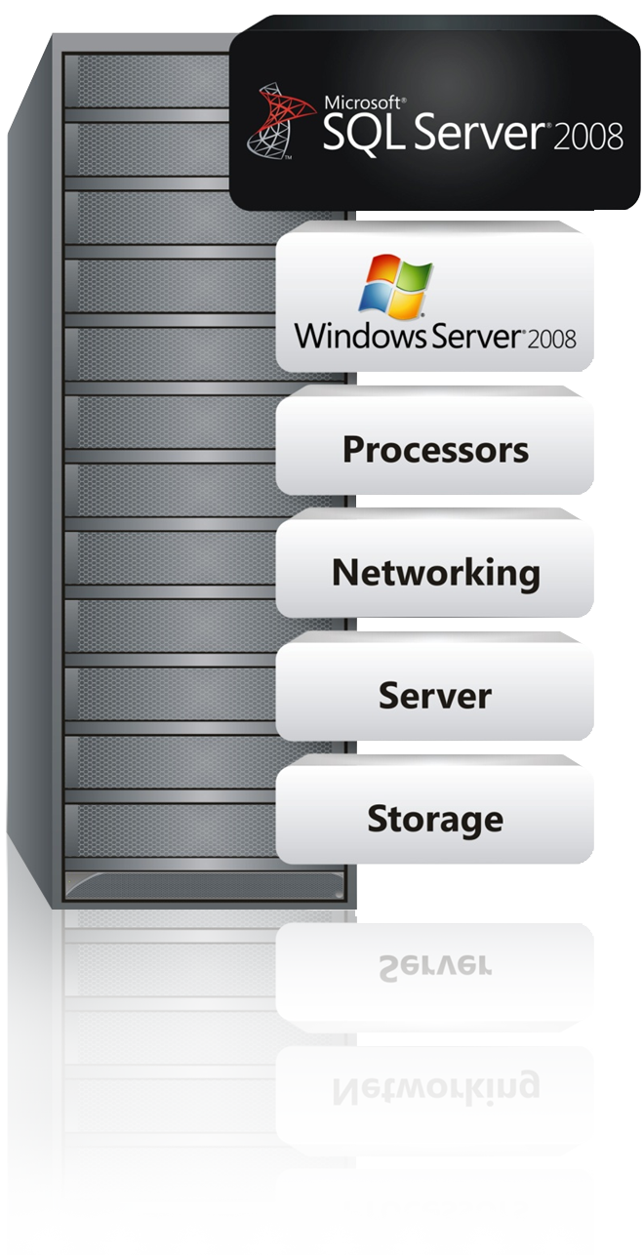
Fast Track Data Warehouse Components
Software:
SQL Server 2008 Enterprise
Windows Server 2008
Configuration guidelines:
Physical table structures
Indexes
Compression
SQL Server settings
Windows Server settings
Loading
Hardware:
Tight specifications for servers, storage and networking
‘Per core’ building block
<Session Name> Microsoft NDA-only

Slide 10






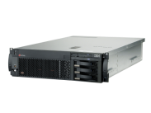


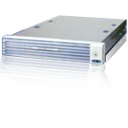






Fast Track Data Warehouse 2.0
Twelve SMP Reference Architectures
SI Solution Templates

Slide 11






Fast Track Data Warehouse value prop
Appliance-like time to value
Reduces DBA effort; fewer indexes, much higher level of sequential I/O
Choice of HW Platforms
Dell, HP, Bull, EMC and IBM – more in future
Low TCO Through
Industry standard Hardware and value pricing; Lower storage costs.
High Scale
New reference architectures scale up to 48 TB (assuming 2.5x compression)
Reduced Risk
Validated by Microsoft; better choice of hardware; application of Best Practice
<Session Name> Microsoft NDA-only

Slide 12
Fast Track Case Study - Environment
Current Environment
Teradata 4-node (5450 model) with 6TB of user data
BI: Business Objects
ETL: Informatica and BTEQ scripts
Proposed Microsoft Platform
SQL Server Fast Track Data Warehouse
HP DL580 Server - 4 Quadcore Processors (16 core total)
256 GB Memory
SAN Storage: MSA 2000 (Qty 4) – 8TB User Data Capacity
BI: Business Objects
ETL: SQL Server and SSIS

Slide 13
Fast Track Case Study – Results
 | Teradata | SQL Server Fast Track DW | Comparison
Loading Subject Area 1 | 5:10:21 total time | 0:51:31 total time | R 6x faster
Loading Subject Area 2 | 4:36:08 total time | 1:50.01 total time | R 2.5x faster
Query times Subject Area 1 | 3:03 avg query time (using 9 benchmark queries) | 0:15 avg query time (using 9 benchmark queries) | R 12x faster
Query times Subject Area 2 | 56:44 avg query time (using 4 benchmark queries) | 8:09 avg query time (using 4 benchmark queries) | R 7x faster

Slide 14
Fast Track Case Study - Pricing
Fast Track Pricing* (at List)
Hardware (8TB capacity) $152,500
SQL Server – 2 options
Server CAL (100) License $26,119
Total SW & HW* $178, 619
Price per TB (8TB) – CAL $22,327
Expand to 16 TB
Additional Hardware* $37,016
Total Price w/CAL license $215,635
Price per TB (16TB) – CAL $13,477
*NOTE: The above calculation is based on Microsoft estimated retail price for SQL Server 2008 Enterprise, Windows Server 2003, and published hardware prices available through participating resellers as of May 2009. Actual reseller prices may vary.

Slide 15

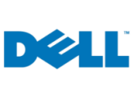

Fast Track Reference Configurations
2 Processor Configurations 4 – 12 TB
HP ProLiant DL380 G6
HP ProLiant DL385 G6
IBM System x3650 M2
Dell Power Edge R710
Bull Novascale R460 E2
4 Processor Configurations 12 – 24 TB
HP ProLiant DL 580 G5
HP ProLiant DL 585 G6
IBM System x3850 M2
Dell Power Edge R900
Bull Novascale R480 E1
8 processor Configurations 16 – 48 TB
HP ProLiant DL 785 G6
IBM System x3950 M2
Represents storage array fully populated with 300GB15k SAS and use of 2.5:1 compression ratio. This includes the addition of one storage expansion tray per enclosure. 30% of this storage should be reserved for DBA operations

Slide 16

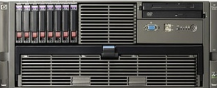
SQL Server Fast Track Data Warehouse 2.0 for HP – now on G6 Platform
Five AMD and Intel based Reference configurations available for HP:
AMD Based Reference Architectures
2 Processor Configuration
Server: HP ProLiant DL385 G6 with 2 6-core AMD Opteron CPUs
Storage server: MSA Storage
Scalability: 4 – 12 TB
4 Processor Configuration
Server: HP ProLiant DL 585 G6 with 4 6-core AMD Opteron CPUs
Storage server: MSA Storage
Scalability: 12 – 24 TB
8 processor Configuration
Server: HP ProLiant DL 785 G6 with 8 6-core AMD
Opteron CPUs
Storage server: MSA Storage
Scalability: 24 – 48TB

Slide 17

SQL Server Fast Track Data Warehouse 2.0 for HP – now on G6 Platform
Intel Based Reference Architectures
2 Processor Configuration
Server: HP ProLiant DL380 G6 with 2 4-core Intel Xeon® 5500 Series CPUs
Storage server: MSA Storage
Scalability: 4 – 8 TB
4 Processor Configuration
Server: HP ProLiant DL 580 G5 with 4 6-core Intel Xeon® 7400 Series CPUs
Storage server: MSA Storage
Scalability: 12 – 24 TB

Slide 18
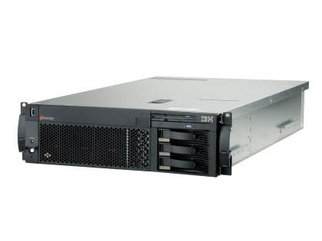
New Fast Track Data Warehouse 2.0 for IBM
Three Reference configurations available for IBM:
2 Processor Configuration
Server: IBM System x3650 M2 with 2 Quad-core Intel Xeon CPUs
Storage server: IBM System Storage DS3400
Scalability: 4 – 8 TB
4 Processor Configuration
Server: IBM System x3850 M2 with 4 6-core Intel Xeon CPUs
Storage server: IBM System Storage DS3400
Scalability: 12 – 24 TB
8 processor Configuration
Server: IBM System x3950 M2 with 8 Quad-core Intel Xeon CPUs
Storage server: IBM System Storage DS3400
Scalability: 16 – 32TB

Slide 19
SQL Server Fast Track Data Warehouse 2.0 for DELL
Two Reference configurations available for DELL:
2 Processor Configuration
Server: Dell Power Edge R710 with 2 Quad-core Intel Xeon processors
8 CPU Cores
32GB Memory
Storage server: EMC CLARiiON AX4
Scalability: 4 – 8 TB
4 Processor Configuration
Server: Dell Power Edge R900 with 4 6-core Intel Xeon processors
24 CPU Cores
96 GB Memory
Storage server: EMC CLARiiON AX4
Scalability: 12 – 24 TB

Slide 20
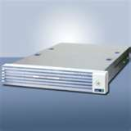
SQL Server Fast Track Data Warehouse for BULL
Two Reference configurations available for BULL:
2 Processor Configuration
Server: Bull Novascale R460 E2 with 2 Quad-core Intel Xeon processors
Storage server: EMC CLARiiON AX4
Scalability: 4 – 8 TB
4 Processor Configuration
Server: Bull Novascale R480 E1 with 4 6-core Intel Xeon processors
Storage server: EMC CLARiiON AX4
Scalability: 12 – 24 TB
Also included in the Rack:
SQL Server Analysis Services
SQL Server Reporting Services
SQL Server Integration Services
HA Server
Administration Server (with Management Studio, Backup Server

Slide 21






Fast Track Data Warehouse Timeline
Fast Track vNext
2.0
Enterprise ETL Services
Star Join Query Optimizations
Data Compression
Partitioned table parallelism
New Reference Architectures from IBM
Updated Configurations from HP, Dell and Bull
EMC as a Service Partner for Fast Track
Future Partners to create new Validated Reference Architectures with Test Harness
2008
2009
2010
Beyond
Test Harness for Partners
Microsoft to create Test Harness for validation of new Fast Track configurations
NEC to validate new Reference Architectures
DW Reference Architectures
Predictable performance at low cost
Faster time to solution
?
?
?
Preliminary Information Subject to Change

Slide 22
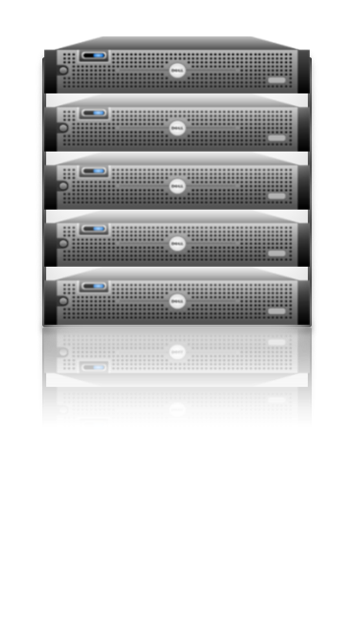




Hub and Spoke – Flexible Business Alignment
EDW provides “single version of truth” but makes it difficult to support mixed workloads and multiple user groups, each requiring SLAs
Notes:
The Enterprise Data Warehouse (EDW) is a common way to centralize business data for all BI needs throughout the organization. In this case, the EDW is a “single version of the truth”. The centralized architecture simplifies data governance, making it straightforward to track and audit data. Yet as the EDW becomes successful and adoption increases, it becomes inflexible, expensive, and unresponsive to business needs since it is harder to make changes to the data warehouse.

Slide 23
Hub and Spoke – Flexible Business Alignment
Departmental data marts enable mixed workloads, but make it difficult to consolidate information across the enterprise
Notes:
Independent data marts, each serving the needs of a single user group (e.g. The sales team, the HR team, etc.) provide a decentralized alternative to the EDW model, enabling business units to create and tune data marts to suit their own needs. However, data governance can be difficult because it is harder to link data across the company. Though it is more responsive, this approach often causes serious management issues for IT departments that have to deal with compliance and IT governance across the organization.

Slide 24
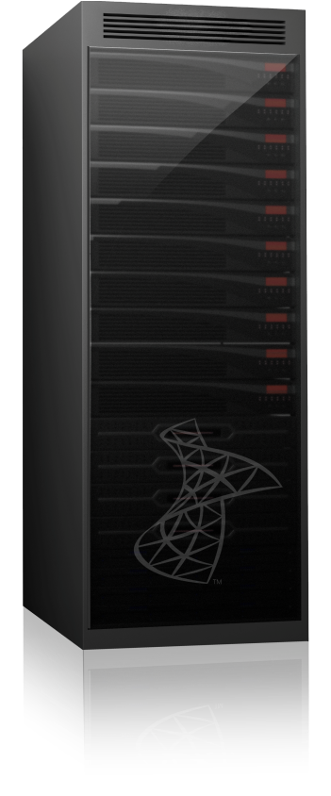



Hub and Spoke – Flexible Business Alignment
Parallel database copy technology enables rapid data movement and consistency between hub and spokes
Support user groups with very different SLAs:
Performance
Capacity
Loading
Concurrency
Create SQL Server 2008, Fast Track Data Warehouse, and SQL Server Analysis Services spokes
A Hub and Spoke solution gives you the flexibility to add/change diverse workloads/user groups, while maintaining data consistency across the enterprise
Notes:
A hub and spoke solution, such as that supported by SQL Server Parallel Data Warehouse, comprises a centralized EDW and a set of loosely coupled data marts. For many years, this has been the preferred approach for enterprise-wide data warehousing, and numerous studies since 2003 confirm that hub and spoke is the most popular data warehouse architecture among DW professionals. Traditionally, implementing a hub and spoke architecture has been challenging due to practical limitations of the database engine and network resources.
With SQL Server Parallel Data Warehouse, you can create a diverse range of types of spoke, from SQL Server Parallel Data Warehouse MPP appliances for user groups with extreme scalability requirements, fast track data warehouse implementations, SQL Server 2008 Enterprise data warehouses, and even SQL Server 2008 Analysis Services OLAP databases.
However, SQL Server Parallel Data Warehouse’s parallel database copy technology enables rapid data integration between spokes and the SQL Server Parallel Data Warehouse hub, making it easier to build hub and spoke solutions that integrate your diverse data marts and the enterprise data warehouse.
SQL Server Parallel Data Warehouse’s Hub and Spoke architecture enables you to support user groups with very different SLAs; supports hot, warm and cold data; different requirements on data Loading, etc.

Slide 25
Next Steps
Learn More:
Visit the Microsoft Data Warehousing portal
Visit the Fast Track and Parallel Data Warehouse web pages
Visit the SQL Server DW Portal on TechNet
Try Now:
Talk to your Microsoft representative about scheduling:
Data Warehouse roadmap service
Fast Track POC

Slide 26



Summary
Faster time to solution
High scale: up to 48TB
Low TCO with better price performance; industry standard hardware
Better performance out of the box and predictable performance
Reduced risk through balanced hardware & Best practices
Integration with Madison Hub & Spoke Architecture
Fast Track Data Warehouse offers customers
SQL Server Fast Track Data Warehouse has 2 components
Twelve reference architectures from HP, Dell, Bull, EMC and IBM
System Integrators with industry solution templates – Avanade, HP, Hitachi, Cognizant and EMC

Slide 27

© 2009 Microsoft Corporation. All rights reserved. Microsoft, Windows, Windows Vista and other product names are or may be registered trademarks and/or trademarks in the U.S. and/or other countries.
The information herein is for informational purposes only and represents the current view of Microsoft Corporation as of the date of this presentation. Because Microsoft must respond to changing market conditions, it should not be interpreted to be a commitment on the part of Microsoft, and Microsoft cannot guarantee the accuracy of any information provided after the date of this presentation. MICROSOFT MAKES NO WARRANTIES, EXPRESS, IMPLIED OR STATUTORY, AS TO THE INFORMATION IN THIS PRESENTATION.

