Slide 1


Slide 2

Security Features
Vitalis Konopelec
Technology Solution Professional
vitalis.konopelec@microsoft.com
Microsoft Slovakia s.r.o.

Slide 3
Windows Server 2008 Security
Improved Networking
Complex Server Protection
Server Hardening
BitLocker ™ Drive Encryption
Network Access Protection
Server Core
Read-only Domain controller
AD Right Management Services
AD Federation Services

Slide 4
Complete Redesign of TCP/IP
Winsock
User Mode
WSK Clients
AFD
TDI Clients
Kernel Mode
TDI
WSK
Next Generation TCP/IP Stack (tcpip.sys)
TDX
TCP
UDP
RAW
Next Generation TCP/IP Stack (tcpip.sys)
TCP
UDP
RAW
IPv4
IPv6
IPv4
IPv6
Inspection API
802.3
WLAN
Loop-back
IPv4 Tunnel
IPv6 Tunnel
802.3
WLAN
Loop-back
IPv4 Tunnel
IPv6 Tunnel
NDIS
Dual-IP layer architecture for native IPv4 and IPv6 support
Improved Network Performance Troubleshooting
Improved performance via hardware acceleration and autotuning
Greater extensibility and reliability through rich APIs
Completely manageable through Group Policy

Slide 5








Key New Networking Features
Receive Window Autotuning
Windows Filtering Platform
Automatically senses network environment and adjusts key performance settings
Allows increase of the size of the TCP/IP send / receive window
Provides filtering capability at all layers of the TCP/IP protocol stack
Integrates and provides support for next-generation firewall features
Receive Side Scaling
Policy-based Quality of Service
Previous Windows operating systems limits receive protocol processing to single CPU
RSS resolves this issue by allowing network load from a network adapter to be balanced across multiple CPUs
Prioritize or manage the sending rate for outgoing network traffic
Both DSCP marking and throttling can be used together to manage traffic effectively

Slide 6
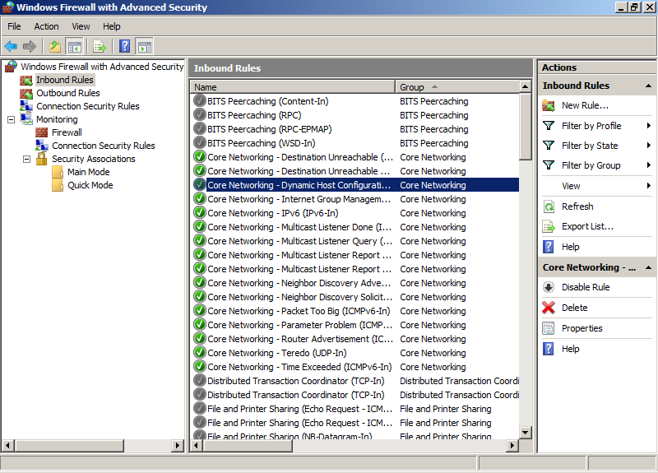
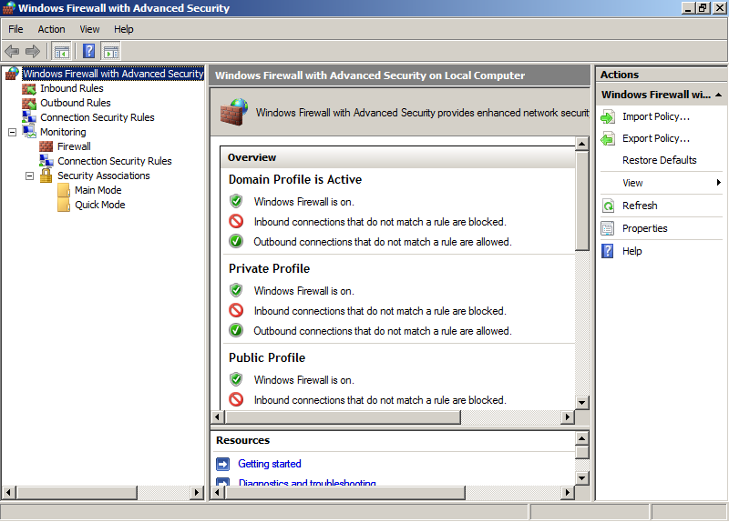
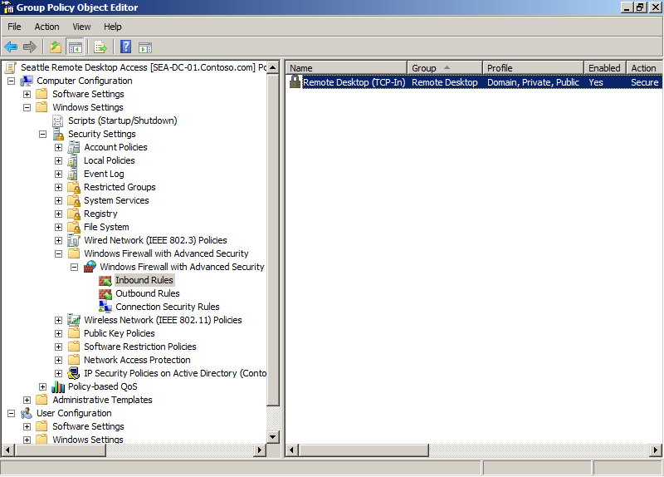
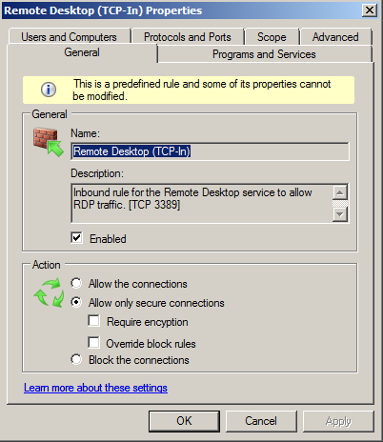
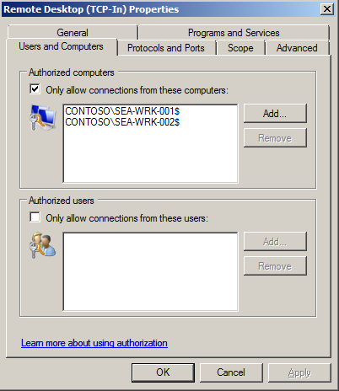
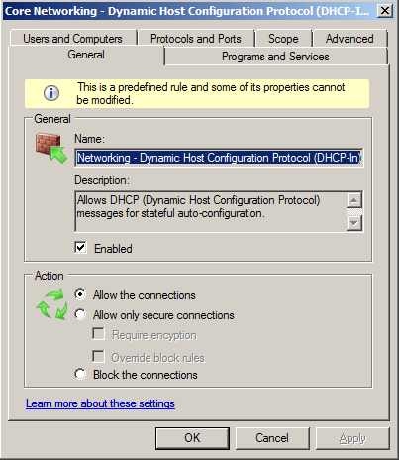
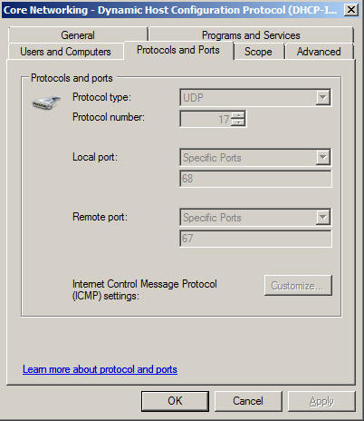
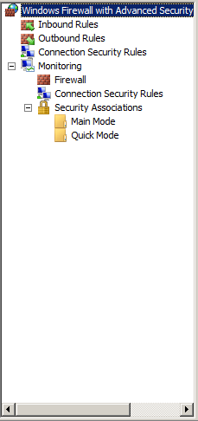
Windows Firewall
Policy-based networking
Firewall rules become more intelligent
Combined firewall and IPsec management

Slide 7
Windows Firewall Demo
Firewall Management Console
Basic Configuration
Advanced networking configuration
Monitoring and diagnostics tools

Slide 8
Server Protection
Security
Compliance
Development Process
Secure Startup and shield up at install
Code integrity
Windows service hardening
Inbound and outbound firewall
Restart Manager
Improved auditing
Network Access Protection
Event Forwarding
Policy Based Networking
Server and Domain Isolation
Removable Device Installation Control
Active Directory Rights Management Services

Slide 9


Server Hardening
Windows Server 2003 R2
Windows Server 2008
LocalSystem
Firewall Restricted
LocalSystem
LocalSystem
Network Service
Fully Restricted
Network Service
Network Service
Network Restricted
Local Service
Local Service
No Network Access
Local Service
Fully Restricted

Slide 10
Security Configuration Wizard Demo
Security Configuration wizard overview
Step by step configuration
Saving, importing and applying of security templates

Slide 11








BitLocker ™ Drive Encryption
Data protection and security
Full Volume Encryption Key (FVEK)
Encryption Policy
Group Policy allows central encryption policy and provides Branch Office protection
Provides data protection, even when the system is in unauthorized hands or is running a different or exploiting Operating System
Uses a v1.2 TPM or USB flash drive for key storage

Slide 12






Network Access Protection (NAP)
Client health and compliance based network access restrictions
What is Network Access Protection?
Policy Servers
such as: Patch, AV
Health Policy Validation
Health Policy Compliance
Not policy compliant
Remediation
Servers
Example: Patch
Ability to Provide Limited Access
Restricted
Network
Enhanced Security
Policy compliant
Windows
Client
DHCP, VPN
Switch/Router
Corporate Network
Increased Business Value
NPS
Cisco and Microsoft Integration Story
Notes:
Title: Using Network Access Protection
Talking Points: Let’s look in more depth in how Network Access Protection works.
Network Access Protection works with agents in the Windows XP SP2 or Windows Vista client operating systems. The client environment includes the System Health Agents (SHAs), a Quarantine Agent (QA) and an Enforcement Client (EC). The Secure Hash Algorithm (SHA) checks the state of a client and declares its health. Each SHA is defined for a system health requirement or a set of system health requirements. For example, there might be an SHA for antivirus signatures and an SHA for operating system updates.
[BUILD1] Try to Connect to a Network: When a Windows client computer connects though DHCP, a VPN, or a router, the system health validators state what the computer’s health is.
[BUILD2] System Health Agent: The access device then forwards the network access request on to the NPS. The NPS includes the System Health Validator (SHV) and the Quarantine Server (QS). The QS coordinates the SHVs which certify declarations made by health agents.
Active Directory stores user and computer accounts and their network access properties for authenticated network access. The NPS itself does not make the authentication decision, but evaluates the connection and then forwards the credentials on to Active Directory.
[BUILD3] Remediation Server: If a computer is not compliant, it is sent to a restricted network, where the remediation servers can apply security updates or whatever else is needed to enable compliance. Remediation servers consist of servers, services, or other resources that a noncompliant computer on the restricted network can access. These resources might store the most recent software updates or components needed to make the computer comply with health requirements. For example, a secondary DNS server, an antivirus signature file server, and a software update server could all be remediation servers.
[BUILD4] Computer that meets Health Policy: If a client is compliant, then the system is given access to the corporate network.
Additional Information:
http://www.microsoft.com/windowsserver2008/default.mspx
www.microsoft.com/technet/Add-301.ppt , Add-302.ppt

Slide 13


Using Network Access Protection
Policy Servers
such as: Patch, AV
3
1
2
Not policy compliant
4
Remediation
Servers
Example: Patch
Windows
Client
DHCP, VPN
Switch/Router
NPS
Restricted
Network
Policy compliant
5
Corporate Network
If not policy compliant, client is put in a restricted VLAN and given access to fix up resources to download patches, configurations, signatures (Repeat 1 - 4)
Network Policy Server (NPS) validates against IT-defined health policy
Client requests access to network and presents current health state
DHCP, VPN or Switch/Router relays health status to Microsoft Network Policy Server (RADIUS)
2
If policy compliant, client is granted full access to corporate network
3
4
5
1

Slide 14
NAP Demo
Configuration of DHCP / NAP protection
Configuration of VPN / RAS protection
System Health Validators
NAP Live: access via VPN
NAP Live: access from internal network

Slide 15
Server Core
Minimal server footprint for reduced maintenance
Server Core
Security, TCP/IP, File Systems, RPC, plus other Core Server Sub-Systems
WSv
AD DS
DHCP
AD LDS
DNS
Media
GUI, CLR, Shell, IE, OE, etc.
File
Print
Only a subset of the executable files and DLLs installed
No GUI interface installed
Five available Server Roles
Can be managed with remote tools

Slide 16
Server Core
Server Core management console
Server Core – configuring network & firewall

Slide 17

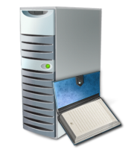
Read-only Domain Controller
Minimal server footprint for reduced maintenance
RODC
Main Office
Branch Office
Features
Read Only Active Directory Database
Only allowed user passwords are stored on RODC
Unidirectional Replication
Role Separation
Benefits
Increases security for remote Domain Controllers where physical security cannot be guaranteed
Support
ADFS,DNS, DHCP, FRS V1, DFSR (FRS V2), Group Policy, IAS/VPN, DFS, SMS, ADSI queries, MOM
Notes:
Title: Read-Only Domain Controller (RODC)
Talking Points: The Read-Only Domain Controller (RODC) provides increased security for locations such as Branch Offices.
A read-only domain controller (RODC) is a new type of domain controller in the Windows Server 2008 operating system. The Read-Only Domain Controller (RODC) is primarily targeted toward branch offices or edge sites. RODC doesn’t store any passwords, by default. That way, if the RODC is compromised, then an administrator doesn’t have to worry about someone gaining access to the entire network using the information stored on that server. This addresses the lack of security that can occur at branch offices. So the threat to the Active Directory is drastically reduced.
[BUILD1] RODC Features: RODC are read-only state with unidirectional (read-only) replication for Active Directory and FRS\DFSR. Each RODC has its own KDC KrbTGT account—this is the account that issues tickets. This provides cryptographic isolation. RODC uses workstation accounts, so it has very limited rights to write in Active Directory, to minimize unauthorized access. And since RODCs have workstation accounts, they have no EDC or Display Data Channel (DDC) group membership.
Because no changes are written directly to the RODC, and therefore do not originate locally, writable domain controllers that are replication partners do not have to pull changes from the RODC. This reduces the workload of bridgehead servers in the hub site, and the effort required to monitor replication.
RODC unidirectional replication applies to both AD DS and Distributed File System Replication. The RODC performs normal inbound replication for AD DS and Distributed File System Replication changes.
RODC also uses credential caching. Credential caching is the storage of user or computer credentials. Credentials consist of a small set of approximately 10 passwords that are associated with security principals.
With Role Separation you can delegate the local administrator role of an RODC to any domain user without granting that user any user rights for the domain, or other domain controllers. This permits a local branch user to log on to an RODC and perform maintenance work on the server, such as upgrading a driver. However, the branch user cannot log on to any other domain controller or perform any other administrative task in the domain. In this way, the branch user can be delegated the ability to effectively manage the RODC in the branch office without compromising the security of the rest of the domain.
[BUILD2] RODC Benefits: RODCs provide a way to deploy a domain controller more securely in a branch office location, extranet, or an application-facing role. RODCs are designed to be placed in locations that require rapid, reliable, and robust authentication services but that might also have a security limitation that prevents deployment of a writable domain controller. With an RODC, organizations can easily deploy a domain controller in locations where physical security cannot be guaranteed.
[BUILD3] RODC Support: RODCs provide support for: ADFS, DNS, DHCP, FRS V1, DFSR (FRS V2), Group Policy, IAS/VPN, DFS, SMS, ADSI queries, and MOM.
We provide more detailed information on how RODC works and what is required to implement RODC in Windows Server 2008 in the next two slides.
Additional Information:
http://windowslaunch
http://www.microsoft.com/windowsserver2008/default.mspx
http://www.microsoft.com/windowsserver2008/branch-office.mspx
www.microsoft.com/technet/Add-301.ppt

Slide 18

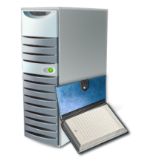
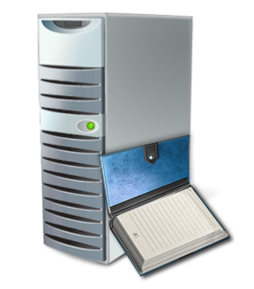



How RODC works
Minimal server footprint for reduced maintenance
Windows Server 2008 DC
Read Only DC
3
4
2
Hub
RODC
Branch
5
6
1
6
RODC: Looks in DB: "I don't have the users secrets"
Forwards Request to Windows Server 2008 DC
Windows Server 2008 DC authenticates request
Returns authentication response and TGT back to the RODC
2
RODC gives TGT to User and RODC will cache credentials
3
4
5
6
1
User logs on and authenticates
Notes:
Title: How RODC Works
Talking point: This describes how RODC works, and what is required by IT staff to run an RODC on Windows Server 2008.
Let’s look at how the RODC works.
[BUILD1] A user in the branch office attempts to log on to the domain and an Authentication Service Request is sent to the RODC, requesting a Ticket-Granting Ticket (TGT).
[BUILD2] Next, RODC looks in its database to determine if the user request information can be located. In this case, it cannot locate the user’s password.
[BUILD3] RODC then forwards the request to a writable domain controller; in this case, the Windows Server 2008 Domain Controller in the hub site.
[BUILD4] The writable domain controller recognizes that the request is coming from an RODC, because of the use of the special krbtgt account of the RODC. It then authenticates the request. The Password Replication Policy that is enforced at the writable domain controller determines if a user's credentials or a computer's credentials can be replicated from the writable domain controller to the RODC.
[BUILD5] The writable domain controller then returns the authentication response and TGT to the RODC.
[BUILD6] The RODC then gives the TGT to user. If the Password Replication Policy allows it, the RODC replicates the credentials from the writable domain controller, and the RODC will cache them. After the credentials are cached on the RODC, the RODC can directly service that user's or computer's logon requests, until the credentials change.
What is required to run RODC: There are many changes to how RODC works in Windows Server 2008. The Windows Server 2008 RODC is designed to run in existing environments. The only thing required is Windows Server 2003 Forest Functional Mode, because of linked value replication; and one domain controller running Windows Server 2008. This domain controller must hold the PDC emulator operations master role for the domain to create the new KrbTGT account for the RODC. The RODC needs to forward authentication requests to a domain controller running Windows Server 2008. The Password Replication Policy is set on this domain controller to determine if credentials are replicated to the branch location for a forwarded request from the RODC. The domain functional level must be Windows Server 2003 or later, so that Kerberos constrained delegation is available. Constrained delegation is for security calls that need to be impersonated under the context of the caller. The forest functional level must be Windows Server 2003 or later, so that linked-value replication is available, which provides a higher level of replication consistency.
There is no patching to down-level DC or clients or domain restructuring required. Multiple Windows Server 2008 Domain Controllers per domain are recommended, to load-balance RODC replication. Because of unidirectional replication and x64, IT staff may be able to consolidate bridgehead servers, because they don’t have to worry about that serial replication from hundreds of branches. Multiple RODCs for the same domain in the same site are not supported because RODCs in the same site do not share information with each other. Therefore, deploying multiple RODCs for the same domain in the same site can lead to inconsistent logon experiences for users if the writeable domain controllers cannot be reached on the network.
Additional Information:
http://www.microsoft.com/windowsserver2008/default.mspx
http://www.microsoft.com/windowsserver2008/branch-office.mspx
www.microsoft.com/technet/Add-306.ppt

Slide 19
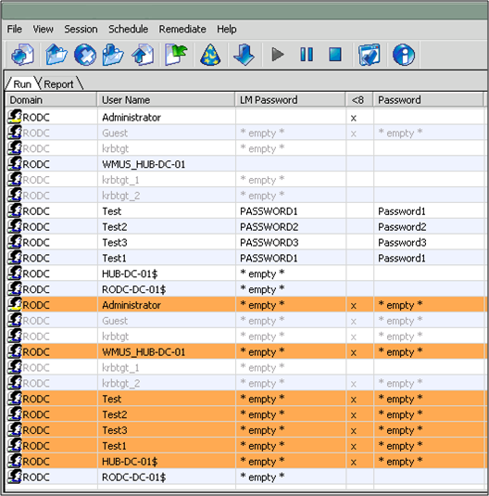
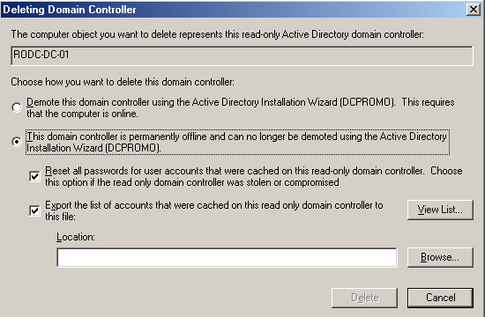
Read-only DC Mitigates “Stolen DC”
Hub Admin Perspective
Attacker Perspective
Notes:
Title: How RODC Mitigates a Stolen DC
Talking Points: A Read-only Domain Controller (RODC) can be used in places such as branch offices where security is important or staff may have limited IT expertise. The RODC provides extra security that protects from attacks by limiting the chance of a stolen domain controller.
RODC addresses some of the problems commonly found in branch offices. These locations might not have a domain controller. Alternatively, they might have a writable domain controller, but not the physical security, network bandwidth, or local expertise to support it.
Attacker Perspective: On an RODC, only the passwords for accounts available on the RODC are displayed. If the system is attacked, the attacker would have access to fewer passwords.
RODC Reduces the Chance of an Attack: The chances of an attack are reduced when using RODC because of the way passwords are stored. On a non-RODC server, all passwords are stored on the server. In case of a malicious attack, the attacker would have access to all passwords.
[BUILD1] Hub Admin Perspective: If a RODC is compromised, the administrator can demote the RODC and can quickly reset all passwords for accounts that were cached on that RODC.
Provide the Optimal System Defense by Combining RODC with BitLocker: For the optimal security and defense against data theft, RODC can be combined with BitLocker Drive Encryption.
RODC Has Lower Bandwidth Requirements: Remote sites, such as branch offices, often have poor network bandwidth when connected to a hub site. This can increase the amount of time required for a user to log on, and it can also hamper a user’s access to network resources. An added benefit when using RODC is that users experience faster logon times, there is more efficient access to resources on the network, and improved network bandwidth.
Additional Information:
http://windowslaunch
http://www.microsoft.com/windowsserver2008/default.mspx
http://www.microsoft.com/windowsserver2008/branch-office.mspx
www.microsoft.com/technet/Add-301.ppt

Slide 20
Demoting RODC Demo
Demoting RODC on Hub DC

Slide 21





AD Rights Management Services
AD RMS protects access to an organization’s digital files
AD RMS in Windows Server 2008 includes several new features
Improved installation and administration experience
Self-enrollment of the AD RMS cluster
Integration with AD Federation Services
New AD RMS administrative roles
RMS Server
SQL
AD
Information Author
The Recipient
Notes:
Title: Active Directory Rights Management Services (AD RMS)
Talking Points: Windows Server 2008 Active Directory Rights Management Services protects access to an organization’s digital files. It is a security technology that works with applications to help safeguard digital content—no matter where it goes—for people who need to protect sensitive Web content, documents, and e-mail messages.
In Windows Server 2008, the Active Directory Rights Management Services (AD RMS), a format and application-agnostic technology, provides services to enable the creation of information-protection solutions. It will work with any AD RMS-enabled application to provide persistent usage policies for sensitive information. Content that can be protected by using AD RMS includes intranet Web sites, e-mail messages, and documents. AD RMS includes a set of core functions that allow developers to add information protection to the functionality of existing applications. For Windows Server 2008, AD RMS includes several new features that were not available in Microsoft Windows Rights Management Services (RMS). These new features are designed to ease administrative overhead of AD RMS and to extend its use outside of an organization.
AD RMS Protects Access to an Organization’s Digital Files
Ensuring Privacy and protection of digital files and information is a difficult ongoing task. Traditional solutions in organizations protect initial access using a combination of perimeter-based security technologies to protect sensitive data: network access is protected by firewalls, servers hosting sensitive files can be restricted by Access Control Lists (ACLs), and confidential e-mail messages can be encrypted in transit to assure no tampering. However, this may result in information leaks and unauthorized users gaining access to information.
These forms of information protection, while immensely valuable, share a common limitation: after the intended (or unintended) recipient gains access to the information, he or she is free to use it in whatever manner they wish. For example, he or she can forward e-mail messages around the world in a single click– sometimes to unintended recipients—or save it to a mobile computer or USB drive. What if those get portable devices get stolen? A user can burn a CD to work at home, but then carelessly store the CD, or perhaps lose it. . While this can be done accidentally or on purpose, it happens too often, and the risks are high.
In Windows Server 2008, AD RMS can help protect information from unauthorized use. AD RMS is information protection technology that works with AD RMS enabled applications to help safeguard digital information from unauthorized use. Content owners can define exactly how a recipient can use the information, such as who can open, modify, print, forward, or take other actions with the information. Organizations can create custom usage rights templates such as "Confidential—Read Only" that can be applied directly to information such as financial reports, product specifications, customer data, and e-mail messages.
[BUILD1] Active Directory Rights Management Services in Windows Server 2008:
New features of AD RMS were designed to ease administrative overhead of AD RMS, and to extend its use outside of an organization. These new features include:
AD RMS is included with Windows Server 2008, and is installed as a server role.
[BUILD2] Improved installation and administration experience: AD RMS administration is done through an MMC, as opposed to the Web site administration presented in the earlier versions.
[BUILD3] Self-enrollment of the AD RMS cluster: AD RMS cluster can be enrolled without having to connect to the Microsoft Enrollment Service. Through the use of a server self-enrollment certificate, the enrollment process is done entirely on the local computer.
[BUILD4] Integration with AD Federation Services: Enterprises are increasingly feeling the need to collaborate outside their enterprise boundaries, and are looking at federation as a solution. Federation support with AD RMS will allow enterprises to leverage their established federated relationships to enable collaboration with external partners. For example, an organization that has deployed AD RMS can set up federation with an external entity by using AD FS, and can leverage this relationship to share rights-protected content across the two organizations without requiring a deployment of AD RMS in both places. This is covered in more detail in the next 2 slides.
[BUILD5] New AD RMS administrative roles: The ability to delegate AD RMS tasks to different administrators is needed in any enterprise environment and is included with this version of AD RMS. Three administrative roles have been created: AD RMS Enterprise Administrators, AD RMS Template Administrators, and AD RMS Auditors.
Additional Information:
http://www.microsoft.com/windowsserver2008/default.mspx
http://www.microsoft.com/windowsserver2008/ida-mw.mspx
http://windowslaunch
http://technet2.microsoft.com/WindowsServer/f/?en/Library/9b24bb70-47ed-46d0-a321-e693d16b1eb01033.mspx

Slide 22
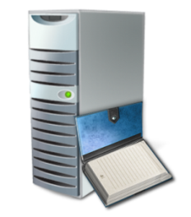

Active Directory Federation Services
Contoso
Adatum
AD FS provides an identity access solution
Deploy federation servers in multiple organizations to facilitate business-to-business (B2B) transactions
AD FS provides a Web-based, SSO solution
AD FS interoperates with other security products that support the Web Services Architecture
AD FS improved in Windows Server 2008
AD
AD
Account Federation Server
Federation Trust
Resource Federation Server
Web Server
Notes:
Title: Active Directory Federation Services (AD FS)
Talking Points: Active Directory Federation Services (AD FS) is a feature of the Windows Server 2008 operating system that provides an identity access solution. You can use the AD FS server role to create a highly extensible, Internet-scalable, and secure identity access solution that can operate across multiple platforms, which includes both Windows and non-Windows environments.
Active Directory Federation Services (AD FS) is a feature of the Windows Server 2008 operating system that provides an identity access solution. Using AD FS will give browser-based clients, both inside and outside the network, “one prompt” access to protected, Internet-facing applications, even when user accounts and applications are located in different networks or organizations.
A typical scenario, occurs when an application is in one network and a user account is in another network, and the user is required to enter secondary credentials when he or she attempts to access the application. However, with AD FS secondary accounts are not necessary. Instead trust relationships can be used to project a user's digital identity and access rights to trusted partners. In this federated environment, each organization continues to manage its own identities, but each organization can securely project and accept identities from other organizations.
[BUILD1] Deploy federation servers in multiple organizations to facilitate business-to-business (B2B) transactions: By deploying federation servers in multiple organizations business-to-business (B2B) transactions can be facilitated between trusted partner organizations. Federated B2B partnerships identify both business partners as either of these organization types, resource or account organization.
Organizations that own and manage resources that are accessible from the Internet can deploy AD FS federation servers and AD FS–enabled Web servers that manage access to the protected resources for trusted partners only. These trusted partners can include external third parties, other departments, or subsidiaries in the same organization.
In addition, organizations that own and manage user accounts can deploy AD FS federation servers that authenticate local users and create security tokens. Federation servers in the resource organization can use these security decisions to make authorization decisions.
[BUILD2] AD FS provides a Web-based, SSO solution: The process of authenticating to one network while accessing resources in another network—without the burden of repeated logon actions—is known as single sign-on (SSO). AD FS provides a Web-based, SSO solution that authenticates users to multiple Web applications over the life of a single browser session.
[BUILD3] AD FS interoperates with other security products that support the Web Services Architecture: AD FS provides a federated identity management solution that interoperates with other security products that support the WS-* Web Services Architecture. AD FS employs the federation specification of WS-*, called the WS-Federation Passive Requestor Profile (WS-F PRP). This specification makes it possible for environments that do not use the Microsoft Windows® identity model to federate with Windows environments.
[BUILD4] AD FS improved in Windows Server 2008: For Windows Server 2008, AD FS includes new functionality that was not available in Windows Server 2003 R2. This new functionality is designed to ease administrative overhead and to further extend support for key applications:
• Improved installation—AD FS is included in Windows Server 2008 as a server role, and there are new server validation checks in the installation wizard.
• Improved application support—AD FS is more tightly integrated with Microsoft Office SharePoint® Server 2007 and Active Directory Rights Management Services (AD RMS).
• A better administrative experience when you establish federated trusts—Improved trust policy import and export functionality helps to minimize partner-based configuration issues that are commonly associated with federated trust establishment.
Additional Information:
http://windowslaunch
http://www.microsoft.com/windowsserver2008/default.mspx
http://www.microsoft.com/windowsserver2008/ida-mw.mspx
http://technet2.microsoft.com/windowsserver2008/en/library/61f7f298-2cac-4cfb-977f-88fd4b781b4e1033.mspx

Slide 23

Federated Rights Management
Contoso
Adatum
AD
AD
Together AD FS and AD RMS enable users from different domains to securely share documents based on federated identities
AD RMS is fully claims-aware and can interpret AD FS claims
Office SharePoint Server 2007 can be configured to accept federated identity claims
Account Federation Server
Federation Trust
Resource Federation Server
RMS
Web SSO
Notes:
Title: Federated Rights Management
Talking Points: AD RMS and AD FS in Windows Server 2008 provide a new way to protect sensitive information that is both more comprehensive and easier to administer.
AD RMS and AD FS in Windows Server 2008 provide a new way to protect sensitive information: Windows Server 2008 enables a new way to protect sensitive information that is both more comprehensive and easier to administer. As in Windows Server 2003, Active Directory Federation Services (AD FS) enables one organization to set up a federated trust with another organization. Users sign on once—to their local domain—and gain access to a partner domain through identity and access federation. Because AD RMS has been integrated with AD FS in Windows Server 2008, a federated trust now allows AD RMS to grant appropriate RMS permissions to an external user without requiring them to sign in locally or have their own AD RMS server. Additionally, Microsoft Office SharePoint Server 2007 can also be configured to use federated trusts to apply RMS permissions without recourse to a local Active Directory profile.
[BUILD1] AD RMS is fully claims-aware and can interpret AD FS claims: In Windows Server 2008, AD FS and AD RMS work together to enable users from different domains to securely share documents based on federated identities, rather than local Active Directory profiles. AD RMS in Windows Server 2008 is fully claims-aware. It can interpret AD FS claims to authenticate users and control their access to content. When external users sign on to their local AD domains, they are provided with federation claims that contain their credentials and the access rights they should be granted. When they access the external resource, the resource provider’s AD FS server contacts the requester’s AD FS server to check the validity of the requester’s claims. If the claims are valid, the resource provider’s AD FS server passes the claims on to the application, allowing the external user appropriate access RMS-protected content.
This creates a powerful new content sharing scenario—federated document collaboration—that eliminates the need to maintain shadow accounts for external users and provides those users with single sign-on access to RMS-protected content. Once two entities have set up a federated trust, users can share and utilize protected content almost as if they were in the same domain. Administrators at the resource provider can control the fine points of who has what kind of access to what kinds of content without needing to manage identities for individual users.
[BUILD2] Office SharePoint Server 2007 can be configured to accept federated identity claims: Microsoft Office SharePoint Server 2007 can also be configured to use identity and access federation to apply RMS permissions without requiring a local Active Directory profile. In a SharePoint repository, RMS permissions are not applied directly to documents. Instead, SharePoint dynamically applies RMS protection to stored documents when they are requested by a user. In previous versions of SharePoint, this was achieved using Windows NT tokens tied to a user’s AD profile. As with earlier iterations of RMS in general, this required administrators to maintain redundant AD profiles for external users if organizations wanted to share content across firewalls, presenting the same challenges to security, management and SSO enablement.
Office SharePoint Server 2007, on the other hand, can be configured to accept federated identity claims to enable organizations to control user access to documents and how those documents are used. It, too, applies RMS permissions to resources as they are consumed by the user, but based on the authenticated user’s AD FS claims rather than on a separate identity stored in the AD records associated with the Office SharePoint Server 2007 host. Federated RMS permissions can be managed using the same tools they would be if the users were internal to the company hosting the content. This enables resource-side users to apply claims-based controls rather than relying on user-user or group-group mapping between organizations. No shadow account is needed on the resource AD FS server side.
Additional Information:
http://www.microsoft.com/windowsserver2008/default.mspx
http://www.microsoft.com/windowsserver2008/ida-mw.mspx
http://technet2.microsoft.com/WindowsServer/f/?en/Library/9b24bb70-47ed-46d0-a321-e693d16b1eb01033.mspx
http://technet2.microsoft.com/windowsserver2008/en/library/61f7f298-2cac-4cfb-977f-88fd4b781b4e1033.mspx
Federated Rights Management in Windows Server 2008.doc white paper

Slide 24
© 2005 Microsoft Corporation. All rights reserved.
This presentation is for informational purposes only. Microsoft makes no warranties, express or implied, in this summary.

