Slide 1


Slide 2

More Control and Flexibility
Vitalis Konopelec
Technology Solution Professional
vitalis.konopelec@microsoft.com
Microsoft Slovakia s.r.o.

Slide 3
  Windows Server 2008
Server Manager
Managing Server Roles
PowerShell
Server Core
Windows Deployment Services
Failover Clustering
Branch Office Deployments

Slide 4
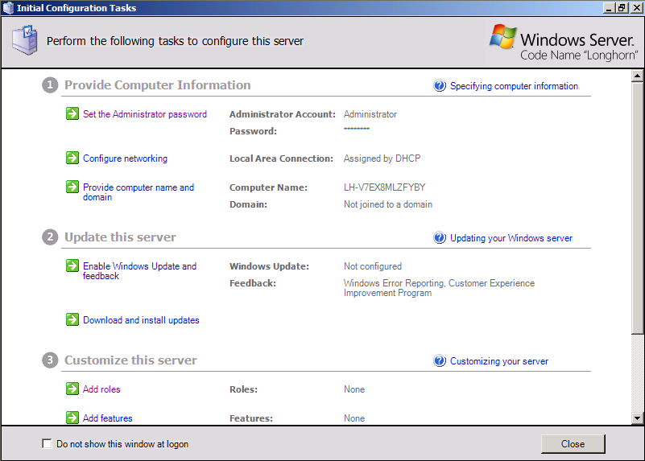
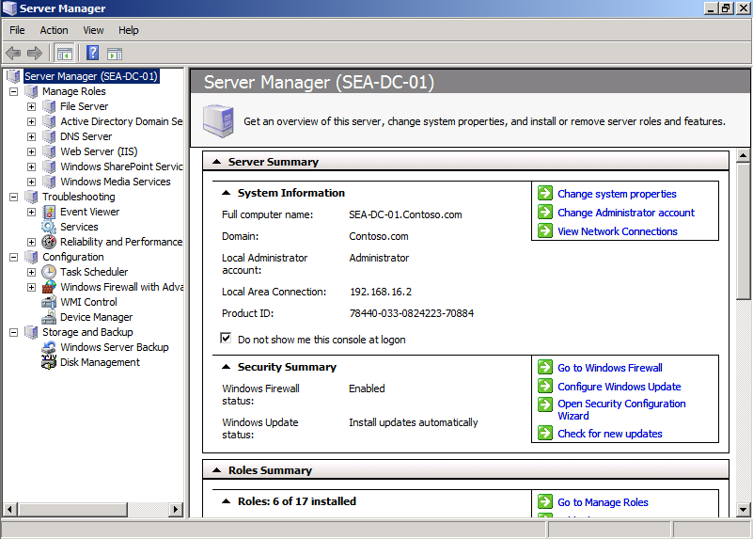
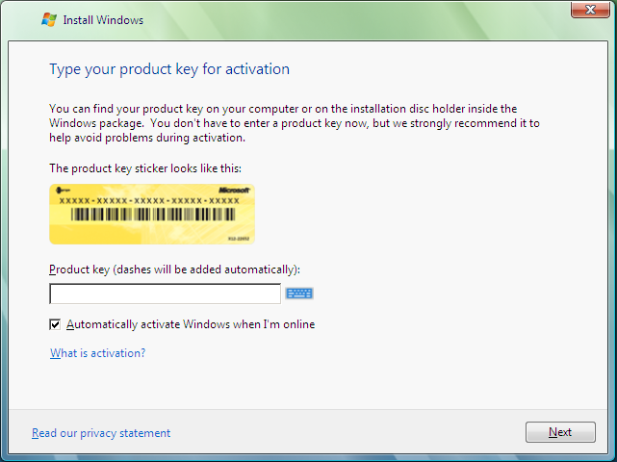
  Managing Windows Server 2008
Server Manager
Initial Configuration
Product Installation

Slide 5
  Server Manager Demo
Initial Configuration Tasks
Server Manager
Other management tools

Slide 6
  Managing Roles Demo
Managing and configuring Server Roles and Features

Slide 7
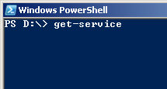






  PowerShell
New Command-line shell & Scripting Language
Improves productivity & control
Accelerates automation of system admin
Easy-to-use
Works with existing scripts
Remote server management via WMI
Partners
Futures
Will ship in Windows
Admin GUIs layered over PowerShell
One-to-many remote management using WS-MGMT

Slide 8
  PowerShell
TechNet ScriptCenter
  Exchange Server 2007
  Terminal Server
  WMI, Registry, Hardware, etc.
  Community-Submitted scripts
MyITForum.com
Hundreds of Scripts
Books & Training
Materials
Manning Publications
O’Reilly Media
Sapien Press & others…
MS MVPs
PowerShell Team Blog
Active Newsgroup
Channel 9: DFO Show
IIS.net
Community Support

Slide 9
  PowerShell Demo
PowerShell console
Creating and executing scripts
Using cmdlets

Slide 10

  Server Core Installation Option
Server Core
Security, TCP/IP, File Systems, RPC,
plus other Core Server Sub-Systems
WSv
AD DS
DHCP
AD LDS
DNS
Media
GUI, CLR,
Shell, IE, OE,
etc.
File
Print
Only a subset of the executable files and DLLs installed
No GUI interface installed
Five available Server Roles
Can be managed with remote tools

Slide 11
  Server Core Roles
Active Directory Domain Services
Active Directory Lightweight Directory Services (AD LDS)
Dynamic Host Configuration Protocol (DHCP) Server
DNS Server
File Services
Print Server
Streaming Media Services
Web Server (IIS)
Hyper-V (Virtualization)

Slide 12
  Server Core Additonal Features
Microsoft Failover Cluster
Network Load Balancing
Subsystem for UNIX-based Applications
Windows Backup
Multipath I/O
Removable Storage Management
Windows Bitlocker Drive Encryption
Simple Network Management Protocol (SNMP)
Windows Internet Naming Service (WINS)
Telnet client
Quality of Service (QoS)

Slide 13
  Server Core Demo
Managing Server Core
Configuring networking
Managing roles
Remote management using PowerShell

Slide 14




  Windows Deployment Services
WDS
Rapidly deploy Windows operating systems
Updated and redesigned version of Remote Installation Services (RIS)
Server components
Client components
Management components
Windows Deployment Services provides several enhancements to RIS
Windows Server 2008
Windows Vista

Slide 15


  Failover Clustering
Node
A
Node
B
Active Node
Heartbeat
Passive Node
New Validation Wizard
Support for GUID partition table (GPT) disks in cluster storage
Improved cluster setup and migration
Improvements to stability and security – no single point of failure
IPv6 support
Geographically dispersed clusters

Slide 16



  Branch Office
Optimization
  SysVol Replication
  DFS Replication
  Protocols
Security
  BitLocker
  Server Core
  Read-Only Domain Controller
  Role Separation
Administration
  Print Management Console
  PowerShell, WinRS, WinRM
  Virtualization
  Restartable Active Directory
Hub Site
Branch Office

Slide 17
© 2005 Microsoft Corporation. All rights reserved.
This presentation is for informational purposes only. Microsoft makes no warranties, express or implied, in this summary.

