Slide 1


Slide 2

Next Generation Web
Vitalis Konopelec
Technology Solution Professional
vitalis.konopelec@microsoft.com
Microsoft Slovakia s.r.o.

Slide 3
  Windows Server 2008
Modular Architecture
Security features
More control in IIS 7.0
Scalable and flexible application base
Windows Sharepoint services
Windows Media Services

Slide 4




  IIS 7.0 overview
IIS 7
Web
Customization
Enhanced security and reduced attack surface
Troubleshooting
True application xcopy deployment
Administration
Application and health management for WFC services

Slide 5




  IIS 7.0 Web Administration
Enhanced Web Administration at
Every Stage in the Application Lifecycle
Simpler Application Deployment to Web Farms & UNC Shares
More Secure, Reliable Application Hosting
Deploy
Troubleshoot
Host
Reduced Downtime From Faster Troubleshooting
Manage
Greater Productivity Via Delegated Management
& Better Tools

Slide 6










  Managing your web with IIS7.0
Secure HTTPS
IIS7
Internet
XML
Administrator
AppHost.config
UNC
Shared
Config
Delegation
Manage Remotely
Better Tools
Intuitive, Task Oriented GUI
.NET Management API
Unified WMI Provider for IIS/ASP.NET
Powerful Command Line Support
Rich Runtime State Information
Automatic Failure Tracing & Logging
IIS7
XCopy Deploy
IIS7
XML
Shared App Hosting
Site Owner
App
Web.config
Web Farm
Arsenal of Admin Tools
Secure Remote Management
Delegated Management
Shared Config for Web Farms

Slide 7
  IIS 7.0 Demo
Enabling and configuring Web Server Role
Configuring additional features
Managing IIS 7.0

Slide 8
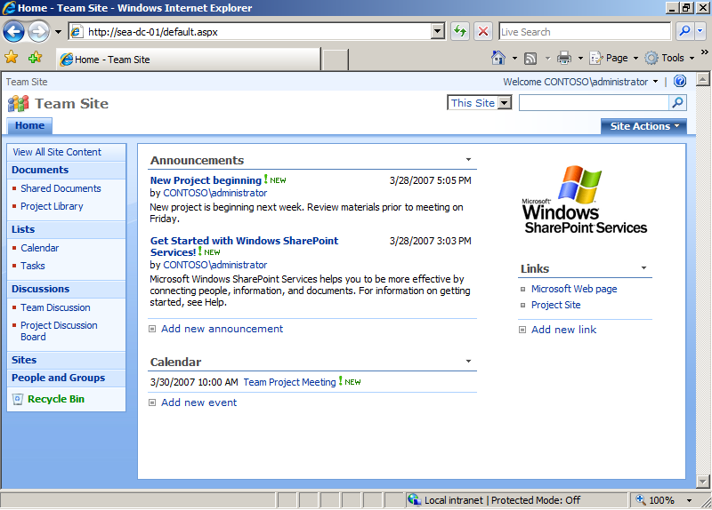


  Windows Sharepoint Services
WSS
Administration model enhancements
New and improved compliance features and capabilities
New and improved operational tools and capabilities
Improved support for network configuration
Extensibility enhancements

Slide 9


  Windows Media Services
WMS
Ultimate Streaming
Experience
Fast Streaming delivers instant-on/always-on
Intelligent Streaming optimizes the experience
Dynamic Content
Programming
Manage channels on-the-fly
Generate revenue with Lead-In and Interstitial Ads
Industrial-Strength
Platform
Increases industry-leading scalability
Rich administration with broad range of tools

Slide 10
  IIS 7.0 Demo
Installing, configuring and managing Media Server Role

Slide 11
© 2005 Microsoft Corporation. All rights reserved.
This presentation is for informational purposes only. Microsoft makes no warranties, express or implied, in this summary.

