Slide 1
Physical / Virtual Server Management
Guruprakash S
Associate Consultant | Microsoft Corporation

Slide 2
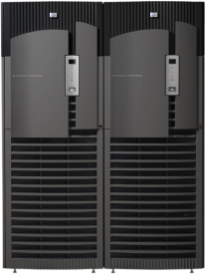




Data Center Management
Configuration Management
End to End
Monitoring
Server Compliance
Data Protection and Recovery
Automated Provisioning and Updating of Physical and Virtual Environments
Server Consolidation Through Virtualization
Proactive Platform Monitoring
Application & Service Level Monitoring
Interoperable and Extensible Platform
Configuration Controls and Reporting
Centralized Security Auditing
Comprehensive Security & Identity and Access Mgmt
Business Continuity Thru Virtualization Mgmt
Backup and Recovery of Physical and Virtual Resources
Disaster Recovery

Slide 3



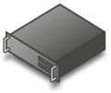







Microsoft Virtualization From the datacenter to the desktop
User State Virtualization
Document redirection
Offline files
Server Virtualization
Presentation
Virtualization
Desktop Virtualization
Application Virtualization

Slide 4








System Center Solutions People, process, & technology
Knowledge
Management Packs
Connectors for Interoperability
Solution Accelerators
Microsoft Operations Framework (MOF / ITIL)
Partner Ecosystem
Microsoft Consulting Services
Data Center Management
Products
Solutions
Desktop & Device Management
Infrastructure
Windows Platform
Virtualization Technology
Open Standards
Mid-Market
Notes:
4
© 2006 Microsoft Corporation. All rights reserved. Microsoft, Windows, Windows Vista and other product names are or may be registered trademarks and/or trademarks in the U.S. and/or other countries.
The information herein is for informational purposes only and represents the current view of Microsoft Corporation as of the date of this presentation. Because Microsoft must respond to changing market conditions, it should not be interpreted to be a commitment on the part of Microsoft, and Microsoft cannot guarantee the accuracy of any information provided after the date of this presentation. MICROSOFT MAKES NO WARRANTIES, EXPRESS, IMPLIED OR STATUTORY, AS TO THE INFORMATION IN THIS PRESENTATION.

Slide 5
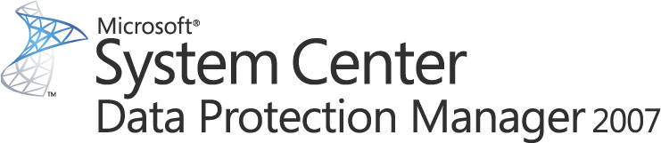
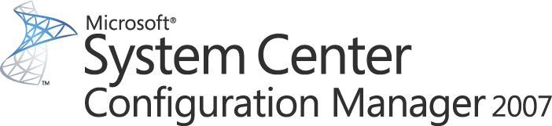
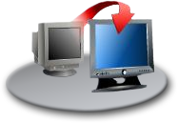
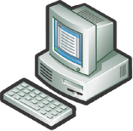








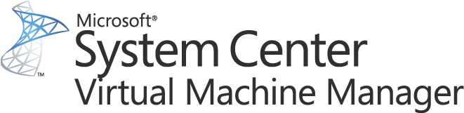

Managing The Server Lifecycle
Backup
Hardware Provisioning
Live host level virtual machine backup
In guest consistency
Rapid recovery
Patch management and deployment
OS and application configuration management
Software upgrades
Server Management Suite Enterprise
Disaster Recovery
Virtual Workload Provisioning
End to end service management
Server and application health monitoring & management
Performance reporting and analysis
Virtual machine management
Server consolidation and resource utilization optimization
Conversions: P2V and V2V
OS / Software Deploy, Patching and State Mgmt
Performance and Health Monitoring
Notes:
5

Slide 6
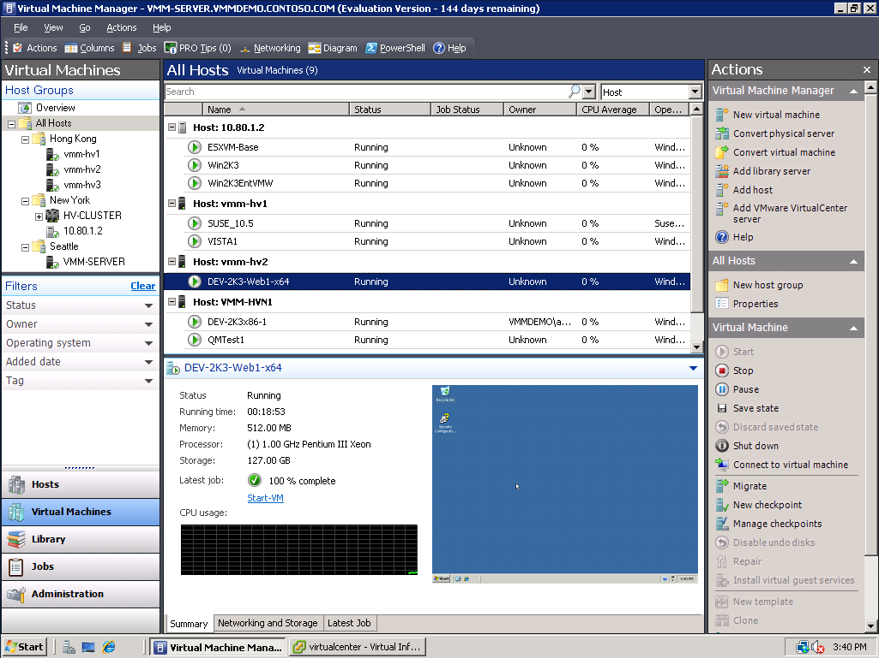
A Centralized, Heterogeneous Management Solution For The Virtual Datacenter
Maximize Resources
Centralized virtual machine deployment and management for Hyper-V, Virtual Server, and VMware ESX servers
Intelligent placement of Virtual Machines
Fast and reliable P2V and V2V conversion
Comprehensive application and service-level monitoring with Operations Manager
Integrated Performance and Resource Optimization (PRO) of VMs
Increase Agility
Rapid provisioning of new and virtual machines with templates
Centralized library of infrastructure components
Leverage and extend existing storage infrastructure and clusters
Allow for delegated management and access of VMs
Leverage Skills
Familiar interface, common foundation
Monitor physical and virtual machines from one console
Fully scriptable using PowerShell

Slide 7










VMM 2008 Architecture
Administrator’s Console
Self Service Web Portal
Operator’s Console
Web Console
Windows PowerShell
Windows® PowerShell
Connector
Virtual Machine Manager Server
Operations Manager Server
Management Interfaces
VMM Library Server
VMware VI3
Virtual Center Server
VM
VM
VM
Template
VM
VM
VM
VM
ESX Host
VM
VM
ISO
VHD
Script
VM
VM
VM
VM
VM
VM
VM
VM
SAN Storage
Notes:
Here we have the VMM 2008 architecture. In the upper left, we have the VMM server, which accepts inputs from the Powershell interface and issues the commands to the virtualization systems. Powershell forms the basis of VMM 2008,

Slide 8








End To End Monitoring Proactive platform, application and service-level monitoring
Challenges Addressed
IT services, applications and servers must run smoothly
Increasing pressure for service levels that ensure optimal uptime and responsiveness
ERP Application
Key Capabilities
Proactively monitor availability, performance and configuration across heterogeneous platforms
Perform deep application and service-level monitoring
Databases
Servers
Web Servers
Order Tracker DB
DN-App1
OTW-IIS-01
OTW-IIS-02
“I can provide our system administrators with more in-depth monitoring and more explicit alerting. We can configure server reports to show downtime warnings, downtime events, and the start time and end time of every occurrence. We can also quickly learn why a server experienced downtime—whether it was a power outage, a hardware or software malfunction, or a server maintenance issue.”
- Paul Johnson, Windows Monitoring Architect & Systems Engineer, Gates Corp

Slide 9
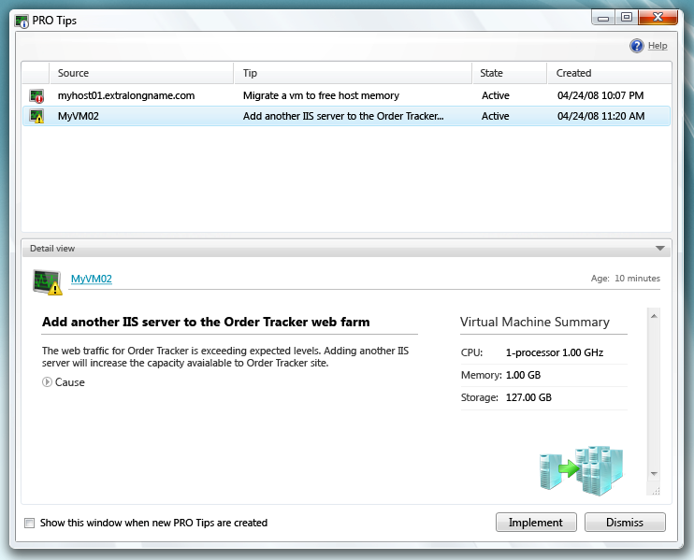
Performance And Resource Optimization (PRO)
Workload and application aware resource optimization
Extensible through the Operations Manager 2007 MP framework
Create policies that VMM acts upon tips automatically or manually
Minimize downtime and accelerating time to resolution
Enables partners to deliver value add to our mutual customers

Slide 10

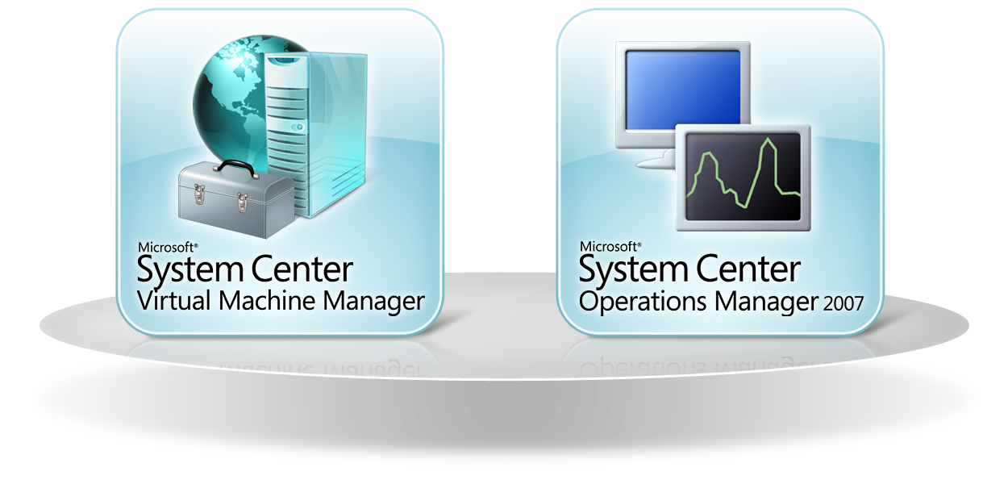

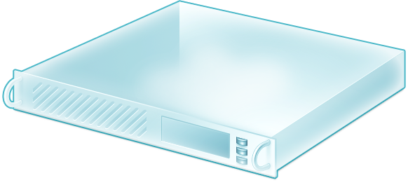


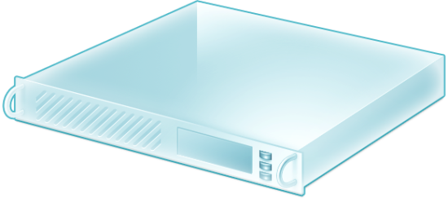
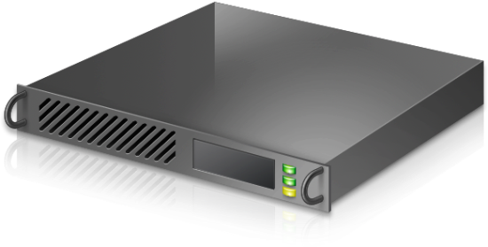


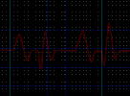
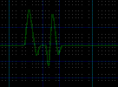
Performance And Resource Optimization (PRO)

Slide 11
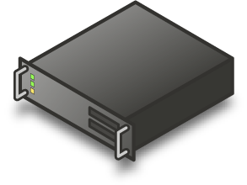

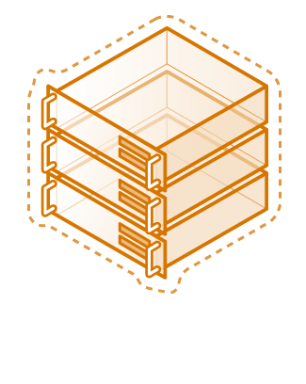
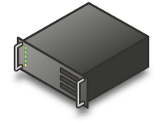

Configuration Management Automated provisioning and server consolidation through virtualization
Challenges Addressed
Power, space and maintenance costs forcing more efficient use of resources
Dispersed servers and applications difficult to manage and update
Key Capabilities
Manage virtual machines to consolidate physical servers
Provision operating systems, applications, and patches in the data center
“We understood that if we consolidated servers we would reduce energy consumption. [System Center is a] one-stop, single-point approach to managing hundreds of Virtual Server–based virtual machines and all the hosts, while also easily performing physical-to-virtual migrations.”
- Jason Foster, Systems Architect Sr. Manager of Technology, Continental

Slide 12
Offline Virtual Machine Servicing Solution Accelerator
Identify
Identify the offline VM’s to patch in VMM library
Assess
Assess the capacity of the maintenance hosts
Patch
Use ConfgMgr/WSUS to patch
Report
Report real time servicing status
Automating patching of virtual machine libraries
Integration and automation with VMM, ConfigMgr, WSUS
Real time status reporting
Installation and use guide
Available now for VMM 2007, update for 2008 coming

Slide 13
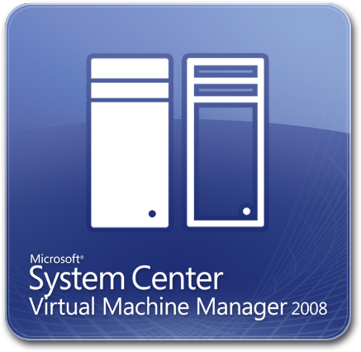
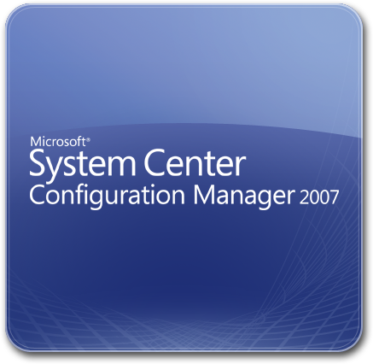




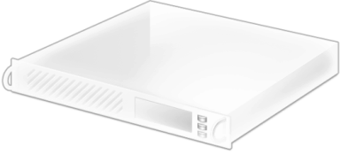

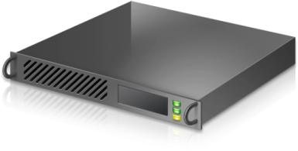

Offline VM Patching

Slide 14


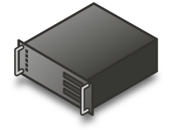

Data Protection And Recovery Backup & restore and business continuity through virtualization mgmt
Challenges Addressed
High availability and business continuity needed to meet service levels and optimal uptime
Simple disaster recovery and backup & restoration of data and information
Backup and Restore
Key Capabilities
Dynamically replicate and move virtual machines and applications to distribute workloads in the event of an outage
Recover and restore the physical and virtual environments in the data center through continuous data protection
Data Center A
Data Center B
“We really liked the looks of [System Center] for three key reasons, its disk-to-disk-to-tape design, the fact that we could eliminate full backups altogether and simply take snapshots, and its disaster recovery features.”
- Ed Olson, Lead Windows Infrastructure Engineer, AutoNation

Slide 15
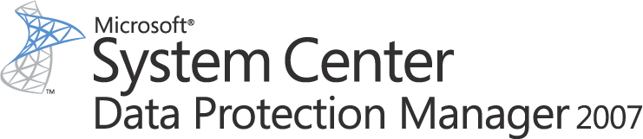
















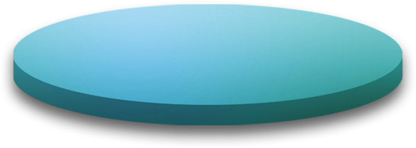




Disk-based
Recovery Online Snapshots (up to 512)
Active Directory®
System State
Up to Every 15 minutes
DPM 2007
With Integrated Disk & Tape
Tape-based
Archive
Offline Tape
Windows XP
Windows Vista
Windows Server 2003
Windows Server 2008
file shares and directories
DPM 2007
Continuous Data Protection for Windows Application and File Servers
Rapid and Reliable Recovery from disk instead of tape
Advanced Technology for enterprises of all sizes

Slide 16

Hyper-V Host-based Protection
Windows Server
2003
SQL2005
No downtime
Recursive VSS consistency
DPM 2007 SP1 supports Hyper-V hosts

Slide 17
Disaster Recovery Staging
P2V – Physical to Virtual weekly … VMM
Svr1
Data Protection every 15 minutes … DPM
System State daily … DPM
SVR1
data
Hyper-V
VMM 2008
DPM 2007 SP1
P2V – Physical to Virtual weekly … VMM
Svr2
Data Protection every 15 minutes … DPM
System State daily … DPM
SVR2
data
P2V – Physical to Virtual weekly … VMM
Svr3
Data Protection every 15 minutes … DPM
System State daily … DPM
SVR3 data

Slide 18
Demonstration
System Center Virtual Machine Manager 2008
System Center Operations Manager 2007 SP1

Slide 19

Server Management Suite Enterprise
The System Center Server Management Suite Enterprise is the solution for virtualization management
Provides comprehensive management for physical and Windows Server and storage environments and includes
System Center Virtual Machine Manager 2008
System Center Operations Manager 2007 Enterprise Edition
System Center Data Protection Manager 2007 Enterprise Edition
System Center Configuration Manager 2007
Provides the rights to manage an unlimited number of operating system environments (“OSEs”) on a physical host server
The Server Management Suite Enterprise is licensed on a per physical host basis

Slide 20
Server Management Capabilities
Virtualization Management Capabilities | Virtual Machine Manager | Operations Manager | Configuration Manager | Data Protection Manager
Server consolidation through virtual migration | x
Virtual machine provisioning and configuration | x
Server health monitoring, management |  | x
Performance reporting, analysis |  | x
Patch management, software upgrades |  |  | x
Virtual machine backup and restore |  |  |  | x
Disaster Recovery |  |  |  | x

Slide 21
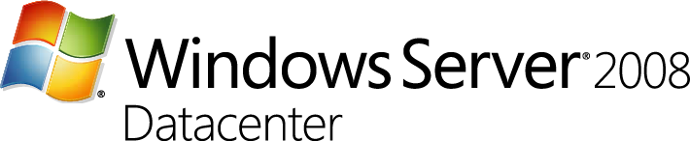
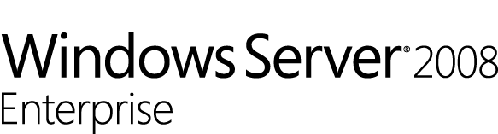

Unlimited Virtualization With Datacenter
Virtual Sessions
Per License
Unlimited
..
32
16
8
4
1
Host OS Included

Slide 22

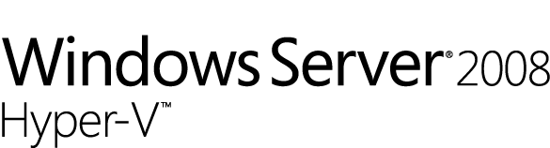

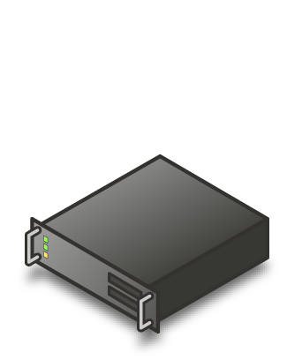
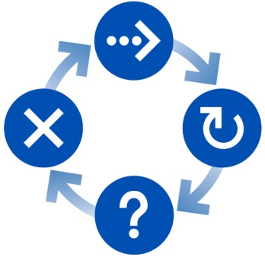


Microsoft Server Virtualization Solution
Enabling Key Scenarios
Server consolidation
Business continuity
Dynamic provisioning
At 1/3rd the cost of VMware
Integrate virtualization into existing environments and processes
Manage virtual and physical and into applications from one toolset

Slide 23
Resources
Microsoft Virtualization Homepage
http://www.microsoft.com/virtualization
Events
Whitepapers
Downloads
Case Studies
Microsoft System Center Homepage
http://www.microsoft.com/systemcenter/
Microsoft Windows Server 2008 Hyper-V Homepage
http://www.microsoft.com/hyper-v/

Slide 24
Feedback / QnA
Your Feedback is Important!
Please take a few moments to fill out our online feedback form at:
<< Feedback URL – Ask your organizer for this in advance>>
For detailed feedback, use the form at http://www.connectwithlife.co.in/vtd/helpdesk.aspx
Or email us at vtd@microsoft.com
Use the Question Manager on LiveMeeting to ask your questions now!

Slide 25
Contact
Email Address
gurup@microsoft.com

